Slide 1
Privacy and Anonymity
Nick Feamster
CS 6262
Spring 2009

Slide 2
Today’s Lecture
Anonymity and privacy
  Who should care
  Anonymous communication primitives
Attacks on anonymous communication
  Traffic analysis
Infranet: Anonymity without encryption
Recent trends

Slide 3
Privacy and Anonymity
Privacy: Protecting sensitive information from others
Anonymity: Being indistinguishable from others in a group

Slide 4
Who should care?
Individuals
  Web surfing
  Email
  VOIP
  Purchasing habits
  Work patterns and locations
Corporations
  Collaborations, partners
Political dissidents

Slide 5
Why should you care?
Most anonymous communication systems address this challenge only
Surveillance
Censorship
A few exceptions: Freenet, Infranet, Tangler

Slide 6

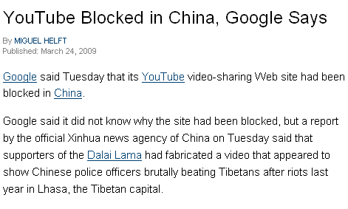
Anonymity and Privacy in the News

Slide 7
Anonymity: Requires Company
“Traditional” security requirements (confidentiality, integrity, etc.): can be achieved between a pair of participants
Anonymity requires each participant to carry traffic for others
Requires some notion of distributed trust.

Slide 8
Types of Anonymity
Single proxy
  Encryption: Safeweb, anonymizer, etc.
  Covert channels: Infranet
Network of proxies
  Mixnets
  Encryption (onion routing): nym.alias.net, Tor
  Dining Cryptographer Networks: Herbivore

Slide 9



Single-Proxy Anonymization
Initiator
Proxy
Responder
Advantages
  Typically fast, low-latency communication
Disadvantages
  Initiator must trust the proxy
  Single point of failure and attack
anon.penet.fi, anonymizer.com, safeweb.com,

Slide 10
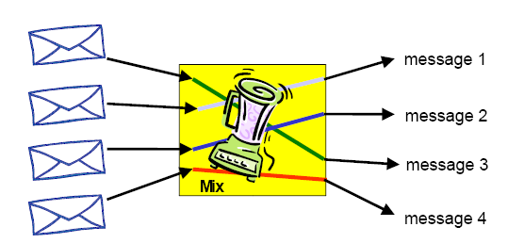
Mixnets
First proposed in 1981 by Chaum
Each proxy handles messages in batches
Key property: unlinkability
Challenge: Designing low-latency mix networks

Slide 11
Onion Routing
Utilizes advantages provided by both proxies and mixnets
Initiator
X
Y
Z
Responder
Y
Z
R
data
Y
Z
R
data
Z
R
data
R
data

Slide 12
Systems with Onion-Style Routing
nym.alias.net: Pseudonymous Remailer

Slide 13
Dining Cryptographers
Proxies organized in a ring topology
Proxy flips a coin and shares with left neighbor
  Each proxy publishes the parity (XOR) of two bits
To send a (1-bit) message, initiator lies when publicizing the coin flip
  When everyone tells the truth: statements consistent
  When one party is lying: statements are inconsistent, but can’t identify source of inconsistency
Information-theoretically anonymous, but rather impractical.

Slide 14


Non-Payer’s View: Same Coins
“same”
“different”
“same”
“different”
?
?
payer
payer

Slide 15
Non-Payer’s View: Different Coins
“same”
“same”
“same”
“same”
?
?
payer
payer

Slide 16
Some Attacks on Anonymous Communication Systems
Timing attacks: traffic into and out of the network may reveal communication patterns
Communication patterns: e.g., exploit timezone information
Packet counting attacks: onion routing sends streams along the same path
User interaction attacks: sender of the user behaves differently than someone who is relaying

Slide 17
Resisting Surveillance and Censorship
Many governments/companies trying to limit their citizens’ access to information
  Censorship (prevent access)
  Punishment (deter access)
  Surveillance (spy on or monitor access)
  China, Saudi Arabia, many companies

Slide 18
Web Censorship
Government manages national web firewall
  Not optional: catches ALL web traffic
Block certain requests
  Possibly based on content
  More commonly on DNS name / IP address/publisher
  China: Western news sites, Falun Gong, etc.
Log requests to detect troublemakers
  Even without blocking, may just watch traffic
But they don’t block all Web traffic
  Creates a crack in their barrier

Slide 19
An “Old” Problem
Many governments/companies trying to limit their citizens’ access to information
  Censorship (prevent access)
  Punishment (deter access)
  Surveillance (spy on or monitor access)
  China, Saudi Arabia, many companies
How can we defeat such attempts?
  Circumvent censorship
  Undetectably

Slide 20
Goal
Circumvent censor via innocent web activity
  Normal web server and client cooperate to create covert channel
Without consequence for client
  Censor shouldn’t be able to detect use
And without consequence for server
  Broad participation increases system robustness
  Offering service shouldn’t lead to trouble
    E.g., loss of business through being blocked
    Or legal implications (?)

Slide 21
Requirements
Confidentiality…and covertness.
Client deniability
  Detection could be embarrassing or worse
Client statistical deniability
  Even suspicion could be a problem
Server covertness/statistical deniability
  If server detected, can be blocked
  Behave identically for clients and others
Communication robustness
  Even without detecting, censor could scramble covert channel
Performance (bandwidth, latency)

Slide 22
Some Options
SSL
  Encrypted connection---can’t tell content
  Suspicious!
  Doesn’t help reach blocked servers
  Govt. can require revealing SSL keys
Anonymizing Proxies
  Prevent servers from knowing identity of client
  But proxy inside censor can’t reach content
  And proxy outside censor can be blocked
  And use of proxy is suspicious

Slide 23
Conventional Mechanism: Safeweb
Operation
  Client contacts triangle-boy “reflector”
  Reflector forwards requests to blocked server
  Server returns content to client (IP spoof)
But very easily detected
  “Local monitoring of the user only reveals an encrypted conversation....” (Safeweb manual)
  Engenders suspicion (e.g., China blocks most SSL)u

Slide 24
Bottom Line
Easy to hide what you are getting
  e.g., just use SSL or some other confidential channel
And easy to “get through” censors
  Reflection (e.g., Safeweb)
But hard to hide that you are doing it!
To be practical, all these problems must be solved
Want both confidentiality and covertness

Slide 25
Circumventing Censors
Censors allow certain traffic
Use to construct a covert channel
  Talk to normal servers
  Embed requests for censored content in normal-seeming requests
  Receive censored content hidden in normal-seeming responses
Requester: client asking for hidden content
Responder: server covertly providing it

Slide 26
Infranet Architecture
User computer
User
browser
Infranet comm. tunnel
Uncensored
Web site
Censored
Web site
GET cnn.com
Visible requests
Hidden requests
CENSOR
Block/Tamper
Responder
Requester
Std.
HTTP
Visible responses
Hidden responses
www.*.edu
Ubiquitously
deployed!
cnn.com
E.g., Great Firewall of China
Tunnel is covert in both directions
Tunnel is confidential in both directions

Slide 27
Problems to Be Solved
Hiding transmission of downstream content
  How does the client transmit requests
Upstream
  Sending requests covertly to responder

Slide 28
Downstream Communication: Easier
Responder is a normal web server, serving images (among other things)
Encrypt data using a session key
Embed in “unimportant, random” bits of images
  Hide it, e.g., in high-order color bits → steganography
  Tamper-resistant → watermarking
Encrypted data looks random---only requester can tell it isn’t (and decrypt)

Slide 29
Goals Analysis
Client looks innocent
Server less so
  Any one image seems innocent
  Same image with different “random bits” in each is suspicious
  Evasion: webcams, banner ads, etc.
Performance: ~1 KB/small image (variable)

Slide 30
Blocking Techniques
What if censor erases high-order bits of the image?
Answer 1: “not our problem”
  Leave it to watermarking research to figure out non-erasable watermarks
Answer 2: semantic embeddings
  Use position of objects in document
  Prevents erasure because might be ruining content
Answer 3: embed data in broadcast signals
  Voice of America
  Satellite broadcast TV channel

Slide 31
Upstream Requests: More challenging
No “random content bits” that can be fiddled to send messages to responder
  Munging HTTP or TCP header fields problematic
Solution: let browsing pattern itself be the message
Suppose web page has k links.
  GET on i^{th} link signifies symbol “i” to requester
  Result: log₂(k) message bits from link click
Can be automated
To prevent censor from seeing message, encrypt with responder key

Slide 32
Goals
Deniability: requester generates standard http GETs to allowed web sites
  Fact of GETs isn’t itself proof of wrongdoing
  Known rule for translating GETs to message, but message is encrypted, so no evidence
Statistical deniability
  Encrypting message produces “random” string
  Sent via series of “random” GETs
  Problem: normal user browsing not random
    Some links rare
    Conditional dependence of browsing on past browsing

Slide 33
Upstream: Paranoid Mode
Settle for one message bit per GET
  Odd/even links on page
  Or generalize to “mod k” for some small k
User has many link choices for each bit
  Can choose one that is reasonable
  Incorporate error correcting code in case no reasonable next link sends correct bit
Drawback: user must be directly involved in sending each message bit
  Very low bandwidth vs time spent

Slide 34
Higher Performance
Idea: Arithmetic coding of hidden requests
  If request i has probability p_{i}, then entropy of request distribution is –Σ p_{i} log p_{i}
  Arithmetic coding encodes request i using log p_{i} bits
  Result: expected request size equals entropy
  Optimal
Problem: Requester doesn’t know probability distribution of hidden requests
  Doesn’t have info needed for encoding

Slide 35
Solution: Range-Mapping
Responder serves many requesters
  Uses past requests to build C, distribution of hidden requests
  Sends to requester on “easy” downstream path
Requester uses C to build arithmetic code and send encoded request
Use visible GETs (“clicks”) as symbols that are sent (not bits)
From its own server access logs, responder knows that different “clicks” have different conditional probabilities

Slide 36
Toy Example
Suppose possible hidden requests fewer than links on page
Responder sends dictionary:
  “link 1 means http://cnn.com/”
  “link 2 means http://bbc.co.uk/”
  Assigns common requests to common GETs
Requester GETs link matching intended request
One GET sends full (possibly huge) request
Problem: in general, ∞ possible requests
  Can’t send a dictionary for all

Slide 37
Generalize: Twenty Questions
Order all hidden request strings lexicographically
Identify “split string” such that
  Strings up to split have total probability 0.5
  Strings after split have total probability 0.5
Responder sends split string
Requester sends 0/1 as desired request precedes/follows split string
Recurse on half of distribution selected
Result: requester sends O(entropy) bits

Slide 38
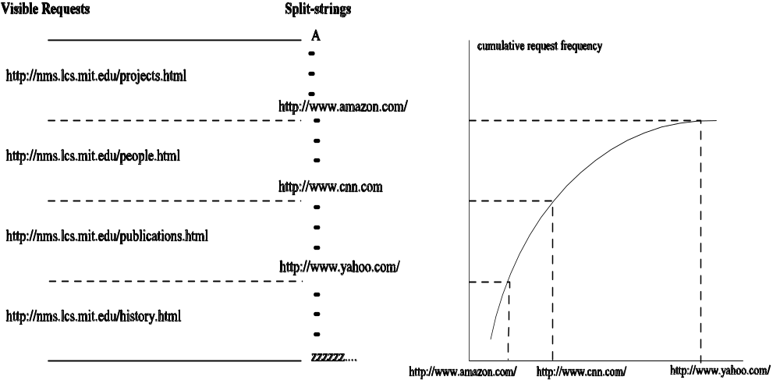
Range-Mapping in Pictures
If each page has k links, each request transmits lg(k) bits
Expected # of visible requests to modulate a hidden request = ceil[H(C) / lg (k)] + 2

Slide 39
Problems and Next Steps
Responders can be discovered and blocked
  The discovery problem: allowing clients to discover responders “ahead of” censors
All clients need not fetch content from the origin. Instead:
  Some clients obtain content from origin (e.g., via responder, USB key, etc.)
  CDN behind firewall distributes content to rest of clients
  General idea: separation of upstream/downstream

