Slide 1
COS 432: Information Security Isolation and Sandboxing
Nick Feamster Princeton University

Slide 2
Access Control using ACLs
Subject = (user, program)
Verb = action
Object = resources
Policy specifies (subject, verb, object) triples
(User, program)
Monitor
Resource
Action
Policy
Notes:
A subject is a specific program acting on behalf of a specific user.
Monitor is typically the OS.
Policy specifies (subject, verb, object) triples. Answers the question can User U running Program P perform Action A on Resource R?

Slide 3
What is a “Policy”? (and Why Do We Need One?)

Slide 4
What is a Security Policy
A Security Policy is a set of guidelines established to safeguard the organization from attacks, both from inside and outside the organization.
Usable
Not impede or interfere with the business
Enforceable with security tools

Slide 5
What is Included in a Security Policy
Security education, training and awareness
Backups and business continuity plans
Physical Security
Access Controls
Authentication
Encryption
Network Security
Auditing and Reviews
Compliance
…

Slide 6

Why is a Security Policy Necessary
Bucket Theory: A bucket can only fill with the volume of water the shortest plank allows.
Ideally, we want to make everything perfect without considering the budget.
But, in reality…
How to balance the planks
How to prioritize the limited resources
How to maximize the gaining (benefit - cost)

Slide 7
Access Control (Review)
Access control is a collection of methods and components that supports
confidentiality
integrity
Goal: allow only authorized subjects to access permitted objects
E.g., Least privilege philosophy
A subject is granted permissions needed to accomplish required tasks and nothing more
Notes:
Access control is to control how resources are accessed so that they can be protected from unauthorized modification, use, or disclosure. (p123)
It is usually considered the first line of defense in asset protection. (217)
Access control is a broad term that covers several different types of mechanisms that enforce access control features on computer systems, networks, and information. (124)
Subject: An active entity that requests access to an object or the data within an object. (p123)
Can be a user, program, or process that accesses an object to accomplish a task. (p123)
For a subject to be able to access a resource, it must be identified, authenticated, authorized, and should be held accountable for its actions. (219)
Object: A passive entity that contains information. (p124)
Can be a computer, database, file, computer program, directory, or field in a table in a database, etc. (p124)
When a program accesses a file, the program is the subject and the file is the object.

Slide 8
Access Control Designs
Access control designs define rules for users accessing files or devices
Three common access control designs
Mandatory access control
Discretionary access control
Role-based access control

Slide 9
Mandatory Access Control
It is a restrictive scheme that does not allow users to define permissions on files, regardless of ownership.
Instead, security decisions are made by a central policy administrator.
A common implementation is rule-based access control
Subject demonstrates need-to-know in addition to proper security clearance
Need-to-know indicates that a subject requires access to object to complete a particular task
Security-Enhanced Linux (SELinux) incorporates mandatory access control.
Notes:
Historically and traditionally, MAC has been closely associated with multi-level security (MLS) and specialized military systems. In this context, MAC implies a high degree of rigor to satisfy the constraints of MLS systems. More recently, however, MAC has evolved out of the MLS niche and has started to become more mainstream. The more recent MAC implementations, such as SELinux and AppArmor for Linux and Mandatory Integrity Control for Windows, allow administrators to focus on issues such as network attacks and malware without the rigor or constraints of MLS.
All references are from All in One Book (Shon Harris, 2005)
In a mandatory access control (MAC) model, users and data owners do not have as much freedom to determine who can access files. (163)
Operating systems enforce the system’s security policy through the use of security labels. (166)
In MAC implementations, the system makes access decisions by comparing the subject’s clearance and need-to-know level to that of the security label. (165)
This type of model is used in environments where information classification and confidentiality is of utmost importance, such as a military installation. (163)
The operating system makes the final decision and can override the user’s wishes. (163)
MAC uses a security label system. Users have clearances and resources have security labels that contain data classifications. MAC compares these two attributes to determine access control capabilities. (218)
Users are given a security clearance and data is classified the same way. Users have access to data classified equal and lesser than their own status. (163)
Security labels are attached to all objects; thus, every file, directory, and device has its own security label with its classification information. (163)
The terms “security labels” and “sensitivity labels” can be used interchangeably. (163)
When a MAC model is being used, every subject and object must have a sensitivity label. (164)
The sensitivity label contains a classification and different categories. (164)
The classification indicates the sensitivity label, and the categories enforce need-to-know rules. (164)
Classifications are hierarchical, categories are not. (164)

Slide 10
Discretionary Access Control
Discretionary access control, or DAC, refers to a scheme where users are given the ability to determine the permissions governing access to their own files.
DAC typically features the concept of both users and groups
In addition, DAC schemes allow users to grant privileges on resources to other users on the same system.
Common design in commercial operating systems
Generally less secure than mandatory control
Generally easier to implement and more flexible
Notes:
A system that uses discretionary access control (DAC) enables the owner of the resource to specify which subjects can access specific resources. This model is called discretionary because the control of access is based on the discretion of the owner. (162)
Data owners decide who has access to resources and ACLs are used to enforce the security policy. (166)
DAC systems grant or deny access based on the identity of the subject. The identity can be a user identity or group membership. (163)
The most common implementation of DAC is through ACLs, which are dictated and set by the owners and enforced by the operating system. (162)
This does not lend itself to a centrally controlled environment and can make a user’s ability to access information dynamic versus the more static role of mandatory access control. (162)
When you look at the properties of a file or directory and you see the choices that allow you to control which users can have access to this resource and to what degree, you are witnessing an instance of ACLs enforcing a DAC model. (162)
DACs can be applied to both the directory tree structure and the files it contains. (162)

Slide 11
Role-Based Access Control
The role-based access control (RBAC) model can be viewed as an evolution of the notion of group-based permissions in file systems.
An RBAC system is defined with respect to an organization, such as company, a set of resources, such as documents, print services, and network services, and a set of users, such as employees, suppliers, and customers
Uses a subject’s role or task to grant or deny object access
In the role-
Notes:
This type of model allows access to resources to be based on the role the user holds within the company. (165)
A role is defined in terms of the operations and tasks that the role will need to carry out. (165)
The RBAC approach simplifies access control administration by allowing permissions to be managed in terms of user job roles. (165)
Introducing roles also introduces the difference between rights being assigned explicitly and implicitly.
If rights and permissions are assigned explicitly, it indicates that they are assigned to a specific individual. (165)
If rights are assigned implicitly, it indicates that they are assigned to a role or group and the user inherits those attributes. (165)
An RBAC is the best system for a company that has high employee turnover. (165)

Slide 12
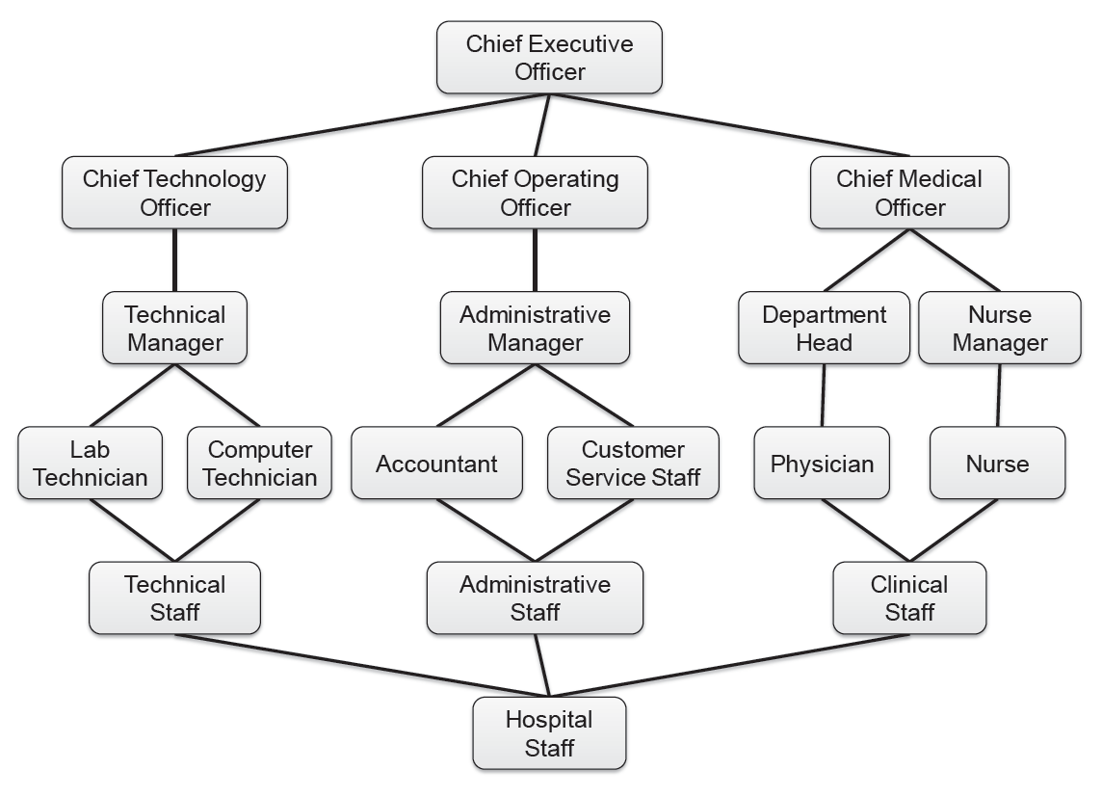
Visualizing Role Hierarchy

Slide 13
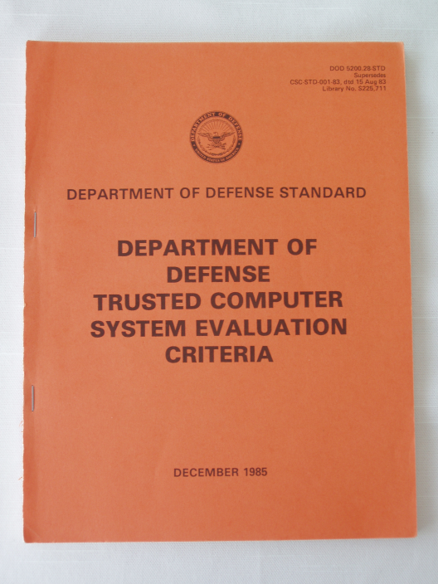
E.g., The Orange Book
Trusted Computer System Evaluation Criteria (TCSEC)
Division D: “minimal protection”
Division C: “Discretionary protection”
Division B: “Mandatory protection”
Division A: “Verified protection”
Notes:
Trusted Computer System Evaluation Criteria (TCSEC) is a United States Government Department of Defense (DoD) standard that sets basic requirements for assessing the effectiveness of computer security controls built into a computer system. The TCSEC was used to evaluate, classify and select computer systems being considered for the processing, storage and retrieval of sensitive or classified information.[1]
Mandatory Security Policy - Enforces access control rules based directly on an individual's clearance, authorization for the information and the confidentiality level of the information being sought. Other indirect factors are physical and environmental. This policy must also accurately reflect the laws, general policies and other relevant guidance from which the rules are derived.
Marking - Systems designed to enforce a mandatory security policy must store and preserve the integrity of access control labels and retain the labels if the object is exported.
Discretionary Security Policy - Enforces a consistent set of rules for controlling and limiting access based on identified individuals who have been determined to have a need-to-know for the information.

Slide 14

Best Practices of Information Classification
Military classifications of access rights for documents based on concepts
Unclassified
Confidential
Secret
Top secret
U.S. government image in the public domain.

Slide 15
Cisco Best Practices
Preparation
Create Usage Policy Statement
Conduct a Risk Analysis
Establish a Security Team Structure
Prevention
Approving Security Changes
Monitoring Security of Your Network
Response
Security Violations
Restoration
Review

Slide 16
Example Threat and Policy
USB Storage

Slide 17
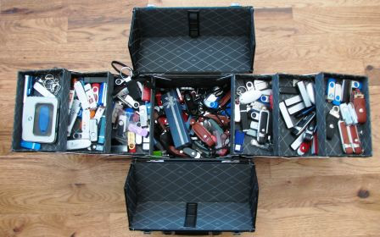
Lost USBs
Millions of USB flash drives are in use today worldwide and thousands are lost each day, according to one estimate

Slide 18
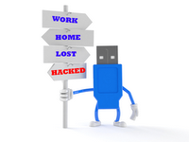
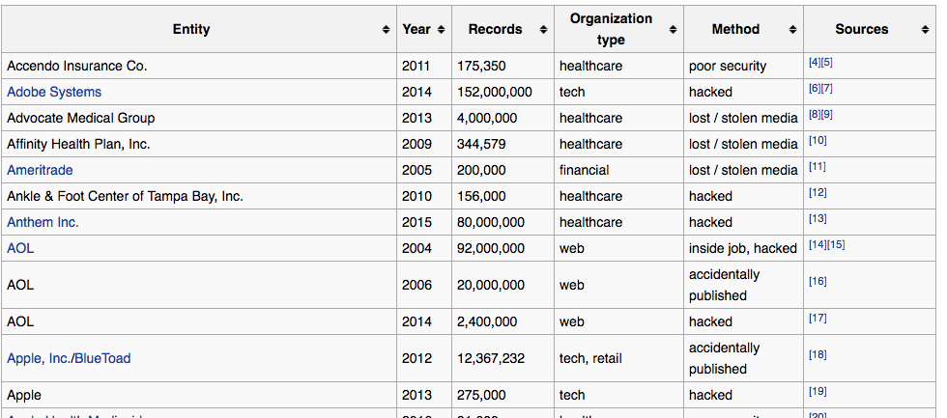
Data Leakage by Lost Devices

Slide 19
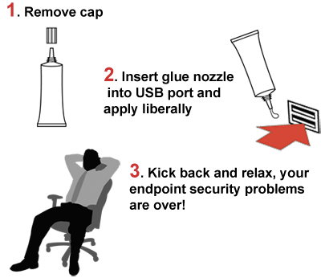
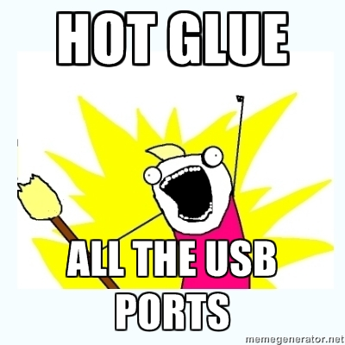
Glue it?

Slide 20
Fine it？

Slide 21
Example Threat and Policy
Laptops

Slide 22
Lost Laptops
Lost and stolen laptops are a common occurrence
Estimated occurrences in US airports every week: 12,000
Average cost of a lost laptop for a corporation is $50K
Costs include data breach, intellectual property loss, forensics, lost productivity, legal and regulatory expenses
Data breach much more serious than hardware loss
Data breach cost estimated at $200 per customer record
Direct costs include discovery, notification and response
Indirect costs include customer turnover (higher loss and lower acquisition)
Data can also be copied while laptop is unattended
Ponemon Institute. Research Studies & White Papers: Security

Slide 23
From Device to Data – Encryption
In a perfect world, we would not store sensitive data on portable devices
All sensitive data should be held on secure servers.
Unfortunately, this approach is not always practical.
Keep the benefit of using portable devices
Reduce the risk of data leakage by encryption

Slide 24
Encrypted File Systems
Disk encryption
Block-level encryption
Encryption of physical or logical drive
BitLocker in Windows Vista and 7
TrueCrypt open source software
File system encryption
File-level encryption
Encrypting File System (EFS) in Windows

Slide 25
Common Policy: Confinement/Isolation
Ensure a misbehaving application does not harm the rest of the system
Example: Untrusted code
Many ways to implement…

Slide 26
Running Untrusted Code
We often need to run buggy/unstrusted code:
programs from untrusted Internet sites:
Apps, extensions, plug-ins, codecs for media player
exposed applications: pdf viewers, outlook
legacy daemons: sendmail, bind
honeypots
Goal: if application “misbehaves” ⇒ kill it

Slide 27
Implementing Confinement
Key component: reference monitor
Mediates requests from applications
Implements protection policy
Enforces isolation and confinement
Must always be invoked:
Every application request must be mediated
Tamperproof:
Reference monitor cannot be killed
… or if killed, then monitored process is killed too
Small enough to be analyzed and validated

Slide 28
Approaches to Confinement
Isolated hardware
System call interposition
Sandboxing
Virtual machines

Slide 29


Confinement: Hardware
Confinement: ensure misbehaving app cannot harm rest of system
Can be implemented at many levels:
Hardware: run application on isolated hw (air gap)
⇒ difficult to manage
app 1
app 2
Network 2
air gap
network 1

Slide 30
Confinement: System Call Interposition

Slide 31

Confinement: System Call Interposition
Confinement: ensure misbehaving app cannot harm rest of system
Can be implemented at many levels:
Process: System Call Interposition
Isolate a process in a single operating system
process 1
process 2
Operating System

Slide 32
System Call Interposition
Observation: to damage host system (e.g., persistent changes) app must make system calls:
To delete/overwrite files: unlink, open, write
To do network attacks: socket, bind, connect, send
Idea: monitor app’s system calls and block unauthorized calls
Implementation options:
Completely kernel space (e.g., GSWTK)
Completely user space (e.g., program shepherding)
Hybrid (e.g., Systrace)
Notes:
GSWTK: generic software wrapper toolkit

Slide 33
Initial Implementation (Janus)
Linux ptrace: process tracing
process calls: ptrace (… , pid_t pid , …)
and wakes up when pid makes sys call.
Monitor kills application if request is disallowed
user space
monitored
application
(browser)
monitor
open(“/etc/passwd”, “r”)
OS Kernel

Slide 34
Complications
cd(“/tmp”)
open(“passwd”, “r”)
cd(“/etc”)
open(“passwd”, “r”)
If app forks, monitor must also fork
forked monitor monitors forked app
If monitor crashes, app must be killed
Monitor must maintain all OS state associated with app
Working directory (CWD), UID, EUID, GID
When app does “cd path”, monitor must update its CWD
otherwise: relative path requests interpreted incorrectly

Slide 35
Problems with ptrace
Ptrace is coarse
Trace all system calls or none
inefficient: no need to trace “close” system call
Monitor cannot abort sys-call without killing app
Security problems: race conditions
Example: symlink: me ⟶ mydata.dat
proc 1: open(“me”)
monitor checks and authorizes
proc 2: me ⟶ /etc/passwd
OS executes open(“me”)
Classic TOCTOU bug: time-of-check / time-of-use
time
not atomic

Slide 36
Alternate Design: systrace [P’02]
user space
monitored
application
(browser)
monitor
policy file
for app
open(“etc/passwd”, “r”)
OS Kernel
sys-call
gateway
systrace
permit/deny
systrace only forwards monitored sys-calls to monitor (efficiency)
systrace resolves sym-links and replaces sys-call path arguments by full path to target
When app calls execve, monitor loads new policy file
Notes:
Efficiency: saves context switches

Slide 37
Policy
Sample policy file:
path allow /tmp/*
path deny /etc/passwd
network deny all
Manually specifying policy for an app can be difficult:
Systrace can auto-generate policy by learning how app behaves on “good” inputs
If policy does not cover a specific sys-call, ask user
… but user has no way to decide
Difficulty with choosing policy for specific apps (e.g., browser) is the main reason this approach is not widely used

Slide 38
Confinement: Sandboxing (“jailing”)
Limit the access rights of a program running inside of an OS
Coined by Cheswick in the 1990s; relies on chroot, a system call that has been in UNIX since the 1970s

Slide 39
Sandboxing Example: chroot (“jails”)
Often used for “guest” accounts on ftp sites
To use do: (must be root)
chroot /tmp/guest root dir “/” is now “/tmp/guest”
su guest EUID set to “guest”
Now “/tmp/guest” is added to file system accesses for applications in jail
open(“/etc/passwd”, “r”) ⇒ open(“/tmp/guest/etc/passwd” , “r”)
application cannot access files outside of jail

Slide 40
Jailkit
Problem: all utility progs (ls, ps, vi) must live inside jail
jailkit project: auto builds files, libs, and dirs for jail env
jk_init: creates jail environment
jk_check: checks jail env for security problems
checks for any modified programs,
checks for world writable directories, etc.
jk_lsh: restricted shell to be used inside jail
note: simple chroot jail does not limit network access

Slide 41
Escaping From jails
Early escapes: relative paths
open( “../../etc/passwd”, “r”) ⇒ open(“/tmp/guest/../../etc/passwd”, “r”)
chroot should only be executable by root.
otherwise jailed app can do:
create dummy file “/aaa/etc/passwd”
run chroot “/aaa”
run su root to become root
(bug in Ultrix 4.0)

Slide 42
Problems with chroot and jail
Coarse policies:
All or nothing access to parts of file system
Inappropriate for apps like a web browser
Needs read access to files outside jail (e.g. for sending attachments in Gmail)
Does not prevent malicious apps from:
Accessing network and messing with other machines
Trying to crash host OS

Slide 43
Confinement: Virtual Machines
Confinement: ensure misbehaving app cannot harm rest of system
Can be implemented at many levels:
Virtual machines: isolate OSes on a single machine
OS₁
OS₂
app1
app2
Virtual Machine Monitor (VMM)

Slide 44
Virtual Machines (and “The Cloud”)

Slide 45
Virtual Machines
VM2
VM1
Apps
Apps
Guest OS 2
Guest OS 1
Virtual Machine Monitor (VMM)
Host OS
Hardware
Example: VMWare, VirtualBox, NSA NetTop
single HW platform used for both classified and unclassified data
Notes:
Simple idea: run an OS as a guest program in virtual address space provided by the “hypervisor” (also called VMM).
Privileged instructions trap to the hypervisor.

Slide 46
Why so popular now?
VMs in the 1960’s:
Few computers, lots of users
VMs allow many users to share a single computer
VMs 1970’s – 2000: non-existent
VMs since 2000:
Many services
Print server, Mail server, Web server, File server, Database , …
Wasteful to run each service on different hardware
VMs heavily used in cloud computing

Slide 47
Example Operation
Virtualized OS wants to write a block of memory to the disk.
Hypervisor takes control of this operation
Creates and destroys VMs, allocates and managed resources of underlying hardware.
Hypervisor is, in effect, an OS of its own
Guest OSes are also OSes
Notes:
Don’t become magically less secure because of the existence of a hypervisor.
(In fact, may even become *less* secure if management of OSes are an issue.)

Slide 48
Why Would a Virtual/Guest OS Be More Secure?
Smaller attack surface
From the perspective of the hypervisor, almost no privileged instructions
This means fewer opportunities for mistakes
Historically, OS bugs are also less likely
Hypervisor can perform intrusion detection and instruction scanning of guest OSes

Slide 49
VMM Security Assumption
VMM Security assumption:
Malware can infect guest OS and guest apps
But malware cannot escape from the infected VM
Cannot infect host OS
Cannot infect other VMs on the same hardware
Requires that VMM protect itself and is not buggy
VMM is much simpler than full OS
… but device drivers run in Host OS

Slide 50
Intrusion Detection in the VMM
Runs as part of OS kernel and user space process
Kernel root kit can shutdown protection system
Common practice for modern malware
Standard: run IDS in the network
Shortcoming: insufficient visibility into user’s machine
Additionally: run IDS as part of VMM (protected from malware)
VMM can monitor virtual hardware for anomalies
VMI: Virtual Machine Introspection
Allows VMM to check Guest OS internals
Notes:
IDS = Intrusion Detection System

Slide 51
Infected VM
malware
Guest OS
VMM
IDS
Hardware

Slide 52
VMM Sample Checks
Stealth root-kit malware:
Creates processes that are invisible to “ps”
Opens sockets that are invisible to “netstat”
1. Lie detector check
Goal: detect stealth malware that hides processes and network activity
Method:
VMM lists processes running in GuestOS
VMM requests GuestOS to list processes (e.g., ps)
If mismatch: kill VM

Slide 53
VMM: Example Checks
2. Application code integrity detector
VMM computes hash of user app code running in VM
Compare to whitelist of hashes
Kills VM if unknown program appears
3. Ensure GuestOS kernel integrity
example: detect changes to sys_call_table
4. Virus signature detector
Run virus signature detector on GuestOS memory

Slide 54
Downsides to VMs
Maintenance can be tricky
Patching requires maintenance of an entire OS
Sometimes isolation is too strong
Cannot share information easily across VMs
Opening up channels creates possibility for covert channels, other information flows
Another approach: Sandboxing (Does not solve all of these issues.)

Slide 55
Subverting the VMM: Subvirt [King et al. 2006]
Virus idea:
Once on victim machine, install a malicious VMM
Virus hides in VMM
Invisible to virus detector running inside VM
anti-virus
anti-virus
⇒
OS
OS
VMM and virus
HW
HW
Notes:
Virtualization essentially acts as another ring with even higher privileges than ring 0. Anyone who compromises the virtualization environment practically controls the whole physical environment on which the system runs. Malware hiding in this layer is even more difficult to discover and to remove than malware in kernel mode.
Researchers at the University of Michigan and from Microsoft Research demonstrated an initial proof of concept rootkit dubbed SubVirt [1] in March 2006, thus spawning the first generation of rootkits to exploit virtualization. After infecting a computer, the rootkit installs itself below the existing system and runs on a virtual machine after rebooting.
To allow this to happen, SubVirt also modifies the boot sequence so that the BIOS no longer loads the Master Boot Record (MBR) belonging to the operating system directly but instead starts a virtual machine. The virtual machine then executes the BIOS and launches the operating system copied into the virtual environment via the MBR.
While users carry on working on their – virtual – operating systems, unaware of what has happened, SubVirt launches a second instance and performs all kinds of nasty tricks. The rootkit cannot be terminated or uninstalled by the guest system because the rootkit controls the virtual machine on which the victim's guest system is running. Security researchers refer to this technique as a virtual machine-based rootkit (VMBR).

Slide 56
VM-Based Malware
Virtual Machine-Based Rootkit (VMBR): a virus that installs a malicious VMM (hypervisor)
Microsoft Security Bulletin
Suggests disabling hardware virtualization features by default for client-side systems
But VMBRs are easy to defeat
A guest OS can detect that it is running on top of VMM

Slide 57
Problem: covert channels
Covert channel: unintended communication channel between isolated components
Can be used to leak classified data from secure component to public component
Classified VM
Public VM
secret
doc
malware
covert
channel
listener
VMM

Slide 58
Cloud Security
Availability
Bandwidth, storage redundancy, backups
Diversity (?)
Integrity
Confidentiality
Harder to assess (Bellovin discusses)
“Subpoena attacks”

Slide 59
Cloud Security: Infrastructure
Windows or Linux?
How is virtualization implemented?
Where are files stored?
How is the network partitioned?
Who has physical access to the data center?

Slide 60
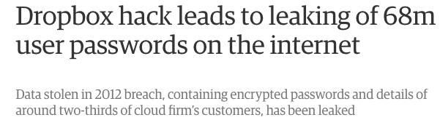
Cloud Security: Maintenance
How are resources provisioned (and enforced)?
Who is maintaining the OS?
Storage (networked file systems, naming…)
Single bug or vulnerability can cause widespread outages or breaches
Getting Access Control Lists (ACLs) right is hard!

