Slide 1
MP4: Checkpoint 2
CS461 / ECE422 – UIUC Spring 2016
Simon Kim

Slide 2
Introduction
4.2.1. Network attacks
Crack the wireless network password (WEP)
Sniff and analyze the network
Obtain a client’s login credentials
4.2.2. Anomaly (port scanning) detection
Write a program that takes a pcap filename as an argument and checks TCP flag bits to detect port scanning.

Slide 3
Network attacks
Read the recommended setup provided in the MP document
Use Kali Linux 32 bit
Kali Linux comes pre-installed with tools you need
Aircrack-ng Suite
Nmap
Wireshark
Notes:
Icmp, tcp, udp
Tcp header

Slide 4
Network attacks: WEP crack
Aircrack-ng Suite includes:
Airmon-ng - Enable and disable monitor mode on wireless interfaces.
Aireplay-ng - Inject and replay wireless frames.
Airodump-ng - Capture raw 802.11 frames.
Aircrack-ng - 802.11 WEP and WPA/WPA2-PSK key cracking program.
More details: http://www.aircrack-ng.org/documentation.html
WEP crack tutorial: http://www.aircrack-ng.org/doku.php?id=simple_wep_crack

Slide 5
Network attacks: WEP crack
DO NOT USE
Aircrack-ng Suite includes:
Airmon-ng - Enable and disable monitor mode on wireless interfaces.
Aireplay-ng - Inject and replay wireless frames.
Airodump-ng - Capture raw 802.11 frames.
Aircrack-ng - 802.11 WEP and WPA/WPA2-PSK key cracking program.
More details: http://www.aircrack-ng.org/documentation.html
WEP crack tutorial: http://www.aircrack-ng.org/doku.php?id=simple_wep_crack
Skip any step that uses aireplay-ng.

Slide 6
Wireless network terms
BSSID – the MAC address of the wireless access point (https://en.wikipedia.org/wiki/Service_set_(802.11_network)#Basic_service_set_identification_.28BSSID.29)
ESSID – a ID for a set of two or more interconnected wireless BSSs with the same network name (https://en.wikipedia.org/wiki/Service_set_(802.11_network)#Extended_service_set)
Channel # - the number of the channel that a wireless network is configured to use for communication (https://en.wikipedia.org/wiki/List_of_WLAN_channels)
Our network uses 2.4GHz range only.
# IV (data/packet) - the number of initialization vectors gathered (https://en.wikipedia.org/wiki/Initialization_vector#WEP_IV)

Slide 7
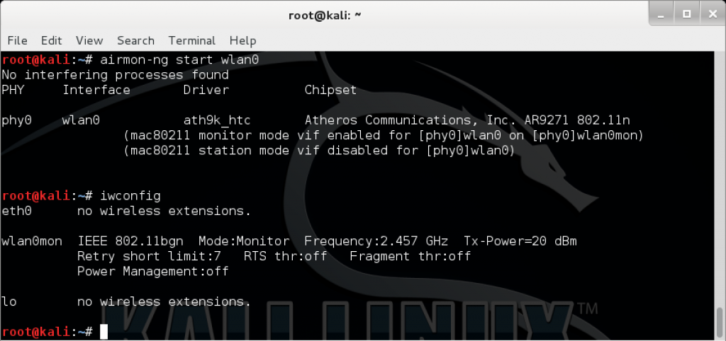
Airmon-ng
Source: https://www.kali.org/penetration-testing/pixiewps-reaver-aircrack-ng-updates/

Slide 8
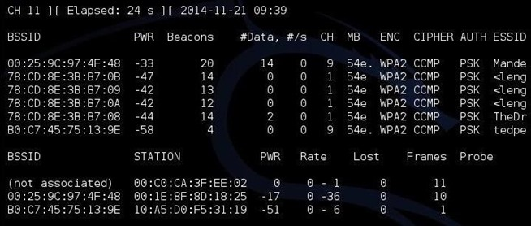
Airodump-ng
Source: http://null-byte.wonderhowto.com/how-to/hack-wi-fi-breaking-wps-pin-get-password-with-bully-0158819/

Slide 9
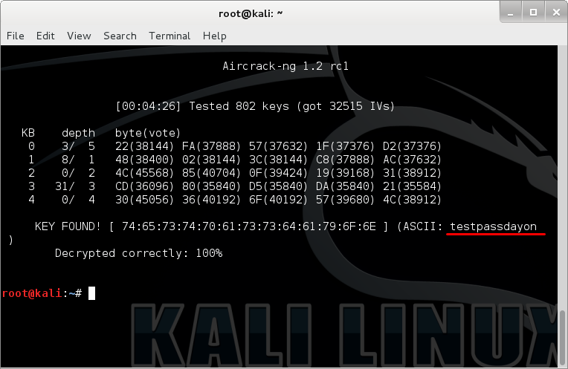
Aircrack-ng
Source: http://nvnote.com/wep-crack-kalilinux/

Slide 10
Sidenote: promiscuous vs. monitor
Promiscuous mode: sniffing after connecting to the access point, becoming part of the network
Monitor mode: sniffing without connecting to the access point
https://wiki.wireshark.org/CaptureSetup/WLAN
http://security.stackexchange.com/questions/36997/what-is-the-difference-between-promiscuous-and-monitor-mode-in-wireless-networks
http://lazysolutions.blogspot.ca/2008/10/difference-promiscuous-vs-monitor-mode.html

Slide 11
Network attacks: network analysis
How many hosts are there?
Which one is the server?
What services are present on the network?
Use Wireshark to identify hosts and analyze live traffics
Use nmap (network mapper) to obtain more details on hosts
Your own interpretation of network behavior
Don’t rely on one result. See if other findings agree with what you observe.
For example, how is your IP address assigned? Static? DHCP? Can you confirm this in anyway?

Slide 12
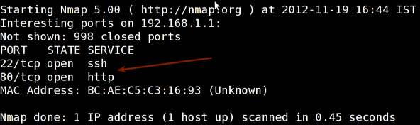
Nmap
Open/closed/filtered ports - https://nmap.org/book/man-port-scanning-basics.html
Port scanning techniques - https://nmap.org/book/man-port-scanning-techniques.html
Don’t forget about UDP.
Our network has no services running above port 4096.
Source: http://www.cyberciti.biz/networking/nmap-command-examples-tutorials/

Slide 13
Network attacks: information retrieval
Client’s login credential is sent over HTTPS
What do you need to decrypt the content?
Is it available anywhere accessible?
No need to perform any sort of attack
Be curious about what you find.
What is it used for?
How is it used?

Slide 14
Anomaly detection
Assumption: if #SYN > 3 * # SYN+ACK, then consider the activity as attack, port scanning.
You MUST use dpkt; we will not grade codes using scapy.
Know the OSI model:
Which layer handles which protocols
What fields exist within protocol headers
Notes:
Icmp, tcp, udp
Tcp header

Slide 15
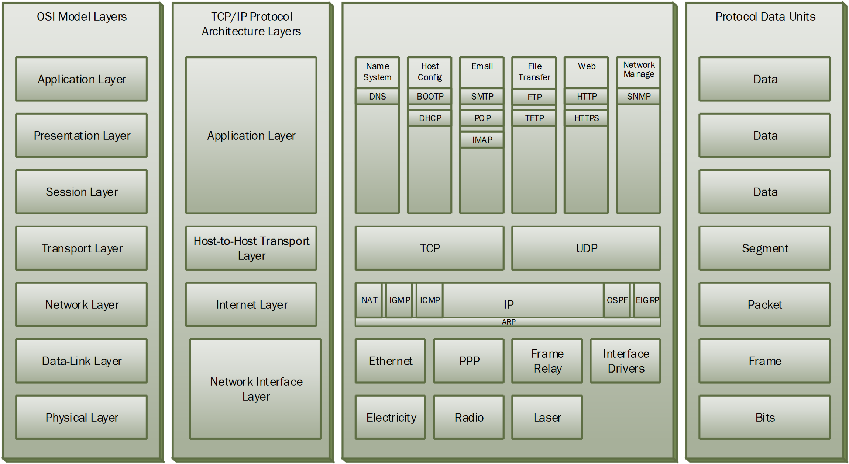
Networking basics: OSI Model and Protocols
Source: http://teachweb.milin.cc/images/datacommunicatie/TCP-IP_vs_OSI_Model.png

Slide 16
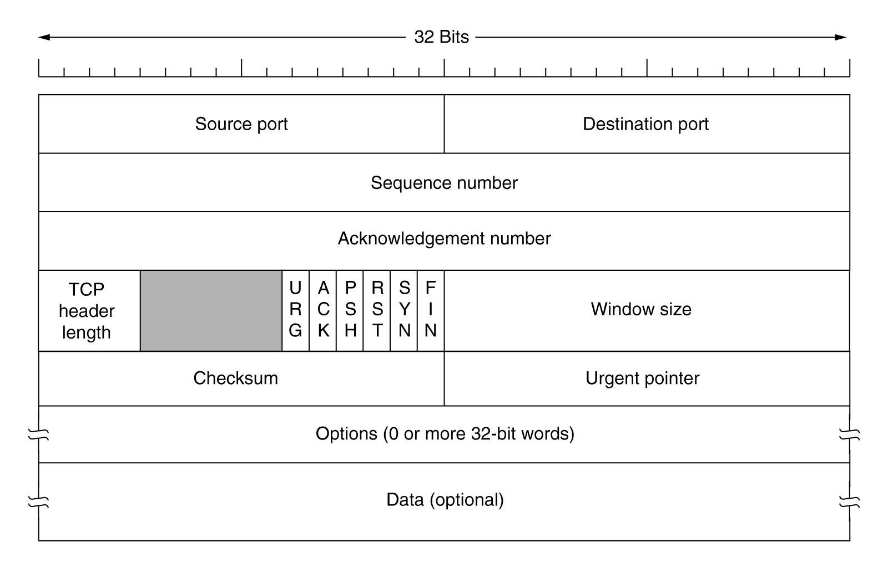
Networking basics: TCP header
Source: https://elguber.wordpress.com/category/networking/page/2/

Slide 17
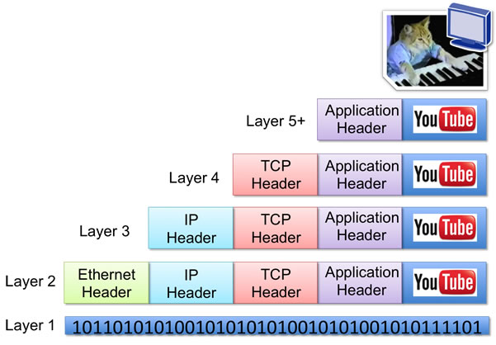
Networking basics: data encapsulation
Source: http://networkstatic.net/how-headers-encapsulate-in-the-osi-stack/

Slide 18
Anomaly detection: dpkt example
#!/usr/bin/python2.7
import dpkt
f = open('test.pcap')
pcap = dpkt.pcap.Reader(f)
for ts, buf in pcap:
eth = dpkt.ethernet.Ethernet(buf)
ip = eth.data
tcp = ip.data
if tcp.dport == 80 and len(tcp.data) > 0:
http = dpkt.http.Request(tcp.data)
print http.uri
f.close()
Source: https://jon.oberheide.org/blog/2008/10/15/dpkt-tutorial-2-parsing-a-pcap-file/

Slide 19
Test correctness
https://subversion.ews.illinois.edu/svn/sp16-ece422/_shared/mp4/lbl-internal.20041004-1305.port002.dump.anon.pcap
Source: ftp://ftp.bro-ids.org/enterprise-traces/hdr-traces05
http://networker.wikia.com/wiki/File:Portscan.pcap
A very small example created using Nmap

Slide 20
Tips
Use try-except to handle/ignore malformed packets
Don’t just dissect every packet
http://stackoverflow.com/questions/8849635/python-dpkt-find-out-if-packet-is-a-tcp-packet-or-a-udp-packet
dpkt cheatsheet: http://engineering-notebook.readthedocs.org/en/latest/engineering/dpkt.html

