Slide 1
Lecture 08 – Passwords and Authentication
Michael Bailey
University of Illinois
ECE 422/CS 461 – Spring 2016

Slide 2
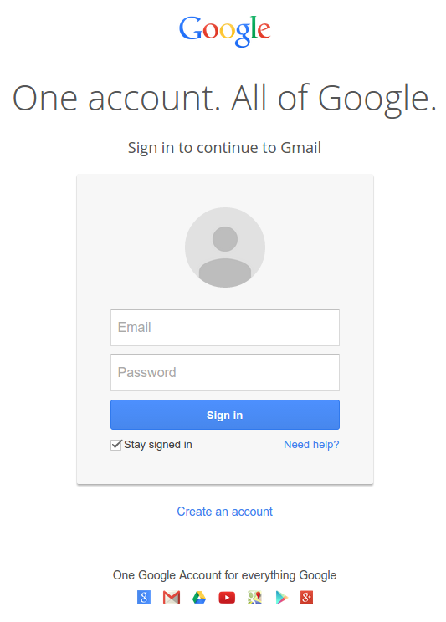
Passwords

Slide 3
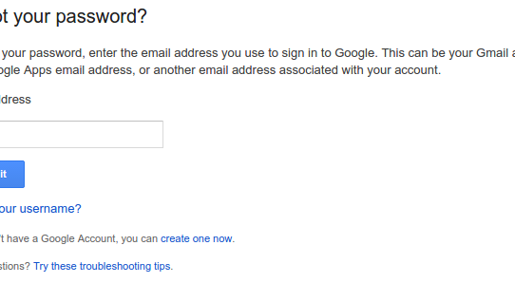
Passwords – Usability
Notes:
Have to remember it
Have to enter it before access to the website, and not mistype it

Slide 4
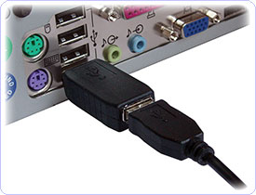
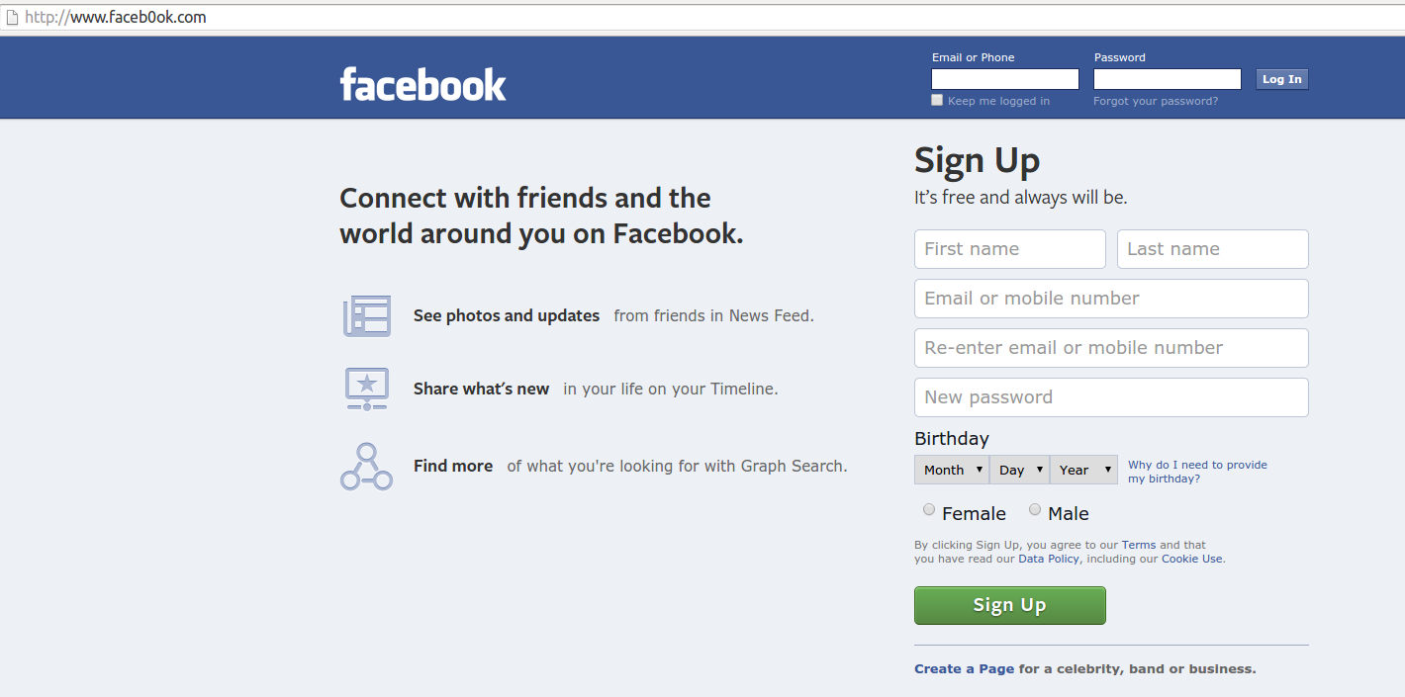
Attacks – Stealing passwords
From the user
Key loggers (hardware, malware, shoulder surfing)
Phishing attacks
Network attacks

Slide 5
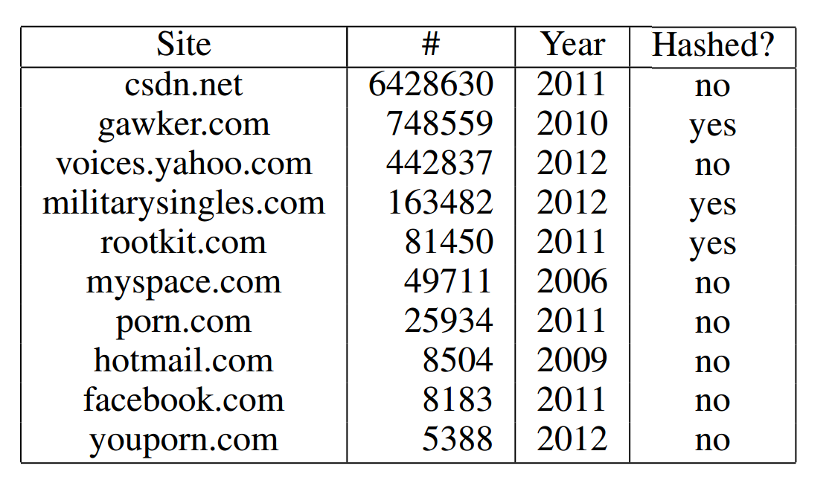
Attacks – Stealing passwords
From the website
Malware on website
Database dump (SQL Injection, shell injection)

Slide 6
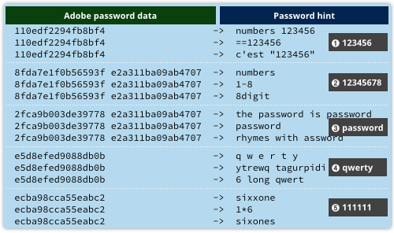
Attacks – Stealing passwords
From other websites
Password reuse

Slide 7
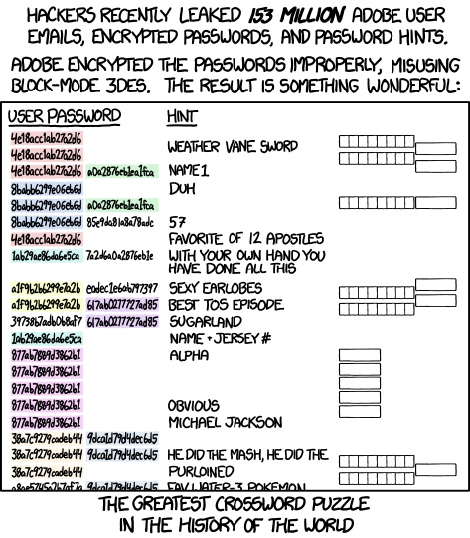
Attacks – Stealing passwords

Slide 8
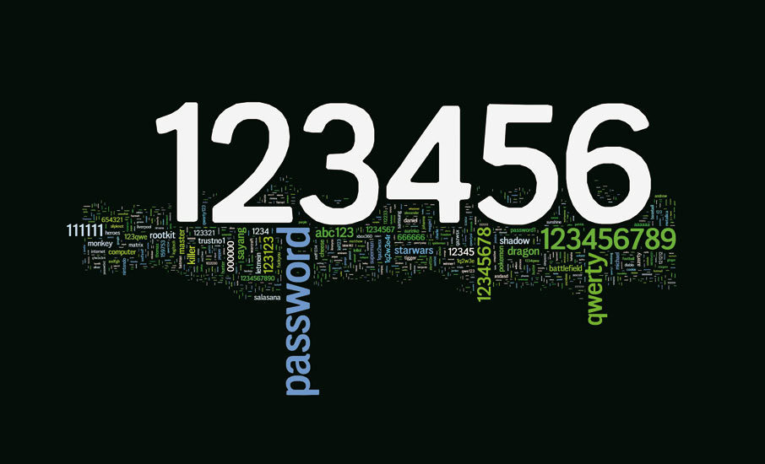
Attacks – Password guessing

Slide 9
Attacks – Password guessing
PIN | Frequency
1234 | 10.713%
1111 | 6.016%
0000 | 1.881%
1212 | 1.197%
7777 | 0.745%
1004 | 0.616%
2000 | 0.613%
4444 | 0.526%
2222 | 0.516%
6969 | 0.512%
9999 | 0.451%
3333 | 0.419%
5555 | 0.395%
6666 | 0.391%
1122 | 0.366%
1313 | 0.304%
8888 | 0.303%
4321 | 0.293%
2001 | 0.290%
1010 | 0.285%
Notes:
Online attacks:
Detectable, shut off after n attempts, longer timeouts each incorrect guess, etc.
Potential denial of service

Slide 10
Attacks – Password Databases
Server must be able to authenticate users
Could store username/password in database
Better solutions?
Notes:
Password should be hashed

Slide 11
Password Hashing
Simple:
store H(Password)
Attacks?
Notes:
Brute force attacks, especially over common passwords

Slide 12
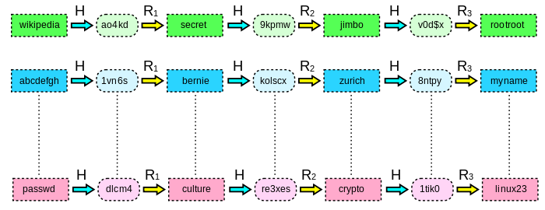
Rainbow tables
Similar to a lookup table
Attacker(s) can trade-off disk-space vs. CPU time
Recovered 90% of 6.5M LinkedIn passwords in 6 days

Slide 13
Rainbow table defense
Good: salted hashes
Store H(Password + user-specific salt)
Better: slow hash functions
Bcrypt
Based off expensive key-setup of Blowfish
Scrypt
Requires large amounts of memory
Though can be traded off for CPU time
Cryptocurrencies have spurred ASIC implementations
Notes:
Salt your passwords

Slide 14
Password Recovery
Sometimes users forget passwords
Or are locked out!
Reset vs. Recovery
Have to authenticate – but how?
Notes:
Phone, (other?) email, something you know that the server also knows (facebook friends), security questions

Slide 15
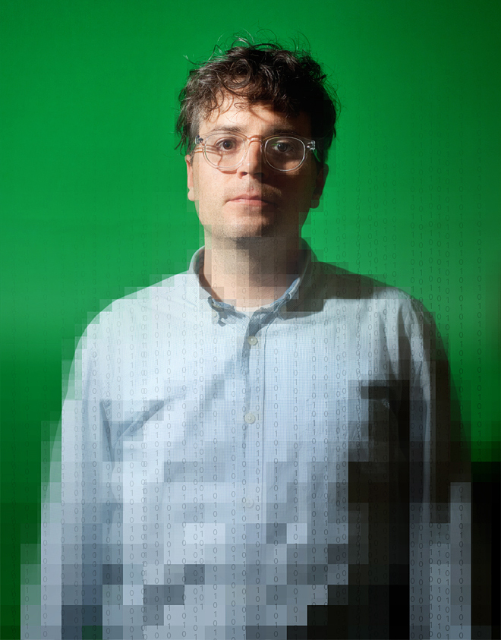




Password recovery gone wrong
Mat Honan Photo: Ariel Zambelich/Wired. Illustration: Ross Patton/Wired

Slide 16
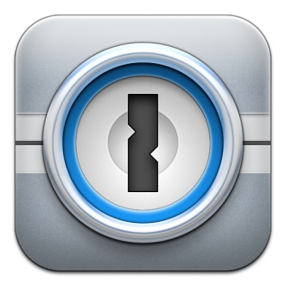


Password Managers
Store passwords
Generally encrypted under master password
Generate passwords
Allows easier unique passwords per site

Slide 17
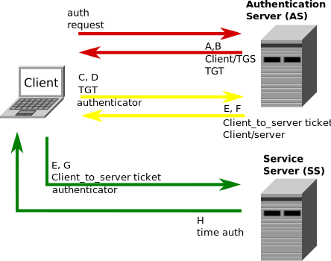
Network authentication
User sends password
Hopefully over encrypted channel (TLS/SSH)
Challenge-based authentication
Server sends challenge (nonce)
User sends response (H(password, nonce))
Kerberos

Slide 18
Multi-factor authentication
Something you know, something you have, something you are

Slide 19
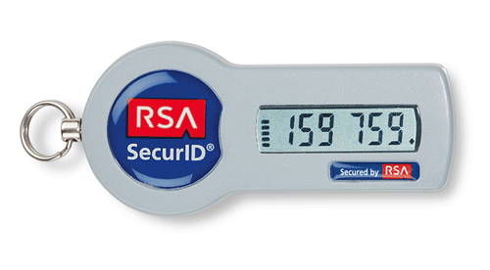

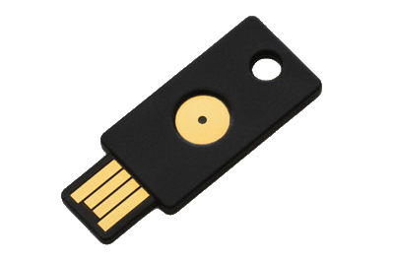
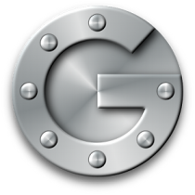

Something you have
Physical (hardware) token
RSA token
Yubikey
Smartphone?
Common Protocols
HOTP: (HMAC(K,C) & 0x7FFFFFFF) mod 10^{d}
TOTP: HOTP, where C = (now - T₀) / T_{step}

Slide 20
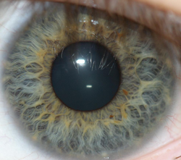
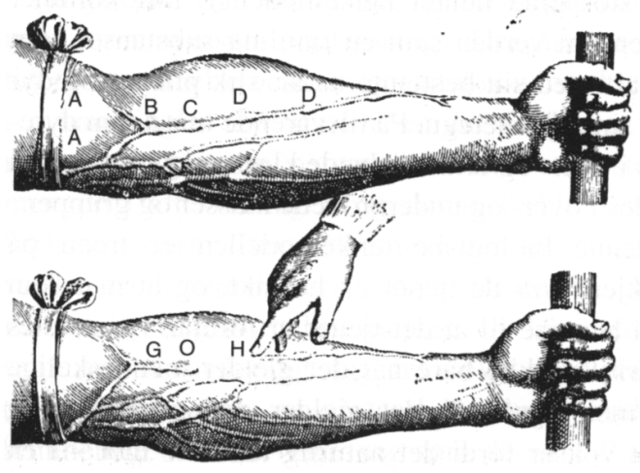
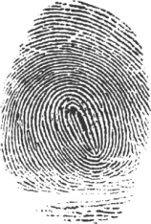
Something you are
Biometrics
Hopefully unique to you
Disadvantages?
Challenges?
Notes:
Doesn’t change, can’t get a new iris or fingerprint if yours is compromised
Not an exact match, have to handle noisy data…
Touch-ID hack:
https://vimeo.com/75324765

Slide 21
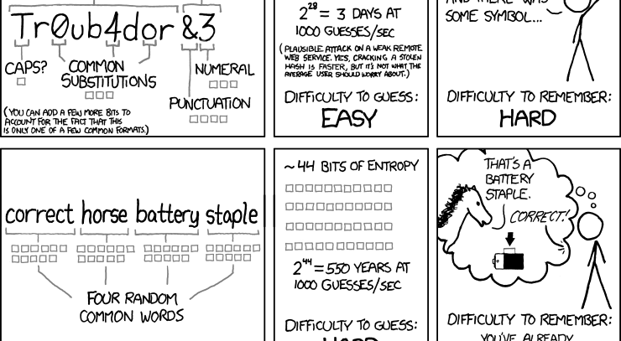
Password strength

Slide 22
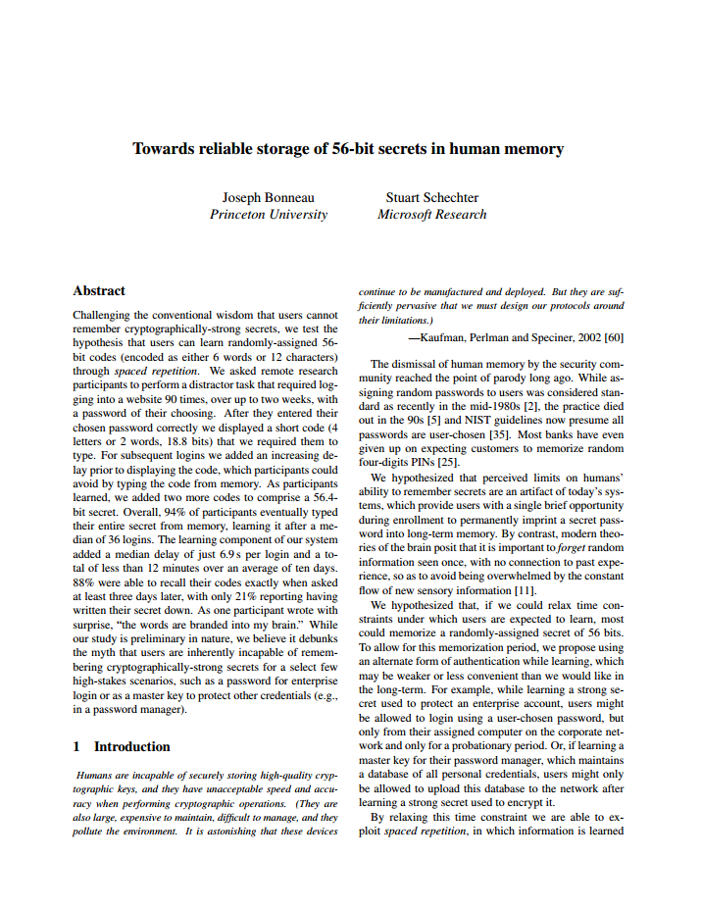
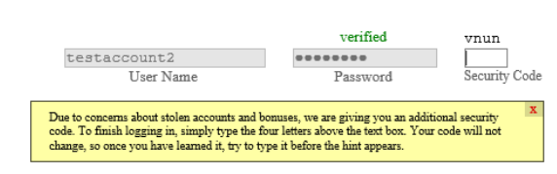
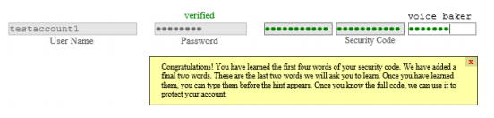
Users can memorize long passwords

Slide 23
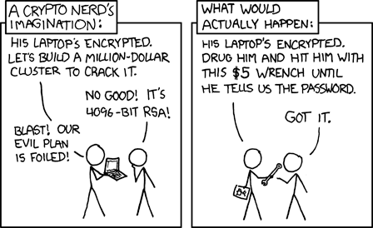

Slide 24
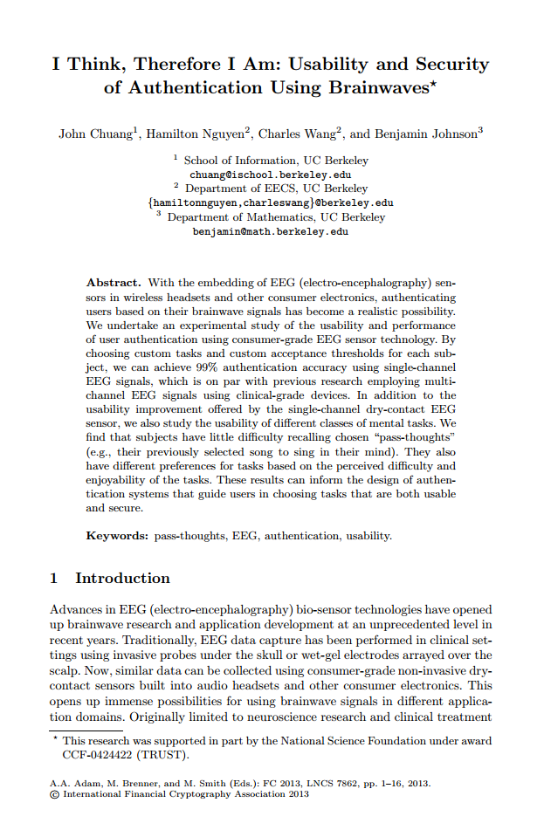
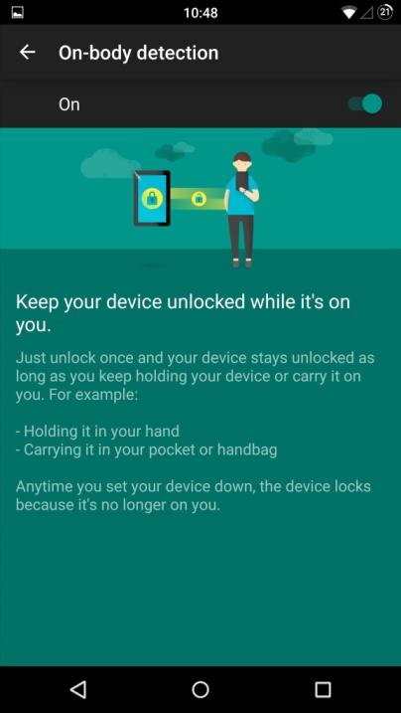
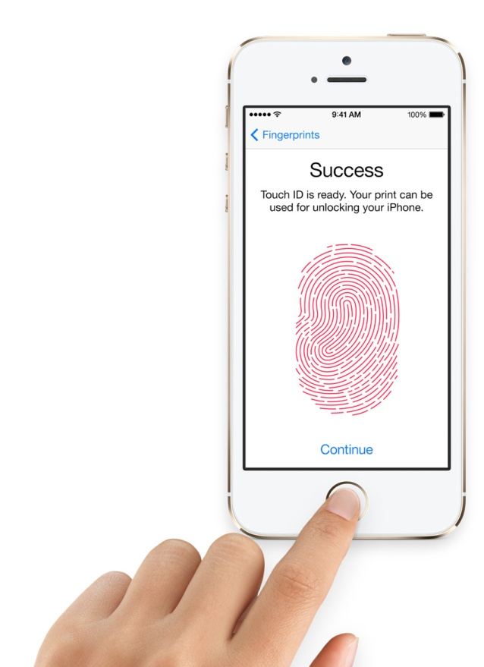
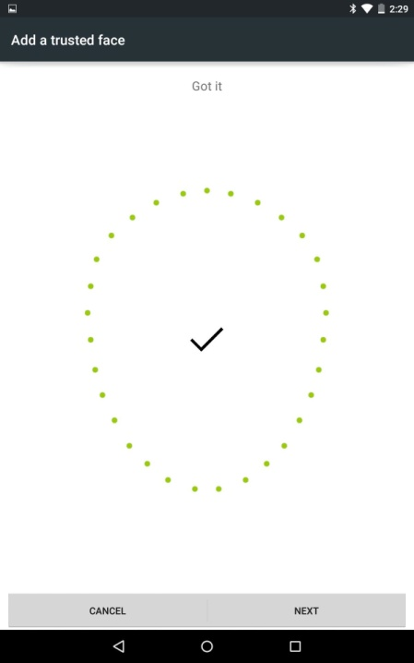
Future of authentication?
Notes:
Crazy ideas: use brainwaves to authenticate people without them “realizing it”
Using phones as single modes of authentication; now phone has to be authenticated. Pin? TouchID? Face recognition? On body-detection? Most of those broken (why? Pin reuse, predictable, touch id hack, face recognition fooled by picture, on body detection … not yet, but heuristic based (and fallback to pin?))
Interesting things from apple wrt pin login, store strong encryption key for device in Secure Enclave, and have secure enclave authenticate pin; can enforce lockout etc. brute force now not possible.

