Slide 1
Lecture 12 – Networking Attacks
Michael Bailey
University of Illinois
ECE 422/CS 461 – Fall 2015

Slide 2
Hacking the network
Attacks at all layers of the network
Data-link layer
Network layer
Transport layer
Application layer
Attacks against all of the properties we care about
Availability
Integrity
Confidentiality

Slide 3
Why?
Unencrypted transmission
Eavesdropping possible at any intermediate host during routing
No source authentication
Sender can spoof source address, making it difficult to trace packet back to attacker
No integrity checking
Entire packet, header and payload, can be modified while en route to destination, enabling content forgeries, redirections, and man-in-the-middle attacks
No bandwidth constraints
Large number of packets can be injected into network to launch a denial-of-service attack

Slide 4
Link Layer Attacks

Slide 5
Sniffing and attacks against confidentiality
Gathering packets from the local network
Passive (wired network with a hub or a wireless network)
Active (wired network built with a switch)
Traffic is not encrypted

Slide 6
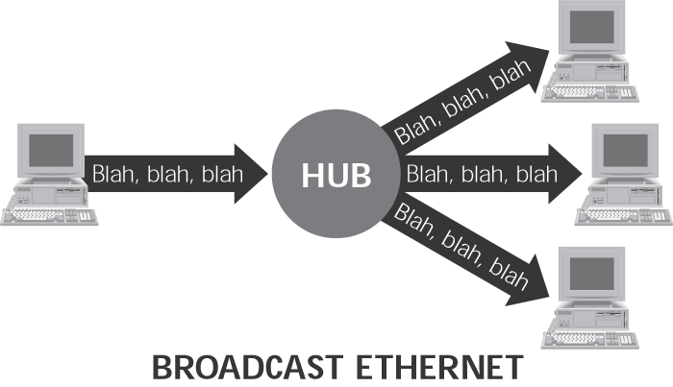

Slide 7
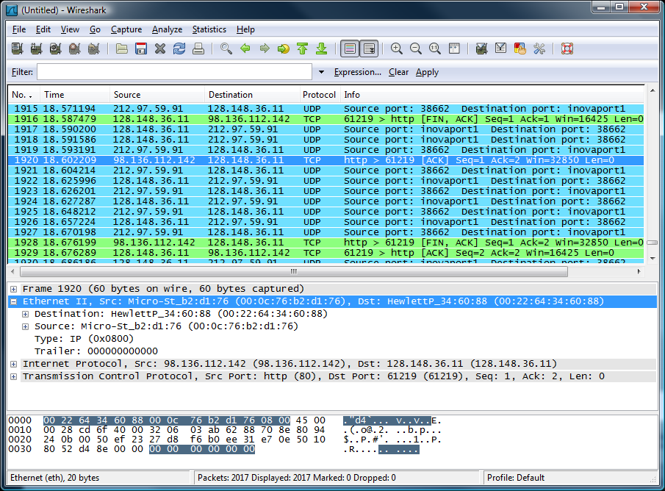
⬅ menu
⬅ main toolbar
⬅ filter toolbar
⬅ packet list pane
⬅ packet details pane
⬅ packet bytes pane
⬅ status bar

Slide 8

Google?

Slide 9
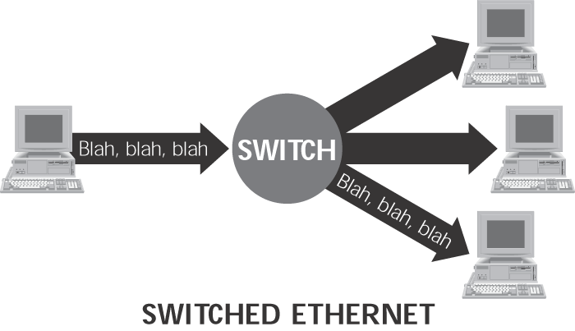

Slide 10
Active Sniffing
Fool the switch into sending the packets to the sniffer
MAC Flooding
Send a flood of traffic with random MAC addresses
Fill up the switch’s memory
Switches will then forward packets to all links on the switch
Dsniff program Macof
ARP spoofing
Send fake ARP replies to change the victim’s ARP table
Dsniff program Arpspoof
Attacker configures his or her system to forward any traffic it receives to the router.
Any traffic from the target machine is sent to the attacker’s machine before being transferred to the local network.

Slide 11
Address Resolution Protocol
A mapping is needed between IP and physical (MAC) address
Dynamically established using the Address Resolution Protocol (ARP)
Broadcast protocol implemented at the link layer
Considered to be a layer 2.5 protocol
Used by Ethernet, 802.11, many other link layer protocols with IPv4
Message types:
who-has requests – “Who has IP 192.168.0.2?”
is-at replies – “00:01:2D:00:5F:CC has IP 192.168.0.2”
Problem:
No binding between ARP messages and sender identity
In other words, no authentication
www.ccs.neu.edu/home/cbw/6740/slides/3_Low_Level_Attacks.pptx

Slide 12





ARP Example
Internet
192.168.0.10 is-at
01:02:03:04:05:06
Router
192.168.0.1
00:AA:BB:CC:00:11
192.168.0.10
01:02:03:04:05:06
Src: 192.168.0.11
Dst: 192.168.0.10
IP
192.168.0.11
1A:2B:3C:4D:5E:6F
Src: 1A:2B:3C:4D:5E:6F
Dst: 01:02:03:04:05:06
Src: 1A:2B:3C:4D:5E:6F
Dst: ???
who-has 192.168.0.10?
Eth.
Eth.

Slide 13

ARP Example
8.8.8.8
Internet
192.168.0.1 is-at
00:AA:BB:CC:00:11
Router
192.168.0.1
00:AA:BB:CC:00:11
192.168.0.10
01:02:03:04:05:06
Src: 192.168.0.11
Dst: 8.8.8.8
IP
192.168.0.11
1A:2B:3C:4D:5E:6F
Src: 1A:2B:3C:4D:5E:6F
Dst: 00:AA:BB:CC:00:11
Src: 1A:2B:3C:4D:5E:6F
Dst: ???
who-has 192.168.0.1?
Eth.
Eth.

Slide 14
MAC modification/Spoofing
Finding arp mapping on your network
Arp –a
Change the MAC on a Host (Cloning)
Linux (ifconfig)
Windows Network Settings
Creating Link Layer Packets (Spoofing)
libnet (API)
Linkcat (tool – netcat for link layer)
Notes:
Linkcat - part of the paketto toolset - like netcat only for link layer – useful for making packets literally by hand and sending them out, or intercepting packets and modifying parts as strings and then retransmitting.

Slide 15
ARP Spoofing
CLIENT
LAN: 192.168.1.x
SERVER
Regular traffic
switch
Alice
Using arp poisoning
Bob
.10
.100
MAC: 00:0A:E4:2E:9B:11
MAC: 00:0A:E4:3B:47:7E
gratuitous arp reply
Bob’s IP→ Cracker’s MAC
arpspoof 192.168.1.10 192.168.1.100
gratuitous arp reply
Alice’s IP→ Cracker’s MAC
arpspoof 192.168.1.100 192.168.1.10
victim ip
gateway ip
victim ip
gateway ip
Cracker
MAC: 00:22:64:34:60:88
.1

Slide 16
Catch telnet password
CLIENT
LAN: 192.168.1.x
SERVER
Regular traffic
switch
Alice
Using arp poisoning
Bob
.10
.100
With dsniff, we catch the passwords used to log in to a telnet service:
dsniff -n
Acts as a router
Cracker
.1

Slide 17
Network layer hacks

Slide 18
IP Spoofing
IP Spoofing is an attempt by an intruder to send packets from one IP address that appear to originate at another
If the server thinks it is receiving messages from the real source after authenticating a session, it could inadvertently behave maliciously
There are two basic forms of IP Spoofing
Blind Spoofing
Attack from any source
Non-Blind Spoofing
Attack from the same subnet

Slide 19
IP Spoofing
Attacks made possible by IP spoofing include
Denial of Service (DOS)
Session Hijacking
Man in the Middle
To take over a TCP stream, sequence and acknowledgement numbers must be sniffed or predicted.

Slide 20
TCP Connection Setup and Flags
Why do we need connection setup?
To establish state on both hosts
Most important state: sequence numbers
Count the number of bytes that have been sent
Initial value chosen at random
Random initial sequence numbers are a form of authentication
Important TCP flags (1 bit each)
SYN – synchronization, used for connection setup
ACK – acknowledge received data
FIN – finish, used to tear down connection
RST – unrecoverable error, immediately terminate the connection
www.ccs.neu.edu/home/cbw/6740/slides/3_Low_Level_Attacks.pptx

Slide 21
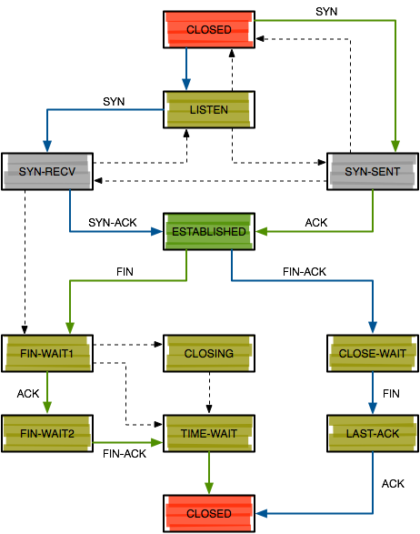
Three Way Handshake
Choose SeqC at random
Choose SeqS at random
Client
Server
SYN <SeqC, 0>
SYN/ACK <SeqS, SeqC+1>
At this point, only the client and server should know SeqC and SeqS
ACK <SeqC+1, SeqS+1>

Slide 22

Attack Strategies
Send a FIN packet?
Triggers a multi-packet, graceful shutdown
Send a RST packet?
Only works if you can guess both ports and the seq/ack numbers
???
Server
84.79.0.1:80
RST seq=? ack=?
Src: 84.79.0.1:80
Dst: 193.54.34.101:?
I wanna kill that connection!
FIN/ACK
Internet
FIN
???
193.54.34.101:8641
72.80.02.01

Slide 23
Guessing Sequence Numbers
The security of TCP connections relies on the randomness of the initial sequence numbers (ISNs)
If an attacker knows the sequence numbers, they can spoof packets
Problem: many OSs used to have low-entropy ISN generators
Typically seeded by the current time
RFC793 – “increase the ISN by 1 every 4 microseconds”
Windows NT 4.0 – ISN = ms * 10 % 2^32
Attacker can measure the victim’s ISN generators
NTP query
Repeatedly open connections to known services like HTTP, FTP, echo, etc.

Slide 24
TCP RST Attack
Server port is typically known, client port must be guessed
Older OSs accepted a wide range of plausible seq/ack numbers with RST
Modern OSs are more conservative
Seq. must be “reasonable”
Ack. must be within the sender’s window
Server
84.79.0.1:80
Okay, connection closed.
RST
???
Internet
???
???
193.54.34.101:8641
72.80.02.01

Slide 25
TCP Connection Hijacking
RST attacks enable DoS, but not packet injection
Attackers can hijack TCP connections by:
Silencing one participant (A)
Sending spoofed packets to the other participant (B)
If B accepts a spoofed packet, the connection becomes desynchronized
Why is it useful to silence one participant?
A may RST the connection if they observe a desynchronization or unsolicited packets

Slide 26
rsh Connection Hijacking Example
Remote shell (rsh) was the predecessor to ssh
Typically allowed connections from a preconfigured list of “trusted” hosts
Attacker goal: spoof a TCP connection from a trusted host
Finish login, redirect stdout/stderr to /dev/null, create a new account for the attacker, etc.
Server
84.79.0.1:514
SYN seq=1 ack=0
Src: 193.54.34.101:666
Dst: 193.54.34.101:514
ACK seq=2 ack=guess
Src: 193.54.34.101:666
Dst: 193.54.34.101:514
Make many TCP connections, measure initial sequence number distribution
Make sure the trusted host is offline, or DoS them
SYN/ACK
ACK
Internet
Trusted Host
193.54.34.101
72.80.02.01

Slide 27
Modern TCP
Modern OSs choose ISNs purely at random
This makes off-path hijacking attacks extremely difficult
Does this mean TCP is now secure from spoofing and hijacking?
No.
On-path attackers still see everything, no guessing required
May drop, modify, or inject packets at will
This is why we need IPSEC, TLS, etc.

Slide 28
DDoS Attacks

Slide 29
Attacks against Availability: Denial of Service attacks
An attempt to consume finite resources, exploit weaknesses in software design or implementation, or exploit lack of infrastructure capacity
Effects the availability and utility of computing and network resources

Slide 30
Simple DoS
Attacker
Victim
Victim
Victim

Slide 31
Distributed DoS
Attacker
Handler
Handler
Agent
Agent
Agent
Agent
Agent
Victim

Slide 32
DoS History
Locally-induced crash
exploit operating system or server software bug
Local resource consumption
fork() bomb, fill disks, deep directory nesting
Deny service to individual hosts
force crash or outage of critical services
Remotely-induced crash
“magic” packets – ping of death, teardrop
Remote resource consumption
syslog, SYN, fragment flood, UDP storm
Notes:
Evolution of dos techniques?

Slide 33
DoS History (cont.)
Deny service to an entire network
target vulnerable links or critical network infrastructure / information
Remotely-induced network outage
attacks against routers, DNS servers
redirected routes – forged routing information
Remote network congestion
forged directed broadcasts – smurf, fraggle
remote control of compromised hosts (“zombies”) for coordinated flooding – DDoS
Notes:
Evolution of dos techniques
Targets get larger in scope

Slide 34
Timeline of a DDoS attack
A large set of machines are compromised
Attacker identifies exploitable hosts with scanners, or other techniques
Attacker accesses the system with automated remote exploits, sniffers, password cracking, worms, trojans
Attacker installs attack tools
Attacker remotely instructs compromised machines to attack target

Slide 35



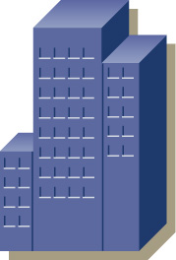
Distributed Denial of Service
Dallas
C&W
WorldCom
Boston
AT&T
Sprint
Verizon
New York
Level 3
National
Bank
Qwest
San Francisco
Genuity
TELUS
Large
Enterprise
Federal
Customer

Slide 36

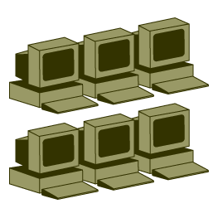


Blind spoofing and Smurf Denial of Service (DOS) Attacks
Reflector Network
2.2.2.*
ICMP Echo Request
SRC
DST
ICMP Echo Replies
3.3.3.100
2.2.2.255
SRC
DST
2.2.2.*
3.3.3.100
Attacker
Target
1.1.1.100
3.3.3.100

Slide 37
Example: TCP SYN Flood
Normal sequence for TCP connection establishment (3-way handshake)
CLOSED
CLOSED
SYN 141:141
SYN 182:182
SYN_SENT
SYN_RCVD
ACK 142
Server
Client
ACK 183
ESTABLISHED
ESTABLISHED
Notes:
I think we should talk about how talk about how various commonly exploited elements of tcp/ip should work, and then introduce examples of exploitation
Attacks which take advantage of refraction for force multipliers, attacks which are direct
Tcp state: session setup and tear down
syn flood, ack flood, null flood, time_wait based attacks

Slide 38
Example: TCP SYN Flood (cont.)
Attacker
Server
Listen Queue
SYN 141:141
SYN_RCVD
SYN 241:241
SYN 182:182
SYN_RCVD
SYN 341:341
ACK 142
SYN_RCVD
SYN 441:441
SYN_RCVD
SYN 282:282
SYN_RCVD
SYN 541:541
SYN_RCVD
SYN 641:641
ACK 242
SYN_RCVD
SYN 741:741
SYN 382:382
ACK 342
SYN_RCVD
SYN_RCVD

Slide 39
DNS Attacks

Slide 40
Pharming: DNS Hijacking
Changing IP associated with a server maliciously:
208.77.188.166
74.208.31.63
Normal
DNS
Pharming
attack
www.example.com
www.example.com
http://www.example.com
My Premium Blog Spot
http://www.example.com
My Premium Blog Spot
userID:
password:
userID:
password:
Phishing: the different web sites look the same.

Slide 41
DNS spoofing
Problem
No authentication of responses
Any DNS response is generally believed.
No attempt to distinguish valid data from invalid.
Responses can contain entries that should not be trusted but are
Responses are cached
Just one false root server could disrupt the entire DNS.
Attacks
Inject bogus DNS responses
Attach additional bogus entries in valid DNS responses (especially for internal names)

Slide 42
DNS spoofing
Easy to observe UDP DNS query sent to well known server on well known port.
www.darpa.mil A?
Root DNS Server
www.darpa.mil A 192.5.18.19
Sanjoy’s Laptop
Caching DNS Server
www.darpa.mil A 128.9.128.127
mil DNS Server
Dan’s Laptop
First response wins. Second response is silently dropped on the floor.
darpa.mil DNS Server

Slide 43
DNS Cache Poisoning
Basic idea: give DNS servers false records and get it cached
DNS uses a 16-bit request identifier to pair queries with answers
Cache may be poisoned when a name server:
Disregards identifiers
Has predictable ids
Accepts unsolicited DNS records

Slide 44
DNS cache poisoning
Bell Labs Caching Server
Response www.attacker.com A 128.9.128.127
attacker.com NS ns.attacker.com
attacker.com NS www.google.com
ns.attacker.com A 128.9.128.2
www.google.com A 128.9.128.127
www.google.com
= 128.9.128.127
ns.attacker.com
Query www.attacker.com
Query www.google.com
Any Bell Labs Laptop
Remote attacker

Slide 45
Routing Attacks

Slide 46
How to Hijack a Prefix
The hijacking AS has
Router with eBGP session(s)
Configured to originate the prefix
Getting access to the router
Network operator makes configuration mistake
Disgruntled operator launches an attack
Outsider breaks in to the router and reconfigures
Getting other ASes to believe bogus route
Neighbor ASes not filtering the routes
… e.g., by allowing only expected prefixes
But, specifying filters on peering links is hard
http://www3.cs.stonybrook.edu/~phillipa/CSE390/RoutingSecurity.pptx

Slide 47
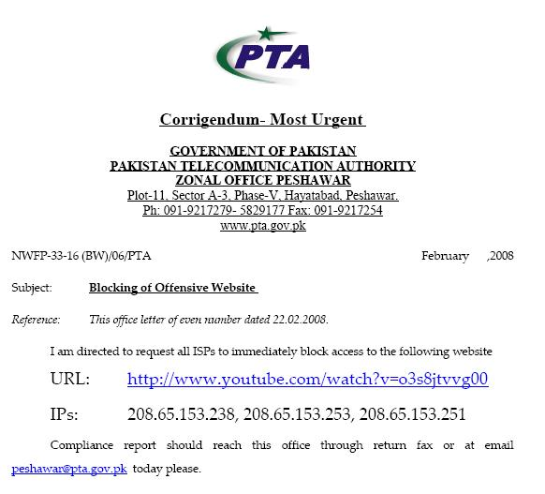
Pakistan Telecom: Sub-prefix hijack
February 2008 : Pakistan Telecom hijacks YouTube
“The Internet”
Pakistan
Telecom
YouTube
I’m YouTube:
IP 208.65.153.0 / 22
Multinet
Pakistan
Telnor
Pakistan
Aga Khan
University
Notes:
-level of autonomous systems
-e.g., YouTube, AT&T, pakistan telecom
-routing is done on IP addresses, so when someone wants to go to YouTube they get YouTube’s IP address and YouTube announces to the world that they have the ip address and traffic is forwarded towards them. So here multinet would route to it’s provider pakistan telecom that then forwards the traffic on to youtube.
-these networks chosen for a specific reason which is that there was an incident in february 2008 pakistan telecom actually high jacked traffic going to youtube (misconfiguration).
-they announced to the world that they’re youtube and traffic destined to youtube was routed to them
-youtube was unavailable for a couple of hours as operators phone each other to figure out what was going on.

Slide 48
Pakistan Telecom: Sub-prefix hijack
Here’s what should have happened….
“The Internet”
Hijack + drop packets going to YouTube
X
Pakistan
Telecom
YouTube
I’m YouTube:
IP 208.65.153.0 / 22
Multinet
Pakistan
Telnor
Pakistan
Aga Khan
University
Block your own customers.

Slide 49
Pakistan Telecom: Sub-prefix hijack
But here’s what Pakistan ended up doing…
“The Internet”
No, I’m YouTube!
IP 208.65.153.0 / 24
Pakistan
Telecom
Pakistan
Telecom
YouTube
I’m YouTube:
IP 208.65.153.0 / 22
Multinet
Pakistan
Telnor
Pakistan
Aga Khan
University
Notes:
Our works focuses on attacks of this flavor..

Slide 50
China Telecom: Interception
Level3, VZW, 22394 66.174.161.0/24
ISP 1
VZW, 22394 66.174.161.0/24
Level 3
China
Telecom
Verizon
Wireless
22394 66.174.161.0/24
22394
Paths chosen based on cost and length.
66.174.161.0/24
Notes:
B4 we start with attacks lets lookat how bgp works
We have this prefix
22.. Ann, verizon routes traffic to it, reannounces it
“ (level 3)
Some of you may remember a recent “interesting incident” that actually made it into the nytimes
Ctel ann prefix; this wrong, b\c it’s not suppose to originate
Lots of isps fell for this, we look at the data and there we a number of large isp, including thisone that remains nameless,that fell for this.
In fact we found that this happened for 50K prefix, including the DoD.
Also, even worse, renesys found that theres an interception
C tel is so big…
There have been many well publicized misconfigurations that illustrate the insecurity of BGP. For example consider the prefix on the last slide. In april 2010 China telecom announced a direct path to this prefix (as well as 50k other ones). So now ISP 1 has two paths to the prefix and needs to pick 1. Since the china telecom path is shorter ISP 1 will choose to route through it. And what’s interesting here, is that since China Telecom is so large they actually had a router in their network that still new the correct path to the prefix so the traffic went back out to level 3 and on to verizon.

Slide 51
China Telecom: Interception
April 2010 : China Telecom intercepts traffic
ChinaTel path is shorter
?
ChinaTel 66.174.161.0/24
Level3, VZW, 22394 66.174.161.0/24
ISP 1
Level 3
China
Telecom
Verizon
Wireless
22394
This prefix and 50K others were announced by China Telecom
Traffic for some prefixes was possibly intercepted
66.174.161.0/24
Notes:
B4 we start with attacks lets lookat how bgp works
We have this prefix
22.. Ann, verizon routes traffic to it, reannounces it
“ (level 3)
Some of you may remember a recent “interesting incident” that actually made it into the nytimes
Ctel ann prefix; this wrong, b\c it’s not suppose to originate
Lots of isps fell for this, we look at the data and there we a number of large isp, including thisone that remains nameless,that fell for this.
In fact we found that this happened for 50K prefix, including the DoD.
Also, even worse, renesys found that theres an interception
C tel is so big…
There have been many well publicized misconfigurations that illustrate the insecurity of BGP. For example consider the prefix on the last slide. In april 2010 China telecom announced a direct path to this prefix (as well as 50k other ones). So now ISP 1 has two paths to the prefix and needs to pick 1. Since the china telecom path is shorter ISP 1 will choose to route through it. And what’s interesting here, is that since China Telecom is so large they actually had a router in their network that still new the correct path to the prefix so the traffic went back out to level 3 and on to verizon.

Slide 52
Canadian Bitcoin hijack (2/3/2014)
Bitcoin Background
Miners solve cryptographic puzzles using their computing power
Once the puzzle is solved new bitcoins are created and the miner gets some reward
Mining is generic: mining pool dictates currency
E.g., dogecoin, bitcoin etc.
Miners communicate with pool server using a protocol called ‘stratum’
Mining server can redirect user to a different server (e.g., for load balancing)
http://www.secureworks.com/cyber-threat-intelligence/threats/bgp-hijacking-for-cryptocurrency-profit/

Slide 53
Canadian Bitcoin hijack (2/3/2014)
Hijacked users got directed to a mining server IP that was under the control of the hijacker and redirects them to a malicious mining pool.
Miners continue to receive tasks and solve puzzles but don’t get compensated. ☹
http://www.secureworks.com/cyber-threat-intelligence/threats/bgp-hijacking-for-cryptocurrency-profit/

Slide 54
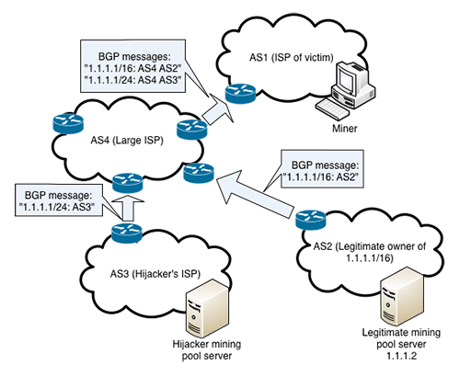
Canadian Bitcoin hijack (2/3/2014)

Slide 55
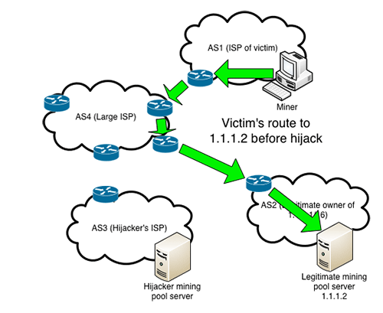
Canadian Bitcoin hijack (2/3/2014)

Slide 56
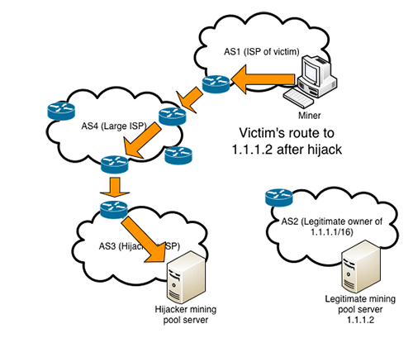
Canadian Bitcoin hijack (2/3/2014)

Slide 57
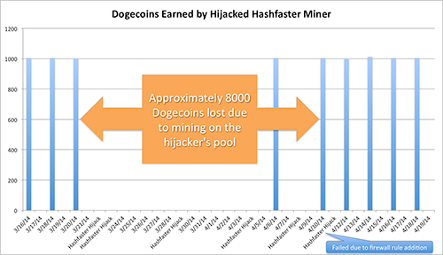
Canadian Bitcoin hijack (2/3/2014)
Estimated loss of $83,000

