Slide 1
Routing Security
Security, Privacy, and Consumer Protection Nick Feamster University of Chicago
Notes:
Assignment 2: Wednesday
Midterm: October 24 (will cover material through this week)
Wednesday’s lecture: Recorded. Extra office hour TBD (Friday afternoon)

Slide 2
Internet Routing Protocol: BGP
Autonomous Systems (ASes)
Route Advertisement
Destination Next-hop AS Path
128.135.0.0/16
Traffic
192.5.89.89
10578..160
128.135.0.0/16
66.250.252.44
174… 160
Session
Notes:
Diagram of routing table is very confusing because it’s not pointing to anything
Green arrow shorter, and too thick… green is a msg
More intuition about how the system actually works.
Don’t say “interdomain”
DESTINATION-BASED Routing
Tables look like a set of possible routes and a rankings over these routes
(pop up a simplified table fragment)

Slide 3
Border Gateway Protocol
Internet’s interdomain routing protocol, BGP, essentially has no security — will believe any routes advertised by neighboring router.
Different ways to interfere with Internet routing:
Cut-off (Egypt case)
BGP “route hijacking”

Slide 4
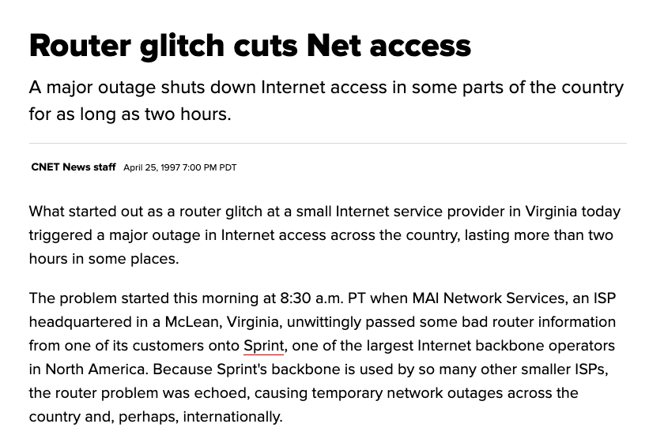

Slide 5
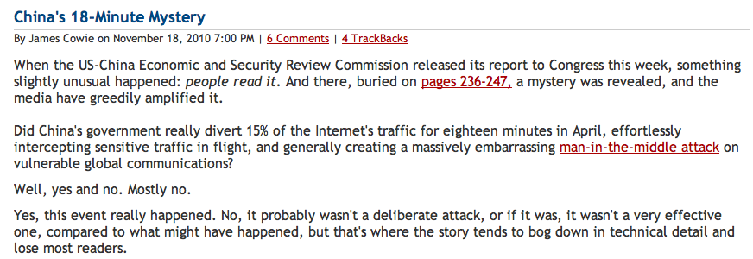
China’s Accidental Hijack

Slide 6
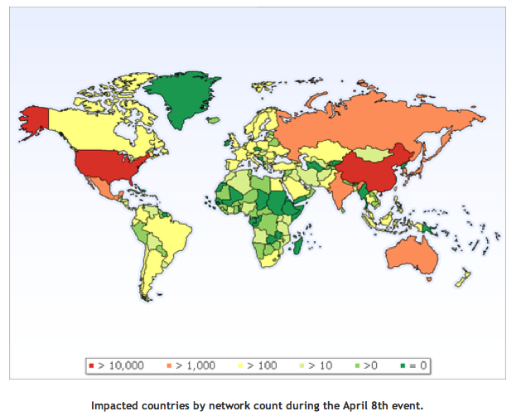
China Hijack: Sequence of Events
On April 8, 2010, China advertised about 50,000 blocks of IP addresses from 170 different countries
60,000 prefixes from the US
Event lasted for 20 minutes
Why did most people not notice?
How might more traffic have been intercepted?
http://www.renesys.com/blog/2010/11/chinas-18-minute-mystery.shtml

Slide 7
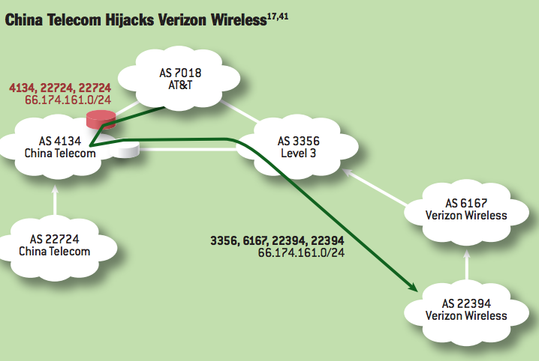
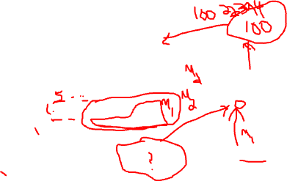
Notes:
China Telecom’s AS 22724 hijacks Verizon Wireless’s prefix 66.174.161.0/24. The bogus route originated by AS 22724 propagates through the AS-level graph and is eventually selected by AT&T because it is shorter than the legitimate route originating at Verizon Wireless’s AS 22394. Meanwhile, Level3 selects the legitimate route, because it is shorter than the bogus route. Thus, network traffic splits between the hijacking AS and the legitimate origin AS, with the nature of the split depending on routing policies used by individual ASes and the topology of the AS-level graph.

Slide 8
Other “Famous” Hijack Events
February 24, 2008: Pakistan advertises a small part of YouTube’s AS 36561
Likely as a botched attempt to block YouTube in Pakistan, following a government order
January 22, 2006: Con Edison (AS 27605) mistakenly advertises lot of networks (Level 3, UUNet, Panix ISP, …)
April 25, 1995: AS 7007 incident
“Ultimately, though, the problem remains on of transitive trust. A provider can and should limit the advertisements it will accept from a customer.”

Slide 9
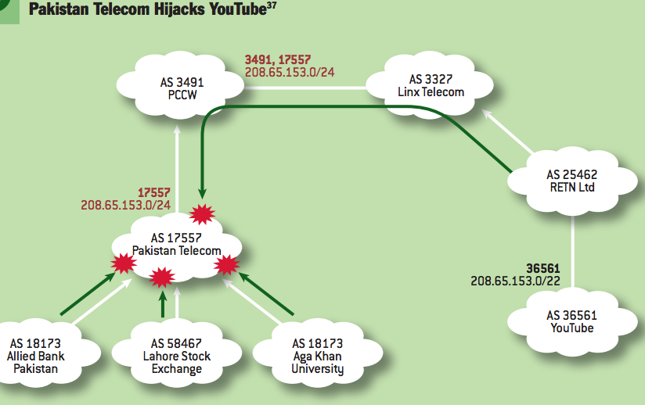
Notes:
Perhaps the most famous subprefix hijack occurred on February 24, 2008, when Pakistan Telecom took YouTube offline. The incident2 began when Pakistani authorities demanded that YouTube to be censored within Pakistan. To accomplish this, Pakistan Telecom’s AS 17557 launched a subprefix hijack by originating the subprefix 208.65.153.0/24 of YouTube’s prefix 208.65.153.0/22 to its customer ASes in Pakistan (e.g., Aga Khan University, Lahore Stock Exchange, Allied Bank Pakistan), as in figure 3.37,41 This meant that traffic destined for YouTube’s servers in AS 36561 would instead be forwarded to the longer IP prefix originated by Pakistan Telecom’s AS 17557, where traffic could then be dropped. Events took an unexpected turn when Pakistan Telecom’s bogus BGP announcement leaked out of Pakistan. PCCW, a large ISP that provides global network connectively to Pakistan Telecom, received the bogus routing announcement, selected the bogus route, and announced it to its own neighbors. Because the bogus route was for a longer prefix (/24) than the legitimate route (/22), longest-prefixmatch routing meant the bogus route was always more preferred by the legitimate route, and within minutes, at least two-thirds of the Internet was sending its YouTube traffic to Pakistan.2

Slide 10
Attacks on Routing
How these attacks can happen
Compromised routers
Unscrupulous ISPs
Configuration error
Problems
Bogus origination of routes
Bogus modification of routes

Slide 11
China’s Accidental Hijack

Slide 12
China Hijack: Sequence of Events
On April 8, 2010, China advertised about 50,000 blocks of IP addresses from 170 different countries
60,000 prefixes from the US
Event lasted for 20 minutes
Why did most people not notice?
How might more traffic have been intercepted?
http://www.renesys.com/blog/2010/11/chinas-18-minute-mystery.shtml

Slide 13
Attacks against BGP
Tampering with routing software
Tampering with update data en route
Router compromise and “misconfiguration”
Tampering with router management software

Slide 14
Intradomain Routing Security
Shared secrets guard against new machines being plugged in, but not against an authorized party being dishonest.
Solution: digitally sign each LSA (expensive!). List authorizations in certificate.
Note: everyone sees the whole map; monitoring station can note discrepancies from reality.

Slide 15
Who Needs Origin Authentication?
Prefix hijacking
Route leaks (cf. AS 7007 incident from L6)
Redirection (e.g., for phishing)
Blackholing traffic
Spamming
De-aggregation attacks (or misconfiguration)
Can be lethal when combined with hijacking

Slide 16
Why Origin Auth Matters: Phishing
BGP Route to authoritative DNS server
BGP Route to Web server
Hijacking DNS (cache poisoning)
Hijacking web server
In theory, SSL should protect, but…
Question: Why does path authentication matter?

Slide 17
Who Needs Origin Authentication?
Prefix hijacking
Route leaks (cf. AS 7007 incident from L6)
Redirection (e.g., for phishing)
Blackholing traffic
Spamming
De-aggregation attacks (or misconfiguration)
Can be lethal when combined with hijacking

Slide 18
Data Plane Security
No guarantees about the path that packets will actually traverse
S-BGP, soBGP do not protect against internal routing snafus
AS 2
AS Path = 1 2 …
AS 1
AS 3
Misconfiguration can cause packet deflections.

Slide 19
What This Means
Rootkits + 0day → rogue announcements → Man-in-middle attacks, with our clues applied
No need for three-way-handshake when you’re in-line
Nearly invisible exploitation potential, globally
Endpoint enumeration - direct discovery of who and what your network talks to
Can be accomplished globally, any-to-any
How would you know if this isn’t happening right now to your traffic at DEFCON?

Slide 20
BGP MITM Hijack Concept
We originate the route like we always did
Win through usual means (prefix length, shorter as-path w/ several origin points, etc)
“Win” is some definition of “most of the internet chooses your route”
We return the packets somehow
Coordinating delivery was non-trivial
Vpn/tunnel involve untenable coordination at target
Then it clicked – use the Internet itself as reply path, but how?

Slide 21
BGP MITM Setup
Traceroute & plan reply path to target
Note the ASN’s seen towards target from traceroute & bgp table on your router
Apply as-path prepends naming each of the ASN’s intended for reply path
Nail up static routes towards the next-hop of the first AS in reply path
Done

Slide 22
BGP MITM – First Observe
View of Forwarding Information Base (FIB) for 10.10.220.0/22 after converging
ASN 200 originates 10.10.220.0/22, sends announcements to AS20 and AS30
Internet is converged towards valid route
Random User ASN 100
AS10
AS40
AS60
AS20
AS30
Target ASN 200
AS50

Slide 23
BGP MITM – Plan reply path
ASN 100’s FIB shows route for 10.10.200.0/22 via AS10
Attacker ASN 100
We then build our as-path prepend list to include AS 10, 20, and 200
AS10
AS40
AS60
AS20
AS30
Target ASN 200
AS50

Slide 24
BGP MITM – Setup Routes
10.10.220.0/24 is announced with a route-map:
Then, install static route in AS100 for 10.10.220.0/24 to AS10’s link
ip route 10.10.220.0 255.255.255.0 4.3.2.1
Attacker ASN 100
AS10
AS40
AS60
AS20
AS30
Target ASN 200
AS50

Slide 25
Anonymzing The Hijacker
We adjust TTL of packets in transit
Effectively ‘hides’ the IP devices handling the hijacked inbound traffic (ttl additive)
Also hides the ‘outbound’ networks towards the target (ttl additive)
Result: presence of the hijacker isn’t revealed

Slide 26
Without TTL adjustment
2 12.87.94.9 [AS 7018] 4 msec 4 msec 8 msec
3 tbr1.cgcil.ip.att.net (12.122.99.38) [AS 7018] 4 msec 8 msec 4 msec
4 ggr2.cgcil.ip.att.net (12.123.6.29) [AS 7018] 8 msec 4 msec 8 msec
5 192.205.35.42 [AS 7018] 4 msec 8 msec 4 msec
6 cr2-loopback.chd.savvis.net (208.172.2.71) [AS 3561] 24 msec 16 msec 28 msec
7 cr2-pos-0-0-5-0.NewYork.savvis.net (204.70.192.110) [AS 3561] 28 msec 28 msec 28 msec
8 204.70.196.70 [AS 3561] 28 msec 32 msec 32 msec
9 208.175.194.10 [AS 3561] 28 msec 32 msec 32 msec
10 colo-69-31-40-107.pilosoft.com (69.31.40.107) [AS 26627] 32 msec 28 msec 28 msec
11 tge2-3-103.ar1.nyc3.us.nlayer.net (69.31.95.97) [AS 4436] 32 msec 32 msec 32 msec
12 * * * (missing from trace, 198.32.160.134 – exchange point)
13 tge1-2.fr4.ord.llnw.net (69.28.171.193) [AS 22822] 32 msec 32 msec 40 msec
14 ve6.fr3.ord.llnw.net (69.28.172.41) [AS 22822] 36 msec 32 msec 40 msec
15 tge1-3.fr4.sjc.llnw.net (69.28.171.66) [AS 22822] 84 msec 84 msec 84 msec
16 ve5.fr3.sjc.llnw.net (69.28.171.209) [AS 22822] 96 msec 96 msec 80 msec
17 tge1-1.fr4.lax.llnw.net (69.28.171.117) [AS 22822] 88 msec 92 msec 92 msec
18 tge2-4.fr3.las.llnw.net (69.28.172.85) [AS 22822] 96 msec 96 msec 100 msec
19 switch.ge3-1.fr3.las.llnw.net (208.111.176.2) [AS 22822] 84 msec 88 msec 88 msec
20 gig5-1.esw03.las.switchcommgroup.com (66.209.64.186) [AS 23005] 84 msec 88 msec 88 msec
21 66.209.64.85 [AS 23005] 88 msec 88 msec 88 msec
22 gig0-2.esw07.las.switchcommgroup.com (66.209.64.178) [AS 23005] 88 msec 88 msec 88 msec
23 acs-wireless.demarc.switchcommgroup.com (66.209.64.70) [AS 23005] 88 msec 84 msec 84 msec

Slide 27
With TTL Adjustments
2 12.87.94.9 [AS 7018] 8 msec 8 msec 4 msec
3 tbr1.cgcil.ip.att.net (12.122.99.38) [AS 7018] 4 msec 8 msec 8 msec
4 ggr2.cgcil.ip.att.net (12.123.6.29) [AS 7018] 4 msec 8 msec 4 msec
5 192.205.35.42 [AS 7018] 8 msec 4 msec 8 msec
6 cr2-loopback.chd.savvis.net (208.172.2.71) [AS 3561] 16 msec 12 msec *
7 cr2-pos-0-0-5-0.NewYork.savvis.net (204.70.192.110) [AS 3561] 28 msec 32 msec 32 msec
8 204.70.196.70 [AS 3561] 28 msec 32 msec 32 msec
9 208.175.194.10 [AS 3561] 32 msec 32 msec 32 msec
10 gig5-1.esw03.las.switchcommgroup.com (66.209.64.186) [AS 23005] 88 msec 88 msec 84 msec
11 66.209.64.85 [AS 23005] 88 msec 88 msec 88 msec
12 gig0-2.esw07.las.switchcommgroup.com (66.209.64.178) [AS 23005] 84 msec 84 msec 88 msec
13 acs-wireless.demarc.switchcommgroup.com (66.209.64.70) [AS 23005] 88 msec 88 msec 88 msec

Slide 28
Compare Original BGP & Route Path
Original:
2 12.87.94.9 [AS 7018] 8 msec 8 msec 4 msec
3 tbr1.cgcil.ip.att.net (12.122.99.38) [AS 7018] 8 msec 8 msec 8 msec
4 12.122.99.17 [AS 7018] 8 msec 4 msec 8 msec
5 12.86.156.10 [AS 7018] 12 msec 8 msec 4 msec
6 tge1-3.fr4.sjc.llnw.net (69.28.171.66) [AS 22822] 68 msec 56 msec 68 msec
7 ve5.fr3.sjc.llnw.net (69.28.171.209) [AS 22822] 56 msec 68 msec 56 msec
8 tge1-1.fr4.lax.llnw.net (69.28.171.117) [AS 22822] 64 msec 64 msec 72 msec
9 tge2-4.fr3.las.llnw.net (69.28.172.85) [AS 22822] 68 msec 72 msec 72 msec
10 switch.ge3-1.fr3.las.llnw.net (208.111.176.2) [AS 22822] 60 msec 60 msec 60 msec
11 gig5-1.esw03.las.switchcommgroup.com (66.209.64.186) [AS 23005] 60 msec 60 msec 60 msec
12 66.209.64.85 [AS 23005] 64 msec 60 msec 60 msec
13 gig0-2.esw07.las.switchcommgroup.com (66.209.64.178) [AS 23005] 60 msec 64 msec 60 msec
14 acs-wireless.demarc.switchcommgroup.com (66.209.64.70) [AS 23005] 60 msec 60 msec 60 msec
Hijacked:
2 12.87.94.9 [AS 7018] 8 msec 8 msec 4 msec
3 tbr1.cgcil.ip.att.net (12.122.99.38) [AS 7018] 4 msec 8 msec 8 msec
4 ggr2.cgcil.ip.att.net (12.123.6.29) [AS 7018] 4 msec 8 msec 4 msec
5 192.205.35.42 [AS 7018] 8 msec 4 msec 8 msec
6 cr2-loopback.chd.savvis.net (208.172.2.71) [AS 3561] 16 msec 12 msec *
7 cr2-pos-0-0-5-0.NewYork.savvis.net (204.70.192.110) [AS 3561] 28 msec 32 msec 32 msec
8 204.70.196.70 [AS 3561] 28 msec 32 msec 32 msec
9 208.175.194.10 [AS 3561] 32 msec 32 msec 32 msec
10 gig5-1.esw03.las.switchcommgroup.com (66.209.64.186) [AS 23005] 88 msec 88 msec 84 msec
11 66.209.64.85 [AS 23005] 88 msec 88 msec 88 msec
12 gig0-2.esw07.las.switchcommgroup.com (66.209.64.178) [AS 23005] 84 msec 84 msec 88 msec
13 acs-wireless.demarc.switchcommgroup.com (66.209.64.70) [AS 23005] 88 msec 88 msec 88 msec

Slide 29
Control Plane Security: Authentication
Session Authentication/Integrity
Who’s on the other end of that BGP session?
Are the routing messages correct?
Path Authentication
Is the AS path correct?
Origin Authentication
Does the prefix of the route correspond to the AS that actually owns that prefix

Slide 30
Session Authentication: TCP MD5
Authenticate packets received from a peer using TCP MD5.
Key distribution: manual.
Key rollover: vendor-dependent

Slide 31
Session Authentication: TTL Hack
Insight: Most eBGP sessions are only a single hop; attackers typically are remote
Remote packet injection can’t have a TTL >= 254
Transmits all
packets with a
TTL of 255
Doesn’t accept
packets with a TTL
lower than 254
eBGP

Slide 32
Proposals for Control Plane Security
S-BGP: Secure BGP
PKI-based
Signatures on every element of the path
soBGP: “Secure Origin” BGP
Use PKI only for origin authentication
Topology database for path authentication

Slide 33
S-BGP
Address-based PKI: validate signatures
Authentication of
ownership for IP address blocks,
AS number,
an AS's identity, and
a BGP router's identity
Use existing infrastructure (Internet registries etc.)
Routing origination is digitally signed
BGP updates are digitally signed
Route attestations: A new, optional, BGP transitive path attribute
carries digital signatures covering the routing information in updates

Slide 34
Attestations: Update Format
BGP Hdr: Withdrawn NLRI, Path Attributes, Dest. NLRI
Issuer, Cert ID, Validity, Subject, Path, NLRI, SIG
Issuer, Cert ID, Validity, Subject, Path, NLRI, SIG
Route Attestations
Issuer, Cert ID, Validity, Subject, Path, NLRI, SIG
Owning Org, NLRI, first Hop AS, SIG
Address Attestation
Address attestation is usually omitted
Question: Why are there multiple route attestations?

Slide 35
Attestation Format: More Details
Issuer: an AS
Certificate ID: for joining with certificate information received from third party
AS Path
Validity: how long is this routing update good?

Slide 36
Reducing Message Overhead
Problem: How to distribute certificates, revocation lists, address attestations?
Note: This data is quite redundant across updates
Solution: use servers for these data items
replicate for redundancy & scalability
locate at NAPs for direct (non-routed) access
download options:
whole certificate/AA/CRL databases
queries for specific certificates/AAs/CRLs

Slide 37
S-BGP Optimizations
Handling peak loads (e.g., BGP session reset)
Extra CPUs
Deferred verification
Background verification of alternate routes
Observation: Most updates caused by “flapping”
Cache previously validated routes

Slide 38
Practical Problems with S-BGP
Requires Public-Key Infrastructure
Lots of digital signatures to calculate and verify.
Message overhead
CPU overhead
Calculation expense is greatest when topology is changing
Caching can help
Route aggregation is problematic (maybe that’s OK)
Secure route withdrawals when link or node fails?
Address ownership data out of date
Deployment

Slide 39
Public Key Infrastructure (PKI)
Problem: Key distribution
How do you find out someone’s public key?
How do you know it isn’t someone else’s key?
Root of PKI: Certificate Authority (CA)
Bob takes public key and identifies himself to CA
CA signs Bob’s public key with digital signature to create a certificate
Alice can get Bob’s key (doesn’t matter how) and verify the certificate with the CA
PKIs are typically organized into hierarchies

Slide 40
Address Block PKI is Natural

Slide 41
Reducing Message Overhead
Problem: How to distribute certificates, revocation lists, address attestations?
Note: This data is quite redundant across updates
Solution: use servers for these data items
replicate for redundancy & scalability
locate at NAPs for direct (non-routed) access
download options:
whole certificate/AA/CRL databases
queries for specific certificates/AAs/CRLs

Slide 42
Attack: Path Shortening Attack
AS Path = 2 4
AS 2
AS 3
AS 1
AS 4
AS 6
Adversary AS shortens AS path to divert traffic.

Slide 43
Preventing Shortening in S-BGP
AS Path = 2 4
AS 2
AS 3
AS 1
AS 4
Must be able to generate signature for AS Path “2 4”
Why is this not possible in S-BGP?

Slide 44
What Attacks Does S-BGP Not Prevent?
Message suppression: Failure to advertise route withdrawal
Replay attacks: Premature re-advertisement of withdrawn routes
Data plane security: Erroneous traffic forwarding, bogus traffic generation, etc. (not really a BGP issue)

Slide 45
Secure Origin BGP (soBGP)
Three Goals
AS is authorized to originate a prefix
Advertised prefix is reachable within the origin AS
Peer that is advertising a prefix has at least one valid path to the destination

Slide 46
Limitations of soBGP
BGP transport Connection
Handled by MD5 authentication
Route attributes
The validity of the AS path
Relies on consistency checks

Slide 47
soBGP Design Constraints
No central authority
Incremental deployability
Deployment flexibility (on/off box cryptography, etc.)
Flexible signaling mechanism
Should not rely on routing to secure routing (No external database connection on system initialization).
Minimize impact to current BGPv4 implementations

Slide 48
Step 1: AS Identity (EntityCert)
Signatures by trusted third party
AS
PuK
Sig
AS
AS
PuK
Sig
PuK
Sig
AS
AS
PuK
Sig
PuK
Sig
Each AS creates a public/private key pair (signed by third party)
The key and AS can be validated using the signer’s public key

Slide 49
Step 2: Origin Authentication (AuthCert)
AuthCert
AS65500
AS65500
Sig
EntityCert
AS65503
10.0.0.0/8
Public Key
Sig
AS65501
10.1.1.0/24
Public Key
AS65502
AS65504
Sig
Sig
10.2.0.0/16
10.1.2.0/24
Delegation
AS65501
Sig
10.1.0.0/16
Signed certificate authorizes another AS to advertise a prefix

Slide 50
Step 3: Policy Authentication (PolicyCert)
Each AS builds a certificate which contains policy information (e.g., maximum prefix length).
AS 65500
AS 65501
AS65501
AS 65502
The longest prefix in 10.1.0.0/16 will be a /20.

Slide 51
Step 4: Path Authentication (PolicyCert)
Signed PolicyCert contains a signed list of peers PolicyCerts are flooded throughout the network
I’m attached to AS 4
AS 1
AS 2
AS 3
AS 4
Question: How to prevent lying about false edges in PolcyCert?

Slide 52
Preventing Shortening in soBGP
If AS 3 attempts to make its path to AS 5 shorter by cutting AS 4 out of the path, AS 1 might be able to detect the alteration in the AS Path.
Problems:
No protection against replay
No protection, depending on topology
AS 1
I’m attached to 1, 4, & 5
AS 2
AS 3
AS 4
Now What? Must update PolicyCert?!
AS 5
I’m attached to 2 & 4

Slide 53
Preventing False Edges in soBGP
AS 1
Two-way policy check will fail.
AS 2
AS 3
Possible denial-of-service attacks based on this mechanism?
AS 4 is behind me.
AS 4
AS 4 is behind me.
I’m connected to AS 2

Slide 54
Preventing False Edges in S-BGP
AS Path = 1 3 4
AS 1
AS 3 must be able to generate a signed route attestation for the path 3 4 (and whatever prefix that involves).
AS 2
AS 3
AS 4

Slide 55
Certificate Distribution in soBGP
Transport agnostic (distributed out of band)
Possible problem: setting routes to distribute policy certs?
One mode of transport is provided in the soBGP drafts themselves:
New BGP SECURITY message
Negotiated at session startup
Certificates may be exchanged before routing
Routing may be exchanged before certificates
Certificates only may be exchanged

Slide 56
Problems with soBGP
Integrity problems: Cannot validate that the update actually traversed the path (!)
Collusion: Colluding ASes can create false edges
PolicyCert/Topology map does not prevent against replay attacks (or advertising a path that has been recently withdrawn)
No security for withdrawals

Slide 57
S-BGP vs. soBGP
Path authentication
Computational cost
Message overhead (bandwidth)
Memory
Administrative delay
What is the process by which a new prefix can be added to the infrastructure
Accuracy of address ownership information
Problem with both schemes

Slide 58
S-BGP vs. soBGP: Requirements
 | soBGP | S-BGP
Does the AS Path exist? | Maybe: PolicyCerts | Yes
Did the received update travel along that path? | No | Yes: Route Attestation + Validity
Was the update authorized to traverse that path by the originator? | Maybe: Depends on how PolicyCerts are written | No

