Slide 1
Course Overview and Introduction
Nick Feamster
CS 6262: Network Security
Spring 2009

Slide 2
What is Security?
Security is the prevention of certain types of intentional actions from occurring
  These potential actions are threats
  Threats that are carried out are attacks
  Intentional attacks are carried out by an attacker
  Objects of attacks are assets

Slide 3
Goals of Security
Prevention
  Prevent attackers from violating security policy
Detection
  Detect attackers’ violation of security policy
Recovery
  Stop attack, assess and repair damage
Survivability
  Continue to function correctly even if attack succeeds
Notes:
Prevention is ideal, because then there are no successful attacks.
Detection occurs after someone violates the policy. The mechanism determines that a violation of the policy has occurred (or is underway), and reports it. The system (or system security officer) must then respond appropriately.
Recovery means that the system continues to function correctly, possibly after a period during which it fails to function correctly. If the system functions correctly always, but possibly with degraded services, it is said to be intrusion tolerant. This is very difficult to do correctly; usually, recovery means that the attack is stopped, the system fixed (which may involve shutting down the system for some time, or making it unavailable to all users except the system security officers), and then the system resumes correct operations.

Slide 4
Components of Security
Confidentiality
  Keeping data and resources hidden. Privacy.
Integrity
  Preventing unauthorized changes to data or resources.
Availability
  Enabling access to data and resources
Notes:
Confidentiality: a good example is cryptography, which traditionally is used to protect secret messages. But cryptography is traditionally used to protect data, not resources. Resources are protected by limiting information, for example by using firewalls or address translation mechanisms.
Integrity: a good example here is that of an interrupted database transaction, leaving the database in an inconsistent state (this foreshadows the Clark-Wilson model). Trustworthiness of both data and origin affects integrity, as noted in the book’s example. That integrity is tied to trustworthiness makes it much harder to quantify than confidentiality. Cryptography provides mechanisms for detecting violations of integrity, but not preventing them (e.g., a digital signature can be used to determine if data has changed).
Availability: this is usually defined in terms of “quality of service,” in which authorized users are expected to receive a specific level of service (stated in terms of a metric). Denial of service attacks are attempts to block availability.

Slide 5
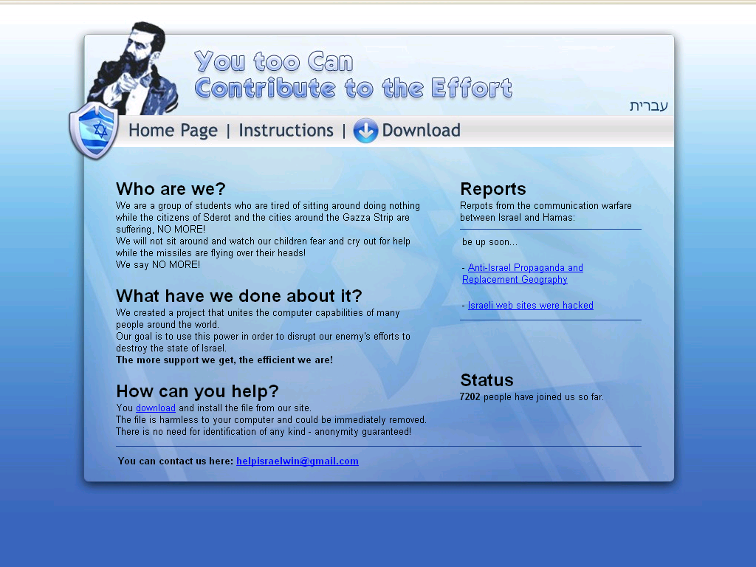
Example: Israeli Botnet

Slide 6
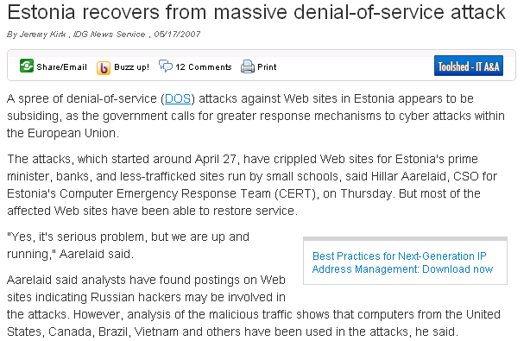
Denial of Service

Slide 7
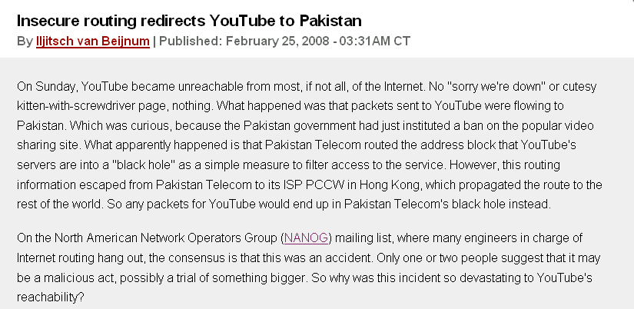
Your YouTube Traffic: Pwned!

Slide 8
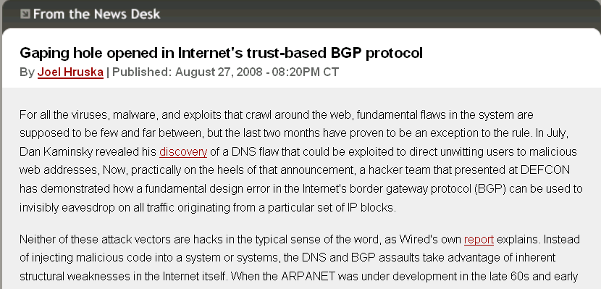
Attack on BGP Routing
August 2008
“Man-in-the-middle” attack

Slide 9
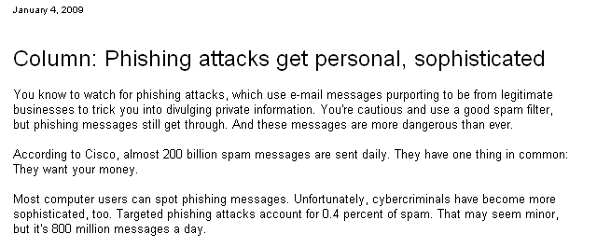
Phishing
Spam: 95+% of all email traffic on the Internet (200 billion spam messages per day, as of January 2009)
Unique phishing attacks rose 13% (to over 28k!) in for second quarter 2008
294 hijacked brands
442 unique malicious application variants in May 2008

Slide 10
Course Objectives
Understanding of basic issues, concepts, principles, and mechanisms in information security
  Security goals and threats to networking infrastructure and applications
  Introduction to cryptography
  Network security applications
  System security applications
Exposure to latest research in security

Slide 11
Prerequisites
Networking (CS 4251), operating systems, discrete mathematics, and programming
(C or C++, Java)
The right motivation

Slide 12
Textbooks and References
Required textbooks
  Network security: Private communication in a Public world (2nd Edition)
  by Kaufman, Perlman, and Speciner
    I will follow it as much as possible
Research papers
  Read the papers before class

Slide 13
Course Mechanics
Web page
http://www.gtnoise.net/classes/cs6262/spring_2009/
  For course materials, e.g., lecture slides, homework files, papers, tools, etc.
Grading
  30% Problem Sets
  35% Final Project
  30% 2 Quizzes
  5% Participation
Mailing list

Slide 14
Course Project
Can be (a combination of)
  Design of new algorithms and protocols
    Or new attacks!
  Analysis/evaluation of existing algorithms, protocols, and systems
    Vulnerabilities, efficiency, etc.
  Implementation and experimentation
Small team: one to three persons.
Proposal, work, and final demo/write-up
Topics: Will be posted to Web page within two weeks

Slide 15
Course Outline
Primitives: Introduction to Cryptography
Network/Security Management
  Key distribution
  Authentication (and network admission)
  Information flow control/Taint analysis
System Security
Network Security
Application Security

Slide 16
A Motivating Example
Requirements of an e-Commerce site
  Performance
    # of concurrent transactions
  Usability
    Easy to follow GUIs, convenience (cookies?)
  Security
    Secure transmission and storage of costumer financial/personal data
    Protect the Web servers and the enterprise network from illegitimate access
    Provide continuous/uninterrupted services

Slide 17
Networking Technologies

Slide 18
Trends: by Application Demands
Hunger for bandwidth
  Hardware (Physics) breakthroughs seem to come easier than software
Wider spectrum of application sophistication:
  Best-effort to guaranteed
  Built-in security?
Drive for ubiquitous access
Economics/profitability

Slide 19
Quest for Better Services
Real-time audio/video requires guaranteed end-to-end delay and jitter bounds
Adaptive multimedia application requires minimum bandwidth and loss assurance
Intelligent application demands reliable feedback from the network
Security

Slide 20
Quest for Ubiquitous Access ...
Information age is a reality
Everything depends on reliable and efficient information processing
  Quality of our everyday life
  Development of national/world economy
  Security of national defense/world peace
Networking is one critical part of this underlying information infrastructure

Slide 21
Economic Pressure
Service providers want the most bang on their buck - the most profitable technology?
  Cautious adoption of new technologies
    Even for security
  Emphasis on leveraging deployed technologies
  Increased utilization of existing facilities

Slide 22
Networking Technologies
Switching modes.
  Circuit switching
  Packet switching - Ethernet, fiber channel, IP routing, frame relay, ATM, IP switching/tag switching
High-speed transmission media
  SONET/SDH, WDM
Ubiquitous access media
  xDSL/cable modem, IEEE802.11, LEOSs
We will study the common security issues.

Slide 23
The Internet: A Network of Networks
Autonomous Systems (ASes)
Abilene
Comcast
Georgia
Tech
AT&T
Cogent
Interconnected of the Internet Service Providers (ISPs) provide data communications services
  Networks are connected using routers that support communication in a hierarchical fashion
  Often need other special devices at the boundaries for security, accounting, …
Hosts and networks have to follow a common set of rules (protocols)

Slide 24
Layering
User A
User B
Application
(message)
Transport
(segment)
Network
(datagram)
Link (frame)
Get index.html
Connection ID
Source/Destination
Link Address
This can be more complex
Example: Network layers can be encapsulated within another network layer

Slide 25
Security Implications
Vulnerabilities - from weak design, to “feature-rich” implementation, to compromised entity
Heterogeneous networking technologies adds to security complexity
  But improves survivability
Higher-speed communication puts more information at risk in given time period
  Easier to attack than to defend
Ubiquitous access increases exposure to risks

Slide 26
The Good News
Plenty of basic means for end-user protection - authentication, access control, integrity checking
Intensive R&D effort on security solutions (government sponsored research & private industry development)
Increasing public awareness of security issues
New crops of security(-aware) researchers and engineers

Slide 27
The Bad News
(Existing) information infrastructure as a whole is vulnerable, which makes all critical national infrastructure vulnerable
  e.g., Denial-of-service attacks are particularly dangerous to the Internet infrastructure
  Do we continue to band-aid or re-design?
Serious lack of effective technologies, policies, and management framework

Slide 28
Internet’s Design: Insecure
Designed for simplicity
“On by default” design
Readily available zombie machines
Attacks look like normal traffic
Internet’s federated operation obstructs cooperation for diagnosis/mitigation

Slide 29
How much do you trust?
Ken Thompson’s compiler hack from “Reflections on Trusting Trust.”
  Modified C compiler does two things:
    If compiling a compiler, inserts the self-replicating code into the executable of the new compiler.
    If compiling login, inserts code to allow a backdoor password
  After recompiling and installing old C compiler:
    Source code for Trojan horse does not appear anywhere in login or C compiler
    Only method of finding Trojan is analyzing binary

