Slide 1
Domain Name System Security and Privacy
Security, Privacy, and Consumer Protection Nick Feamster University of Chicago

Slide 2
What is DNS?
DNS (Domain Name Service) is primarily used to translate human readable names into machine usable addresses, e.g., IP addresses.
DNS goal:
Efficiently locate resources. E.g., Map name → IP address
Scale to many users over a large area
Scale to many updates
Notes:
2

Slide 3
Domain Name System (DNS)
Properties of DNS
Hierarchical name space divided into zones
Distributed over a collection of DNS servers
Hierarchy of DNS servers
Root servers
Top-level domain (TLD) servers
Authoritative DNS servers
Performing the translations
Local DNS servers and client resolvers
3

Slide 4
Domain Name System Goals
Scalability
Decentralized maintenance
Robustness
Global scope: Names mean the same thing everywhere
Notes:
4
ACID
Atomic
Consistent
Isolated
Durable

Slide 5



The Domain Name System: Privacy Vulnerabilities
Naming
Root server,
.com
www.foo.com ??
www.foo.com ??
com 1.2.3.4
www.foo.com ??
www.foo.com
3.4.5.6
TLD Server,
1.2.3.4
Client
Stub Resolver
foo.com
2.3.4.5
Local
Recursive Resolver
www.foo.com ??
www.foo.com
3.4.5.6
Name Server,
2.3.4.5
Vulnerable to traffic monitoring, fingerprinting (application, website, etc.)
Notes:
-walk through DNS lookup to show how it compromises privacy
-tie back to data requests/surveillance

Slide 6
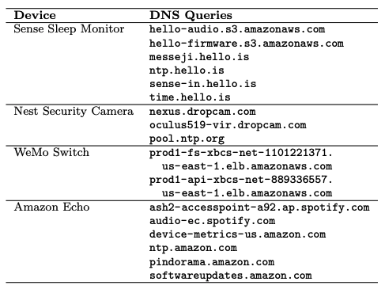
Things that Can Be Learned from DNS…
Web browsing behavior
The websites you visit
The web pages you visit
The devices that you own
Your activity on the Internet, at home, etc.
…

Slide 7
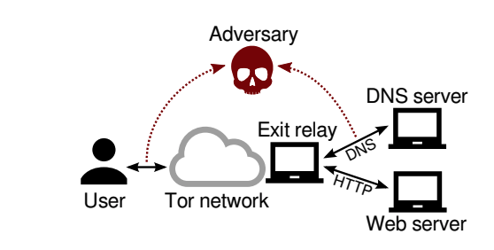
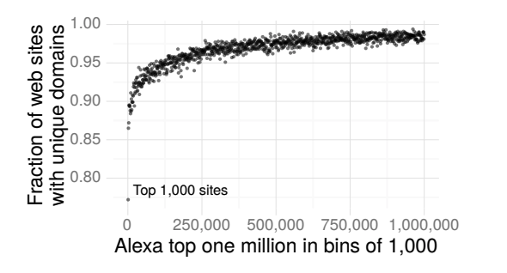
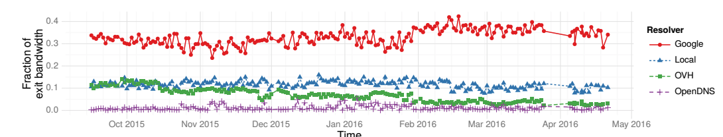
Example Attack: Website Fingerprinting
More than 90% of Alexa top 1M have at least one unique DNS domain name.
A significant fraction of DNS queries from Tor are currently resolved by Google.

Slide 8
DNS Privacy: Existing Approaches
Naming
Focus on data confidentiality & integrity in transit
DNS-over-TLS (DoT), DNS-over-HTTPS (DoH)
DNSCurve, DNSCrypt
DNSSEC (for integrity, not privacy)
Minimize privacy
DNS QNAME Minimization

Slide 9
Existing Approaches Don’t Address First Hop as Adversary
Naming
Root server,
.com
TLD Server,
1.2.3.4
Client
Stub Resolver
Local
Recursive Resolver
ISPs often operate clients’ recursive resolvers, allowing them to monitor clients’ browsing patterns
Name Server,
2.3.4.5

Slide 10
Strawman: Change DNS Providers, and Encrypt Transport (“DNS over HTTPS”)
Naming
Root server,
.com
TLD Server,
1.2.3.4
Client
Stub Resolver
3rd Party Recursive Resolver
Name Server,
2.3.4.5
Notes:
Cloudflare’s 1.1.1.1
-use DNS QNAME minimization
-use DNS-over-TLS
-based on Knot resolver
-Quad9
-uses DNSSEC
-no EDNS client subnet
-DNS over TLS
-blacklist malicious domains
-add animation of notes where IP and domain name are still visible and coupled
----- Meeting Notes (5/11/18 17:30) -----
tie back to data requests

Slide 11

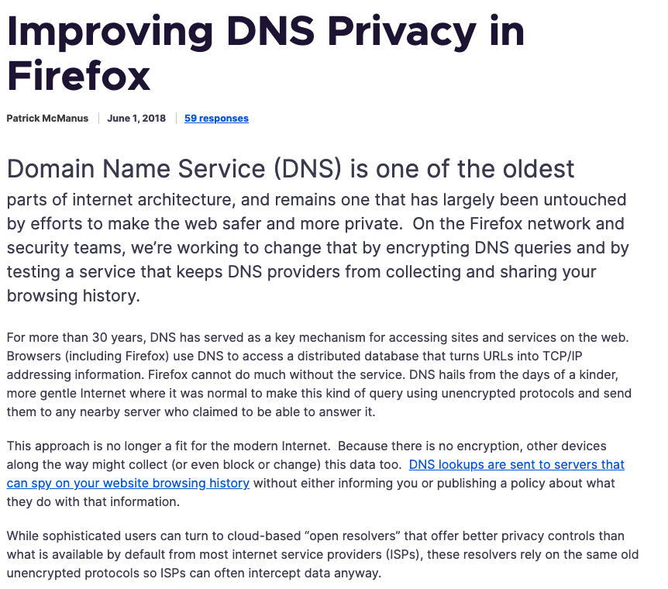

Slide 12

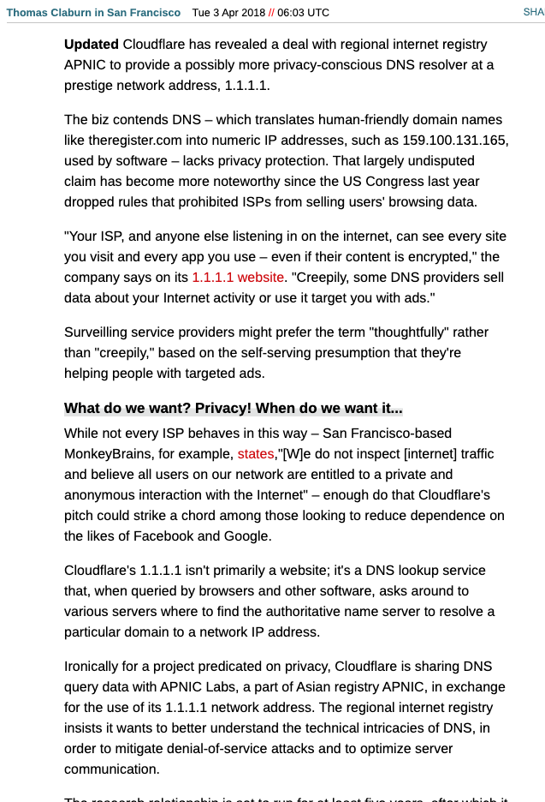
Changing DNS resolvers only shifts the problem of trust!
Instead of sending your queries to your ISP, you are now sending them to Cloudflare, Google, etc. …

Slide 13

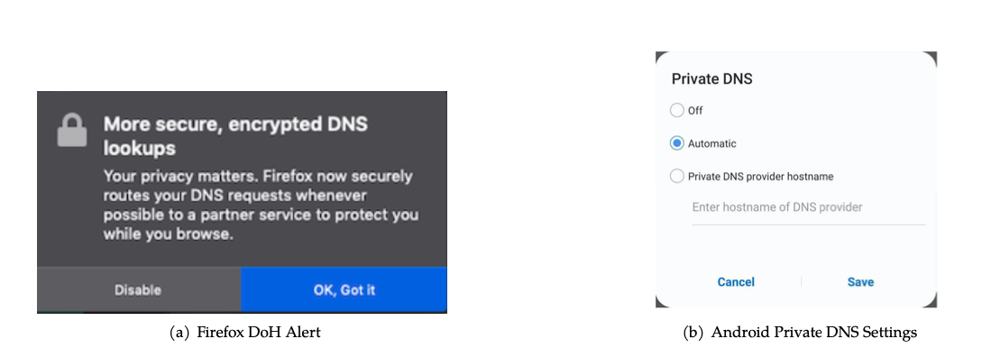

Slide 14
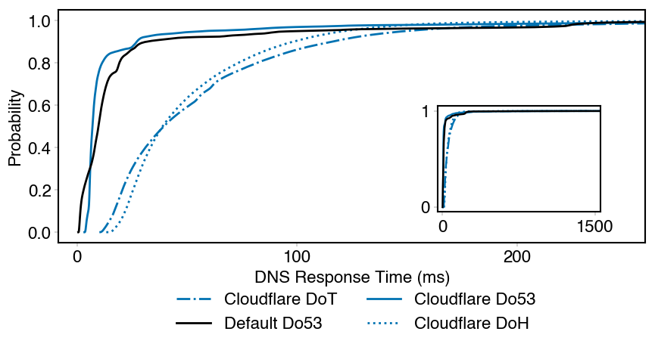
The Good News: DoH Sometimes Performs Well
DoH outperforms DNS in the tail
DoH outperforms 50% of DoT queries
Notes:
This is a CDF of DNS response times with each protocol.
Cloudflare DoH outperforms DoT for 50% of queries.
Cloudflare DoH actually slightly outperforms university Do53 and Cloudflare Do53 in the tail.

Slide 15
Encrypted DNS is Now Often “On by Default”
Encrypted DNS is being deployed in browsers, operating systems
Often it is enabled by default
Trusted recursive resolver is also selected by default
Chromium: Opportunistic DoH
Firefox and Opera: Cloudflare is default TRRs
Do users want this?
Do they understand it?
Do they know how to change it?

Slide 16
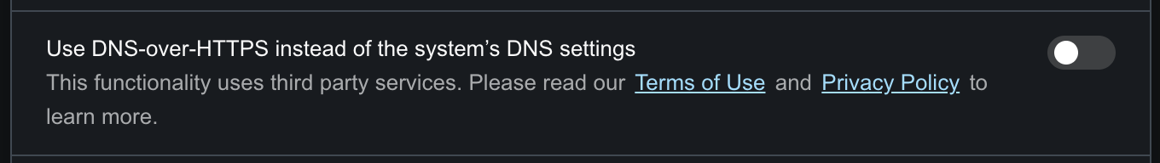

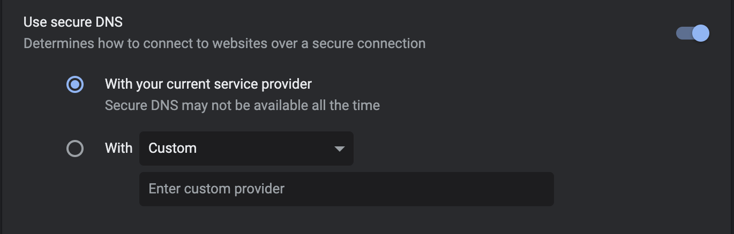
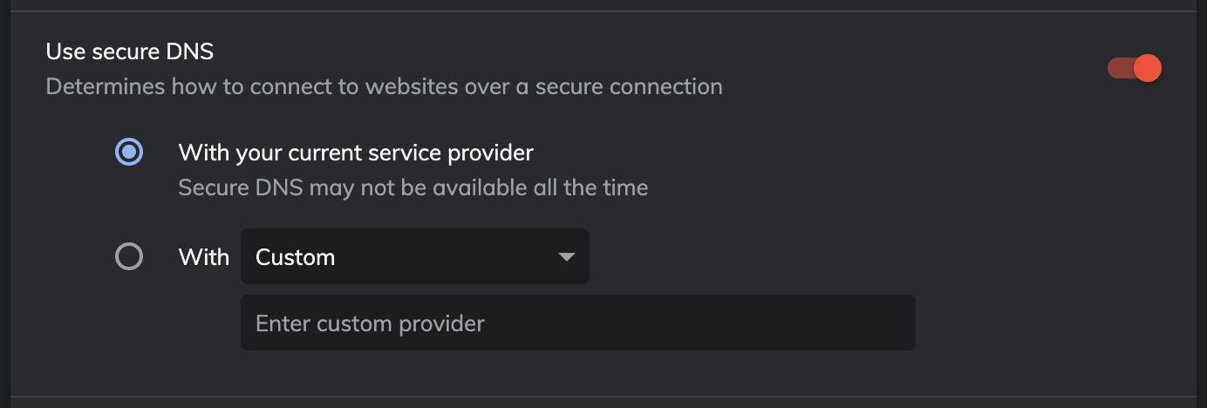


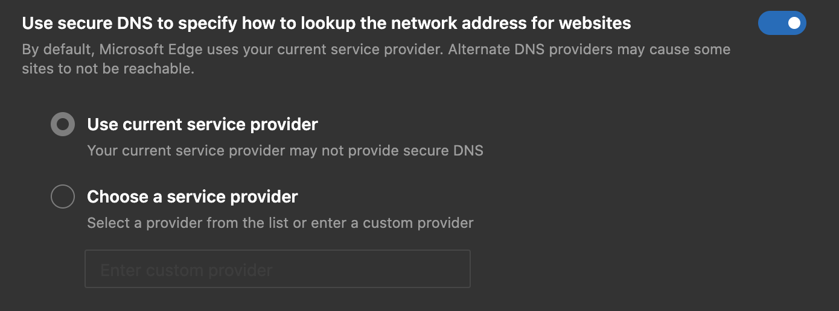



Example Current Interfaces
Notes:
Different interfaces
Different defaults
Different behaviors

Slide 17
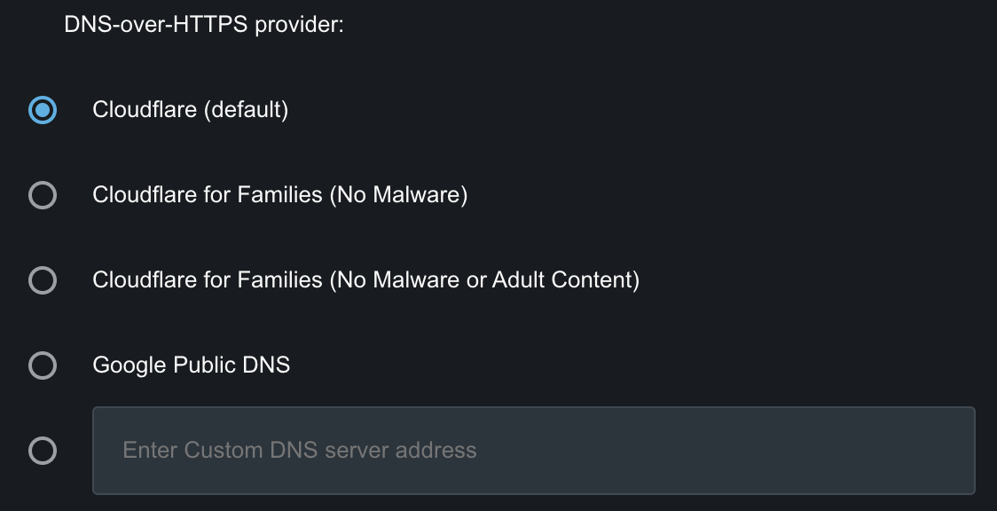
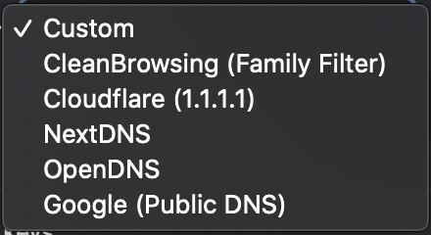
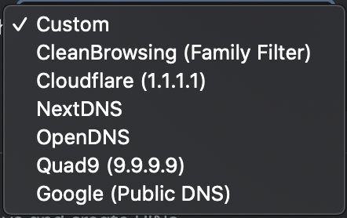
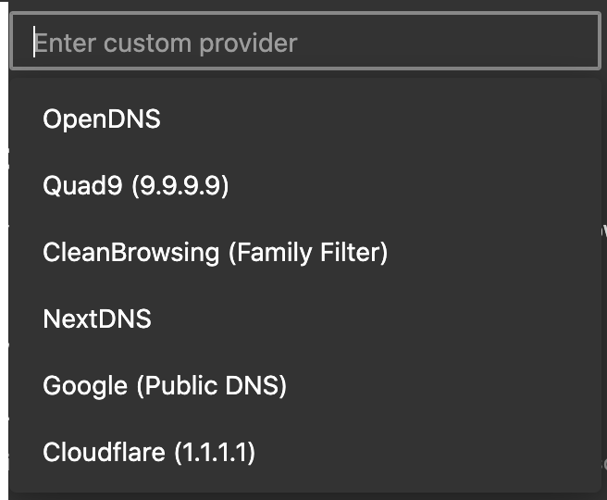
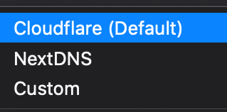
Recommended Resolver Options
Notes:
Standardize order and labels with Slide 3

Slide 18
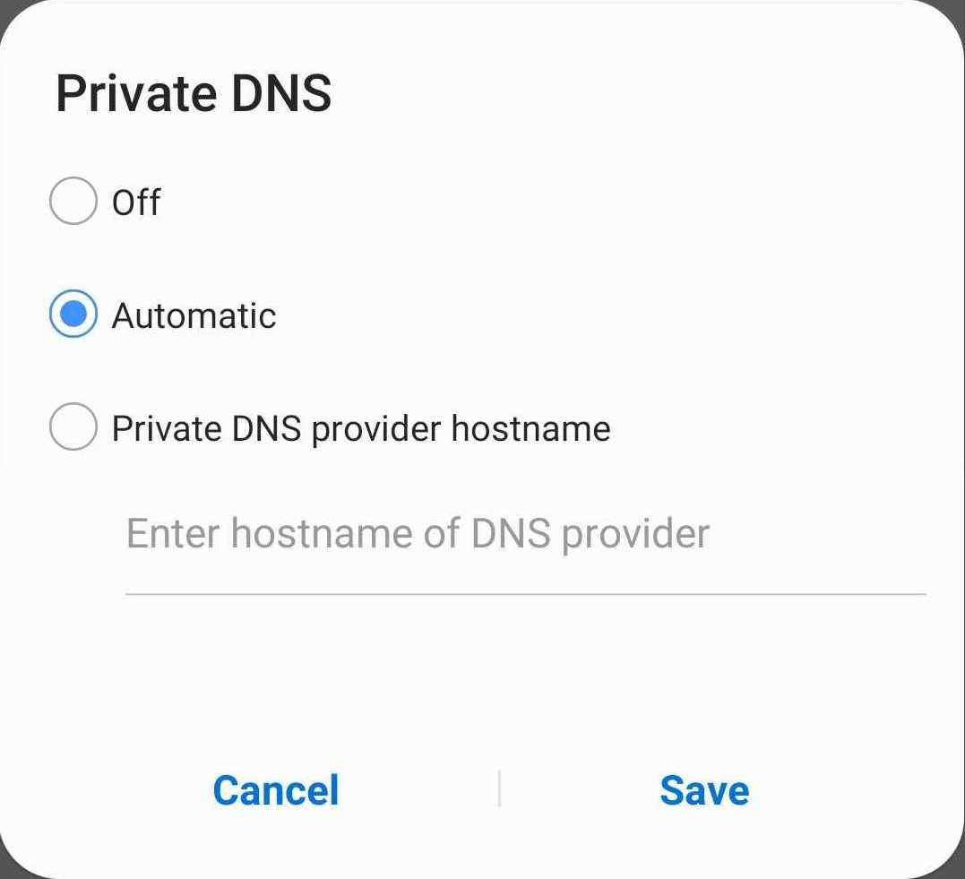
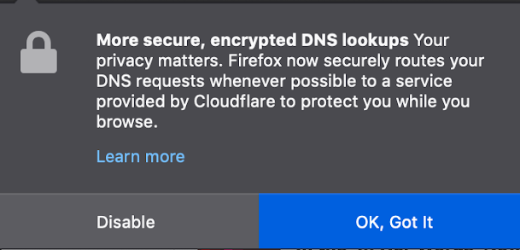
Pilot Survey: Questions
Do users understand what DNS setting options do?
Users have misconceptions about DNS settings
How do users interact with current DNS setting options?
They mostly don’t interact with these settings or leave them on their default options
Why do users choose the settings that they do?
Users stick with default settings when they lack information
Many thought the defaults were necessary for their phone to work
Does being provided with more information on DNS settings change the settings option that users choose?
Some users DO change their settings while others stuck with their original choice
Do people know about the different DNS resolvers and do they trust them?
People had limited knowledge of DNS resolvers
Trust in those resolvers varied among participants
Notes:
Present as Q&A. Add answer as summary.
Make sure we can connect each of slides 6-8 to a question here.

Slide 19
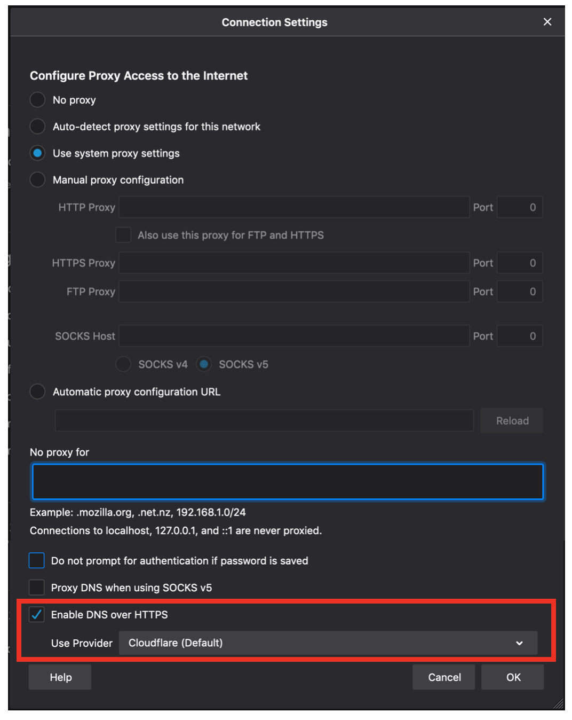
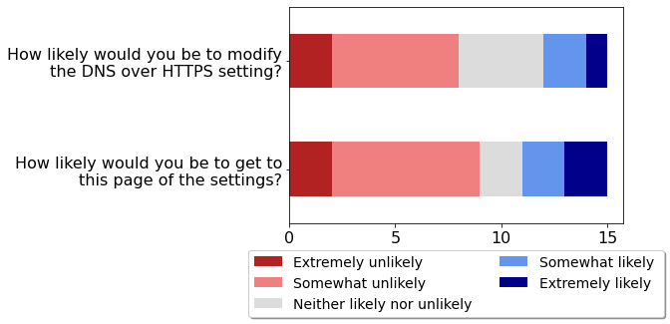
Firefox DoH Responses
User responses to questions about Firefox’s DoH settings

Slide 20
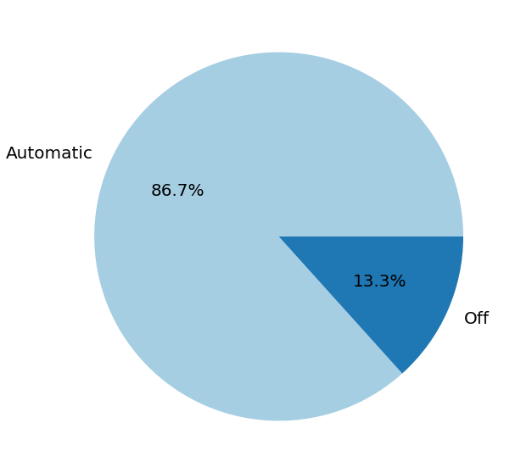
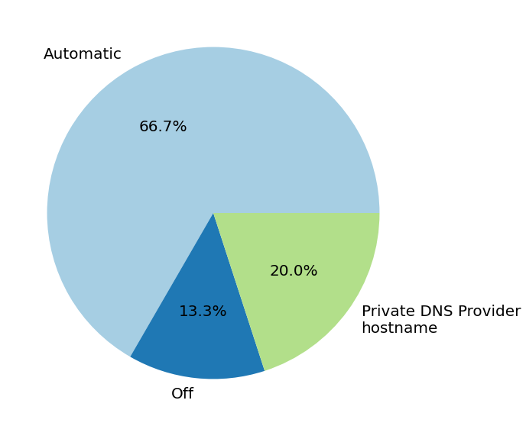
Private DNS Settings Choices
Private DNS setting choice without additional information
Private DNS setting choice with additional information

Slide 21
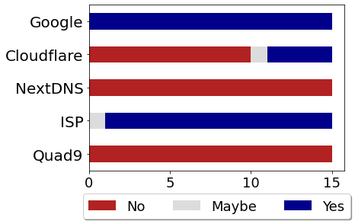
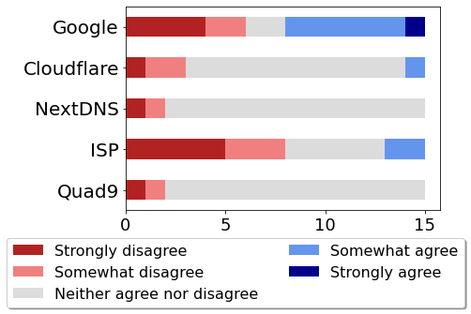
Knowledge of and Trust in DNS Providers
If participants had heard of different DNS providers
If participants reported trusting different DNS providers

Slide 22
Summary and Future Directions
Main Findings
Many people stick with default settings options making the choice of default very important
People don’t understand the ramifications of selecting different options
Being given more information does cause some people to choose a different option
There is still a lot of work to do on explaining these settings to users
Future Directions
Larger sample size
More extensive interface testing
Test newly implemented interfaces
Design and test alternative interfaces
Have more participants be able to interact with their own settings
Better understand users’ expectations for each encrypted DNS configuration

Slide 23
The Bad News: Changing DNS Providers Doesn’t Solve the Privacy Problem!
Naming
Root server,
.com
TLD Server,
1.2.3.4
Client
Stub Resolver
3rd Party Recursive Resolver
Shifts trust from ISP to 3rd party
Name Server,
2.3.4.5
IP address and domain names still visible and coupled
Still vulnerable to monitoring & data requests
Notes:
Cloudflare’s 1.1.1.1
-use DNS QNAME minimization
-use DNS-over-TLS
-based on Knot resolver
-Quad9
-uses DNSSEC
-no EDNS client subnet
-DNS over TLS
-blacklist malicious domains
-add animation of notes where IP and domain name are still visible and coupled
----- Meeting Notes (5/11/18 17:30) -----
tie back to data requests

Slide 24
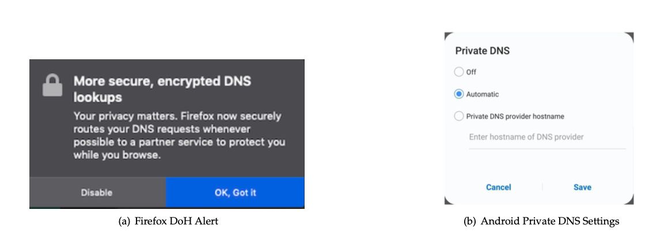
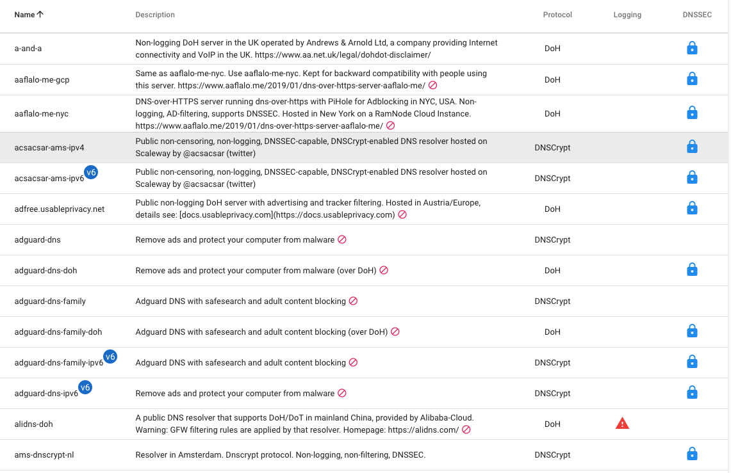
An Architectural Crisis: DNS is Getting Encrypted, but More Centralized
Modern browsers, OSes, etc. will select a “trusted recursive resolver” by default, sending all DNS queries to a single resolver.
Centralization is not a given: 100+ Encrypted DNS TRRs already exist
https://dnscrypt.info/public-servers/
Settings in Firefox, Android default to centralized DNS over HTTPS (DoH).

Slide 25
Step 1: Encrypt Traffic Through the Recursive Oblivious DNS (ODNS)
Naming
Goal: Decouple the DNS query (and response) from the IP address that issued the query
1. Obfuscate the DNS query before sending it to the local recursive resolver
2. Generate a referral to an ODNS authoritative server that can decipher the query
3. ODNS authoritative server can see the DNS query, but not the IP address of the requesting client
Notes:
-Recall that conventional DNS looks like this…
-animate the addition of ODNS stub + auth
-”stub encrypts & formats domain with session key”, “ODNS auth acts as recursive resolver”
-animate notes that say the recursive can’t see queries and the auth can’t see identities
----- Meeting Notes (5/11/18 17:30) -----
not necessary --> move goal to next slide

Slide 26
Oblivious DNS
Naming
Root server,
.com
ODNS
Authoritative
Server
TLD Server,
1.2.3.4
Client
Stub Resolver
Recursive Resolver
Goal: Decouple the DNS query (and response) from the IP address that issued the query
Name Server,
2.3.4.5
Notes:
-Recall that conventional DNS looks like this…
-animate the addition of ODNS stub + auth
-”stub encrypts & formats domain with session key”, “ODNS auth acts as recursive resolver”
-animate notes that say the recursive can’t see queries and the auth can’t see identities

Slide 27
Oblivious DNS
Naming
Root server,
.com
www.foo.com ??
www.foo.com ??
{www.foo.com}.odns
www.foo.com ??
{www.foo.com}.odns
com 1.2.3.4
www.foo.com ??
ODNS
Authoritative
Server
foo.com
2.3.4.5
TLD Server,
1.2.3.4
Client
Stub Resolver
Recursive
Resolver
www.foo.com
3.4.5.6
www.foo.com ??
{www.foo.com}.odns
{3.4.5.6}
www.foo.com
3.4.5.6
{www.foo.com}.odns
{3.4.5.6}
www.foo.com
3.4.5.6
Name Server,
2.3.4.5
Notes:
Walk through a DNS query with animations

Slide 28
Distributing ODNS Keys to Clients
Naming
special.odns ??
special.odns ??
self-certifying.odns
self-certifying.odns
Client
Stub Resolver
Recursive
Resolver
ODNS
Authoritative
Server
ODNS authoritative servers are replicated and anycasted, resulting in selection of the closest ODNS authoritative server

Slide 29
Changes/Additions to DNS
Stub resolver
Session key generation
Encryption of session key with authoritative PK
Domain name augmentation
Appends session key in additional section
Authoritative DNS server
Decrypt session key and query
Forward recursive query as before

Slide 30
Ongoing Implementation Efforts
Prototype implementation in Go w/Go DNS library
Some initial progress with Unbound at Hackathon
Implementation detail: Ciphertext of encrypted QNAME too large for 0.6% of names in lookup trace

Slide 31
Performance Evaluation: ODNS
Overhead of cryptographic operations
Additional latency for DNS lookups
Additional Web page load time
Reduced caching at recursive resolver

Slide 32
Practical Considerations
EDNS0 Client Subnet
Challenge: Local recursive can pass on client IP address in query
Solution: Local recursive should strip EDNS0 CS
OPT Records and Query Length
Challenge: Keys are big. Encrypted query/session key can’t go in OPT because most resolvers strip it!
Near-term Solution: QNAME (4 x 63 bytes)
16-byte AES keys, ECIES encrypted key (44 bytes)
We use base64 encoding for encrypted domain & key (drawback: no 0x20 encoding)
QTYPE is in the clear
Use TXT records and encrypt everything (?) [From Hackathon]

Slide 33
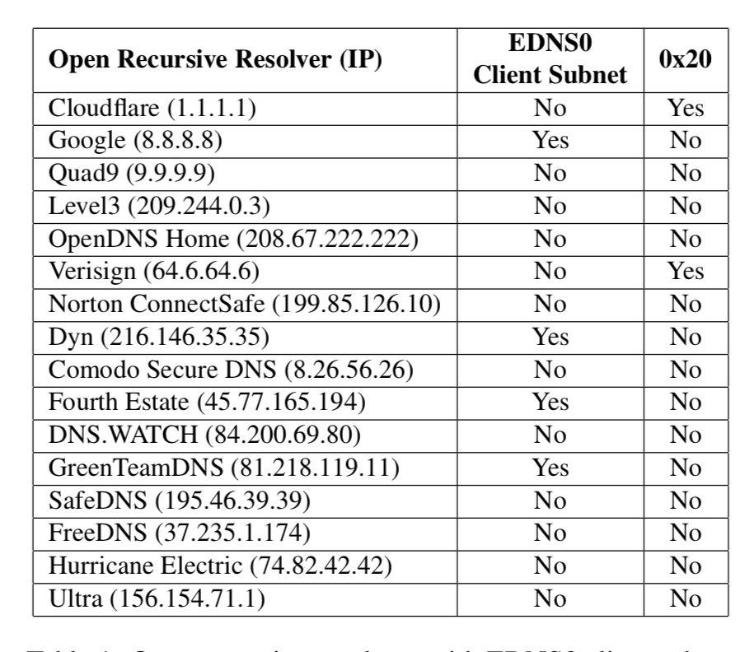
Which Recursives Can ODNS Use Today?
No EDNS0 Client Subnet, No 0x20...
✓
✓
✓
✓
✓
✓
✓
✓
✓
✓

Slide 34
Oblivious DNS: Summary
Naming
ODNS protects privacy by decoupling clients’ identities from their queries
Implementation and evaluation show feasibility and low overhead
ODNS is compatible with existing recursive resolvers and name servers

Slide 35
Step 2: Distribute Encrypted DNS Queries (“Re-Decentralize the DNS”)
Question: Distribute queries across a larger set of trusted recursive resolvers.
Example Distribution Strategies:
Round robin: Cycle through TRRs
Random: Randomly select (by 2LD, etc.)
“Sticky random”: Map domain to same TRR
CDN-affinity: If object served from CDN, use its TRR
Adversary Model: Fleibig et al.’s Deep Fingerprinting (works for any eavesdropping adversary)

Slide 36
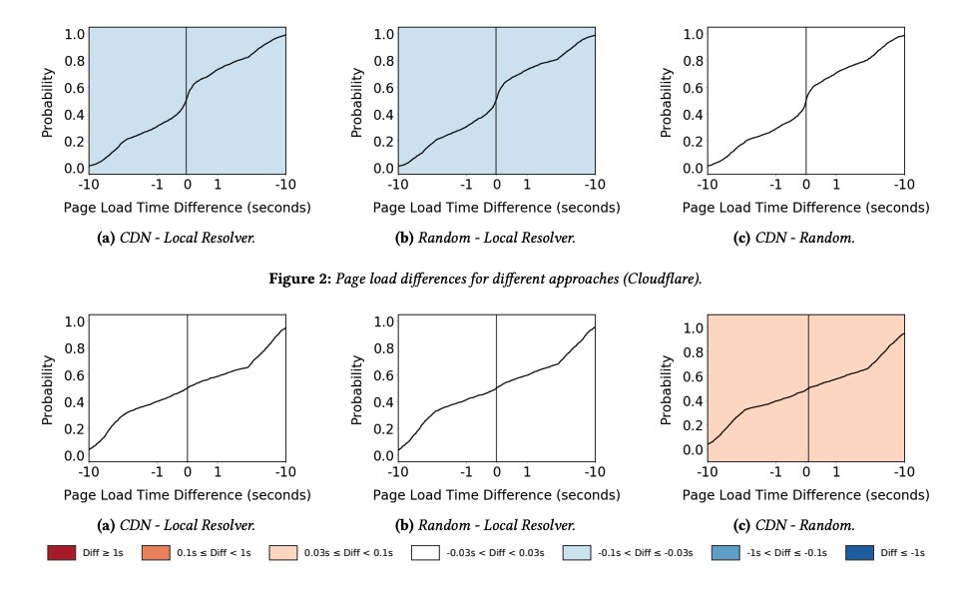
Preliminary Results: Distributing Queries is Feasible
Open Research Question:
Which DNS query distribution strategies best preserve privacy?

