Slide 1
Privacy Law
Security, Privacy, and Consumer Protection Nick Feamster University of Chicago

Slide 2
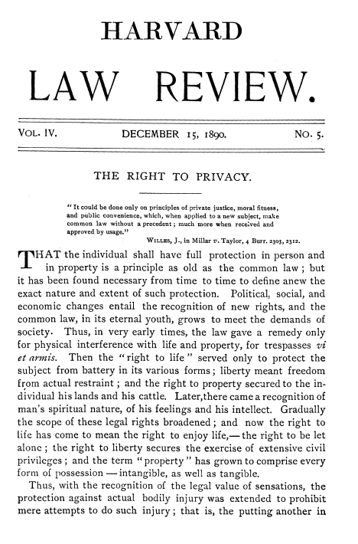

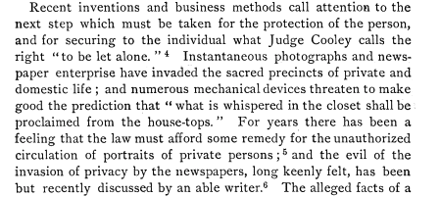
argued that
the law must provide some relief to
individuals when the acts of others
interfere with their right to be let alone.

Slide 3
Computerized Records: New Privacy Threats
Unknown databases that have information about you
Large amounts of data collection are more cost effective
One-to-many dissemination
Collection of different types of information, in different ways
Notes:
First, with new computerized collections
of personal information,
you might have an unknown database
that contains information about you.
Second, computerized compilations enabled
the collection of large amounts of
information in cost effective ways.
Third, with computers, you could have
easy dissemination of personal information
to many, many people.
Fourth, computers facilitated the collection
of different types of information
than was previously collected,
again, because it was so cost effective to do so.
Fifth, information collected through computers
started to be used in
different ways than it was previously.

Slide 4
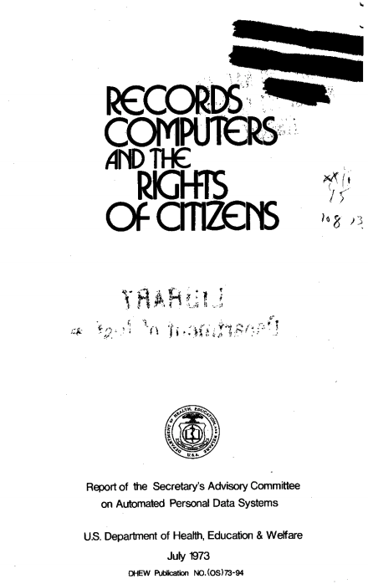
Published by the department of Health, Education, and Welfare
Resulted in the publication of Fair Information Principles:
No secret personal data record keeping systems
There must be a way for an individual to find out what information about him or her is in a record and how it's used
there must be a way for an individual to prevent information about him or her obtained for one purpose from being used or made available for other purposes without consent
there must be a way for an individual to correct or amend a record of identifiable information about him or her.
Any organization creating, maintaining, using, or disseminating records of identifiable personal data must assure the reliability of the data for their intended use and must take reasonable precautions to prevent misuse of the data

Slide 5
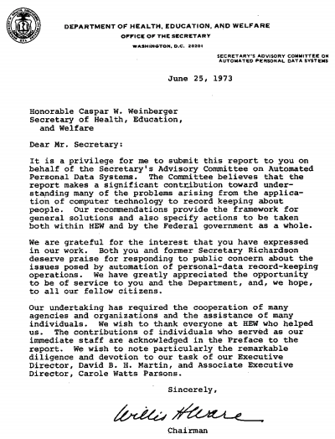

Slide 6


Slide 7
Notice
A person should be provided notice of what an organization of computer system is collecting, using, and sharing regarding their data.
Why?
Value of transparency
Self-reflection into organizational practices
Commitment to promises

Slide 8
Appropriate Uses
A person’s information should be used for “appropriate” purposes
Primary uses: What the information was collected for
Secondary beneficial uses
National security
Public health and safety
Oversight of operations
Law enforcement purposes

Slide 9
Example: National Directory of New Hires
Allowed government to locate people who were not paying child support

Slide 10
Individual Choice
Gives data subject some control over their information
Beyond clear expected uses (or uses for society’s benefit), information about individuals can only be used for purposes consistent with their choice
Two regimes:
Opt in: Data will not be shared for a new purpose without consent
Opt out: Data will be shared for new purpose unless the subject opts out

Slide 11
Access and Correction
Calls on organizations collecting information to provide individual access
A person should be able to know what information about them is being held in the system
A person should be able to use a process to change any incorrect information in that database

Slide 12
Security
Information cannot be kept private if it is not held securely
Reasonable administrative, process, technical safeguards to protect the data

Slide 13
Other Fair Information Practices
Minimization
Downstream assurances
Mitigation of privacy harm that occurs
Data breach notification

Slide 14
FIPPs
Fair Information Practice Principles are part of the orthodox privacy religion.
Arguably, they should be re-examined. Perhaps they’re off target. Or perhaps they’re orthogonal to the problem in some ways.
Example: data must be correct – but nowadays we often rely on deliberate errors (“noise”) as part of a privacy strategy.

Slide 15
How our current theories differ
Interact with data via queries, rather than data-shipping
focus on interactive protocols
Meaning of data more than what is evident on its face
assume probabilistic inference from data
depends how data was generated
Harm is (additional) inference about an individual, rather than linking of records
Presumption that interaction is disclosive, absent evidence to the contrary

Slide 16
Personally Identifiable Information
Data carries risk if it contains PII
If no PII, then risk is minimal, because sensitive information in the data cannot be associated with any specific individual.
Render data safe by scrubbing PII out of it

Slide 17
Underlying model of data and computing
What computers do: store data for later retrieval
Meaning of data is evident on its face
No processing of data, other than simple joins
ID data
ID more data
ID data more data

Slide 18
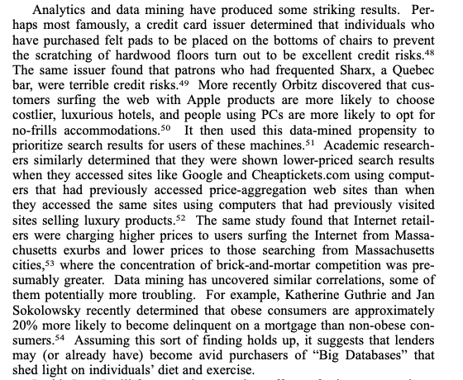

Slide 19
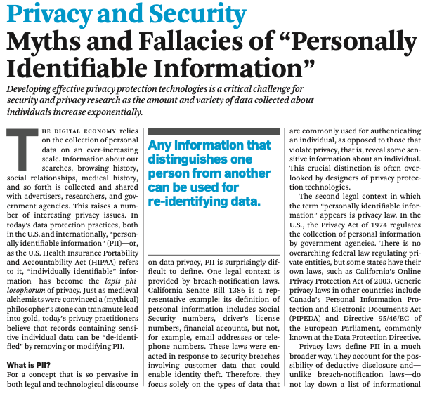

Slide 20
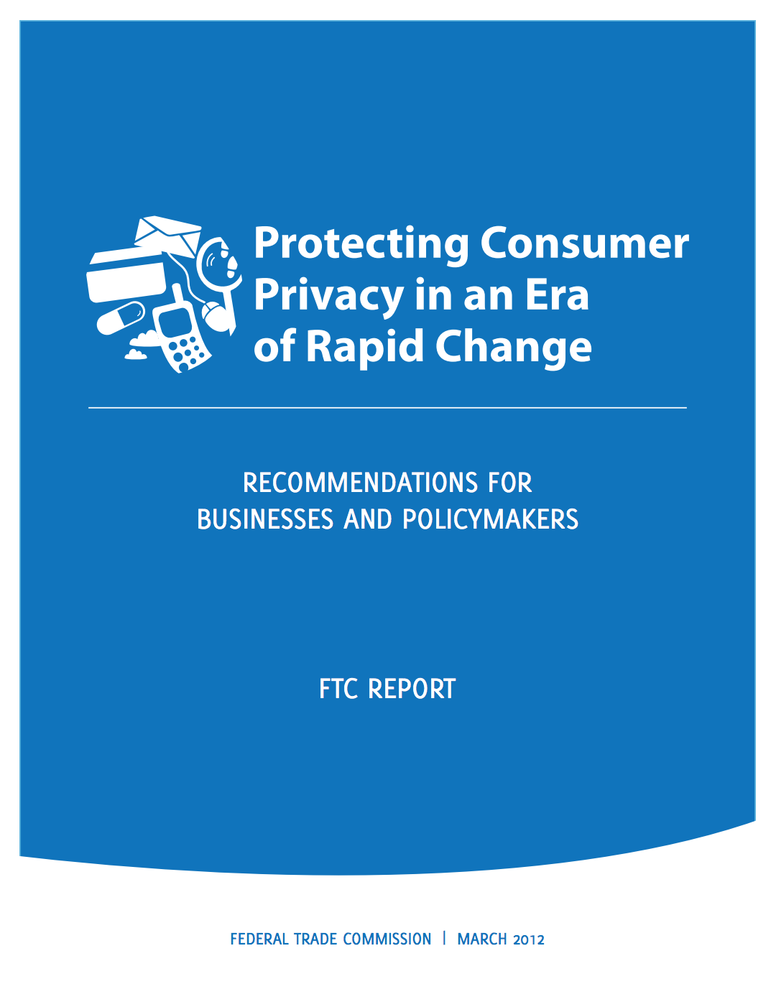
Re-Litigating Definitions
To de-identify, “must achieve a reasonable level of justified confidence that the data cannot reasonably be used to infer information about, or otherwise be linked to, a particular consumer, computer, or other device.”

Slide 21
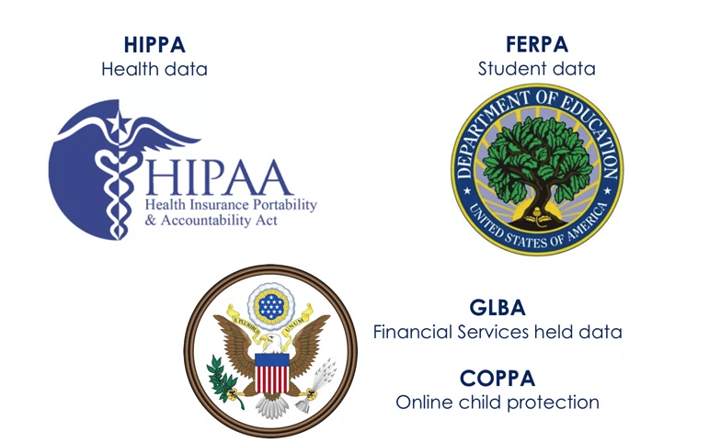
Statutory Landscape in the US
Who has the data
Mitigation of specific harm
Part of a data-sharing initiative

Slide 22
Statutory Landscape
Based on the Data
1960s: Only the government and credit bureaus were the only sectors with data on millions of people
The Privacy Act (regulation on personal information collected by a federal agency)
Fair Credit Reporting Act (regulating data collected by consumer reporting agencies)
Based on Anecdote
FERPA: in response to an elementary school collecting information from children about their parents and home life
Video Privacy Protection Act: in response to a local paper reporting a list of videos Judge Bork had rented
Driver’s Policy Protection Act: in response to South Carolina selling drivers license data

Slide 23
Statutory Landscape (Continued)
Data-Sharing Initiatives
Health Insurance Portability and Accountability Act (HIPAA): drafed to ensure insurance portability and facilitate electronic records
Gramm-Leach-Bliley: Paved the way for commercial banks to share information
Special Harm
Children’s Online Privacy Protection Act (COPPA): Drafted to protect against the collection of information from children under 13 without verifiable parental consent
Genetic Information Non-Discrimination Act (GINA): protect against employment and insurance discrimination based on genetic information

Slide 24
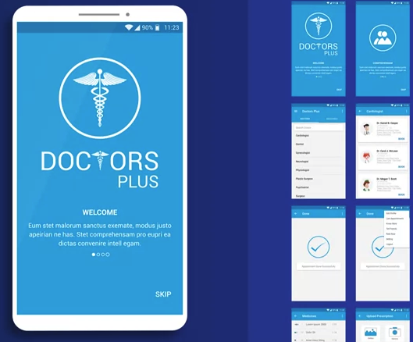
HIPAA
Only health information covered by certain kinds of organizations
Health care providers who are billing electronically, plans, clearing hosues
And vendors who are performing an operation on behalf of the provider
Excluded:
Free services
Those using paper records
Many mobile apps (not providers, plans, or healthcare clearinghouses)

Slide 25
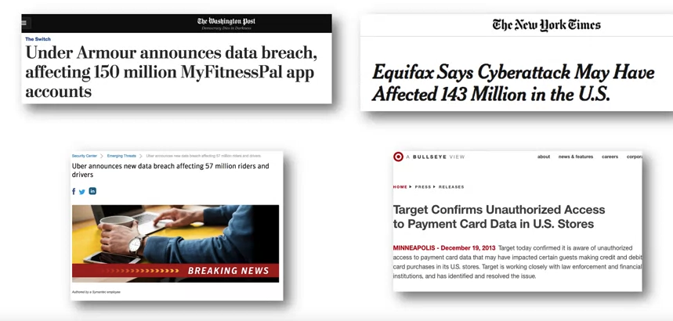
Breach Notification: Regulation by Consequence

Slide 26
Breach Notification Laws
2003: California enacted a law requiring companies to notify any California resident whose computerized data was breached
Privacy and security became a top corporate priority, since without proper security, these breaches would become major headlines
Today, every state has a data breach notification law.
HIPAA also was amended to add a data breach notification provision.

Slide 27
What Data Triggers Notification
“Personal information”
Name
SSN
DL number
Account/credit card numbers
Some add: medical data, student data, biometrics, birth/marriage
Some states are automatic, others do risk analysis
Some laws require notification to media
Some laws require notification ”without unreasonable delay”, or within a certain number of days

Slide 28
Compliance Complications
Having so many different laws is problematic
Breach notification requirements have strengthened security
These programs can minimize security breaches but are unlikely to eliminate them.

Slide 29
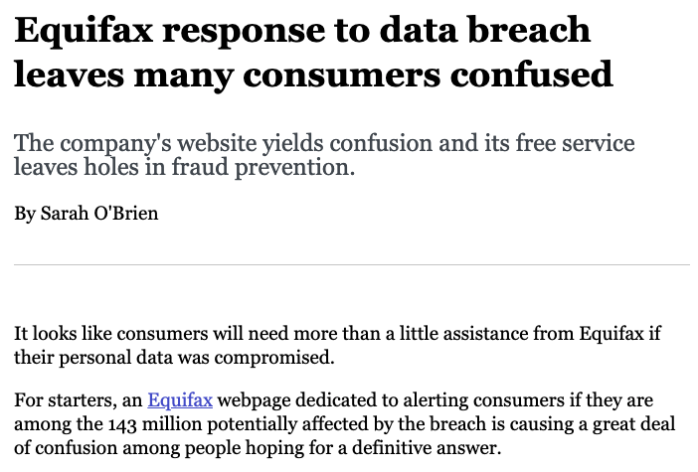
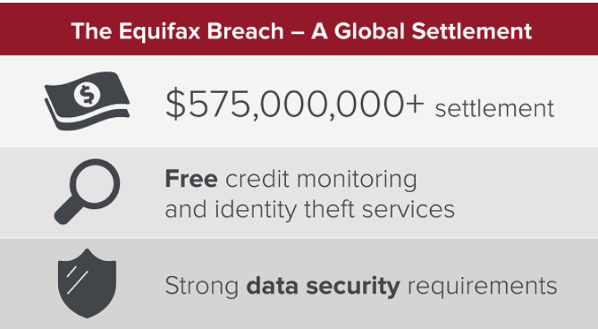
Equifax (September 2017)
Slow to react,
Communicated erroneous information,
Setup a questionable non-secure and spoofable separate website,
Tried to profit from credit-free solutions offered to effected individuals
…

Slide 30
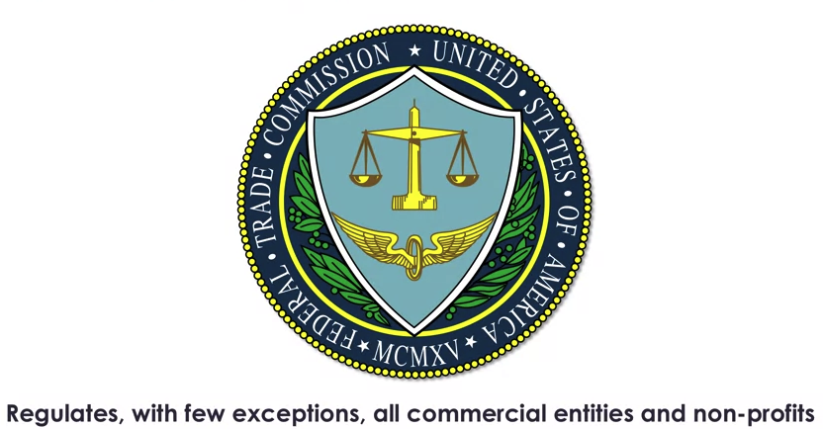
Federal Trade Commission

Slide 31
Section 5 of FTC Act
Provides that “unfair or deceptive acts or practices in or affecting commerce are declared unlawful”.
Deception under this standard is a representation, omission, or practice that's likely to mislead the consumer.
Unfair practices under this standard are those that cause or are likely to cause substantial injury to consumers, which is not reasonably avoidable by consumers themselves and which is not outweighed by countervailing benefits to consumers or to competition.
The FTC has been very active in bringing privacy cases based on finding certain acts and practices deceptive or unfair: 60 cases between 2002 and 2017.

Slide 32
Example: FTC vs. Uber
Misrepresented its privacy statements
FTC alleged that its statements were deceptive
Case settled with no admission of wrongdoing but a consent decree
Prohibition on deceptive statements
Comprehensive privacy program (risk assessment, software testing, etc.)

Slide 33
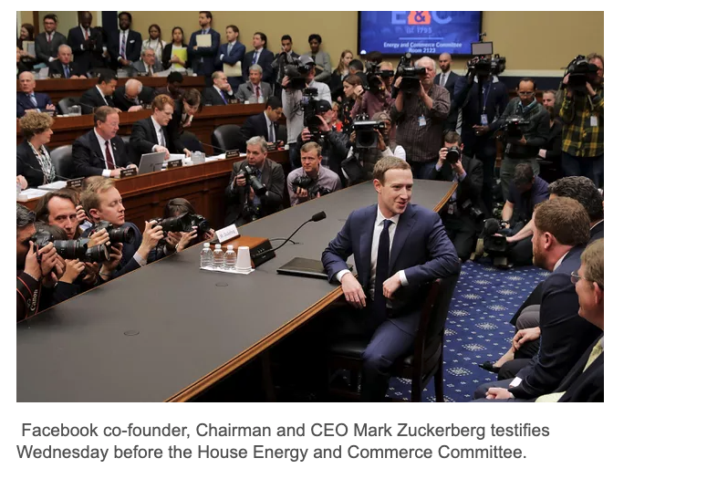
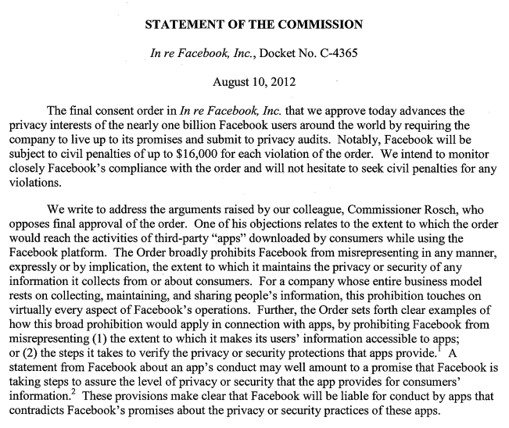
Example: Facebook Consent Decree
Notes:
The FTC is currently investigating to answer this question. But many experts, including former FTC officials, say it looks like it has. David Vladeck, the former director of the FTC's Bureau of Consumer Protection, who worked on the FTC's enforcement case against Facebook, writes in a Harvard Law Review blog "Facebook's apparent violations … of the decree is troubling." He suggested that even aside from the consent decree, the way Facebook allowed Kogan to harvest user data "plainly violated the Federal Trade Commission Act's prohibition against 'deceptive acts or practices.'"
And then there's the questions of the third-party audits that Facebook was supposed to be doing in order to verify it was protecting user data.
Zuckerberg explained during the hearing that when Facebook discovered Kogan had sold the data to Cambridge Analytica, the company asked the firm to delete the information. But Facebook didn't verify that it had actually done that. The company also didn't notify users that their data had been shared without their permission. Vladeck said that's a blatant violation of the consent decree.
"It doesn't appear that Facebook had even the most basic compliance framework to safeguard access to user data," he said in his blog post. "It is entirely predictable that if app developers are not held to their promises about data collection and sharing, they might not be candid with Facebook about their intentions. Yet it seems that Facebook made no effort to establish the bona fides of developers, much less verify or audit what user data app developers actually harvested and shared."

Slide 34
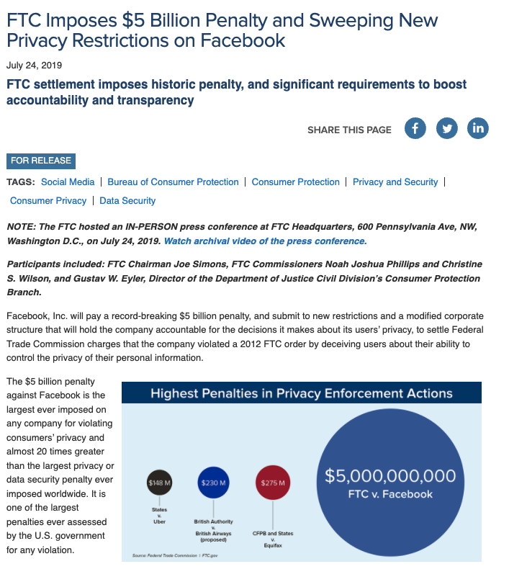
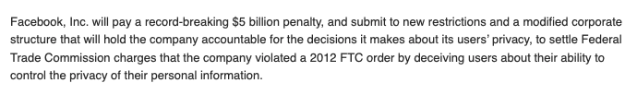
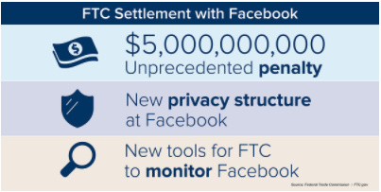

Slide 35
New Restrictions on Facebook
Facebook must exercise greater oversight over third-party apps, including by terminating app developers that fail to certify that they are in compliance with Facebook’s platform policies or fail to justify their need for specific user data;
Facebook is prohibited from using telephone numbers obtained to enable a security feature (e.g., two-factor authentication) for advertising;
Facebook must provide clear and conspicuous notice of its use of facial recognition technology, and obtain affirmative express user consent prior to any use that materially exceeds its prior disclosures to users;
Facebook must establish, implement, and maintain a comprehensive data security program;
Facebook must encrypt user passwords and regularly scan to detect whether any passwords are stored in plaintext; and
Facebook is prohibited from asking for email passwords to other services when consumers sign up for its services.

Slide 36
International Laws
140+ countries have some sort of privacy law
European Union
EU Privacy Directive in the 1990s was omnibus, but generally not enforced
Now General Data Protection Requirement (GDPR)

Slide 37
General Data Privacy Regulation (GDPR)
Applies to organizations located in the EU, not just EU companies
Applies to organizations based anywhere to the extent that any component of the organization is based in the EU
Applied to organizations wherever they're located to the extent that they're offering goods or services to individuals located in the EU or to the extent that they are monitoring the behavior of individuals located in the EU.
All companies have to consider whether the law applies!

Slide 38
Familiar GDPR Requirements
Notice
Access with rectification (Correction)
Lawful Basis for Processing
Consent and appropriate use: contractual necessity, legitimate interests of organization
“Right to Be Forgotten”
Data subject can request the erasure of information about them
Exceptions: Freedom of expression, necessary for health/science purposes

Slide 39
New GDPR Requirements
Cross-border transfers of personal data
Only permitted to countries that the European Commission has determined has adequate level of preotection for personal data
Data privacy impact assessment (DPIA)
Must conduct before data processing
Processing must take place before analysis of individuals, etc.

Slide 40

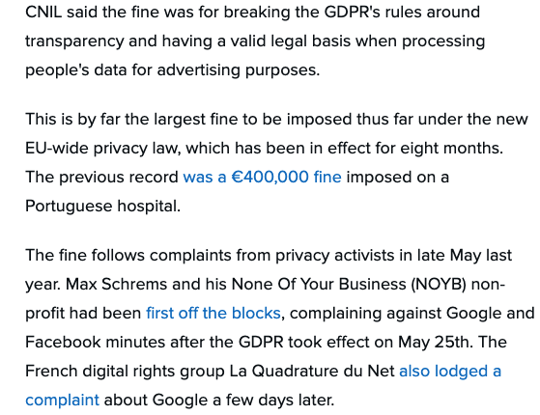

Slide 41

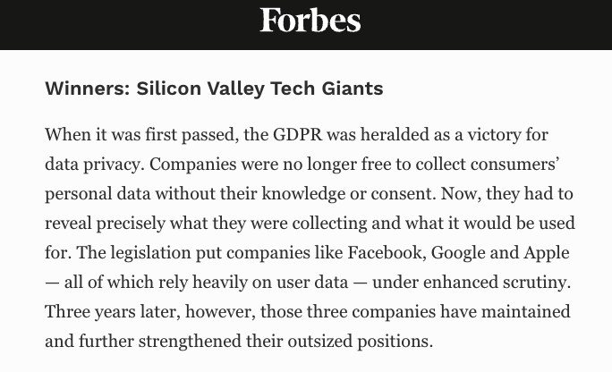
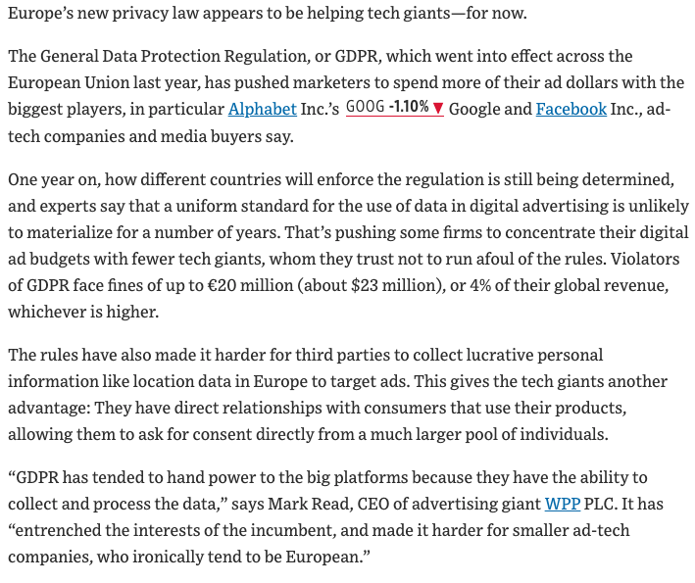
GDPR: A Win for Privacy …or Strengthening the Incumbents?

Slide 42
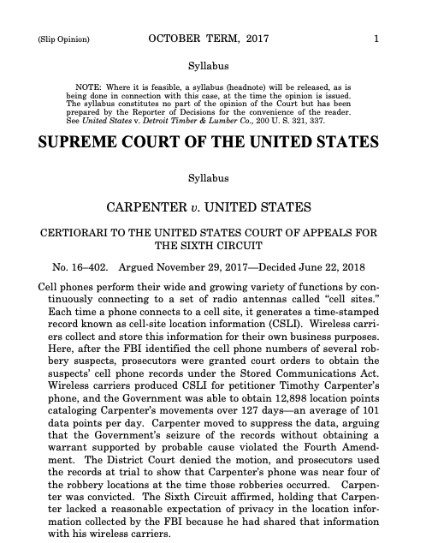
Other Important Cases

