Slide 1
Algorithmic Fairness
Security, Privacy, and Consumer Protection Nick Feamster University of Chicago

Slide 2
Overview
There is a huge literature in algorithmic fairness.
We are still truly coming to understand definitions of fairness, ramifications, etc.
There still remain main open questions about definitions of fairness, the best ways to implement fairness, etc.

Slide 3
What We Know
Bias encoded in data
Minimizing average error fits majority populations
Importance of exploring

Slide 4
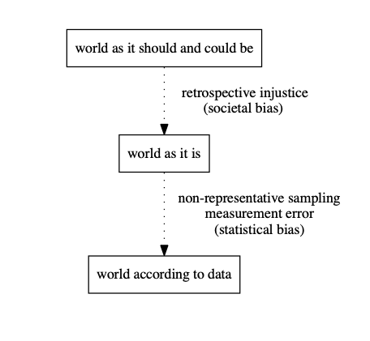
Societal Bias vs. Statistical Bias
Bias can arise from both:
Societal bias: objectionable social structures
Statistical bias: measurement errors due to non-representative sampling
Prediction bias can reinforce societal bias

Slide 5

Bias in Training Data
Training data we use to train models already includes human biases.
Examples
Recidivism prediction: We have data only on who is arrested, not who commits crimes. (Arrests may bias towards certain populations.)
Training language models: Language embeddings often contain gendered pronouns that can manifest as bias in translation.

Slide 6
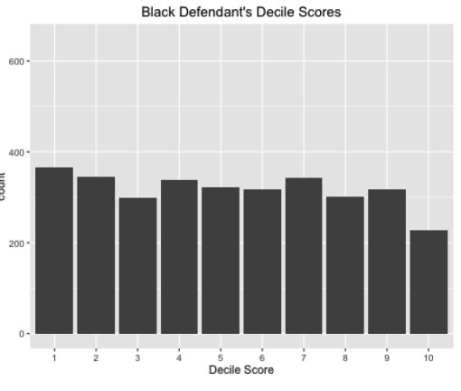
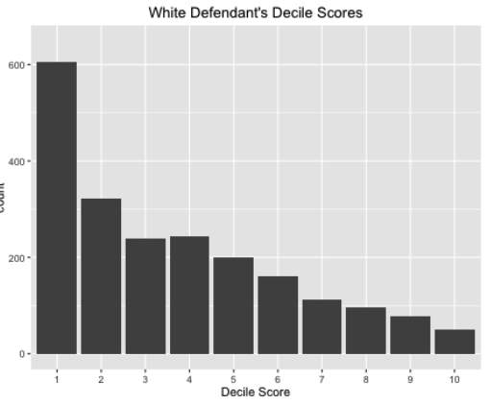
Case Study: COMPAS
Correctional Offender Management Profiling for Alternative Sanctions (COMPAS). Tool to assess a criminal defendant’s likelihood of re-offending.
Findings:
Black defendants found to be at higher risk of recidivism than they actually were
White defendants were found to be less risky than they actually were
The bias held, even when controlling for higher crimes.

Slide 7
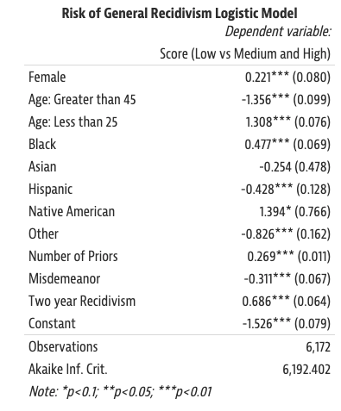
Further Analysis
Age is the most predictive feature
Race is the next most important feature in the model
False positive rates on Black defendants almost twice as high as whites

Slide 8
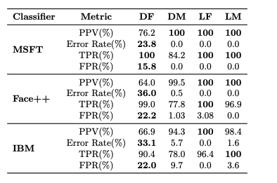
Minimizing Average Error Fits Majority Populations
Example: Predicting SAT scores
Majority population uses tutors, takes the test multiple times, only reports highest score, etc.
Minority population does not.
Model fit that aims to minimize error in overall population will fit according to the majority population.
Easy to quantify this effect and can be mitigated with appropriate data gathering in the training set.
Example: Facial Recognition

Slide 9
Definitions of Fairness
Statistical definitions of fairness
Parity of statistical measures across groups (classification rates, accuracy, etc.)
Pros: Simple, no assumptions on data, verifiable
Cons: No guarantees to individuals or structured subgroups (only fair “on average”)
Individual definitions of fairness
Constraints on pairs of individuals (“similar individuals should be treated similarly”)
Cons: Requires some definition of a similarity metric

Slide 10
Flavors of Fairness
Single threshold rules (e.g., loan scores)
Equal prediction metrics (considering group-specific metrics)
Equal accuracy (across groups)
Equality conditioned on outcomes: FPR/TNR, TPR/FNR (people with the same outcome are treated the same, regardless of group membership)
Equality conditioned on decisions: NPV, PPV, False Discovery Rate (people with the same decision would have had similar outcomes, regardless of group)
Connections to Scores
AUC Parity
Calibration within groups

Slide 11
Open Questions
Data evolution, definitions, dynamics:
How do algorithms dynamically affect their environment?
How do algorithms and outcomes affect incentives of human actors?
Correcting for bias in datasets
Automation reflects bias in existing datasets, but may reinforce or exacerbate bias (e.g., police more likely to make arrests in heavily policed areas)
Correcting for bias requires knowing the aspects that give rise to bias in the first place
Beyond classification
Personalization, ranking, etc.

Slide 12
Is COMPAS Unfair?
“even if we could decide that Equality of PPVs or Equality of NPVs was the relevant notion of fairness, if we also want to constrain the model to avoid disparate impact by requiring demographic parity, this would only be possible if we lived in a world in which there are no racial disparities in re-arrest and/or we have a completely useless predictive model.”
It depends: Definitions of fairness are inconsistent
On the one hand: COMPAS does not satisfy FPRs by race
Wrong predictions of high risk were disproportionately Black.
On the other hand, COMPAS satisfies equal PPVs by race:
Among those called higher risk, the proportion of defendants who were re-arrested was the same regardless of race. (recall the same across race)
Which definition is correct? Impossible to reconcile.

