Slide 1
Denial of Service Attacks
Security, Privacy, and Consumer Protection Nick Feamster University of Chicago
Notes:
Assignment 2: Wednesday
Midterm: October 24 (will cover material through this week)
Wednesday’s lecture: Recorded. Extra office hour TBD (Friday afternoon)

Slide 2
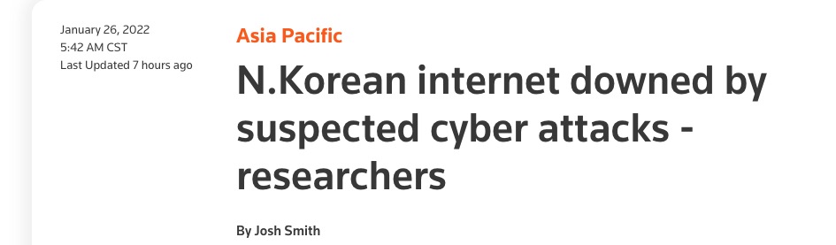
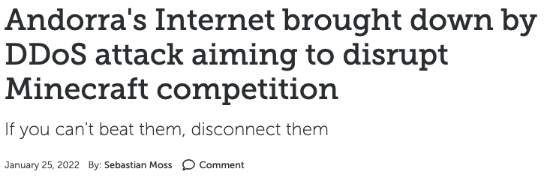
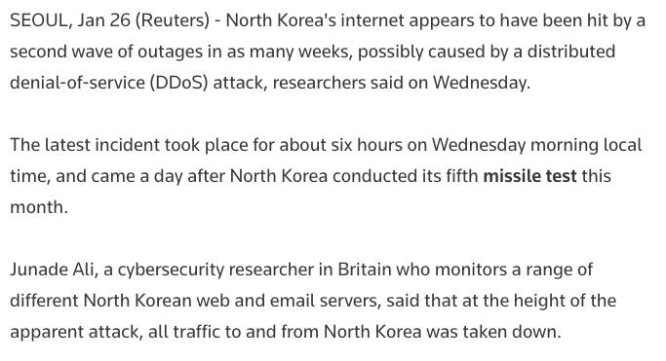
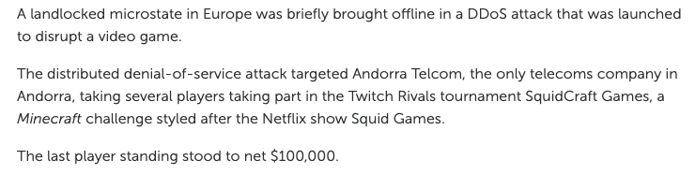
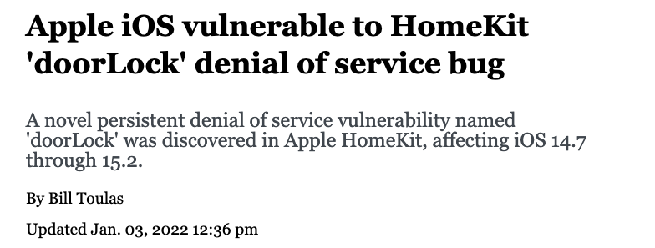
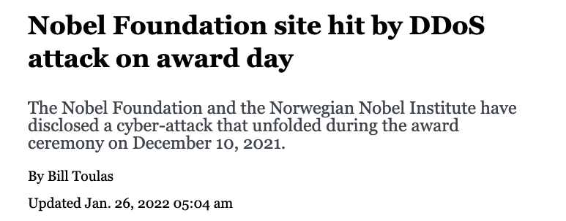
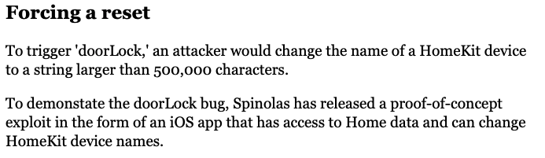

Slide 3


Slide 4
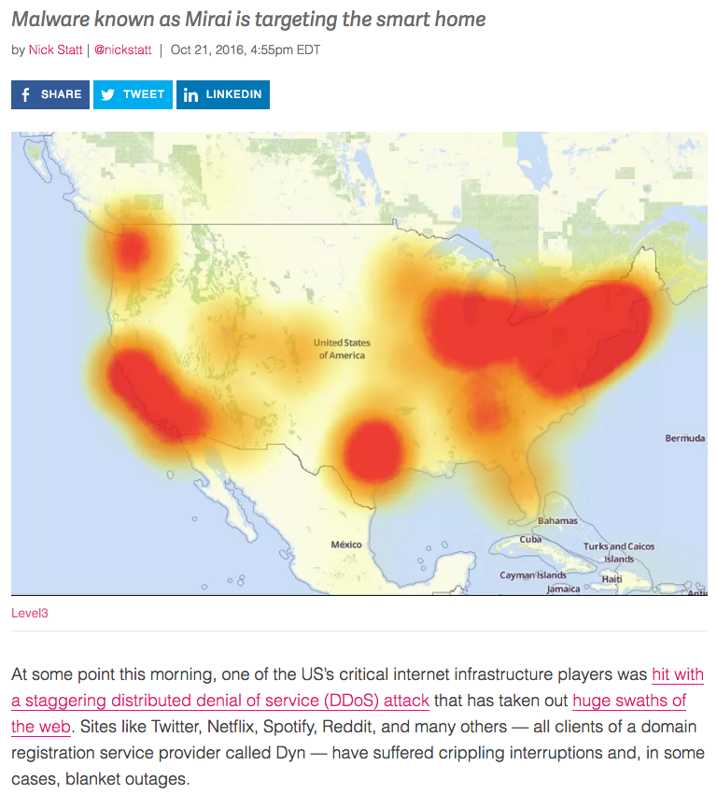
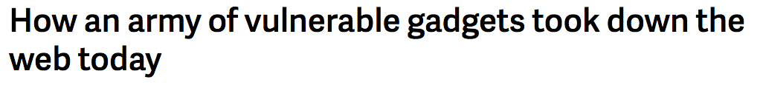
IoT-Based Botnets (More on Botnets Soon…)

Slide 5
Mirai DDoS Post-Mortem
“During a DDoS which uses the DNS protocol it can be difficult to distinguish legitimate traffic from attack traffic. For example, the impact of the attack generated a storm of legitimate retry activity as recursive servers attempted to refresh their caches, creating 10-20X normal traffic volume across a large number of IP addresses. When DNS traffic congestion occurs, legitimate retries can further contribute to traffic volume.
We saw both attack and legitimate traffic coming from millions of IPs across all geographies. It appears the malicious attacks were sourced from at least one botnet, with the retry storm providing a false indicator of a significantly larger set of endpoints than we now know it to be. We are still working on analyzing the data but the estimate at the time of this report is up to 100,000 malicious endpoints. We are able to confirm that a significant volume of attack traffic originated from Mirai-based botnets.

Slide 6
Denial of Service: What is it?
Attacker
Victim
Attempt to exhaust resources
Network: Bandwidth
Transport: TCP connections
Application: Server resources
Typically high-rate attacks, but not always

Slide 7
Targets of Attack
End hosts
Critical servers (disrupt C/S network)
Web, File, Authentication, Update
DNS
Infrastructure
Routers within org
All routers in upstream path
Notes:
----- Meeting Notes (11/14/16 11:29) -----
Cisco DoS vulnerability

Slide 8
Denial of Service: Common Themes
Asymmetry
Reflection and Amplification
Botnets
Difficulty of distinguishing legitimate traffic from attack traffic
(Often) Spoofing of IP addresses

Slide 9
Early Denial of Service
DoS Tools
Single-source, single target tools
IP source address spoofing
Packet amplification (e.g., smurf)
Deployment
Widespread scanning and exploitation via scripted tools
Hand-installed tools and toolkits on compromised hosts (unix)
Use
Hand executed on source host

Slide 10
Basic Amplification Attack
1. ICMP Echo Request Src: DoS Target
Dest: broadcast address
3 ICMP Echo Reply Dest: Dos Target
Send ping request to broadcast address (ICMP Echo Req)
Lots of responses:
Every host on target network generates a ping reply (ICMP Echo Reply) to victim
Network switch
DoS Target
DoS Source

Slide 11
Transmission Control Protocol (TCP)

Slide 12
TCP SYN Flooding Attack
90% of DoS attacks use TCP SYN floods
Streaming spoofed TCP SYNs
Takes advantage of three way handshake
Server start “half-open” connections
These build up… until queue is full and all additional requests are blocked

Slide 13
TCP Connection Management
Three way handshake:
Step 1: client host sends TCP SYN segment to server
specifies initial seq #
no data
Step 2: server host receives SYN, replies with SYNACK segment
server allocates buffers
specifies server initial seq. #
Step 3: client receives SYNACK, replies with ACK segment, which may contain data
Recall: TCP sender, receiver establish “connection” before exchanging data segments
initialize TCP variables:
seq. #s
buffers, flow control info (e.g., RcvWindow)
client: connection initiator
server: contacted by client

Slide 14
TCP: 3-Way Handshake
C
S
SYN_{C}
Listening
Store data
SYN_{S}, ACK_{C}
Wait
ACK_{S}
Connected

Slide 15
TCP Handshake
Each arriving SYN stores state at the server
TCP Control Block (TCB)
~ 280 bytes
FlowID, timer info, Sequence number, flow control status, out-of-band data, MSS, other options agreed to
Half-open TCB entries exist until timeout
Fixed bound on half-open connections
Resources exhausted ⇒ requests rejected

Slide 16
TCP SYN Flooding
Problem: No client authentication of packets before resources allocated
Attacker sends many connection requests
Spoofed source addresses
RSTs quickly generated if source address exists
No reply for non-existent sources
Attacker exhausts TCP buffer to w/ half-open connections

Slide 17
SYN Flooding
C
S
SYN_{C1}
Listening
SYN_{C2}
Store data
SYN_{C3}
SYN_{C4}
SYN_{C5}

Slide 18
A Classic SYN Flood Example
MS Blaster (2003)
Infected machines at noon on Aug 16th:
SYN flood on port 80 to windowsupdate.com
50 SYN packets every second.
each packet is 40 bytes.
Spoofed source IP: a.b.X.Y where X,Y random.
Defense
new name: windowsupdate.microsoft.com
Win update file delivered by Akamai
Notes:
Infected IP: a.b.c.d. a.b.X.Y avoids ingress filtering ISPs. Note: evades Savage’s /8 backscatter monitor.

Slide 19
Domain Name System (DNS)

Slide 20
DNS DoS Attacks
DNS runs on UDP port 53
DNS entry for victim.com hosted at victim_isp.com
DDoS attack:
flood victim_isp.com with requests for victim.com
Random source IP address in UDP packets
Takes out entire DNS server: (collateral damage)
bluesecurity DNS hosted at Tucows DNS server
DNS DDoS took out Tucows hosting many many sites
Notes:
TLD DNS servers: each root server on 200 machines. Requests use IP any cast.

Slide 21
Root Level DNS Attacks
Feb. 6, 2007:
Botnet attack on the 13 Internet DNS root servers
Lasted 2.5 hours
None crashed, but two performed badly:
g-root (DoD), l-root (ICANN)
Most other root servers use anycast
Notes:
Root servers specify where the TLDs are (.com, .net, …)
f-root is supported by 42 different locations.
Only one root server is sufficient to make the Internet work.

Slide 22
DNS Amplification (Common Today)
DNS Amplification attack: ( ×40 amplification )
DNS Query SrcIP: Dos Target
(60 bytes)
EDNS Reponse
(3000 bytes)
DoS Source
DNS Server
DoS Target
Prevention: reject DNS queries from external addresses
Notes:
Other measurements: (MeasurementFactory):
There are an estimated 7.5 million external DNS servers on the public Internet. Over 75% of domain
name servers (of roughly 1.3 million sampled) allow recursive name service to arbitrary queriers.

Slide 23
DoS of SSL/TLS
SSL/TLS handshake [SD’03]
RSA-encrypt speed ≈ 10× RSA-decrypt speed
⇒ Single machine can bring down ten web servers
Similar problem with application DoS:
Send HTTP request for some large PDF file
⇒ Easy work for client, hard work for server.
Client Hello
Web
Server
Server Hello (pub-key)
RSA
Encrypt
Client key exchange
RSA
Decrypt

Slide 24
Defenses

Slide 25
Mirai DDoS: Defenses
Traffic shaping
Rebalancing traffic across load-balanced services
Third-party scrubbing services

Slide 26
Defense: Ingress Filtering
Drop all packets with source address other than 204.69.207.0/24
Internet
204.69.207.0/24
RFC 2827: Routers install filters to drop packets from networks that are not downstream
Feasible at edges
Difficult to configure closer to network “core”

Slide 27
Preventing Denial of Service
DoS is caused by asymmetric state allocation
If responder opens new state for each connection attempt, attacker can initiate thousands of connections from bogus or forged IP addresses
Cookies ensure that the responder is stateless until initiator produced at least two messages
Responder’s state (IP addresses and ports of the connection) is stored in a cookie and sent to initiator
After initiator responds, cookie is regenerated and compared with the cookie returned by the initiator

Slide 28
Defense: TCP SYN cookies
General idea
Client sends SYN w/ ACK number
Server responds to Client with SYN-ACK cookie
sqn = f(src addr, src port, dest addr, dest port, rand)
Server does not save state
Honest client responds with ACK(sqn)
Server checks response
If matches SYN-ACK, establishes connection

Slide 29
TCP SYN cookie
TCP SYN/ACK seqno encodes a cookie
32-bit sequence number
t mod 32: counter to ensure sequence numbers increase every 64 seconds
MSS: encoding of server MSS (can only have 8 settings)
Cookie: easy to create and validate, hard to forge
Includes timestamp, nonce, 4-tuple
32
0
t mod 32
MSS
Cookie=HMAC(t, N_{s}, SIP, SPort, DIP, DPort)
5 bits
3 bits

Slide 30
SYN Cookies
client
sends SYN packet and ACK number to server
waits for SYN-ACK from server w/ matching ACK number
server
responds w/ SYN-ACK packet w/ initial SYN-cookie sequence number
Sequence number is cryptographically generated value based on client address, port, and time.
client
sends ACK to server w/ matching sequence number
server
If ACK is to an unopened socket, server validates returned sequence number as SYN-cookie
If value is reasonable, a buffer is allocated and socket is opened
SYN
ack-number
SYN-ACK
seq-number as SYN-cookie,
ack-number
NO BUFFER ALLOCATED
ACK
seq_number
ack-number+data
SYN-ACK
seq-number, ack-number
TCP BUFFER ALLOCATED

Slide 31
Defense: uRPF Checks
Accept packet from interface only if forwarding table entry for source IP address matches ingress interface
Strict Mode
uRPF Enabled
10.0.18.3 from wrong interface
“A” Routing Table
Destination Next Hop
10.0.1.0/24 Int. 1
10.0.18.0/24 Int. 2
Unicast Reverse Path Forwarding
Cisco: “ip verify unicast reverse-path”
Requires symmetric routing

Slide 32
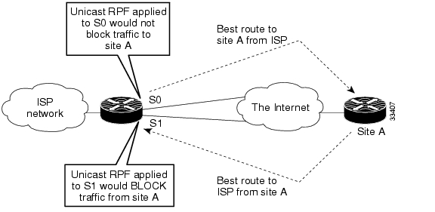
Problems with uRPF
Asymmetric routing…

Slide 33
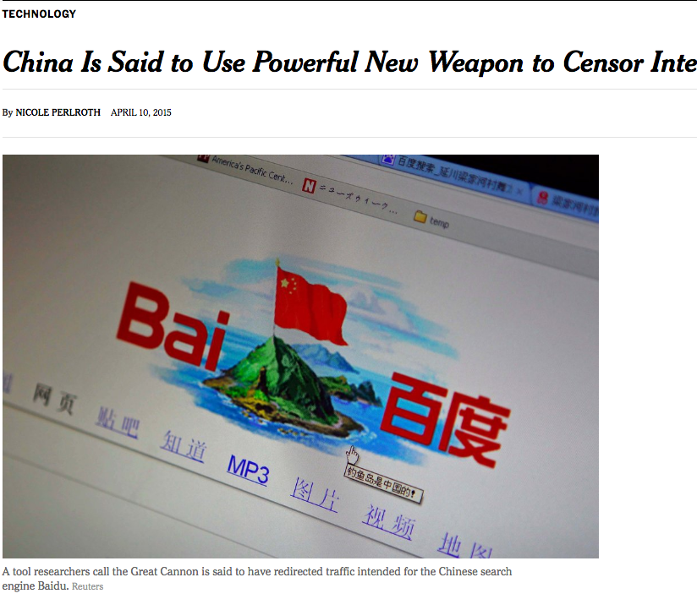
China’s Great Cannon
March 26, 2016: Github pages run by Greatfire.org are victims of DoS attack
Malicious traffic directed from Baidu servers
Baidu said that their servers were not compromised…
Instead: Traffic manipulation of “bystander” systems (i.e., client browsers)

Slide 34
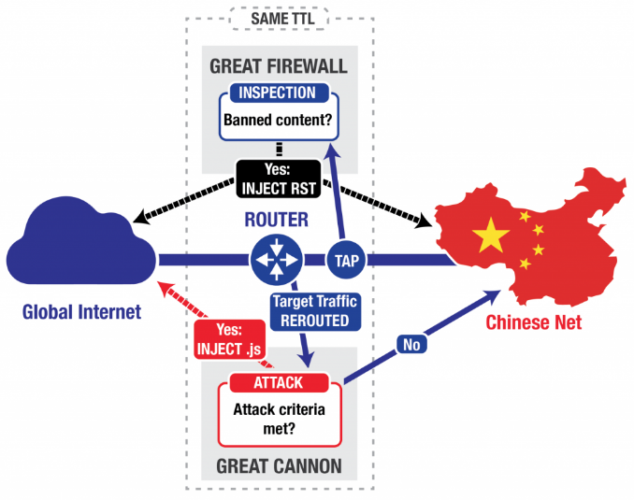
“On-Path” Attack System
Eavesdrop traffic between China & rest of world
Terminate requests for banned content with TCP RST
Appears to be co-located with the “Great Firewall”, load-balanced
Differences: probabilistic, no packet reassembly

Slide 35
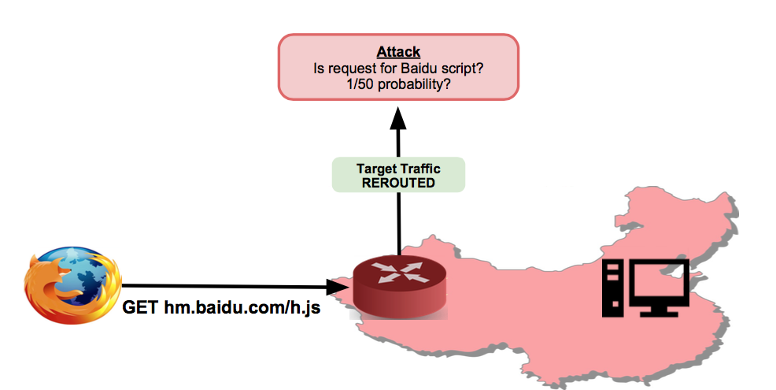
China’s “Great Cannon”

Slide 36
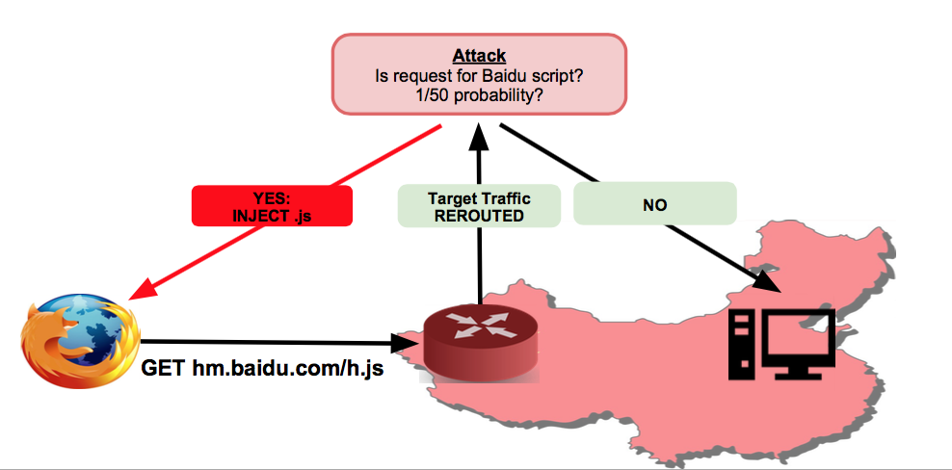
Great Cannon: Inject Javascript

Slide 37
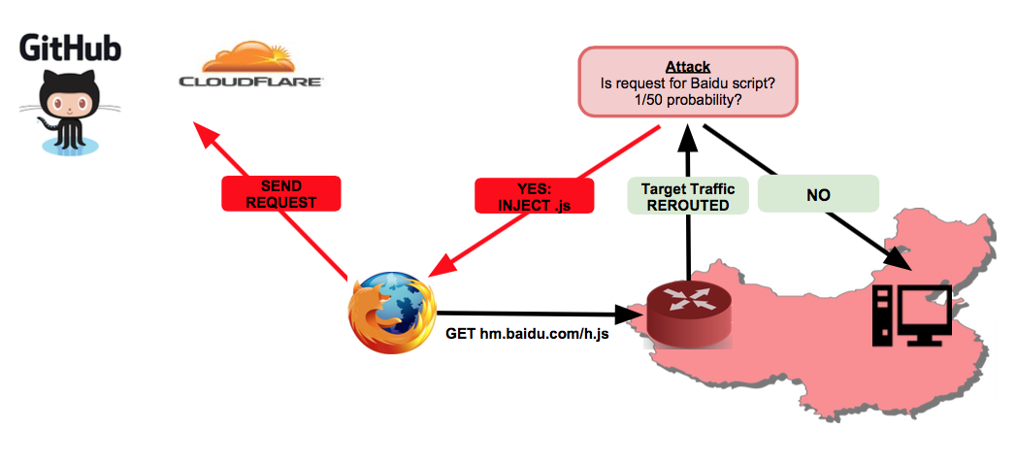
Great Cannon: Direct HTTP at Victim

Slide 38
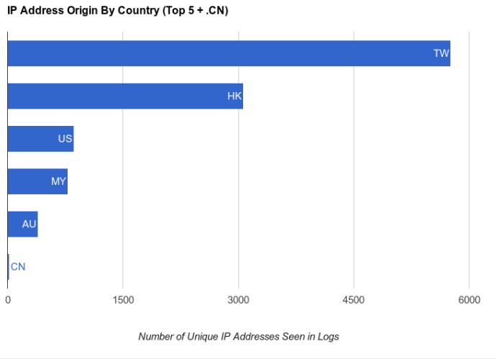
Where Were the Attacking Clients?

Slide 39
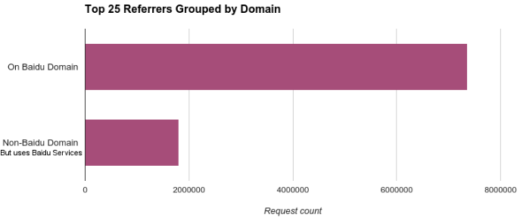
What Domains Had Code Injected?
Most common: pos.baidu.com
Baidu is fourth most-visited site globally

