Slide 1
Access Control and Protection COS 432: Information Security
Nick Feamster

Slide 2
OS Security Goals
Protect users from each other
Protect apps from each other
Protect the system from network
Allow sharing across these boundaries

Slide 3

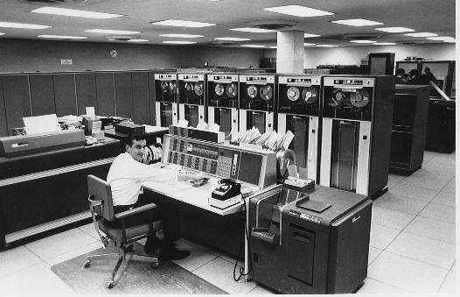
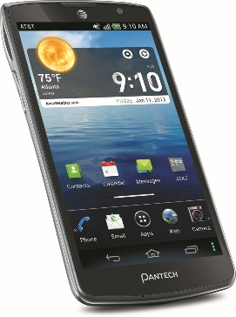
Evolution of OS Threat Model
DOS is truly single user.
MacOS, Linux, Windows are multiuser, but typically used by only one user
 | Single user | Multi-user
Trusted apps
Untrusted apps
??
Notes:
In the early days (top right), machines were expensive, so they were shared by many users. Apps are trusted since users were actually creating programs themselves and were responsible for them.
In a typical PC OS, apps are trusted. The rationale for this security model is that the user is responsible for the programs she runs on her computer. PC OSes are spiritual descendants of traditional multi-user OSes.
Smartphone vendors knew that the PC security model would simply kill the platform. So they rethought security from the ground up, and designed the platform to support untrusted apps.
Do you have any examples of the last category?

Slide 4
What’s Old is New Again
Modern multi-user systems:
Cloud computing
Facebook, Google docs (not OSes)
What about web browser?
Single user, untrusted apps (web pages)
Notes:
A lot of the techniques for multi-user systems have now been repurposed for multi-app systems.
One often hears the claim that browsers are the new OS. There is some merit to this, and JavaScript is a full fledged programming environment.

Slide 5
Types of Intruder
Casual prying
Snooping by insiders
Attempts to make money
Espionage (Commercial, military)
Notes:
From Tannenbaum OS book (Sec 4.4.1)
Note: passive and active intruders
Security vs. Privacy

Slide 6
Protection and Access Control

Slide 7
How Does Protection Occur?
OS controls what users/processes can do
OS control is triggered through interrupts, system calls
CPU supports privilege levels to ensure only OS can execute privileged instructions

Slide 8
An OS Protects Resources
User
Resource
OS
User
Resource
Processes
User
Resource
Notes:
Resources: memory, filesystem, peripherals,
OS here mainly refers to kernel

Slide 9
Classic Examples in UNIX
Core Dump Overwrite
Linking /etc/passwd to a file called “core”
Causing a SETUID program to dump core, subsequently overwriting the passwd file.
Directory Creation Race Condition
Mkdir would create inode as root, then change UID of inode
Race: link to passwd after inode creation but before chown
Notes:
Serious problem: Timesharing system

Slide 10
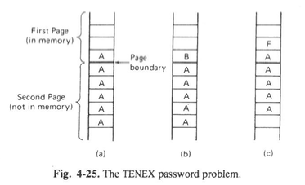
More
Timing attacks (TENEX)
File access required password check
Align password guess across page boundary
OS would abort on incorrect character
Time of check to time of use (OS/360)
Password check
Re-read filename after password check

Slide 11
Various Attacks on Access Control
Requests of memory, disk, etc.
Illegal system calls, or legal system calls with illegal parameters
Modification of OS data structures in user space)
Trapdoor attacks
…

Slide 12
Protection Design Principles
Public design
Default is “no access”
Check for current authority
Least privileges
Build security into the lowest system layers possible

Slide 13
System Layers
Web page
Browser
JVM
OS
VM
Hardware
Notes:
Hardware includes firmware.
Not all systems have all layers. For example most browsers are probably not running on top of a Java Virtual Machine.

Slide 14
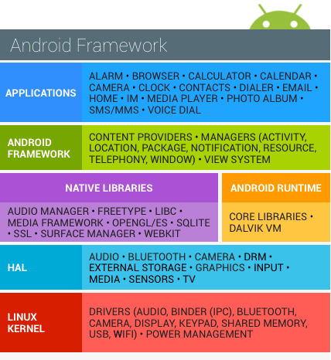
System Layers
Web page
Browser
JVM
OS
VM
Hardware
Notes:
The OS layer in fact contains many layers within itself.

Slide 15
Two Types of Access Control
Access Control Lists
Capabilities

Slide 16
Access Control Lists
Capabilities
Examples
Door fingerprint reader
Passport control
Identity/authentication needed
Delegation not possible
Lower user/client security risk
Easy to revoke access / change rights
Examples
Regular key
Plane ticket
Identity not needed (more privacy)
Just copy the capability/token
Capabilities can “get away from you”
Difficult to revoke access or change rights
Notes:
Two different ways of doing access control.

Slide 17
Access Control List or Capability?
BufferedReader reader =
new BufferedReader(new FileReader(filename));
String line = reader.readLine();
Both!
Opening a file gives the process a “file descriptor”
Can be passed around to other processes
Preserves permissions even if file permissions change
Notes:
Opening a file involves checking an Access Control List to see if the user has permission to open the file.
Reading from the file involves checking a capability.

Slide 18
Typical Security Sequence
Authorization
Accountability
Identification & authentication
Access control
Logging & auditing
Preventive
Reactive
Notes:
Did we see a method to authenticate users? Passwords
Did we see a method to authenticate apps? Code signing
Accountability is typically in addition to authorization, but can sometimes be instead of authorization
Physical security examples: keys (access control), security camera or sign-in sheet (accountability)
Also useful as defense-in-depth security because access control often breached. e.g., Intrusion detection

Slide 19
Access Control using ACLs
Subject = (user, program)
Verb = action
Object = resources
Policy specifies (subject, verb, object) triples
(User, program)
Monitor
Resource
Action
Policy
Notes:
A subject is a specific program acting on behalf of a specific user.
Monitor is typically the OS.
Policy specifies (subject, verb, object) triples. Answers the question can User U running Program P perform Action A on Resource R?

Slide 20
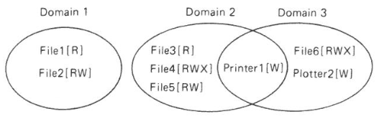
Objects and Protection Domains
Objects: CPUs, memory segments, storage, printers, processes, files databases, locks
Protection Domain: Set of (object, rights) pairs
Notes:
At every instance of time, each process runs in some protection domain. Processes can switch between domains during execution; the rules for domain switching depend a lot on the system.
“Rights” == “Verb” in our notes here.

Slide 21
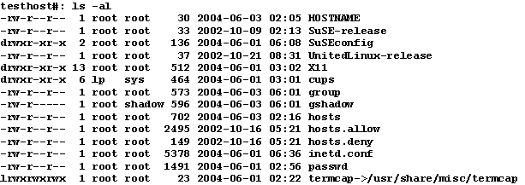
Example: Unix Access Control List
Notes:
This was considered a simplified model compared to other OSes of the day.
Nevertheless, it hasn’t proved very user friendly.
Given any (uid, gid) combination, it is possible to make a complete list of all objects that can be accessed, and whether they can be accessed for read, write, or execute.
Each process has a user part and a kernel part.

Slide 22
Unix: Simplified Access Control Model
Subject: User-space Process
PC OSes are multi-user even if in practice only 1 human user
Some programs run as their own user (e.g., webserver)
Root/administrator/superuser: protects system files
Verb: read/write/execute
Object: files, memory File includes sockets, special OS functions, …
Hack!
Notes:
Simplified access control compared to Multics before it, not compared to (say) Windows.
For the most part all processes initiated by a user have the same permissions. The subject is the user, not (user, program). There are some hacks to get around this limitation, such as treating a web server as its own user. This means that if the server gets hacked, attacker doesn’t have full privileges on the system.
This is an example of repurposing a multi-user security feature for an untrusted-app world.

Slide 23
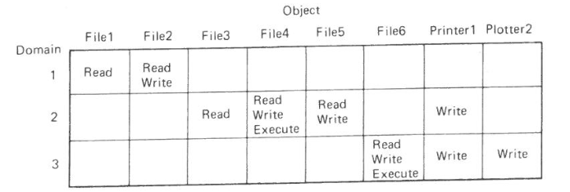
Protection Matrix

Slide 24
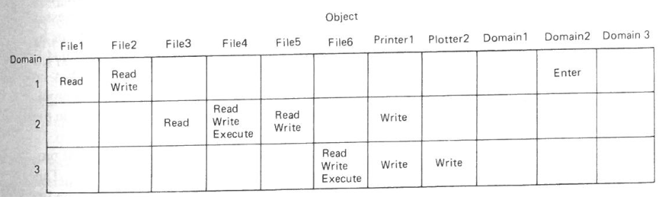
Protection Matrix with Domain Switching

Slide 25
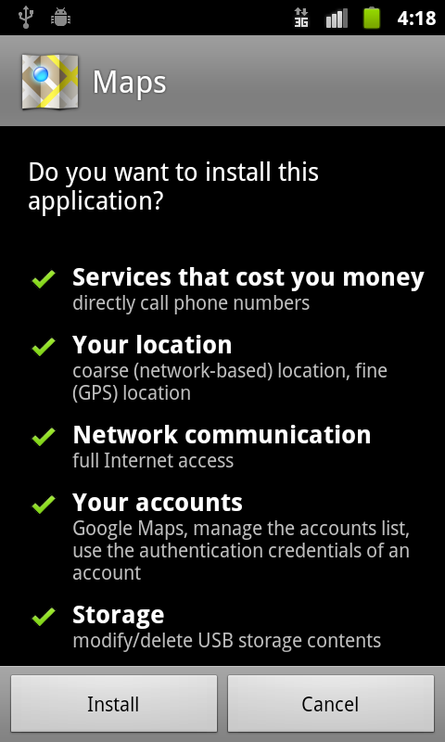
Android Access Control
Notes:
This was the original version of Android’s ACL.
* there are hundreds of possible sub-permissions
* users don’t understand them, at least not well enough to make informed decisions.
* in fact developers don’t understand them either, and this leads to frustration.
Now it has been greatly simplified. Apps can request groups of permissions (all or nothing for each group). Of course, this comes with its own problems.

Slide 26
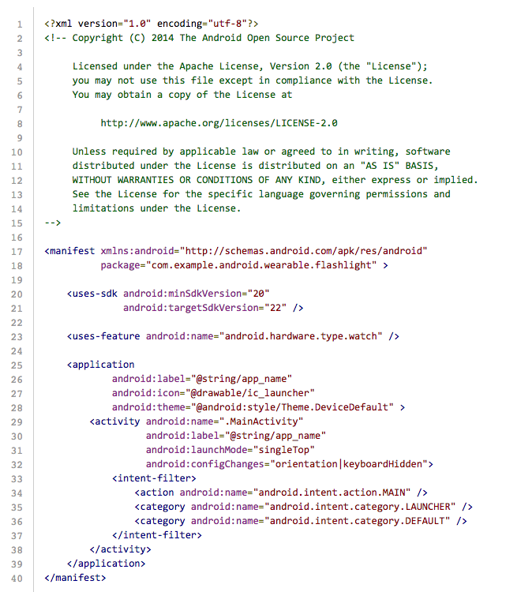
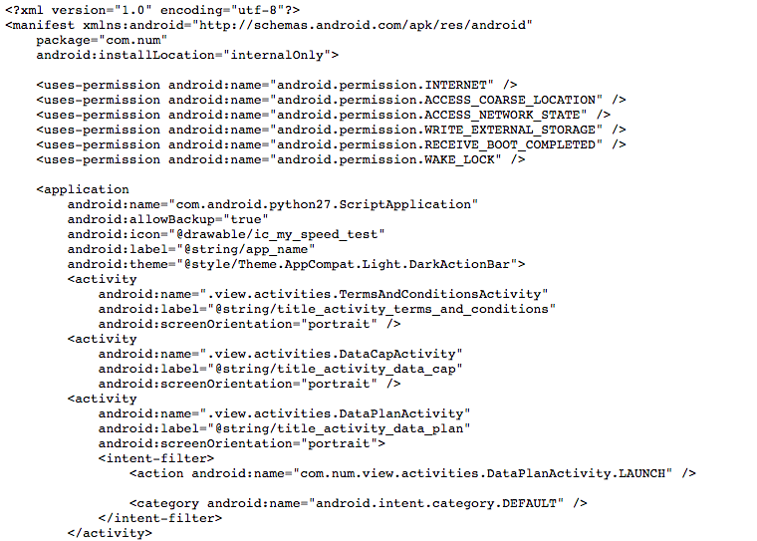
Android Manifest File
Notes:
This is how the app specifies the ACL to the system.

Slide 27
Android Subject/Verb/Object
Subjects: app Android runs on top of Linux kernel Each app gets its own user ID
Objects: Regular files, other apps, camera, telephony, personal data, …
Verbs: Each object/resource defines its own set of verbs

Slide 28
Smartphone Model vs. PC Model
Advantages of smartphone model
OK to run untrusted app from web
Disadvantages of smartphone model
Harder to share between apps
Harder to tinker with system

Slide 29
Understanding Subject, Verb, Object
Subject = (user, program) pair
Verb = action
Object = resources
Consider Facebook.
Identify as many subjects, verbs and objects as you can.

Slide 30
Access Control Policy
Who sets policy?
(Theoretically) users, with system defaults and restrictions
How is access control list stored?
Sparse matrix (default deny), store as list
How does OS enforce policy?
OS exposes API to apps, with privileged operations
Checks ACL when API functions are called
Notes:
The matrix of all possible (subject, verb, object) triples may be too big to store, but you can store only the list of allowed triples.
For example, on Google docs there may be millions of users and millions of documents, so Google can’t store it as a matrix, but each user has access to only a few tens to hundreds of documents, so they can store it as a list.

Slide 31
Usability Problems in Access Control
Too much complexity
Too many decisions
#principals x #actions x #objects
Notes:
Think about apps on your phone. You don’t want to mentally keep track of which data each app has access to.

Slide 32
Abstraction: Classification Levels
Cosmic
Top Secret
Secret
Restricted
Unclassified
Each subject (person) has a clearance level
Each object (document) has a classification level
No read up
No write down
Notes:
This is one way to simplify access control, in the military context.
You can’t read above your clearance level, or write below it. You can transfer information from a higher to a lower-level document in special cases, for example, declassification.

Slide 33
Sometimes There’s No Strict Order: Lattice-based Access Control
Top secret (nuclear, bio)
Top secret (nuclear)
Top secret (bio)
Secret (nuclear, bio)
Secret (nuclear)
Secret
(bio)
Public
Notes:
In this example there are two types of secrets, nuclear and biological, and each has a couple of security levels. Of course, being cleared for Secret nuclear documents doesn’t automatically give you any clearance for biological documents. So we need a “lattice” to represent clearance and classification levels.
More info: Denning’s Lattice-based Security

Slide 34
Other Abstractions: Roles, Groups
Useful in (e.g.) corporate context with various projects, collaborations, privileges

Slide 35
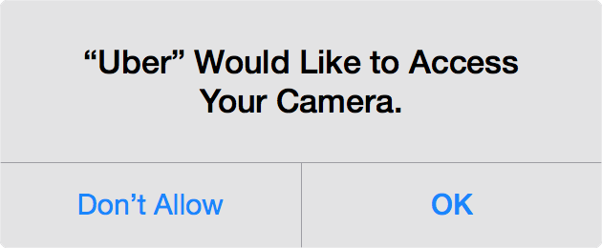
Simplifying Access Control: Emphasize Action over Configuration
Combine with sensible system defaults
Notes:
This is the iOS model.
Why would Uber want to access your camera? It needs it if you want it to automatically scan your credit card instead of typing in the number.
This iOS-style prompt has several advantages over the Android model. If you stuck the camera permission in the app-installation screen, most users would pay no attention; those that did would be confused and annoyed because it’s not obvious why Uber should need your camera. Besides, the prompt allows you to give access only when it’s actually needed, rather than all the time.
We can go farther and combine the user’s request for an action with the granting of the corresponding permission in a single button. This has been proposed but not yet implemented in mainstream OSes http://research.microsoft.com/pubs/152495/user-driven-access-control-nov2011.pdf

Slide 36
Capabilities: Alternative to ACLs
Combines resource locator and permission
Very common on the web
Notes:
Capabilities are most closely analogous to physical keys
In the unix example the subjects are processes but in the Google docs example the subjects are users. Very different situations, same principle
In a true capability system even the verb (anyone with a link can view/edit) would be specified as part of the capability URL.
Youtube has unlisted videos. Same concept.
Security comes from people agreeing to not share the link only with those whom they think should have access
A priori, you don’t know who will have access
However, you trust that people will exercise judgment in sharing the link

Slide 37
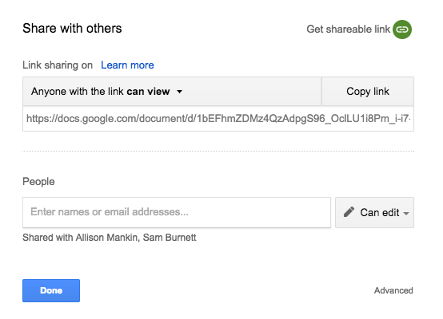
Google Docs Access Control
Notes:
Google docs supports both capabilities (top) and Access Control Lists (bottom).
These aren’t true capabilities because the permission isn’t encoded into the URL. In other words, with true capabilities, the feature that allows you to change the permissions of link holders (as you can see in the screenshot) wouldn’t be possible. The link itself would encode the set of permissions that it grants, and there would be different links for different sets of permissions. If you received a link that promised edit access to a particular doc, you could be confident that that access can’t be revoked.

Slide 38
Example of Capability URL
Notes:
It needs to be long so that it’s unforgeable.
What crypto primitive would you use to generate unforgeable URLs?

Slide 39
Memory Safety

Slide 40
Memory Safety
Challenge: how to ensure a process can access only its own memory locations?

Slide 41
Virtual Memory
Virtual address:
(p#, offset)
Physical address:
(f#, offset)
Page table
contains r/w/x
bits
Pages (virtual)
Frames (real)
Notes:
OS sets policy (which processes can access which addresses), leaves enforcement to hardware.
Page table translates page number to frame number. Offset remains the same.
Each page (say 8KB) has a few bits associated with it for permission checking.

Slide 42
System Calls (syscalls)
Kernel: privileged code, sets up page table, protection bits, etc.
Hardware “privileged bit”
Allows modifying permissions
On when kernel is running
Syscall: way for apps to call kernel
HW sets privileged bit to true
Jumps to kernel’s syscall handler (same address each time)
Kernel does access checks

Slide 43
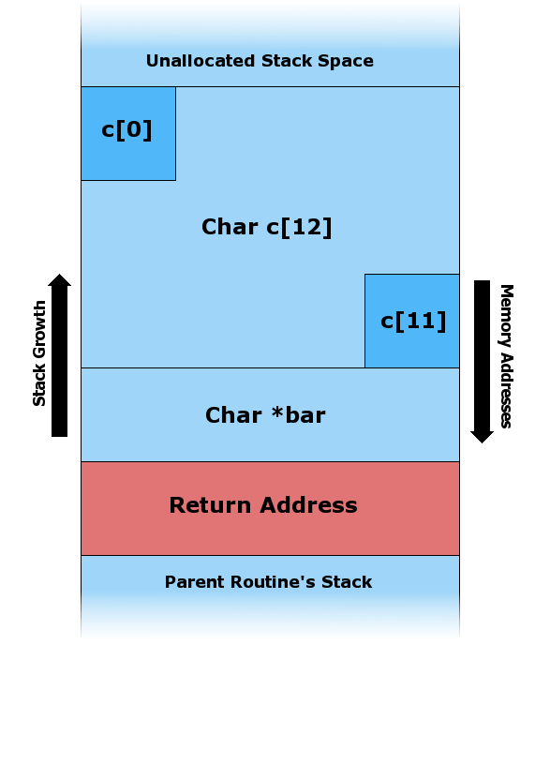
Buffer Overflow
void insecure(char *bar)
{
char c[12];
strcpy (c, bar);
}
Notes:
A buffer overflow is a violation of memory safety. It’s a particularly important special case. In one sense it’s not really the OS’s problem, because it results from a buggy program, but it’s so pervasive and serious that OSes (and hardware) have features to mitigate it.
In this C example the input ‘bar’ is untrusted, i.e., it might be provided by the attacker over the Internet. If it is longer than 12 bytes, the strcpy (string copy) function will overrun the end of the 12-byte buffer allocated to ‘c’, and might overwrite the return address on the stack.
When the function finishes, control will jump to an address determined by the attacker. The attacker might further be able to jump to a location overwritten by strcpy. That means the data provided by the attacker will be treated as code and executed (a.k.a. shellcode). Alternately, the attacker might jump to a function that’s already present in the process memory space (a.k.a. return-to-libc).
Here’s an old classic on exploiting buffer overflows http://www-inst.eecs.berkeley.edu/~cs161/fa08/papers/stack_smashing.pdf

Slide 44
Outline
Computer
CPU
Instructions
The Stack (x86)
What is a stack
How it is used by programs
Technical details
Buffer overflows
Adapted from Aleph One’s “Smashing the Stack for Fun and Profit”

Slide 45
CPU
Executes assembly instructions
ADD, SUB, MULT, XOR, CMP, JMP, …
Has built-in “variables” called registers
General Purpose
EAX, EBX, ECX, EDX, EDI, ESI
Special Purpose:
EIP: Instruction Pointer
ESP: Stack Pointer
EBP: Frame/Base Pointer

Slide 46
Stack
push 0x0a
0a

Slide 47
Stack
push 0x0a
push 0x6c
6c
0a

Slide 48
Stack
push 0x0a
push 0x6c
push 0xff
ff
6c
0a

Slide 49
Stack
push 0x0a
push 0x6c
push 0xff
pop r1 #0xff
ff
6c
0a

Slide 50
Stack
push 0x0a
push 0x6c
push 0xff
pop r1 #0xff
pop r2 #0x6c
ff
6c
0a

Slide 51
Stack
push 0x0a
push 0x6c
push 0xff
pop r1 #0xff
pop r2 #0x6c
push 0x88
ff
6c
88
0a

Slide 52
example.c
void foo(int a, int b) {
char buf1[10];
}
void main() {
foo(3,6);
}
Notes:
A function call in c is like a jump (to a procedure) – but when you are done with the function, we return to where we called it.

Slide 53
C stack frames
}
SP
main
Local variables
FP
Notes:
In order to do this, we’ll use a stack. On our stack, we’ll put some frames…
The stack frame contains all the local information to an instance of a function. In addition to our stack pointer (SP), compilers/programmers often use a Frame Pointer (FP), so that local variables are a constant offset from FP while the SP moves throughout the execution of the function. In this case, we see the main stack frame – for now it contains some local variables defined in the function main.

Slide 54
C stack frames
SP
}
function args
main
Local variables
FP
Notes:
Now let’s call our function, foo. We’ll start by pushing our function arguments onto the stack

Slide 55
C stack frames
SP
return address
}
function args
main
Local variables
FP
Notes:
When we return from foo, we’ll want to continue running where we left off in main. To do that, we’ll store the instruction to jump back to on the stack, as our return address.

Slide 56
C stack frames
}
foo
SP
main’s FP
return address
}
function args
main
Local variables
FP
Notes:
We want to update the FP, but we also need to be able to restore it back to main’s stack frame when we return. To do that, the function foo will store the previous FP value on the stack.

Slide 57
C stack frames
}
foo
SP
FP
main’s FP
return address
}
function args
main
Local variables
Notes:
Now we can update our FP

Slide 58
C stack frames
}
SP
foo
Local variables
FP
main’s FP
return address
}
function args
main
Local variables
Notes:
Now the function foo can allocate space for its local variables, and reference them based off its FP.

Slide 59
C stack frames (x86 specific)
Grows toward lower address
Starts ~end of VA space
Two related registers
%ESP - Stack Pointer
%EBP - Frame Pointer
Low address 0x00
High address 0xff

Slide 60
example.c
void foo(int a, int b) {
char buf1[10];
}
void main() {
foo(3,6);
}
Notes:
Let’s take a look at example.c in x86

Slide 61
example.s (x86)
main:
pushl %ebp
movl %esp, %ebp
subl $8, %esp
movl $6, 4(%esp)
movl $3, (%esp)
call foo
leave
ret
prev FP
Notes:
Store the previous FP on the stack

Slide 62
example.s (x86)
main:
pushl %ebp
movl %esp, %ebp
subl $8, %esp
movl $6, 4(%esp)
movl $3, (%esp)
call foo
leave
ret
prev FP
Notes:
Move the FP to the current frame

Slide 63
example.s (x86)
main:
pushl %ebp
movl %esp, %ebp
subl $8, %esp
movl $6, 4(%esp)
movl $3, (%esp)
call foo
leave
ret
prev FP
Notes:
Allocate local variables

Slide 64
example.s (x86)
main:
pushl %ebp
movl %esp, %ebp
subl $8, %esp
movl $6, 4(%esp)
movl $3, (%esp)
call foo
leave
ret
6
prev FP
Notes:
Put the second argument on the stack

Slide 65
example.s (x86)
main:
pushl %ebp
movl %esp, %ebp
subl $8, %esp
movl $6, 4(%esp)
movl $3, (%esp)
call foo
leave
ret
3
6
prev FP
Notes:
Put the first argument on the stack

Slide 66
example.s (x86)
main:
pushl %ebp
movl %esp, %ebp
subl $8, %esp
movl $6, 4(%esp)
movl $3, (%esp)
call foo
leave
ret
return
3
6
prev FP
Notes:
Call the function. This will push the return address on the stack, and jump to the function

Slide 67
example.s (x86)
foo:
pushl %ebp
movl %esp, %ebp
subl $16, %esp
leave
ret
main FP
return
3
6
prev FP
Notes:
Push the previous FP to the stack

Slide 68
example.s (x86)
foo:
pushl %ebp
movl %esp, %ebp
subl $16, %esp
leave
ret
main FP
return
3
6
prev FP
Notes:
Update the frame pointer

Slide 69
example.s (x86)
foo:
pushl %ebp
movl %esp, %ebp
subl $16, %esp
leave
ret
…
main FP
return
3
6
prev FP
Notes:
Allocate 16 bytes on the stack for local variables/buffers

Slide 70
example.s (x86)
foo:
pushl %ebp
movl %esp, %ebp
subl $16, %esp
leave
ret
…
main FP
return
3
6
mov %ebp, %esp
pop %ebp
prev FP
Notes:
Leave is a macro for: mov %ebp, %esp
pop %ebp

Slide 71
example.s (x86)
foo:
pushl %ebp
movl %esp, %ebp
subl $16, %esp
leave
ret
…
main FP
return
3
6
mov %ebp, %esp
pop %ebp
prev FP
Notes:
Leave: mov %ebp, %esp
pop %ebp

Slide 72
example.s (x86)
foo:
pushl %ebp
movl %esp, %ebp
subl $16, %esp
leave
ret
…
return
3
6
mov %ebp, %esp
pop %ebp
prev FP
Notes:
Leave: mov %ebp, %esp
pop %ebp

Slide 73
example.s (x86)
foo:
pushl %ebp
movl %esp, %ebp
subl $16, %esp
leave
ret
…
return
3
6
mov %ebp, %esp
pop %ebp
prev FP
Notes:
Ret:
pop %eip

Slide 74
example.s (x86)
main:
pushl %ebp
movl %esp, %ebp
subl $8, %esp
movl $6, 4(%esp)
movl $3, (%esp)
call foo
leave
ret
…
3
6
prev FP
mov %ebp, %esp
pop %ebp
Notes:
Ret:
pop %eip

Slide 75
example.s (x86)
main:
pushl %ebp
movl %esp, %ebp
subl $8, %esp
movl $6, 4(%esp)
movl $3, (%esp)
call foo
leave
ret
…
prev FP
mov %ebp, %esp
pop %ebp
Notes:
Ret:
pop %eip

Slide 76
example.s (x86)
main:
pushl %ebp
movl %esp, %ebp
subl $8, %esp
movl $6, 4(%esp)
movl $3, (%esp)
call foo
leave
ret
…
mov %ebp, %esp
pop %ebp
Notes:
Ret:
pop %eip

Slide 77
Buffer Overflow Example
void foo(char *str) {
char buffer[16];
strcpy(buffer, str);
}
void main() {
char buf[256];
memset(buf, ‘A’, 255);
buf[255] = ‘\x00’;
foo(buf);
}
Notes:
Let’s change our program slightly. Here, in main, we’re going to make a 256 character buffer, and fill it with a null-terminated string of 255 ‘A’ characters.
Then, we’ll call foo, which is going to allocate a 16-byte buffer, and try to copy our 256-character string to it.

Slide 78
Buffer Overflow Example
void foo(char *str) {
char buffer[16];
strcpy(buffer, str);
}
void main() {
char buf[256];
memset(buf, ‘A’, 255);
buf[255] = ‘\x00’;
foo(buf);
}
Notes:
Let’s look at the stack, as we go through this example. We’ll stay in C for now.

Slide 79
Buffer Overflow Example
void foo(char *str) {
char buffer[16];
strcpy(buffer, str);
}
void main() {
char buf[256];
memset(buf, ‘A’, 255);
buf[255] = ‘\x00’;
foo(buf);
}
AAAAAAA…
prev FP

Slide 80
Buffer Overflow Example
void foo(char *str) {
char buffer[16];
strcpy(buffer, str);
}
void main() {
char buf[256];
memset(buf, ‘A’, 255);
buf[255] = ‘\x00’;
foo(buf);
}
foo_arg1
AAAAAAA…
prev FP

Slide 81
Buffer Overflow Example
void foo(char *str) {
char buffer[16];
strcpy(buffer, str);
}
void main() {
char buf[256];
memset(buf, ‘A’, 255);
buf[255] = ‘\x00’;
foo(buf);
}
return
foo_arg1
AAAAAAA…
prev FP

Slide 82
Buffer Overflow Example
void foo(char *str) {
char buffer[16];
strcpy(buffer, str);
}
void main() {
char buf[256];
memset(buf, ‘A’, 255);
buf[255] = ‘\x00’;
foo(buf);
}
main FP
return
foo_arg1
AAAAAAA…
prev FP

Slide 83
Buffer Overflow Example
void foo(char *str) {
char buffer[16];
strcpy(buffer, str);
}
void main() {
char buf[256];
memset(buf, ‘A’, 255);
buf[255] = ‘\x00’;
foo(buf);
}
main FP
return
foo_arg1
AAAAAAA…
prev FP

Slide 84
Buffer Overflow Example
AAAAAAA…
void foo(char *str) {
char buffer[16];
strcpy(buffer, str);
}
void main() {
char buf[256];
memset(buf, ‘A’, 255);
buf[255] = ‘\x00’;
foo(buf);
}
0x41414141
0x41414141
0x41414141
AAAAAAA…
prev FP

Slide 85
Buffer Overflow Example
AAAAAAA…
void foo(char *str) {
char buffer[16];
strcpy(buffer, str);
}
void main() {
char buf[256];
memset(buf, ‘A’, 255);
buf[255] = ‘\x00’;
foo(buf);
}
mov %ebp, %esp
pop %ebp
ret
0x41414141
0x41414141
0x41414141
AAAAAAA…
prev FP

Slide 86
Buffer Overflow Example
AAAAAA…
void foo(char *str) {
char buffer[16];
strcpy(buffer, str);
}
void main() {
char buf[256];
memset(buf, ‘A’, 255);
buf[255] = ‘\x00’;
foo(buf);
}
mov %ebp, %esp
pop %ebp
ret
0x41414141
0x41414141
0x41414141
AAAAAAA…
prev FP

Slide 87
Buffer Overflow Example
AAAAAA…
void foo(char *str) {
char buffer[16];
strcpy(buffer, str);
}
void main() {
char buf[256];
memset(buf, ‘A’, 255);
buf[255] = ‘\x00’;
foo(buf);
}
mov %ebp, %esp
pop %ebp
ret
0x41414141
0x41414141
0x41414141
AAAAAAA…
?
prev FP

Slide 88
Buffer Overflow Example
AAAAAA…
void foo(char *str) {
char buffer[16];
strcpy(buffer, str);
}
void main() {
char buf[256];
memset(buf, ‘A’, 255);
buf[255] = ‘\x00’;
foo(buf);
}
mov %ebp, %esp
pop %ebp
ret
0x41414141
0x41414141
0x41414141
AAAAAAA…
?
prev FP

Slide 89
Buffer Overflow Example
AAAAAA…
%eip = 0x41414141
???
0x41414141
0x41414141
0x41414141
AAAAAAA…
?
prev FP

Slide 90
Buffer overflow FTW
Success! Program crashed!
Can we do better?
Yes
How?

Slide 91
Exploiting Buffer Overflows
void foo(char *str) {
char buffer[16];
strcpy(buffer, str);
}
void main() {
char buf[256];
memset(buf, ‘A’, 255);
buf[255] = ‘\x00’;
((int*)buf)[5] = (int)buf;
foo(buf);
}
Notes:
Note: you’ll need to get padding right. For me, I needed [7] for this to “work”

Slide 92
Exploiting Buffer Overflows
AAAAAAA…
void foo(char *str) {
char buffer[16];
strcpy(buffer, str);
}
void main() {
char buf[256];
memset(buf, ‘A’, 255);
buf[255] = ‘\x00’;
((int*)buf)[5] = (int)buf;
foo(buf);
}
0x41414141
buf
0x41414141
AAAAAAA…
prev FP
Notes:
Now we’ve set the return address to point to some memory. Great! When we return, we will be executing code off the stack!
(arbitrary code/etc)

Slide 93
Exploiting Buffer Overflows
AAAAAAA…
void foo(char *str) {
char buffer[16];
strcpy(buffer, str);
}
void main() {
char buf[256];
memset(buf, ‘A’, 255);
buf[255] = ‘\x00’;
((int*)buf)[5] = (int)buf;
foo(buf);
}
mov %ebp, %esp
pop %ebp
ret
0x41414141
buf
0x41414141
AAAAAAA…
prev FP
Notes:
Now we’ve set the return address to point to some memory. Great! When we return, we will be executing code off the stack!
(arbitrary code/etc)

Slide 94
Exploiting Buffer Overflows
AAAAAAA…
void foo(char *str) {
char buffer[16];
strcpy(buffer, str);
}
void main() {
char buf[256];
memset(buf, ‘A’, 255);
buf[255] = ‘\x00’;
((int*)buf)[5] = (int)buf;
foo(buf);
}
mov %ebp, %esp
pop %ebp
ret
0x41414141
buf
0x41414141
AAAAAAA…
prev FP
Notes:
Now we’ve set the return address to point to some memory. Great! When we return, we will be executing code off the stack!
(arbitrary code/etc)

Slide 95
Exploiting Buffer Overflows
AAAAAAA…
void foo(char *str) {
char buffer[16];
strcpy(buffer, str);
}
void main() {
char buf[256];
memset(buf, ‘A’, 255);
buf[255] = ‘\x00’;
((int*)buf)[5] = (int)buf;
foo(buf);
}
mov %ebp, %esp
pop %ebp
ret
0x41414141
buf
0x41414141
AAAAAAA…
prev FP
Notes:
Now we’ve set the return address to point to some memory. Great! When we return, we will be executing code off the stack!
(arbitrary code/etc)

Slide 96
(slightly) more realistic vulnerability
void main()
{
char buffer[100];
printf("Enter name: ");
gets(buffer);
printf("Hello, %s!\n", buffer);
}

Slide 97
(slightly) more realistic vulnerability
void main()
{
char buffer[100];
printf("Enter name: ");
gets(buffer);
printf("Hello, %s!\n", buffer);
}
python –c “print ‘\x90’*110 + \
‘\xeb\xfe’ + ‘\x00\xd0\xff\xff’” | \
./a.out
Notes:
nop sled + jmp -1 + return to stack

Slide 98
Simple attack payload
0xffffd000
nop
nop
nop
nop
…
jmp -2 0xffffd000
return addr

Slide 99
Buffer Overflows
Not just for the return address
Function pointers
Arbitrary data
C++: exceptions
C++: objects
Heap/free list
Any code pointer!

Slide 100
Q. If you download and run Spotify on your laptop/smartphone, can it delete your photos?
Typical PC operating systems have no separation between apps.
Typical smartphone opeårating systems do.
Notes:
We need to understand the history to see why this is the case and where things are going.

Slide 101
Understanding Subject, Verb, Object
Thought Question: Consider PC OS and smartphone OS.
In each case, identify as many subjects, verbs and objects as you can.
Notes:
In PC: subject = user (not subject-user pair since they don’t distinguish between apps)

Slide 102

Anti-DRM campaign: “Defective by Design”
“Instead of buying a DRM or proprietary game, why not donate to a free software project instead?”
“Most DVDs and apparently all Blu-Ray discs have
DRM .. why not take a friend to the movies instead?”
Notes:
defectivebydesign.org
My view: DRM by itself is not the problem. But having to lock down devices inflicts collateral damage. E.g., users can’t easily customize devices or run different software.

Slide 103
S/V/O in Facebook
Subject: user (plain Facebook) User + app (FB app ecosystem)
Object: statuses, photos, comments, events, groups, other users, apps…
Verbs:
view/edit/delete
like, comment
message (another user)
join (a group)
tag (someone in a photo)

Slide 104
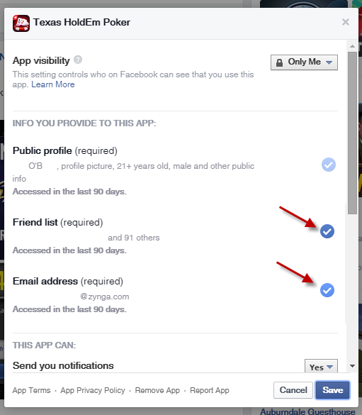
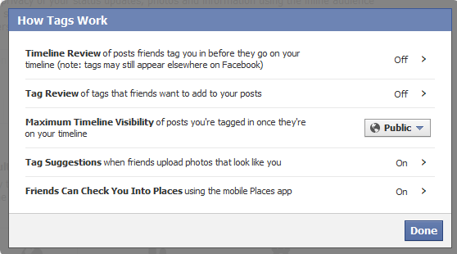
Facebook: Variety of Access Controls
Notes:
Facebook access controls have evolved over the years, and even though Facebook has attempted to simplify them, they’re pretty complex. There are more controls buried in the settings than you may be aware of.

