Slide 1
Message Integrity and Pseudorandom Functions COS 432: Information Security
Nick Feamster

Slide 2
Message Integrity

Slide 3
Goal: Message Integrity
Alice wants to send message m to Bob
don’t fully trust the messenger or network carrying the message
want to be sure what Bob receives is actually what Alice sent
Threat model:
Mallory can see, modify, forge messages
Mallory wants to trick Bob into accepting a message Alice didn’t send
Alice
m
Mallory
m′
Bob

Slide 4
Solution: Message Authentication Code (MAC)
One approach:
1. Alice computes v := f(m)
2.
3. Bob verifies that v′ = f(m′), accepts message iff this is true
Function f ?
Easily computable by Alice and Bob; not computable by Mallory
(Idea: Secret only Alice & Bob know)
We’re sunk if Mallory can learn f(x) for any x ≠ m!
e.g. “Attack at dawn”, 628369867…
Alice
m, v
Mallory
m′, v′
Bob

Slide 5
Candidate f: Random function
Input: Any size up to huge maximum
Output: Fixed size (e.g. 256 bits)
Defined by a giant lookup table that’s filled in by flipping coins
Completely impractical
Provably secure
0 → 0011111001010001… 1 → 1110011010010100… 2 → 0101010001010000…
[Why?]
[Why?]
…
…
Notes:
Provably secure because given any output, Alice and Bob can check the original message.
Mallory does not know the function, and outputs are random.

Slide 6
Want a function that’s practical but “looks random”… Pseudorandom function (PRF)
Let’s build one:
Start with a big family of functions f₀, f₁, f₂, … all known to Mallory
Use f_{k}, where k is a secret value (or “key”) known only to Alice/Bob
k is (say) 256 bits, chosen randomly
Kerckhoffs’s Principle
Don’t rely on secret functions
Use a secret key, to choose from a function family
[Why?]
Notes:
Auguste Kerckhoffs (1883)
Why Kerchoffs’s Principle?
can quantify probability that adversary will guess key because chosen randomly from known space
different people can use same system, different keys: Alice and Bob use one key, Charlie and Diane use another
can change key if something goes wrong
• The system must be practically, if not mathematically, indecipherable;
• It should not require secrecy, and it should not be a problem if it falls into enemy hands;
• It must be possible to communicate and remember the key without using written notes, and correspondents must be able to change or modify it at will;
• It must be applicable to telegraph communications;
• It must be portable, and should not require several persons to handle or operate;
• Lastly, given the circumstances in which it is to be used, the system must be easy to use and should not be stressful to use or require its users to know and comply with a long list of rules.
Kerckhoffs's principle was reformulated (or perhaps independently formulated) by Claude Shannon as "the enemy knows the system", [1] i.e., "one ought to design systems under the assumption that the enemy will immediately gain full familiarity with them". In that form, it is called Shannon's maxim. In contrast to "security through obscurity", it is widely embraced by cryptographers.

Slide 7
Formal definition of a secure PRF:
Game against Mallory
We flip a coin secretly to get bit b
If b=0, let g be a random function If b=1, let g = f_{k}, where k is a randomly chosen secret
Repeat until Mallory says “stop”: Mallory chooses x; we announce g(x)
Mallory guesses b
We say f is a secure PRF if Mallory can’t do better than random guessing*
i.e., f_{k} is indistinguishable in practice from a random function, unless you know k.
Important fact: There’s an algorithm that always wins for Mallory
[What is it?] [How to fix it?]
Notes:
*actually, it’s OK if Mallory has a negligible advantage over guessing, so long as it’s vanishingly small
---
Important fact:
There is an algorithm that always wins for Mallory
get a long list of (x, g(x)) pairs
try every value of k to see whether f_{k} matches that list
guess b=1 iff some f_{k} matches
To fix this, need to limit Mallory to “practical” or “efficient” algorithms
Won’t define this precisely in this course (but precise definitions do exist)

Slide 8
A solution for Alice and Bob:
Let f be a secure PRF
In advance, choose a random k known only to Alice and Bob
Alice computes v := f_{k}(m)
Bob verifies that v′ = f_{k}(m′), accepts message iff this is true
[Important assumptions?]
What if Alice and Bob want to send more than one message?
[Attacks?] [Solutions?]
k
m, v
m′, v′
k
Alice
Mallory
Bob
Notes:
Important Assumptions:
Physical security
Key management - Note: key exchange has happened in advance
--
What if Alice and Bob want to send more than one message? - can’t just redo same plan
- replay attacks / reordering attacks
Solutions:
- add sequence number to message
- or, use different key each time

Slide 9
Annoying question: Do PRFs actually exist?
Annoying answer: We don’t know!
So how do we get a MAC?
Well-studied functions where we haven’t spotted a problem yet (e.g. HMAC-SHA256)

Slide 10
New Approach: Hash-based MAC (HMAC)
HMAC-SHA256 see RFC 2104
HMAC_{k}(m) =
XOR
0x3636…
0x5c5c…
Concatenation
SHA256 function takes arbitrary length input, returns 256-bit output

Slide 11
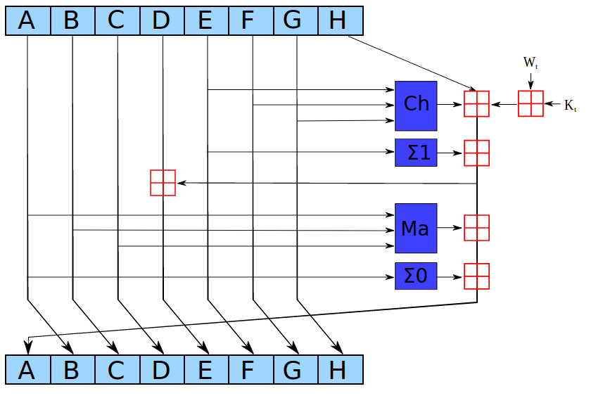
What is SHA256?
“Cryptographic hash function”
Input: arbitrary length data (No key) Output: 256 bits
Built with “compression function” h
(256 bits, 512 bits) in → 256 bits out
Designed to be really hairy (64 rounds of this):
Entire algorithm:
Pad input to multiple of 512 bits (using a fixed algorithm [Why?] )
Break into 512-bit blocks b₀, b₁, … b_{n-1}
y₀ = const, y₁ = h(y₀,b₀), …, y_{i} = h(y_{i-1},b_{i-1})
Return y_{n}
Notes:
Pad using a fixed algorithm – why?
Part of the definition of the function
Otherwise different implementations would calculate different outputs for the same inputs
Compression function h:
designed to be really hairy
lots of bit twiddling
- look up in book if you want; not very enlightening

Slide 12
Merkle–Damgård Construction
- Arbitrary-length input - Fixed-length output
- Built from fixed-size “compression function”
IV
Fixed-length inputs/outputs
b₀
h
pad
b₁
h
M
…
…
Arbitrary length input
b_{n-1}
h
Fixed length output
H(M)

Slide 13
Hash Function Properties
Good hash functions should make it difficult to find …
First pre-image:
given h(m), find m
Second pre-image:
given m₁, find m₂ s.t. h(m₁) = h(m₂)
Collision:
find any m₁ != m₂ s.t. h(m₁) = h(m₂)

Slide 14
Other hash functions:
MD5
Once ubiquitous
Broken in 2004
Turns out to be easy to find collisions (pairs of messages with same MD5 hash)
SHA1
Currently widely used
Suspected to be weak
Don’t use in new applications
SHA3
Different construction: “Sponge”
Not susceptible to length-extension

Slide 15
Message Authentication Code (MAC) e.g. HMAC-SHA256 vs.
Cryptographic hash function e.g. SHA256 not a strong PRF
Used to think the distinction didn’t matter, now we think it does e.g., length extension attacks
Better to use a MAC/PRF (not a hash)
$ openssl dgst -sha256 -hmac <key>
[What if you don’t need a key?]
Notes:
If you don’t need a secret key, pick a key and announce it, use different keys for different purposes to be safe.
--
Also useful to “stretch” a shared secret: given one shared secret key, generate two
Do this trick over and over to generate N shared secret keys “pseudorandom generator” topic of the next lecture
In cryptography and computer security, a length extension attack is a type of attack where an attacker can use Hash(message1) and the length of message1 to calculate Hash(message1 ∥ message2) for an attacker-controlled message2. In cryptography and computer security, a length extension attack is a type of attack where an attacker can use Hash(message1) and the length of message1 to calculate Hash(message1 ∥ message2) for an attacker-controlled message2.

Slide 16
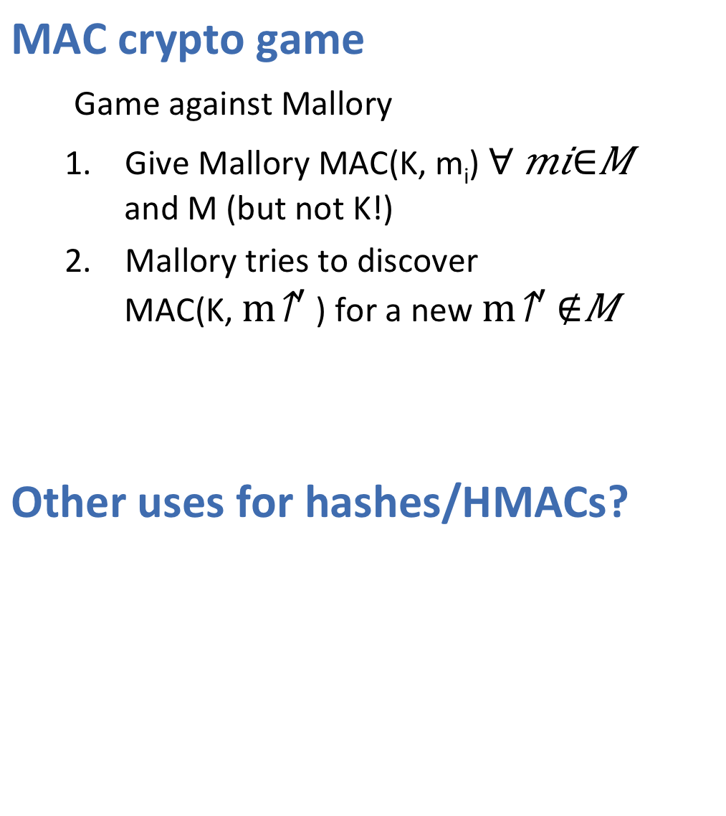
MAC crypto game
Game against Mallory
Give Mallory MAC(K, m_{i}) $∀ mi∈M$ and M (but not K!)
Mallory tries to discover MAC(K, $m^{′}$) for a new$m^{′}∉M$
Other uses for hashes/HMACs?
Notes:
They can also be used as ordinary hash functions, to index data in hash tables, for fingerprinting, to detect duplicate data or uniquely identify files, and as checksums to detect accidental data corruption.
While MAC functions are similar to cryptographic hash functions, they possess different security requirements. To be considered secure, a MAC function must resist existential forgery under chosen-plaintext attacks. This means that even if an attacker has access to an oracle which possesses the secret key and generates MACs for messages of the attacker's choosing, the attacker cannot guess the MAC for other messages (which were not used to query the oracle) without performing infeasible amounts of computation.

Slide 17
Randomness and Pseudorandomness
Notes:
Intro:
Randomness has a central role in cryptography,
but randomness is hard to get, hard to share,
so want to use pseudorandomness instead.

Slide 18
Review
Problem: Integrity of message from Alice to Bob
Alice must append bits to message that only Alice (or Bob) can make
Solution: Message Authentication Code (MAC)
Practical solution: Hash-based MAC (HMAC) – HMAC-SHA256_{k}(M)
Where do these random keys k come from … ? Careful: We’re often sloppy about what is “random”
Notes:
we’re often sloppy about what is “random” e.g., rand() function is C library is not at all random “some random kids were there”
need to be precise in crypto --- or we’ll be sorry

Slide 19
Where Does Randomness Come From?
Cannot produce random bits by starting from deterministic bits
But what about applying a random function to those bits?
Well, how do you decide which function to apply?
Need random bits
Notes:
Cannot generate random bits by computation. Need to get it from somewhere else.
It may be helpful to think of true randomness as a basic resource, like memory or bandwidth

Slide 20
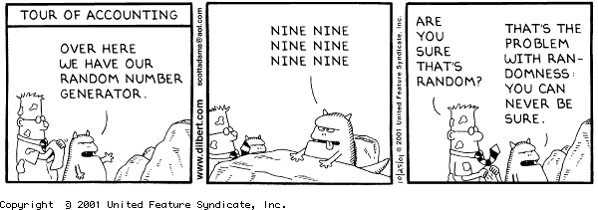
RNG =
random number-generator
randomly picked generator of numbers
random-number generator
generator of random numbers
No such thing as a random number
✓
✘

Slide 21

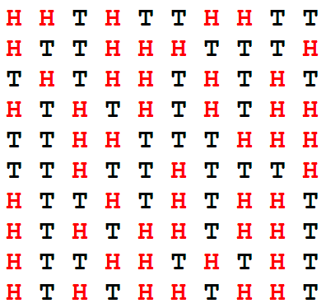
One of these is random. Which one?
Random
Flip with probability 2/3
Humans suck at randomness
Notes:
Answer: the first.
In the second, there’s a 2/3 probability of being different from the previous. Most people pick the second because we intuitively expect much shorter runs than you see from truly random sequences (note a run of 10 T’s in the first).
Machine easily beats humans at rock/paper/scissors. You can try it online. Uses machine learning to learn the imperfect RNGs in our heads.

Slide 22
True Randomness
Output of a physical process that is inherently random
Scarce and hard to get
Pseudorandom Generator (PRG)
Takes small seed that is really random
Generates long sequence of numbers that are “as good as random”
Notes:
This should sound familiar…

Slide 23
Definition: PRG is secure if it’s indistinguishable from random
Similar game to PRF definition:
We flip a coin secretly to get a bit b
If b=0, let s be a truly random stream If b=1, let s be g_{k} for random secret k
Mallory can see as much of the output of s as he/she wants
Mallory guesses b, wins if guesses correctly
Say g is a secure PRG if there is no winning strategy for Mallory*
Notes:
*usual caveats:
- OK if negligible advantage,
- only practical strategies allowed

Slide 24
Here’s a simple PRG that works
For some random k and PRF f, output: f_{k}(0) || f_{k}(1) || f_{k}(2) || …
Theorem: If f is a secure PRF, and g is built from f by this construction, then g is a secure PRG.
Proof: Assume f is a secure PRF, we need to show that g is a secure PRG.
Proof by contradiction:
Assume g is not secure; therefore Mallory can win the PRG game
This gives Mallory a winning strategy for the PRF game: a. query the PRF with inputs 0, 1, 2, … b. apply the PRG-distinguishing algorithm
Therefore, Mallory can win the PRF game, which is a contradiction
Therefore, g is secure
Notes:
Leadout:
…it seems like we’re in good shape, but we still need a truly random value k.
We could measure physical randomness… but: often, bits are biased, not independent … and how do we know if we have enough “randomness”?
And: Does physical randomness actually exist? i.e., Is the universe inherently random? while philosophers are debating that question, let’s try another approach

Slide 25
Where do we get true randomness?
Want “indistinguishable from random” which means: adversary can’t guess it
Gather lots of details about the computer that the adversary will have trouble guessing [Examples?]
Problem: Adversary can predict some of this
Problem: How do you know when you have enough randomness?
Modern OSes typically collect randomness, give you API calls to get it
e.g., Linux:
/dev/random is a device that gives random bits, blocks until available
/dev/urandom gives output of a PRG, nonblocking, seeded from /dev/random eventually
Notes:
Examples of random sources?
*exact* history of keypresses, including micro-time
*exact* path of mouse
*exact* history of network packet arrival
internal temperature of computer
ambient noise picked up by the microphone
maybe even add hardware that will behave unpredictably
example: camera pointed at lava lamps
--
Problem: Adversary can predict some of this
Not a problem, as long as there is “enough randomness” in the data
Gather data for “a long time” then run it through a PRF
Intuition: “distill out” the randomness, reduce size but keep randomness
Problem: How do you know when you have enough randomness?
If you use PRF output before you have enough, you’ll be sorry
- Usual solution: Collect way too much, just to be sure

Slide 26
True Randomness
Outcome of an inherently random physical process
Scarce and hard to get
Does it really exist?
Physicists and philosophers debate
Meanwhile, we have to ship code…
Notes:
Radioactive decay is thought to be possibly a source of true randomness

Slide 27
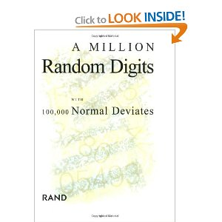
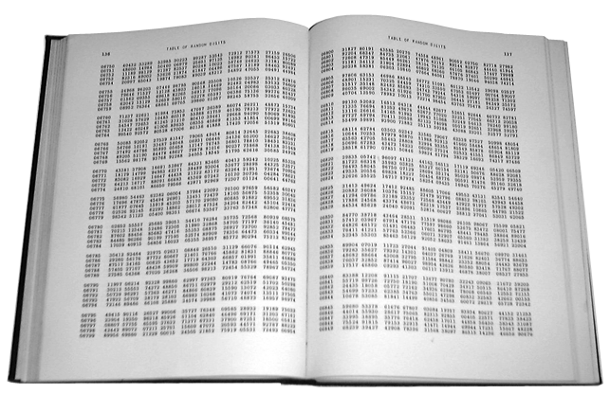
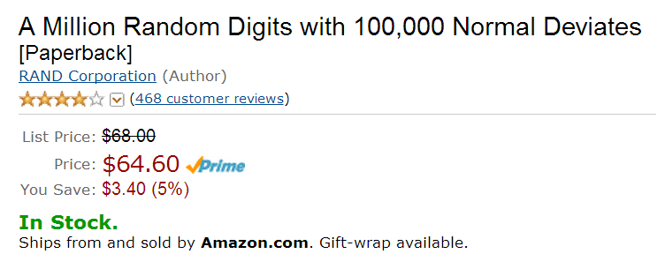
One Way to Get Random Numbers
The RAND table was an important breakthrough in delivering random numbers, because such a large and carefully prepared table had never before been available.
– Wikipedia
Notes:
This is totally legit.
Back in the day it was an important way for scientists obtained random sequences for experiments and such.
Obviously, public sources of randomness such as this and the NIST beacon (http://www.nist.gov/itl/csd/ct/nist_beacon.cfm) are not useful in crypto because the randomness needs to be unpredictable to the adversary
The meat of the book is the "Table of Random Digits." It lists them in five-digit groups -- "10097 32533 76520 13586 ..." -- 50 on a line and 50 lines on a page. The table goes on for 400 pages and, except for a particularly racy section on page 283 which reads "69696," makes for a boring read.

Slide 28
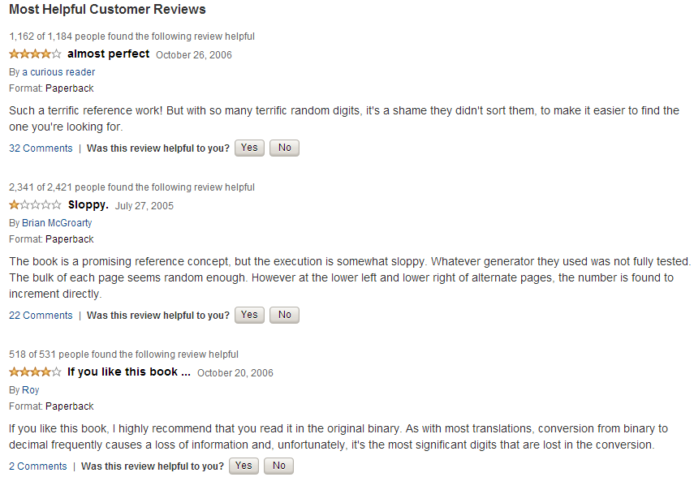

Slide 29
Generating random bits is hard
Cryptographic randomness further needs to be unpredictable
Homework: if Alice uses a true random number generator to index into the RAND table, how many bits of randomness does she get?
Notes:
Answer: only 20 bits of randomness (log of 1 million)

Slide 30
Pseudorandom Generator
Input: a small “seed” that’s truly random
Generates a long sequence of numbers
“as good as random”
Maintains “hidden state”
changes as generator produces output

Slide 31
PRG game: Us vs. Mallory
Mallory wins if she guesses with > 50% probability
Usual caveats: efficient algorithm, negligible advantage OK
Note: Mallory does not have to guess random seed
We pick with 50/50 probability
either truly random stream
or generator g_{k} for random k
Repeat until Mallory says stop:
We announce g(1), g(2), …
Mallory guesses if PRG or truly random
Notes:
As always: this is just a mathematical game, we don’t have to worry about how to get a truly random stream

Slide 32
PRF vs. PRG
Discussion:
Given a PRF, how do you create a PRG?
Notes:
Solution:
A PRF is a function that takes a message as input
A PRG is a sequence
(Both are indexed by a key)
Recall that a sequence is the same as a function on the integers. So just pass consecutive integers to the PRF to make it behave like a PRG

Slide 33
Generating a PRG from PRF
Given PRF f and a seed
Recall: f_{k}(m) = f(k, m)
Call f_{k} with “messages” 0, 1, 2….
Think of PRG as analogous to Java iterator
Initialize count = 0
Generate output f(seed, count)
count = count + 1
Pretty good, but…
Notes:
Initialize is like a constructor, generate is like a next function
This structure is analogous to Java iterator and its .next() call
For now, we only want to generate one stream. We’ll talk about multiple streams later

Slide 34
Forward Secrecy
If Mallory figures out generator’s state at time t
She shouldn’t be able to reconstruct output produced at time t’ < t
Useful for security
Especially generating crypto keys
Prevents this attack: Mallory saves ciphertext, hacks your machine later
Notes:
State could be grabbed from hacking into your machine
Discussion: why is the above PRG not FS?
Because we need to save the seed
How to avoid saving the seed: next slide
Note: in case of compromise, we cannot do anything about an adversary being able to predict future output, except by recovering from compromise and refreshing the seed

Slide 35
Forward-Secure PRG
Given a PRF f and a seed:
Initialize state = seed
Generate output f(state, 0)
state = f(state, 1)
Why does this work?
Iterated application of f
n^{th} output is f(f(f(f…..(seed,1)…), 1), 0)

Slide 36
Randomness/Pseudorandomness as a System Service
Need true randomness to
Initialize seed
Renew if compromised by adversary
True randomness not needed beyond seed
(if PRG is secure)
Randomness can be “stretched”
Notes:
Example: in Linux /dev/random is a source of randomness and /dev/urandom is a source of pseudorandomness

Slide 37
Measuring Physical Randomness
Problem: often biased, non-independent
Good news: bias easily corrected (next slide)
Non-independence is harder (in a few slides)
Notes:
Can you have biased but independent coins, unbiased but dependent coins? (yes and yes)
Non-biased source that is not independent: first flip is random, then each flip is opposite of previous flip

Slide 38
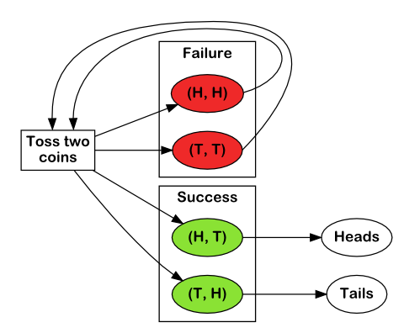
Correcting Bias
Puzzle
Given: coin that comes up heads 60% of the time
Successive tosses are independent
Generate a sequence of uniform random bits
Solution
To generate a bit, toss the coin twice
If HT output 0, if TH output 1
If HH or TT, discard and toss twice again (repeat)
Notes:
This amazingly simple strategy does yield heads and tails with equal probabilities, because coin tosses, though biased, are assumed to be independent. Therefore, if heads come out with probability p, and tails with probability 1−p, then both (head, tails) and (tails, heads) sequences occur with probability p(1−p)
http://pit-claudel.fr/clement/blog/generating-uniformly-random-data-from-skewed-input-biased-coins-loaded-dice-skew-correction-and-the-von-neumann-extractor/

Slide 39
Generating random Unpredictable Bits
Exact history of keypresses
including micro-time
Exact path of mouse
Periodic screenshots
Exact history of network packet arrival
Internal temperature of computer
Ambient noise picked up by mic
Special-purpose hardware
Example: camera pointed at lava lamps
Notes:
Instead of worrying about whether these sources are truly physically random or not, let’s worry about whether or not they are unpredictable to the adversary
Funny example: Lavarand run by SGI

Slide 40
Generating Unpredictable Bits from the Environment
Problem: adversary could predict some sources
Good news: we’re OK as long as there is “enough randomness” in the data
Gather data for “a long time” then run it through a PRF
intuition: “distill out” the randomness, reduce size but keep randomness
After distillation, mix new randomness in with generator’s secret state
we’re OK if either old bits or new bits are unpredictable

Slide 41
Generating Unpredictable Bits from the Environment
Problem: How do you know when you have enough randomness?
Usual solution: collect way too much, just to be sure
Problem: not much entropy on boot
But need to generate keys
Possible solution: save pseudorandom value before shutdown
Notes:
Hard to estimate randomness, need to be a bit conservative

Slide 42
Diversity in Random Sources
We’re OK as long as some of them are unpredictable to the adversary
And those sources have enough entropy
We don’t have to know which ones are unpredictable

Slide 43
(Pseudo)randomness generation:
Easy in theory, surprisingly tricky in practice
Homework: find examples of systems that were broken due to weakness in (pseudo)randomness

Slide 44
So Far
Message Integrity
Randomness /Pseudorandomness
Next…
Confidentiality: Stream Ciphers, Block Ciphers
Key Exchange, Key Management, Public Key Crypto

Slide 45
Example: Linux RDRAND controversy
Intel hardware random number generator (RDRAND instruction)
Closed source driver
Could be compromised by NSA?!

Slide 46
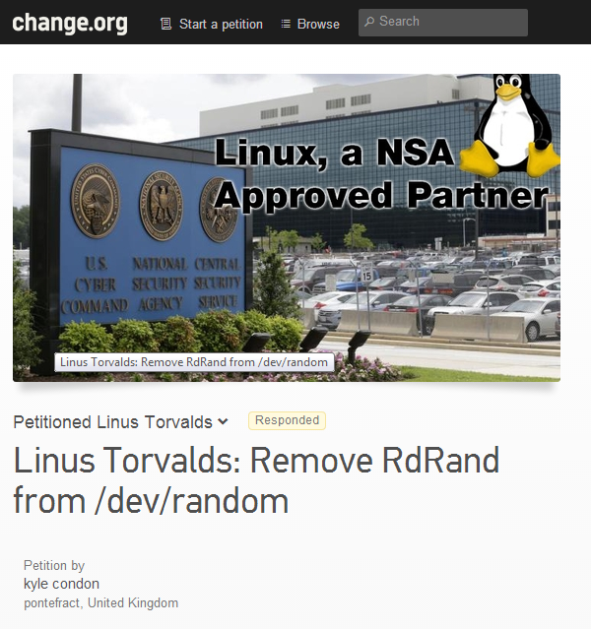
Notes:
More info on /dev/random: https://en.wikipedia.org/wiki//dev/random

Slide 47
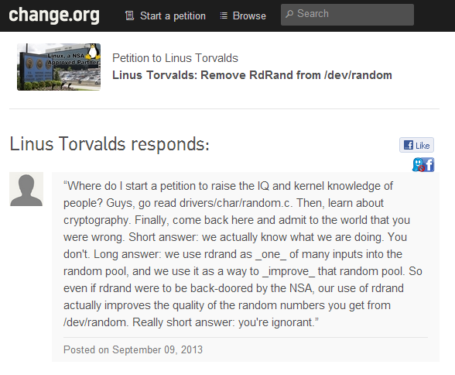
Notes:
#burn

Slide 48
Diversity of random sources is good
Even if RDRAND is totally compromised by NSA:
Adding RDRAND as a source makes it no worse
Improves security for everyone whose adversary is not the NSA

