Slide 1
Intrusion Detection Systems, VPNs, and Anonymous Communication COS 432: Information Security
Nick Feamster

Slide 2
Intrusion Detection Systems

Slide 3
Intrusion Detection
“Burglar alarms for the network.”
Idea: make systems sensitive to threatening actions, and make them capable of alerting authorities when they notice anomalies
Necessarily post-hoc
Broad types
Statistical analyzers (anomaly based)
Rules-based systems, Attack-signature detectors (misuse)
Others

Slide 4
Know Your Attacker
Most attackers run scripts to probe for vulnerabilities, then return later to exploit them
Probes tend to come in waves as new holes are discovered
Probes look very different than typical network use
Actual attack may come long after probe

Slide 5
Types of Intrusion Detection
Signature-Based
define “what is abnormal” using attack signatures
traffic that matches an attack signature as attack traffic
Anomaly-Based
define “what is normal” using profiles
traffic that does not match the profile as abnormal

Slide 6
Simple IDS
v=listen(frequently-exploited-unused-port);
while(1) {
s=accept(v, who, howbig);
notify_the_authorities(s, who, howbig);
close(s);
}
This won’t catch stealth scanners
Doesn’t have a global view
Can’t detect attacks on systems in use
Surprisingly effective at catching scans nonetheless

Slide 7
Statistical Analysis
Constantly capture packets, watch logs, note typical flows
“95% of traffic flows from inside the firewall to outside web services”
Trigger alarms when traffic not matching typical flows is seen
Can be a first alert against configuration problems
Tends to rely on a more global view

Slide 8
Rule-based Systems
Monitor logs and network for behavior violating or matching static rules
Require some knowledge of attack behaviors
Less prone to false alarms
Often combined with anomaly detectors

Slide 9
Using an IDS
Plan your incident response process well before you install the system
Know what you’re looking for
Make the system comprehensive
Don’t overreact to alarms
If using a rules-based system, keep up with vulnerability reports

Slide 10
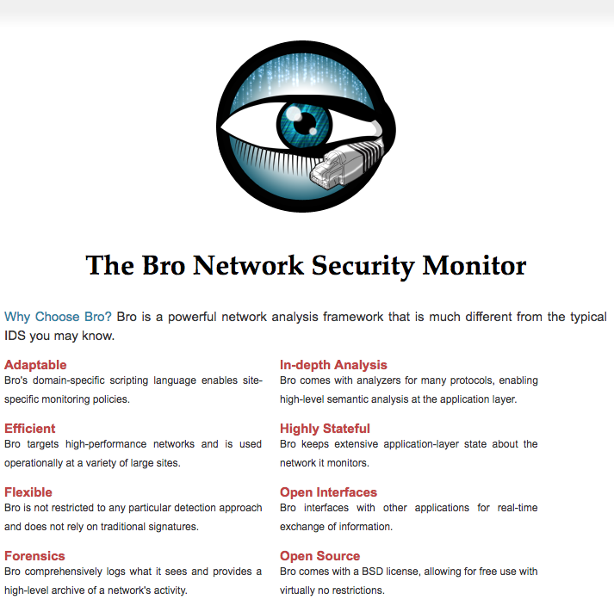

Slide 11
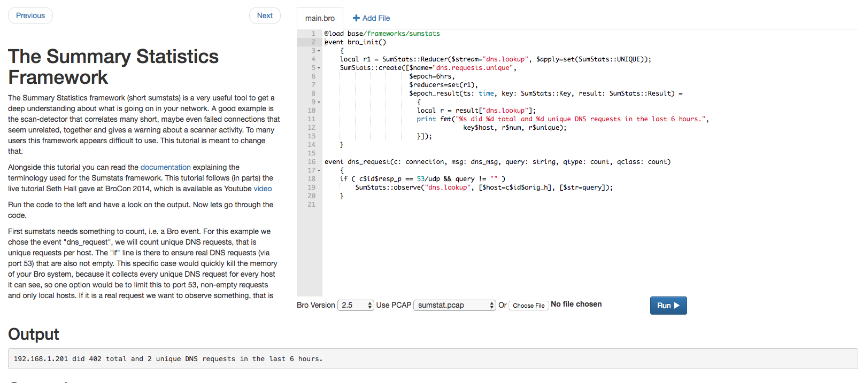
Notes:
http://try.bro.org/

Slide 12
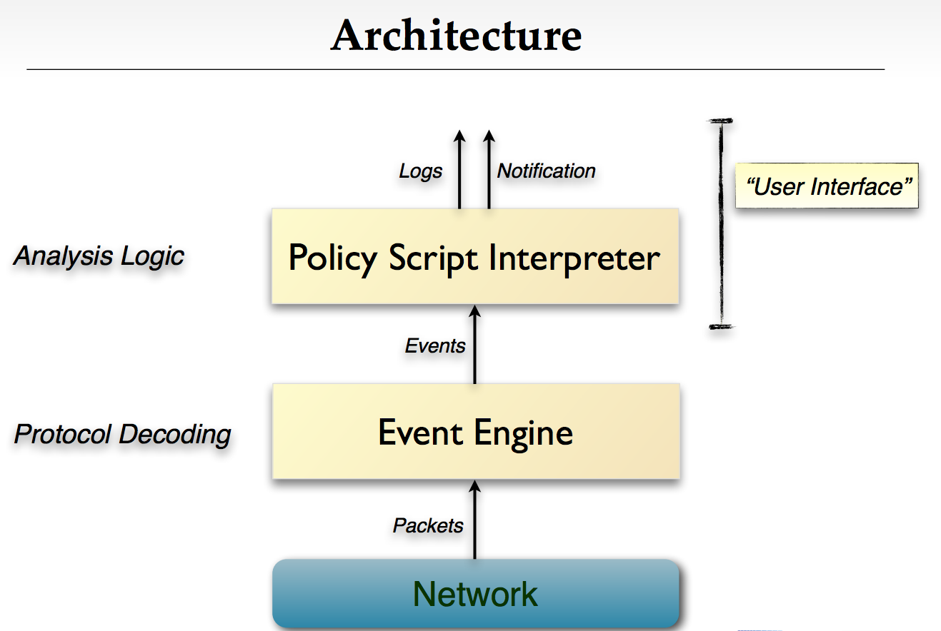

Slide 13
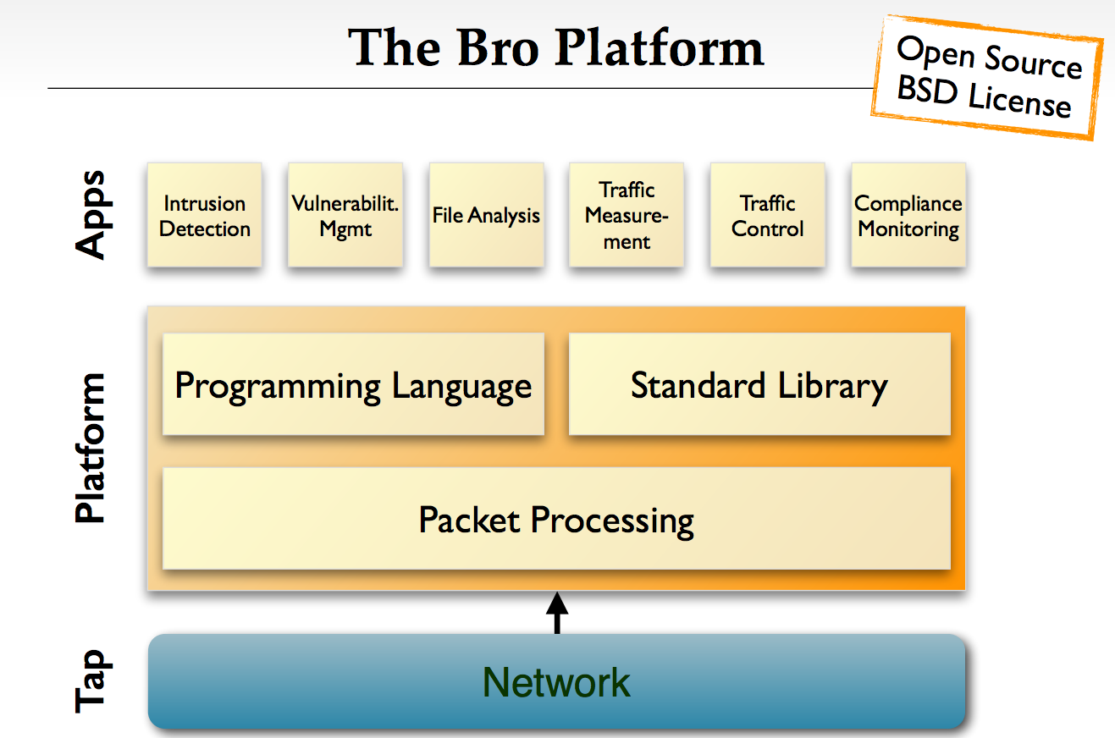

Slide 14
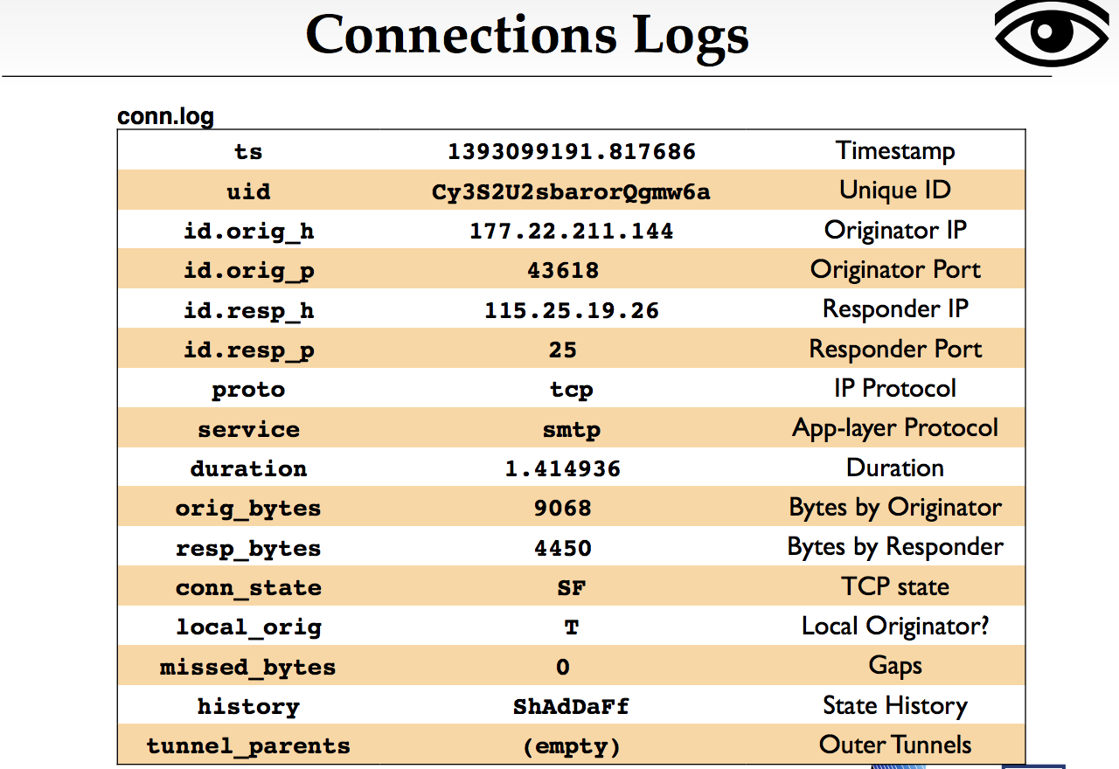

Slide 15
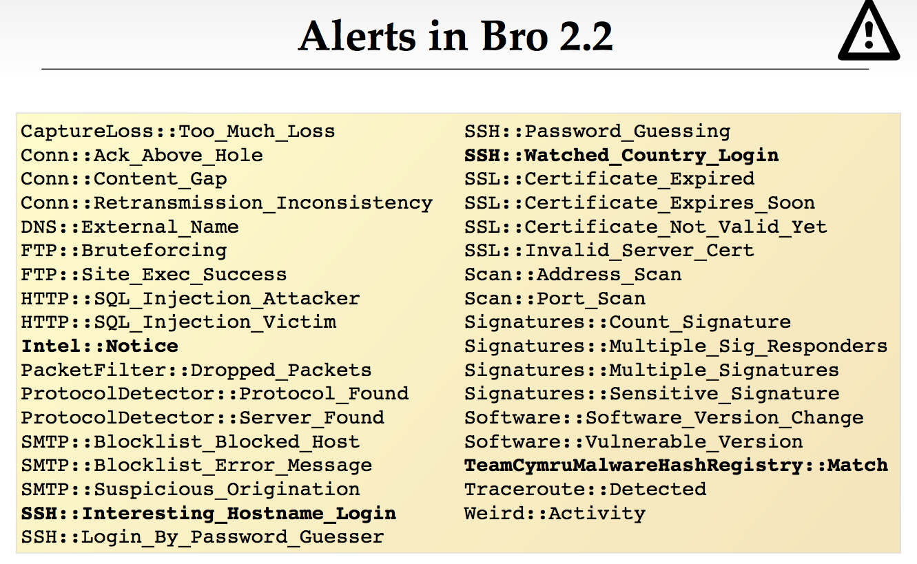

Slide 16
Virtual Private Networks

Slide 17
What is a VPN?
Making a shared network look like a private network.
Why do this?
Private networks have all kinds of advantages
But building a private network is expensive
(cheaper to have shared resources rather than dedicated)

Slide 18
VPN
“Extend the perimeter”
(Typically) uses crypto
There are some exceptions, but we won’t cover them in this class.
Goal: make branch offices behave as if they’re on the same private network w.r.t. security

Slide 19


IPSec VPN – Setup
VPN Server is on the firewall, has dual interface
Internal IP: 192.168.1.1
External IP: 11.22.33.44
User at home on laptop
IP: 55.66.77.88
User starts VPN client
Authenticates to VPN server using username/password or (better) client certificate
Obtains shared session key
Client connected to VPN server’s external interface
VPN server assigns intranet IP to client: 192.168.1.50
VPN server adds mapping 192.168.1.50 ↔ 55.66.77.88 to routing table
“Tunnel” established
192.168.1.1
11.22.33.44

Slide 20



IPSec VPN
192.168.1.50
Routing table
55.66.77.88 ↔ 192.168.1.50
From: A_{pub} To: dst
[Content]
From : A_{pub} To: FW_{pub}
From: A_{priv}
To: dst
[Content]
192.168.1.1
From: A_{priv}
To: dst
[Content]
55.66.77.88
11.22.33.44
NAT or
Intranet
From: src
To: A_{pub}
[Content]
From : FW_{pub} To: A_{pub}
From: src
To: A_{priv}
[Content]
From: src
To: A_{priv}
[Content]
Notes:
Client on laptop generates an IP packet
Could be bound for intranet or external destination
VPN client securely encapsulates it in another IP packet
Outer packet: src = 55.66.77.88; dst = 11.22.33.44
Inner packet: src = 192.168.1.50; dst = whatever
VPN server decrypts outer packet, forwards inner packet
Receives a response addressed to 192.168.1.50
Looks at routing table, realizes this is via VPN
Encapsulates it in an outer packet with src = whatever, dst = 55.66.77.88 and forwards it
VPN client decrypts outer packet, passes on inner packet to application software
Result: client applications think and act as if they are on Intranet

Slide 21
IPSec VPN – Tunnel operation
Client on laptop generates an IP packet
Could be bound for intranet or external destination
VPN client securely encapsulates it in another IP packet
Outer packet: src = 55.66.77.88; dst = 11.22.33.44
Inner packet: src = 192.168.1.50; dst = whatever
VPN server decrypts outer packet, forwards inner packet
Receives a response addressed to 192.168.1.50
Looks at routing table, realizes this is via VPN
Encapsulates it in an outer packet with src = whatever, dst = 55.66.77.88 and forwards it
VPN client decrypts outer packet, passes on inner packet to application software
Result: client applications think and act as if they are on Intranet
Notes:
VPN also used for anonymity.
Client on laptop generates an IP packet
Could be bound for intranet or external destination
VPN client securely encapsulates it in another IP packet
Outer packet: src = 55.66.77.88; dst = 11.22.33.44
Inner packet: src = 192.168.1.50; dst = whatever
VPN server decrypts outer packet, forwards inner packet
Receives a response addressed to 192.168.1.50
Looks at routing table, realizes this is via VPN
Encapsulates it in an outer packet with src = whatever, dst = 55.66.77.88 and forwards it
VPN client decrypts outer packet, passes on inner packet to application software
Result: client applications think and act as if they are on Intranet

Slide 22
VPNs
Tunneling, security, QoS
Can also tunnel through SSH instead of IP
Encryption, tunneling, firewall all possible in different layers!

Slide 23
Benefits of VPNs
IP not really global (private addresses)
VPN makes separated IP sites look like one private IP network
Security
Bandwidth guarantees across ISP
QoS, SLAs
Simplified network operation
ISP can do the routing for you

Slide 24
End-to-end VPNs
Solves problem of how to connect remote hosts to a firewalled network
Site (private network)
Site
Host
Internet
FW/
VPN
IPsec
Tunnels
Remote
Host
Site
Host
Remote
Host

Slide 25
Customer-based Network VPNs
Site
Site
CE
CE
Internet
CE
CE
Site
Site
Customer buys own equipment, configures IPsec tunnels over the global internet, manages addressing and routing. ISP plays no role.

Slide 26
Provider-based Network VPNs
Site
Site
CE
CE
PE
PE
ISP
PE
PE
Site
CE
CE
Site
Provider manages all the complexity of the VPN. Customer simply connects to the provider equipment.

Slide 27
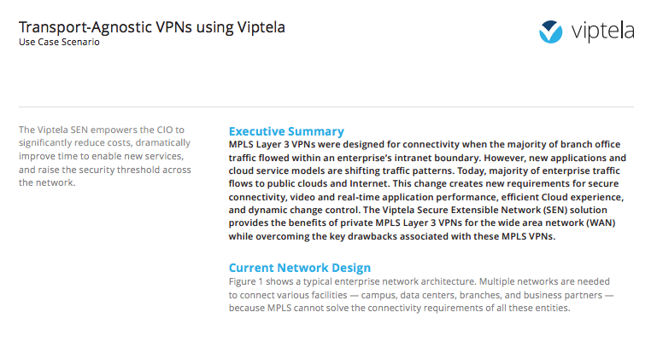

Slide 28
Anonymous Communication: Tor

Slide 29
Anonymous Web Browsing
Why?
Discuss health issues or financial matters anonymously
Bypass Internet censorship in parts of the world
Conceal interaction with gambling sites
Law enforcement
Two goals:
Hide user identity from target web site: (1), (4)
Hide browsing pattern from employer or ISP: (2), (3)
Stronger goal: mutual anonymity (e.g. remailers)

Slide 30
Step 1: Network-layer Privacy
Goals:
Hide user’s IP address from target web site
Hide browsing destinations from network

Slide 31
Anonymizing Proxy
HTTPS:// anonymizer.com ? URL=target
User₁
SSL
Web₁
anonymizer.com
HTTP
User₂
Web₂
User₃
Web₃

Slide 32
Security of Anonymizing Proxies
Monitoring ONE link: eavesdropper gets nothing
Monitoring TWO links:
Eavesdropper can do traffic analysis
More difficult if lots of traffic through proxy
Trust: proxy is a single point of failure
Can be corrupt or subpoenaed
Protocol issues:
Long-lived cookies make connections to site linkable

Slide 33
How a Proxy Works
Proxy rewrites all links in response from web site
Updated links point to anonymizer.com
Ensures all subsequent clicks are anonymized
Proxy rewrites/removes cookies and some HTTP headers
Proxy IP address:
if a single address, could be blocked by site or ISP
anonymizer.com consists of >20,000 addresses
Globally distributed, registered to multiple domains
Note: chinese firewall blocks ALL anonymizer.com addresses
Other issues: attacks through proxy

Slide 34
Step 2: MIX Nets
Goal: no single point of failure

Slide 35
MIX nets [C’81]
R₃
R₅
R₁
msg
R₆
srvr
R₂
R₄
Every router has public/private key pair
Sender knows all public keys
To send packet:
Pick random route: R₂ → R₃ → R₆ → srvr
Prepare onion packet:
E_{pk2}( R₃,
E_{pk3}( R₆,
packet =
E_{pk6}( srvr , msg)

Slide 36
Eavesdropper’s View at a Single MIX
R_{i}
user₁
batch
user₂
user₃
Eavesdropper observes incoming and outgoing traffic
Crypto prevents linking input/output pairs
Assuming enough packets in incoming batch
If variable length packets then must pad all to max len
Note: router is stateless
Notes:
Mix R_{i} outputs packets in lexicographic order

Slide 37
Performance
Main benefit:
Privacy as long as at least one honest router on path
Problems:
High latency (lots of public key ops)
Inappropriate for interactive sessions
May be OK for email (e.g. Babel system)
No forward security
Homework puzzle: how does server respond?
hint: user includes “response onion” in forward packet
R₂
R₃
R₆
srvr

Slide 38
3rd Attempt: Tor MIX circuit-based method
Goals: privacy as long as one honest router on path, and reasonable performance

Slide 39
The Tor Design
Trusted directory contains list of Tor routers
User’s machine creates a circuit
Used for many TCP streams
stream₁
R₃
R₁
R₅
stream₁
srvr₁
stream₂
R₄
R₂
R₆
stream₂
srvr₂

Slide 40
Creating Circuits
TLS encrypted
TLS encrypted
R₁
R₂
Create C₁
D-H key exchange
K₁
K₁
Relay C₁ Extend R₂
Extend R₂
D-H key exchange
K₂
K₂

Slide 41
Once circuit is created
K_{1,} K₂, K₃, K₄
K₁
R₁
R₂
K₂
K₃
R₃
K₄
R₄
User has shared key with each router in circuit
Routers only know ID of successor and predecessor

Slide 42
Sending Data
K₂
K₁
R₁
R₂
Relay C₁ Begin site:80
Relay C₂ Begin site:80
TCP handshake
Relay C₁ data HTTP GET
Relay C₂ data HTTP GET
HTTP GET
Relay C₁ data resp
Relay C₂ data resp
resp

Slide 43
Properties
Performance:
Fast connection time: circuit is pre-established
Traffic encrypted with AES: no pub-key on traffic
Tor crypto:
provides end-to-end integrity for traffic
Forward secrecy via TLS
Downside:
Routers must maintain state per circuit
Each router can link multiple streams via CircuitID

Slide 44
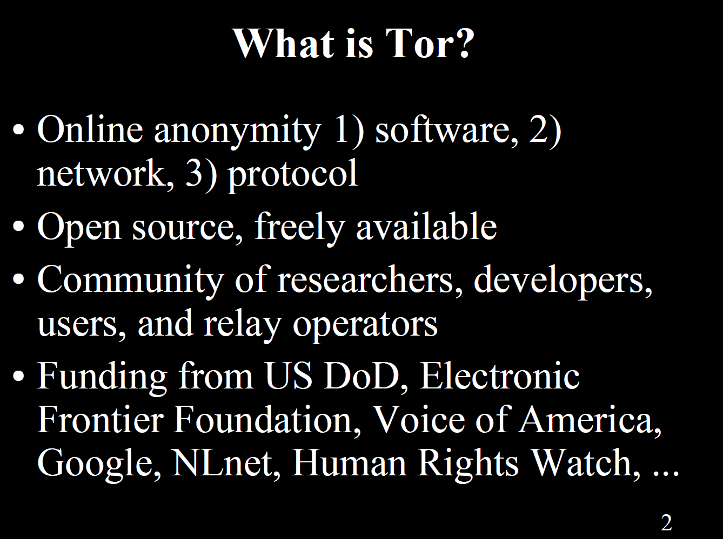

Slide 45
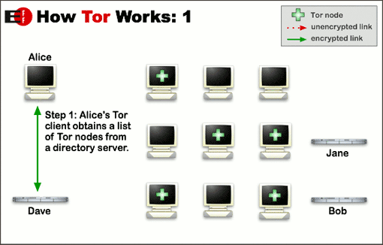
How Tor Works
(directory server)

Slide 46
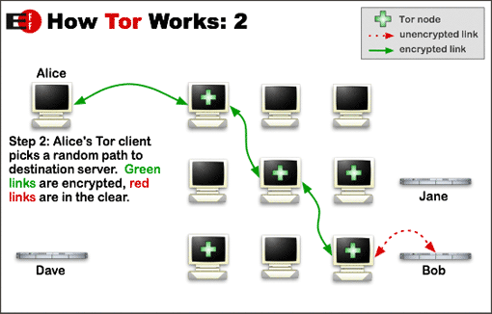
How Tor Works

Slide 47
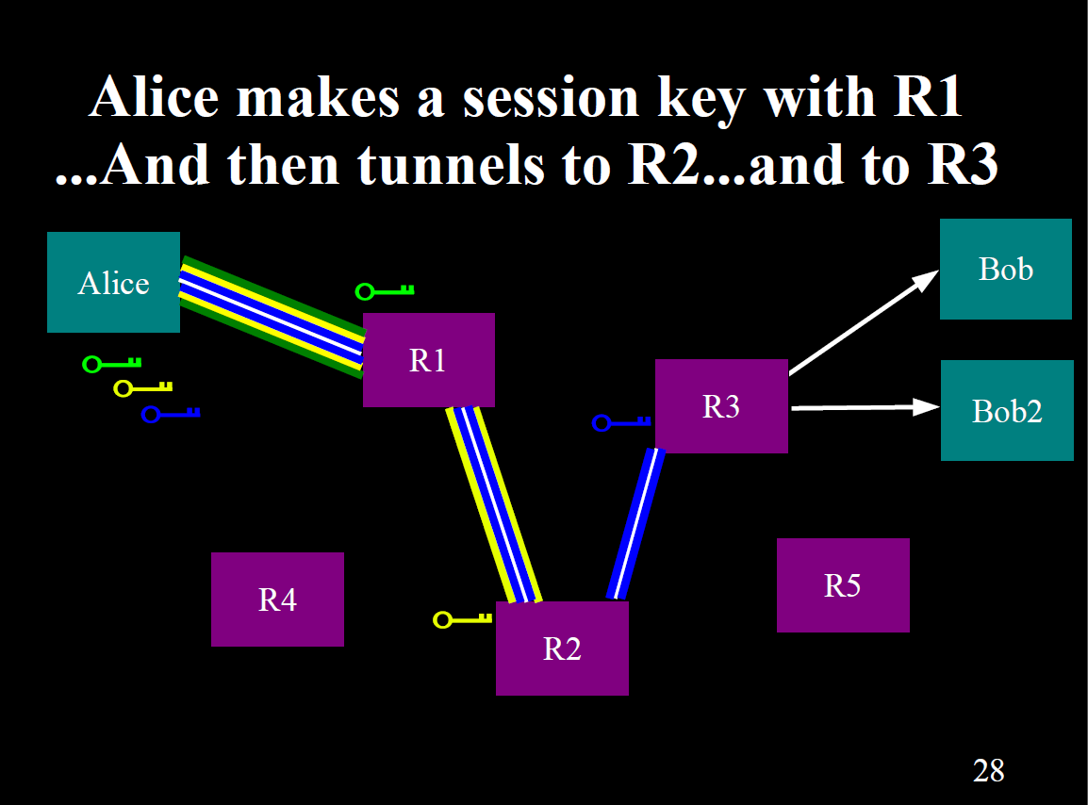

Slide 48
Encryption Keys in Tor
Each relay has a long-term ``identity’’ public/private key pair used to sign TLS certificates (public keys signed by directory)
Medium-term (one week) public/private ``onion’’ keys are used to decrypt requests to extend circuits – so first node can’t spoof the whole path. These keys are deleted so that if relay is compromised, old traffic can’t be decrypted.
Short-term “connection” or “ephemeral” shared private keys are used to encrypt connections.

Slide 49
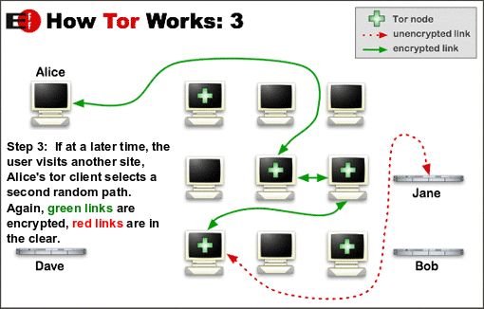
How Tor Works

Slide 50
Bridge Relays (a.k.a. Bridges)
Some ISPs/governments block all traffic to relays that appear in the Tor directory.
Bridges are relays that don’t appear in the directory.
User has to solve the problem of finding a bridge.

Slide 51
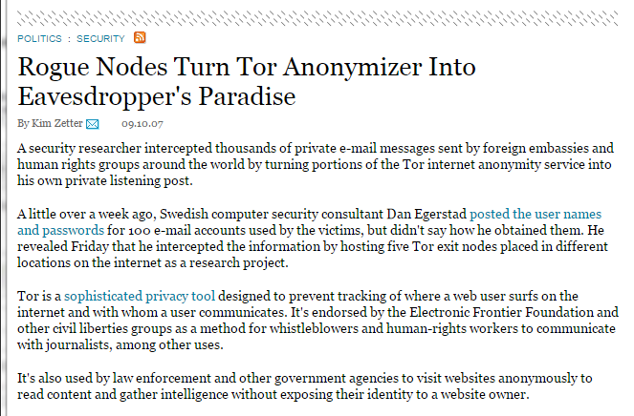
Tor Exit Nodes See Plaintext!
http://archive.wired.com/politics/security/news/2007/09/embassy_hacks?currentPage=all

Slide 52
Material Beyond Here Was Not Covered in Lecture.

Slide 53
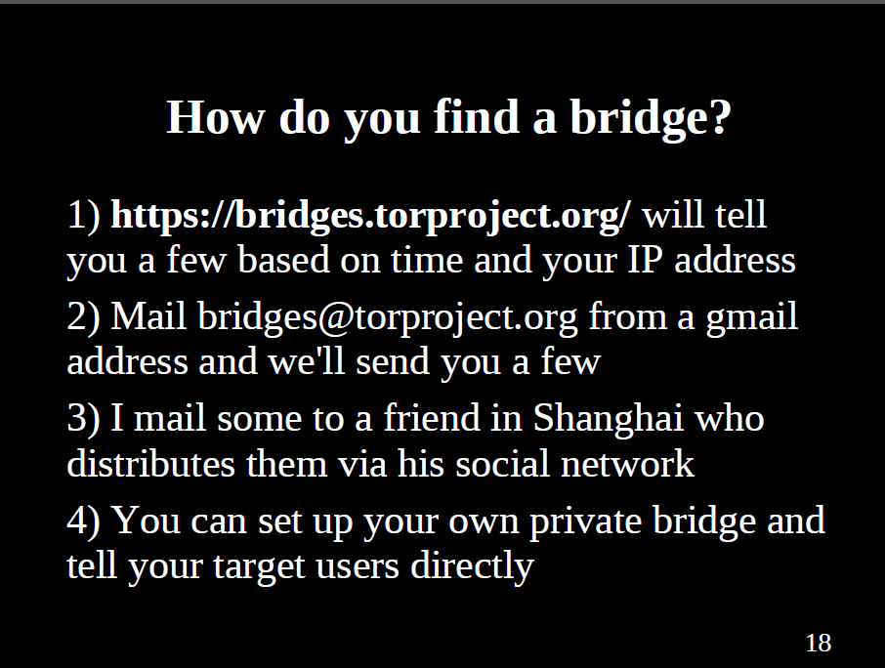

Slide 54
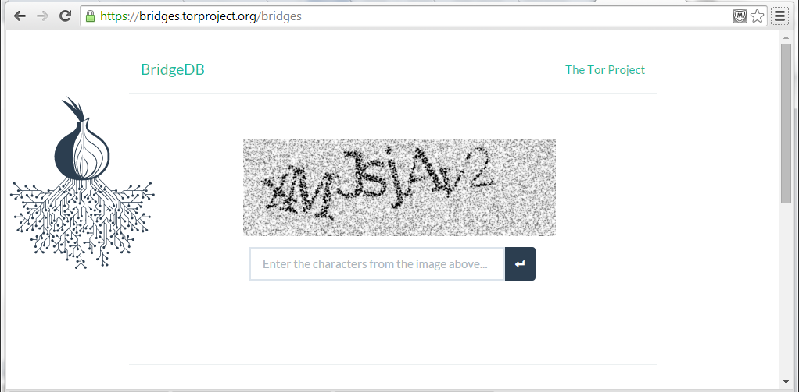
Solve a Captcha to Get Bridge Address

Slide 55
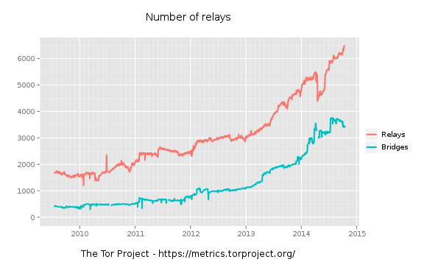
Growth of Tor Network

Slide 56
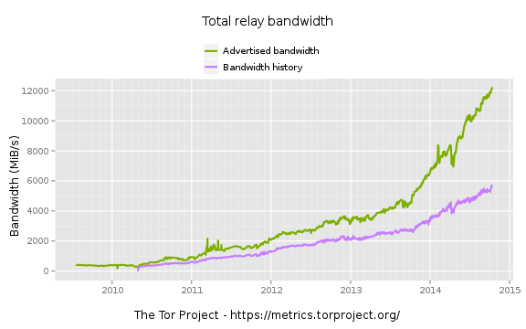
Growth of Tor Network

Slide 57
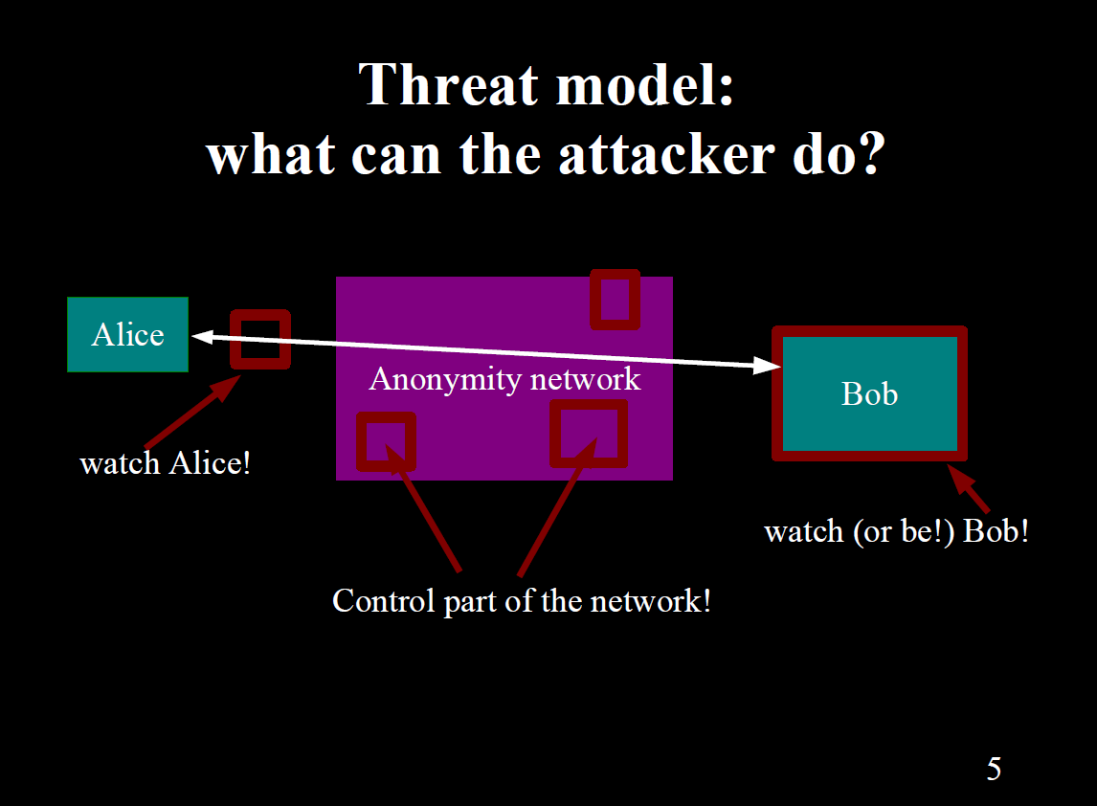

Slide 58
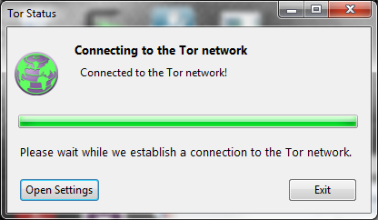
Tor Browser

Slide 59
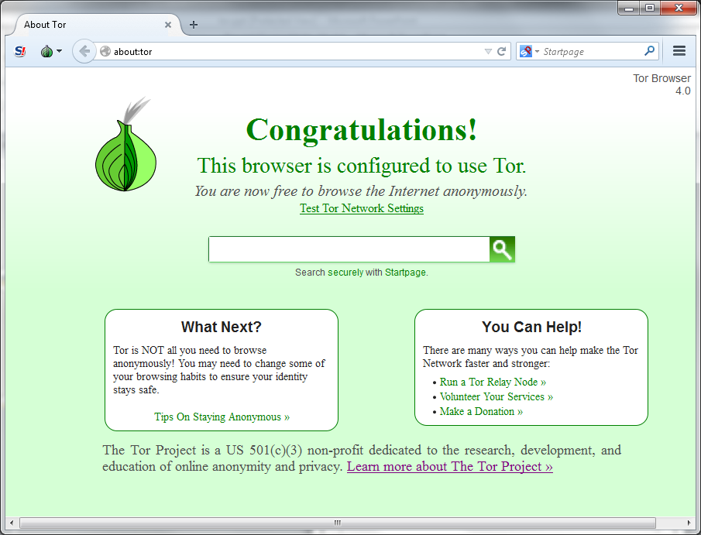
Tor Browser

Slide 60
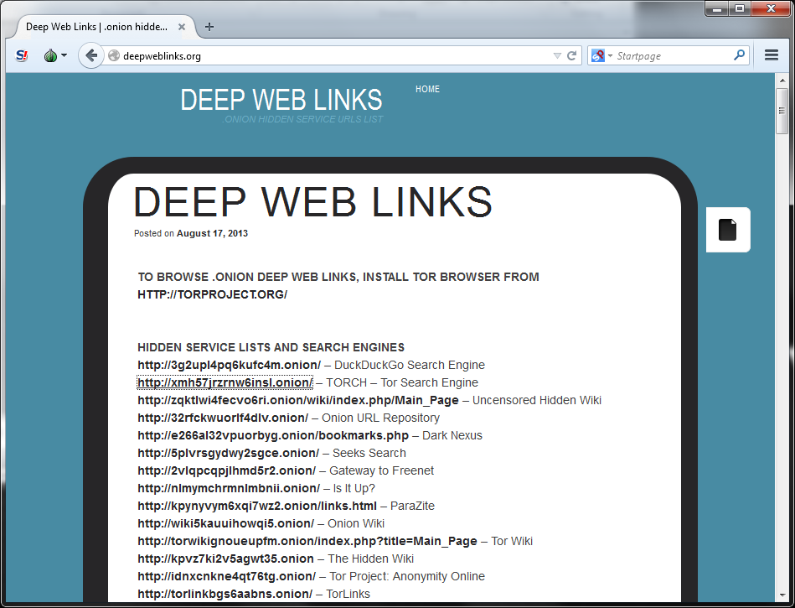
Tor-Aware Web Servers
Connect directly to Tor, do not advertise their network addresses.

Slide 61
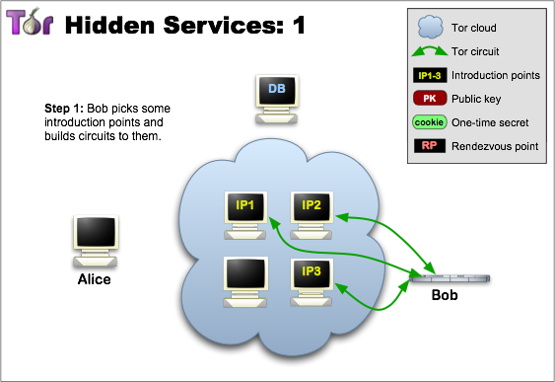
Establishing a Hidden Service

Slide 62
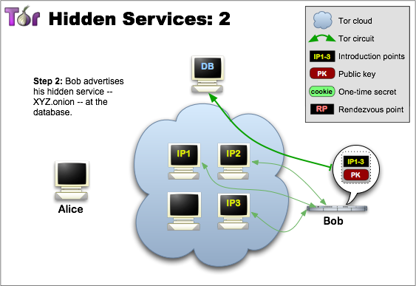
Establishing a Hidden Service

Slide 63
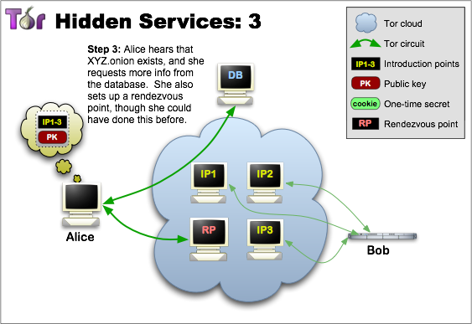
Finding a Hidden Service

Slide 64
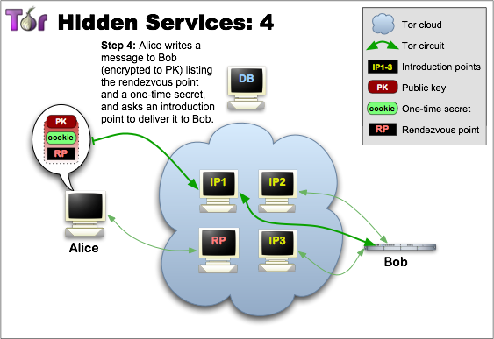
Contacting a Hidden Service

Slide 65
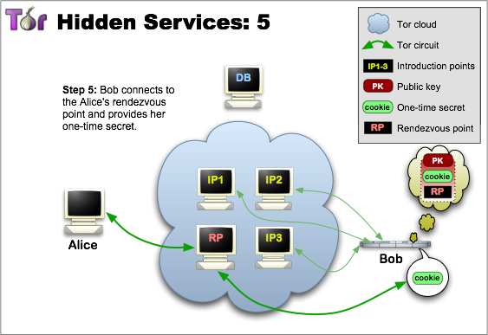
Contacting a Hidden Service

Slide 66
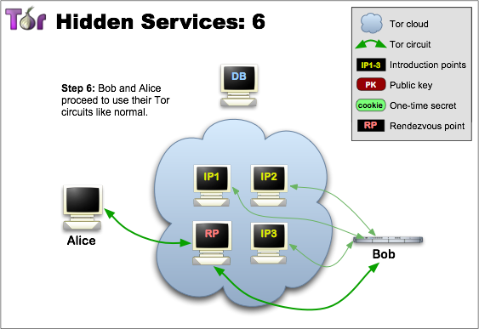
Communicating with a Hidden Service

Slide 67
Anonymity Attacks: Timing
R₁
R₂
R₃
Goal: R₁ and R₃ want to test if user is communicating with server
Basic idea:
R₁ and R₃ share sequence: Δ₁, Δ₂, … , Δ_{n} ∈ {-10,…,10}
R₁: introduce inter-packet delay to packets leaving R₁ and bound for R₂ . Packet i delayed by Δ_{i} (ms)
Detect signal at R₃

Slide 68
Anonymity Attacks: Congestion
R₁
R₂
R₃
R₈
Main idea: R₈ can send Tor traffic to R₁ and measure load on R₁
Exploit: malicious server wants to identify user
Server sends burst of packets to user every 10 seconds
R₈ identifies when bursts are received at R₁
Follow packets from R₁ to discover user’s ID

Slide 69
Network-Layer Security

Slide 70
IPSec: Network layer security
 | TLS | IPsec
What’s authenticated | Hostnames | IP addresses
What’s encrypted | Sessions over TCP | IP packets
How keys are distributed/verified | Certificate authorities | Delegate to DNSSEC or manual sharing
Deployment status | Widely deployed, works decently | N/A…
Notes:
Homework: think about how/why/when one would delegate to DNS when doing IPSec.
Example of why IPSec is a clusterf*ck:
From http://tools.ietf.org/html/draft-ietf-ipsec-isakmp-04
Certificates require an infrastructure for generation, verification, management and distribution. The Internet Policy Registration Authority (IPRA) [RFC-1422] has been established to direct this infrastructure for the IETF. The IPRA certifies Policy Certification Authorities (PCA). PCAs control Certificate Authorities (CA) which certify users and subordinate entities. Current certificate related work includes the Domain Name System (DNS) Security Extensions [DNSSEC] which will provide signed entity keys in the DNS. The Public Key Infrastucture (PKIX) working group is specifying an Internet profile for X.509 certificates. There is also work going on in industry to develop X.500 Directory Services which would provide X.509 certificates to users. The U.S. Post Office is developing a (CA) hierarchy. The NIST Public Key Infrastructure Working Group has also been doing work in this area. The DOD Multi Level Information System Security Initiative (MISSI) program has begun deploying a certificate infrastructure for the U.S. Government. Alternatively, if no infrastructure exists, the PGP Web of Trust certificates can be used to provide user authentication and privacy in a community of users who know and trust each other.
Too many options, but none of them works well

Slide 71
IPsec: Network Layer Security
Network-layer secrecy:
sending host encrypts the data in IP datagram
TCP and UDP segments; ICMP and SNMP messages.
Network-layer authentication
destination host can authenticate source IP address
Two principle protocols:
authentication header (AH) protocol
encapsulation security payload (ESP) protocol
For both AH and ESP, source, destination handshake:
create network-layer logical channel called a security association (SA)
Each SA unidirectional.
Uniquely determined by:
security protocol (AH or ESP)
source IP address
32-bit connection ID

Slide 72
Authentication Header (AH) Protocol
provides source authentication, data integrity, no confidentiality
AH header inserted between IP header, data field.
protocol field: 51
intermediate routers process datagrams as usual
AH header includes:
connection identifier
authentication data: source- signed message digest calculated over original IP datagram.
next header field: specifies type of data (e.g., TCP, UDP, ICMP)
IP header
AH header
data (e.g., TCP, UDP segment)

Slide 73
Encapsulating Security Payload (ESP) Protocol
provides secrecy, host authentication, data integrity.
data, ESP trailer encrypted.
next header field is in ESP trailer.
ESP authentication field is similar to AH authentication field.
Protocol = 50.
authenticated
encrypted
IP header
ESP
header
ESP
trailer
ESP
authent.
TCP/UDP segment

Slide 74
IPsec vs. TLS
IPsec idea: don’t change applications or API to applications, just OS
TLS idea: don’t change OS, only change application (if they run over TCP)

Slide 75
IPsec vs. TLS
IPsec has technical advantages
Rogue packets in TLS: TCP doesn’t participate in crypto, so attacker can inject bogus packet, no way for TCP to recover
easier to do outboard hardware processing (since each packet independently encrypted)
TLS easier to deploy

Slide 76
Problems with IPSec
IP is stateless, but keeping state is required for encryption
Routers need to modify IP packets
e.g. Fragmentation, NAT
Many security problems can only be solved in application-specific way

Slide 77
Why IPSec?
Automatically tunnel all traffic independent of application
Some applications may not even support encryption
Well-suited for:
VPN
Datacenter-to-datacenter security

