Slide 1
Access Control and Protection COS 432: Information Security
Nick Feamster
Notes:
Assignment 2: Wednesday
Midterm: October 24 (will cover material through this week)
Wednesday’s lecture: Recorded. Extra office hour TBD (Friday afternoon)

Slide 2
OS Security Goals
Protect users from each other
Protect apps from each other
Protect the system from network
Allow sharing across these boundaries

Slide 3

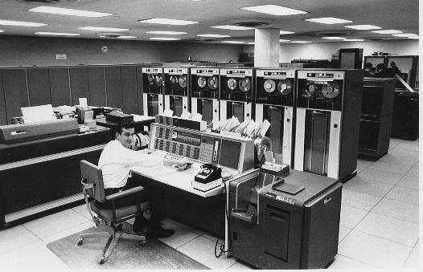
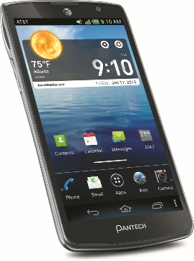
Evolution of OS Threat Model
DOS is truly single user.
MacOS, Linux, Windows are multiuser, but typically used by only one user
 | Single user | Multi-user
Trusted apps
Untrusted apps
??
Notes:
In the early days (top right), machines were expensive, so they were shared by many users. Apps are trusted since users were actually creating programs themselves and were responsible for them.
In a typical PC OS, apps are trusted. The rationale for this security model is that the user is responsible for the programs she runs on her computer. PC OSes are spiritual descendants of traditional multi-user OSes.
Smartphone vendors knew that the PC security model would simply kill the platform. So they rethought security from the ground up, and designed the platform to support untrusted apps.
Do you have any examples of the last category?

Slide 4
What’s Old is New Again
Modern multi-user systems:
Cloud computing
Facebook, Google docs (not OSes)
What about web browser?
Single user, untrusted apps (web pages)
Notes:
A lot of the techniques for multi-user systems have now been repurposed for multi-app systems.
One often hears the claim that browsers are the new OS. There is some merit to this, and JavaScript is a full fledged programming environment.

Slide 5
Types of Intruder
Casual prying
Snooping by insiders
Attempts to make money
Espionage (Commercial, military)
Notes:
From Tannenbaum OS book (Sec 4.4.1)
Note: passive and active intruders
Security vs. Privacy

Slide 6
Protection and Access Control

Slide 7
How Does Protection Occur?
OS controls what users/processes can do
OS control is triggered through interrupts, system calls
CPU supports privilege levels to ensure only OS can execute privileged instructions

Slide 8
An OS Protects Resources
User
Resource
OS
User
Resource
Processes
User
Resource
Notes:
Resources: memory, filesystem, peripherals,
OS here mainly refers to kernel

Slide 9
Classic Examples in UNIX
Core Dump Overwrite
Linking /etc/passwd to a file called “core”
Causing a SETUID program to dump core, subsequently overwriting the passwd file.
Directory Creation Race Condition
Mkdir would create inode as root, then change UID of inode
Race: link to passwd after inode creation but before chown
Notes:
Serious problem: Timesharing system

Slide 10
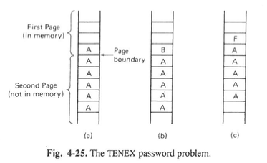
More
Timing attacks (TENEX)
File access required password check
Align password guess across page boundary
OS would abort on incorrect character
Time of check to time of use (OS/360)
Password check
Re-read filename after password check

Slide 11
Various Attacks on Access Control
Requests of memory, disk, etc.
Illegal system calls, or legal system calls with illegal parameters
Modification of OS data structures in user space)
Trapdoor attacks
…

Slide 12
Protection Design Principles
Public design
Default is “no access”
Check for current authority
Least privileges
Build security into the lowest system layers possible

Slide 13
System Layers
Web page
Browser
JVM
OS
VM
Hardware
Notes:
Hardware includes firmware.
Not all systems have all layers. For example most browsers are probably not running on top of a Java Virtual Machine.

Slide 14
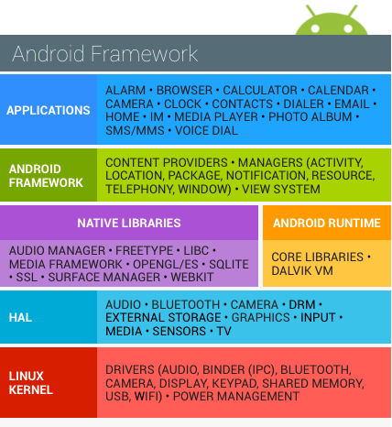
System Layers
Web page
Browser
JVM
OS
VM
Hardware
Notes:
The OS layer in fact contains many layers within itself.

Slide 15
Two Types of Access Control
Access Control Lists
Capabilities

Slide 16
Access Control Lists
Capabilities
Examples
Door fingerprint reader
Passport control
Identity/authentication needed
Delegation not possible
Lower user/client security risk
Easy to revoke access / change rights
Examples
Regular key
Concert ticket
Identity not needed (more privacy)
Just copy the capability/token
Capabilities can “get away from you”
Difficult to revoke access or change rights
Notes:
Two different ways of doing access control.

Slide 17
Access Control List or Capability?
BufferedReader reader =
new BufferedReader(new FileReader(filename));
String line = reader.readLine();
Both!
Opening a file gives the process a “file descriptor”
Can be passed around to other processes
Preserves permissions even if file permissions change
Notes:
Opening a file involves checking an Access Control List to see if the user has permission to open the file.
Reading from the file involves checking a capability.

Slide 18
Typical Security Sequence
Authorization
Accountability
Identification & authentication
Access control
Logging & auditing
Preventive
Reactive
Notes:
Did we see a method to authenticate users? Passwords
Did we see a method to authenticate apps? Code signing
Accountability is typically in addition to authorization, but can sometimes be instead of authorization
Physical security examples: keys (access control), security camera or sign-in sheet (accountability)
Also useful as defense-in-depth security because access control often breached. e.g., Intrusion detection

Slide 19
Access Control using ACLs
Subject = (user, program)
Verb = action
Object = resources
Policy specifies (subject, verb, object) triples
(User, program)
Monitor
Resource
Action
Policy
Notes:
A subject is a specific program acting on behalf of a specific user.
Monitor is typically the OS.
Policy specifies (subject, verb, object) triples. Answers the question can User U running Program P perform Action A on Resource R?

Slide 20
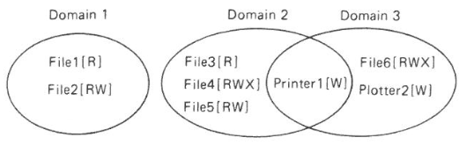
Objects and Protection Domains
Objects: CPUs, memory segments, storage, printers, processes, files, databases, locks
Protection Domain: Set of (object, rights) pairs
Notes:
At every instance of time, each process runs in some protection domain. Processes can switch between domains during execution; the rules for domain switching depend a lot on the system.
“Rights” == “Verb” in our notes here.

Slide 21
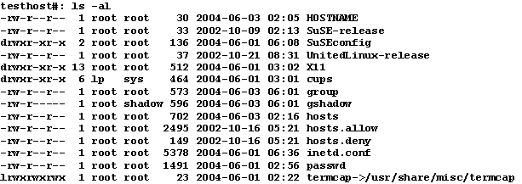
Example: Unix Access Control List
Notes:
This was considered a simplified model compared to other OSes of the day.
Nevertheless, it hasn’t proved very user friendly.
Given any (uid, gid) combination, it is possible to make a complete list of all objects that can be accessed, and whether they can be accessed for read, write, or execute.
Each process has a user part and a kernel part.

Slide 22
Unix: Simplified Access Control Model
Subject: User-space Process
PC OSes are multi-user even if in practice only 1 human user
Some programs run as their own user (e.g., webserver)
Root/administrator/superuser: protects system files
Verb: read/write/execute
Object: files, memory File includes sockets, special OS functions, …
Hack!
Notes:
Simplified access control compared to Multics before it, not compared to (say) Windows.
For the most part all processes initiated by a user have the same permissions. The subject is the user, not (user, program). There are some hacks to get around this limitation, such as treating a web server as its own user. This means that if the server gets hacked, attacker doesn’t have full privileges on the system.
This is an example of repurposing a multi-user security feature for an untrusted-app world.

Slide 23
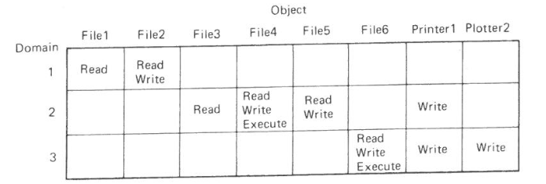
Protection Matrix

Slide 24
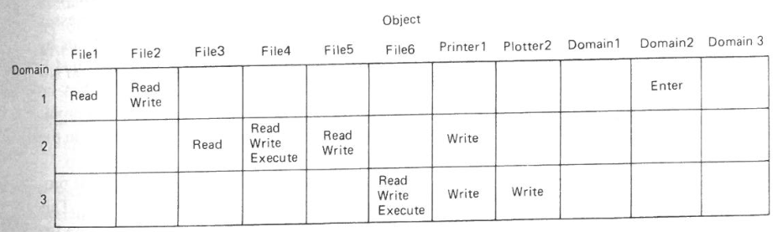
Protection Matrix with Domain Switching

Slide 25
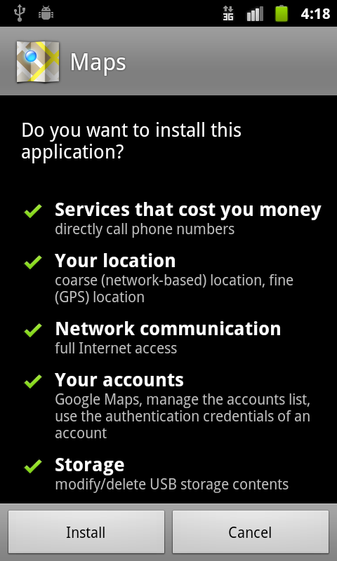
Android Access Control
Notes:
This was the original version of Android’s ACL.
* there are hundreds of possible sub-permissions
* users don’t understand them, at least not well enough to make informed decisions.
* in fact developers don’t understand them either, and this leads to frustration.
Now it has been greatly simplified. Apps can request groups of permissions (all or nothing for each group). Of course, this comes with its own problems.

Slide 26
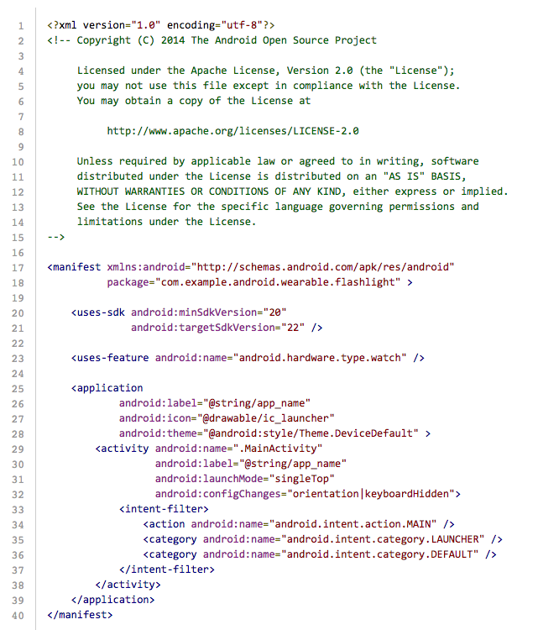
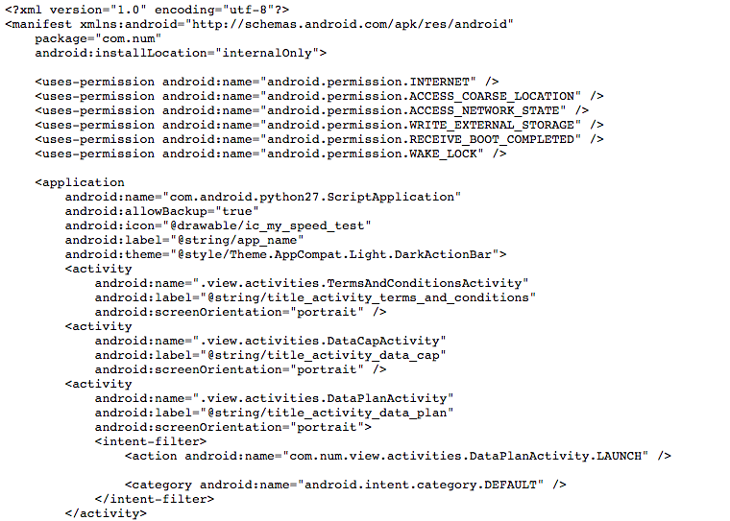
Android Manifest File
Notes:
This is how the app specifies the ACL to the system.

Slide 27
Android Subject/Verb/Object
Subjects: app Android runs on top of Linux kernel Each app gets its own user ID
Objects: Regular files, other apps, camera, telephony, personal data, …
Verbs: Each object/resource defines its own set of verbs

Slide 28
Smartphone Model vs. PC Model
Advantages of smartphone model
OK to run untrusted app from web
Disadvantages of smartphone model
Harder to share between apps
Harder to tinker with system

Slide 29
Understanding Subject, Verb, Object
Subject = (user, program) pair
Verb = action
Object = resources
Consider Facebook.
Identify as many subjects, verbs and objects as you can.

Slide 30
Access Control Policy
Who sets policy?
(Theoretically) users, with system defaults and restrictions
How is access control list stored?
Sparse matrix (default deny), store as list
How does OS enforce policy?
OS exposes API to apps, with privileged operations
Checks ACL when API functions are called
Notes:
The matrix of all possible (subject, verb, object) triples may be too big to store, but you can store only the list of allowed triples.
For example, on Google docs there may be millions of users and millions of documents, so Google can’t store it as a matrix, but each user has access to only a few tens to hundreds of documents, so they can store it as a list.

Slide 31
Usability Problems in Access Control
Too much complexity
Too many decisions
#principals x #actions x #objects
Notes:
Think about apps on your phone. You don’t want to mentally keep track of which data each app has access to.

Slide 32
Abstraction: Classification Levels
Cosmic
Top Secret
Secret
Restricted
Unclassified
Each subject (person) has a clearance level
Each object (document) has a classification level
No read up
No write down
Notes:
This is one way to simplify access control, in the military context.
You can’t read above your clearance level, or write below it. You can transfer information from a higher to a lower-level document in special cases, for example, declassification.

Slide 33
Sometimes There’s No Strict Order: Lattice-based Access Control
Top secret (nuclear, bio)
Top secret (nuclear)
Top secret (bio)
Secret (nuclear, bio)
Secret (nuclear)
Secret
(bio)
Public
Notes:
In this example there are two types of secrets, nuclear and biological, and each has a couple of security levels. Of course, being cleared for Secret nuclear documents doesn’t automatically give you any clearance for biological documents. So we need a “lattice” to represent clearance and classification levels.
More info: Denning’s Lattice-based Security

Slide 34
Other Abstractions: Roles, Groups
Useful in (e.g.) corporate context with various projects, collaborations, privileges

Slide 35
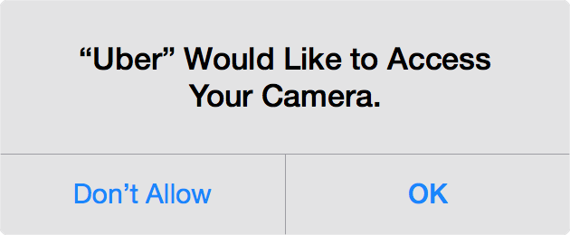
Simplifying Access Control: Emphasize Action over Configuration
Combine with sensible system defaults
Notes:
This is the iOS model.
Why would Uber want to access your camera? It needs it if you want it to automatically scan your credit card instead of typing in the number.
This iOS-style prompt has several advantages over the Android model. If you stuck the camera permission in the app-installation screen, most users would pay no attention; those that did would be confused and annoyed because it’s not obvious why Uber should need your camera. Besides, the prompt allows you to give access only when it’s actually needed, rather than all the time.
We can go farther and combine the user’s request for an action with the granting of the corresponding permission in a single button. This has been proposed but not yet implemented in mainstream OSes http://research.microsoft.com/pubs/152495/user-driven-access-control-nov2011.pdf

Slide 36
Capabilities: Alternative to ACLs
Combines resource locator and permission
Very common on the web
Notes:
Capabilities are most closely analogous to physical keys
In the unix example the subjects are processes but in the Google docs example the subjects are users. Very different situations, same principle
In a true capability system even the verb (anyone with a link can view/edit) would be specified as part of the capability URL.
Youtube has unlisted videos. Same concept.
Security comes from people agreeing to not share the link only with those whom they think should have access
A priori, you don’t know who will have access
However, you trust that people will exercise judgment in sharing the link

Slide 37
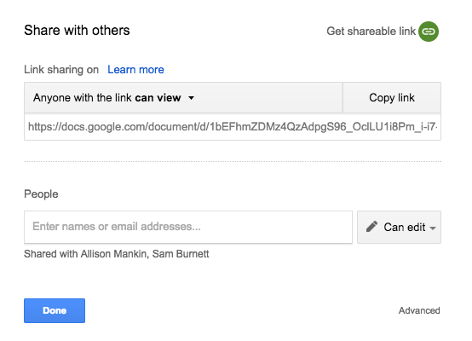
Google Docs Access Control
Notes:
Google docs supports both capabilities (top) and Access Control Lists (bottom).
These aren’t true capabilities because the permission isn’t encoded into the URL. In other words, with true capabilities, the feature that allows you to change the permissions of link holders (as you can see in the screenshot) wouldn’t be possible. The link itself would encode the set of permissions that it grants, and there would be different links for different sets of permissions. If you received a link that promised edit access to a particular doc, you could be confident that that access can’t be revoked.

Slide 38
Example of Capability URL
Notes:
It needs to be long so that it’s unforgeable.
What crypto primitive would you use to generate unforgeable URLs?

Slide 39
Q. If you download and run Spotify on your laptop/smartphone, can it delete your photos?
Typical PC operating systems have no separation between apps.
Typical smartphone opeårating systems do.
Notes:
We need to understand the history to see why this is the case and where things are going.

Slide 40
Understanding Subject, Verb, Object
Thought Question: Consider PC OS and smartphone OS.
In each case, identify as many subjects, verbs and objects as you can.
Notes:
In PC: subject = user (not subject-user pair since they don’t distinguish between apps)

Slide 41

Anti-DRM campaign: “Defective by Design”
“Instead of buying a DRM or proprietary game, why not donate to a free software project instead?”
“Most DVDs and apparently all Blu-Ray discs have
DRM .. why not take a friend to the movies instead?”
Notes:
defectivebydesign.org
My view: DRM by itself is not the problem. But having to lock down devices inflicts collateral damage. E.g., users can’t easily customize devices or run different software.

Slide 42
S/V/O in Facebook
Subject: user (plain Facebook) User + app (FB app ecosystem)
Object: statuses, photos, comments, events, groups, other users, apps…
Verbs:
view/edit/delete
like, comment
message (another user)
join (a group)
tag (someone in a photo)

Slide 43
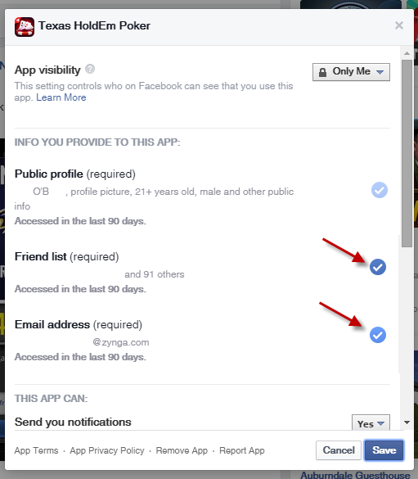
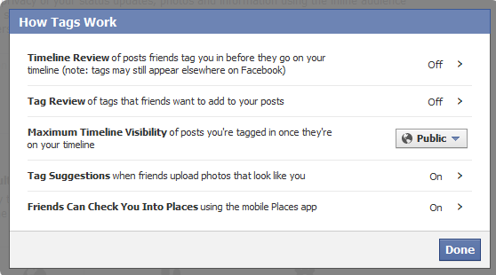
Facebook: Variety of Access Controls
Notes:
Facebook access controls have evolved over the years, and even though Facebook has attempted to simplify them, they’re pretty complex. There are more controls buried in the settings than you may be aware of.

