Slide 1
Worms and Botnets
Security, Privacy, and Consumer Protection Nick Feamster University of Chicago

Slide 2
Viruses
“Infect” a program by modifying it
Self-copied into the program to spread
Four stages:
dormant phase
propagation phase
E.g., attachment to email
triggering phase
execution phase

Slide 3
Virus Structure
First line: go to “main” of virus program
Second line: a special mark (infected or not)
Main:
find uninfected programs
infect and mark them
do something damaging to the system
now “go to” the first line of the original program
appear to do the normal work
Avoid detection by looking at size of program:
compress/decompress the original program

Slide 4
Types of Viruses
Parasitic virus
search and infect executable files
Memory-resident virus
infect running programs
Boot sector virus
spreads whenever the system is booted
Stealth virus
Polymorphic virus
encrypt part of the virus program using randomly generated key

Slide 5
What is a Worm?
Code that replicates and propagates across the network
Often carries a “payload”
Usually spread via exploiting flaws in open services
“Viruses” require user action to spread
First worm: Robert Morris, November 1988
6-10% of all Internet hosts infected (!)
Many more since, but none on that scale until July 2001

Slide 6
Worms: then and now
Notes:
Shifting gears a bit

Slide 7

Morris Worm
Nov 2, 1988 – First major worm
∼10% of Internet-connected machines affected
Robert Tappan Morris
Cornell student
Son of computer security expert
Motivated by curiosity
First CFAA prosecution
Now part of YCombinator
Notes:
The first worm was written by someone with no malicious intent, just for curiosity and fun. Things are very different today
Great writeup here
http://www.washingtonpost.com/blogs/the-switch/wp/2013/11/01/how-a-grad-student-trying-to-build-the-first-botnet-brought-the-internet-to-its-knees/
(Accidentally said in class that he was in college, actually grad school)

Slide 8
Morris Internet Worm
What it did
Determine where it could spread
Spread its infection
Remain undiscovered and undiscoverable
Effect
Resource exhaustion – repeated infection due to a programming bug
Servers are disconnected from the Internet by sys admin to stop infection

Slide 9
Morris Internet Worm
How it worked
Where to spread
Exploit security flaws
Guess password (encrypted passwd file readable)
fingerd: buffer overflow
sendmail: trapdoor (accepts shell commands)
Spread
Bootstrap loader to target machine, then fetch rest of code (password authenticated)
Remain undiscoverable
Load code in memory, encrypt, remove file
Periodically changed name and process ID

Slide 10
Morris Worm Redux
1988: No malicious payload, but bogged down infected machines by uncontrolled spawning
Infected 10% of all Internet hosts at the time
Multiple propagation vectors
Remote execution using rsh and cracked passwords
Tried to crack passwords using small dictionary and publicly readable password file; targeted hosts from /etc/hosts.equiv
Buffer overflow in fingerd on VAX
Standard stack smashing exploit
DEBUG command in Sendmail
In early Sendmail versions, possible to execute a command on a remote machine by sending an SMTP (mail transfer) message

Slide 11
2000s: Worms Go “Mainstream”

Slide 12
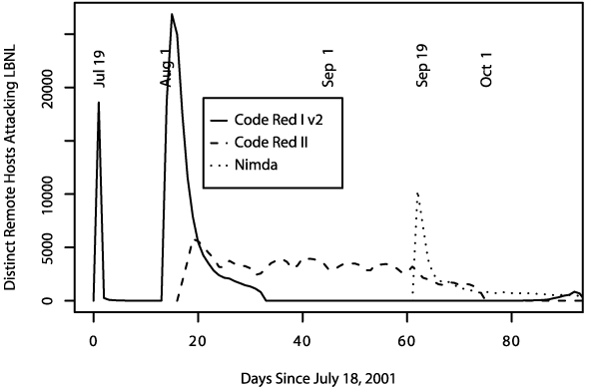
Summer of 2001
Three major worm
outbreaks

Slide 13
Example Worm: Code Red
Initial version: July 13, 2001
Exploited known ISAPI vulnerability in Microsoft IIS Web servers
1st through 20th of each month: spread 20th through end of each month: attack
Payload: Web site defacement
Scanning: Random IP addresses
Bug: failure to seed random number generator

Slide 14
Code Red I
July 13, 2001: First worm of the modern era
Exploited buffer overflow in Microsoft’s Internet Information Server (IIS)
1st through 20th of each month: spread
Find new targets by random scan of IP address space
Spawn 99 threads to generate addresses and look for IIS
Creator forgot to seed the random number generator, and every copy scanned the same set of addresses ☺
21st through the end of each month: attack
Deface websites with “HELLO! Welcome to http://www.worm.com! Hacked by Chinese!”

Slide 15
Code Red: Revisions
Released July 19, 2001
Payload: flooding attack on www.whitehouse.gov
Attack was mounted at the IP address of the Web site
Bug: died after 20th of each month
Random number generator for IP scanning fixed

Slide 16
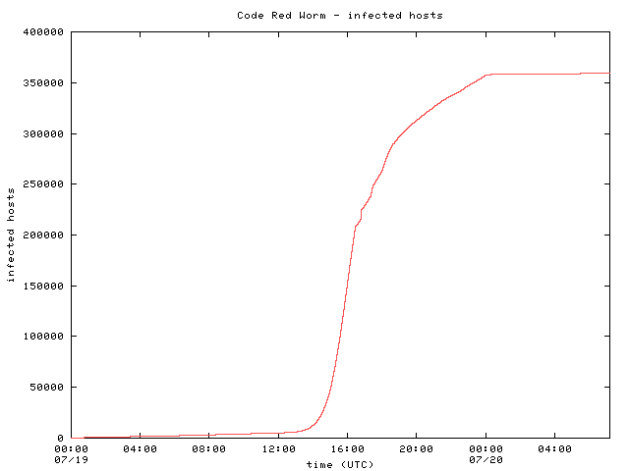
Code Red: Host Infection Rate
Exponential infection rate

Slide 17

Modeling the Spread of Code Red
Random Constant Spread model
K: initial compromise rate
N: number of vulnerable hosts
a: fraction of vulnerable machines already compromised
Newly infected machines in dt
Machines already infected
Rate at which uninfected machines are compromised

Slide 18

Modeling the Spread of Code Red
Growth rate depends only on K
Curve-fitting: K ~ 1.8
Peak scanning rate was about 500k/hour

Slide 19
Designing Fast-Spreading Worms
Hit-list scanning
Time to infect first 10k hosts dominates infection time
Solution: Reconnaissance (stealthy scans, etc.)
Permutation scanning
Observation: Most scanning is redundant
Idea: Shared permutation of address space. Start scanning from own IP address. Re-randomize when another infected machine is found.
Internet-scale hit lists
Flash worm: complete infection within 30 seconds

Slide 20
Code Red I v2
July 19, 2001: Same codebase as Code Red I, but fixed the bug in random IP address generation
Compromised all vulnerable IIS servers on the Internet
Large vulnerable population meant fast worm spread
Scanned address space grew exponentially
350,000 hosts infected in 14 hours!!
Payload: distributed packet flooding (denial of service) attack on www.whitehouse.gov
Coding bug causes it to die on the 20th of each month… but if victim’s clock is wrong, resurrects on the 1st

Slide 21
Code Red II
August 4, 2001: Same IIS vulnerability, completely different code, kills Code Red I
Known as “Code Red II” because of comment in code
Worked only on Windows 2000, crashed NT
Scanning algorithm preferred nearby addresses
Chose addresses from same class A with probability ½, same class B with probability 3/8, and randomly from the entire Internet with probability 1/8
Payload: installed root backdoor in IIS servers for unrestricted remote access
Died by design on October 1, 2001

Slide 22
Nimda
September 18, 2001: Multi-modal worm using several propagation vectors
Exploit same IIS buffer overflow as Code Red I and II
Bulk-email itself as an attachment to email addresses harvested from infected machines
Copy itself across open network shares
Add exploit code to Web pages on compromised sites to infect visiting browsers
Scan for backdoors left by Code Red II
Payload: turned-off code deleting all data on hard drives of infected machines

Slide 23
Signature-Based Defenses Don’t Help
Nimda leaped firewalls
Many firewalls passed mail untouched, relying on mail servers to filter out infections
Most filters simply scan attachments for signatures (code snippets) of known viruses and worms
Nimda was a brand-new infection with unknown signature, and scanners could not detect it
Big challenge: detection of zero-day attacks
When a worm first appears in the wild, signature is not extracted until minutes or hours later

Slide 24
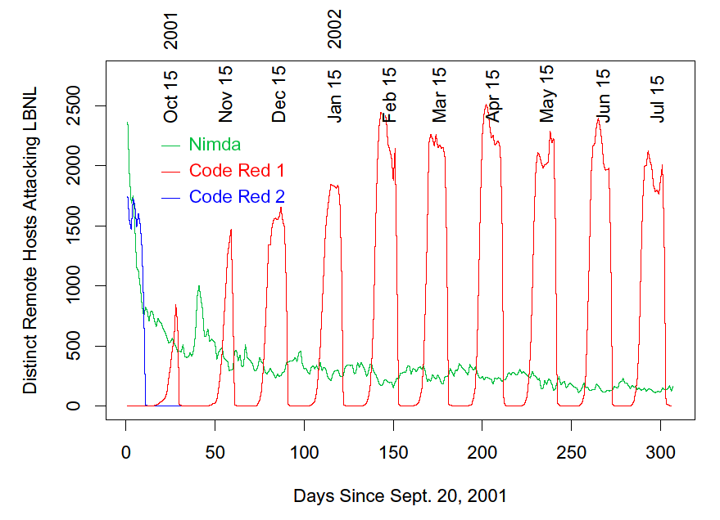
Code Red I and II (Paxson)
With its predator gone, Code Red I comes back, still exhibiting monthly pattern
Code Red II dies off as programmed

Slide 25
Designing Fast-Spreading Worms
Hit-list scanning
Time to infect first 10k hosts dominates infection time
Solution: Reconnaissance (stealthy scans, etc.)
Permutation scanning
Observation: Most scanning is redundant
Idea: Shared permutation of address space. Start scanning from own IP address. Re-randomize when another infected machine is found.
Internet-scale hit lists
Flash worm: complete infection within 30 seconds

Slide 26
Code Red Worm Background
Sent HTTP Get request to buffer overflow Win IIS server.
It generated 100 threads to scan simultaneously
One reason for its fast spreading.
Huge scan traffic might have caused congestion.
Characteristics:
Uniformly picked IP addresses to send scan packets.
Code Red worm incident of July 19th, 2001:
Showed how fast a worm can spread.
more than 350,000 infected in less than one day.
Notes:
Some background on the Code Red worm. Code Red used HTTP get request to buffer overflow vulnerable Windows IIS servers. It generated 100 threads to scan simultaneously. That’s one reason why it spread so fast. And since each copy of the worm generated so many scan packets, the huge scan traffic on that day might have caused congestion to the Internet.
One important property of the Code Red worm is that it uniformly picked IP addresses to scan. I’ll discuss this property several times later.

Slide 27
Slammer (Sapphire) Worm
January 24/25, 2003: UDP worm exploiting buffer overflow in Microsoft’s SQL Server
Overflow was already known and patched by Microsoft… but not everybody installed the patch
Entire code fits into a single 404-byte UDP packet
Worm binary followed by overflow pointer back to itself
Classic buffer overflow combined with random scanning: once control is passed to worm code, it randomly generates IP addresses and attempts to send a copy of itself to port 1434
MS-SQL listens at port 1434

Slide 28
Slammer Propagation
Scan rate of 55,000,000 addresses per second
Scan rate = rate at which worm generates IP addresses of potential targets
Up to 30,000 single-packet worm copies per second
Initial infection was doubling in 8.5 seconds (!!)
Doubling time of Code Red was 37 minutes
Worm-generated packets saturated carrying capacity of the Internet in 10 minutes
75,000 SQL servers compromised
And that’s in spite of broken pseudo-random number generator used for IP address generation

Slide 29
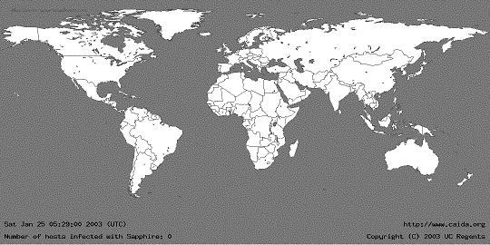
05:29:00 UTC, January 25, 2003
[from Moore et al. “The Spread of the Sapphire/Slammer Worm”]

Slide 30
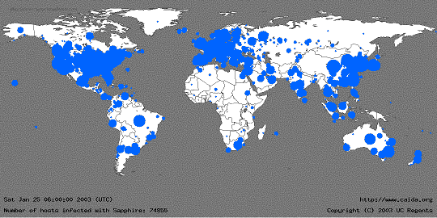
30 Minutes Later
[from Moore et al. “The Spread of the Sapphire/Slammer Worm”]
Size of circles is logarithmic in
the number of infected machines

Slide 31
Slammer Impact
$1.25 Billion of damage
Temporarily knocked out many elements of critical infrastructure
Bank of America ATM network
Entire cell phone network in South Korea
Five root DNS servers
Continental Airlines’ ticket processing software
The worm did not even have malicious payload… simply bandwidth exhaustion on the network and resource exhaustion on infected machines

Slide 32
Slammer’s Speed
Old-style worms (Code Red) spawn a new thread which tries to establish a TCP connection and, if successful, send a copy of itself over TCP
Limited by latency of the network
Slammer was a connectionless UDP worm
No connection establishment, simply send 404-byte UDP packet to randomly generated IP addresses
Limited only by bandwidth of the network
A TCP worm can scan even faster
Dump zillions of 40-byte TCP-SYN packets into link layer, send worm copy only if SYN-ACK comes back

Slide 33
Storm / Peacomm (2007)
Spreads by cleverly designed spam campaign
Arrives as an email with catchy subject
First instance: “230 dead as storm batters Europe”
Other examples: “Condoleeza Rice has kicked German Chancellor”, “Radical Muslim drinking enemies’s blood”, “Saddam Hussein alive!”, “Fidel Castro dead”, etc.
Attachment or URL with malicious payload
FullVideo.exe, MoreHere.exe, ReadMore.exe, etc.
Also masquerades as flash postcards
Once opened, installs Trojan (wincom32) & rootkit

Slide 34
Storm Worm Characteristics
Infected machine joins botnet
Between 1 and 5 million machines infected (Sep 2007)
Obfuscated peer-to-peer control structure
Interacts with peers via eDonkey protocol
Obfuscated code, anti-debugging defenses
Goes into infinite loop if detects VMware or Virtual PC
Large number of spurious probes (evidence of external analysis) triggers distributed DoS attack

Slide 35
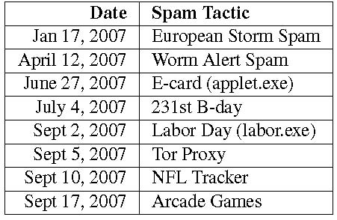
Storm Worm Outbreaks
Spambot binary used to spread new infections in subsequent campaigns
Looks for email addresses and mailing lists in the files on the infected machines

Slide 36
Other “Famous” Botnets
Conficker (2008)
Mega-D (2009)
Zeus (2010)
Mirai (2016)

Slide 37
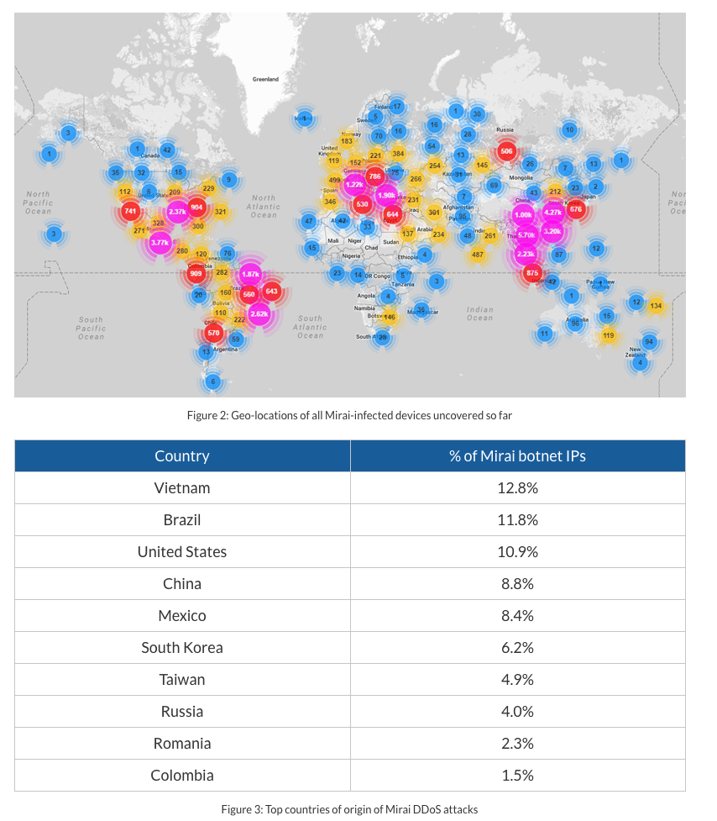
Mirai (2016)
50,000 unique IP addresses in 160+ countries
Default passwords on IoT devices
Notes:
https://www.incapsula.com/blog/malware-analysis-mirai-ddos-botnet.html

Slide 38
Botnets

Slide 39
Botnets
Bots: Autonomous programs performing tasks
Plenty of “benign” bots
e.g., weatherbug
Botnets: group of bots
Typically carries malicious connotation
Large numbers of infected machines
Machines “enlisted” with infection vectors like worms
Available for simultaneous control

Slide 40
“Rallying” the Botnet
Easy to combine worm, backdoor functionality
Problem: how to learn about successfully infected machines?
Options
Email
Hard-coded email address

Slide 41
Botnet Control
Dynamic DNS
Infected Machine
Botnet Controller
Botnet master typically runs on some server
Infected machine contacts botnet via DNS
Dynamic DNS: allows controller to move about freely

Slide 42
Botnet Command and Control (C&C)
From the Botmaster point of view
Centralized
Pro - easy to setup, fast commands dissemination
Cons - easy to detect , single point of failure
Peer-to-Peer Topology
Pro – decentralized, not easy to detect , not single point of failure
Cons – not easy to setup (more complex), message delivery not guaranteed and high latency

Slide 43
Botnet History: How we got here
Early 1990s: IRC bots
eggdrop: automated management of IRC channels
1999-2000: DDoS tools
Trinoo, TFN2k, Stacheldraht
1998-2000: Trojans
BackOrifice, BackOrifice2k, SubSeven
2001- : Worms
Code Red, Blaster, Sasser
Fast spreading capabilities pose big threat
Put these pieces together and add a controller…

Slide 44
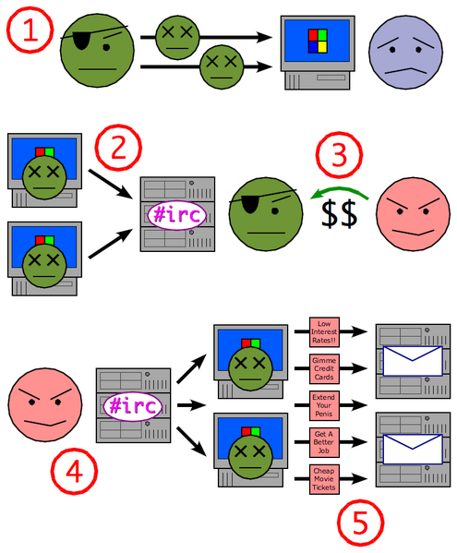
Putting it together
Miscreant (botherd) launches worm, virus, or other mechanism to infect Windows machine.
Infected machines contact botnet controller.
Spammer (sponsor) pays miscreant for use of botnet.
Spammer uses botnet to send spam emails.
Source: Wikipedia

Slide 45
Botnet Usage
DDOS
Spam
Sniffing traffic
Keylogging
Installing Advertisement Add-ons and Browser Helper Objects (BHOs)
Manipulating online polls/games
Mass ID theft

Slide 46
Defenses: Monitoring and Takedown

Slide 47
Early Days: IRC-Based Monitoring
Join IRC channel, monitor all communications
This approach became more difficult over time
Move towards encrypted C&C Communication
Move away from IRC-based botnets (as predicted)

Slide 48
Botnet Detection and Tracking
Network Intrusion Detection Systems (e.g., Snort)
Signature: alert tcp any any -> any any (msg:"Agobot/Phatbot Infection Successful"; flow:established; content:"221
Honetpots/Honeynets: gather information
Run unpatched version of Windows
Usually infected within 10 minutes
Capture binary
determine scanning patterns, etc.
Capture network traffic
Locate identity of command and control, other bots, etc.
“Internet Motion Sensor”

Slide 49
Using DNS Traffic to Find Controllers
Different types of queries may reveal info
Repetitive A queries may indicate bot/controller
MX queries may indicate spam bot
PTR queries may indicate a server
Usually 3 level: hostname.subdomain.TLD
Names and subdomains that just look rogue
(e.g., irc.big-bot.de)

Slide 50
DNS Monitoring
Command-and-control hijack
Advantages: accurate estimation of bot population
Disadvantages: bot is rendered useless; can’t monitor activity from command and control
Complete TCP three-way handshakes
Can distinguish distinct infections
Can distinguish infected bots from port scans, etc.

