Slide 1
Web Privacy and Tracking
Security, Privacy, and Consumer Protection Nick Feamster University of Chicago

Slide 2
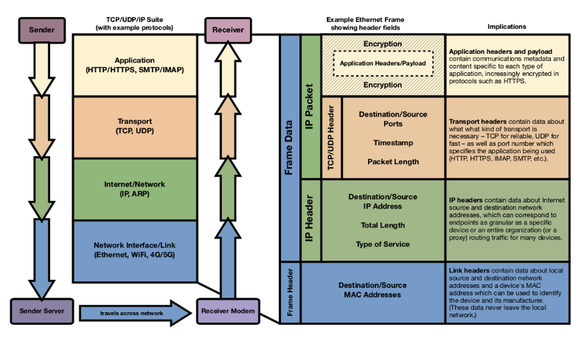

Slide 3
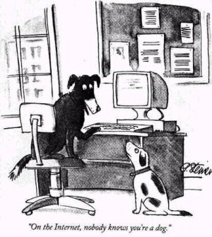
It’s the Internet! Of course they know you’re a dog. They also know your favorite brand of pet food and the name of the cute poodle at the park you have a crush on!
Notes:
Imagine if this cartoon from 1993 were published today…

Slide 4
“Third Party” Online Tracking
Sites other than the one you’re visiting
typically invisible
compiling profiles of your browsing history

Slide 5
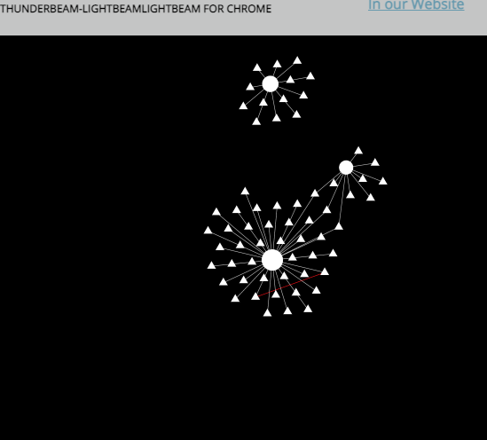
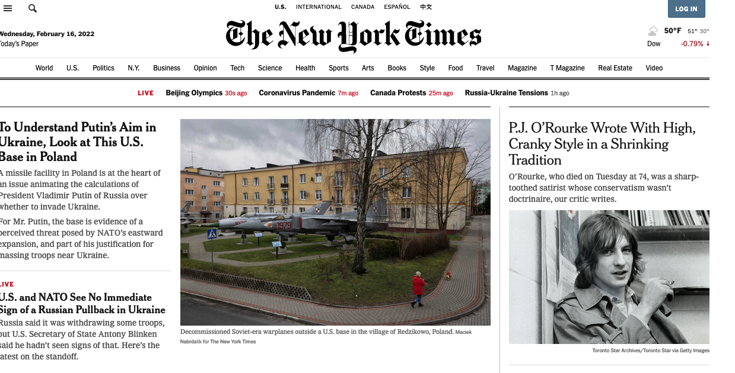
GET https://youtube.com/watch?v=gHStnhGxlP
Cookie: id=35c192bcfe0000b1...
Referer: https://www.nytimes.com/
Notes:
Screenshot is from a 2012 study of third-party online tracking https://cyberlaw.stanford.edu/files/publication/files/trackingsurvey12.pdf
Notice all the red boxes: Typically this content is not served by the NYT. There are a lot more trackers that are invisible.
The combination of cookie and referer is what enables third-party tracking.
Funny aside: the HTTP protocol misspells referrer as referer. It’s part of the protocol specification so it can’t be changed.

Slide 6
Thunderbeam/Lightbeam Experiment

Slide 7
What if User Blocks Referer?
GET http://youtube.com/watch?v=gHStnhGxlP
Cookie: id=35c192bcfe0000b1...
Read page URL using JavaScript? (top.location.href)
Yes, but not if inside iframe
Notes:
It’s not very easy to prevent the ability to track. One try is to block the referer header, but third-party JavaScript can read it anyway, unless it’s in an iFrame.

Slide 8
Cooperative Tracking
http://firstparty.com
GET https://tracker.com/?from=firstparty.com
Cookie: id=35c192bcfe0000b1...
https://tracker.com/…
Notes:
Co-operative tracking is particularly hard to prevent --- here the first party tells the third party the referring URL.

Slide 9
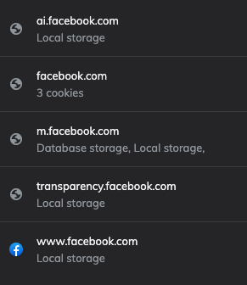
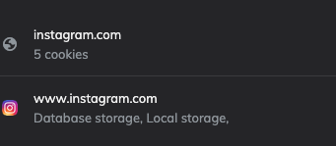
Cookies from Embedded Content

Slide 10
64
Independent tracking mechanisms on typical top-50 sites

Slide 11
Who are the Third Parties?
Some prominent trackers:
Facebook
Google
bluekai.com
revsci.net
112.2o7.net
Notes:
Think about why these entities are in the business of tracking. You might want to look up some of these and which companies they belong to.

Slide 12
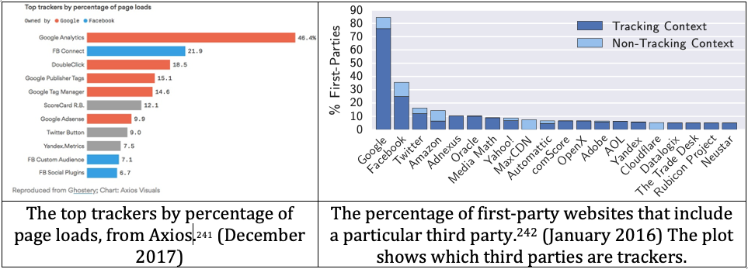

Slide 13
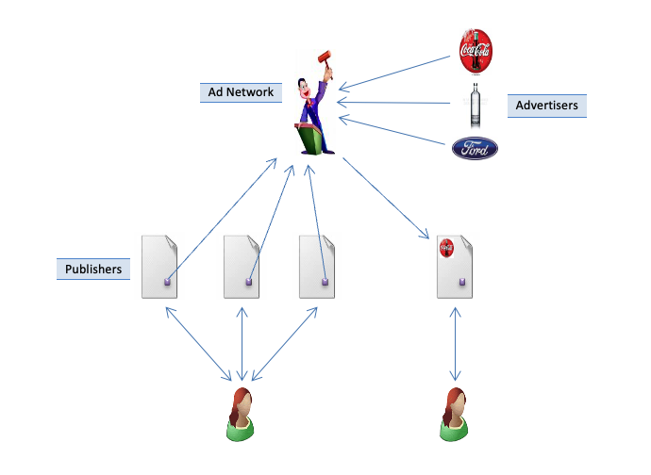
What is Behavioral Targeting?
Notes:
Profiles based on user’s past activity help ad networks serve targeted ads based on real-time ad auctions.

Slide 14
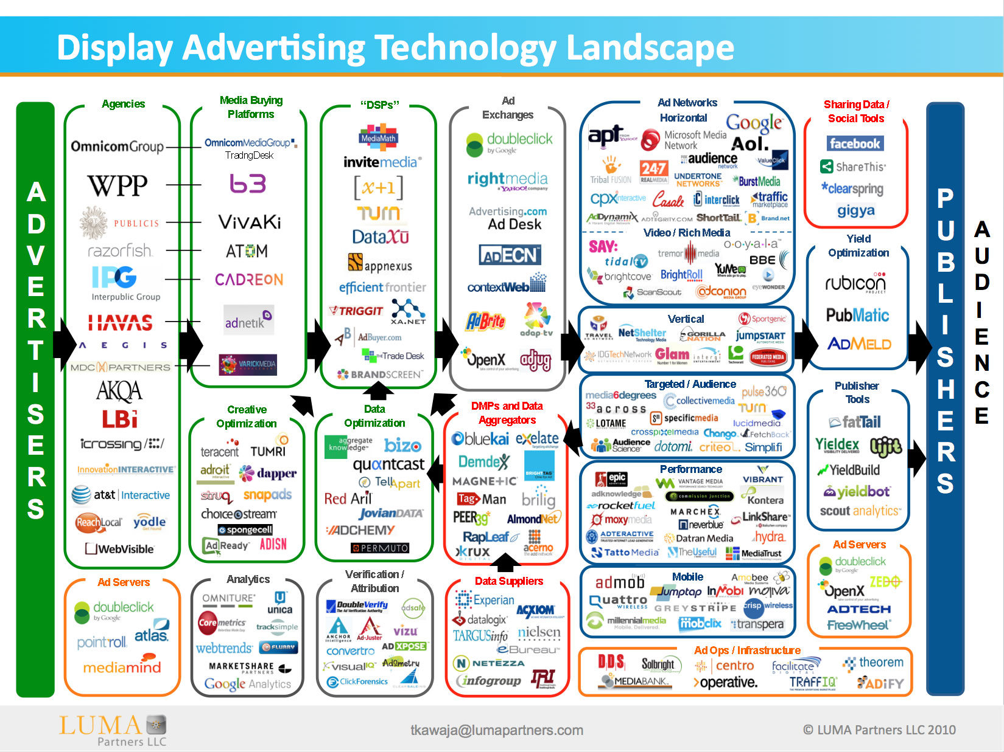

Slide 15
Privacy Worries
Intellectual privacy
Behavioral targeting
Price discrimination
NSA
Notes:
NSA piggybacks on ad cookies for surveillance and delivering exploits: https://www.washingtonpost.com/news/the-switch/wp/2013/12/10/nsa-uses-google-cookies-to-pinpoint-targets-for-hacking/

Slide 16
Tracking Techniques

Slide 17
Tagging: Placing Data in the Browser
HTTP Cookies
HTTP Auth
HTTP Etags
Content cache
IE userdata
HTML5 protocol & content handlers
HTML5 Storage
Flash cookies
Silverlight storage
TLS session ID & resume
Browsing history
window.name
HTTP STS
DNS cache
Notes:
The point of this slide is that numerous web APIs allow placing data in the browser, directly or indirectly, and all of these can be used for uniquely identifying the user and hence tracking their browsing

Slide 18
Fingerprinting: Observing the Browser’s Behavior
User-Agent
HTTP ACCEPT headers
Browser plug-ins
MIME support
Clock skew
Installed fonts
Cookies enabled?
Browser add-ons
Screen resolution
Notes:
Fingerprinting is more insidious, as it leaves no trace in the browser that the user is being tracked.
Different devices/browsers will have different fingerprints based on a combination of attributes listed on this slide, and more.

Slide 19
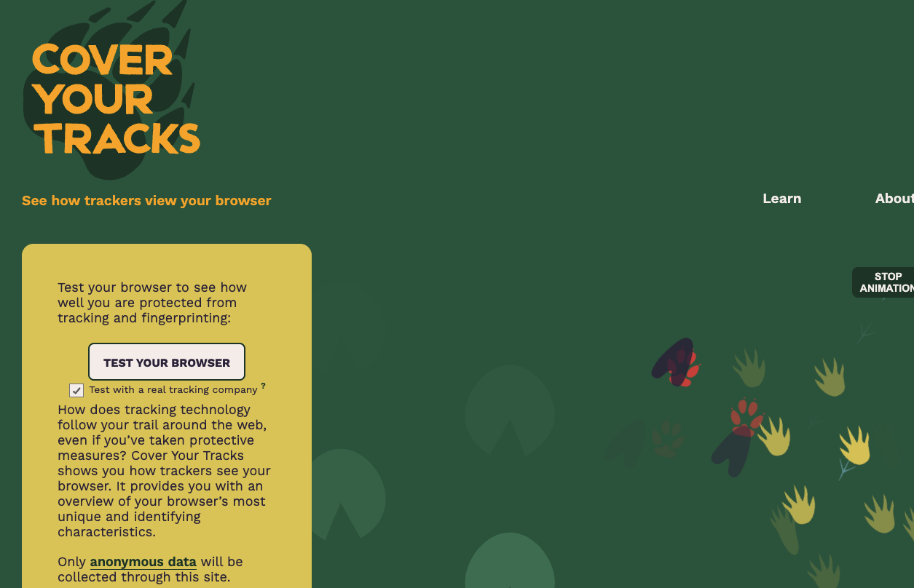
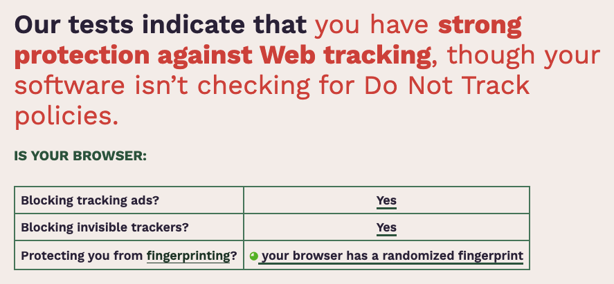

Slide 20
Hands-On/Walk Through (Cover Your Tracks)

Slide 21
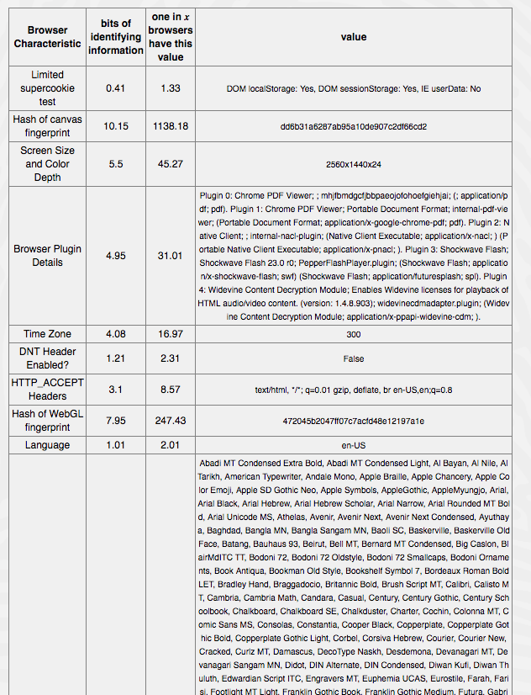

Slide 22
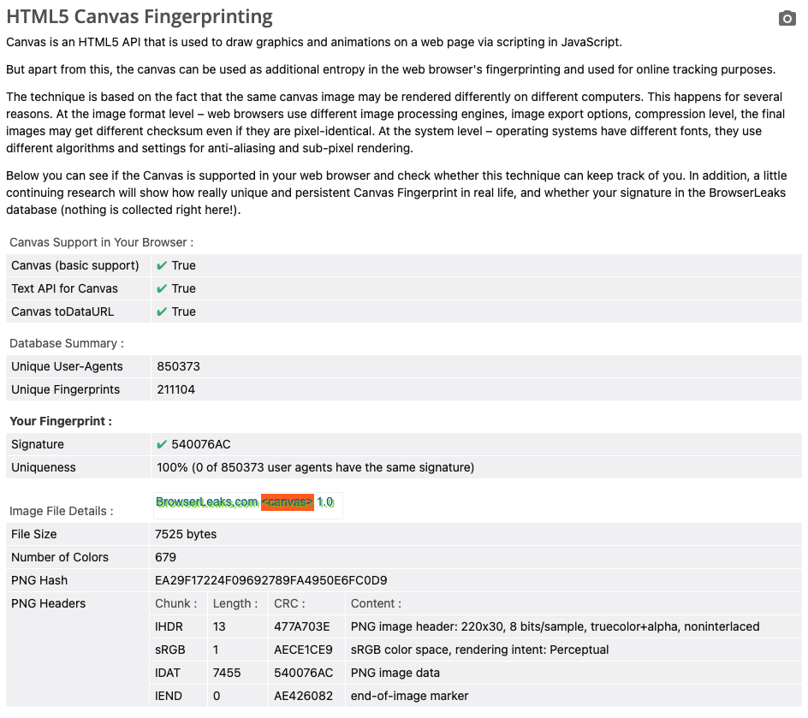
Canvas Fingerprinting
Vast majority of browsers/devices have unique fingerprints (among millions of other devices)

Slide 23
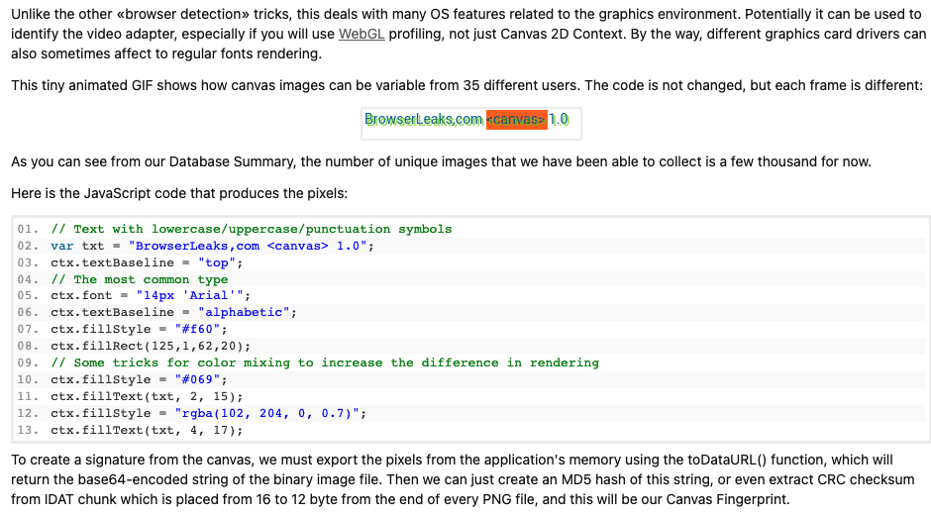

Slide 24
Anonymous Tracking? Not Quite
1. Third party is sometimes a first party

Slide 25
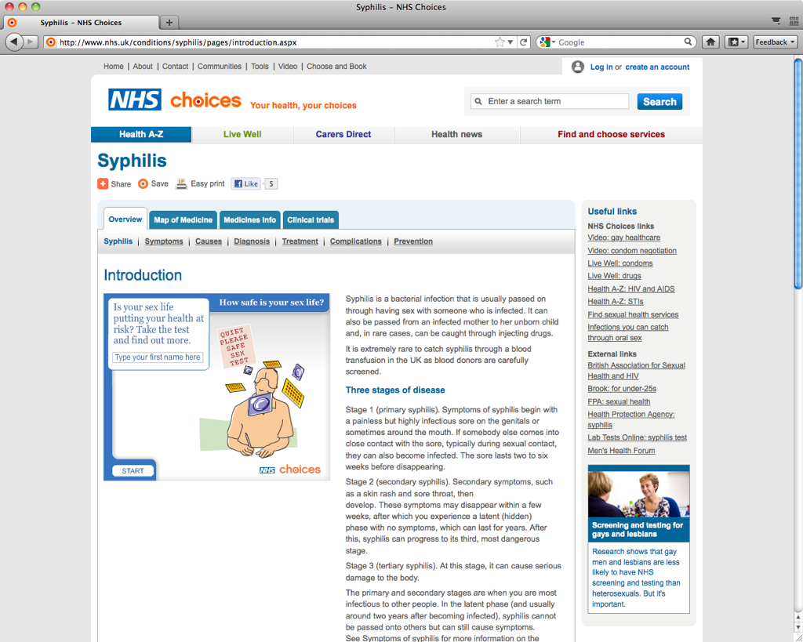
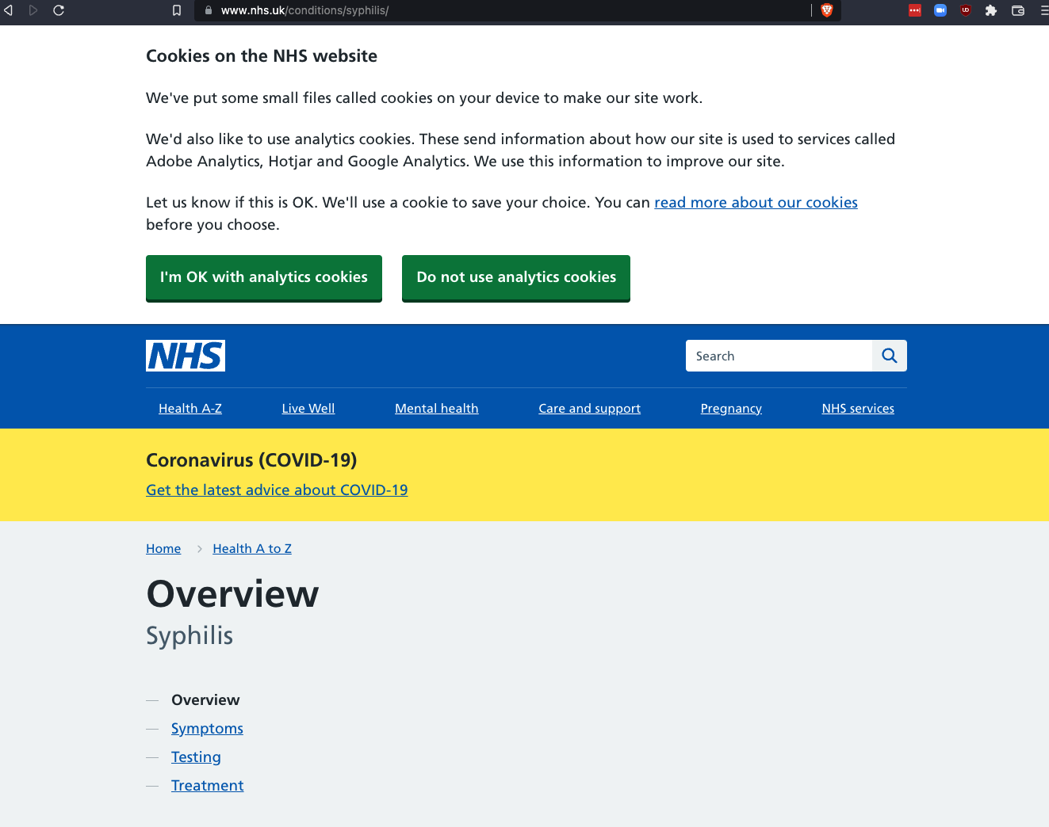
Notes:
Facebook can connect your identity with their tracking of your browsing through the Like button

Slide 26
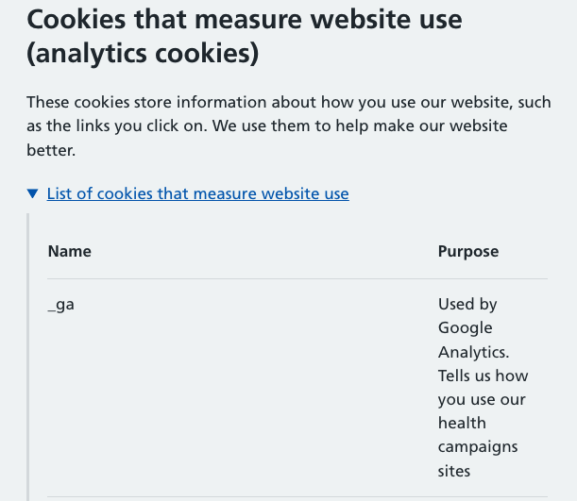
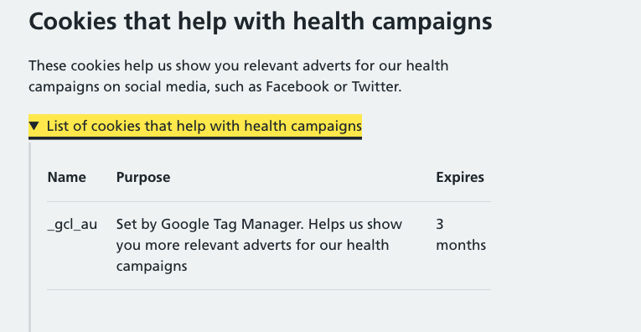

Slide 27
Anonymous Tracking? Not Quite
2. Leakage of identifiers
GET http:/​/ad.doubleclick.net/adj/... Referer: http:/​/submit.SPORTS.com/...?email=jdoe@email.com Cookie: id=35c192bcfe0000b1...
Notes:
Slide shows a request to a third-party resource embedded on a page (in this case sports.com). This is a result of careless programming: the referer header leaks your identity.
Search terms also frequently leak to third parties.

Slide 28
Merging Across Distinct Databases
Different trackers have different IDs for the user
Different IDs on different devices of the same user
Retail trackers have offline databases
Linking across any of these boundaries is possible.

Slide 29
Cookie Syncing
Tracker X knows a user U by the id x
Tracker Y knows a user U by the id y
How can X & Y link x & y in their databases?
Hint: this must happen via the browser when user visits a site with either X or Y embedded
Notes:
For example, cookie syncing allows linking different IDs that different trackers have assigned to the same user (first bullet in previous slide.)
Other linking techniques: onboarding (online--offline), cross-device tracking (different devices belonging to same user).

Slide 30
http://firstparty.com
TrackerX embeds its ID for the user into the GET request as a parameter
GET https://trackerY.com/?uid=xxxxxxx
Referer: http://trackerX.com/…
Cookie: id=yyyyyyy
https://trackerX.com/…
https://trackerY.com/…
redirect
Notes:
TrackerX embeds its ID for the user into the GET request as a parameter

Slide 31
Defenses

Slide 32
1. Referer Blocking
Two drawbacks
Blocking referer indiscriminately will break many sites

Slide 33
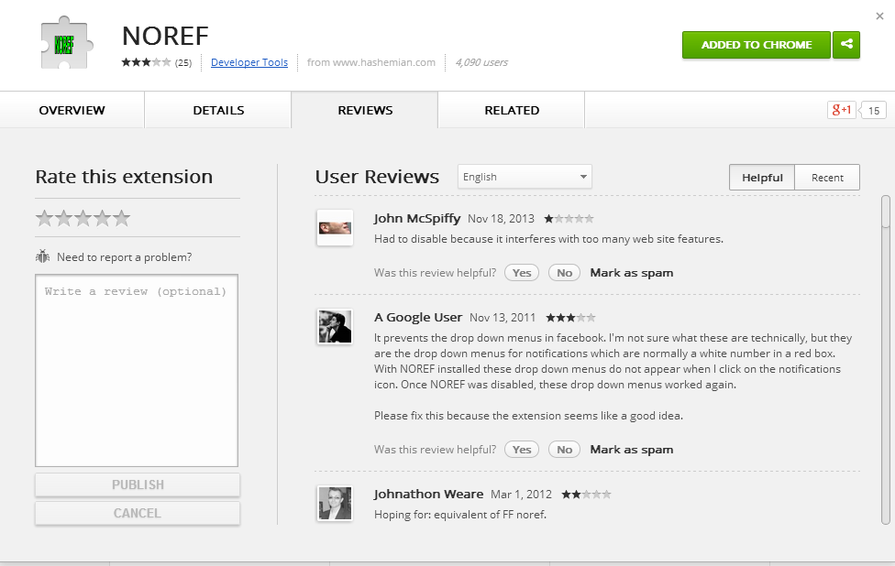
Notes:
Note complaints about breakage for this referer-blocking extension

Slide 34
1. Referer Blocking
Two drawbacks
Many sites check referer header for XSRF defense Blocking referer indiscriminately will break sites
Can’t prevent cooperative tracking

Slide 35
Third-party Cookie Blocking
Relatively little breakage, but…
Doesn’t prevent fingerprinting

Slide 36
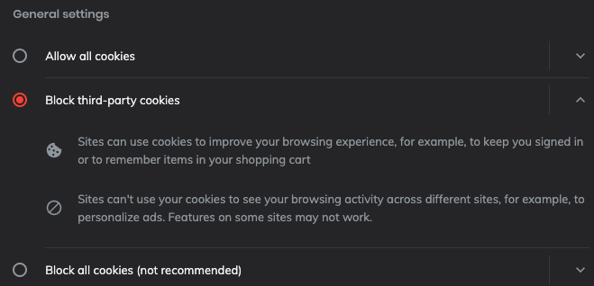

Slide 37
HTTP Request Blocking
Compile and maintain a big list of known trackers
Semi-automated analysis
Based on domains and regular expressions
User installs browser extension
Downloads list
Blocks requests to objects on the list
Drawbacks:
False positives and negatives
Need to trust list
Notes:
This is by far the most successful approach so far.

Slide 38

Example: Social Media Blocking

Slide 39

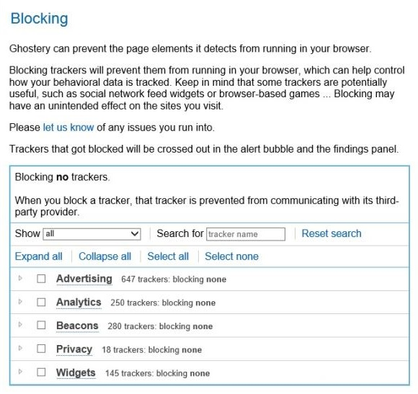

Blocking tools
AdBlock Plus
Ghostery
Notes:
AdBlock plus: need to install blocklist separately (e.g. EasyPrivacy) to block all trackers like analytics and social widgets.
There are tradeoffs. E.g., there is some breakage.
Exercise: if trackers wanted to avoid being blocked by these tools, how would they do it? If an arms race develops, which side has the advantage?

Slide 40
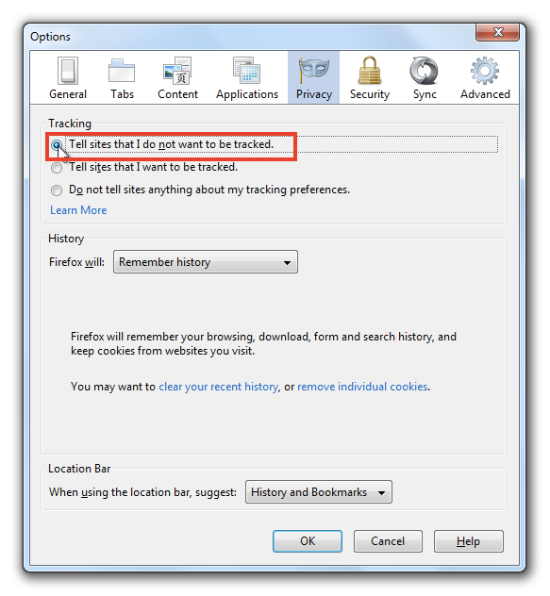
Do Not Track
Notes:
Do Not Track signals a user’s opt-out preference with an HTTP header, a simple technology that is completely compatible with the existing web. While some third parties have committed to honor Do Not Track, many more have not. In February 2012, the major online advertising trade groups pledged at the White House to support Do Not Track by year-end; that promise remains unfulfilled. Efforts to standardize Do Not Track in the World Wide Web Consortium have resulted in deadlock, despite frequent urging by American and European policymakers.

Slide 41
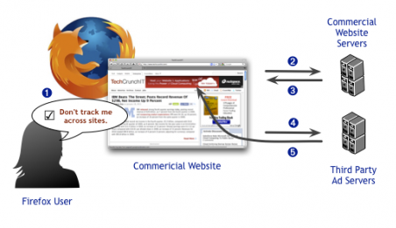
How Do Not Track is Supposed to Work
Notes:
The idea is to give users a universal way to opt-out of all third-party tracking. Single checkbox in browser, preference is communicated to all sites via HTTP header.
Very few sites respect Do Not Track, absent regulatory or commercial pressures.

