Slide 1
Privacy Law
Security, Privacy, and Consumer Protection Nick Feamster University of Chicago

Slide 2
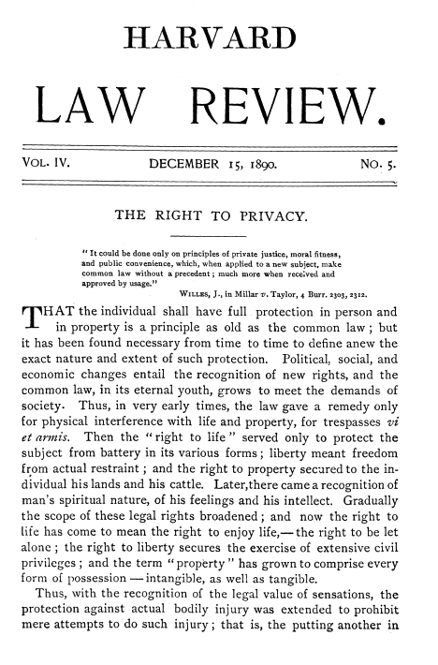

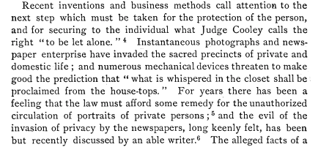
argued that
the law must provide some relief to
individuals when the acts of others
interfere with their right to be let alone.
Notes:
Context: This is the 1890 Harvard Law Review article "The Right to Privacy"
What to say: "This article was written in response to new photography technology and gossip journalism. Warren was upset about newspapers covering his family's social events. Sound familiar? Privacy law always responds to new technology."
URL: https://www.cs.cornell.edu/~shmat/courses/cs5436/warren-brandeis.pdf

Slide 3
Computerized Records: New Privacy Threats
Unknown databases that have information about you
Large amounts of data collection are more cost effective
One-to-many dissemination
Collection of different types of information, in different ways
Notes:
Context: 1970s concerns about mainframe computers
What to say: "These concerns from the 1970s sound quaint now, but they led to the Fair Information Practice Principles. Notice how every concern is 100x worse today with cloud computing and smartphones."

Slide 4
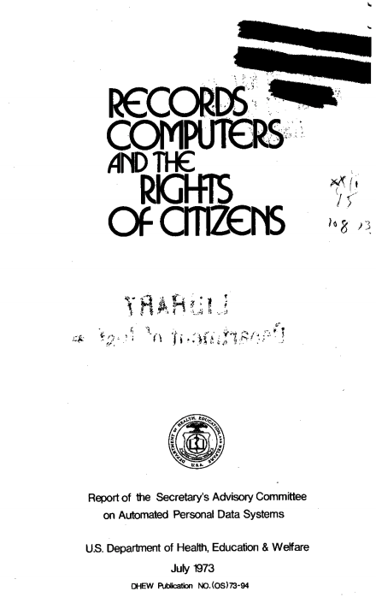
Published by the department of Health, Education, and Welfare
Resulted in the publication of Fair Information Principles:
No secret personal data record keeping systems
There must be a way for an individual to find out what information about him or her is in a record and how it's used
there must be a way for an individual to prevent information about him or her obtained for one purpose from being used or made available for other purposes without consent
there must be a way for an individual to correct or amend a record of identifiable information about him or her.
Any organization creating, maintaining, using, or disseminating records of identifiable personal data must assure the reliability of the data for their intended use and must take reasonable precautions to prevent misuse of the data
Notes:
Context: 1973 HEW report
What to say: "These principles became the foundation for most privacy law worldwide. Notice the focus on transparency and individual control - we'll come back to whether this model still works."

Slide 5
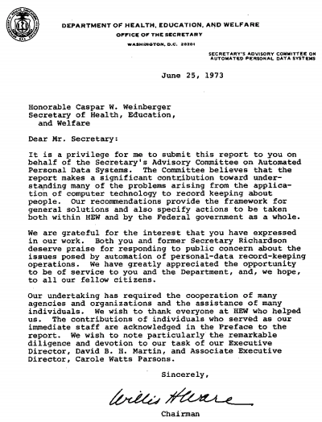

Slide 6


Slide 7
Notice
A person should be provided notice of what an organization of computer system is collecting, using, and sharing regarding their data.
Why?
Value of transparency
Self-reflection into organizational practices
Commitment to promises
Notes:
What to say: "This is why every website has a privacy policy. Problem: they're unreadable. Instagram's is 10,000+ words. The notice-and-consent model is fundamentally broken."
URL to demo: https://tosdr.org/ - "Terms of Service; Didn't Read" rates privacy policies

Slide 8
Appropriate Uses
A person’s information should be used for “appropriate” purposes
Primary uses: What the information was collected for
Secondary beneficial uses
National security
Public health and safety
Oversight of operations
Law enforcement purposes
Notes:
What to say: "Primary use: obvious. Secondary uses: contentious. When is it OK to use data for purposes beyond what it was collected for?"
Example: Target figured out a teen was pregnant before her father knew, based on purchasing patterns. Appropriate use of data?

Slide 9
Example: National Directory of New Hires
Allowed government to locate people who were not paying child support
Notes:
What to say: "Classic secondary use debate. Collected for employment, used for law enforcement. Most people think this is reasonable. But where's the line?"

Slide 10
Individual Choice
Gives data subject some control over their information
Beyond clear expected uses (or uses for society’s benefit), information about individuals can only be used for purposes consistent with their choice
Two regimes:
Opt in: Data will not be shared for a new purpose without consent
Opt out: Data will be shared for new purpose unless the subject opts out
Notes:
What to say: "GDPR requires opt-in for most things. US typically allows opt-out. Huge difference in practice - opt-out means most people never opt out."
Demo: Show annoying cookie consent banners on EU sites vs. US sites with no banners

Slide 11
Access and Correction
Calls on organizations collecting information to provide individual access
A person should be able to know what information about them is being held in the system
A person should be able to use a process to change any incorrect information in that database
Notes:
What to say: "GDPR's 'Right to Access' is powerful - you can request all data a company has on you. Try it with Google or Facebook - you'll be shocked."
URL: https://support.google.com/accounts/answer/3024190 - How to download your Google data

Slide 12
Security
Information cannot be kept private if it is not held securely
Reasonable administrative, process, technical safeguards to protect the data
Notes:
What to say: "Security enables privacy. No point in privacy laws if data gets breached. This led to breach notification laws."

Slide 13
Other Fair Information Practices
Minimization
Downstream assurances
Mitigation of privacy harm that occurs
Data breach notification
Notes:
What to say: "Modern additions: minimization (collect only what you need), breach notification, accountability. These evolved as weaknesses in original FIPPs became clear."

Slide 14
FIPPs
Fair Information Practice Principles are part of the orthodox privacy religion.
Arguably, they should be re-examined. Perhaps they’re off target. Or perhaps they’re orthogonal to the problem in some ways.
Example: data must be correct – but nowadays we often rely on deliberate errors (“noise”) as part of a privacy strategy.
Notes:
What to say: "Are FIPPs outdated? Example: differential privacy deliberately adds noise to data. That violates 'data must be correct' but enhances privacy. The paradigm may need updating for modern ML/AI."

Slide 15
How our current theories differ
Interact with data via queries, rather than data-shipping
focus on interactive protocols
Meaning of data more than what is evident on its face
assume probabilistic inference from data
depends how data was generated
Harm is (additional) inference about an individual, rather than linking of records
Presumption that interaction is disclosive, absent evidence to the contrary
Notes:
What to say: "Old model: data is static, stored in databases. New model: data is queried, inferred from, probabilistically analyzed. FIPPs weren't designed for this."

Slide 16
Personally Identifiable Information
Data carries risk if it contains PII
If no PII, then risk is minimal, because sensitive information in the data cannot be associated with any specific individual.
Render data safe by scrubbing PII out of it
Notes:
What to say: "PII concept is also outdated. Remove name, SSN, address = safe? Wrong. Netflix 'anonymized' data was re-identified. AOL search data was re-identified. PII is not a bright line."
Famous case: Netflix Prize dataset re-identification (2006)

Slide 17
Underlying model of data and computing
What computers do: store data for later retrieval
Meaning of data is evident on its face
No processing of data, other than simple joins
ID data
ID more data
ID data more data
Notes:
What to say: "FIPPs assume data sits in databases and gets retrieved. But modern ML does inference, prediction, pattern matching. Different threat model."

Slide 18
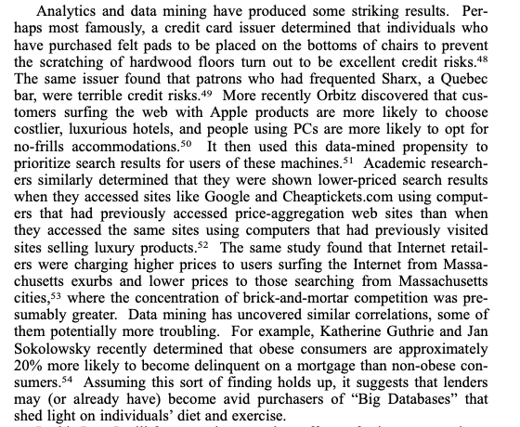

Slide 19
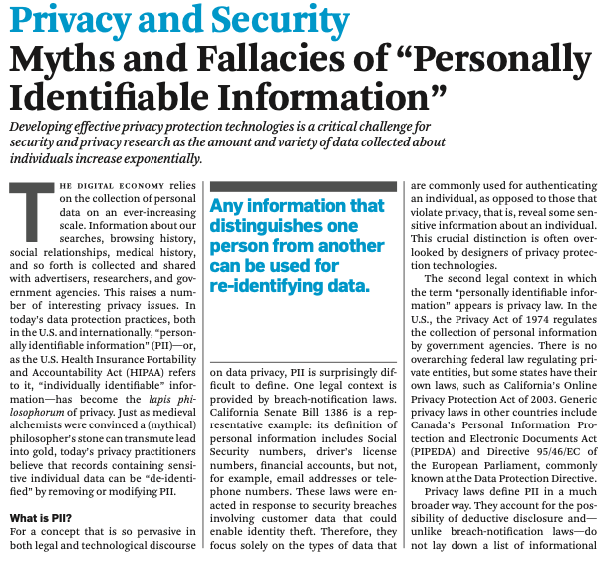

Slide 20
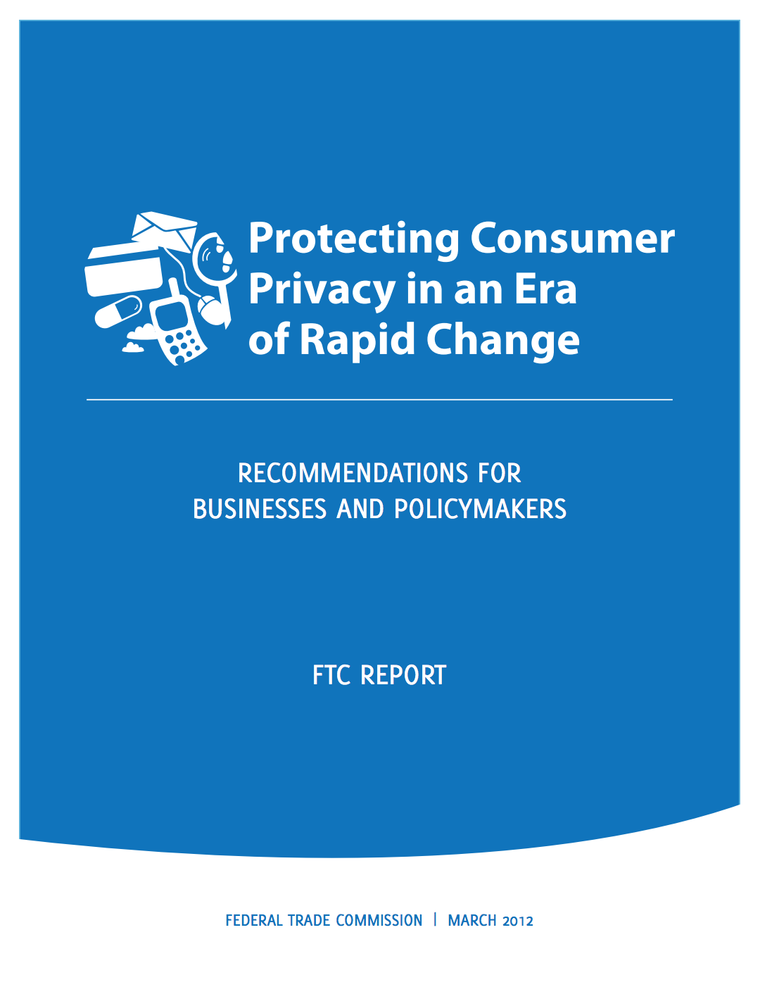
Re-Litigating Definitions
To de-identify, “must achieve a reasonable level of justified confidence that the data cannot reasonably be used to infer information about, or otherwise be linked to, a particular consumer, computer, or other device.”
Notes:
What to say: "Modern laws like California's CCPA try to fix the PII problem with 'de-identification' standards. But it's hard to define 'reasonably linked.'"

Slide 21
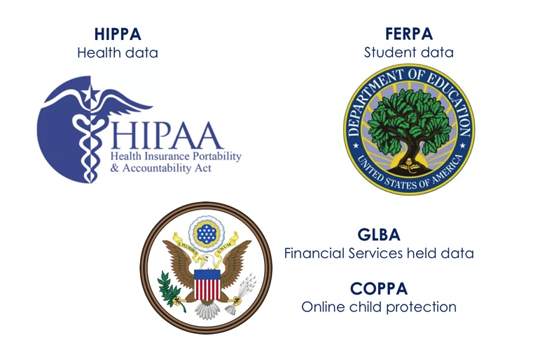
Statutory Landscape in the US
Who has the data
Mitigation of specific harm
Part of a data-sharing initiative
Notes:
What to say: "US privacy law is a patchwork based on: (1) who has the data, (2) what harm might occur, (3) what transaction is happening. No comprehensive federal law."

Slide 22
Statutory Landscape
Based on the Data
1960s: Only the government and credit bureaus were the only sectors with data on millions of people
The Privacy Act (regulation on personal information collected by a federal agency)
Fair Credit Reporting Act (regulating data collected by consumer reporting agencies)
Based on Anecdote
FERPA: in response to an elementary school collecting information from children about their parents and home life
Video Privacy Protection Act: in response to a local paper reporting a list of videos Judge Bork had rented
Driver’s Policy Protection Act: in response to South Carolina selling drivers license data
Notes:
What to say:
- Privacy Act (1974): Post-Watergate, only applies to federal agencies
- FCRA (1970): Credit bureaus only
- FERPA (1974): Schools collected data on kids' home lives - Congress freaked out
- Video Privacy Protection Act (1988): Reporter published Judge Bork's video rental history during Supreme Court nomination. Congress passed law within months.
- Driver's Privacy Protection Act (1994): States were selling DMV data

Slide 23
Statutory Landscape (Continued)
Data-Sharing Initiatives
Health Insurance Portability and Accountability Act (HIPAA): drafed to ensure insurance portability and facilitate electronic records
Gramm-Leach-Bliley: Paved the way for commercial banks to share information
Special Harm
Children’s Online Privacy Protection Act (COPPA): Drafted to protect against the collection of information from children under 13 without verifiable parental consent
Genetic Information Non-Discrimination Act (GINA): protect against employment and insurance discrimination based on genetic information
Notes:
What to say:
- HIPAA (1996): Covers healthcare providers/insurers but NOT fitness apps, 23andMe, etc.
- GLBA (1999): Banks can share data among affiliates
- COPPA (1998): Kids under 13 need parental consent
- GINA (2008): Can't discriminate based on genetic information

Slide 24
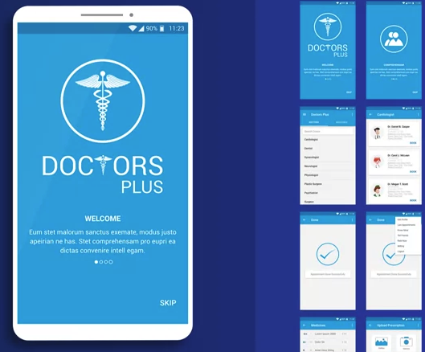
HIPAA
Only health information covered by certain kinds of organizations
Health care providers who are billing electronically, plans, clearing hosues
And vendors who are performing an operation on behalf of the provider
Excluded:
Free services
Those using paper records
Many mobile apps (not providers, plans, or healthcare clearinghouses)
Notes:
What to say: "Huge gap: fitness apps, period trackers, mental health apps are NOT covered by HIPAA. They can sell your health data."
Recent case: BetterHelp (mental health app) fined $7.8M for sharing data with Facebook
URL: https://www.ftc.gov/news-events/news/press-releases/2023/03/ftc-ban-betterhelp-revealing-consumers-data-including-sensitive-mental-health-information-facebook

Slide 25
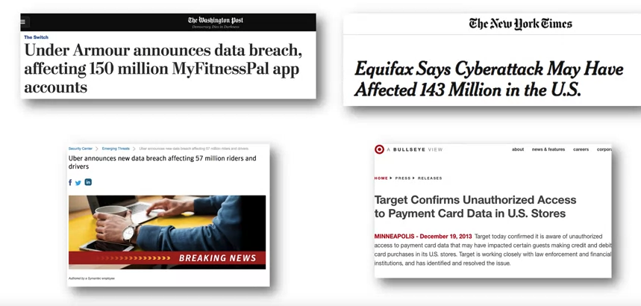
Breach Notification: Regulation by Consequence
Notes:
What to say: "Before 2003, companies could suffer massive breaches and never tell anyone. California changed everything."

Slide 26
Breach Notification Laws
2003: California enacted a law requiring companies to notify any California resident whose computerized data was breached
Privacy and security became a top corporate priority, since without proper security, these breaches would become major headlines
Today, every state has a data breach notification law.
HIPAA also was amended to add a data breach notification provision.
Notes:
What to say: "Now all 50 states have breach notification laws. Made security a board-level issue. If you get breached, it's front page news."

Slide 27
What Data Triggers Notification
“Personal information”
Name
SSN
DL number
Account/credit card numbers
Some add: medical data, student data, biometrics, birth/marriage
Some states are automatic, others do risk analysis
Some laws require notification to media
Some laws require notification ”without unreasonable delay”, or within a certain number of days
Notes:
What to say: "Varies by state - this is the patchwork problem. Some states require notification for any breach, others only if 'harm likely.'"

Slide 28
Compliance Complications
Having so many different laws is problematic
Breach notification requirements have strengthened security
These programs can minimize security breaches but are unlikely to eliminate them.
Notes:
What to say: "Companies just apply the strictest state law (usually California) to everyone. Easier than 50 different compliance regimes."

Slide 29
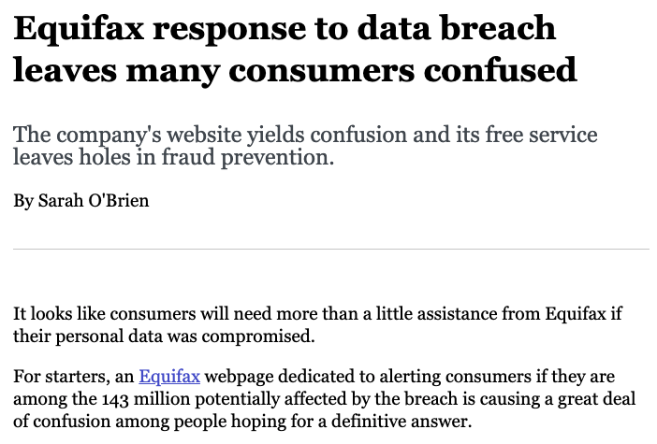
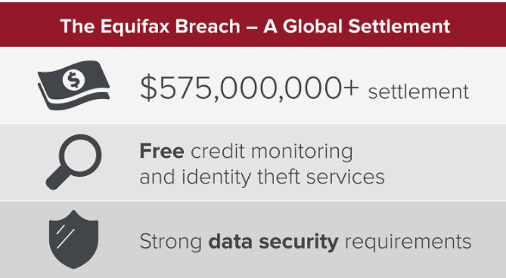
Equifax (September 2017)
Slow to react,
Communicated erroneous information,
Setup a questionable non-secure and spoofable separate website,
Tried to profit from credit-free solutions offered to effected individuals
…
Notes:
What to say: "147 million Americans' data breached. Equifax's response was a disaster: took 6 weeks to disclose, set up fake-looking website, tried to profit from credit monitoring."
URL: https://www.ftc.gov/equifax-data-breach
Result: $700M settlement, CEO resigned

Slide 30
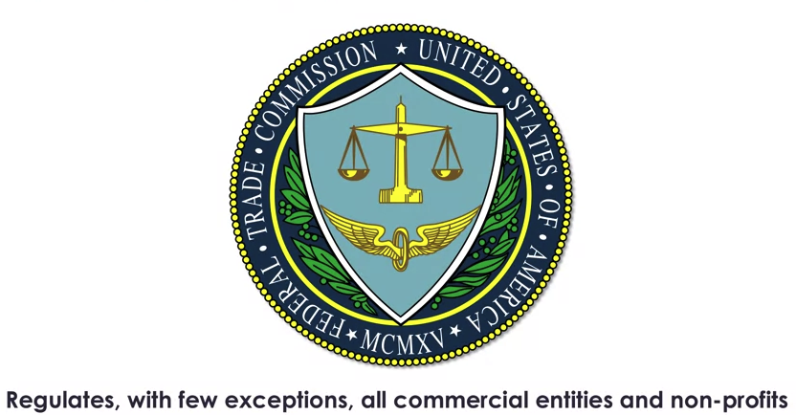
Federal Trade Commission
Notes:
What to say: "FTC is the de facto privacy regulator in the US, but they don't have a specific privacy statute. They use Section 5..."

Slide 31
Section 5 of FTC Act
Provides that “unfair or deceptive acts or practices in or affecting commerce are declared unlawful”.
Deception under this standard is a representation, omission, or practice that's likely to mislead the consumer.
Unfair practices under this standard are those that cause or are likely to cause substantial injury to consumers, which is not reasonably avoidable by consumers themselves and which is not outweighed by countervailing benefits to consumers or to competition.
The FTC has been very active in bringing privacy cases based on finding certain acts and practices deceptive or unfair: 60 cases between 2002 and 2017.
Notes:
What to say: "Section 5 bans 'unfair or deceptive' practices. FTC stretches this to cover privacy. Not ideal - built for consumer protection, not privacy rights."
Deceptive: You promised X, did Y
Unfair: Causes substantial harm consumers can't avoid

Slide 32
Example: FTC vs. Uber
Misrepresented its privacy statements
FTC alleged that its statements were deceptive
Case settled with no admission of wrongdoing but a consent decree
Prohibition on deceptive statements
Comprehensive privacy program (risk assessment, software testing, etc.)
Notes:
What to say: "Uber claimed 'God View' tracking of users was limited. FTC found they were monitoring journalists, politicians, exes. Settled with consent decree."
URL: https://www.ftc.gov/news-events/news/press-releases/2017/08/uber-settles-ftc-allegations-it-made-deceptive-privacy-data-security-claims

Slide 33
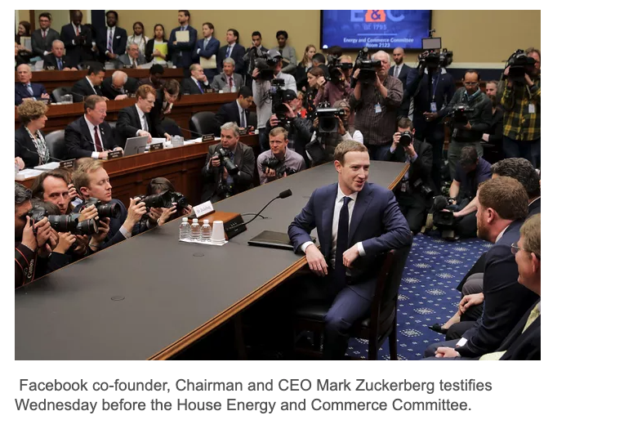
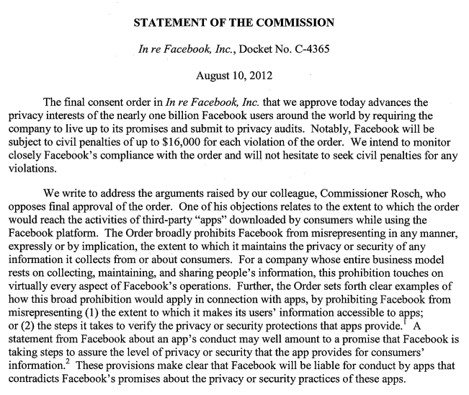
Example: Facebook Consent Decree
Notes:
Context: 2011 consent decree, then Cambridge Analytica 2018
What to say: "Facebook settled with FTC in 2011 for privacy violations. Consent decree required audits, compliance. Then Cambridge Analytica happened - 87 million users' data harvested. Did Facebook violate the decree?"
URL: https://www.ftc.gov/news-events/news/press-releases/2019/07/ftc-imposes-5-billion-penalty-sweeping-new-privacy-restrictions-facebook
Result: $5 billion fine (2019) - largest FTC penalty ever

Slide 34
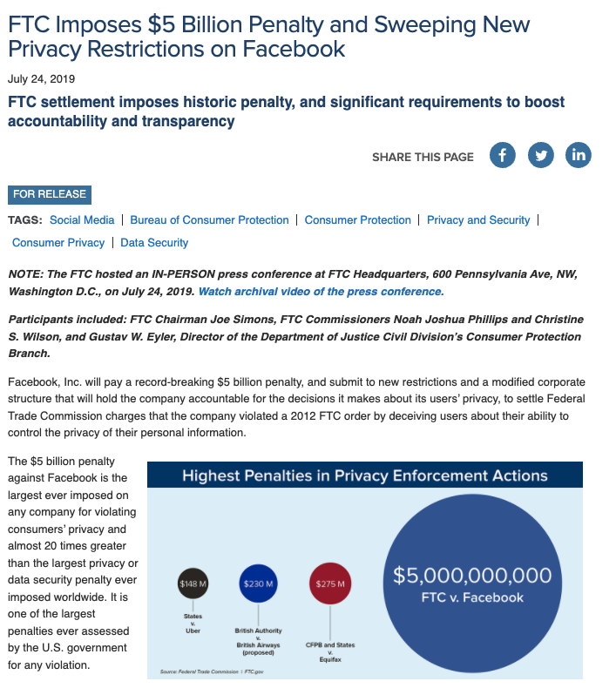
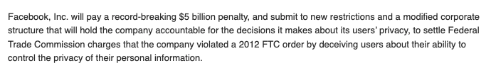
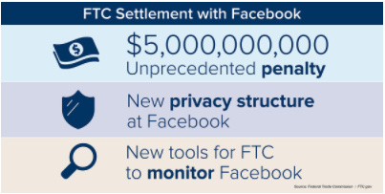

Slide 35
New Restrictions on Facebook
Facebook must exercise greater oversight over third-party apps, including by terminating app developers that fail to certify that they are in compliance with Facebook’s platform policies or fail to justify their need for specific user data;
Facebook is prohibited from using telephone numbers obtained to enable a security feature (e.g., two-factor authentication) for advertising;
Facebook must provide clear and conspicuous notice of its use of facial recognition technology, and obtain affirmative express user consent prior to any use that materially exceeds its prior disclosures to users;
Facebook must establish, implement, and maintain a comprehensive data security program;
Facebook must encrypt user passwords and regularly scan to detect whether any passwords are stored in plaintext; and
Facebook is prohibited from asking for email passwords to other services when consumers sign up for its services.
Notes:
What to say: "2019 consent decree is much stricter. Two-factor authentication phone numbers were being used for ads - now prohibited. Facial recognition requires explicit consent."

Slide 36
International Laws
140+ countries have some sort of privacy law
European Union
EU Privacy Directive in the 1990s was omnibus, but generally not enforced
Now General Data Protection Requirement (GDPR)
Notes:
What to say: "140+ countries have privacy laws. EU's GDPR is the most influential - it has extraterritorial reach, so it affects US companies too."

Slide 37
General Data Privacy Regulation (GDPR)
Applies to organizations located in the EU, not just EU companies
Applies to organizations based anywhere to the extent that any component of the organization is based in the EU
Applied to organizations wherever they're located to the extent that they're offering goods or services to individuals located in the EU or to the extent that they are monitoring the behavior of individuals located in the EU.
All companies have to consider whether the law applies!
Notes:
What to say: "GDPR applies to ANY company offering services to EU residents. US companies must comply. This is regulatory imperialism - EU law governing US companies."
Example: If you have a website that EU citizens can access, GDPR may apply to you.

Slide 38
Familiar GDPR Requirements
Notice
Access with rectification (Correction)
Lawful Basis for Processing
Consent and appropriate use: contractual necessity, legitimate interests of organization
“Right to Be Forgotten”
Data subject can request the erasure of information about them
Exceptions: Freedom of expression, necessary for health/science purposes
Notes:
What to say: "'Right to be forgotten' is controversial. Google must remove search results in EU if requested (with exceptions). Doesn't apply in US - First Amendment conflict."
URL: https://transparencyreport.google.com/eu-privacy/overview - Google's transparency report on GDPR requests

Slide 39
New GDPR Requirements
Cross-border transfers of personal data
Only permitted to countries that the European Commission has determined has adequate level of preotection for personal data
Data privacy impact assessment (DPIA)
Must conduct before data processing
Processing must take place before analysis of individuals, etc.
Notes:
What to say: "Cross-border transfers are complicated. EU says US doesn't have 'adequate' privacy protection. Privacy Shield was invalidated in 2020 (Schrems II). New framework in 2023, but legal challenges continue."
URL: https://www.dataprivacyframework.gov/ - New EU-US Data Privacy Framework

Slide 40

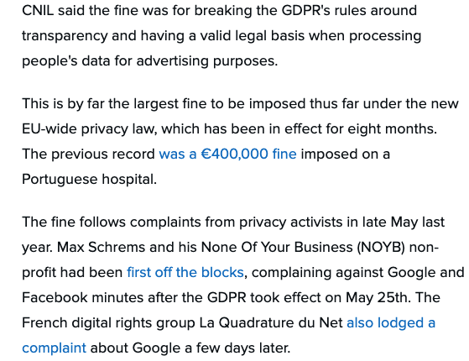
Notes:
Context: GDPR enforcement examples
What to show: https://www.enforcementtracker.com/ - Live GDPR fines tracker
Examples: Meta €1.2B (2023), Amazon €746M (2021), Google €90M (2021)

Slide 41

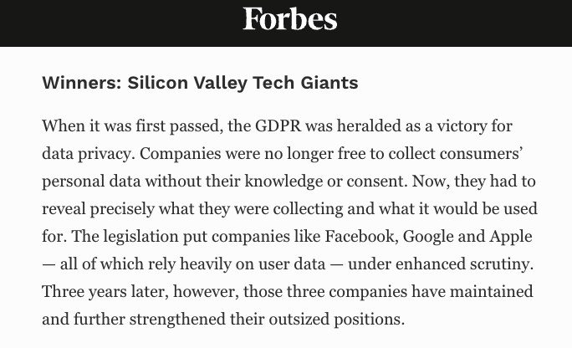
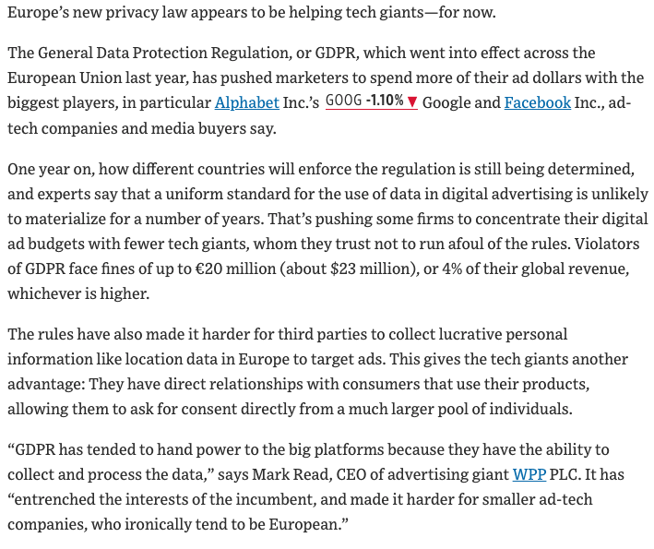
GDPR: A Win for Privacy …or Strengthening the Incumbents?
Notes:
What to say: "Debate: Does GDPR protect privacy or just make compliance so expensive that only big tech can afford it? Small startups struggle with compliance. Cookie consent is annoying UX. But enforcement is real."
Counterpoint: GDPR hasn't stopped big tech dominance

Slide 42
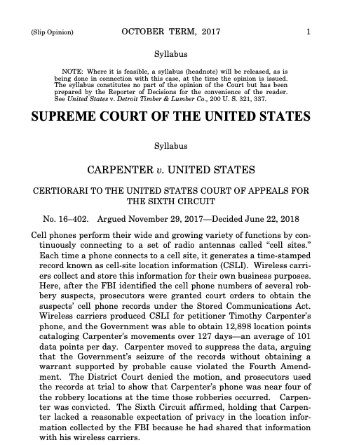
Other Important Cases
Notes:
URLs to show:
- TikTok: https://www.nytimes.com/2024/01/29/technology/tiktok-data-privacy-lawsuit.html
- Cars selling data: https://foundation.mozilla.org/en/privacynotincluded/categories/cars/
- GoodRx: https://www.ftc.gov/news-events/news/press-releases/2023/02/ftc-enforcement-action-bar-goodrx-sharing-consumers-sensitive-health-info-advertising
- Twitter 2FA: https://www.ftc.gov/news-events/news/press-releases/2022/05/ftc-charges-twitter-deceptively-using-account-security-data-sell-targeted-ads

