Slide 1
Vulnerability Discovery and Disclosure
Security, Privacy, and Consumer Protection Nick Feamster University of Chicago

Slide 2
Vulnerabilities
Software is complex, imperfect!
Lots of independent, third-party vulnerability researchers
Key to discovering bugs!
Yet, these relationships can be sometimes adversarial
Also, lots of legal hurdles to surmount…
Typically, we’ve talked about security vulnerabilities, but there are also “privacy vulnerabilities”

Slide 3
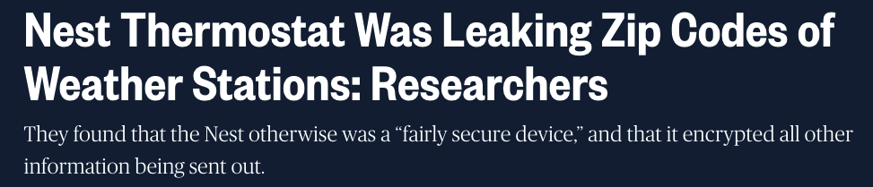
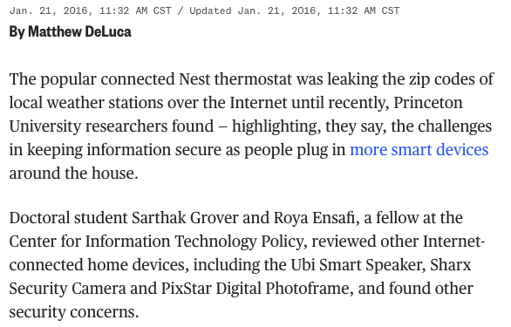
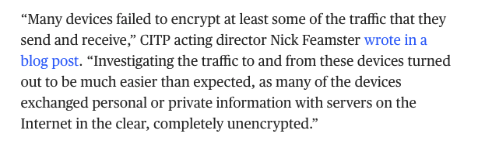

Slide 4
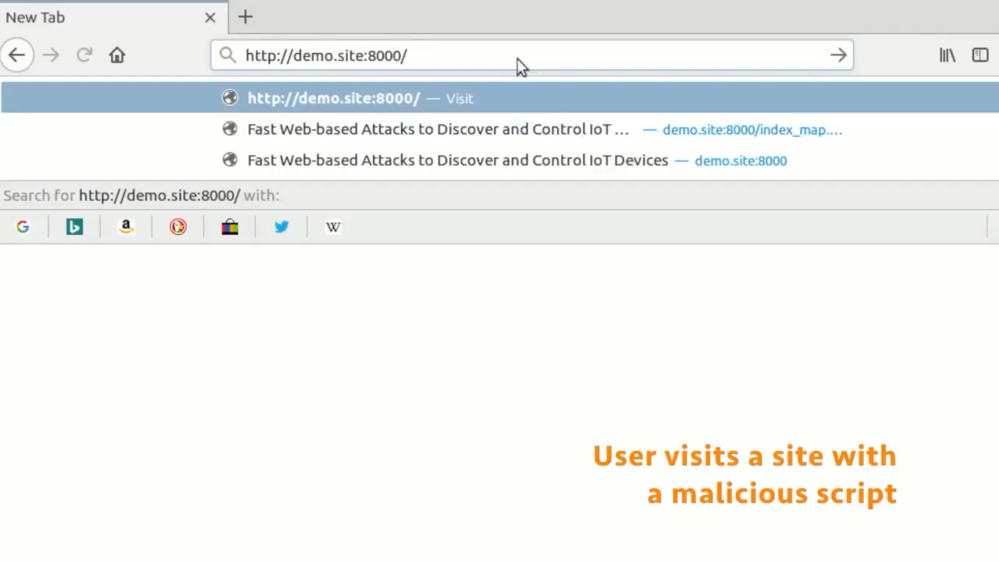
Fast Web-based Attacks to Discover and Control IoT Devices Gunes Acar, Danny Y. Huang, Frank Li, Arvind Narayanan, and Nick Feamster. ACM SIGCOMM Workshop on IoT Security and Privacy. 2018.
Notes:
Many of these devices interface with their smartphone app companion through a (simple, insecure, unauthenticated) web server.
This means that…
Classical web-based attacks also work on many of these devices!

Slide 5
Legal Constructs
Digital Millennium Copyright Act (DMCA)
Computer Fraud and Abuse Act (CFAA)

Slide 6
DMCA
Makes it a crime to produce or disseminate technology that can circumvent copyright protection mechanisms
Don’t need to infringe copyright to commit a crime
Security implications?
Cannot research software to ensure provides appropriate protection mechanisms (Felten v. RIAA, Sklyarov v. Adobe)
Strongly supported by media industries
Notes:
Sklyarov was a PhD student researching cryptanalysis and an employee of the Russian software company ElcomSoft, where he created "The Advanced eBook Processor" (AEBR) software.
On July 16, 2001, after giving a presentation called "eBook's Security — Theory and Practice" at the DEF CON convention in Las Vegas, he was arrested by the FBI as he was about to return to Moscow and charged with distributing a product designed to circumvent copyright protection measures, under the terms of the Digital Millennium Copyright Act.
ElcomSoft's Advanced eBook Processor (AEBPR) allegedly removes the technological protection from eBooks that are in Adobe's eBook format and converts them into Adobe's Portable Document Format, so that people can use eBooks in more expanded ways than currently available under the Adobe eBook format. It also allows the eBooks to be read or processed by third-party software, not just Adobe's eBook Reader software. In effect, the AEBPR program removes the various restrictions (against copying, printing, text-to-speech processing, etc.) that publishers can enable or disable under Adobe's digital rights management system. The program is designed to work only with eBooks that have been lawfully purchased from sales outlets.
http://www.eff.org/IP/DMCA/US_v_Elcomsoft/us_v_sklyarov_faq.html#AEBPR
---
Professor Felten is one of the plaintiffs in EFF's challenge of the DMCA. The noted scientist is the leader of a research team that participated in the Secure Digital Music Initiative's (SDMI) "Public Challenge" (also know as "Hack SDMI") and successfully defeated the technology. His team authored, "Reading Between the Lines: Lessons from the SDMI Challenge," explaining their research findings that was accepted for publication at the 4th International Information Hiding Workshop Conference in April 2001 (http://www.cert.org/IHW2001/). Just prior to the conference, the Princeton Professor received a letter from Matt Oppenheim from the Recording Industry Association of America (RIAA) and the Secure Digital Music Initiative (SDMI) that threatened a lawsuit against Professor Felten's team and their universities and the workshop organizers if the paper was published.
The recording studios claim that the research paper written by the Princeton Professor and his colleagues is a "circumvention device" in violation of the DMCA since the paper describes how the technology works.
http://www.eff.org/IP/DMCA/Felten_v_RIAA/faq_felten.html

Slide 7
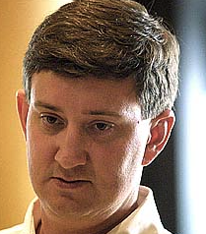

Slide 8
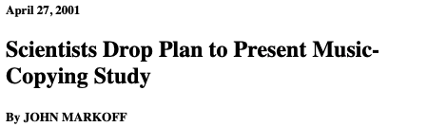
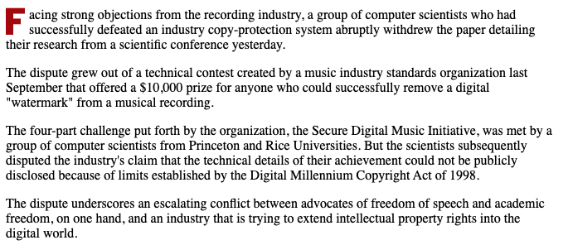

Slide 9
Timeline
September 2000: SDMI Challenge introduced
November 8, 2000: Ed Felten successfully breaks code and intends to publish paper
April 9, 2001: RIAA/SDMI Legally threats Ed Felten
April 26, 2001: Ed Felten publicly announces decision not to publish paper.
May 3, 2001: RIAA/SDMI claim they never intended to sue
June 6, 2001: Ed Felten files lawsuit against RIAA/SDMI
July 12, 2001: The case is dismissed by the court
August 15, 2001: Paper is published

Slide 10
Conflicts with Disclosure
Ed Felten vs. RIAA: Freedom of Speech vs. copyright laws and a company’s rights
Conflict between a discloser (i.e., Ed Felten) and a company (SDMI)
Subsequent 1A challenges to the CFAA have been brought to the Supreme Court…

Slide 11
Computer Fraud and Abuse Act
Passed in 1984
Most comprehensive law regarding computer crimes
Defines specific felonies, including…
Using computers to obtain classified information
Using computers to defraud others
Damaging or denying service to computers used in Interstate Commerce or Communications

Slide 12
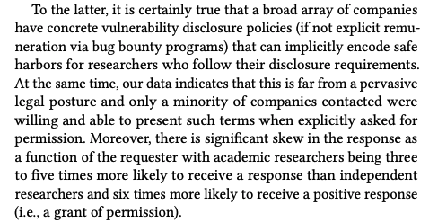
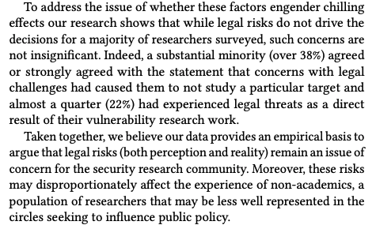
Chilling Effects?

Slide 13
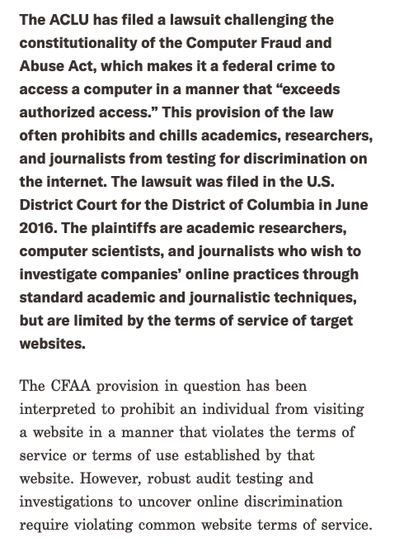
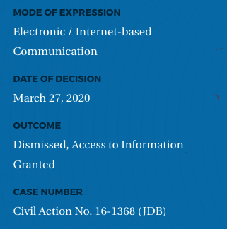
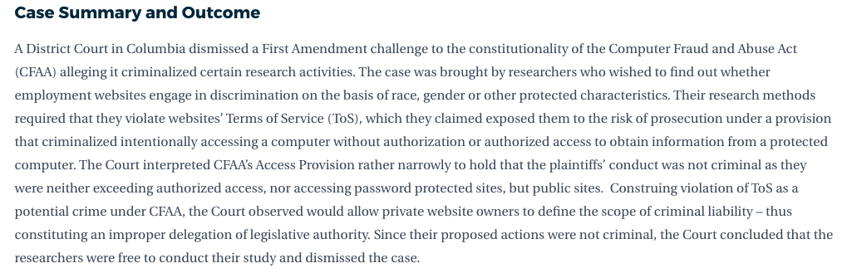
Notes:
https://globalfreedomofexpression.columbia.edu/cases/sandvig-v-barr/

Slide 14
CFAA and ToS: Various Interpretations
2009: Courts reject CFAA prosecution against Lori Drew (MySpace hoax) on arguments of ToS violation
2014: Courts reject CFAA prosection on basis of ToS violation
2016: Courts side with Facebook against a startup that had logged in using credentials supplied by users to scrape data
2019: hiQ labs found not to violate CFAA when it scraped data from LinkedIn, violating terms of service
Notes:
https://arstechnica.com/tech-policy/2020/03/court-violating-a-sites-terms-of-service-isnt-criminal-hacking/

Slide 15
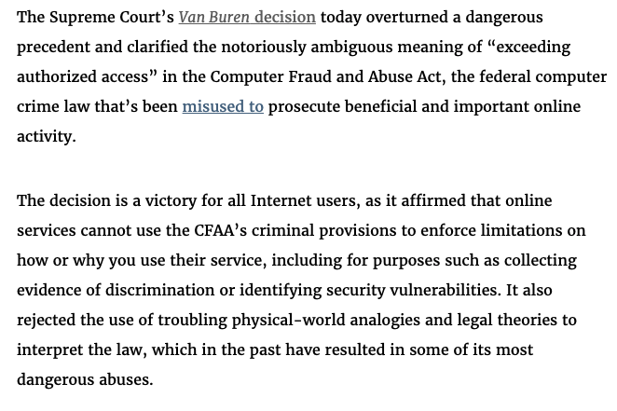

Slide 16
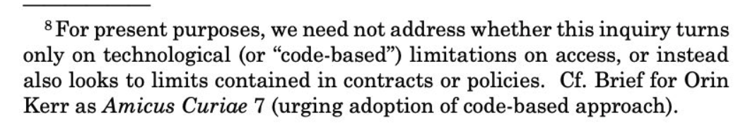
Left Open: Terms of Service and “Policy-Based Restrictions”

Slide 17
Discussion: Vulnerability Disclosure
In case you do find a vulnerability in software, what is your responsibility?
Options:
Tell the world (full disclosure)
Tell the company/group responsible for the software (responsible disclosure)
Sell the information to the grey or black market (no disclosure)
Notes:
What about hardware vulnerabilities?

Slide 18
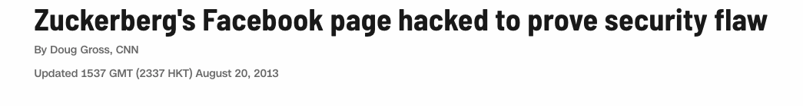
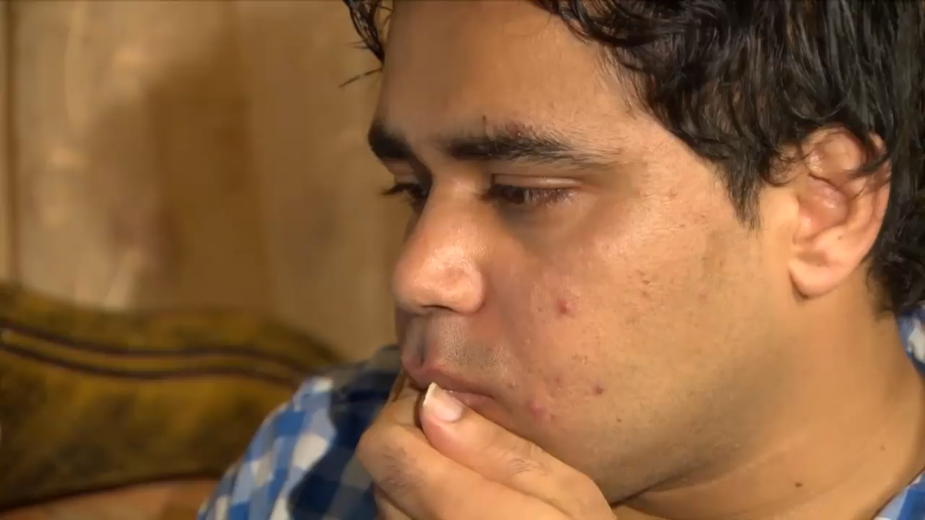
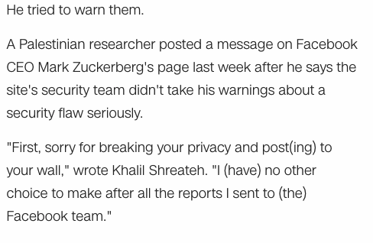

Slide 19
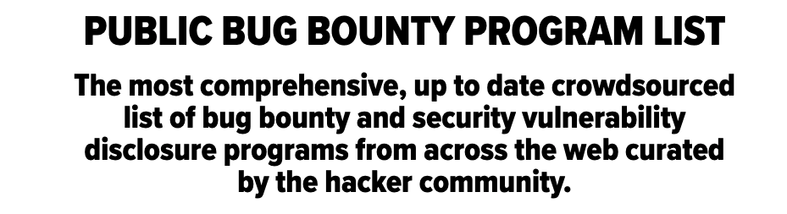
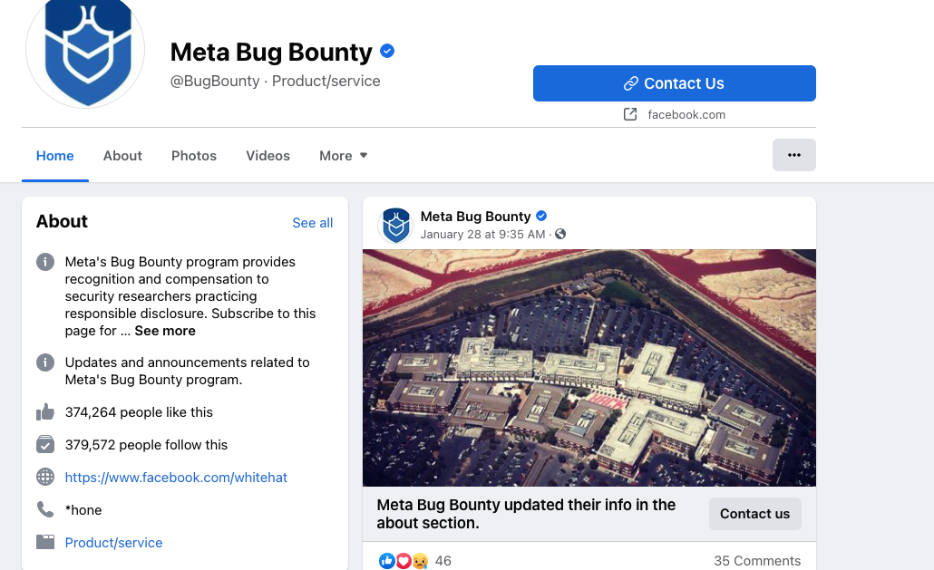
Bug Bounty Programs: Would You Hire a Hacker?
Open problem and subject of much discussion
Pro: “I want somebody who can find problems before the bad guys do"
Skillful, motivated, etc.
Con: “I don’t want to hire an arsonist as a Fire Marshal"
Problem with teamwork, may damage company, etc.
In general assessment of personality is important (morals, ethics, attitude)
How would you fire a hacker?

Slide 20
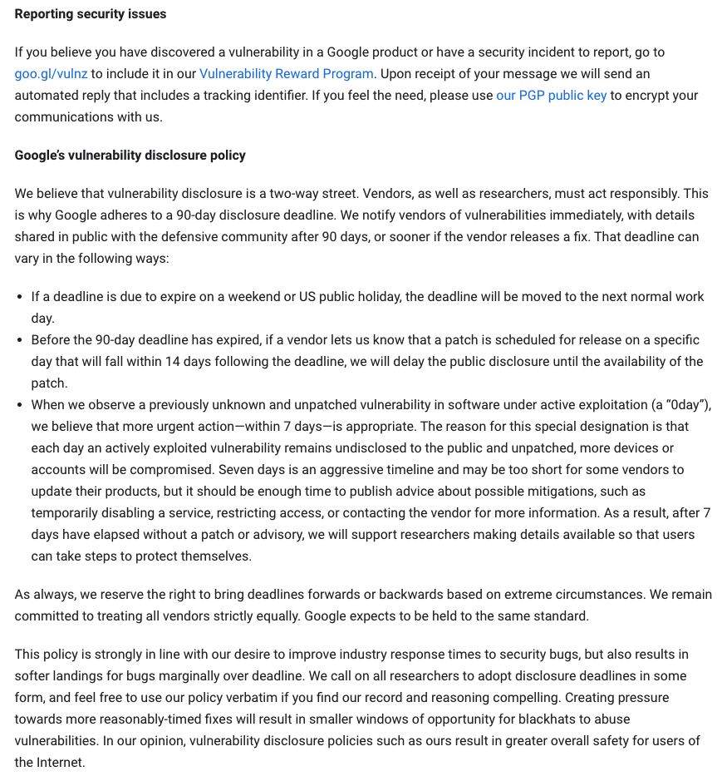
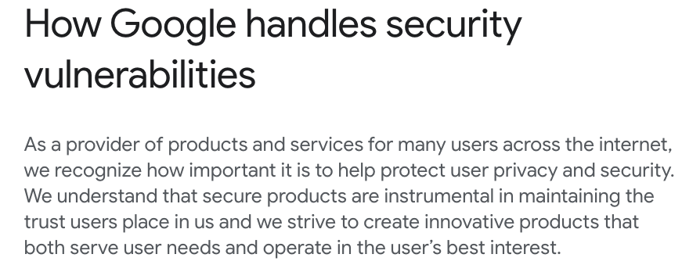
Notes:
https://about.google/appsecurity/

Slide 21
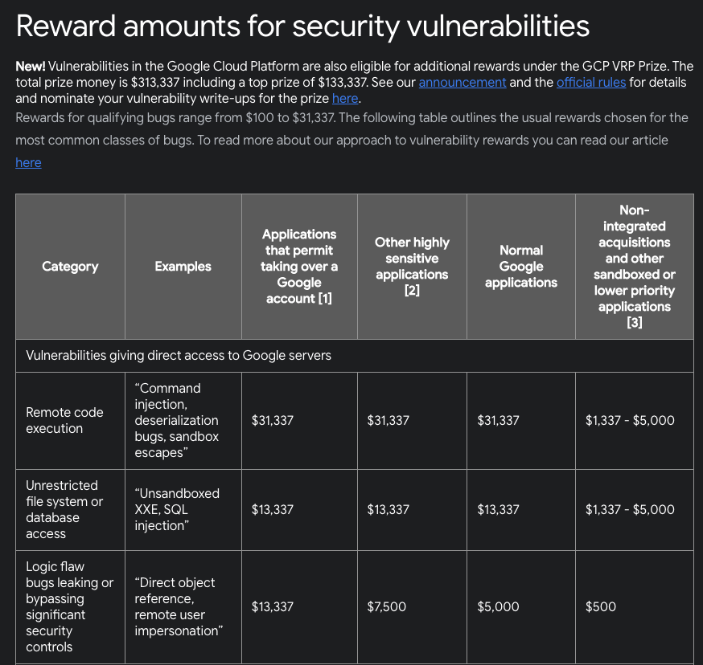
Notes:
https://bughunters.google.com/about/rules/6625378258649088

Slide 22
Bug Bounty Challenges
Organizations worry that some might damage a production system, steal user data, or disclose vulnerabilities found to other parties, or even to the public.
Participants worry that they might face legal charges for vulnerability research and disclosure.
Regulatory area is not well-defined/murky.

Slide 23
Penetration Testing and Audits
Vulnerability analysis followed by exploitation
Assumptions and hypothesis derived from the analysis are verified on the field
It is usually “black-box”
Penetration testing is part of the (larger) security auditing/analysis process, but not always a complete solution
A comprehensive security analysis process takes into account many other aspects (e.g., source code analysis, policy analysis, social engineering

Slide 24
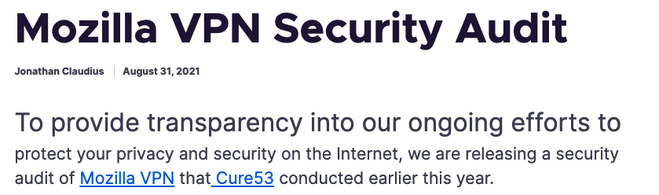
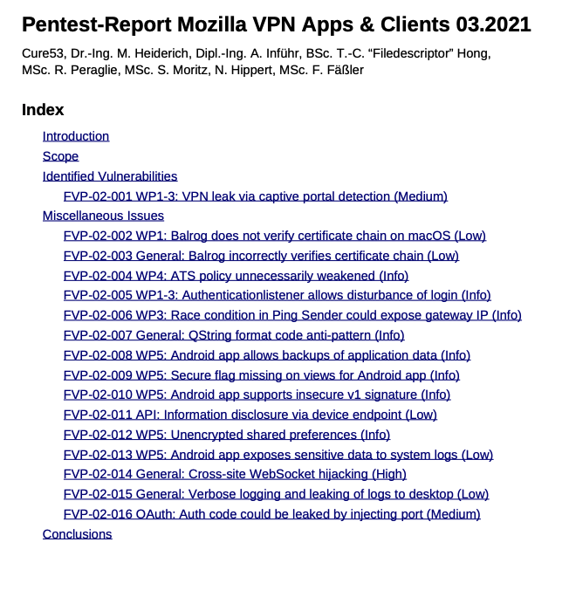

Slide 25
Discussion: Is Penetration Testing Useful?

