Slide 1
Worms and Botnets
Security, Privacy, and Consumer Protection
Nick Feamster
University of Chicago

Slide 2
Viruses
“Infect” a program by modifying it
Self-copied into the program to spread
Four stages:
  dormant phase
  propagation phase
    E.g., attachment to email
  triggering phase
  execution phase

Slide 3
Virus Structure
First line: go to “main” of virus program
Second line: a special mark (infected or not)
Main:
  find uninfected programs
    infect and mark them
  do something damaging to the system
  now “go to” the first line of the original program
    appear to do the normal work
Avoid detection by looking at size of program:
  compress/decompress the original program

Slide 4
Types of Viruses
Parasitic virus
  search and infect executable files
Memory-resident virus
  infect running programs
Boot sector virus
  spreads whenever the system is booted
Stealth virus
Polymorphic virus
  encrypt part of the virus program using randomly generated key

Slide 5
What is a Worm?
Code that replicates and propagates across the network
  Often carries a “payload”
Usually spread via exploiting flaws in open services
  “Viruses” require user action to spread
First worm: Robert Morris, November 1988
  6-10% of all Internet hosts infected (!)
Many more since, but none on that scale until July 2001

Slide 6
WORMS: THEN AND NOW
Notes:
Shifting gears a bit

Slide 7

Morris Worm
Nov 2, 1988 – First major worm
∼10% of Internet-connected machines affected
Robert Tappan Morris
  Cornell student
  Son of computer security expert
  Motivated by curiosity
  First CFAA prosecution
  Now part of YCombinator
Notes:
The first worm was written by someone with no malicious intent, just for curiosity and fun. Things are very different today
Great writeup here
http://www.washingtonpost.com/blogs/the-switch/wp/2013/11/01/how-a-grad-student-trying-to-build-the-first-botnet-brought-the-internet-to-its-knees/
(Accidentally said in class that he was in college, actually grad school)

Slide 8
Morris Internet Worm
What it did
  Determine where it could spread
  Spread its infection
  Remain undiscovered and undiscoverable
Effect
  Resource exhaustion – repeated infection due to a programming bug
  Servers are disconnected from the Internet by sys admin to stop infection

Slide 9
Morris Internet Worm
How it worked
  Where to spread
    Exploit security flaws
      Guess password (encrypted passwd file readable)
      fingerd: buffer overflow
      sendmail: trapdoor (accepts shell commands)
  Spread
    Bootstrap loader to target machine, then fetch rest of code (password authenticated)
  Remain undiscoverable
    Load code in memory, encrypt, remove file
    Periodically changed name and process ID

Slide 10
Morris Worm Redux
1988: No malicious payload, but bogged down infected machines by uncontrolled spawning
  Infected 10% of all Internet hosts at the time
Multiple propagation vectors
  Remote execution using rsh and cracked passwords
    Tried to crack passwords using small dictionary and publicly readable password file; targeted hosts from /etc/hosts.equiv
  Buffer overflow in fingerd on VAX
    Standard stack smashing exploit
  DEBUG command in Sendmail
    In early Sendmail versions, possible to execute a command on a remote machine by sending an SMTP (mail transfer) message

Slide 11
2000s: Worms Go “Mainstream”

Slide 12
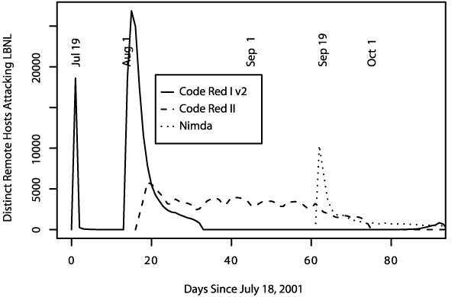
Summer of 2001
Three major worm
outbreaks

Slide 13
Example Worm: Code Red
Initial version: July 13, 2001
Exploited known ISAPI vulnerability in Microsoft IIS Web servers
1st through 20th of each month: spread
20th through end of each month: attack
Payload: Web site defacement
Scanning: Random IP addresses
Bug: failure to seed random number generator

Slide 14
Code Red I
July 13, 2001: First worm of the modern era
Exploited buffer overflow in Microsoft’s Internet Information Server (IIS)
1st through 20th of each month: spread
  Find new targets by random scan of IP address space
    Spawn 99 threads to generate addresses and look for IIS
  Creator forgot to seed the random number generator, and every copy scanned the same set of addresses ☺
21st through the end of each month: attack
  Deface websites with “HELLO! Welcome to http://www.worm.com! Hacked by Chinese!”

Slide 15
Code Red: Revisions
Released July 19, 2001
Payload: flooding attack on www.whitehouse.gov
  Attack was mounted at the IP address of the Web site
Bug: died after 20th of each month
Random number generator for IP scanning fixed

Slide 16
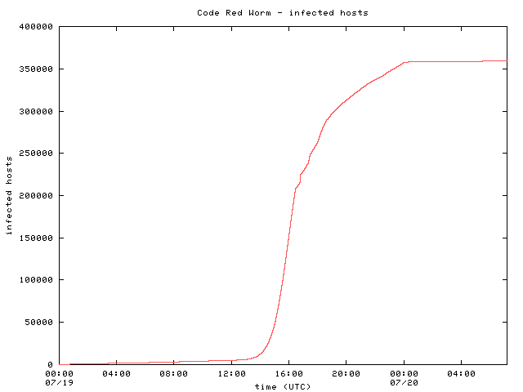
Code Red: Host Infection Rate
Exponential infection rate

Slide 17

Modeling the Spread of Code Red
Random Constant Spread model
  K: initial compromise rate
  N: number of vulnerable hosts
  a: fraction of vulnerable machines already compromised
Newly infected machines in dt
Machines already infected
Rate at which uninfected machines are compromised

Slide 18

Modeling the Spread of Code Red
Growth rate depends only on K
Curve-fitting: K ~ 1.8
Peak scanning rate was about 500k/hour

Slide 19
Designing Fast-Spreading Worms
Hit-list scanning
  Time to infect first 10k hosts dominates infection time
  Solution: Reconnaissance (stealthy scans, etc.)
Permutation scanning
  Observation: Most scanning is redundant
  Idea: Shared permutation of address space. Start scanning from own IP address. Re-randomize when another infected machine is found.
Internet-scale hit lists
  Flash worm: complete infection within 30 seconds

Slide 20
Code Red I v2
July 19, 2001: Same codebase as Code Red I, but fixed the bug in random IP address generation
  Compromised all vulnerable IIS servers on the Internet
  Large vulnerable population meant fast worm spread
    Scanned address space grew exponentially
    350,000 hosts infected in 14 hours!!
Payload: distributed packet flooding (denial of service) attack on www.whitehouse.gov
  Coding bug causes it to die on the 20th of each month… but if victim’s clock is wrong, resurrects on the 1st

Slide 21
Code Red II
August 4, 2001: Same IIS vulnerability, completely different code, kills Code Red I
  Known as “Code Red II” because of comment in code
  Worked only on Windows 2000, crashed NT
Scanning algorithm preferred nearby addresses
  Chose addresses from same class A with probability ½, same class B with probability 3/8, and randomly from the entire Internet with probability 1/8
Payload: installed root backdoor in IIS servers for unrestricted remote access
Died by design on October 1, 2001

Slide 22
Nimda
September 18, 2001: Multi-modal worm using several propagation vectors
  Exploit same IIS buffer overflow as Code Red I and II
  Bulk-email itself as an attachment to email addresses harvested from infected machines
  Copy itself across open network shares
  Add exploit code to Web pages on compromised sites to infect visiting browsers
  Scan for backdoors left by Code Red II
Payload: turned-off code deleting all data on hard drives of infected machines

Slide 23
Signature-Based Defenses Don’t Help
Nimda leaped firewalls
Many firewalls passed mail untouched, relying on mail servers to filter out infections
  Most filters simply scan attachments for signatures (code snippets) of known viruses and worms
Nimda was a brand-new infection with unknown signature, and scanners could not detect it
Big challenge: detection of zero-day attacks
  When a worm first appears in the wild, signature is not extracted until minutes or hours later

Slide 24
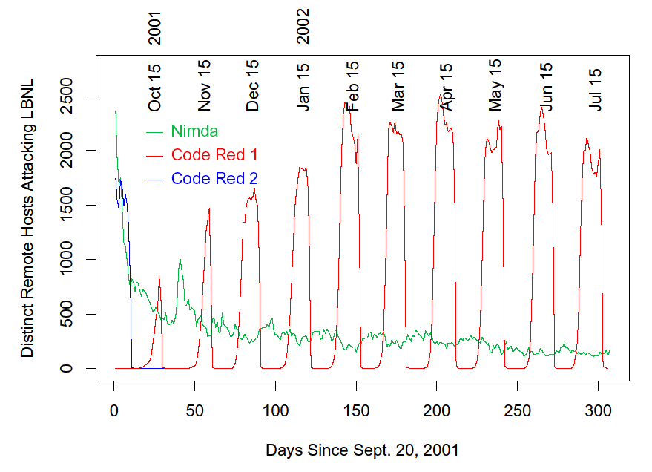
Code Red I and II (Paxson)
With its predator gone, Code Red I comes back, still exhibiting monthly pattern
Code Red II dies off as programmed

Slide 25
Designing Fast-Spreading Worms
Hit-list scanning
  Time to infect first 10k hosts dominates infection time
  Solution: Reconnaissance (stealthy scans, etc.)
Permutation scanning
  Observation: Most scanning is redundant
  Idea: Shared permutation of address space. Start scanning from own IP address. Re-randomize when another infected machine is found.
Internet-scale hit lists
  Flash worm: complete infection within 30 seconds

Slide 26
Code Red Worm Background
Sent HTTP Get request to buffer overflow Win IIS server.
It generated 100 threads to scan simultaneously
  One reason for its fast spreading.
  Huge scan traffic might have caused congestion.
Characteristics:
  Uniformly picked IP addresses to send scan packets.
Code Red worm incident of July 19th, 2001:
  Showed how fast a worm can spread.
    more than 350,000 infected in less than one day.
Notes:
Some background on the Code Red worm. Code Red used HTTP get request to buffer overflow vulnerable Windows IIS servers. It generated 100 threads to scan simultaneously. That’s one reason why it spread so fast. And since each copy of the worm generated so many scan packets, the huge scan traffic on that day might have caused congestion to the Internet.
One important property of the Code Red worm is that it uniformly picked IP addresses to scan. I’ll discuss this property several times later.

Slide 27
Slammer (Sapphire) Worm
January 24/25, 2003: UDP worm exploiting buffer overflow in Microsoft’s SQL Server
  Overflow was already known and patched by Microsoft… but not everybody installed the patch
Entire code fits into a single 404-byte UDP packet
  Worm binary followed by overflow pointer back to itself
Classic buffer overflow combined with random scanning: once control is passed to worm code, it randomly generates IP addresses and attempts to send a copy of itself to port 1434
  MS-SQL listens at port 1434

Slide 28
Slammer Propagation
Scan rate of 55,000,000 addresses per second
  Scan rate = rate at which worm generates IP addresses of potential targets
  Up to 30,000 single-packet worm copies per second
Initial infection was doubling in 8.5 seconds (!!)
  Doubling time of Code Red was 37 minutes
Worm-generated packets saturated carrying capacity of the Internet in 10 minutes
  75,000 SQL servers compromised
  And that’s in spite of broken pseudo-random number generator used for IP address generation

Slide 29
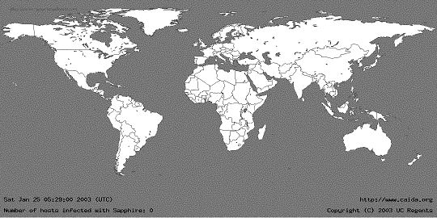
05:29:00 UTC, January 25, 2003
[from Moore et al. “The Spread of the Sapphire/Slammer Worm”]

Slide 30
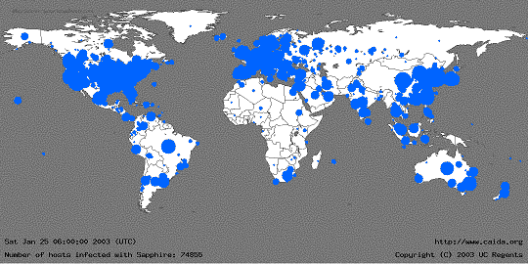
30 Minutes Later
[from Moore et al. “The Spread of the Sapphire/Slammer Worm”]
Size of circles is logarithmic in
the number of infected machines

Slide 31
Slammer Impact
$1.25 Billion of damage
Temporarily knocked out many elements of critical infrastructure
  Bank of America ATM network
  Entire cell phone network in South Korea
  Five root DNS servers
  Continental Airlines’ ticket processing software
The worm did not even have malicious payload… simply bandwidth exhaustion on the network and resource exhaustion on infected machines

Slide 32
Slammer’s Speed
Old-style worms (Code Red) spawn a new thread which tries to establish a TCP connection and, if successful, send a copy of itself over TCP
  Limited by latency of the network
Slammer was a connectionless UDP worm
  No connection establishment, simply send 404-byte UDP packet to randomly generated IP addresses
  Limited only by bandwidth of the network
A TCP worm can scan even faster
  Dump zillions of 40-byte TCP-SYN packets into link layer, send worm copy only if SYN-ACK comes back

Slide 33
Storm / Peacomm (2007)
Spreads by cleverly designed spam campaign
  Arrives as an email with catchy subject
    First instance: “230 dead as storm batters Europe”
    Other examples: “Condoleeza Rice has kicked German Chancellor”, “Radical Muslim drinking enemies’s blood”, “Saddam Hussein alive!”, “Fidel Castro dead”, etc.
Attachment or URL with malicious payload
  FullVideo.exe, MoreHere.exe, ReadMore.exe, etc.
  Also masquerades as flash postcards
Once opened, installs Trojan (wincom32) & rootkit

Slide 34
Storm Worm Characteristics
Infected machine joins botnet
  Between 1 and 5 million machines infected (Sep 2007)
Obfuscated peer-to-peer control structure
  Interacts with peers via eDonkey protocol
Obfuscated code, anti-debugging defenses
  Goes into infinite loop if detects VMware or Virtual PC
  Large number of spurious probes (evidence of external analysis) triggers distributed DoS attack

Slide 35
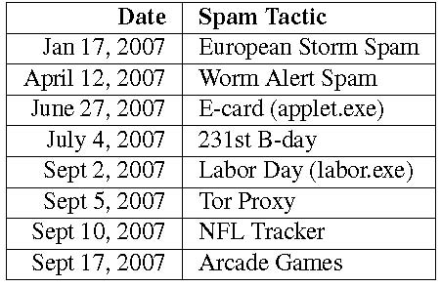
Storm Worm Outbreaks
Spambot binary used to spread new infections in subsequent campaigns
  Looks for email addresses and mailing lists in the files on the infected machines

Slide 36
Other “Famous” Botnets
Conficker (2008)
Mega-D (2009)
Zeus (2010)
Mirai (2016)

Slide 37
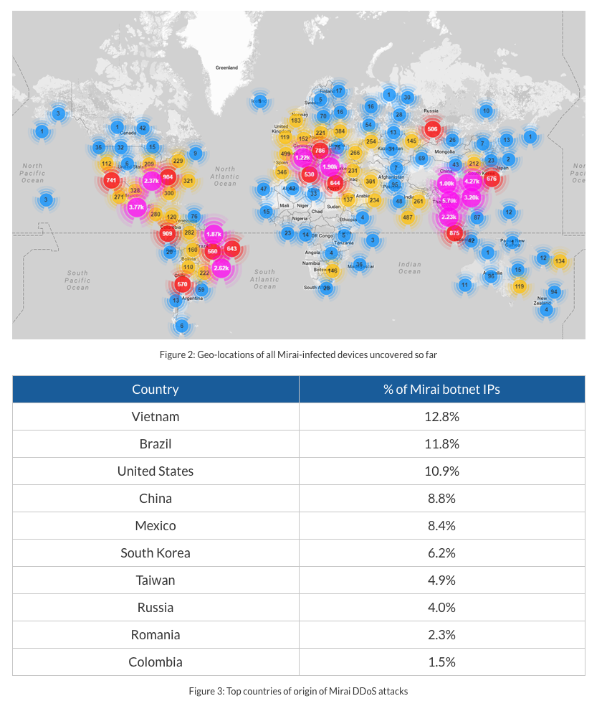
Mirai (2016)
50,000 unique IP addresses in 160+ countries
Default passwords on IoT devices
Notes:
https://www.incapsula.com/blog/malware-analysis-mirai-ddos-botnet.html

Slide 38
Botnets

Slide 39
Botnets
Bots: Autonomous programs performing tasks
Plenty of “benign” bots
  e.g., weatherbug
Botnets: group of bots
  Typically carries malicious connotation
  Large numbers of infected machines
  Machines “enlisted” with infection vectors like worms
Available for simultaneous control

Slide 40
“Rallying” the Botnet
Easy to combine worm, backdoor functionality
Problem: how to learn about successfully infected machines?
Options
  Email
  Hard-coded email address

Slide 41
Botnet Control
Dynamic
DNS
Infected Machine
Botnet
Controller
Botnet master typically runs on some server
Infected machine contacts botnet via DNS
Dynamic DNS: allows controller to move about freely

Slide 42
Botnet Command and Control (C&C)
From the Botmaster point of view
Centralized
  Pro - easy to setup, fast commands dissemination
  Cons - easy to detect , single point of failure
Peer-to-Peer Topology
  Pro – decentralized, not easy to detect , not single point of failure
  Cons – not easy to setup (more complex), message delivery not guaranteed and high latency

Slide 43
Botnet History: How we got here
Early 1990s: IRC bots
  eggdrop: automated management of IRC channels
1999-2000: DDoS tools
  Trinoo, TFN2k, Stacheldraht
1998-2000: Trojans
  BackOrifice, BackOrifice2k, SubSeven
2001- : Worms
  Code Red, Blaster, Sasser
Fast spreading capabilities pose big threat
Put these pieces together and add a controller…

Slide 44
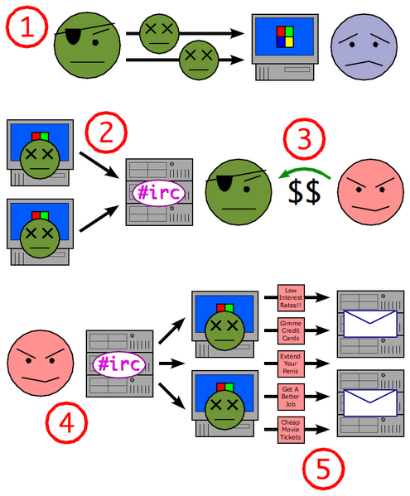
Putting it together
Miscreant (botherd) launches worm, virus, or other mechanism to infect Windows machine.
Infected machines contact botnet controller.
Spammer (sponsor) pays miscreant for use of botnet.
Spammer uses botnet to send spam emails.
Source: Wikipedia

Slide 45
Botnet Usage
DDOS
Spam
Sniffing traffic
Keylogging
Installing Advertisement Add-ons and Browser Helper Objects (BHOs)
Manipulating online polls/games
Mass ID theft

Slide 46
Defenses: Monitoring and Takedown

Slide 47
Early Days: IRC-Based Monitoring
Join IRC channel, monitor all communications
This approach became more difficult over time
  Move towards encrypted C&C Communication
  Move away from IRC-based botnets (as predicted)

Slide 48
Botnet Detection and Tracking
Network Intrusion Detection Systems (e.g., Snort)
  Signature: alert tcp any any -> any any (msg:"Agobot/Phatbot Infection Successful"; flow:established; content:"221
Honetpots/Honeynets: gather information
  Run unpatched version of Windows
  Usually infected within 10 minutes
  Capture binary
    determine scanning patterns, etc.
  Capture network traffic
    Locate identity of command and control, other bots, etc.
“Internet Motion Sensor”

Slide 49
Using DNS Traffic to Find Controllers
Different types of queries may reveal info
  Repetitive A queries may indicate bot/controller
  MX queries may indicate spam bot
  PTR queries may indicate a server
Usually 3 level: hostname.subdomain.TLD
Names and subdomains that just look rogue
  (e.g., irc.big-bot.de)

Slide 50
DNS Monitoring
Command-and-control hijack
  Advantages: accurate estimation of bot population
  Disadvantages: bot is rendered useless; can’t monitor activity from command and control
Complete TCP three-way handshakes
  Can distinguish distinct infections
  Can distinguish infected bots from port scans, etc.

