Slide 1
Why Cryptosystems Fail (1993-Present)
Security, Privacy, and Consumer Protection Nick Feamster University of Chicago

Slide 2
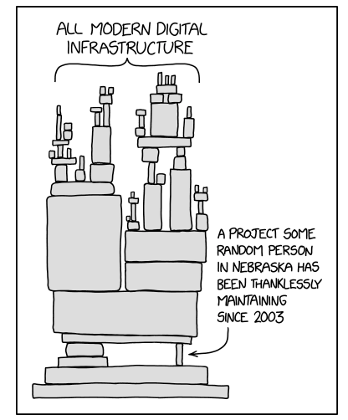
Notes:
https://xkcd.com/2347/

Slide 3

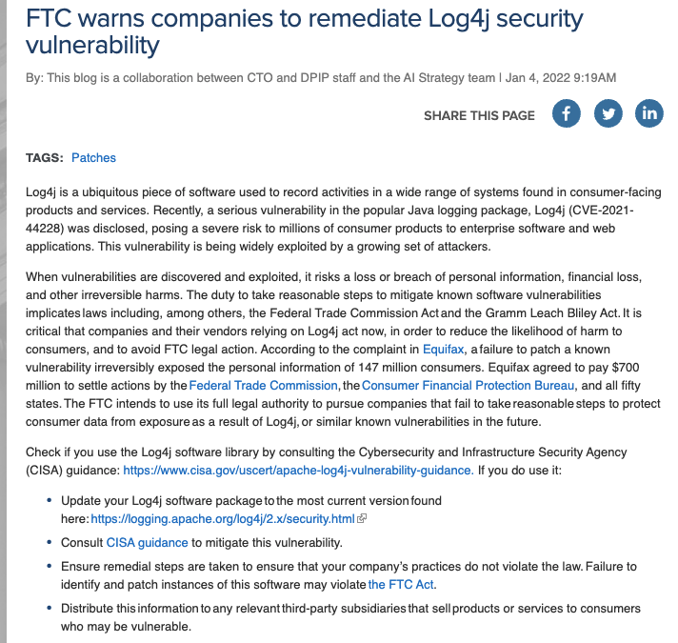
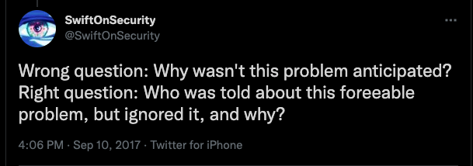
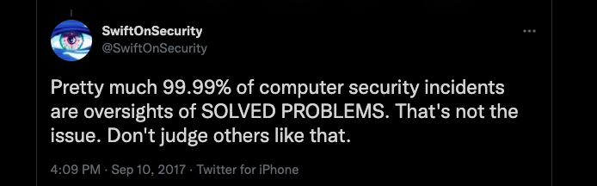
Notes:
When vulnerabilities are discovered and exploited, it risks a loss or breach of personal information, financial loss, and other irreversible harms. The duty to take reasonable steps to mitigate known software vulnerabilities implicates laws including, among others, the Federal Trade Commission Act and the Gramm Leach Bliley Act. It is critical that companies and their vendors relying on Log4j act now, in order to reduce the likelihood of harm to consumers, and to avoid FTC legal action.

Slide 4
Differences Between Cryptology and Other Forms of Engineering
In contrast, hard to get public feedback about how cryptosystems fail.
Hence, the same mistakes are made repeatedly.
Cryptosystem designers are at a disadvantage.

Slide 5
Case Study: Banking and ATMs
Banks carry risks of new technology in the US.
In the UK, not so…
Court cases resulted…
Study of ATM failures.

Slide 6
How ATM Fraud Takes Place
Insider attacks
Bank clerk who issued extra card.
Complaints stonewalled.
Outsiders
Observe PINs, copy account numbers to blank cards, …
Replay attack of “pay” response from bank to ATM. (Jackpotting)
Insertion of telephone card.
False terminals

Slide 7
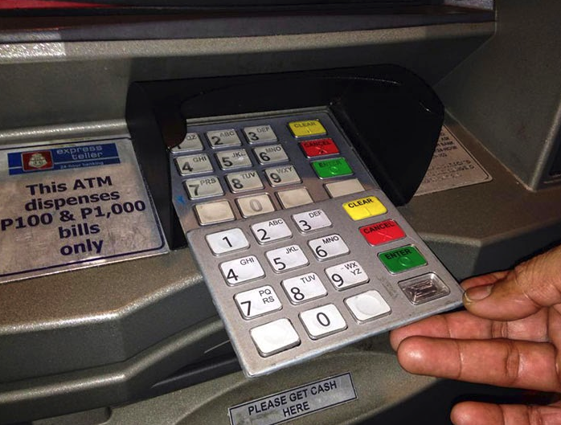

Slide 8

How ATM Fraud Takes Place
PINs
Checksums reducing entropy
Issuing same PIN to all customers
Writing PIN down
…
Bogus ATMs

Slide 9
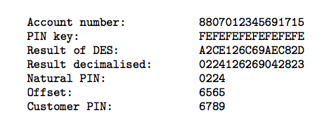
More Sophisticated Attacks
PIN Derived from account number.
Problems
PIN key must be kept secret. (Yet, it must be distributed.)
Key must be available for use at all times.
Poor software implementations and sloppy operating procedures (open files, sharing).

Slide 10
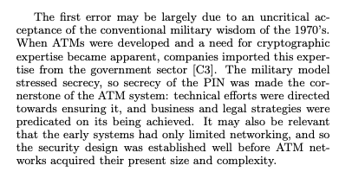

Fundamental Errors

Slide 11
Activity
Faulty software implementation
Cryptanalysis
Poor key management
Human factors / failure to estimate user sophistication

Slide 12
Takeaways
“The vast majority of security failures occur at the level of implementation detail.”
Operating procedures often weakest link
Suppliers overestimate customers’ level of security design sophistication
Security functions implemented at application level often neglected

Slide 13
Options for Equipment Vendors
To design products which can be integrated into systems, and thereafter maintained and managed, by computer staff with a realistic level of expertise
To train and certify the client personnel who will implement the product into a system, and to provide enough continuing support to ensure that it gets maintained and managed adequately
To supply their own trained and bonded personnel to implement, maintain and manage the system.

Slide 14
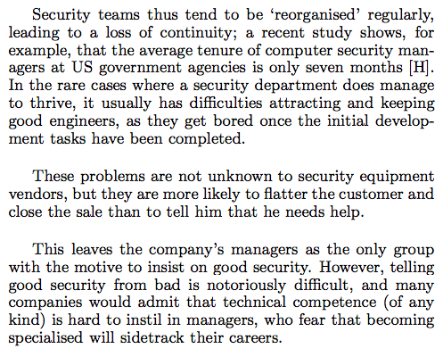

Slide 15
Specifications
Should list all possible failure modes.
Should make prevention strategies clear.
Explain how these strategies are implemented.
Test whether the equipment can be operated by people with the level of skill and experience assumed in the specification.

Slide 16


Constant feedback
Incremental improvement
Pilot in control
Redundant interlocks
Formal verification
System in control

Slide 17
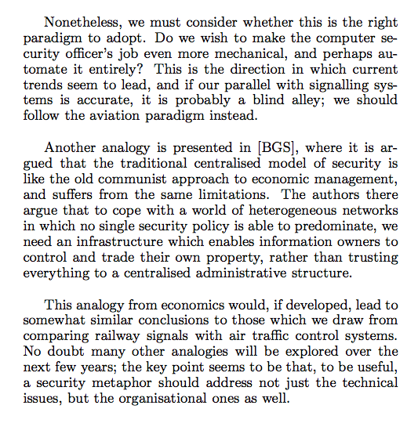
Notes:
Good point for debate.

Slide 18
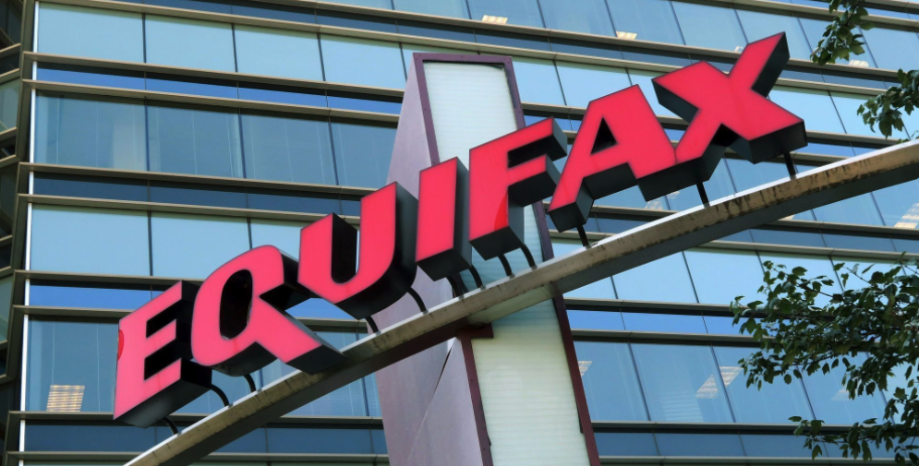

Slide 19
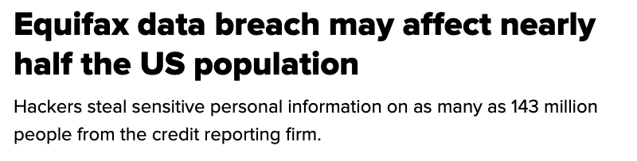
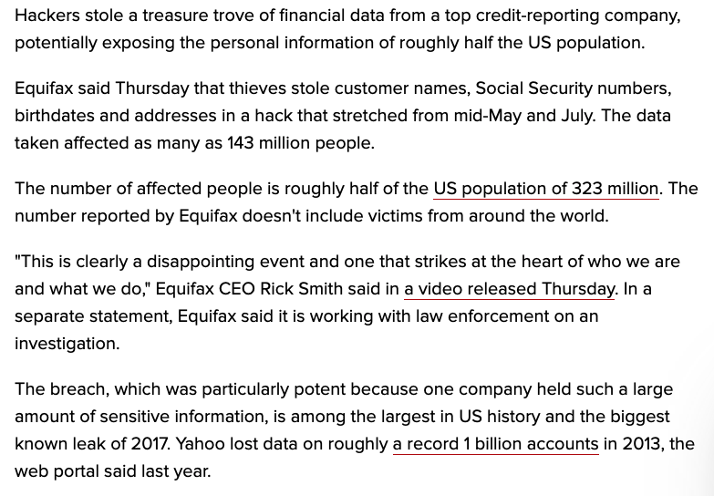
Notes:
The data breach into Equifax was principally through a third-party software exploit that had been patched, and Equifax failed to update their servers with it. Equifax had been using the open-source Apache Struts as its website framework for systems handling credit disputes from consumers. A key security patch for Apache Struts was released on March 7, 2017 after a security exploit was found and all users of the framework were urged to update immediately.^{[3]} Security experts found an unknown hacking group trying to find websites that had failed to update Struts as early as March 10, 2017 as to find a system to exploit.^{[4]}
The Equifax data breach occurred between May and July 2017 at the American credit bureau Equifax. Private records of 147.9 million Americans along with 15.2 million British citizens and about 19,000 Canadian citizens were compromised in the breach, making it one of the largest cybercrimes related to identity theft. In a settlement with the United States Federal Trade Commission, Equifax offered affected users settlement funds and free credit monitoring.
In February 2020, the United States government indicted members of China's People's Liberation Army for hacking into Equifax and plundering sensitive data as part of a massive heist that also included stealing trade secrets, though the Chinese Communist Party denied these claims.^{[1][2]}

Slide 20

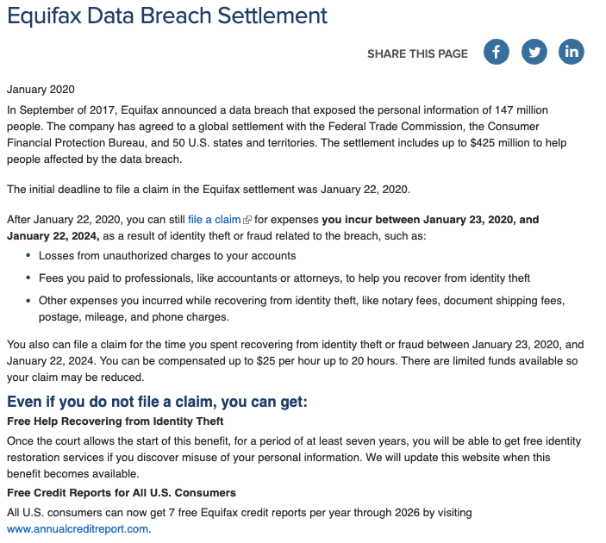
Notes:
On July 22, 2019, Equifax agreed to a settlement with the Federal Trade Commission (FTC), CFPB, 48 U.S. states, Washington, D.C., and Puerto Rico to alleviate damages to affected individuals and make organizational changes to avoid similar breaches in the future. The total cost of the settlement included $300 million to a fund for victim compensation, $175 million to the states and territories in the agreement, and $100 million to the CFPB in fines.^{[53]} In July 2019, the FTC published information on how affected individuals could file a claim against the victim compensation fund using the website EquifaxBreachSettlement.com.^{[54]}

Slide 21
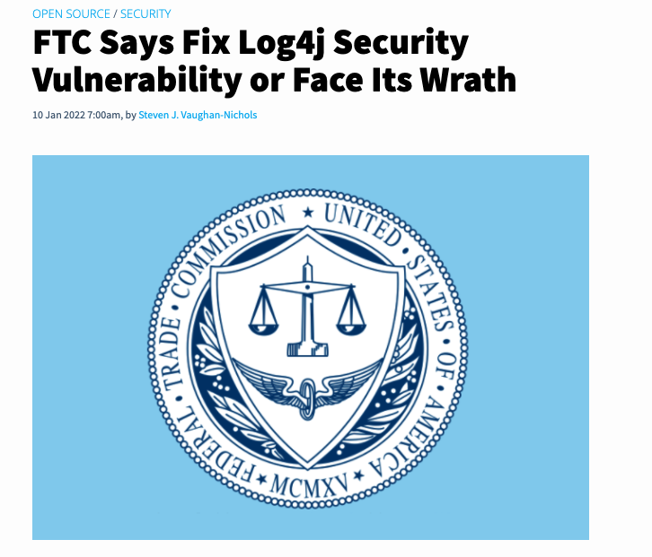
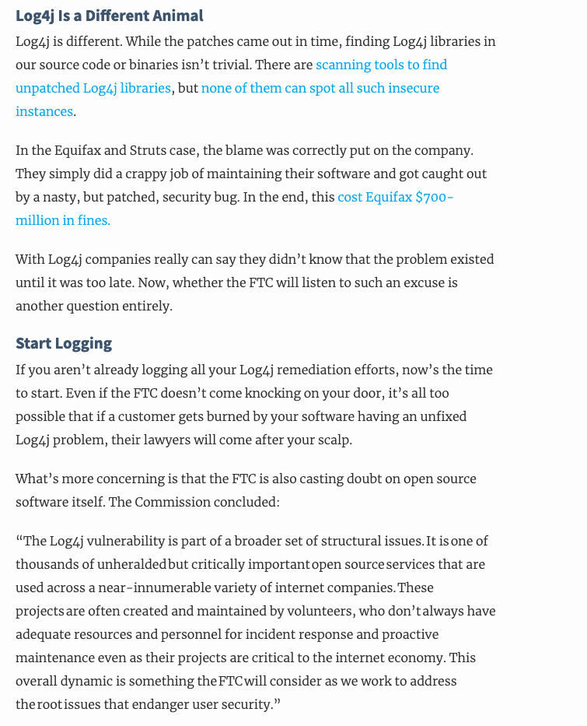

Slide 22
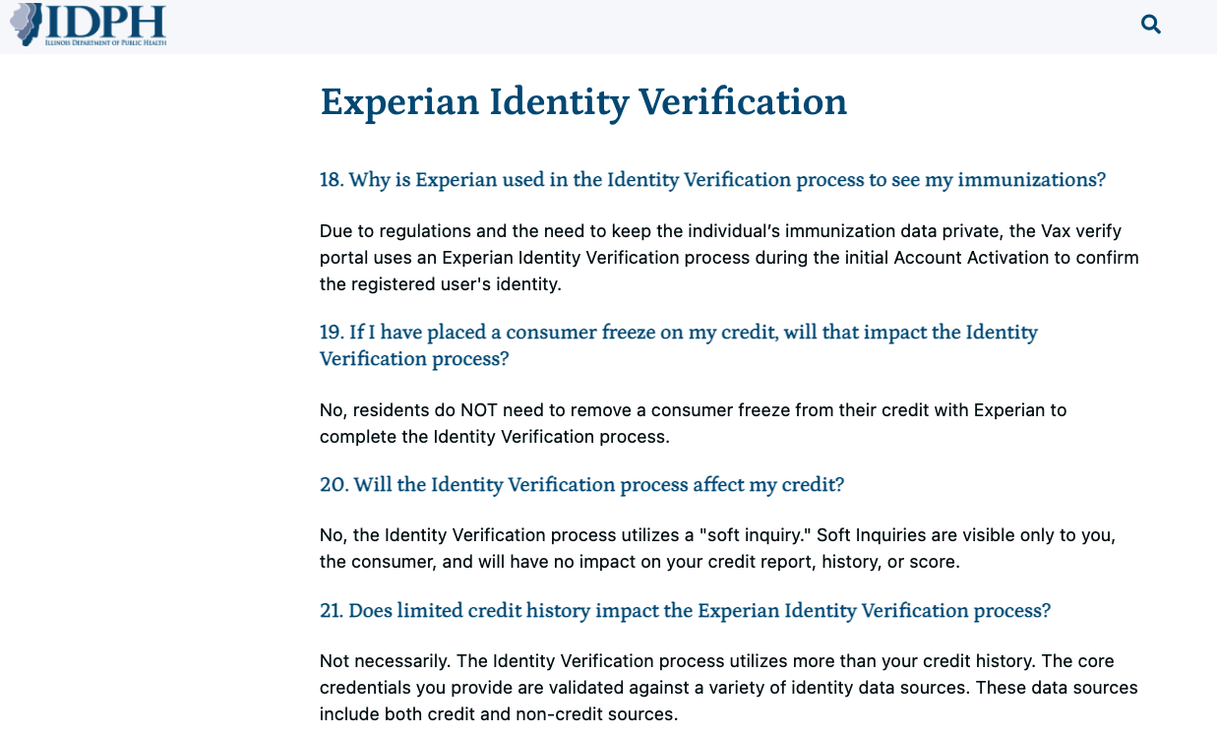
Food for Thought: IDPH Identity Verification…

