Slide 1
Networking Review
CS461 / ECE422 – UIUC Spring 2016
Simon Kim

Slide 2
Topics
Networking Basics (Lecture 15)
Attacks (Lecture 16, 17, 20)
Sniffing
IP Spoofing
DDoS
Worms (Lecture 20)
Botnets (Lecture 20)
Defense (Lecture 18)
Firewall
IDS
SSL, IPsec
VPN
802.11 Security
Anonymity (Lecture 19)
MP4
Traffic analysis
Capturing in monitor mode

Slide 3
Networking Basics
OSI Layer
TCP/UDP
Packet Encapsulation
Network interface – promiscuous vs monitor
MAC and IP addresses
CIDR (Classless Inter-Domain Routing) – subnets
E.g. 192.168.100.1/24
NAT (Network Address Translation) – between internal (private) address and external (public) address

Slide 4
Attacks
Possible at all layers of the network
Data-link
Network
Transport
Application
Compromises all 3 security properties
Confidentiality (e.g. sniffing, eavesdropping)
Integrity (e.g. spoofing, content forgeries, MITM)
Availability (e.g. denial-of-service)

Slide 5
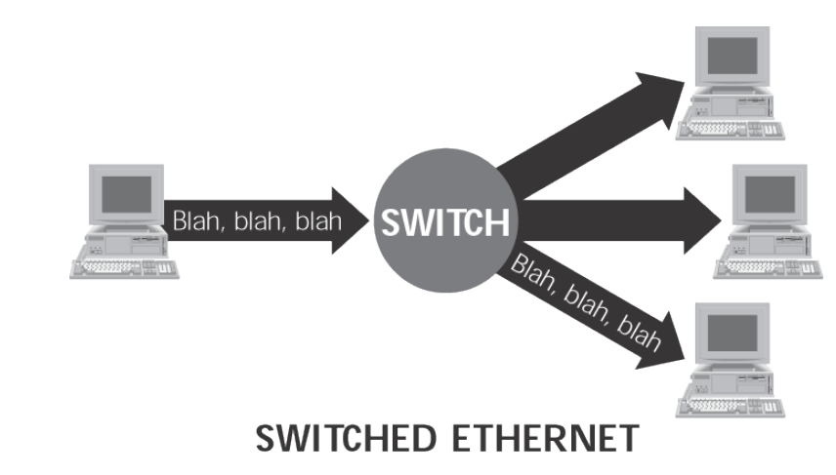
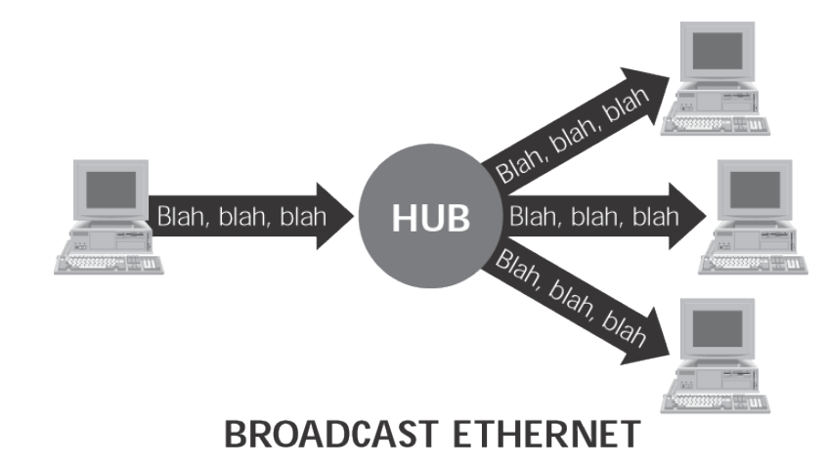
Attacks – Sniffing
Active – packets from a local network built with a switch
Passive – packets from a local network built with a hub or a wireless network
Active
Passive

Slide 6
Attacks – Sniffing (cont.)
Active Sniffing
Need to fool the switch in order to intercept the packets
MAC flooding – fill up switch’s memory with random MAC addresses
ARP spoofing – change victim’s ARP table
ARP – no authentication

Slide 7
Attacks – IP Spoofing
IP spoofing – faking the source IP address to the target’s
Blind spoofing – attack from any source
Non-blind spoofing – attack from the same subnet
Common usage
Denial-of-Service
TCP Session hijacking – Lecture 16 slide 22-26
Man in the Middle

Slide 8
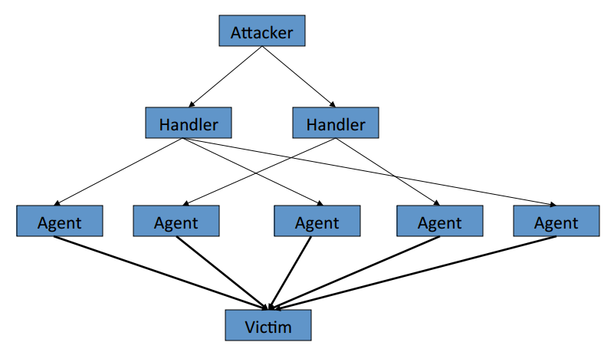
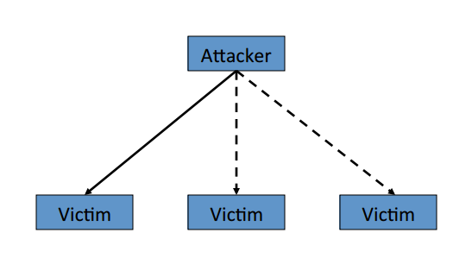
Attacks – DDoS
Distributed Denial of Service – attack against availability
Consume target’s computing and network resources (e.g. fork bomb, fill disk, flooding)
Make service unavailable (e.g. crash or exploit system/service)
Simple DoS
Distributed DoS

Slide 9
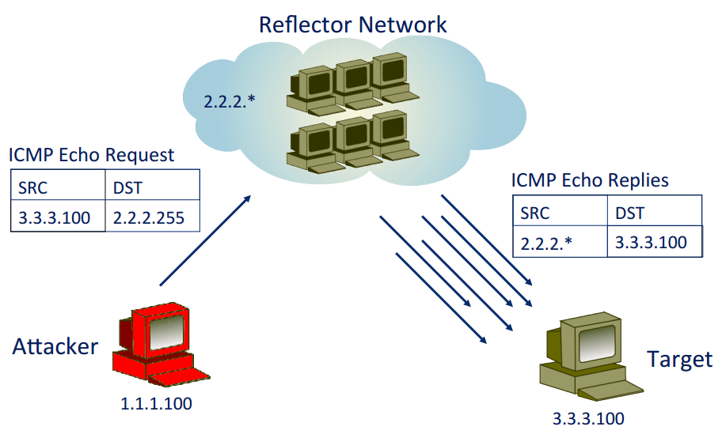
Attacks – DDoS (cont.)
Amplified DDoS attack – small request, large response
Often relies on properties of several UDP-based protocols
Spoofability
Broad deployment
Large response to small request
NTP DDoS – using NTP protocol special diagnostic modes (6 or 7)
Blind spoofing – e.g. TCP SYN flood
Blind spoofing

Slide 10
Attacks – DNS
DNS hijacking – change the IP associated with a server
DNS spoofing – DNS response is easily spoofed
DNS Cache poisoning – give DNS servers false records

Slide 11
Attacks – Worms (Lecture 20)
Self-replicates, spreads through the network
vs Virus, Trojan horse
Virus and Trojan horse rely on human intervention
Can be used to:
Launch DDoS attacks (install bot networks) - availability
Access sensitive information – confidentiality
Corrupt the sensitive information - integrity

Slide 12
Attacks – Worms (cont.)
Propagation
Scanning – chooses random address
Coordinated scanning – different instances scan different addresses
Flash – propagate along pre-assembled tree of targets
Meta-server – ask server for vulnerable target
Topological – use information from infected
Contagion – propagate along with normal communication

Slide 13
Attacks – Botnet (Lecture 20)
Bot – a servant process on a compromised system
Installed by Trojans or worms
Botnet – a network of compromised hosts (i.e. bots, controllers)
Provides
Anonymity
Powerful delivery platform
Lifecycle
Propagation – infection
Communication – command and control
Attack – i.e. DDoS

Slide 14
Attacks – Botnet (cont.)
Application level
Emails
Webpage contents
SNS (social engineering)

Slide 15
Defense – Firewall
Controls incoming and outgoing network traffic
Incoming
DDoS attack – e.g. SYN flooding
Unauthorized access
Outgoing
Bandwidth control
Internet usage – e.g. games, pornography, SNS
Privacy
Types
Application level
Packet-filtering

Slide 16
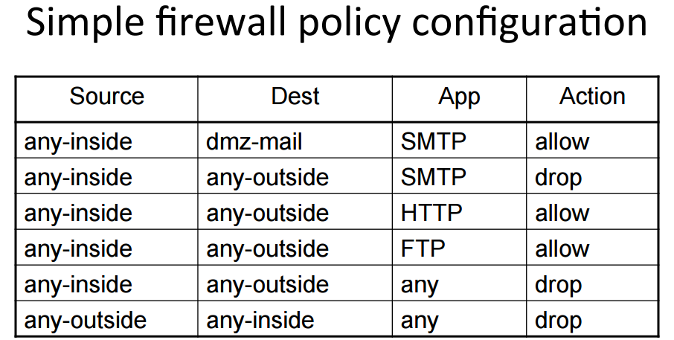
Defense – Firewall (cont.)

Slide 17
Defense - IDS
IDS – intrusion detection system
Alerts when anomalies detected
Post-hoc
Misuse Detection – defines what is abnormal using attack signatures
Rule-based – requires prior knowledge on attacks
Less false-positives
Anomaly Detection – defines what is normal using profiles
Statistical analysis on typical traffic flow

Slide 18
Defense – SSL, IPsec
SSL – Lecture 18 slide 21-22
Transport layer security to TCP-based applications
IPsec – Lecture 18 slide 23-25
Network layer security
More complex
Difficult to define and maintain
More suitable for site-to-site VPN

Slide 19
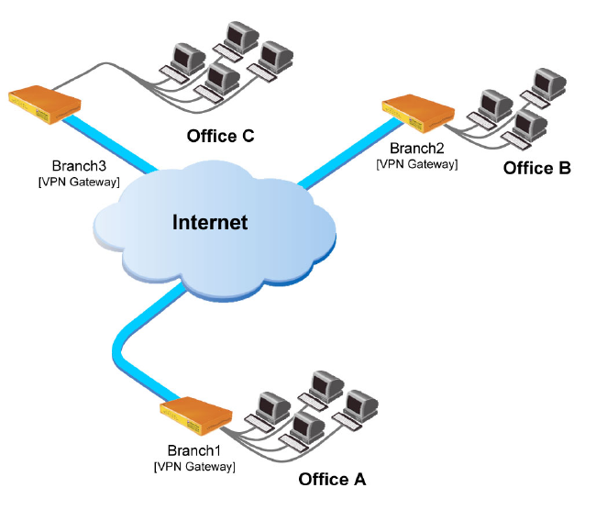
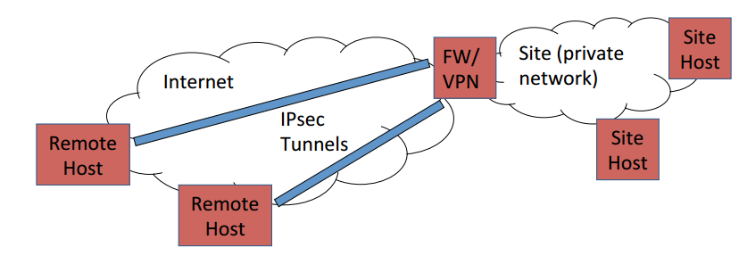
Defense – VPN
VPN – Virtual Private Network
IP (site-to-site) VPN
End-to-end VPN
Connect remote hosts to a firewalled network (e.g. vpn.cites.illinois.edu)
https://answers.uillinois.edu/illinois/47667
Site-to-site VPN
End-to-end VPN
Source: http://sysnetnotes.blogspot.in/2015/06/vpn-basics-site-to-site-vpn-and-remote.html

Slide 20
Defense – 802.11 Security
WEP (Wired Equivalent Privacy)
insecure, broken
(Lecture 18 slide 27-29)
802.11i
WPA (WiFi-Protected Access) – draft 802.11i standard (2003)
WPA2 – full 802.11i standard (2004)

Slide 21
Anonymity
Anonymity – concealing your identity (not contents)
In communications, concealing the identity of source and/or destination
Nymity Spectrum
Verinymity – credit card #s, driver’s license, address
Pseudonymity – pen names, many blogs
Linkable anonymity – loyalty cards, prepaid mobile phone
Unlinkable anonymity – paying in cash, Tor

Slide 22
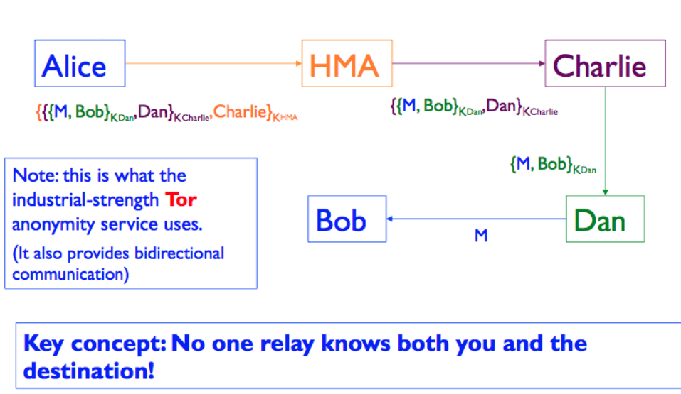
Anonymity (cont.)
How?
Proxy – intermediary that relays traffic
VPN
https://www.bestvpn.com/blog/4085/proxies-vs-vpn-whats-the-difference/
Tor
Onion routing
Does not provide end-to-end encryption (use HTTPS!)
https://www.torproject.org/docs/faq.html.en
Attacks/defense – slide 50-52
Lecture 19 slide 43

Slide 23
Other relevant topics
Desirable communication properties
Forward secrecy
Deniability
Off-the-record
Message confidentiality
Authentication
Perfect forward secrecy
Deniability

Slide 24
MP4
Traffic analysis
Active vs. Passive FTP
Other common network activities
e.g. gateway (router), DNS, DHCP, HTTP/HTTPS
Port scanning
e.g. TCP SYN scanning
Capturing in monitor mode
Wireless network terms
Purpose of each Aircrack-ng Suite tool used for the MP

