Slide 1
MP5 Forensics
Leslie Hwang
University of Illinois
CS461 / ECE422 Spring 2016

Slide 2
Outline
Forensic analysis
Unix file system
Tool setup and demo
File metadata and GPS coordinate conversion
Password cracking
File recovery

Slide 3
Forensic Analysis
Live Analysis
Investigator examines “running” copy of the target
User account password will be required to log in
MP tool: VirtualBox
Dead Analysis
Investigator examines data artifacts from target “without running” the system
User account password is not required for analysis
MP tool: Autopsy

Slide 4
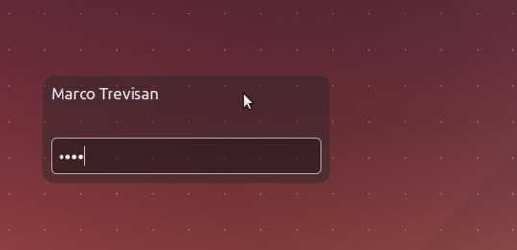
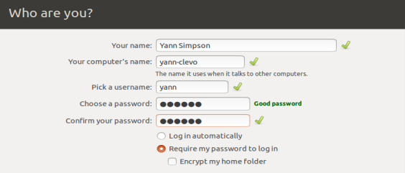
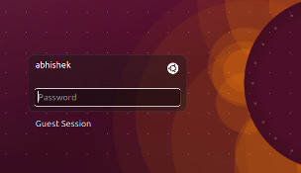
Username vs. Display name?
<Login page examples>

Slide 5
Unix File System
Linux Ubuntu
Ext2
Default filesystem in several Linux distributions (e.g. Debian and Red Hat Linux)
Every file or directory is represented by an inode, "index node". The inode includes data about the size, permission, ownership, and location on disk of the file or directory.
Marks inode blocks as unused in the block bitmaps
When file is deleted, it marks the inode as "deleted" and leaves the block pointers alone
Ext3
Journaled file system, the default file system for many popular Linux distributions.
Journaling improves reliability and eliminates the need to check the file system after an unclean shutdown
To safely resume an unlink after a crash, it zeros out the block pointers in the inode
Ext4
Journaling file system for Linux
Windows: FAT32 and NTFS

Slide 6
Unix/Linux System Administration
Reference: Unix System Administration Handbook (https://subversion.ews.illinois.edu/svn/sp16-ece422/_shared/mp5)
Chapter 4: Access control and rootly powers
Chapter 11: Syslog and log files
Chapter 22: Security

Slide 7
Disk Partition
Division of a computer hard disk
Multiple partitions allows OS to manager information in each region separately.
The disk stores the information about the partitions' locations and sizes in an area known as the partition table that the operating system reads before any other part of the disk.
Each partition appears in the operating system as a distinct "logical" disk that uses part of the actual disk.
https://en.wikipedia.org/wiki/Disk_partitioning

Slide 8
Live Analysis Setup
Use your own machine
Decompressed disk image (.raw) file: >8GB ← Dead Analysis
VirtualBox disk image (.vdi) file: >3GB ← Live Analysis
EWS quota: 10GB
VirtualBox not supported on EWS
VirtualBox download link: https://www.virtualbox.org/wiki/Downloads
Convert raw to vdi %VBoxManage convertdd forensics_sp16_victim.raw forensics_sp16_victim.vdi -format VDI

Slide 9
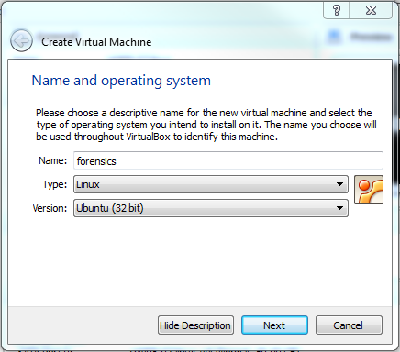
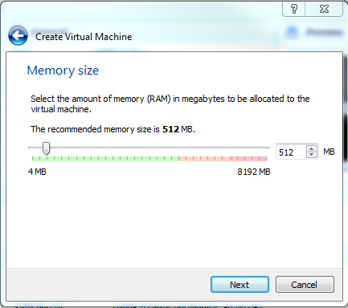
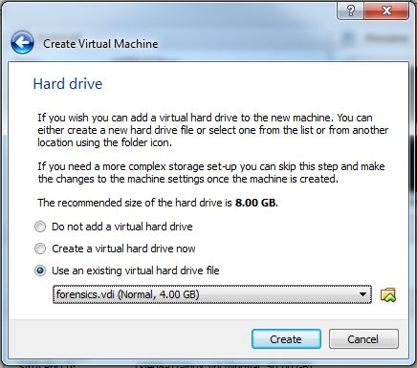
Live Analysis: Windows OS VirtualBox Demo (1)
Step 1. Choose OS type
Step 2. Select memory size
Step 3. Browse existing .vdi file

Slide 10
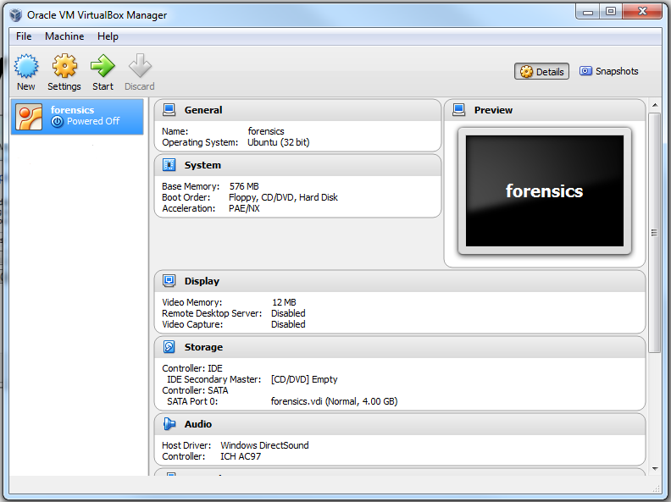
Live Analysis: Windows OS VirtualBox Demo (2)
Step 4. Start the VB

Slide 11
Live Analysis: Troubleshooting
VirtualBox: Convert to VDI
http://serverfault.com/questions/365423/how-to-run-vboxmanage-exe
Manual: https://www.virtualbox.org/manual/ch08.html
Fail to load live VM
READ the error message
Press “ESC” button at the very beginning of boot (message will pop up when to use)

Slide 12
Dead Analysis Setup
You MUST use your own machine
Autopsy installed on EWS Linux is the outdated version
Tool Installation
The Sleuth Kit (TSK): http://www.sleuthkit.org/sleuthkit/download.php
Autopsy (version 3 or higher): http://www.sleuthkit.org/autopsy/
Linux Autopsy tutorial: https://digital-forensics.sans.org/blog/2009/05/11/a-step-by-step-introduction-to-using-the-autopsy-forensic-browser/

Slide 13
Dead Analysis: Autopsy
Tips
Attacker mindset
Trace history
Examine system logs
Check for deleted or encrypted files
Search for strings / keywords that may be relevant
File name, date and time, file extension, size, metadata … etc.
References
http://www.sleuthkit.org/autopsy/help/general.html
http://www.sleuthkit.org/autopsy/v2/
File recovery
http://sleuthkit.org/autopsy/docs/user-docs/3.1/photorec_carver_page.html

Slide 14
Dead Analysis: Autopsy
Modified time vs. Changed time
Accessed: When the file data was last accessed. This time can be modified using the utimes() function.
Modified: When the file data was last modified. This time can be modified using the utimes() function.
Changed: When the file status (inode data) was last changed. This time can not be set using the utimes() function in UNIX (but it will be set when utimes() is used to modify other values).
http://www.sleuthkit.org/autopsy/help/file_mode.html
Allocated file vs. Unallocated file
Allocated: Files that are seen when doing an 'ls' or 'dir' in a directory.
Unallocated: Files that have been deleted, but that TSK can still access. Files in this category include orphan files, which are files that no longer have a name, but whose metadata still exists. If a deleted file name points to an allocated metadata structure, then the name will say “realloc” next to it.

Slide 15
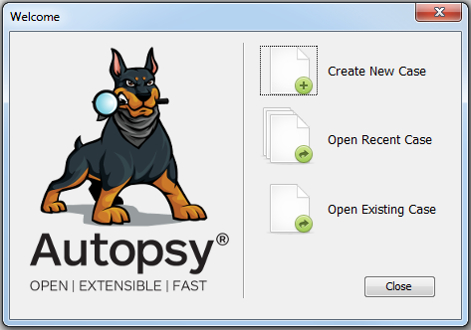
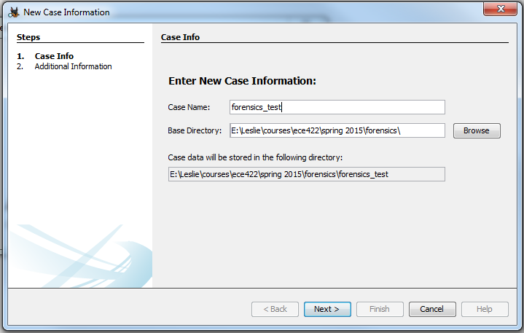
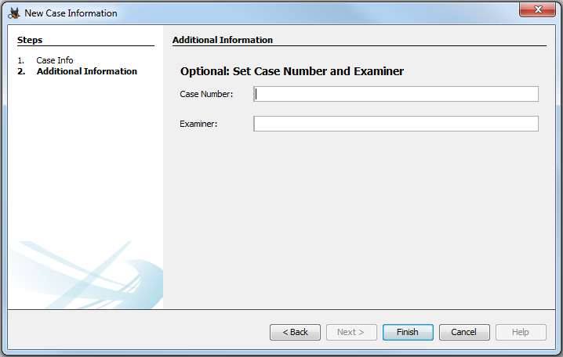
Dead Analysis: Windows OS Autopsy Demo (1)
Step 1. Create new case
Step 2. Choose directory
Step 3. Optional: leave it blank

Slide 16
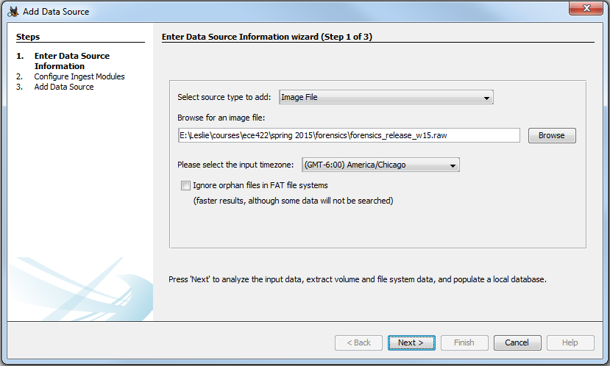
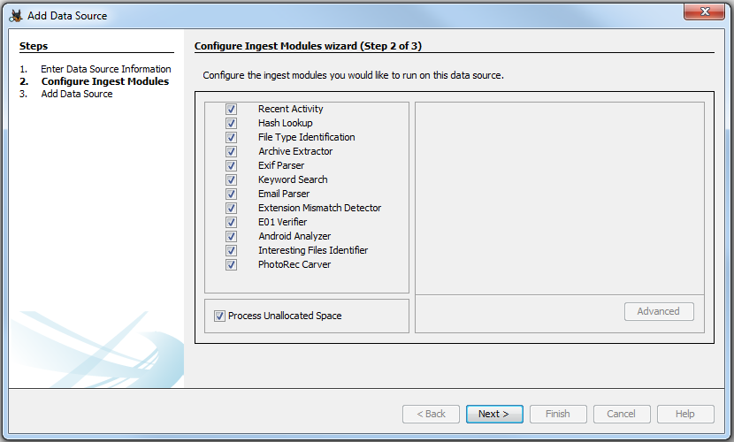
Dead Analysis: Windows OS Autopsy Demo (2)
Step 4. Browse raw disk image
Step 5. Leave as default

Slide 17
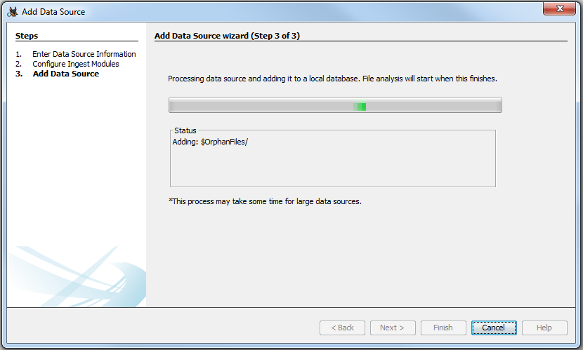
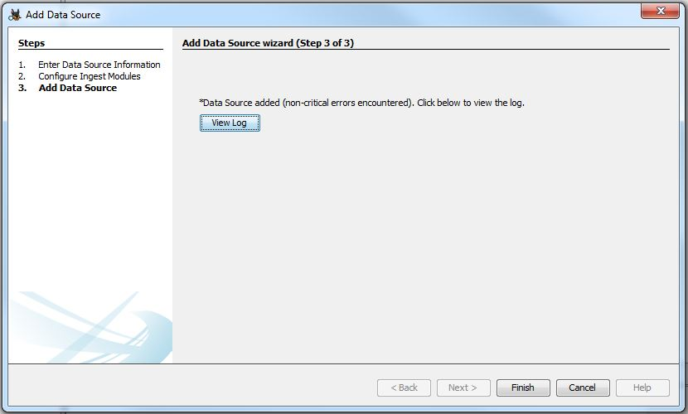
Autopsy: Windows OS Demo (3)
Step 6. Setup wizard
Step 7. Finish creating case

Slide 18
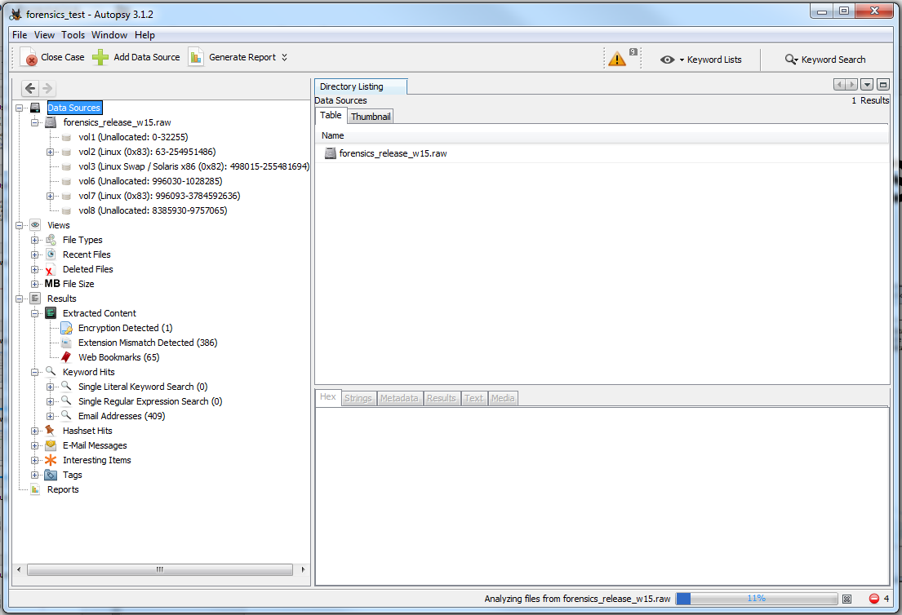
Autopsy: Windows OS Demo (4)
Step 8. Start investigation

Slide 19
File Metadata
Metadata is “data about data”
Two types
Structural metadata is data about the containers of data
Descriptive metadata uses individual instances of application data or the data content
Used to describe digital data, describing the contents and context of data files increases their usefulness
Facilitate in the discovery of relevant information, classified as resource discovery
Helps organize electronic resources, provide digital identification, support archiving and preservation of the resource

Slide 20
Geotag Degree Conversion
Decimal coordinate signs
Latitude: North → positive (+), South → negative (-)
Longitude: East → positive (+), West → negative (-)
EXIF Tool
Obtain metadata from image file
Download link: http://owl.phy.queensu.ca/~phil/exiftool/
Manual: http://owl.phy.queensu.ca/~phil/exiftool/exiftool_pod.html
Decimal format: exiftool -c "%.3f" [imagefile.jpg]
Verify the location result on the map
GPS coordinates converter
http://www.gps-coordinates.net/gps-coordinates-converter

Slide 21
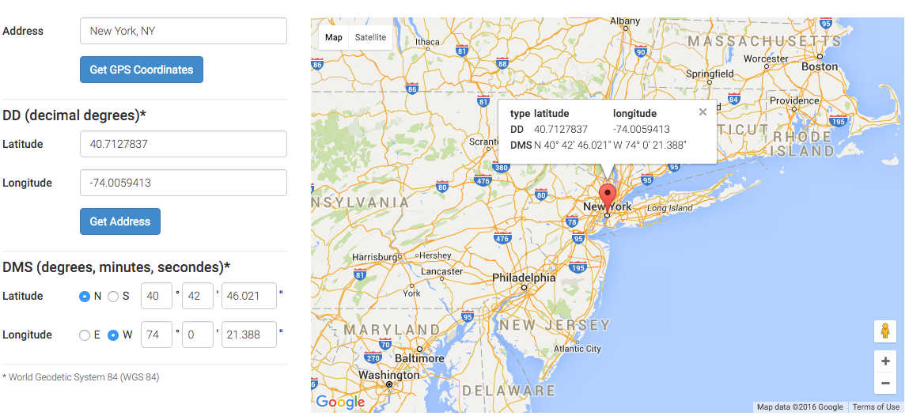
http://www.gps-coordinates.net/gps-coordinates-converter

Slide 22
Password Cracking
Use your own machine
Currently, EWS is not set up for this support
It is never a good idea to run cracking tools on public computer
Tools
John the Ripper: UNIX password cracker
Hydra: Remote login password cracker (brute-force)
Fcrackzip: ZIP password cracker
PDFcrack: PDF password cracker

Slide 23
Password Cracking: Demo
References
http://oldhome.schmorp.de/marc/fcrackzip.html
http://linuxers.org/article/how-crack-zip-file-passwords-linux-using-fcrackzip
Options
-b: brute-force
-c: character-set (e.g. lower case, upper case, digits etc.)
-D: dictionary
-l: length
-p: initial password string
-u: unzips the file (this option doesn’t work on Windows OS)
Unix / Mac OS: fcrackzip demo
%./fcrackzip -b -c a -p aaaaaa -u filename.zip
6-character long: all alphabets

Slide 24
File Recovery
Recover vs. Extract vs. Export?
Photorec
Run photorec: photorec.exe diskimage.raw
Select Drive/Select partition/no partition (whole)
(before pressing enter) right arrow to file ops
Select file extensions to recover
Choose file system
Choose directory to save recovered files
Start searching
Other tools: scalpel, extundelete (w/ kpartx), ext3grep and etc.
References
http://www.cgsecurity.org/wiki/PhotoRec_Step_By_Step
http://www.bootmed.com/bootmed/tutorials-11/how-to-recover-deleted-files-with-photorec/
http://extundelete.sourceforge.net/

