Slide 1
MP1
<checkpoint 1>
CS461 / ECE422 – UIUC Spring 2016
By: Gene Shiue

Slide 2
Outline
-GDB
-Stack frame + x86 assembly
-Endianness
-Shellcode

Slide 3
GDB?
Debugger
Stop/pause programs
Examine memory / registers
Find bugs!
Context of MP: find vulnerabilities

Slide 4
GDB Tutorial - Important Commands
Disassemble: disas function_name
Set breakpoints: b function_name, b *0xbffebee0
Examine: x $eax, x/s $esp, x/wx 0xdeadbeef, x/2wx 0x5adface5
Look at register values: info reg
Run: r
Continue: c
Step(one instruction): si
Show current instruction: display/i $pc

Slide 5
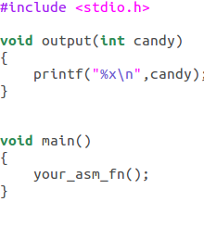
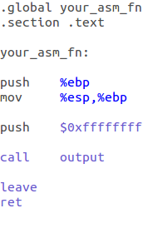
Exercise

Slide 6
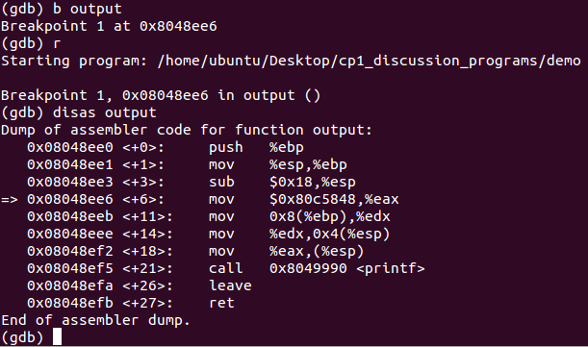

Slide 7
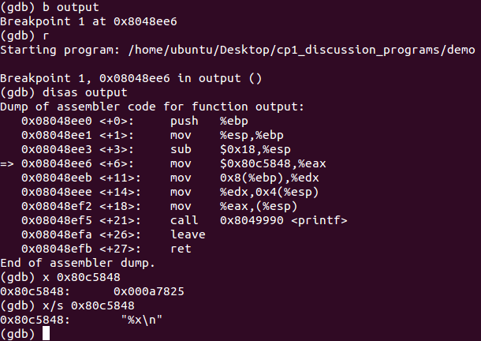

Slide 8
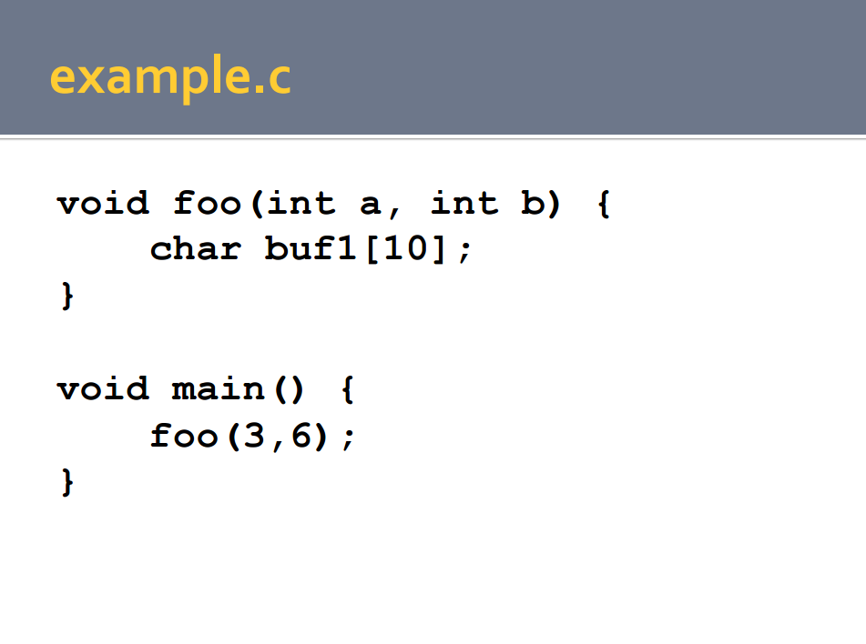

Slide 9
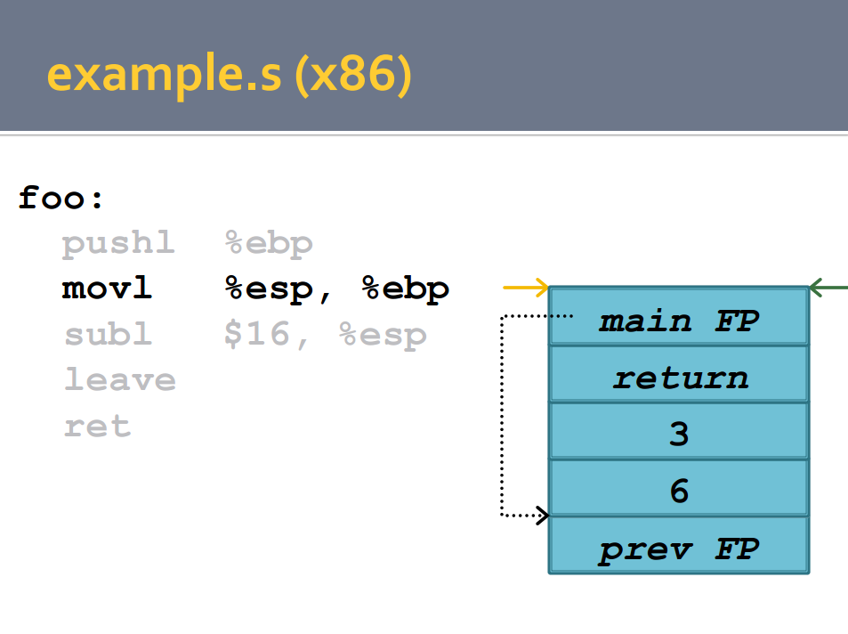

Slide 11
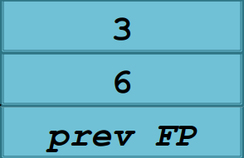
%x\n
0xffffffff

Slide 12
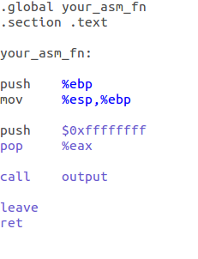
Exercise - ???

Slide 14
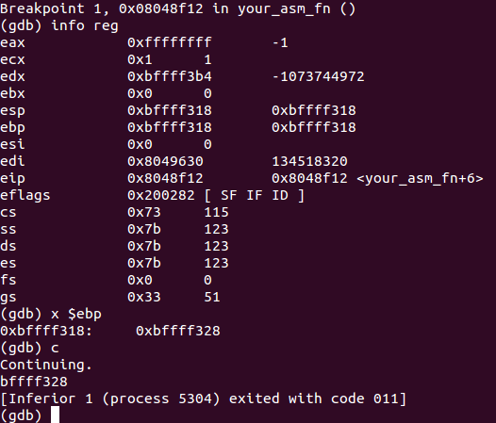
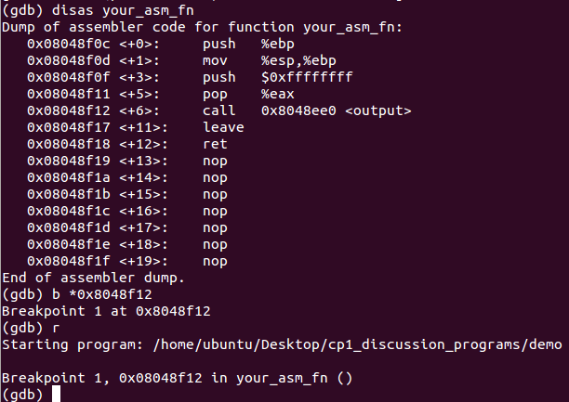

Slide 15
%x\n
0xffffffff

Slide 16
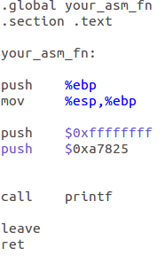

Slide 18
%x\n
%x\n
0xffffffff
0xffffffff

Slide 19
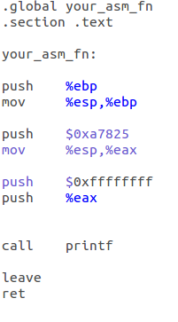

Slide 20
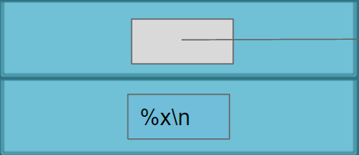
0xffffffff
%x\n

Slide 21
%x\n
0xffffffff
0xffffffff
%x\n

Slide 22
Wait...
0xa7825 == %x\n ?????
0x0a == \n
0x78 == x
0x25 == %

Slide 23
Endianness
0xbfff0000
0xbfff0000
0x000a7825
0x25
0xbfff0001
0x78
0xbfff0002
Byte order for x86 is little endian
Read from top of stack to bottom
(low memory to high memory)
Whatever gets read first is little -> small -> least significant byte
push $0xa7825 = push $0x000a7825
0x0a
0xbfff0003
0x00
0x25 == %
0x78 == x
0x0a == \n
0xa7825 == %x\n

Slide 24
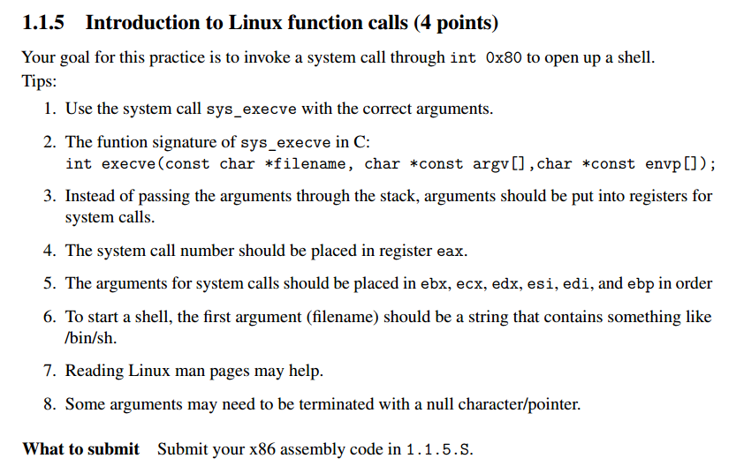

Slide 25
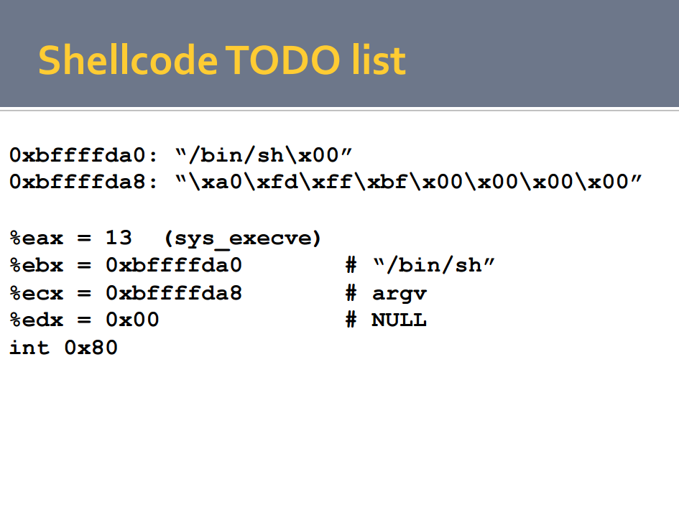
11(0xb)
X

Slide 26
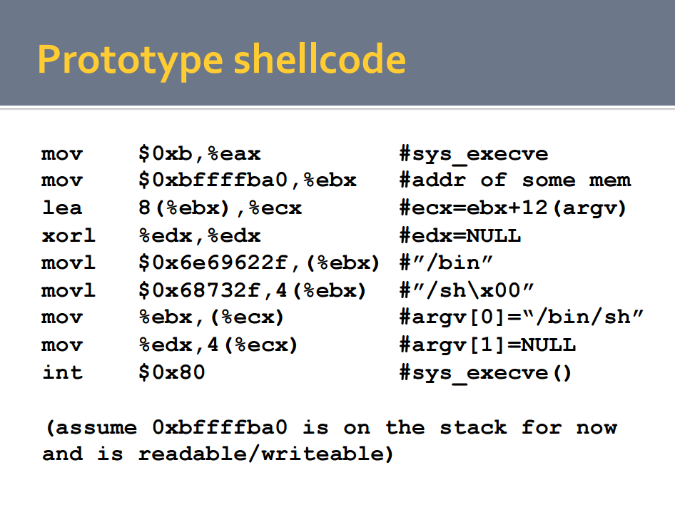
X
+8

Slide 27
Reading Materials:
GCC Assembly
http://www.ibiblio.org/gferg/ldp/GCC-Inline-Assembly-HOWTO.html#s3
x86 Reference Sheet
https://courses.engr.illinois.edu/ece391/references/doc-x86-asm.pdf

