Slide 1
MP1
<checkpoint 2>
CS461 / ECE422 – UIUC SPRING 2016
By: Gene Shiue

Slide 2
Outline
-Buffer overflow
-Return-oriented programming
-A bit on callback shell
-Format String Attack

Slide 3
Buffer Overflow
Modify stack
-Change variables
-Change function pointers
-Change return addresses

Slide 4
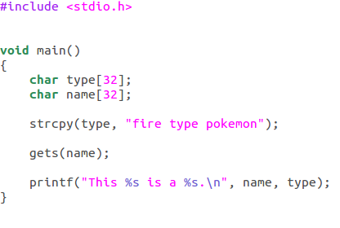
Exercise - Overwriting Variable(s)

Slide 5


Exercise

Slide 6
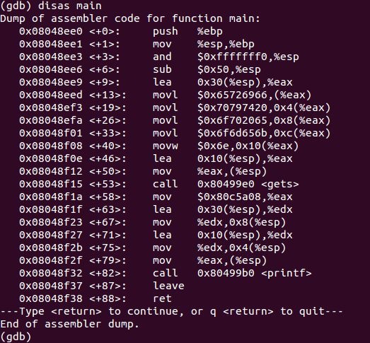
esp
16 (
….
Name[32]
32 (
“fire type …”
Type[32]
Name[32]
Difference = 0x20 = 32 bytes

Slide 7
+\x00
+\x00
+\x00
+\x00
+...
name[32]
“MP1”
type[32]
“fire type …”
“musical ….”

Slide 8
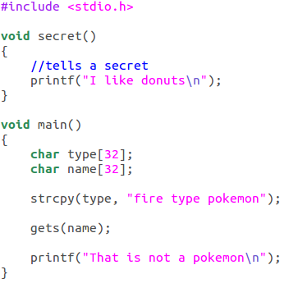
Exercise - Overwriting Return Address

Slide 9
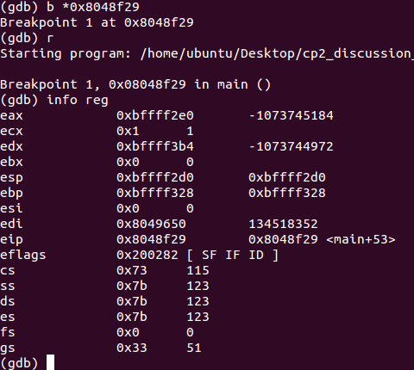
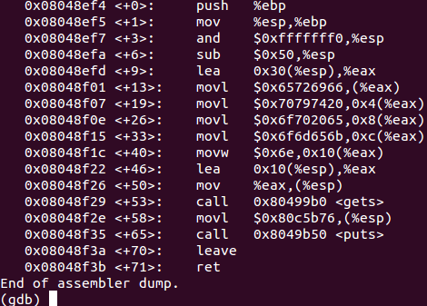

Slide 10
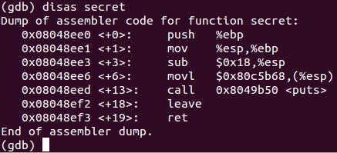
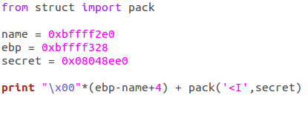
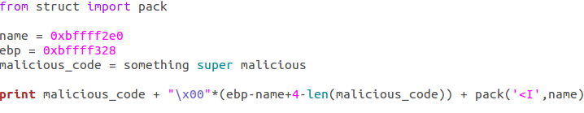

Slide 11
Return-oriented Programming
-Data Execution Prevention(DEP)

Slide 12
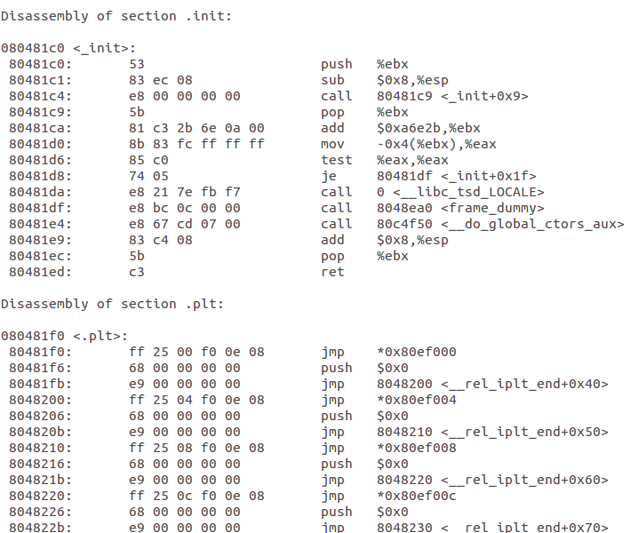
Objdump
objdump -d ./program > program.txt

Slide 13
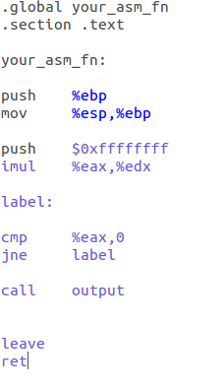
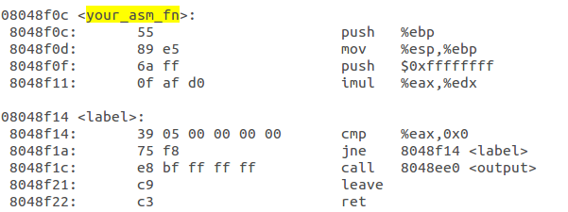
Might be useful for 1.2.10

Slide 14
1.2.9 Return-oriented Programming
0x80481ec
Return Address
value for ebx
Next Gadget
Instruction pointer

Slide 15


Example
0x8057360
0xbfff0000(edx)
0xbfff3230(ecx)
0x12341234(ebx)
0x8055060
Next Gadget

Slide 16
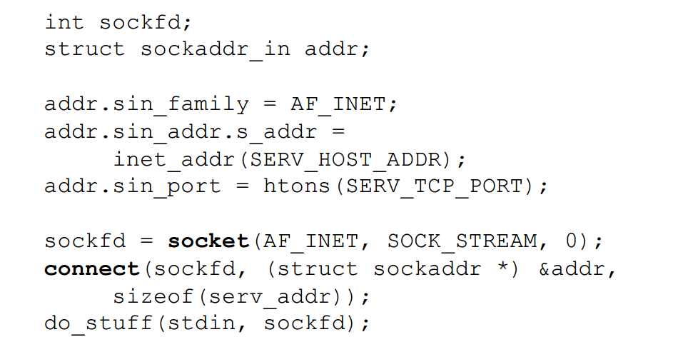
1.2.10 Callback Shell
plus redirect stdin/stdout/stderr to socket descriptor

Slide 17
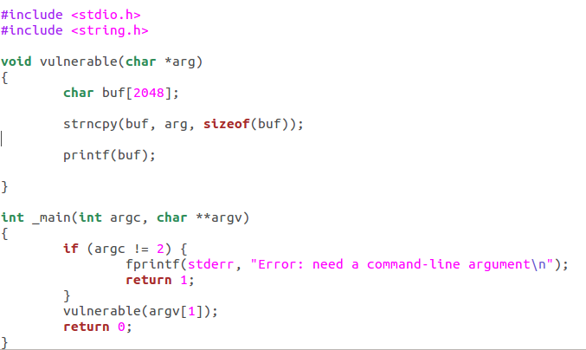
1.2.11 Format String Attack (Med but at the end!)

Slide 18
1.2.11 Format String Attack (Med but at the end!)
printf(“%p%p%p%p”);???????

Slide 19
1.2.11 Format String Attack (Med but at the end!)
%n writes # of characters printed to memory

Slide 20
1.2.11 Format String Attack (Med but at the end!)
Goal: overwrite return address to point to buf that contains shellcode
Proto-answer: print malicious_code + padding + ADDR1 + ADDR2 + “%00000x%04$hn%00000x%05$hn”
e.g. malicious_code at 0xbfff1234
print total of 1234 characters first, write to return address
print total of bfff characters, write to return address+# (think about what the offset is, remember endianness for byte order)

Slide 21
Reading Materials:
ROP:
https://cseweb.ucsd.edu/~hovav/dist/geometry.pdf
Format String Attack:
http://codearcana.com/posts/2013/05/02/introduction-to-format-string-exploits.html

