Slide 1
Review: OS Section
CS461 / ECE422 – UIUC SPRING 2016
By Gene Shiue

Slide 2
Outline
-Application Security
-Malware
-Security Policy/Isolation
-Web App Security
-Authentication

Slide 3
Stack Frame
example: main calls foo
Do stuff in main
Set up arguments to call foo
Set up stack frame for foo
Do stuff in foo
local variables
base pointer for main
return address
arguments to foo
local variables
previous base pointer
esp
foo
ebp
main

Slide 4
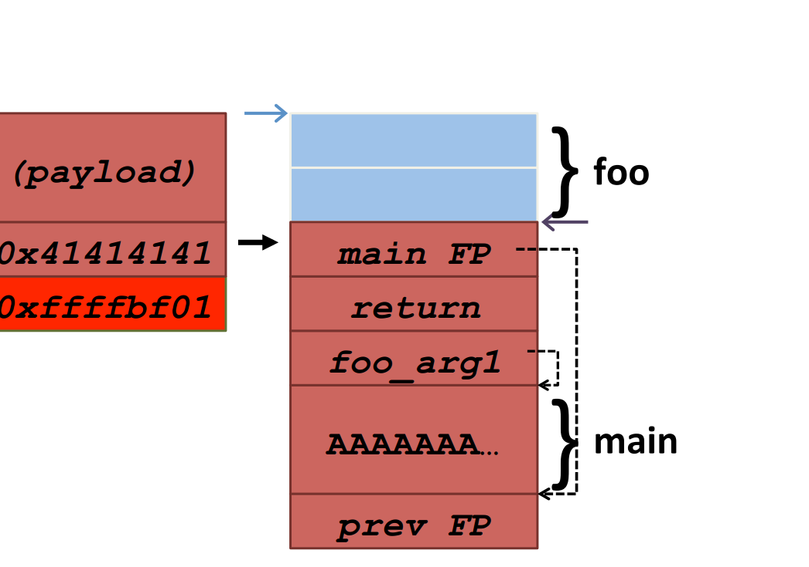

Slide 5
What to do?
Bounds checking:
strcpy, gets vs strncpy, fgets

Slide 6
Defenses
Stack Canary

Slide 7
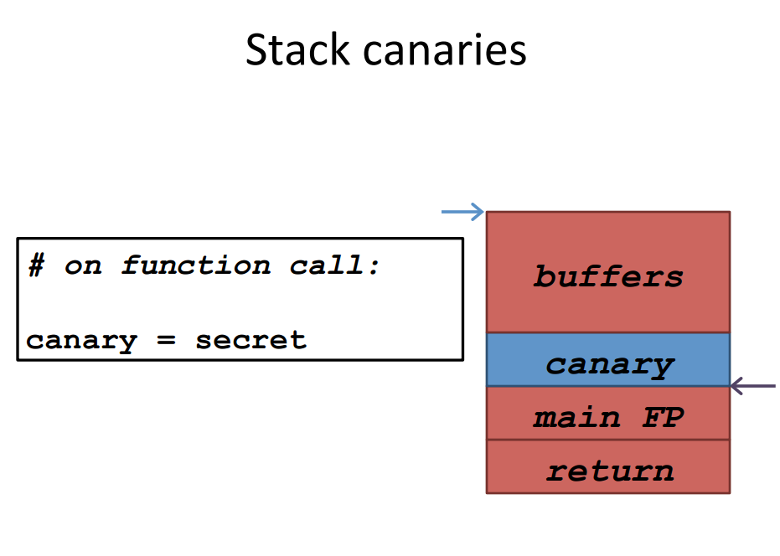

Slide 8
Defenses
Stack Canary
DEP

Slide 9
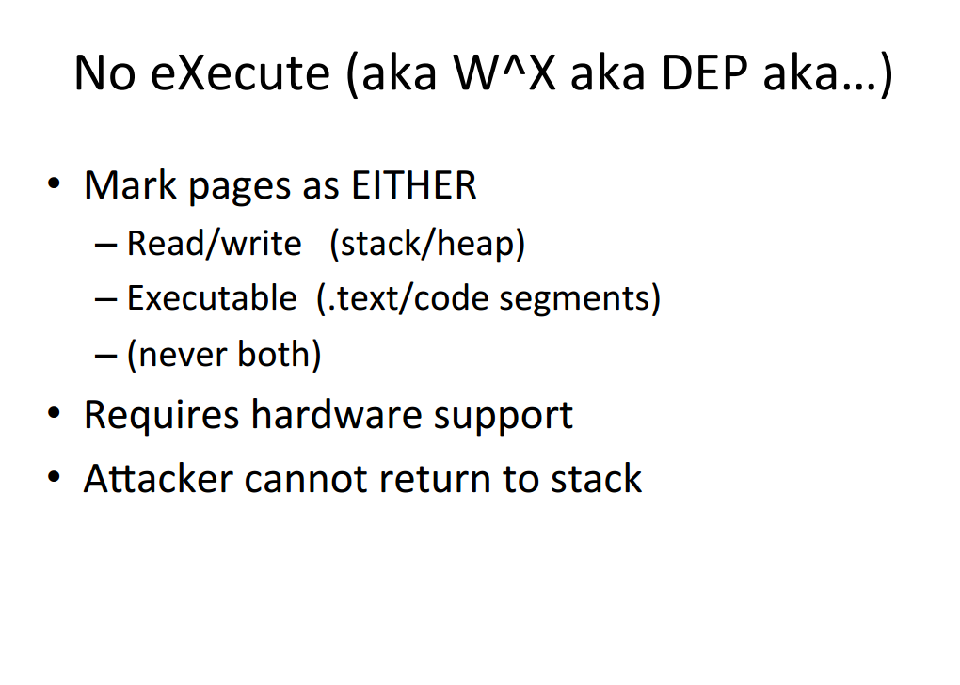

Slide 10


Return-Oriented Programming
(original return addr)
0x8057360
0xbfff0000(edx)
0xbfff3230(ecx)
0x12341234(ebx)
0x8055060
Next Gadget

Slide 11
Defenses
Stack Canary
DEP
ASLR

Slide 12
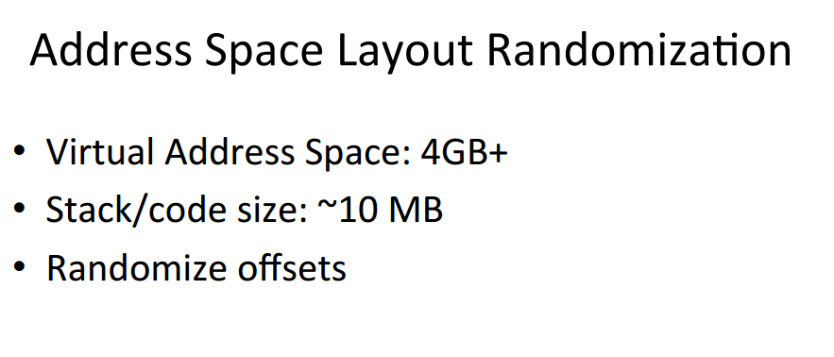

Slide 13
Some other attacks:

Slide 14
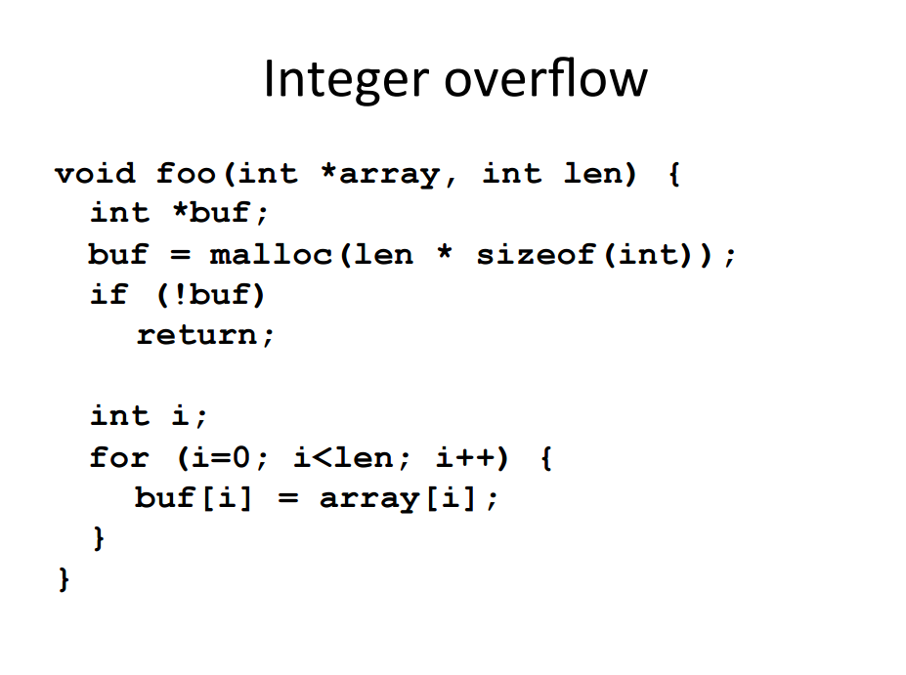

Slide 15
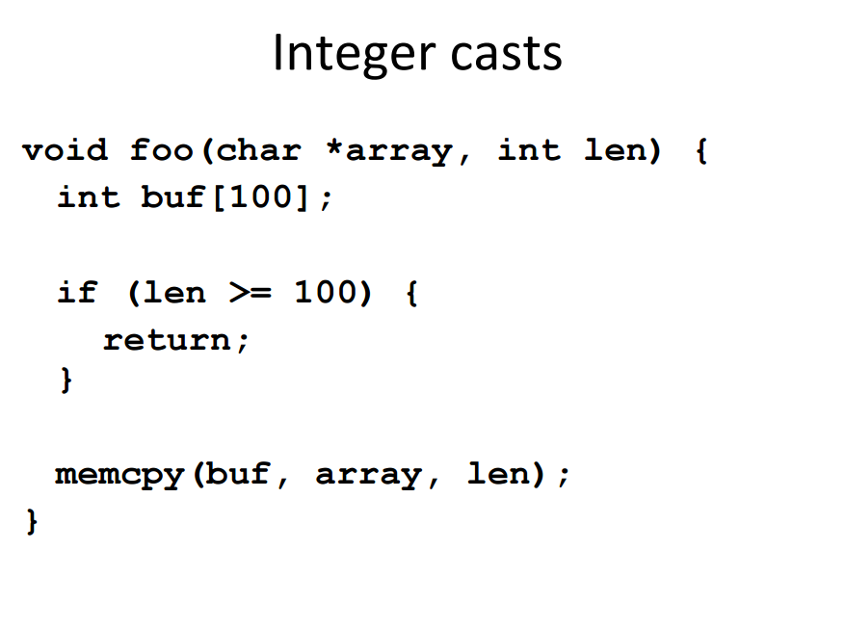

Slide 16
1.2.11 Format String Attack
%n
Proto-answer: print malicious_code + padding + ADDR1 + ADDR2 + “%00000x%04$hn%00000x%05$hn”

Slide 17
Malware:
Virus
Trojan Horses
Rootkits
Worm
Adware
Spyware

Slide 18
Defenses Against Malware
Signatures
White/black listing
Heuristic Analysis

Slide 19
Access Control
Mandatory access control - decisions by admin/root
Discretionary access control - decisions by users
Role-based access control
least privilege philosophy

Slide 20
Isolation
Confinement:
Hardware (different machine) Virtual Machine (different OS on same machine) Process (system call interposition)

Slide 21
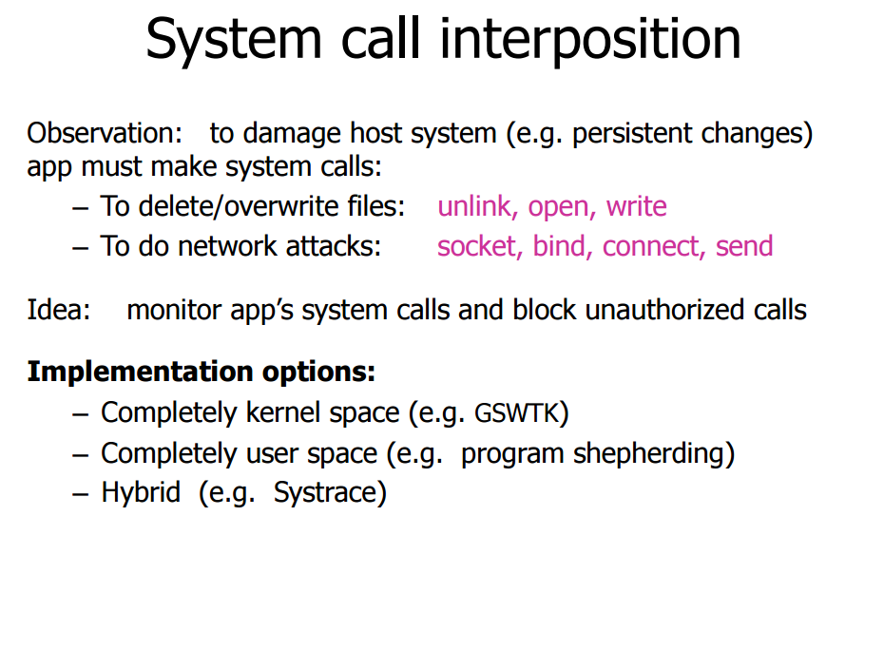

Slide 22
Web App Security:

Slide 23
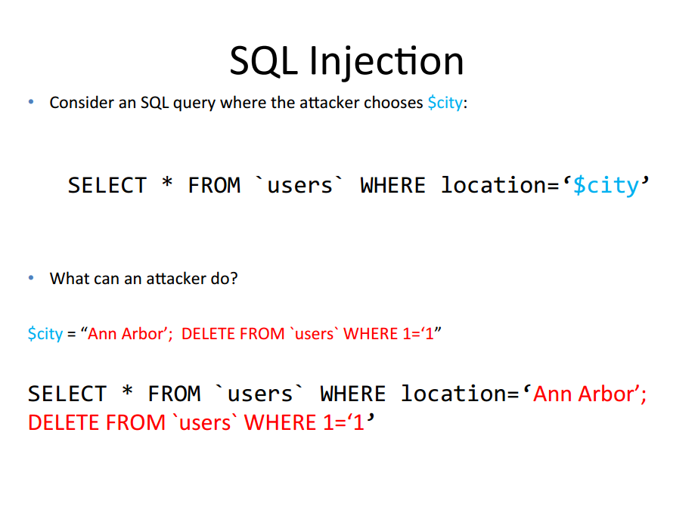

Slide 24
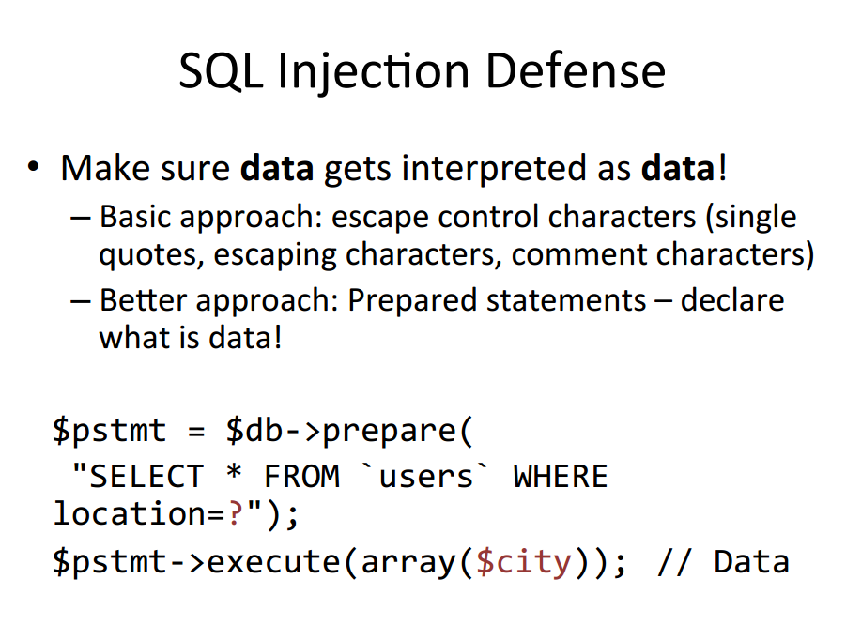

Slide 25
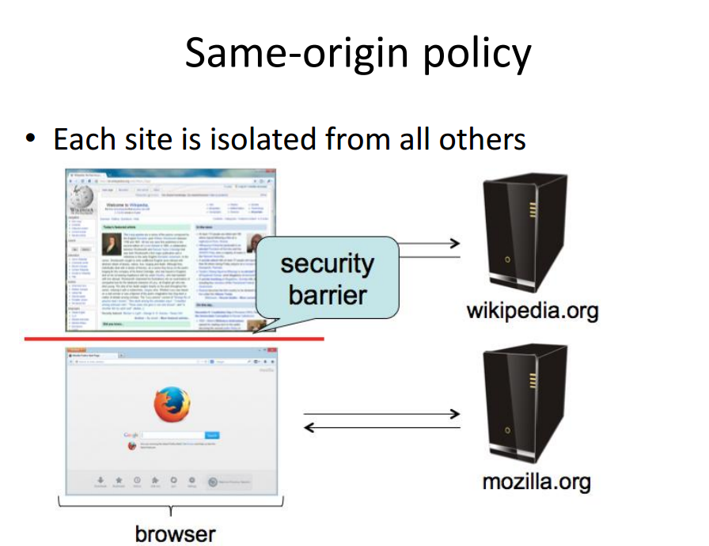

Slide 26
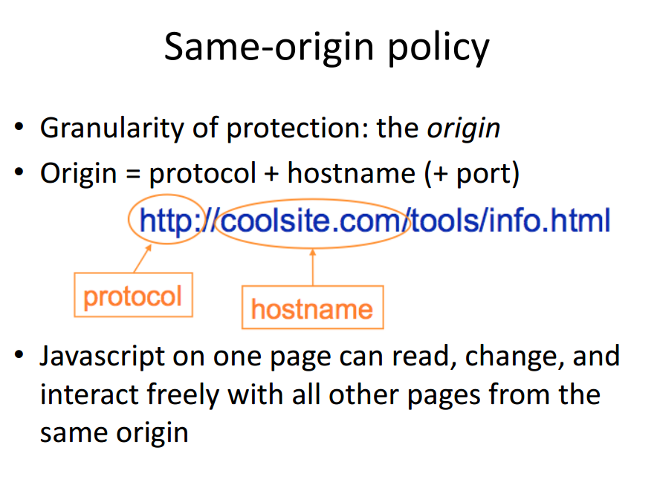

Slide 27
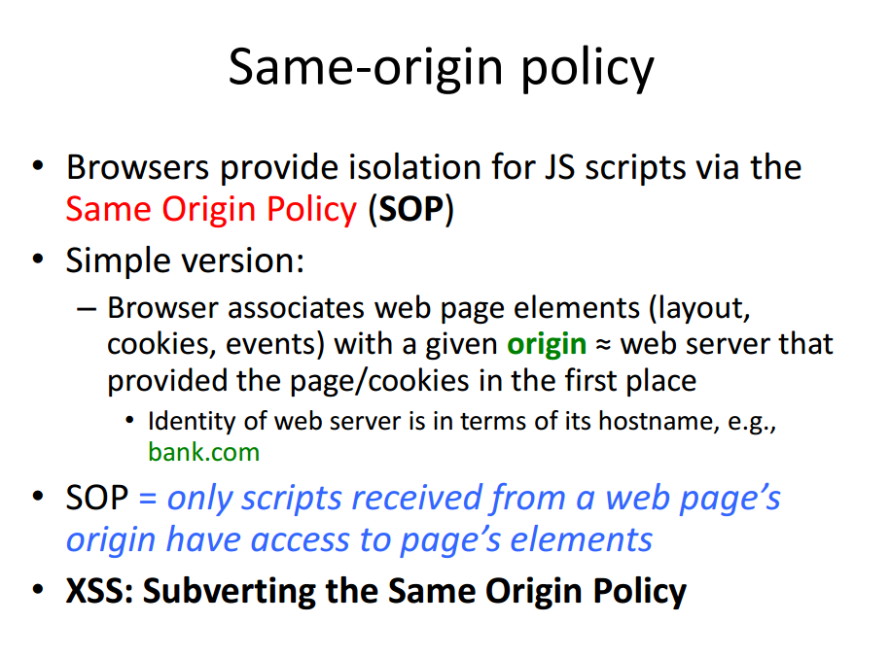

Slide 28
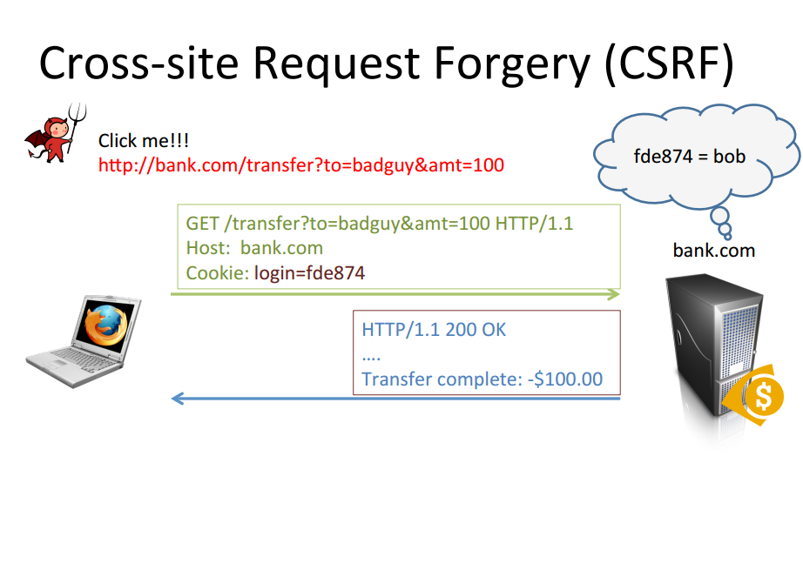

Slide 29
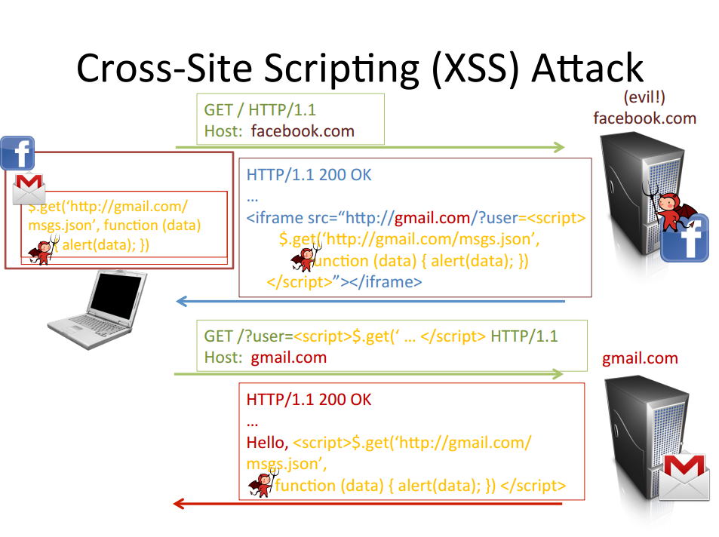

Slide 30
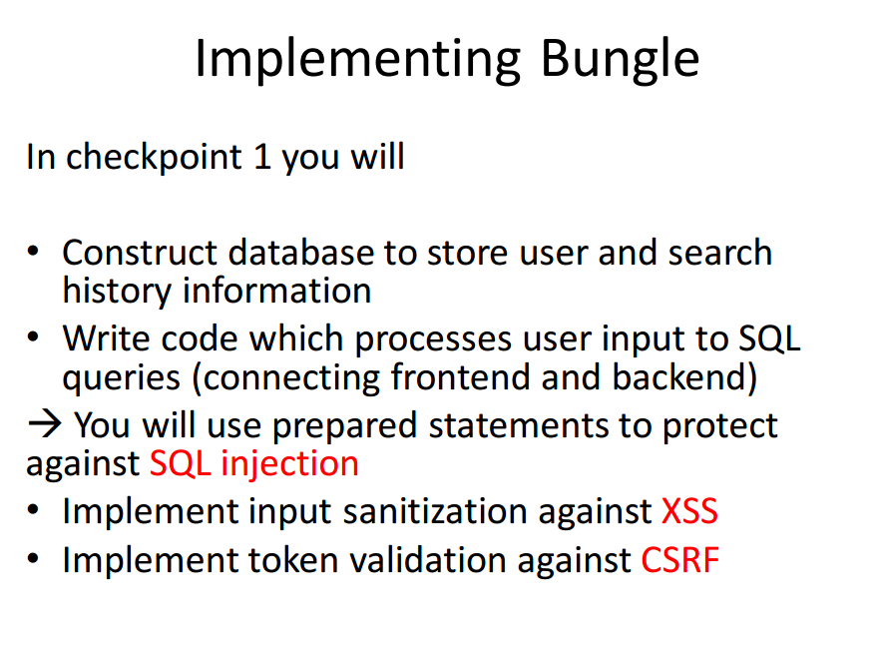

Slide 31
Passwords
From user: key loggers, phishing attack, network attacks
From website: database (plaintext? yes or no?)

Slide 32
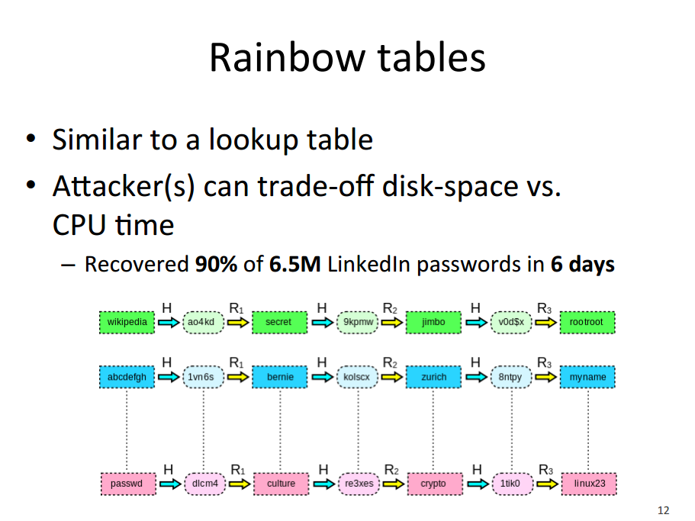
Defense: add salt!!

Slide 33
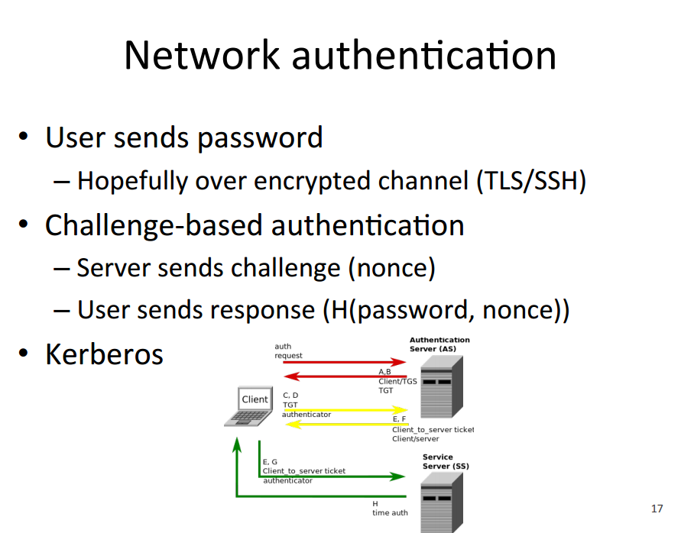

Slide 34
Multi-factor Authentication
Something you know, something you have, something you are
Examples?

