Slide 1
Lecture 07 – Defending
Michael Bailey
University of Illinois
ECE 422/CS 461 – Spring 2016

Slide 2
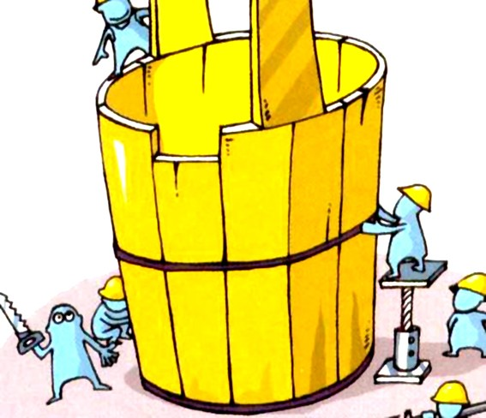
Why is a Security Policy Necessary
Bucket Theory: A bucket can only fill with the volume of water the shortest plank allows.
Ideally, we want to make everything perfect without considering the budget
BUT, in reality…
How to balance the planks
How to prioritize the limited resources
How to maximize the gaining (benefit - cost)

Slide 3
What is a Security Policy
A Security Policy is a set of guidelines established to safeguard the organization from attacks, both from inside and outside the organization.
Usable
Not impede or interfere with the business
Enforceable with security tools

Slide 4
What is included in a Security Policy
Security education, training and awareness
Backups and business continuity plans
Physical Security
Access Controls
Authentication
Encryption
Network Security
Auditing and Reviews
Compliance
…

Slide 5
Access Control
Access control is a collection of methods and components that supports
confidentiality
integrity
Goal: allow only authorized subjects to access permitted objects
E.g., Least privilege philosophy
A subject is granted permissions needed to accomplish required tasks and nothing more
Notes:
Access control is to control how resources are accessed so that they can be protected from unauthorized modification, use, or disclosure. (p123)
It is usually considered the first line of defense in asset protection. (217)
Access control is a broad term that covers several different types of mechanisms that enforce access control features on computer systems, networks, and information. (124)
Subject: An active entity that requests access to an object or the data within an object. (p123)
Can be a user, program, or process that accesses an object to accomplish a task. (p123)
For a subject to be able to access a resource, it must be identified, authenticated, authorized, and should be held accountable for its actions. (219)
Object: A passive entity that contains information. (p124)
Can be a computer, database, file, computer program, directory, or field in a table in a database, etc. (p124)
When a program accesses a file, the program is the subject and the file is the object.

Slide 6
Access Control Designs
Access control designs define rules for users accessing files or devices
Three common access control designs
Mandatory access control
Discretionary access control
Role-based access control

Slide 7
Mandatory Access Control
It is a restrictive scheme that does not allow users to define permissions on files, regardless of ownership.
Instead, security decisions are made by a central policy administrator.
A common implementation is rule-based access control
Subject demonstrates need-to-know in addition to proper security clearance
Need-to-know indicates that a subject requires access to object to complete a particular task
Security-Enhanced Linux (SELinux) incorporates mandatory access control.
Notes:
All references are from All in One Book (Shon Harris, 2005)
In a mandatory access control (MAC) model, users and data owners do not have as much freedom to determine who can access files. (163)
Operating systems enforce the system’s security policy through the use of security labels. (166)
In MAC implementations, the system makes access decisions by comparing the subject’s clearance and need-to-know level to that of the security label. (165)
This type of model is used in environments where information classification and confidentiality is of utmost importance, such as a military installation. (163)
The operating system makes the final decision and can override the user’s wishes. (163)
MAC uses a security label system. Users have clearances and resources have security labels that contain data classifications. MAC compares these two attributes to determine access control capabilities. (218)
Users are given a security clearance and data is classified the same way. Users have access to data classified equal and lesser than their own status. (163)
Security labels are attached to all objects; thus, every file, directory, and device has its own security label with its classification information. (163)
The terms “security labels” and “sensitivity labels” can be used interchangeably. (163)
When a MAC model is being used, every subject and object must have a sensitivity label. (164)
The sensitivity label contains a classification and different categories. (164)
The classification indicates the sensitivity label, and the categories enforce need-to-know rules. (164)
Classifications are hierarchical, categories are not. (164)

Slide 8
Discretionary Access Control
Discretionary access control, or DAC, refers to a scheme where users are given the ability to determine the permissions governing access to their own files.
DAC typically features the concept of both users and groups
In addition, DAC schemes allow users to grant privileges on resources to other users on the same system.
Most common design in commercial operating systems
Generally less secure than mandatory control
Generally easier to implement and more flexible
Notes:
A system that uses discretionary access control (DAC) enables the owner of the resource to specify which subjects can access specific resources. This model is called discretionary because the control of access is based on the discretion of the owner. (162)
Data owners decide who has access to resources and ACLs are used to enforce the security policy. (166)
DAC systems grant or deny access based on the identity of the subject. The identity can be a user identity or group membership. (163)
The most common implementation of DAC is through ACLs, which are dictated and set by the owners and enforced by the operating system. (162)
This does not lend itself to a centrally controlled environment and can make a user’s ability to access information dynamic versus the more static role of mandatory access control. (162)
When you look at the properties of a file or directory and you see the choices that allow you to control which users can have access to this resource and to what degree, you are witnessing an instance of ACLs enforcing a DAC model. (162)
DACs can be applied to both the directory tree structure and the files it contains. (162)

Slide 9
Role-Based Access Control
The role-based access control (RBAC) model can be viewed as an evolution of the notion of group-based permissions in file systems.
An RBAC system is defined with respect to an organization, such as company, a set of resources, such as documents, print services, and network services, and a set of users, such as employees, suppliers, and customers
Uses a subject’s role or task to grant or deny object access
In the role-
Notes:
This type of model allows access to resources to be based on the role the user holds within the company. (165)
A role is defined in terms of the operations and tasks that the role will need to carry out. (165)
The RBAC approach simplifies access control administration by allowing permissions to be managed in terms of user job roles. (165)
Introducing roles also introduces the difference between rights being assigned explicitly and implicitly.
If rights and permissions are assigned explicitly, it indicates that they are assigned to a specific individual. (165)
If rights are assigned implicitly, it indicates that they are assigned to a role or group and the user inherits those attributes. (165)
An RBAC is the best system for a company that has high employee turnover. (165)

Slide 10
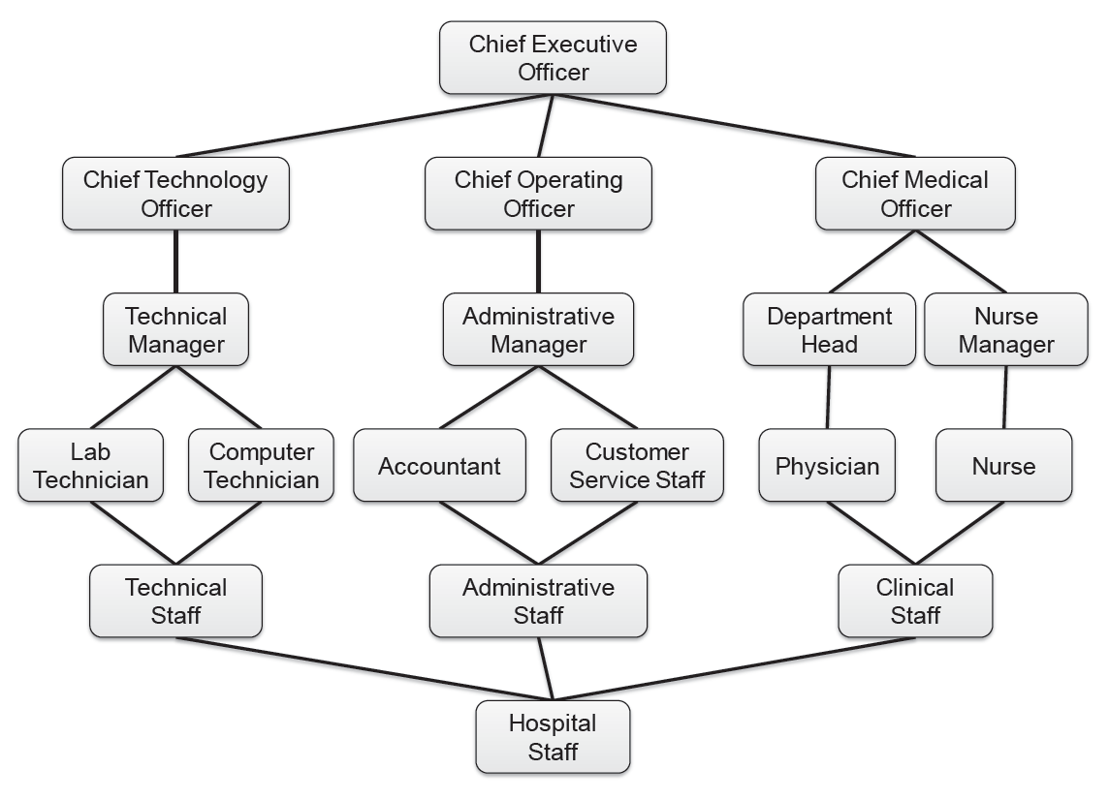
Visualizing Role Hierarchy

Slide 11
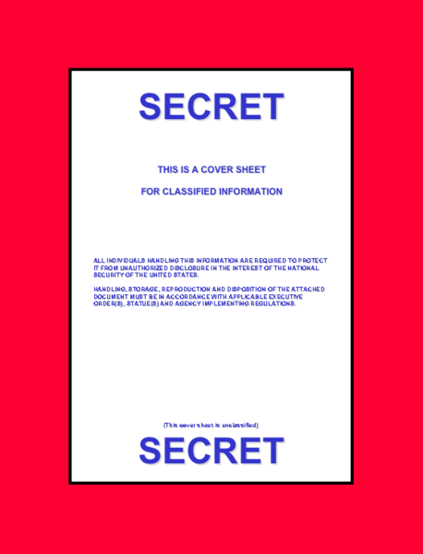
E.g., Best Practices of Information Classification
Military classifications of access rights for documents based on concepts
Unclassified
Confidential
Secret
Top secret
U.S. government image in the public domain.

Slide 12
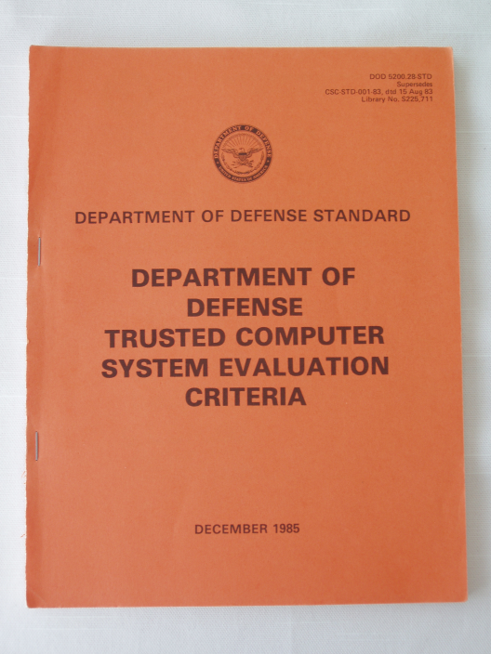
E.g., The Orange Book
Trusted Computer System Evaluation Criteria (TCSEC)
Division D: “minimal protection”
Division C: “Discretionary protection”
Division B: “Mandatory protection”
Division A: “Verified protection”

Slide 13
E.g., Cisco Best Practices
Preparation
Create Usage Policy Statement
Conduct a Risk Analysis
Establish a Security Team Structure
Prevention
Approving Security Changes
Monitoring Security of Your Network
Response
Security Violations
Restoration
Review

Slide 14
Example Threat and Policy
USBs

Slide 15
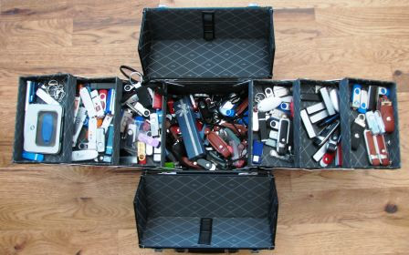
Lost USBs
Millions of USB flash drives are in use today worldwide and thousands are lost each day, according to one estimate

Slide 16
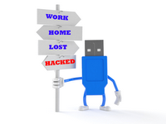
Data Leakage by Lost Devices

Slide 17
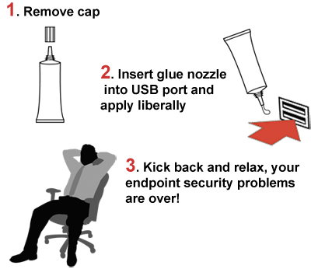
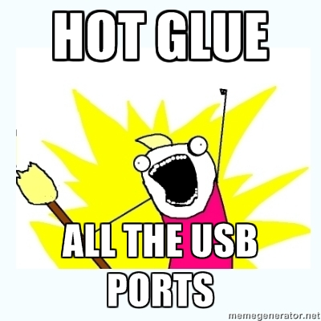
Glue it?

Slide 18
Fine it？

Slide 19
Example Threat and Policy
Laptops

Slide 20
Lost Laptops
Lost and stolen laptops are a common occurrence
Estimated occurrences in US airports every week: 12,000
Average cost of a lost laptop for a corporation is $50K
Costs include data breach, intellectual property loss, forensics, lost productivity, legal and regulatory expenses
Data breach much more serious than hardware loss
Data breach cost estimated at $200 per customer record
Direct costs include discovery, notification and response
Indirect costs include customer turnover (higher loss and lower acquisition)
Data can also be copied while laptop is unattended
Ponemon Institute. Research Studies & White Papers: Security

Slide 21
From Device to Data – Encryption
In a perfect world, we would not store sensitive data on portable devices
All sensitive data should be held on secure servers.
Unfortunately, this approach is not always practical.
Keep the benefit of using portable devices
Reduce the risk of data leakage by encryption

Slide 22
Encryption of File Systems
Disk encryption
Block-level encryption
Encryption of physical or logical drive
BitLocker in Windows Vista and 7
TrueCrypt open source software
File system encryption
File-level encryption
Encrypting File System (EFS) in Windows

Slide 23
Example Threat and Policy
Passwords

Slide 24
Warning to the Users
Do not use shared credentials
Strength your password
2,295: “123456” or a sequential list of number
780: “password”
437: “welcome”

Slide 25


Compromised UofM Accounts
613 incidents related to unauthorized use of university accounts during 2010 and first 6 months of 2011 at UofM
LIBRARY?!
Some people steal university accounts to access the library.

Slide 26
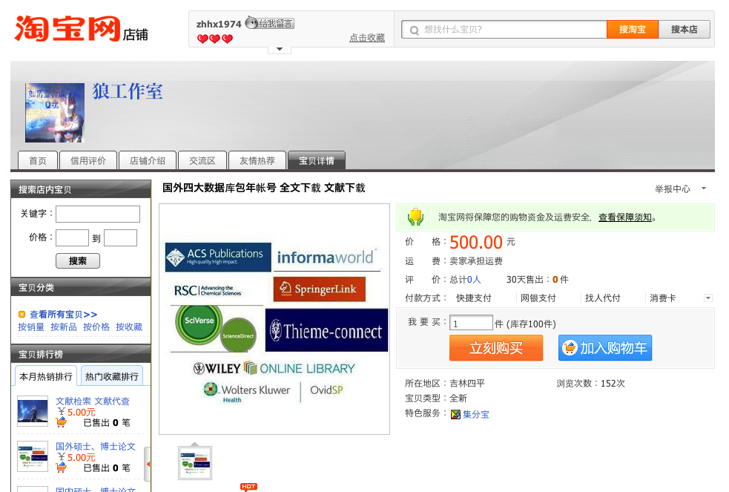
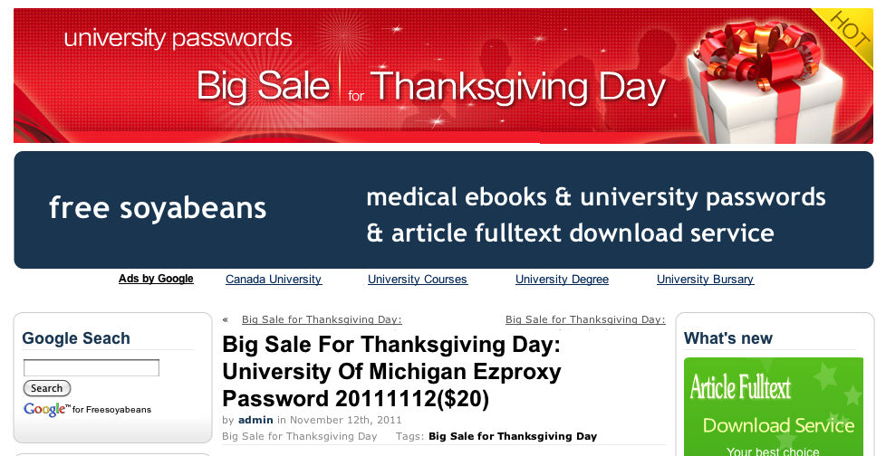
Compromised UofM Accounts
What did they do with the compromised accounts?
Netflow data analysis
Library website repeatedly visited
8.2% of HTTP flows visited consist of 10 websites blocked in China
Login to accounts at 7 universities
Market place for the compromised university accounts
500 RMB ~ less than 100 USD = access to multiple databases for a year
$20 = UofM account with VPN and Library access
New motivation of attackers who steal university credentials:
Free and unfettered access to information

Slide 27
Weak Password Scanning
UofM scan weak password accounts twice a year using a commercial password cracker
2,284 weak password are detected in June, 2011
Whether accounts with weak passwords are a problem?
 | # of total | # of compromised | Pr (compromise)
Weak Password | 2,284 | 12 | 0.525%
Total Population | 550,000 | 380 | 0.069%
Test statistics of deviance of 28.09 and a p-value of 1.16⁻¹⁶

Slide 28
Educating the Users
From ‘what tools to use’ to ‘who uses the tool’
 | # of total | # of compromised | Pr (compromise)
Passed Quiz | 9.227 | 9 | 0.1%
NOT passed | 41,924 | 105 | 0.25%
Test statistics of deviance of 13.52 and a p-value of 2.36⁻⁴
Yearly Security Quiz at UofM

Slide 29
Example of Implementing Policy
Filesystem Access Control

Slide 30
Access Control Entries and Lists
An Access Control List (ACL) for a resource (e.g., a file or folder) is a sorted list of zero or more Access Control Entries (ACEs)
An ACE refers specifies that a certain set of accesses (e.g., read, execute and write) to the resources is allowed or denied for a user or group
Examples of ACEs for folder “Bob’s CS167 Grades”
Bob; Read; Allow
TAs; Read; Allow
TWD; Read, Write; Allow
Bob; Write; Deny
TAs; Write; Allow

Slide 31
Linux File System
Tree of directories (folders)
Each directory has links to zero or more files or directories
Hard link
From a directory to a file
The same file can have hard links from multiple directories, each with its own filename, but all sharing owner, group, and permissions
File deleted when no more hard links to it
Symbolic link (symlink)
From a directory to a target file or directory
Stores path to target, which is traversed for each access
The same file or directory can have multiple symlinks to it
Removal of symlink does not affect target
Removal of target invalidates (but not removes) symlinks to it
Analogue of Windows shortcut or Mac OS alias

Slide 32
Unix Permissions
Standard for all UNIXes
Every file is owned by a user and has an associated group
Permissions often displayed in compact 10-character notation
To see permissions, use ls –l
jk@sphere:~/test$ ls –l
total 0
-rw-r----- 1 jk ugrad 0 2005-10-13 07:18 file1
-rwxrwxrwx 1 jk ugrad 0 2005-10-13 07:18 file2

Slide 33
Permissions Examples (Regular Files)
-rw-r—r--
read/write for owner, read-only for everyone else
-rw-r-----
read/write for owner, read-only for group, forbidden to others
-rwx------
read/write/execute for owner, forbidden to everyone else
-r--r--r--
read-only to everyone, including owner
-rwxrwxrwx
read/write/execute to everyone

Slide 34
Permissions for Directories
Permissions bits interpreted differently for directories
Read bit allows listing names of files in directory, but not their properties like size and permissions
Write bit allows creating and deleting files within the directory
Execute bit allows entering the directory and getting properties of files in the directory
Lines for directories in ls –l output begin with d, as below:
jk@sphere:~/test$ ls –l
Total 4
drwxr-xr-x 2 jk ugrad 4096 2005-10-13 07:37 dir1
-rw-r--r-- 1 jk ugrad 0 2005-10-13 07:18 file1

Slide 35
Permissions Examples (Directories)
drwxr-xr-x
all can enter and list the directory, only owner can add/delete files
drwxrwx---
full access to owner and group, forbidden to others
drwx--x---
full access to owner, group can access known filenames in directory, forbidden to others
-rwxrwxrwx
full access to everyone

Slide 36
Special Permission Bits
Three other permission bits exist
Set-user-ID (“suid” or “setuid”) bit
Set-group-ID (“sgid” or “setgid”) bit
Sticky bit

Slide 37
Set-user-ID
Set-user-ID (“suid” or “setuid”) bit
On executable files, causes the program to run as file owner regardless of who runs it
Ignored for everything else
In 10-character display, replaces the 4th character (x or -) with s (or S if not also executable)
-rwsr-xr-x: setuid, executable by all
-rwxr-xr-x: executable by all, but not setuid
-rwSr--r--: setuid, but not executable - not useful

Slide 38
Root
“root” account is a super-user account, like Administrator on Windows
Multiple roots possible
File permissions do not restrict root
This is dangerous, but necessary, and OK with good practices
Notes:
There can be multiple root accounts, but root is the conventional name. Any account with user ID 0 has root powers. This is like the Windows Administrators group. As the system administrator, root can change any file’s owner, group, or permissions, or delete the file, regardless of who owns it or its permissions. This is clearly dangerous, but necessary, and in practice can be secure. Choosing a good root password is very important, as well as minimizing programs and commands which are run as root. Finally, root is the entity charged with making sure that permissions allow no other users to disrupt the system (accidentally or intentionally), but there is nobody doing oversight on root. Thus, it is wise to think twice before doing anything as root, to guard against mistakes.

Slide 39
Becoming Root
su
Changes home directory, PATH, and shell to that of root, but doesn’t touch most of environment and doesn’t run login scripts
su -
Logs in as root just as if root had done so normally
sudo <command>
Run just one command as root
su [-] <user>
Become another non-root user
Root does not require to enter password
Notes:
To become root, type su or su - and put in the root password when prompted. Sudo functions similarly, but only for the duration of one command.

Slide 40
Changing Permissions
Permissions are changed with chmod or through a GUI like Konqueror
Only the file owner or root can change permissions
If a user owns a file, the user can use chgrp to set its group to any group of which the user is a member
root can change file ownership with chown (and can optionally change group in the same command)
chown, chmod, and chgrp can take the -R option to recur through subdirectories

Slide 41
Examples of Changing Permissions
chown -R root dir1
Changes ownership of dir1 and everything within it to root
chmod g+w,o-rwx file1 file2
Adds group write permission to file1 and file2, denying all access to others
chmod -R g=rwX dir1
Adds group read/write permission to dir1 and everything within it, and group execute permission on files or directories where someone has execute permission
chgrp testgrp file1
Sets file1’s group to testgrp, if the user is a member of that group
chmod u+s file1
Sets the setuid bit on file1. (Doesn’t change execute bit.)

Slide 42
The confinement principle

Slide 43
Running untrusted code
We often need to run buggy/unstrusted code:
programs from untrusted Internet sites:
apps, extensions, plug-ins, codecs for media player
exposed applications: pdf viewers, outlook
legacy daemons: sendmail, bind
honeypots
Goal: if application “misbehaves” ⇒ kill it

Slide 44


Approach: confinement
Confinement: ensure misbehaving app cannot harm rest of system
Can be implemented at many levels:
Hardware: run application on isolated hw (air gap)
⇒ difficult to manage
app 1
app 2
Network 2
air gap
network 1

Slide 45
Approach: confinement
Confinement: ensure misbehaving app cannot harm rest of system
Can be implemented at many levels:
Virtual machines: isolate OS’s on a single machine
OS₁
OS₂
app1
app2
Virtual Machine Monitor (VMM)

Slide 46

Approach: confinement
Confinement: ensure misbehaving app cannot harm rest of system
Can be implemented at many levels:
Process: System Call Interposition
Isolate a process in a single operating system
process 1
process 2
Operating System

Slide 47
Implementing confinement
Key component: reference monitor
Mediates requests from applications
Implements protection policy
Enforces isolation and confinement
Must always be invoked:
Every application request must be mediated
Tamperproof:
Reference monitor cannot be killed
… or if killed, then monitored process is killed too
Small enough to be analyzed and validated

Slide 48
A old example: chroot
Often used for “guest” accounts on ftp sites
To use do: (must be root)
chroot /tmp/guest root dir “/” is now “/tmp/guest”
su guest EUID set to “guest”
Now “/tmp/guest” is added to file system accesses for applications in jail
open(“/etc/passwd”, “r”) ⇒ open(“/tmp/guest/etc/passwd” , “r”)
application cannot access files outside of jail

Slide 49
Jailkit
Problem: all utility progs (ls, ps, vi) must live inside jail
jailkit project: auto builds files, libs, and dirs needed in jail env
jk_init: creates jail environment
jk_check: checks jail env for security problems
checks for any modified programs,
checks for world writable directories, etc.
jk_lsh: restricted shell to be used inside jail
note: simple chroot jail does not limit network access

Slide 50
Escaping from jails
Early escapes: relative paths
open( “../../etc/passwd”, “r”) ⇒ open(“/tmp/guest/../../etc/passwd”, “r”)
chroot should only be executable by root.
otherwise jailed app can do:
create dummy file “/aaa/etc/passwd”
run chroot “/aaa”
run su root to become root
(bug in Ultrix 4.0)

Slide 51
Problems with chroot and jail
Coarse policies:
All or nothing access to parts of file system
Inappropriate for apps like a web browser
Needs read access to files outside jail (e.g. for sending attachments in Gmail)
Does not prevent malicious apps from:
Accessing network and messing with other machines
Trying to crash host OS

Slide 52
System Call Interposition

Slide 53
System call interposition
Observation: to damage host system (e.g. persistent changes) app must make system calls:
To delete/overwrite files: unlink, open, write
To do network attacks: socket, bind, connect, send
Idea: monitor app’s system calls and block unauthorized calls
Implementation options:
Completely kernel space (e.g. GSWTK)
Completely user space (e.g. program shepherding)
Hybrid (e.g. Systrace)
Notes:
GSWTK: generic software wrapper toolkit

Slide 54
Initial implementation (Janus) [GWTB’96]
Linux ptrace: process tracing
process calls: ptrace (… , pid_t pid , …)
and wakes up when pid makes sys call.
Monitor kills application if request is disallowed
user space
monitored
application
(browser)
monitor
open(“/etc/passwd”, “r”)
OS Kernel

Slide 55
Complications
cd(“/tmp”)
open(“passwd”, “r”)
cd(“/etc”)
open(“passwd”, “r”)
If app forks, monitor must also fork
forked monitor monitors forked app
If monitor crashes, app must be killed
Monitor must maintain all OS state associated with app
current-working-dir (CWD), UID, EUID, GID
When app does “cd path” monitor must update its CWD
otherwise: relative path requests interpreted incorrectly

Slide 56
Problems with ptrace
Ptrace is not well suited for this application:
Trace all system calls or none
inefficient: no need to trace “close” system call
Monitor cannot abort sys-call without killing app
Security problems: race conditions
Example: symlink: me ⟶ mydata.dat
proc 1: open(“me”)
monitor checks and authorizes
proc 2: me ⟶ /etc/passwd
OS executes open(“me”)
Classic TOCTOU bug: time-of-check / time-of-use
time
not atomic

Slide 57
Alternate design: systrace [P’02]
user space
monitored
application
(browser)
monitor
policy file
for app
open(“etc/passwd”, “r”)
OS Kernel
sys-call
gateway
systrace
permit/deny
systrace only forwards monitored sys-calls to monitor (efficiency)
systrace resolves sym-links and replaces sys-call path arguments by full path to target
When app calls execve, monitor loads new policy file
Notes:
Efficiency: saves context switches

Slide 58
Policy
Sample policy file:
path allow /tmp/*
path deny /etc/passwd
network deny all
Manually specifying policy for an app can be difficult:
Systrace can auto-generate policy by learning how app behaves on “good” inputs
If policy does not cover a specific sys-call, ask user
… but user has no way to decide
Difficulty with choosing policy for specific apps (e.g. browser) is the main reason this approach is not widely used

Slide 59
Isolation via Virtual Machines

Slide 60
Virtual Machines
VM2
VM1
Apps
Apps
Guest OS 2
Guest OS 1
Virtual Machine Monitor (VMM)
Host OS
Hardware
Example: NSA NetTop
single HW platform used for both classified and unclassified data

Slide 61
Why so popular now?
VMs in the 1960’s:
Few computers, lots of users
VMs allow many users to shares a single computer
VMs 1970’s – 2000: non-existent
VMs since 2000:
Too many computers, too few users
Print server, Mail server, Web server, File server, Database , …
Wasteful to run each service on different hardware
More generally: VMs heavily used in cloud computing

Slide 62
VMM security assumption
VMM Security assumption:
Malware can infect guest OS and guest apps
But malware cannot escape from the infected VM
Cannot infect host OS
Cannot infect other VMs on the same hardware
Requires that VMM protect itself and is not buggy
VMM is much simpler than full OS
… but device drivers run in Host OS

Slide 63
Intrusion Detection / Anti-virus
Runs as part of OS kernel and user space process
Kernel root kit can shutdown protection system
Common practice for modern malware
Standard solution: run IDS system in the network
Problem: insufficient visibility into user’s machine
Better: run IDS as part of VMM (protected from malware)
VMM can monitor virtual hardware for anomalies
VMI: Virtual Machine Introspection
Allows VMM to check Guest OS internals
Notes:
IDS = Intrusion Detection System

Slide 64
Infected VM
malware
Guest OS
VMM
IDS
Hardware

Slide 65
Sample checks
Stealth root-kit malware:
Creates processes that are invisible to “ps”
Opens sockets that are invisible to “netstat”
1. Lie detector check
Goal: detect stealth malware that hides processes and network activity
Method:
VMM lists processes running in GuestOS
VMM requests GuestOS to list processes (e.g. ps)
If mismatch: kill VM

Slide 66
Sample checks
2. Application code integrity detector
VMM computes hash of user app code running in VM
Compare to whitelist of hashes
Kills VM if unknown program appears
3. Ensure GuestOS kernel integrity
example: detect changes to sys_call_table
4. Virus signature detector
Run virus signature detector on GuestOS memory

Slide 67
Problem: Subvirt [King et al. 2006]
Virus idea:
Once on victim machine, install a malicious VMM
Virus hides in VMM
Invisible to virus detector running inside VM
anti-virus
anti-virus
⇒
OS
OS
VMM and virus
HW
HW

Slide 68
Problem: covert channels
Covert channel: unintended communication channel between isolated components
Can be used to leak classified data from secure component to public component
Classified VM
Public VM
secret
doc
malware
covert
channel
listener
VMM

