Slide 1
Lecture 12 – Key Management and Public key Crypto
Michael Bailey
University of Illinois
ECE 422/CS 461 – Spring 2016

Slide 2
Review: Integrity
Problem: Sending a message over an untrusted channel without being changed
Provably-secure solution: Random function
Practical solution:
Pseudorandom function (PRF)
Input: arbitrary-length k Output: fixed-length value
Secure if practically indistinguishable from a random function, unless know k
Real-world use:
Message authentication codes (MACs) built on cryptographic hash functions
Popular example: HMAC-SHA256_{k}(m)
[Cautions?!]
k
k
Alice
m, v := f_{k}(m)
Mallory
m', v’ =? f_{k}(m’)
Bob
e.g. “Attack at dawn”, 628369867…
Notes:
Questions to ask students:
What is integrity? What is the threat model we are concerned with (what can Mallory do)?
Why is it important?

Slide 3
Review: Confidentiality
Problem: Sending message in the presence of an eavesdropper without revealing it
Provably-secure solution: One-time pad
Practical solution:
Pseudorandom generator (PRG)
Input: fixed-length k Output: arbitrary-length stream
Secure if practically indistinguishable from a random stream, unless know k
Real-world use:
Stream ciphers (can’t reuse k) Popular example: AES-128 + CTR mode
Block ciphers (need padding/IV) Popular example: AES-128 + CBC mode
[Cautions?!]
k
c
k
Alice
Bob
c := E_{k}(p)
Eve
p := D_{k}(c)

Slide 4
Key Exchange and Key Management

Slide 5
Issue: How do we get a shared key?
Amazing fact: Alice and Bob can have a public conversation to derive a shared key!
Diffie-Hellman (D-H) key exchange
1976: Whit Diffie, Marty Hellman with ideas from Ralph Merkle (earlier, in secret, by Malcolm Williamson of British intelligence agency)
Relies on a mathematical hardness assumption called discrete log problem (a problem believed to be hard)

Slide 6
D-H protocol
Alice and Bob agree on public parameters (maybe in standards doc) p: a large “safe prime” s.t. (p-1)/2 is also prime g: a square mod p (but not 1)
Alice Generates random secret value a. (0 < a < p)
Bob Generates random secret value b. (0 < b < p)
a
gª mod p
b
Alice
Bob
g^{b} mod p
Computes x = (g^{b} mod p)ª mod p = g^{ba} mod p
Computes x′
= (gª mod p)^{b} mod p = g^{ab} mod p
(Notice that x == x′) Can use k := HMAC₀(x) as a shared key.

Slide 7
Passive eavesdropping attack
Eve knows: p, g, gª mod p, g^{b} mod p
Eve wants to compute x = g^{ab} mod p
Best known approach: Find a or b, then compute x
Finding y given g^{y} mod p is an instance of the discrete log problem: No known efficient algorithm.
[What’s D-H’s big weakness?]
a
gª mod p
b
Alice
Bob
g^{b} mod p
Eve
Notes:
Notice what we’ve done:
Alice and Bob had public conversation to derive shared secret!
it’s a very short conversation, too

Slide 8
Man-in-the-middle (MITM) attack
Alice does D-H exchange, really with Mallory, ends up with g^{au} mod p
Bob does D-H exchange, really with Mallory, ends up with g^{bv} mod p
Alice and Bob each think they are talking with the other, but really Mallory is between them and knows both secrets
Bottom line: D-H gives you secure connection, but you don’t know who’s on the other end!
a
u
v
b
Alice
gª mod p
Mallory
g^{v} mod p
Bob
g^{u} mod p
g^{b} mod p
Notes:
We’ve been talking about confidentiality in terms of a passive eavesdropper, Eve
But some attacks can do more than listen in—remember Mallory, from our discussion of integrity?
* D-H can only give us confidentiality if we already have some assurance of integrity
chess story I know how to play chess against the two best players in the world, and beat one play black vs. Anand on Board 1, white vs. Carlsen on Board 2 algorithm wait for Anand to move on Board 1 copy Anand’s move on Board 2 wait for Carlsen to reply on Board 2 copy Carlsen’s reply on Board 1 etc. Anand and Carlsen are really playing each other but they both think they’re playing me moral of the story:
“in the middle” is a powerful place to be shape the parties’ views of the world

Slide 9
Defending D-H against MITM attacks:
Cross your fingers and hope there isn’t an active adversary.
Rely on out-of-band communication between users. [Examples?]
Rely on physical contact to make sure there’s no MITM. [Examples?]
Integrate D-H with user authentication.
If Alice is using a password to log in to Bob, leverage the password:
Instead of a fixed g, derive g from the password – Mallory can’t participate w/o knowing password.
Use digital signatures. [More next week.]
Notes:
Out-of-band communication (e.g., SSH)
Example: I call you on the phone, confirm my key – works if we recognize each others’ voices
Physical contact (e.g., smartcards)

Slide 10
Exercise:
What happens if Alice uses the same a and gª for all her communication with Bob?

Slide 11
The hard part of crypto Key-management
Principles:
0. Always remember, key management is the hard part!
Each key should have only one purpose.
Vulnerability of a key increases:
The more you use it.
The more places you store it.
The longer you have it.
Keep your keys far from the attacker.
Protect yourself against compromise of old keys.
Goal: forward secrecy — learning old key shouldn’t help adversary learn new key.
[How can we get this?]
Notes:
1. Each key should have only one purpose:
- diff RSA keys for signing, encrypting - diff symmetric keys for encrypting, MACing - diff keys for Alice->Bob and Bob->Alice - diff keys for diff protocols reason: prevent attacker from “repurposing” content example: reflection attack
2. Vulnerability of a key increases…
consequences: - change your keys periodically, use session keys - take care to erase keys from memory when you’re done with them - don’t let your keys get swapped out to disk
3. Keep your keys far from the attacker
- memory of networked, unguarded PC: bad - memory of non-networked, guarded PC: not as bad - stored in tamper-resistant device: better - stored in tamper resistant device, locked in safe: best
4. Protect yourself against compromise of old keys - bad practice: Alice tells Bob, “Here’s the new key: ...” encrypted under old key adversary can record this, then attack old key get old key, then he can get new key worse yet: if long chain of keys, he can attack anyone, chain unravels chain as strong as its weakest link!
goal: “forward secrecy” learning old key doesn’t help adversary learn new key how to do?
– use Diffie-Hellman to negotiate a fresh secret
- can use old key to provide integrity
(as long as attacker doesn’t know it today,
learning old key tomorrow won’t let attacker
discover new key)
also: actively destroy old key when you’re done with it find all copies, write zeroes over them

Slide 12
Public-key Crypto
Michael Bailey
University of Illinois
ECE 422/CS 461 – Spring 2015

Slide 13
Suppose Alice publishes data to lots of people, and they all want to verify integrity…
Can’t share an integrity key with everybody, or else anybody could forge messages
Suppose Bob wants to receive data from lots of people, confidentially…
Schemes we’ve discussed would require a separate key shared with each person
[What to do?]
Notes:
existing scheme is impractical
Alice would have to share an integrity key with everybody
but then anybody could put integrity mark on message
recall that Alice and Bob know the same key, so Bob can make integ marks
not a problem if only Alice and Bob (Bob tricking himself?)
trouble if many recipients

Slide 14
Solution: Public-key Crypto
So far, encryption key == decryption key “symmetric key crypto”
New idea: Keys are distinct, and you can’t find one from the other
Almost always used by splitting key-pair
Alice keeps one key private (“private key”) Publishes the other key (“public key”)
Many applications
Invented in 1976 by Diffie and Hellman (earlier by Clifford Cocks of British intelligence, in secret)
Best known, most common public-key algorithm: RSA Rivest, Shamir, and Adleman 1978

Slide 15
Requirements for a public key crypto system to be secure
Computationally easy for B to generate a key pair: PU_{b}, PR_{b}
Computationally easy for sender A to generate the ciphertext for message M: C=E(PU_{b}, M)
Computationally easy for receiver B to decrypt the ciphertext: M=D(PR_{b}, C)
Computational infeasible to guess PR_{b} knowing PU_{b}.
Computational infeasible to recover M from PU_{b} and C.

Slide 16
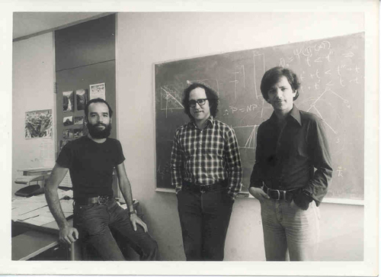
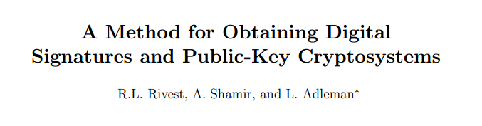

Slide 17
How RSA works
Key generation:
Pick large (say, 1024 bits) random primes p and q
Compute N := pq (RSA uses multiplication mod N)
Pick e to be relatively prime to (p-1)(q-1)
Find d so that ed mod (p-1)(q-1) = 1
Finally: Public key is (e,N) Private key is (d,N)
To encrypt: E(x) = x^{e} mod N To decrypt: D(x) = x^{d} mod N

Slide 18
Why RSA works
“It works” theorem:
For all 0 < x < N, can show that D(E(x)) = x
Proof:
D(E(x)) = (x^{e} mod pq)^{d} mod pq = x^{ed} mod pq = x^{a(p-1)(q-1)+1} mod pq for some a (because ed mod (p-1)(q-1) = 1)
= (x^{(p-1)(q-1)})ªx mod pq = (x^{(p-1)(q-1)} mod pq)ªx mod pq = 1ªx mod pq (because of the fact that if p,q are prime, then for all 0 < x < N, x^{(p-1)(q-1)} mod pq = 1)
= x

Slide 19
Is RSA secure?
Best known way to compute d from e is factoring N into p and q.
Best known factoring algorithm: General number field sieve Takes more than polynomial time but less than exponential time to factor n-bit number.
(Still takes way too long if p,q are large enough and random.)
Fingers crossed… but can’t rule out a breakthrough!

Slide 20
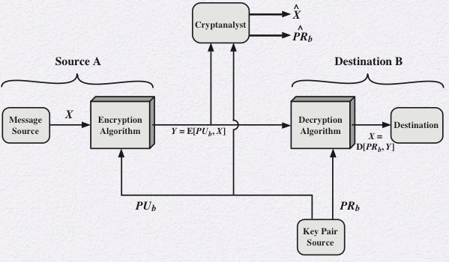
Signing with the public key for confidentiality or secrecy:
Does this provide integrity?

Slide 21
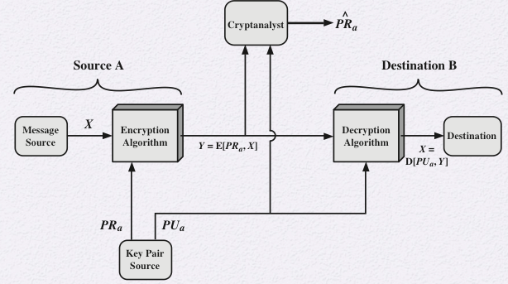
Signing with private key for integrity/authentication.
Does this provide confidentiality?

Slide 22
Subtle fact: RSA can be used for either confidentiality or integrity
RSA for confidentiality:
Encrypt with public key Decrypt with private key “your eyes only” message
RSA for integrity:
Encrypt (“sign”) with private key Decrypt (“verify”) with public key called a digital signature
[What if we want both confidentiality and integrity on the same message?]
Notes:
For both, use RSA twice, once for each purpose (w/ separate key-pairs)

Slide 23
How to have both confidentiality and integrity (using RSA)?
Alice (A) wants to send a secret message to Bob (B) so that Bob can verify that it comes from Alice.
Which one(s) is/are secure?
E(E(M, PR_{A}), PU_{B})
E(E(M, PU_{B}), PR_{A})
C=E(M, PR_{A}) E(MAC(C), PU_{B})
Send C||MAC
C=E(M, PU_{B}) E(MAC(C), PR_{A})

Slide 24
RSA drawback: Performance
Factor of 1000 or more slower than AES.
Dominated by exponentiation – cost goes up (roughly) as cube of key size.
Message must be shorter than N.
[How big should the RSA keys be?]
Use in practice:
Encryption: Use RSA to encrypt a random x < N, compute k := PRF(x), encrypt message using a symmetric cipher and key k
Signing: Compute v := PRF(m), use RSA to sign a carefully padded version of v (many gotchas!)
Almost always should use crypto libraries to get the details right
Notes:
Reasons for larger key size:
- Unlike w/ symmetric key, p and q can’t be chosen uniformly at random (only primes will do)
Also, can attack by factoring (known factoring algorithms are better than dumb brute force)
Need some cushion for when factoring algorithms improve
Good advice today: 2048-bit p and q seem safe for foreseeable future.
Some people still use 1024-bit (risky) or smaller (know insecure!).
Use 4096-bit if you’re paranoid.

Slide 25
True or false:
Public-key encryption is more secure from cryptanalysis than symmetric encryption.

Slide 26
True or false:
Public-key encryption is a general-purpose technique that has made symmetric encryption obsolete

Slide 27
True or false:
Key distribution is trivial when using public-key encryption, compared to the cumbersome handshaking involved with key distribution centers for symmetric encryption.

Slide 28
Attacks against RSA
Brute force: trying all possible private keys
Mathematical attacks: factoring
Timing attacks: using the running time of decryption
Hardware-based fault attack: induce faults in hardware to generate digital signatures
Chosen ciphertext attack

Slide 29
Building a secure channel
What if you want confidentiality and integrity at the same time?
Encrypt, then add integrity, not the other way around. (some reasons are subtle)
Use separate keys for confidentiality and integrity.
Need two shared keys, but only have one? That’s what PRGs are for!
If there’s a reverse (Bob to Alice) channel, use separate keys for that too
Notes:
Encryption functions sometimes become insecure if the adversary can tamper with the message, as we’ll see in a future homework.

Slide 30
Issue: How big should keys be?
Want prob. of guessing to be infinitesimal… but watch out for Moore’s law – safe size gets 1 bit larger every 18 months
128 bits usually safe for ciphers/PRGs
Need larger values for MACs/PRFs due to birthday attack
Often trouble if adversary can find any two messages with same MAC
Attack: Generate random values, look for coincidence.
Requires O(2^{|k|/2}) time, O(2^{|k|/2}) space.
For 128-bit output, takes 2⁶⁴ steps: doable!
[Puzzle: Do it in constant space?]
Upshot: Want output of MACs/PRFs to be twice as big as cipher keys e.g. use HMAC-SHA256 along side AES-128
Notes:
2¹²⁸ is approx. 10³⁹ at 1 trillion guesses/sec., takes 10 quadrillion times lifetime of universe
Birthday paradox: By the pigeonhole principle, 100% probability of two same birthdays with 367 people;
but counter-intuitively, reach 99% probability with only 57 people, and 50% probability with just 23 people
Intuition? (23 choose 2) = 253 pairs – chances for a collision
Floyd’s cycle-finding algorithm

Slide 31
Exercise:
100 people all communicating with each other, how many keys are needed? (using symmetric key crypto)

Slide 32
So Far:
Message Integrity
Confidentiality
Key Exchange
Public Key Crypto
Next Week:
Hot Topics in Crypto
HTTPS: Secure channels for the web

Slide 33
Review: Diffie-Hellman Key Exchange
Lets Alice and Bob agree on a shared secret value by having a public conversation
Problem: Man-in-the-middle attacks
Caution: D-H gives you a shared secret, but don’t know who’s on the other end!
Alice Generates random secret a (0 < a < p)
Bob Generates random secret b (0 < b < p)
a
gª mod p
b
Alice
Bob
g^{b} mod p
Eve
Computes x = (g^{b} mod p)ª mod p = g^{ba} mod p
Computes x′
= (gª mod p)^{b} mod p = g^{ab} mod p
x == x′
a
u
v
b
Alice
gª mod p
Mallory
g^{v} mod p
Bob
g^{u} mod p
g^{b} mod p

