Slide 1

Mining Your Ps and Qs: Detection of Widespread
Weak Keys in Network Devices
Nadia Heninger Zakir Durumeric, Eric Wustrow, J. Alex Halderman
Notes:
Good Morning.
My name is Zakir Durumeric.
I'm going to discuss our recent work on investigating the state of public key cryptography on the Internet
which was conducted by Nadia Heninger, Eric Wustrow, Alex Halderman, and myself

Slide 2
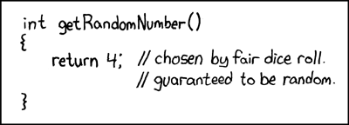
Public Keys and Randomness
Public keys secure Internet communications; e.g. SSL, SSH
Security requires good randomness
Notes:
- There is a long history of security vulnerabilities that have been caused by poor random number generation
- The most notable of these cases being
- Netscape SSL vulnerability that was found in 1996
- and the more recent Debian Weak Keys Incident
- Everyone will agree that both of this incidents had major impacts, BUT they were only found by
- stumbling upon repeated keys
- or by close inspection of a specific implementation

Slide 3

Research Agenda
Collect keys
Look for specific vulnerabilities
Investigate causes
Notes:
Earlier this year, our team decided to inspect the state of public cryptography on the Internet
- however, instead of investigating specific implementations as had been done in the past
- we took a different approach... in which we searched for vulnerabilities that could be found
by analyzing the entire universe of keys as a whole
- Specifically, we analyzed the cryptographic keys used by the two most
common cryptographic protocols on the Internet
- TLS and SSH

Slide 4
Collecting Public Keys
Finding Hosts
Nmap from EC2
25 hosts, <24 hours
Port 443 (HTTPS) | Port 22 (SSH)
29 million hosts | 23 million hosts
Retrieving Keys
Event Driven Process
3 hosts, <48 hours
Port 443 (HTTPS) | Port 22 (SSH)
13 million hosts | 10 million hosts
Parsing Certs
OpenSSL, database
Certificates
6 million certificates (2 million browser-trusted)
Notes:
In order to investigate these issues on a global scale
- we performed comprehensive scans of publicly accessible TLS and SSH hosts on the Internet
- We were inspired by the SSL Observatory Project which previously scanned and collected TLS certificates
- However, instead of looking at the Certificate Authority ecosystem,
we focused on the cryptographic keys
- In the first step, we performed a distributed scan of the IPv4 address space on ports 443 and 22
across 25 Amazon EC2 instances
- This methodology allowed us to perform a scan of the entire Internet in under 24 hours
- We identified 28 million TLS and 23 million SSH hosts
- In the second step, we performed TLS and SSH handshakes with these hosts
- collecting and parsing the presented certificates and keys
- We ultimately collected certificates from over 12 million TLS hosts and 10 million SSH hosts

Slide 5
What could go wrong?
Repeated keys
Notes:
At this point, we have a global perspective -- but what do we look for?
The first obvious answer is to look for repeated keys

Slide 6
Repeated Keys
 | Port 443 (HTTPS) | Port 22 (SSH)
Live Hosts | 12.8 million | 10.2 million
Distinct RSA public keys | 5.6 million | 3.8 million
Distinct DSA public keys | 6,241 | 2.8 million
Why are so many keys shared?
Notes:
- From a theoretical perspective, we wouldn't expect to see hosts utilizing the same keys
- but we can immediately see that a very large number of hosts are sharing keys
- In the cases of both TLS and SSH there are less than half the number of keys as there are hosts

Slide 7

Investigating Shared Keys
Manually investigated hosts sharing keys
Non-vulnerable reasons for shared keys
Corporations share keys across certificates
Shared hosting providers
Notes:
So why do so many hosts utilize repeated keys? Does this actually pose any threats?
There are many legitimate reasons that keys could be shared across multiple certificates or hosts
- Many corporations have a large number of web servers that share the same certificate
- Companies also share the same key across multiple certificates for different domains
- Many large hosting providers also use the same key on the certificates for all of their customer

Slide 8
Investigating Shared Keys
Manually investigated hosts sharing keys
Vulnerable reasons for shared keys
Default certificates and keys
Apparent entropy problems
714,000 (5.6%) of TLS hosts
981,000 (9.6%) of SSH hosts
Notes:
However, even after accounting for these scenario
- there were still a large number keys that were shared across certificates and hosts
In order to determine what was causing this, we
- clustered these hosts by public key
and
- manually investigated these clusters of hosts
- What we ended up finding was that 5% of TLS hosts are network devices using default certificates
- and that another 1/4 of a percent were network devices that appeared to be generating duplicated keys
So what do we mean by network devices? We're talking about headless, often embedded, networked devices
- ranging from routers and firewalls to server management cards and VoIP devices
These shared keys pose a risk because IF an Adversary can extract the private key from the device
- they allow an adversary to impersonate a device
- potentially decrypt communication streams

Slide 9
Snake-oil Keys
Apache ships default certificates with installation
Found 22 CA-signed certificates with keys copied from snake-oil certificate!
Lesson: Users are only going to follow your instructions approximately…

Slide 10
What could go wrong?
Repeated keys
Repeated factors in RSA keys
Notes:
While shared keys do pose some risk, there are much more severe problems that can arise
from poorly generated keys
Given that over 99% of TLS certificate utilize RSA encryption,
naturally, we next investigated specific failure modes within RSA

Slide 11
RSA Keys
Public key modulus N = pq
Factoring N reveals the private key
Factoring 1024-bit RSA not known to be feasible
However…
For N₁ = pq₁ and N₂=pq₂
we can efficiently compute p = GCD(N₁, N₂)
Notes:
We generate RSA keys by
- first generating two large primes p and q
- The public key is composed of the public exponent e and the product of these two primes, N
- So we've discussed what happens when an entire key is shared between multiple hosts
BUT what if only a single prime were shared between two hosts?
- In this case, it's easy to efficiently compute both private keys
- Given two keys with a single shared factor, we can take the GCD of these two moduli
- and ultimately calculate both of the private keys
- Calculating the GCD of two 1024-bit keys takes approximately 15 microseconds.
- In contrast, there are no known methods for efficiently factoring 1024 bit keys
- the largest known factored key is 768 which was computed after a distributed, multi-year project

Slide 12
Looking for Shared RSA Factors
6 x 10¹³ distinct pairs * 15 μs ≈ 30 years
Notes:
Unfortunately, at 15 microseconds, given the size of our dataset, taking the naive approach
- it would take approximately 30 years to calculate the pairwise GCD of the keys in our dataset
- which is out of our reach computationally

Slide 13
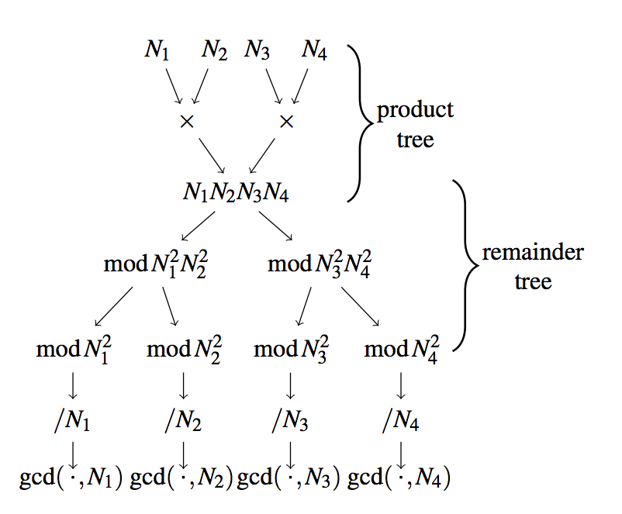
Looking for Shared RSA Factors
All Pairs GCD (algorithm due to Bernstein)
Our Implementation
1.3 hours on EC2
$5.00
2,134 prime factors
Computed private keys for 64,081 TLS hosts (0.50%)
Notes:
Instead, our team implemented an algorithm previously published by Dan Bernstein
- to compute the pairwise GCD of all pairs of RSA moduli
We were able to implement the algorithm using GMP and ~300 lines of C code
and ultimately computed this pairwise computation
- in less than 2 hours on Amazon EC2
- for less than $5
If keys were begin computed properly, we would expect to see no shared, prime factors.
HOWEVER, we ultimately found 2,300 prime factors
- which allowed us to factor private keys for .50% of TLS hosts
We investigated all of the hosts generating these factorable keys
- Found that only two of the certificates with factorable keys were trusted
- Just like the shared keys that were generated with poor entropy, the hosts generating factorable keys were all embedded devices
- Many of the devices were the same brands that were generating repeated keys

Slide 14
What could go wrong?
Repeated keys
Repeated factors in RSA keys
Repeated DSA signature randomness
Notes:
Just like RSA, DSA also has severe failure modes

Slide 15
DSA Signatures
Standard Digital Signature Algorithm
Each signature contains a random ephemeral key
If predictable ⇒ can easily compute private key
Two different signatures with same ephemeral and long-term keys ⇒ can easily compute randomness ⇒ can easily compute private key
Notes:
- DSA is the US federal gsovernment’s signature algorithm standard
based on the discrete log problem
and while we don't have time to get into the details of the algorithm,
there are two important properties that I want to mention
First off
if an adversary can guess the randomness that was used to generate a signature,
then they can easily compute the private key
And secondly that
if a key is ever used to sign two different messages with the same randomness

Slide 16
Looking for shared randomness
We collected DSA signatures during SSH key exchange
4,365 signatures used shared ephemeral keys
Computed private long-term keys for
105,728 (1.03%) of SSH hosts
Notes:
During our SSH scans, we collected the signatures along with host keys
- and looked for repeated randomness
finding that 4,365 signatures shared the same randomness
which ultimately allowed us to compromise the DSA host keys for more than 100,000 hosts -- just over 1% of SSH hosts
Naturally, we investigated the hosts, and found both:
- several faulty software implementations
AND
- that network devices were generating repeated randomness across hosts
- very similar to what we saw generating repeated and factorable keys

Slide 17
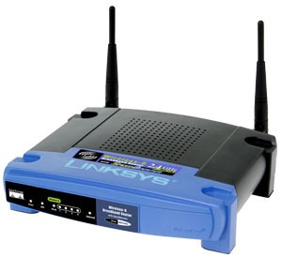
Vulnerable Devices
Vast majority of compromised keys generated by headless or embedded network devices
Routers, Firewalls, Switches, Server Management Cards, Cable Modems, Voice-Over-IP devices
Automatically generate keys
Identified devices from 41 manufacturers
Notes:
In almost all of the cases, we were able to trace weak keys back to
- a specific manufacturer and model
and in the end, we identified devices from 41 manufacturers
- that were generating these weak keys
These were mostly network devices such as
- routers, firewalls
- server management cards
- VoIP phones
and other embedded devices
DEVICES THAT AUTOMATICALLY GENERATE KEYS ON FIRST BOOT
We found a lot of consumer grade hardware,
but we did find enterprise products as well
What's important to note is that:
- This wasn't just one or two bad implementations
- These were issues that were widespread across:
- a variety of device types
AND
- a variety of manufacturers

Slide 18
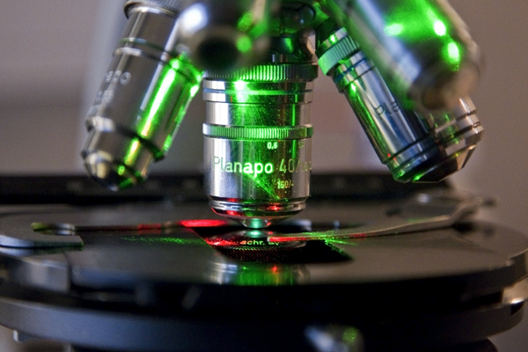
Research Agenda
Collect keys
Look for specific vulnerabilities
Investigate causes
Notes:
In order to better understand why these problems were occurring on such a large range of devices
- we decided to take a deeper look at the software that was being generate some these keys
- and to replicate the problem
We decided to investigate Linux and OpenSSL
- these weren't the only platforms we saw presenting vulnerable keys
- We also saw vulnerable software on BSD and Windows
- BUT they were common among the vulnerable keys

Slide 19
Linux /dev/urandom
Nearly everything uses /dev/urandom
Time of boot
Input Pool
Keyboard /Mouse
Disk Access Timing
Only happens if Input Pool contains more than 192 bits…
Time of boot
Nonblocking Pool
/dev/urandom
Problem 1: Embedded devices may lack all these sources
Problem 2: /dev/urandom can take a long time to “warm up”
Notes:
While Linux recommends that /dev/urandom be used for everything but generating cryptographic keys
- all of the implemenations we found used /dev/urandom
due to unpredictable blocking nature of /dev/random
So how is entropy collected?
- Linux maintains several entropy pools
- As entropy is gathered it is stored in the "Input Pool"
- and is eventually mixed into the "Non-Blocking pool" which feeds /dev/urandom
- However, as we start to go through the list entropy sources, we find that many of the devices we earlier mentioned are missing all of these entropy sources
- Devices do not have a connected keyboard or mouse
- Many times they do not have spindle-based disks or are using custom disk drivers
- In fact, most of these devices don't even support real-time clocks
- and with all of these sources removed, we end up with a deterministic source of randomness
- Further though, entropy isn't mixed from the Input Pool into the Non-Blocking Pool
until more than 192 bits of entropy have been collected
- So even if a small amount of entropy is collected on a device, none of it is available until the pool reaches this threshold

Slide 20
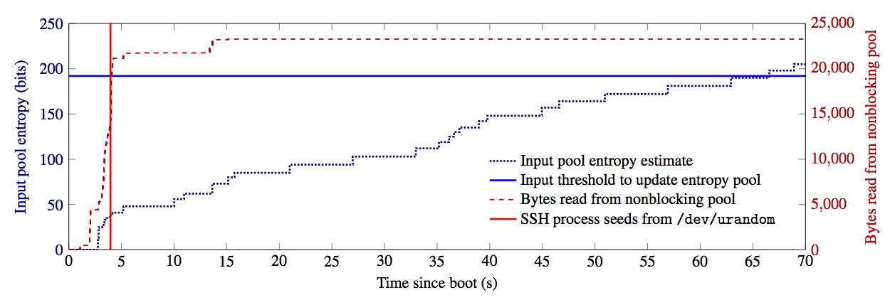
Ubuntu Server 10.04 Test System (Typical boot)
First Input entropy mixed into /dev/urandom
Boot-Time Entropy Hole
OpenSSH seeds from /dev/urandom
/dev/urandom may be predictable for a period after boot.
Notes:
This graph shows the build-up of entropy on the first boot of a typical Ubuntu Desktop Server
- No randomness added from input pool to urandom until 192 bits of entropy is available
- From graph, we can tell that this isn't until fairly late in the boot process
- The only entropy source during this time is time
- Not an issue for subsequent boots because entropy is written to disk at shutdown
This is what we’ve termed the “Boot-Time Entropy Hole”
We expect that this explains some but not all of the entropy problems we observed

Slide 21
Why are keys factorable?
prng.seed(seed) p = prng.generate_random_prime() q = prng.generate_random_prime() N = p*q
Notes:
This might be how you expect a key generation algorithm to look like:
- generate p and then generate q
We would expect to see repeated keys but not necessarily factorable keys
because either both of the keys will be repeated or neither
This is not due to just a reduced key space

Slide 22
Why are keys factorable?
prng.seed(seed) p = prng.generate_random_prime() prng.add_randomness(bits) q = prng.generate_random_prime() N = p*q
Notes:
The following code would explain how a factorable key might be generated…
In a low entropy situation, this might result in p being shared between multiple keys but q being different
And we find that OpenSSL is updating the entropy pool during the key generation process
OpenSSL is doing this in effect for low-entropy situations
- it updates entropy pool with current time in seconds and this can diverge due to clock drift

Slide 23
One unusual case…
Typical factor distribution
for one device model
Factor distribution for
a particular IBM Device
9 possible primes
36 total possible moduli!
Notes:
On the left we see a typical distribution of factored keys from a device
- we can see that a large number of keys are being generated
- this is the type of distribution that would suggest entropy problems

Slide 24
Disclosure
Wrote disclosures to about 60 companies
About 10 had security contact information
Approximately 20 responded
3 have informed us of security advisories
US-CERT is helping us coordinate
Linux Kernel has been patched
Notes:
After identifying devices
- We contacted over 60 companies regarding vulnerable products
- which turned out to be a long and painful process
- About 10 of them had an actual security contact we could find
- Only approximately 20 of the companies responded in four months
- 3 of which have notified us of security advisories
- We recently partnered WITH US CERT and ICS CERT which has been a major help
- While we are not officially endorsing them, I think everyone on our team would immediately turn to them next time we have to do disclosures
Secondly, we have been working with the Linux Kernel Development Team
- The Linux kernel has been patched
- Add randomness from interrupts
- Add unique identifiers from network, USB, and other devices
- Should never see devices directly generate a duplicate or factorable key
- Entropy is gathered much more quickly early in the boot process and then backs off
- Helps us reduce this boot-time entropy hole

Slide 25
Disclosure to end-users
Found a number of Citrix remote-access devices using CA-signed certs with keys copied from default certs
Certs belonged to Fortune 500 companies, insurance providers, law firms, a major public transit authority, and the US Navy.
I tried to contact these companies…

Slide 26
Mitigations
Lessons for OS developers, crypto library developers, app developers, device makers, certificate authorities, end users, security and crypto researchers
More entropy sources
Add hardware sources
Kernel collects more aggressively
Better communication between applications and OS
/dev/urandom isn’t providing the service people need
Created public key check service for end users
Notes:
We’ve notified companies, but how do we prevent this type of problem from occurring going forward?
First off, Devices need to be pulling from additional entropy sources
- and in some cases cases, the kernel needs to be collecting entropy from existing sources more aggressively
Secondly, there needs to be better communication between the OS and applications
- /dev/urandom will provide entropy when it is completely deterministic
which is not providing the service that people actually need
We have also brought up an online keycheck server at factorable.net
- that allows users to check their keys against these vulnerabilties
And in our paper, we outline steps that can be taken at every level
- in order to prevent this type of vulnerability from occuring again

Slide 27
Is this the tip of the iceberg?
Probably mainly see devices without real-time clocks
RTC may mask serious entropy problems
Possible targeted attack
Guess time of first boot and compute key
On traditional PCs, margin of safety for keys generated on first boot is slim
Not observed to be exploitable (so far)
Notes:
Is this the tip of the iceberg?
We’re expect that most of the devices we do not have a real time clock
it’s likely that many devices are missing real entropy sources, but that these issues are masked by real time clocks
And are still potentially vulnerable to a targeted attack if an Adversary can guess the time of first boot
AND
While we weren’t able to observe any exploitable keys on traditional PCs the margin of safety between
- gathering 192 bits of entropy
and
-generating keys on first bot was slim

Slide 28
Future Work
Further cryptographic vulnerabilities
Diffie-Hellman, ECDSA
IMAPS, DNSSEC
Further impacts of boot-time entropy hole
TCP sequence numbers
ASLR
Further applications of top-down methodology
Notes:
We looked at two specific cryptographic protocols: RSA and DSA,
- but vulnerabilities could exist in other Internet and cryptographic protocols
And there may be other impacts of the boot-time entropy hole such as
- predictable tcp sequence numbers
And
- address space randomization

Slide 29
Conclusion
Studied entropy via global perspective on public keys
Found widespread vulnerabilities in embedded devices
Shared keys (5.6% of TLS hosts; 9.6% of SSH)
Factorable RSA keys (0.5% of TLS hosts; 0.03% of SSH)
Repeated DSA randomness (1.0% of SSH hosts)
Secure random number generation still difficult
Notes:
In conclusion,
- we studied entropy and the state of public keys on the Internet via a global perspective
Finding widespread vulnerabilities in embedded devices including that
Problems with random number generation are pervasive in certain devices that secure random number generation is still difficul

Slide 30
Mining Your Ps and Qs: Detection of Widespread
Weak Keys in Network Devices
Our website: https://factorable.net
Nadia Heninger Zakir Durumeric, Eric Wustrow, J. Alex Halderman
Notes:
Lots more in the paper
Visit our website for more
Thanks!

