Slide 1
Lecture 1 – The Security Mindset
Michael Bailey
University of Illinois
ECE 422/CS 461 – Fall 2015

Slide 2
Goals for this Course
Critical thinking
How to think like an attacker
How to reason about threats and risks
How to balance security costs and benefits
Technical skills
How to protect yourself
How to manage and defend systems
How to design and program secure systems
Learn to be a security-conscious citizen
Learn to be a 1337 hax0r, but an ethical one!

Slide 3
What is Computer Security?
Math?
Engineering?
Philosophy?
Natural Sciences?

Slide 4
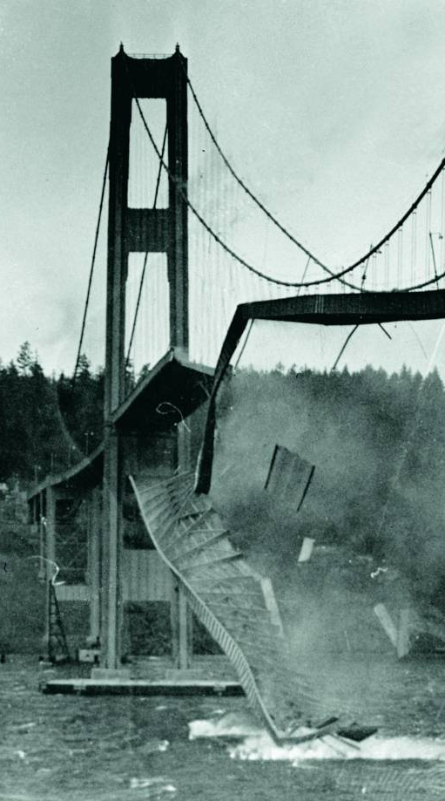
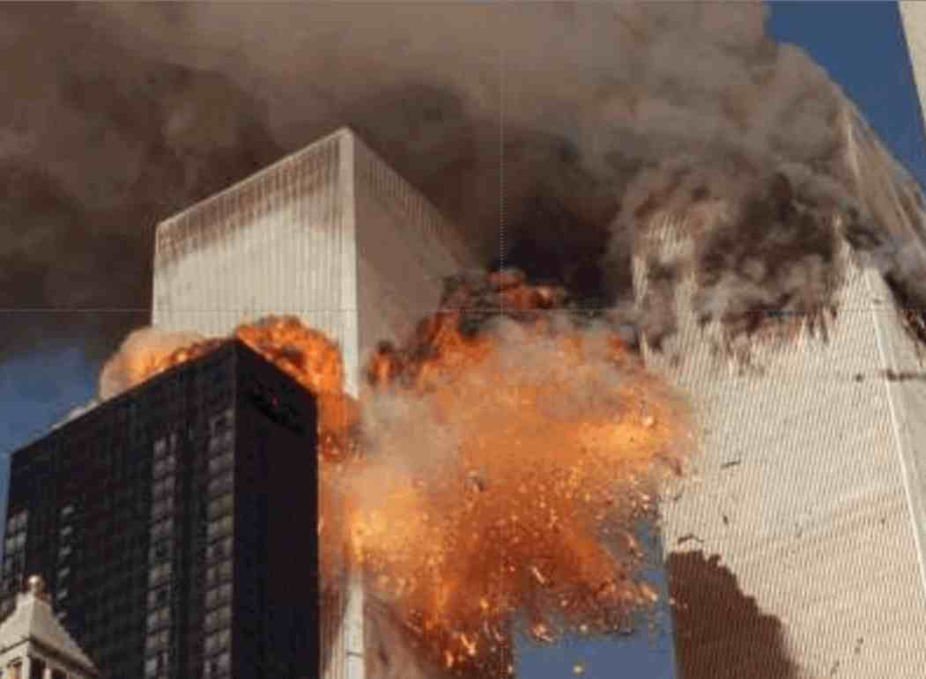
What’s the Difference?

Slide 5
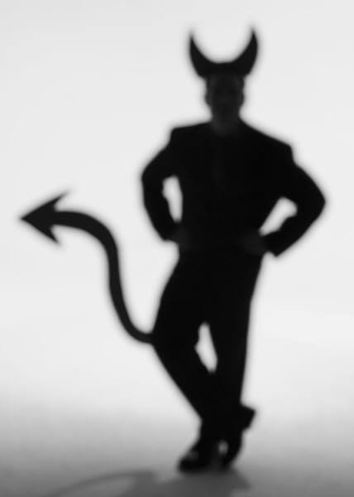
Meet the Adversary
“Computer security studies how systems behave in the presence of an adversary.”
The adversary
a.k.a. the attacker
a.k.a. the bad guy
* An intelligence that actively tries to cause the system to misbehave.

Slide 6
“Know your enemy.”
Motives?
Capabilities?
Degrees of access?

Slide 7
The Security Mindset
Thinking like an attacker
Understand techniques for circumventing security.
Look for ways security can break, not reasons why it won’t.
Thinking like a defender
Know what you’re defending, and against whom.
Weigh benefits vs. costs: No system is ever completely secure.
“Rational paranoia!”

Slide 8
High-Level Approaches
Attacks
Defenses

Slide 9
Why Study Attacks?
Identify vulnerabilities so they can be fixed.
Create incentives for vendors to be careful.
Learn about new classes of threats.
Determine what we need to defend against.
Help designers build stronger systems.
Help users more accurately evaluate risk.

Slide 10
“Insecurity”?
Hierarchy
Level-2 Problem: “Weakness”
Factors that predispose systems to vulnerability
Level-1 Problem: “Vulnerability”
Specific errors that could be exploited in an assault.
“Attack”
Assault recipe, vulnerabilities are ingredients
Level-0 Problem: “Assault”
Actual malicious attempt to cause harm.

Slide 11
Thinking Like an Attacker
Look for weakest links – easiest to attack.
Identify assumptions that security depends on. Are they false?
Think outside the box: Not constrained by system designer’s worldview.
Practice thinking like an attacker: For every system you interact with, think about what it means for it to be secure, and image how it could be exploited by an attacker.

Slide 12
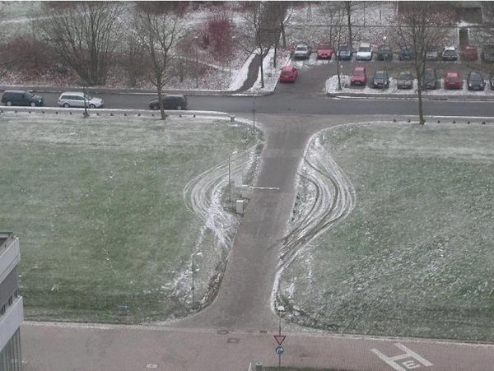
Exercises

Slide 14
Exercises
Breaking into Siebel?

Slide 15
Exercises
What are some security systems you interact with in everyday life?
Notes:
Airplanes
Shoplifting
Banks
Cars
Hospitals

Slide 16
Thinking as a Defender
Security policy
What are we trying to protect?
What properties are we trying to enforce?
Threat model
Who are the attackers? Capabilities? Motivations?
What kind of attack are we trying to prevent?
Risk assessment
What are the weaknesses of the system?
What will successful attacks cost us?
How likely?
Countermeasures
Costs vs. benefits?
Technical vs. nontechnical?
Challenge is to think rationally and rigorously about risk. Rational paranoia.

Slide 17
Security Policies
What assets are we trying to protect?
What properties are we trying to enforce?
Confidentiality
Integrity
Availability
Privacy
Authenticity
…

Slide 18
Threat Models
Who are our adversaries?
Motives?
Capabilities?
What kinds of attacks do we need to prevent? (Think like the attacker!)
Limits: Kinds of attacks we should ignore?

Slide 19
Assessing Risk
Remember: Controlled paranoia
What would security breaches cost us?
Direct costs: Money, property, safety, ...
Indirect costs: Reputation, future business, well being, …
How likely are these costs?
Probability of attacks?
Probability of success?

Slide 20
Countermeasures
Technical countermeasures
Nontechnical countermeasures
Law, policy (government, institutional), procedures, training, auditing, incentives, etc.

Slide 21
Security Costs
No security mechanism is free
Direct costs: Design, implementation, enforcement, false positives
Indirect costs: Lost productivity, added complexity
Challenge is rationally weigh costs vs. risk
Human psychology makes reasoning about high cost/low probability events hard

Slide 22
Exercises
Should you lock your door?
Assets?
Adversaries?
Risk assessment?
Countermeasures?
Costs/benefits?

Slide 23
Exercises
Should you lock your bike?

Slide 24
Secure Design
Common mistake: Trying to convince yourself that the system is secure
Better approach: Identify the weaknesses of your design and focus on correcting them
Secure design is a process
Must be practiced continuously; can’t be retrofitted

Slide 25
Where to Focus Defenses
Trusted components Parts that must function correctly for the system to be secure.
Attack surface Parts of the system exposed to the attacker
Complexity vs. security?

Slide 26
Other Principles
Defense-in-Depth
Diversity
Maintainability
…

Slide 27
Security Testing
Testing against requirements
What are the right requirements?
Adversarial testing
Black box testing
White box testing
Example: Voting

Slide 28
Learning from Failures
Time-honored engineering practice, emerging in security
Identifying causes of failures
What can failure teach us?

Slide 30
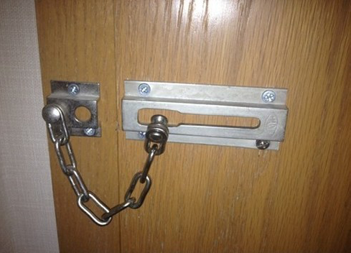

Slide 31
To Learn More …
The Security Mindset. https://www.schneier.com/blog/archives/2008/03/the_security_mi_1.html
https://freedom-to-tinker.com/blog/felten/security-mindset-and-harmless-failures/
https://cubist.cs.washington.edu/Security/2007/11/22/why-a-computer-security-course-blog/

Slide 32
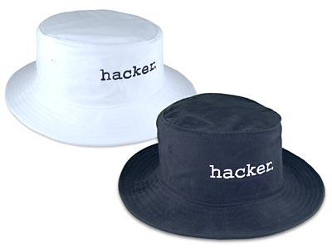
Questions?

