Slide 1
Lecture 11 – Networking Concepts
Michael Bailey
University of Illinois
ECE 422/CS 461 – Fall 2015

Slide 2
Who recognizes this?
int sockfd;
struct sockaddr_in addr;
addr.sin_family = AF_INET;
addr.sin_addr.s_addr =
inet_addr(SERV_HOST_ADDR);
addr.sin_port = htons(SERV_TCP_PORT);
sockfd = socket(AF_INET, SOCK_STREAM, 0);
connect(sockfd, (struct sockaddr *) &addr,
sizeof(serv_addr));
do_stuff(stdin, sockfd);

Slide 3
Classic view of network API
Start with host name (maybe)
foo.bar.com

Slide 4
Classic view of network API
Start with host name
Get an IP address
foo.bar.com
gethostbyname()
10.5.4.3

Slide 5
Classic view of network API
Start with host name
Get an IP address
Make a socket (protocol, address)
foo.bar.com
gethostbyname()
10.5.4.3
socket();connect();…
sock_id

Slide 6
Classic view of network API
Start with host name
Get an IP address
Make a socket (protocol, address)
Send byte stream (TCP) or packets (UDP)
foo.bar.com
gethostbyname()
10.5.4.3
socket();connect();…
sock_id
…
1,2,3,4,5,6,7,8,9 . . .
TCP sock
UDP sock
Network
Eventually arrive in order
May or may not arrive

Slide 7
Circuit and Packet Switching
Circuit switching
Legacy phone network
Single route through sequence of hardware devices established when two nodes start communication
Data sent along route
Route maintained until communication ends
Packet switching
Internet
Data split into packets
Packets transported independently through network
Each packet handled on a best efforts basis
Packets may follow different routes

Slide 8
Packet Switching
B
F
A
3
2
1
D
C
D

Slide 9
Packet Switching
B
F
1
A
3
2
D
C
D

Slide 10
Packet Switching
B
F
1
2
A
3
D
C
D

Slide 11
Packet Switching
B
F
1
3
2
A
D
C
D

Slide 12
Network Layers
Network models typically use a stack of layers
Higher layers use the services of lower layers via encapsulation
A layer can be implemented in hardware or software
The bottom-most layer must be in hardware
A network device may implement several layers
A communication channel between two nodes is established for each layer
Actual channel at the bottom layer
Virtual channel at higher layers

Slide 13
Internet Layers
Application
Application
Transport
Transport
Network
Network
Network
Network
Link
Link
Link
Link
Ethernet
Fiber Optics
Wi-Fi
Physical Layer

Slide 14
Protocols
A protocol defines the rules for communication between computers
Protocols are broadly classified as connectionless and connection oriented
Connectionless protocol
Sends data out as soon as there is enough data to be transmitted
E.g., user datagram protocol (UDP)
Connection-oriented protocol
Provides a reliable connection stream between two nodes
Consists of set up, transmission, and tear down phases
Creates virtual circuit-switched network
E.g., transmission control protocol (TCP)

Slide 15
Encapsulation
A packet typically consists of
Control information for addressing the packet: header and footer
Data: payload
A network protocol N1 can use the services of another network protocol N2
A packet p1 of N1 is encapsulated into a packet p2 of N2
The payload of p2 is p1
The control information of p2 is derived from that of p1
Header
Header
Payload
Footer
Footer
Payload

Slide 16
Internet Packet Encapsulation
Application Packet
Application Layer
TCP
Header
TCP Data
Transport Layer
IP
Header
IP Data
Network Layer
Frame
Header
Frame Data
Frame
Footer
Link Layer

Slide 17
Network Interfaces
Network interface: device connecting a computer to a network
Ethernet card
WiFi adapter
A computer may have multiple network interfaces
Packets transmitted between network interfaces
Most local area networks, (including Ethernet and WiFi) broadcast frames
In regular mode, each network interface gets the frames intended for it
Traffic sniffing can be accomplished by configuring the network interface to read all frames (promiscuous mode)

Slide 18
MAC Addresses
Most network interfaces come with a predefined MAC address
A MAC address is a 48-bit number usually represented in hex
E.g., 00-1A-92-D4-BF-86
The first three octets of any MAC address are IEEE-assigned Organizationally Unique Identifiers
E.g., Cisco 00-1A-A1, D-Link 00-1B-11, ASUSTek 00-1A-92
The next three can be assigned by organizations as they please, with uniqueness being the only constraint
Organizations can utilize MAC addresses to identify computers on their network
MAC address can be reconfigured by network interface driver software
Notes:
MAC addresses can be permanently burned in (BIA), or be a locally administered address (LAA) set by an administrator. A MAC address starting out with 00-08-74 for instance is assigned by Dell, while one starting out with 00-0a-95 is assigned by Apple. Despite the IEEE limitations on LAAs, most OSs allow you to specify an arbitrary MAC for an interface.

Slide 19
Switch
A switch is a common network device
Operates at the link layer
Has multiple ports, each connected to a computer
Operation of a switch
Learn the MAC address of each computer connected to it
Forward frames only to the destination computer

Slide 20
Combining Switches
Switches can be arranged into a tree
Each port learns the MAC addresses of the machines in the segment (subtree) connected to it
Fragments to unknown MAC addresses are broadcast
Frames to MAC addresses in the same segment as the sender are ignored

Slide 21
Types of Wireless Networks
Infrastructure
Client machines establish a radio connection to a special network device, called access point
Access points connected to a wired network, which provides a gateway to the internet
Most common type of wireless network
Peer-to-peer
Multiple peer machines connect to each other
Typically used in ad-hoc networks and internet connection sharing
Access Point
Client
Wired LAN
Client
Client
Peer
Peer
Peer
Peer

Slide 22
Internet Protocol
Connectionless
Each packet is transported independently from other packets
Unreliable
Delivery on a best effort basis
No acknowledgments
Packets may be lost, reordered, corrupted, or duplicated
IP packets
Encapsulate TCP and UDP packets
Encapsulated into link-layer frames
Data link frame
IP packet
TCP or UDP packet

Slide 23
IP packet layout
IP header includes
Source address
Destination address
Packet length (up to 64KB)
Time to live (up to 255)
IP protocol version
Fragmentation information
Transport layer protocol information (e.g., TCP)

Slide 24
IPv4 Packet Header Format
usually IPv4
usually 20 bytes (without options)
4-bit
version
4-bit
hdr len (bytes)
8-bit
Type of Service
(TOS)
IP fragmentation
16-bit total length (bytes)
16-bit Identification
3-bit
Flags
13-bit Fragment Offset
max number
remaining hops
(decremented at
each router)
8-bit Time to
Live (TTL)
8-bit Protocol
20-byte
Header
16-bit header checksum
32-bit Source IP Address
upper layer protocol
to deliver payload to,
e.g., ICMP (1), UDP (17), TCP (6)
32-bit Destination IP Address
Options (if any)
e.g. timestamp,
record route
taken, specify
route
error
check
header
Payload (e.g., TCP/UDP packet, max size?)

Slide 25
IP Addressing
IP address used to route datagrams through network.
IPv4 32 bit address, IPv6 128 bit address.
Divided into two parts: network and host.
Network part: Used to route packets. (ZIP code)
Host part: Used to identify an individual host. (House number)
Usually represented in dotted decimal notation: 141.211.144.212
Each number represents 8 bits: 0-255.

Slide 26
Decimal representation of Internet addresses
octet 1
octet 2
octet 3
Range of addresses
Network ID
Host ID
Class A:
1 to 127
0 to 255
0 to 255
0 to 255
1.0.0.0 to
127.255.255.255
Network ID
Host ID
Class B:
128 to 191
0 to 255
0 to 255
0 to 255
128.0.0.0 to
191.255.255.255
Network ID
Host ID
Class C:
192 to 223
0 to 255
0 to 255
1 to 254
192.0.0.0 to
223.255.255.255
Multicast address
Multicast address
Class D (multicast):
224 to 239
0 to 255
0 to 255
1 to 254
224.0.0.0 to
239.255.255.255
Class E (reserved):
240 to 255
0 to 255
0 to 255
1 to 254
240.0.0.0 to
255.255.255.255

Slide 27
Classless Interdomain Routing (CIDR)
Allow division between network and host portion on any bit boundary.
More efficient use of address space.
Allows division/aggregation of sub-assignments.
Networks now identified by network address and the length of the network portion: 141.213.8.0/24
Hosts identified by address and network mask: 141.213.8.1, 255.255.255.0.
WHY? Rapid depletion of class B address space and poor utilization of the assigned address space

Slide 28
IP subnets
CIDR prefix length | Subnet Mask | Number of hosts
/8 | 255.0.0.0 | 2²⁴
/9 | 255.128.0.0 | 2²³
/10 | 255.192.0.0 | 2²²
/24 | 255.255.255.0 | 2⁸ = 256
/25 | 255.255.255.128 | 2⁷ = 128
/26 | 255.255.255.192 | 2⁶ = 64
/27 | 255.255.255.224 | 2⁵ = 32
/28 | 255.255.255.240 | 2⁴ = 16
/29 | 255.255.255.248 | 2³ = 8
/30 | 255.255.255.252 | 2² = 4

Slide 29
Transmission Control Protocol
TCP is a transport layer protocol guaranteeing reliable data transfer, in-order delivery of messages and the ability to distinguish data for multiple concurrent applications on the same host
Most popular application protocols, including WWW, FTP and SSH are built on top of TCP
TCP takes a stream of 8-bit byte data, packages it into appropriately sized segment and calls on IP to transmit these packets
Delivery order is maintained by marking each packet with a sequence number
Every time TCP receives a packet, it sends out an ACK to indicate successful receipt of the packet.
TCP generally checks data transmitted by comparing a checksum of the data with a checksum encoded in the packet

Slide 30
Ports
TCP supports multiple concurrent applications on the same server
Accomplishes this by having ports, 16 bit numbers identifying where data is directed
The TCP header includes space for both a source and a destination port, thus allowing TCP to route all data
In most cases, both TCP and UDP use the same port numbers for the same applications
Ports 0 through 1023 are reserved for use by known protocols.
Ports 1024 through 49151 are known as user ports, and should be used by most user programs for listening to connections and the like
Ports 49152 through 65535 are private ports used for dynamic allocation by socket libraries

Slide 31
TCP Packet Format
Bit Offset | 0-3 | 4-7 |  | 8-15 | 16-18 | 19-31
0 | Source Port |  |  |  | Destination Port
32 | Sequence Number
64 | Acknowledgment Number
96 | Offset | Reserved | Flags |  | Window Size
128 | Checksum |  |  |  | Urgent Pointer
160 | Options
>= 160 | Payload

Slide 32
Establishing TCP Connections
TCP connections are established through a three way handshake.
The server generally has a passive listener, waiting for a connection request
The client requests a connection by sending out a SYN packet
The server responds by sending a SYN/ACK packet, indicating an acknowledgment for the connection
The client responds by sending an ACK to the server thus establishing connection
SYN
Seq = x
SYN-ACK
Seq = y
Ack = x + 1
ACK
Seq = x + 1
Ack = y + 1

Slide 33
TCP Data Transfer
During connection initialization using the three way handshake, initial sequence numbers are exchanged
The TCP header includes a 16 bit checksum of the data and parts of the header, including the source and destination
Acknowledgment or lack thereof is used by TCP to keep track of network congestion and control flow and such
TCP connections are cleanly terminated with a 4-way handshake
The client which wishes to terminate the connection sends a FIN message to the other client
The other client responds by sending an ACK
The other client sends a FIN
The original client now sends an ACK, and the connection is terminated
Notes:
Sequence numbers are 32 bit numbers, wrapping to 0. ACKs include sequence number for the received package so sender can keep track of packets received by the receiver.

Slide 34
TCP Data Transfer and Teardown
Data seq=x
Fin seq=x
Ack seq=x+1
Ack seq=x+1
Fin seq=y
Data seq=y
Ack seq=y+1
Ack seq=y+1
Client
Server
Client
Server

Slide 35
Autonomous Systems (AS)
R3
R4
R2
R1
R5
R6
The Internet is a collection of autonomous systems.
AS: A set of routers and networks under the same administrative control.
Inter-domain vs. intra-domain routing.

Slide 36
IP Routing
A router bridges two or more networks
Operates at the network layer
Maintains tables to forward packets to the appropriate network
Forwarding decisions based solely on the destination address
Routing table
Maps ranges of addresses to LANs or other gateway routers

Slide 37
Interplay between routing and forwarding
routing algorithm
local forwarding table
header value
output link
0100
0101
0111
1001
3
2
2
1
value in arriving
packet’s header
0111
1
3
2

Slide 38
Internet inter-AS routing: BGP
BGP (Border Gateway Protocol): the de facto standard
BGP provides each AS a means to:
Obtain subnet reachability information from neighboring ASs.
Propagate the reachability information to all routers internal to the AS.
Determine “good” routes to subnets based on reachability information and policy.
Allows a subnet to advertise its existence to rest of the Internet: “I am here”

Slide 39
BGP basics
Pairs of routers (BGP peers) exchange routing info over semi-permanent TCP connections: BGP sessions
Note that BGP sessions do not correspond to physical links.
When AS2 advertises a prefix to AS1, AS2 is promising it will forward any datagrams destined to that prefix towards the prefix.
AS2 can aggregate prefixes in its advertisement
3c
3a
2c
3b
2a
AS3
2b
1c
AS2
1a
1b
AS1
1d
eBGP session
iBGP session

Slide 40
DNS: Domain Name System
People: many identifiers:
SSN, name, passport #
Internet hosts, routers:
IP address (32 bit) - used for addressing datagrams
“name”, e.g., www.eecs.umich.edu - used by humans
Q: map between IP addresses and name ?
Domain Name System:
distributed database implemented in hierarchy of many name servers
application-layer protocol host, routers, name servers to communicate to resolve names (address/name translation)
note: core Internet function, implemented as application-layer protocol
complexity at network’s “edge”

Slide 41
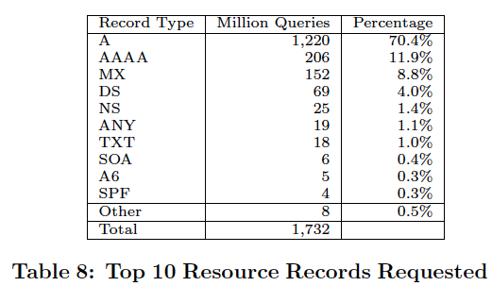
DNS name servers
Why not centralize DNS?
single point of failure
traffic volume
distant centralized database
Maintenance
doesn’t scale!
no server has all name-to-IP address mappings
local name servers:
each ISP, company has local (default) name server
host DNS query first goes to local name server
authoritative name server:
for a host: stores that host’s IP address, name
can perform name/address translation for that host’s name

Slide 42
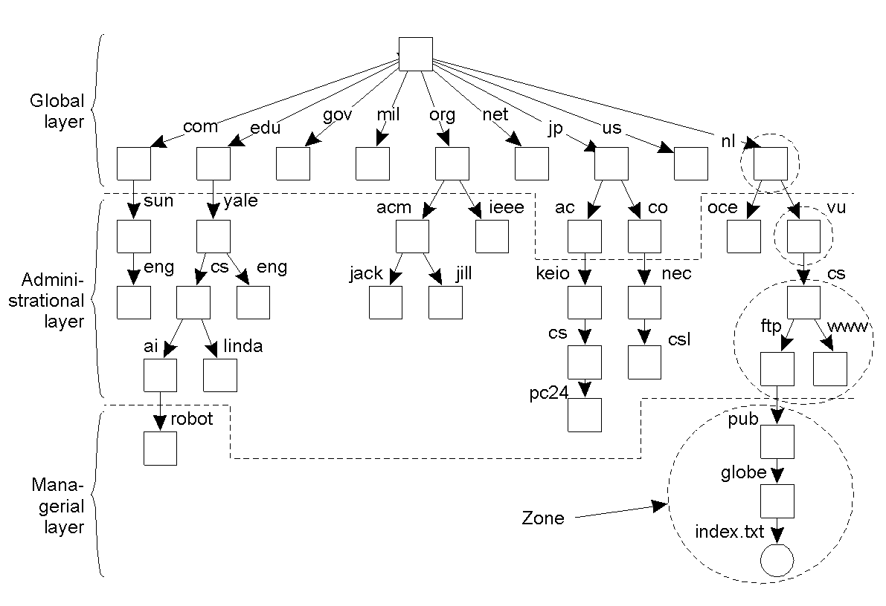
Name Space Distribution
124537172 arin.net
217003127 verisign.com
314529802 apnic.net
414526895 gslb.com
510917319 manitu.net
69167881 sorbs.net
78701029 msft.net
88595104 google.com
97520954 amazon.com
107450839 register.com
117034622 gtld-servers.net
126937887 facebook.com
136779616 coremetrics.com
146574735 msecnd.net
156570337 root-servers.net
165725087 amazonaws.com
175663948 akamai.net
185309527 weather.com
194943117 name-services.com
204902683 yahoo.com

Slide 43
Iterative Name Resolution
. (root)
Resolver
cache
1
answer
query
.com
Local Name Server
Resolver
2
query
Application
Resolver
answer
google.com
cache
cache
query
Resolver
answer
3
cache

Slide 44
DNS Caching
Step 1: query yourdomain.org
Local Machine
Local NS
Authoritative
Name Server
Resolver
Application
Resolver
query
query
cache
cache
Step 2: receive reply and cache at local NS and host
Local Machine
Local NS
Authoritative
Name Server
answer
Resolver
answer
Application
Resolver
cache
cache

Slide 45
DNS Caching (con'd)
Step 3: use cached results rather than querying the ANS
Local NS
Local Machine 1
Application
Resolver
Resolver
cache
cache
query
Local Machine 2
Application
Resolver
answer
cache
Step 4: Evict cache entries upon ttl expiration

