Slide 1

Critical Date Report

Slide 2
Overview
Displays well data combined from 9 systems providing key details and dates for critical milestones in the life cycle of an Antero well.
Used by a variety of users and groups. There are 40 users across 10 departments

Slide 3






Overview
Displays well data combined from 9 systems providing key details and dates for critical milestones in the life cycle of an Antero well.
Aries®
GIS Data
ProCount
FracSchedule
Petra
Notes:
Aries + Aries Planning
WellView
Enertia
ProCount
GIS Database
FracSchedule
SigmaFlow
Petra

Slide 4
Overview
Displays well data combined from 9 systems providing key details and dates for critical milestones in the life cycle of an Antero well.
Current Well Ops (Status)
Current Well Substatus
Well Configuration
Producing Formation
Field Name (Prospect)
State, County
Pad AFE #
Cost Center #
API/UWI
Pad Name
Operator
Working Interest %
Conductor Spud Date
Small Rig Name
Surface Spud Date
Big Rig Name
Resume Drilling Operations Date
RR Date
Completion Date
1st Production Date
First Sales Date (Gas)
First Sales Date (Oil)
Shut In Date
Total Measured Depth
Gross Lateral Length
Pad Ready to RU Frac Date
Surface Location Shape
Surface Latitude and Longitude (NAD27)
Bottom Hole Latitude and Longitude (NAD27)
Comments

Slide 5
Overview
Used by a variety of users and groups. There are 40 users across 10 departments
Accounting
Drilling & Completions
HSSE
Land
Land Administration
Lease Operations-Corporate
Lease Operations-Field
Legal
Reservoir Engineering & Planning
Water

Slide 6
Overview
Used by a variety of users and groups. There are 40 users across 10 departments
Adam Wratchford
Andrew Carlson
Caroline Daves
Cheyenne Padilla
Cody Goff
Craig LeFevre
Daniel Wood
David Ranieri
Donna Zarbock
James McCoy
Jamie Chapman
Jamie Raphael
Jason Parson
Jeffrey Stensgaard
Joseph Jenko
Kenneth Mick
Krystal Dardano
Larry Scheuvront
Mallory Turco
Matt Bergman
Max Green
Max Knop
Megan Davis
Michael Gray
Michael McCormick
Michael Starkey
Nathan Wright
Oksana Slyvko
Rachel McKinney
Raymond Custer
Robert Beeler
Rocky Maxson
Rosemary Diener
Ryan Dial
Serhiy Slyvko
Stefan Gaspar
Steven Cooper
Steven Lee
Tom Kuhn
Tyler Adams

Slide 7
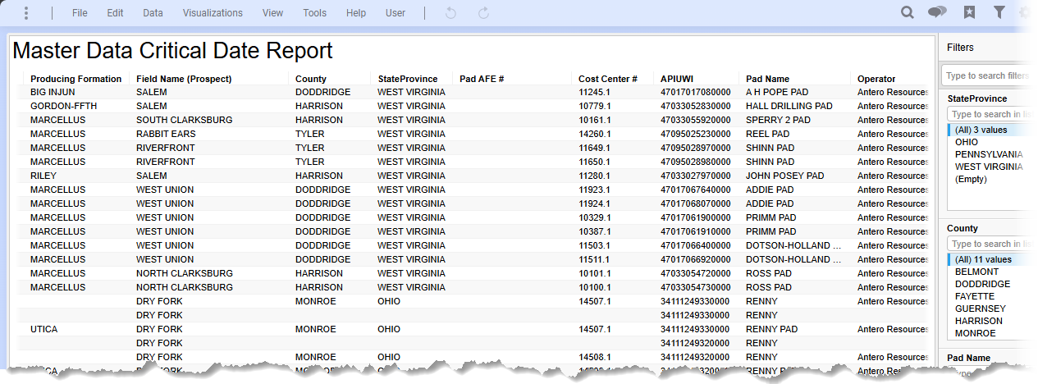
Overview
The data is accessed through the Master Data Critical Date Report hosted in Tibco Spotfire
https://spotfire.anteroresources.com/spotfire/wp/analysis?file=/Analys ...

Slide 8
Questions / Comments

