Slide 1
Brownian motion 1: basic theories
Linear response theory and the Green-Kubo formula
Notes:
In the previous plot, we already see that the self-diffusion constant of Brownian particles is determined through the long-time limit of the mean square displacements.
In this plot, we derive the definition of the diffusion constant in an alternative way using the linear response theory.
The result is an example of the so-called Green-Kubo formula, which can define transport coefficients in terms of equilibrium correlation functions of corresponding variables.

Slide 2
The linear response theory and the G-K formula
Notes:
Let us consider a Brownian particle under the influence of an external drift force in the x-direction.
The Langevin equation is simply modified by just adding the external force on the right hand side as shown in Eq.(41)..

Slide 3
The linear response theory and the G-K formula
Notes:
Here we take steady state average of Eq.(41) under external force.
Using the properties of random force, the each term in Eq.(41) becomes as shown in the following equations.

Slide 4
The linear response theory and the G-K formula
Notes:
By taking care of the x component only, the steady drift velocity is determined to be F_0 divided by the friction constant ¥zeta.
Then using the Einstein relation, the last term of Eq.(42) is obtained.
And finally solving for D, the diffusion constant is determined in Eq.(43).

Slide 5
The linear response theory and the G-K formula
Notes:
Let us now introduce the result of the linear response theory. Its formal derivation is not treated in this course, but will be found in several text books including …
We assume that the system is evolving in time with Hamiltonian H_0 at equilibrium.
Then an external force F(t), which is conjugate with the variable A, is applied to the system giving rize to change in the Hamiltinan to H_0+H’(t), where H’(t) is represented by A times F(t).
While the average value of variable B is B_0 at equilibrium under Hamiltonian H_0, the temporal average value starts to deviate with the amount of ¥Delt B averaged with H_0+H’(t).

Slide 6
The linear response theory and the G-K formula
Notes:
According to the linear response theory, the time evolution of ¥Delta B under external force is given by taking convolute product of ¥Phi_BA, the response function, with the external force and the integrating it from - infinity to t as shown in Eq. (44).
This result is very useful because Eq.(44) predicts the temporal value of B under the influence of external force solely from the equilibrium properties of the system via the response function is defined as the cross correlation function of A dot and B purely at equilibrium.

Slide 7
The linear response theory and the G-K formula
Notes:
From here, we try to apply the linear response theory to define the self-diffusion constant using equilibrium correlation function.
Now we assume A corresponds to the x-component of particle position, B is the velocity, the external force F is conjugate to the particle position with amplitude F_0 multiplied with the Heaviside step function ¥Theta(t) which equals to 1 for t larger than 0, or 0 otherwise.
The figure represents the external force as a function of time t.

Slide 8
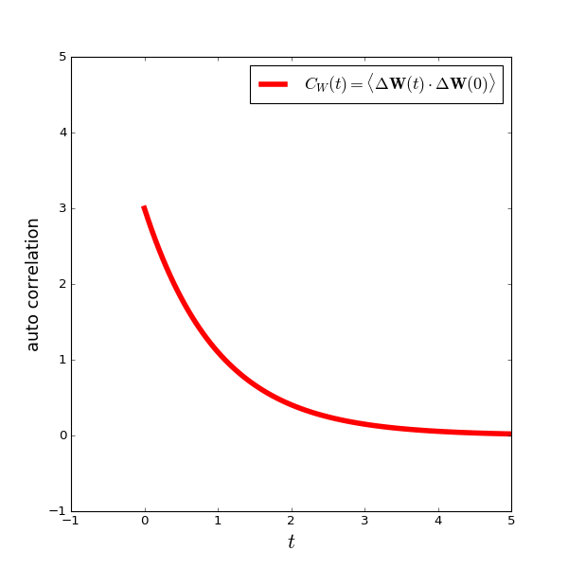
The linear response theory and the G-K formula
Notes:
From the linear response function Eqs.(44) and (45), the drift velocity under Hamiltonian H_0+H’ is represented by integral of velocity autocorrelation function from 0 to t because F=0 for t smaller than 0.
The figure represents the time evolution of the drift velocity after the application of external drift force at t=0.

Slide 9
The linear response theory and the G-K formula
Notes:
From Eqs.(43) and (46), the self diffusion constant of the Brownian particle is obtained by taking the t=infinity limit.
The final result is shown as Eq.(47), which is an example of the so-called Green-Kubo formula, which can define transport coefficients in terms of equilibrium correlation functions of corresponding variables.

