Slide 1
Python programming for beginners
The Euler method for numerical integration
Notes:
In this plot, we study how to solve differential equations using the Euler method.
This is needed to simulate the dynamics of particles using computers.
As a simple example of deterministic dynamics, we will simulate the motion of particle attached to a harmonic spring in a fluid.
In general terms this is referred to as a damped harmonic oscillator.

Slide 2
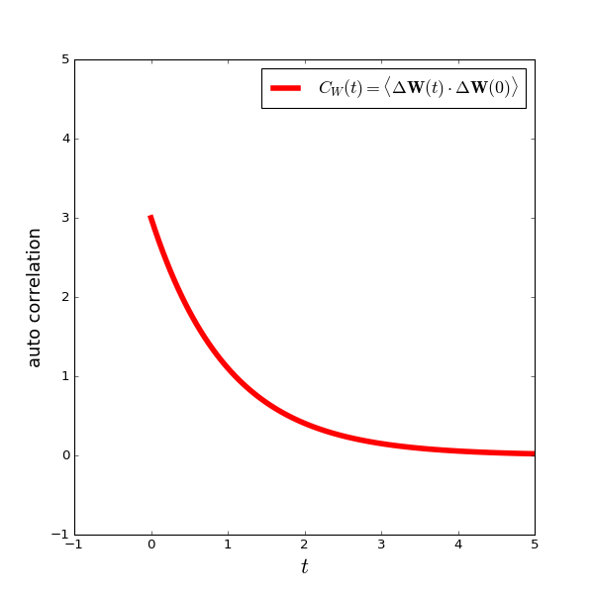
The Euler method for numerical integration
Notes:
Consider a spherical particle of radius $a$ and mass $m$ in a solvent fluid.
Assuming the size of the Brownian particle is much larger than the size of the fluid molecules, we can treat the fluid as a continuum medium with viscosity $\eta$.
Let $R(t)$ be the temporal position of the particle at time $t$ and $V$ its velocity.
To write down Newton’s equation of motion for the Brownian particle, the mass times acceleration should equal the total force acting on the particle.
First, if a body is moving relative to a fluid, it experiences a friction force, colored in blue, which will be proportional to the velocity with the constant of proportionality called the friction constant $\zeta$.
For a spherical particle the friction constant $\zeta$ is given by $6\pi\eta a$, known as Stokes law.
And second, in addition to the friction force, we know that there must be another type of force which gives rise to the irregular motion of the Brownian particle.
We call this the random force $F(t)$ colored in red, which represents the effects of the many collisions taking place between the Brownian particle and the fluid molecules.
Finally, by putting all of this together, we can write down the Langevin equation shown here as Eq.(21).

Slide 3
The Euler method for numerical integration
Notes:
Consider a spherical particle of radius $a$ and mass $m$ in a solvent fluid.
Assuming the size of the Brownian particle is much larger than the size of the fluid molecules, we can treat the fluid as a continuum medium with viscosity $\eta$.
Let $R(t)$ be the temporal position of the particle at time $t$ and $V$ its velocity.
To write down Newton’s equation of motion for the Brownian particle, the mass times acceleration should equal the total force acting on the particle.
First, if a body is moving relative to a fluid, it experiences a friction force, colored in blue, which will be proportional to the velocity with the constant of proportionality called the friction constant $\zeta$.
For a spherical particle the friction constant $\zeta$ is given by $6\pi\eta a$, known as Stokes law.
And second, in addition to the friction force, we know that there must be another type of force which gives rise to the irregular motion of the Brownian particle.
We call this the random force $F(t)$ colored in red, which represents the effects of the many collisions taking place between the Brownian particle and the fluid molecules.
Finally, by putting all of this together, we can write down the Langevin equation shown here as Eq.(21).

Slide 4
The Euler method for numerical integration
Notes:
Consider a spring of constant $k$ with one end attached to the origin and the other end to a particle of mass $m$.
Here the friction constant between the particle and the fluid is $\zeta$, but we assume that the spring is friction free.
Let $R(t)$ be the temporal position of the particle at time $t$ and $V$ its velocity.
There are two forces acting on the particle; the friction force exerted by the fluid and the restoring force by the spring.
The friction force is assumed to be proportional to the velocity of the particle and points in the opposite direction.
The spring force is assumed to be proportional to the distance from the origin and points towards the origin.

Slide 5
The Euler method for numerical integration
Notes:
Then the following two differential equations for the time evolution of the position and the velocity of the particle, must be simultaneously solved.
Eq. (1) is simply the definition of the velocity, and Eq. (2) represents the force balance which is known as Newton’s 2nd law of motion.

Slide 6
The Euler method for numerical integration
Notes:
First let us write down the formal solutions of the differential equations by integrating Eqs. (1) and (2) in time, from 0 to $t$.
Eqs. (3) and (4) give the exact position and velocity of the particle at any given time $t$, starting from the initial condition of $R(0)$ and $V(0)$.
However, an analytical evaluation of the time integrals is only possible for very limited cases.
In most situations, we can solve these differential equations only numerically.
→ computer simulation

Slide 7
The Euler method for numerical integration
Notes:
If a time increment $¥Delta t$ is very small, the time integrals from $t_i$ to $t_i+¥Delta t$ can be approximated to first order as shown in Eqs. (5) and (6).
This is because the integrands can be approximated to be constant within this very short time increment $¥Delta t$.

Slide 8
The Euler method for numerical integration
Notes:
If a time increment $¥Delta t$ is very small, the time integrals from $t_i$ to $t_i+¥Delta t$ can be approximated to first order as shown in Eqs. (5) and (6).
This is because the integrands can be approximated to be constant within this very short time increment $¥Delta t$.
This first order approximation is known as the Euler method.
By repeating this procedure $N$ times, we can obtain an approximation of the position and the velocity at any given time $t=N¥Delta t$.
This method is a typical example of a computer simulation.

Slide 9
The Euler method for numerical integration
Notes:
Consider a spherical particle of radius $a$ and mass $m$ in a solvent fluid.
Assuming the size of the Brownian particle is much larger than the size of the fluid molecules, we can treat the fluid as a continuum medium with viscosity $\eta$.
Let $R(t)$ be the temporal position of the particle at time $t$ and $V$ its velocity.
To write down Newton’s equation of motion for the Brownian particle, the mass times acceleration should equal the total force acting on the particle.
First, if a body is moving relative to a fluid, it experiences a friction force, colored in blue, which will be proportional to the velocity with the constant of proportionality called the friction constant $\zeta$.
For a spherical particle the friction constant $\zeta$ is given by $6\pi\eta a$, known as Stokes law.
And second, in addition to the friction force, we know that there must be another type of force which gives rise to the irregular motion of the Brownian particle.
We call this the random force $F(t)$ colored in red, which represents the effects of the many collisions taking place between the Brownian particle and the fluid molecules.
Finally, by putting all of this together, we can write down the Langevin equation shown here as Eq.(21).

