Slide 1
Brownian motion 1: basic theories
Basic knowledge of stochastic process
Notes:
Brownian motion, the motion of small particles diffusing in a fluid, is highly stochastic in nature.
Therefore, such motions must be modeled as stochastic processes, for which exact predictions are no longer possible.
This means that somewhat different mathematical methods are needed to characterize and analyze stochastic processes.

Slide 2
Stochastic process
Notes:
Before defining what a stochastic process is, let us give a familiar example of something that is not a stochastic process.
Let X be given as some function of time t, such that we know the exact values of X at any given time t.
This is called a deterministic process.

Slide 3
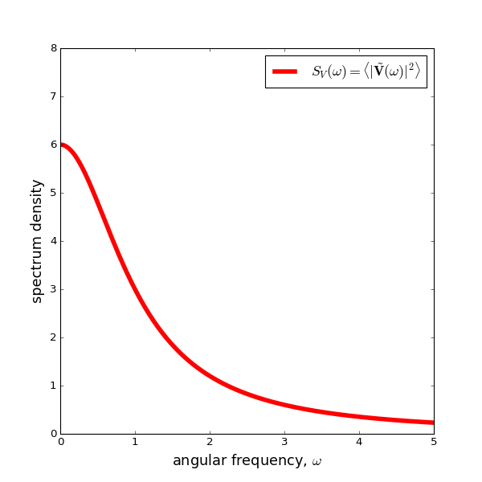
Stochastic process
Notes:
Now let us consider a stochastic process Y(t).
Here, we can no longer specify Y as a function of time.
The only thing we can do is to talk about probabilities.
Instead of giving the value of Y at some time t, we must specify the probability that the random variable has a value y at time t, given that it had a value y_0 at time t_0.
If we were to draw several realizations of this process, we might end up with the trajectories drawn here.
For simplicity, we have only drawn the paths that go through y_0 at at time t_0.
If we consider some later time t, we see that Y can in principle have any value, but the probabilities of the different outcomes will not be the same.

Slide 4
Stochastic process
Notes:
Finally, for the special case when the probabilities are invariant under a shift in time, we say that the stochastic process is steady.
In such cases, only differences in time are important, not the absolute time values.

Slide 5
Stochastic process
Notes:
When studying stochastic processes, it is convenient to be able to go back and forth between real and Fourier space.
Consider that we have a steady stochastic process Y(t), with zero mean.
The Fourier transform is defined as Eq(1), and the inverse Fourier transform as Eq(2).
Where we have assumed that the process Y_T is defined over a time range T, from –T/2 to +T/2, by multiplying the original process Y with a windowing box function such that Y_T = Y inside the range, and zero outside.
And later we will take the limit of T goes to +infty.
This is required in order to properly define the Fourier transform.

Slide 6
Stochastic process
Notes:
For what follows, it will be useful to define the Spectral density or power spectrum of a given stochastic process Y(t) rather than directly evaluating the probability function.
The spectrum density is defined in terms of the Fourier transform as Eq.(4).
This spectral density gives us the importance of the different frequency components or Fourier modes in the process.

Slide 7
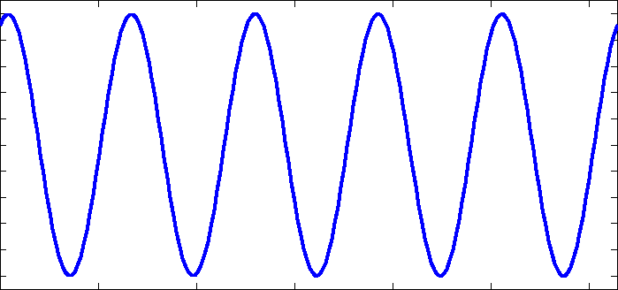
Stochastic process
Notes:
As a first example, let us consider a purely deterministic process.
Let the time evolution of this process be given by a simple cosine wave, of frequency \omega, such that in Eq.(5).
There is no random component here, we know the precise value of Y at any given time t.
When we calculate the power spectrum, we get a single delta peak, centered at \omega_1, with amplitude A^2.
This is not surprising, since we know that Y(t) contains only a single Fourier mode with frequency \omega_1.

Slide 8
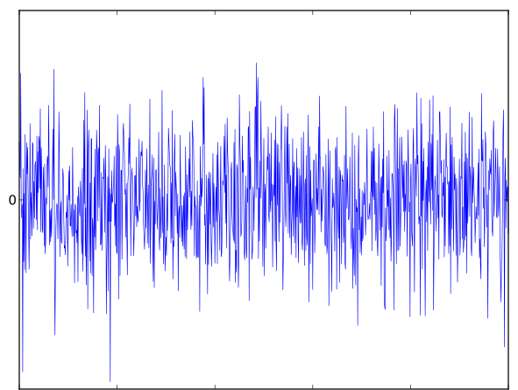
Stochastic process
Notes:
As a second example, let us consider the case of White noise, which is purely stochastic.
On the left, we have a sample realization of a white noise with amplitude A, Y(t) = A \xi(t).
From the path we can see that most values will lie within the range between –A and +A.
The signal looks very complicated, however, a simpler representation can be obtained when you compute the power spectrum S(\omega), which we have plotted on the right.
S(\omega) is just a constant, with amplitude A^2.
In other words, this process not only contains all frequencies, but it contains them all in the same amount.

Slide 9
Stochastic process
Notes:
When studying stochastic process, it is convenient to introduce a special class of functions called correlation functions.
They provide a measure of how related or correlated one or more dynamic variables are, over a separation time t.
For now, we only consider a single stochastic process Y(t), thus we deal with self-correlation functions.
This self-correlation function \phi(t) is defined in Eq.(9).
Imagine again several realizations of a stochastic process, which pass through the same point at time \tau.
What do we know about Y at later times?
Assuming that the paths are continuous, we expect that for short times t, Y(\tau + t) will be very close to Y(¥tau).
But what about for large values of t?
This is the information that the auto-correlation function gives us.

Slide 10
Stochastic process
Notes:
A typical example of this auto-correlation is plotted on the right. At time t=0, \phi(0) = Average(Y^2).
For “short” times we see a weak decay, the correlation functions does not change significantly, but eventually, when t is large enough it finally goes to zero.
Thus, knowing the value of Y at some time t0 gives me some information of Y at future times.
But only for these “short” times, where the values are said to be correlated.
At larger times, my knowledge of Y at time t0 gives me no information as the auto-correlation function has decayed to zero, meaning that the values are not correlated.

Slide 11
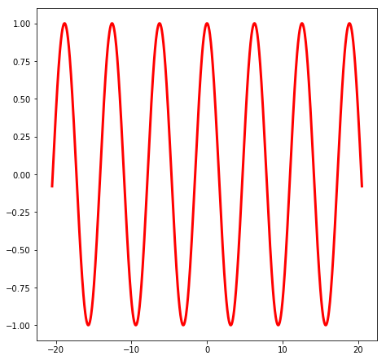
Stochastic process
Notes:
To get an idea of how the correlation function behaves, let us consider again the case of the purely deterministic cosine wave process.
In this case, the auto-correlation function is a constant with the amplitude of A^2, which never decays.
The meaning of this is clear, if we know the value of Y at any given time, we know the value of Y at all times, as expected.

Slide 12
Stochastic process
Notes:
Now let us consider a more interesting case. Going back to the white noise example.
By definition, we know that the value of Y at any given time t, is uncorrelated with the value of Y at any other time t’.
In other words, knowing the value of Y at time t, does not tell me anything about future or past values of Y.
This is exactly what we see when we calculate the autocorrelation function \phi(t), which is just a delta function centered at t=zero, with amplitude of A^2 .
This is what we have plotted on the right.

Slide 13
Stochastic process
Notes:
Using the definition of the correlation function Eq.(9) and the inverse Fourier transform Eq.(2), we can derive the following useful theorem.
First, we express the value of Y at time \t + \tau in terms of its Fourier components.
Second, we rearrange the integrals over \tau and \omega, and write the exponential of the sum as a product of exponentials.
The inner-most integral is nothing but the conjugate of the Fourier transform of Y(t) = Y(-\omega) = Y*(\omega).
Finally, we identify the term in parenthesis as the power spectrum of Y(\omega), S(\omega).

Slide 14
Stochastic process
Notes:
Thus, from Eq.(14) we immediately identify S(w) as the Fourier transform of the correlation function \phi(t).
This is an example of the famous Wiener-Khintchine theorem, which states that “The autocorrelation function of a stationary stochastic process is related to the spectral density or power spectrum of this process through a Fourier transform“.
Inspection of equations (14) and (15) allows us to derive the following simple expressions for the correlation function and power spectrum at zero time and frequency, represented by equations (16) and (17) respectively.
These are called sum rules.

Slide 15
Stochastic process
Supplemental note for the derivation of Eq. (11)
Notes:
Using the definition of the correlation function Eq.(9) and the inverse Fourier transform Eq.(2), we can derive the following useful theorem.
First, we express the value of Y at time \t + \tau in terms of its Fourier components.
Second, we rearrange the integrals over \tau and \omega, and write the exponential of the sum as a product of exponentials.
The inner-most integral is nothing but the conjugate of the Fourier transform of Y(t) = Y(-\omega) = Y*(\omega).
Finally, we identify the term in parenthesis as the power spectrum of Y(\omega), S(\omega).

