Slide 1
Brownian motion 1: basic theories
Brownian motion and the Langevin equation
Notes:
In this plot, we study basic theories of Brownian motion.
Let us start with writing down the celebrated Langevin equation that describes the Brownian motion of a particle diffusing in a fluid.

Slide 2
Brownian motion and the Langevin equation
Notes:
Consider a spherical particle of radius $a$ and mass $m$ in a solvent fluid.
Assuming the size of the Brownian particle is much larger than the size of the fluid molecules, we can treat the fluid as a continuum medium with viscosity $\eta$.
Let $R(t)$ be the temporal position of the particle at time $t$ and $V$ its velocity.
To write down Newton’s equation of motion for the Brownian particle, the mass times acceleration should equal the total force acting on the particle.
First, if a body is moving relative to a fluid, it experiences a friction force, colored in blue, which will be proportional to the velocity with the constant of proportionality called the friction constant $\zeta$.
For a spherical particle the friction constant $\zeta$ is given by $6\pi\eta a$, known as Stokes law.
And second, in addition to the friction force, we know that there must be another type of force which gives rise to the irregular motion of the Brownian particle.
We call this the random force $F(t)$ colored in red, which represents the effects of the many collisions taking place between the Brownian particle and the fluid molecules.
Finally, by putting all of this together, we can write down the Langevin equation shown here as Eq.(21).

Slide 3
Brownian motion and the Langevin equation
Notes:
Now, let us characterize this random force in more detail.
Assuming three-dimensional Cartesian coordinates, the random force has three components along the x, y, and z directions.
Without loss of generality, we can assume that the average of the force along any direction is zero as shown in Eq,(22).
If this was not the case, we could always separate the non-zero part as an extra drift force to be added separately in the Langevin equation.
We still need to specify how the forces at different times, or along different directions are correlated.
We note that we are interested in the dynamics of the Brownian particle at time scales much larger than the time-scales of the collisions with the fluid molecules.
Therefore, we can assume that the successive random forces are uncorrelated on the time scale of the Brownian particle.
This is expressed mathematically in Eq.(23) using the auto-correlation function for the random force.
Here, $\delta of \alpha\beta$ is the Kroenecker’s delta, it is $1$ if $\alpha = \beta$ and zero otherwise.
$\delta(t)$ is the Dirac delta function, it is zero everywhere except at the origin t=0, where it diverges.
The crucial point is that the integral of the delta function equals to one.
Noise which obeys equations (22) and (23) is called white noise or the Gaussian noise.

Slide 4
Brownian motion and the Langevin equation
Notes:
Now, let us calculate the power spectrum of the random force $F(t)$.
Using the Wiener-Kintchine theorem, we can write the power spectrum S_F (\omega) in terms of the random force auto-correlation function ¥phi_F(t).
Using the properties of the white noise, this auto-correlation Eq.(23) is proportional to a delta function, which kills the integral.
Thus, we arrive at the simple result that the power spectrum is a constant proportional to D tilde, which determines the amplitude of the random force in Eq. (23).

Slide 5
Brownian motion and the Langevin equation
Notes:
Let us try and see what the power spectrum and correlation functions look like.
On the left, we plot the power spectrum of the random force, on the right the auto-correlation function.
S_F(\omega) is a constant, as we have just proved, and \phi(t) is proportional to a delta function.

Slide 6
Brownian motion and the Langevin equation
Notes:
Next, let us characterize the properties of the particle velocity $V$.
Taking the Fourier transform of the Langevin equation Eq (1), we obtain a simple algebraic equation for V(\omega).
This can be easily solved, to give the following equation for V(\omega) as a function of F(\omega).
Now, we are in a position to calculate the power spectrum of the velocity.
By definition, S_V(\omega) is given by the square norm of the Fourier transform of the velocity.
Writing $V(\omega)$ in terms of $F(\omega)$, and using Eq.(24) for the power spectrum of the random forces, we obtain Eq.(25).
We note that the form of this equation appears so often in Physics and Mathematics that it has its own name. It is the Lorentzian function.

Slide 7
Brownian motion and the Langevin equation
Notes:
Once we have computed the power spectrum, we can use the Wiener-Khintchine theorem to obtain the velocity auto-correlation function.
In the last step, we have used a well known-result, that the Fourier transform of a Lorentzian is a two-sided decaying exponential.
This means that it is an even function of time t, and therefore depends only on the absolute value of t.
You can look this up in any table of integrals, use a computer algebra system, or do it yourself by hand using Cauchy’s integral formula.

Slide 8
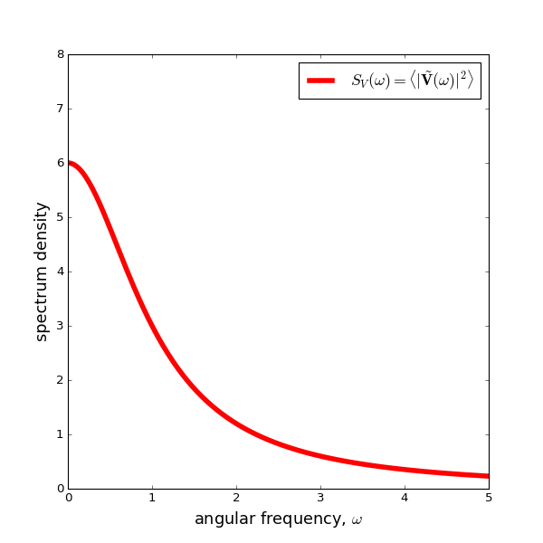
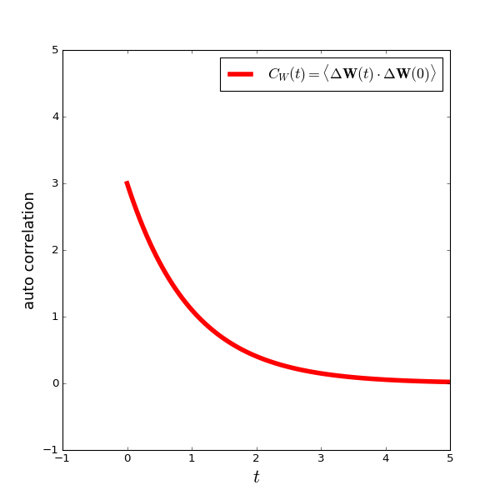
Brownian motion and the Langevin equation
Notes:
Let us now visualize the previously derived results for the velocity of the Brownian particle.
On the left, we have the Lorentzian function describing the Power spectrum, and on the right we have the two-sided decaying exponential which gives us the auto-correlation of the velocities.

Slide 9
Brownian motion and the Langevin equation
Notes:
With the results we have obtained so far, we are in a position to derive a useful relation named the fluctuation-dissipation theorem.
Setting t=0 in Eq.(26), we obtain a simple expression for the average squared velocity: it is proportional to D tilde, and inversely proportional to \zeta and m.
Furthermore, using the equipartition theorem of classical statistical mechanics, we also know that this average should be equal to 3 times kbT divided by m.
Solving for D tilde, we finally obtain the fluctuation-dissipation theorem, which relates the amplitude of the fluctuating random forces with the magnitude of the dissipative friction forces.

Slide 10
Brownian motion and the Langevin equation
Notes:
Let us now turn our attention to looking at the temporal particle positions or displacements, in order to characterize its diffusive motion.
By definition, the displacement of the particle after some time $t$ can be expressed as the time integral of the velocity V from 0 to t.
The mean square displacement of the particle is defined as in this equation.
By rewriting the displacement as a time integral of the velocity, we are left with a double integral of the auto-correlation of the velocity, which has been calculated in Eq.(26), at two distinct times, t_1 and t_2.
The integral can be performed analytically, but care must be taken to properly handle the absolute value that appears in the exponential.
We have drawn the integration domain on the right.
The blue outline gives the original integration limits for t1 and t2, which is represented by a square domain of side length t.
Since the function we are integrating depends only on the absolute value of $t_2 – t_1$, we can divide this domain into an upper triangular part, the red region, where t_2 is larger than t_1, and a lower triangular part where t_1 is larger than t2.
Note that the value of the integral over the upper triangular domain must be equal to the value of the integral over the lower domain, and it should be half of the integral over the square domain.
Thus, we can rearrange the integration limits to go only over the red domain, where t_2 is larger than t1.
With this, we can get rid of the annoying absolute value from the equation, and the integrals over t1 and t2 can now be separated and easily performed.
After doing all this, we see that the mean square displacement is increasing lineally with time t.

Slide 11
Brownian motion and the Langevin equation
Notes:
Let us now turn our attention to looking at the temporal particle positions or displacements, in order to characterize its diffusive motion.
By definition, the displacement of the particle after some time $t$ can be expressed as the time integral of the velocity V from 0 to t.
The mean square displacement of the particle is defined as in this equation.
By rewriting the displacement as a time integral of the velocity, we are left with a double integral of the auto-correlation of the velocity, which has been calculated in Eq.(26), at two distinct times, t_1 and t_2.
The integral can be performed analytically, but care must be taken to properly handle the absolute value that appears in the exponential.
We have drawn the integration domain on the right.
The blue outline gives the original integration limits for t1 and t2, which is represented by a square domain of side length t.
Since the function we are integrating depends only on the absolute value of $t_2 – t_1$, we can divide this domain into an upper triangular part, the red region, where t_2 is larger than t_1, and a lower triangular part where t_1 is larger than t2.
Note that the value of the integral over the upper triangular domain must be equal to the value of the integral over the lower domain, and it should be half of the integral over the square domain.
Thus, we can rearrange the integration limits to go only over the red domain, where t_2 is larger than t1.
With this, we can get rid of the annoying absolute value from the equation, and the integrals over t1 and t2 can now be separated and easily performed.
After doing all this, we see that the mean square displacement is increasing lineally with time t.

Slide 12
Brownian motion and the Langevin equation
Notes:
At the end of the plot, we will define the self-diffusion constant of Brownian particles, as the long-time limit of the mean-square displacement divided by 6 t.
We then obtain that the Diffusion constant is D tilde divided by \zeta^2 as shown in Eq.(30).
Using the fluctuation-dissipation theorem Eq.(29), we arrive at the Einstein relation shown as Eq.(31).
Finally, from the Einstein relation, together with Stokes law, we obtain the Stokes-Einstein relation shown as Eq.(32), which gives a good estimate for the self diffusion constant of spherical particles of radius a, diffusing in a fluid of viscosity \eta at temperature T.

