Slide 1
Introduction to Bonds
Fixed Income Security

Slide 2
Bonds
Fixed Maturity
  Exception: Consols (which never mature)
Fixed income from periodic interest
Principal returned at maturity

Slide 3
Important Bond Terms
Par / Face / Maturity Value
Maturity Date / Period
Coupon Interest Payment
Coupon Rate
Bond Yield
  Yield to Maturity
Bond Ratings

Slide 4
Features of a May Department Stores Bond
Terms Explanations
Amount of issue $125 million The company will issue $125 million worth of bonds.
Date of issue 2/28/86 The bonds were sold on 2/28/86.
Maturity 3/1/16 The principal will be paid in 30 years.
Annual coupon 9.25 The denomination of the bonds is $1,000. Each bondholder will receive $92.50 per bond per year (9.25% of the face value).
Offer price 100 The offer price will be 100% of the $1,000 face value per bond.

Slide 5
Features of a May Department Stores Bond (concluded)
Terms Explanations
Coupon payment dates 3/1, 9/31 Coupons of $92.50/2 = $46.25 will be paid on these dates.
Security None The bonds are debentures.
Sinking fund Annual, The firm will make annual payments beginning 3/1/97 toward the sinking fund. Call provision
Call Provision Not callable The bonds have a deferred call before 2/28/93 feature.
Call price 106.48 initially, After 2/28/93, the company can buy declining to 100 back the bonds for $1,064.80 per bond, declining to $1,000 on 2/28/05.
Rating Moody’s A2 This is one of Moody’s higher ratings. The bonds have a low probability
of default.

Slide 6
Coupon Rate
Coupon Rate = Annual Coupon Payment
Face Value
Coupon rate is always quoted annually
Example: 4 3/4% ATT 98
  4 3/4% is the coupon rate

Slide 7
Bond Trading
Mostly Traded Over the Counter
Treasury Bonds trade very frequently (liquid)
Corporate Bonds trade infrequently (illiquid)

Slide 8
New York Exchange Bonds
Quotations as of 4 p.m. Eastern Time
Monday, March 28, 2001
Corporation Bonds
Volume, $29,780,000
ATT 4 3/4 98 5.0 50 95 5/8 + 7/8
ATT 4 3/8 99 4.7 10 92 1/4 + 1/4
ATT 6s00 6.1 113 98 + 1/8
ATT 5 1/8 01 5.6 130 917/8 - 1/8
ATT 8 5/8 31 8.0 25 107 1/4 - 2
ATT 7 1/8 02 7.0 50 101 3/4 + 1/4
ATT 8 1/8 22 7.9 185 103 1/8 - 1/4
ATT 8 1/8 24 7.8 10 103 3/4 - 1/2
ATT 4 1/2 96 4.6 100 98 1/2 ...
Ann Taylr 8 3/4 00 8.8 166 99 3/8 - 1/4
Arml 8 1/2 01 8.8 38 96 1/8 - 7/8
AshO 6 3/4 14 cv 20 102 1/4 - 1/2
AubmHI 12 3/8 20f ... 50 147 3/4 - ...
Avnet 6s12 cv 37 105 - 2 1/2
BkNY 7 1/2 01 cv 8 142 - 3
Cur Net
Bonds Yld Vol Close Chg.

Slide 9
Sample Wall Street Journal U.S. Treasury Note and Bond Prices
GOVT. BONDS AND NOTES
111/8 Aug 03 125:10 125:16 -6 6.44
117/8 Nov 03 130:04 130:10 -7 6.46
5 7/8 Feb 04n 96:17 96:19 -6 6.46
. . . . .
. . . . .
. . . . .
7 7/8 Feb 21 110:19 110:23 -13 6.95
8 1/8 May 21 113:18 113:22 -14 6.95
8 1/8 Aug 21 113:19 113:23 -14 6.96
8 Nov 21 112:06 112:10 -14 6.95
7 1/4 Aug 22 103:15 103:17 -14 6.95
7 5/8 Nov 22 108:00 108:02 -13 6.95
7 1/8 Feb 23 102:01 102:03 -13 6.95
6 1/4 Aug 23 91:19 91:21 -12 6.94
Source: Reprinted by permission of The Wall Street Journal, © 1996 Dow Jones & Company, Inc. All Rights Reserved Worldwide.
Maturity Ask
Rate Mo/Yr Bid Asked Chg. Yld.

Slide 10
Bond Cash Flows
If a bond has five years to maturity, an $80 annual coupon, and a $1000 face value, its cash flows would look like this:
Time 0 1 2 3 4 5
Coupons $80 $80 $80 $80 $80
Face Value $ 1000
$______

Slide 11
Bond Value
Bond Value = Present value of + Present value of
Coupons Face Amount
Notice:
PV of Coupons = PV of an annuity
PV of Face Amt. = PV of a single future cash flow

Slide 12
Example Bond Valuation
$1,000 Face Value
  $100 Coupon
  20 Years to Maturity
  10% Market Interst Rate
Present Value of Face Value
1
= $1,000
1.10²⁰
= $1,000 .14864
= $148.64
x
x

Slide 13
Valuing a Bond contd….
Annuity Present Value of Coupons
= $100 x (1 - 1/1.10²⁰⁾/.10
= $100 x 8.5136
= $851.36
Total Bond Value = $148.64 + $851.36
= $1,000

Slide 14
Bond value on calculator
PMT
$ Coupon payments =
Maturity in years =
Interest Rate (yield) =
Face/Principal Value =
Bond Value =
N
I/YR
FV
PV

Slide 15
Bond Yield
Market Interest Rate (r) used to discount bond cash flows in order to find bond value
Example: 5-year 6% RJR Nabisco
‘yielding’ 9.5%
i.e., r = 9.5%
Value = __________

Slide 16
Yield to Maturity (YTM)
It is the yield ‘r’ calculated when market price of bond is known
If
  Bond is not called
  bond is held to maturity, AND
  bond does not default
then,
YTM is the return an investor earns on the bond

Slide 17
‘Yield’ vs. ‘YTM’
The difference is subtle, but important
Yield is the ‘r’ input to calculate bond value
  value is unknown: r (yield) --> Value
YTM is the ‘r’ calculated when price is known
  price is known: Price --> r (YTM)

Slide 18
Yield vs Coupon Rate
Coupon Rate and Yield are not the same!
Coupon Rate (expressed as %) simply determines the $ amount of periodic coupon payments. It never changes during the life of the bond.
Bond Yield is the interest rate required in the market. It fluctuates daily as bond prices change

Slide 19
Example Discount Bond
$1,000 Face Value
$100 Coupon
20 Years to Maturity
12% Market Rate
PV of Face = $ 103.66
PV of Coupons = $ 746.95
Total Value = $ 850.60

Slide 20
Example: Premium Bond
$1,000 Face Value
$100 Coupon
20 Years to Maturity
8% Market Rate
PV of Face = $ 214.55
PV of Coupons = $ 981.81
Total Value = $ 1,196.36

Slide 21
Example: Par Bond
$1,000 Face Value
$100 Coupon
20 Years to Maturity
10% Market Rate
PV of Face = $ 148.64
PV of Coupons = $ 851.36
Total Value = $ 1,000.00

Slide 22
Example summary
Face = $1000 Coupon = $100
Therefore, Coupon Rate = 10%
r = 8% Price = $1196.36
r = 10% Price = $1000.00
r = 12% Price = $ 850.60

Slide 23
Bond Price Sensitivity to YTM
Bond price
$1,800
Coupon = $100
20 years to maturity
$1,000 face value
$1,600
$1,400
Notice: bond prices and YTMs are inversely related.
$1,200
$1,000
$ 800
$ 600
Yields to maturity, YTM
4%
6%
8%
10%
12%
14%
16%

Slide 24
Notice..
When Price < Face YTM > Coupon Rate
When Price > Face YTM < Coupon Rate
When Price = Face YTM = Coupon Rate
Bond Prices and Bond Yields are inversely related!!

Slide 25
Semi-Annual Coupons
Almost all the bonds (Treasury, corporate, municipal) pay coupon interest semi-annually
However, the coupon rate is always quoted annually
  E.g. 7-year, 13% coupon bond paying semi-annual coupons
  You get ____ coupons a year each paying $______

Slide 26
Current Yield
An approximation of YTM
Curr. Yld. = Annual Coupon Payments
Market Price
Reported for Corporate bonds in the WSJ

Slide 27
Important to...
Distinguish between:
Yield To Maturity
Coupon Rate
Current Yield
They are not all the same!!

Slide 28
Bond Rates and Yields
Suppose a bond currently sells for $932.90. It pays an annual coupon of $70, and it matures in 10 years. It has a face value of $1000. What are its coupon rate, current yield, and yield to maturity (YTM)?
  1. The coupon rate (or just “coupon”) is the annual dollar coupon expressed as a percentage of the face value:
  Coupon rate = $70 /$_____ = ___%
  2. The current yield is the annual coupon divided by the current market price of the bond:
  Current yield = $___ /_____ = 7.5%
  3. The yield to maturity is = ______ %

Slide 29
Discount Bonds
(Zero coupon bonds)
Have no coupon payments
Pays only principal value at maturity
Always sell at a market price below principal value
All Treasury bills are discount bonds
Discount Bond Value = PV of Principal

Slide 30
Types of Risk - Bonds
Interest Rate Risk
Default Risk

Slide 31

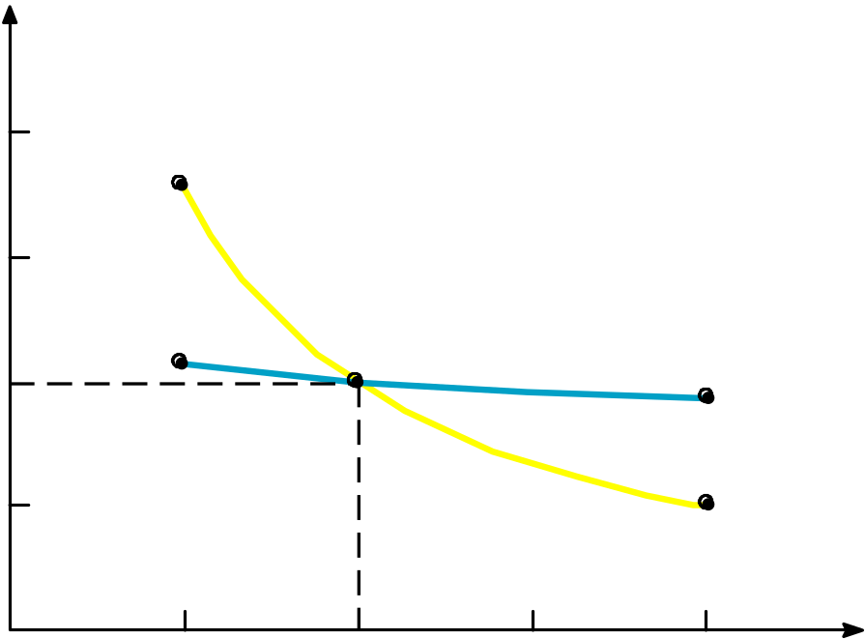
Interest Rate Risk
Bond values ($)
2,000
Interest rate 1 year 30 years
5% $1,047.62 $1,768.62
10 1,000.00 1,000.00
15 956.52 671.70
20 916.67 502.11
$1,768.62
30-year bond
1,500
1,000
$1,047.62
1-year bond
$916.67
500
$502.11
Interest rates (%)
5
10
15
20
Value of a Bond with a 10% Coupon Rate for
Different Interest Rates and Maturities

Slide 32
Interest Rate Risk
Risk arising from changes in bond prices as market interest rate fluctuates
ALL bonds are subject to interest rate risk!
Hence even ‘risk-free’ bonds (Treasury bonds and bills) are risky
  Treasury bonds are called ‘risk-free’ because they are not subject to default

Slide 33
Bond Pricing Theorems
Prices and yields move in opposite directions
Holding other things constant,
  Long-term bonds have greater interest rate risk
  Lower coupon bonds have greater interest rate risk

Slide 34
Default Risk
The risk of the bond issuer not paying interest and/or the principal
ONLY Treasury bonds are default risk-free
  Why?? Ans: _________
ALL other bonds (corporate, municipal etc.) are subject to default risk

Slide 35
Measuring Default Risk
Bond Rating Agencies
  Standard & Poors
  Moody’s
They give relative measure of risk
  e.g. AA rated bond is less risky than BBB
  but can’t really pinpoint the probability of default from bond ratings

Slide 36
Bond Ratings
Low Quality, speculative,
Investment-Quality Bond Ratings and/or “Junk”
High Grade Medium Grade Low Grade Very Low Grade
Standard & Poor’s AAA AA A BBB BB B CCC CC C D
Moody’s Aaa Aa A Baa Ba B Caa Ca C C
Moody’s S&P
Aaa AAA Debt rated Aaa and AAA has the highest rating. Capacity to pay interest and principal is extremely strong.
Aa AA Debt rated Aa and AA has a very strong capacity to pay interest and repay principal. Together with the highest rating, this group comprises the high-grade bond class.
A A Debt rated A has a strong capacity to pay interest and repay principal, although it is somewhat more susceptible to the adverse effects of changes in circumstances and economic conditions than debt in high rated categories.

Slide 37
Bond Ratings
Baa BBB Debt rated Baa and BBB is regarded as having an adequate capacity to pay interest and repay principal. Whereas it normally exhibits adequate protection parameters, adverse economic conditions or changing circumstances are more likely to lead to a weakened capacity to pay interest and repay principal for debt in this category than in higher rated categories. These bonds are medium-grade obligations.
Ba, B BB, B Debt rated in these categories is regarded, on balance, as Ca, C CC, C predominantly speculative with respect to capacity to pay interest and repay principal in accordance with the terms of the obligation. BB and Ba indicate the lowest degree of speculation, and CC and Ca the highest degree of speculation. Although such debt will likely have some quality and protective characteristics, these are out-weighed by large uncertainties or major risk exposures to adverse conditions. Some issues may be in default.
D D Debt rated D is in default, and payment of interest and/or repayment of principal is in arrears

