Slide 1


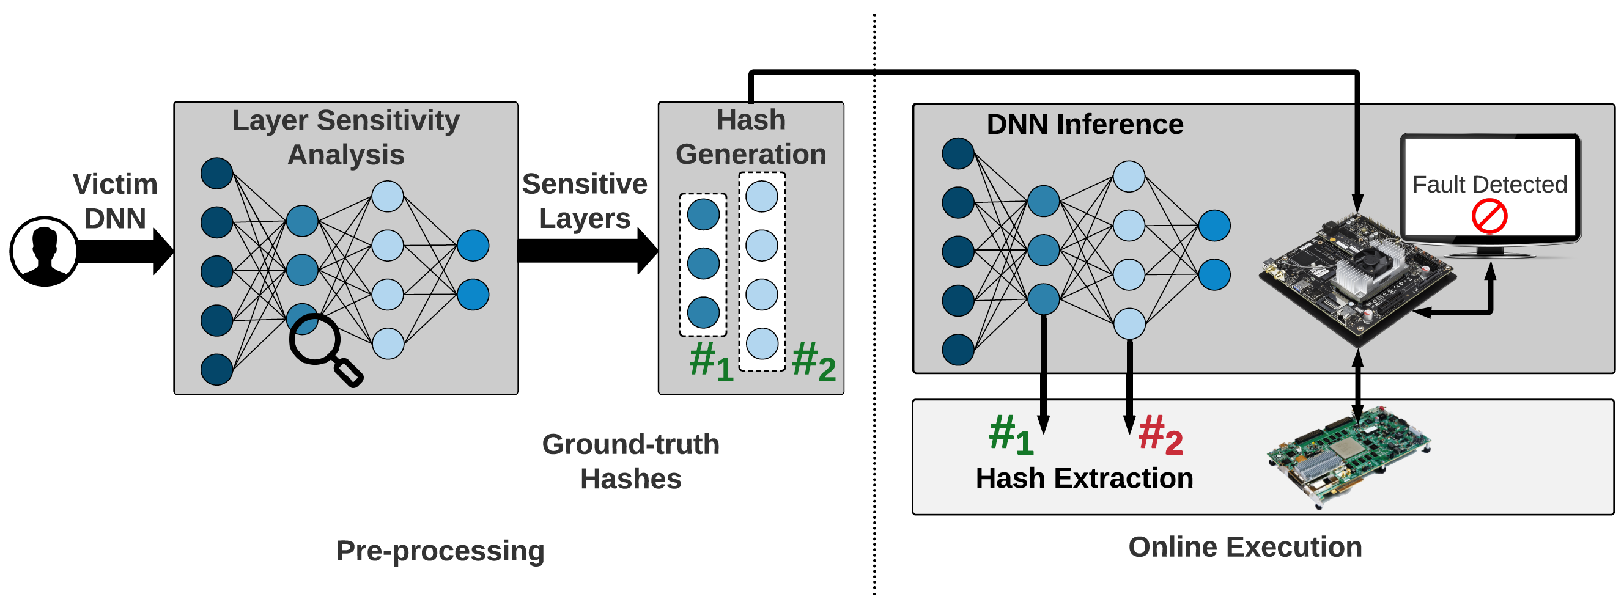
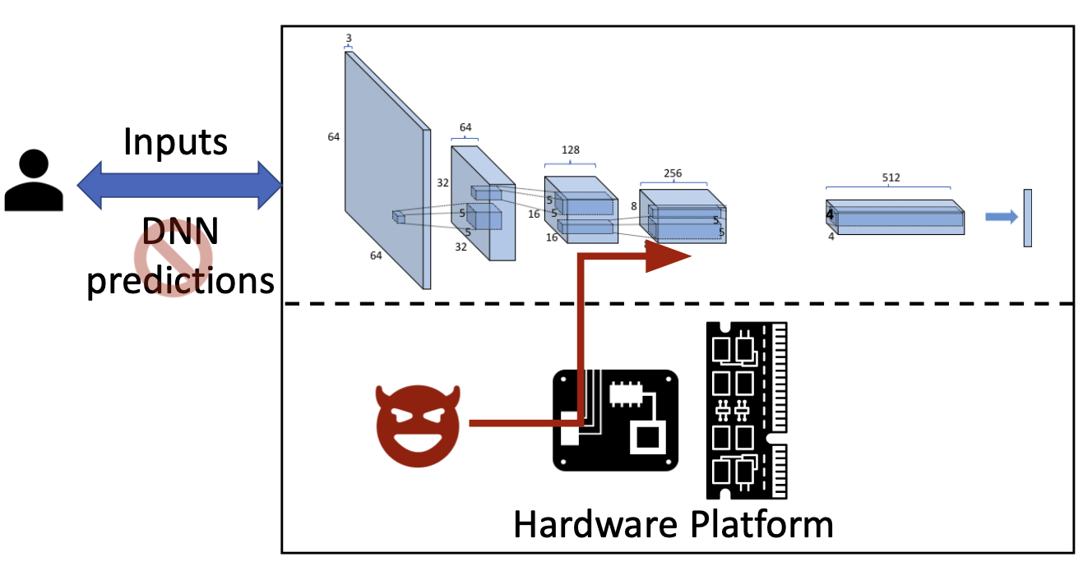
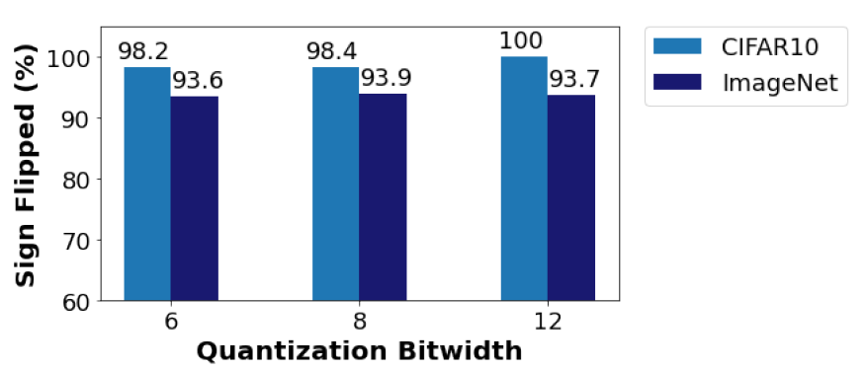
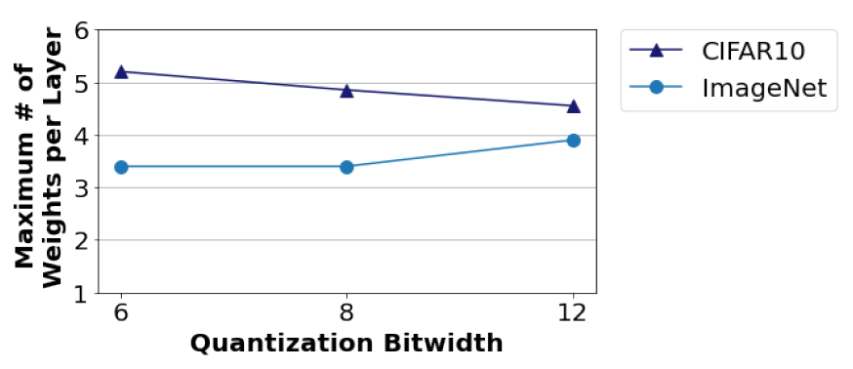

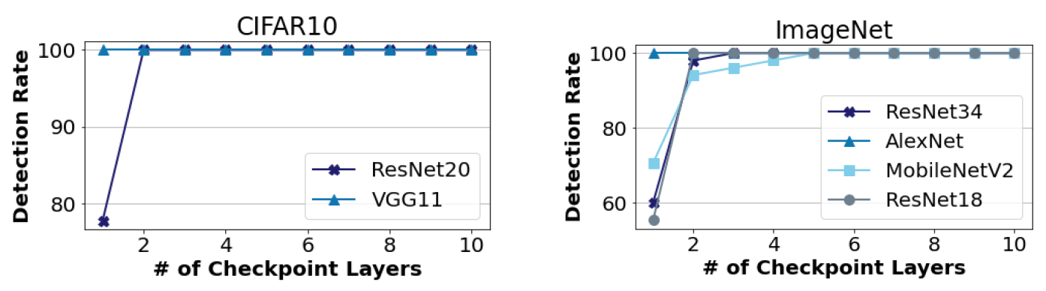

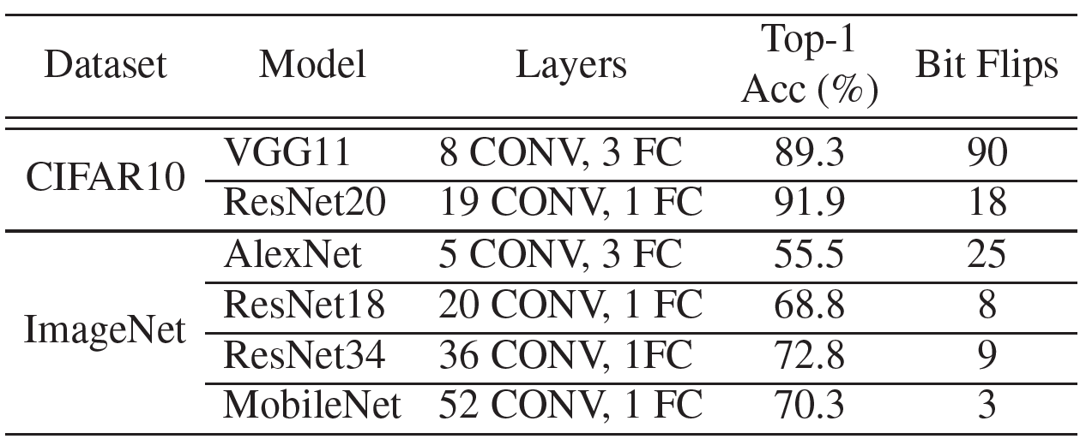
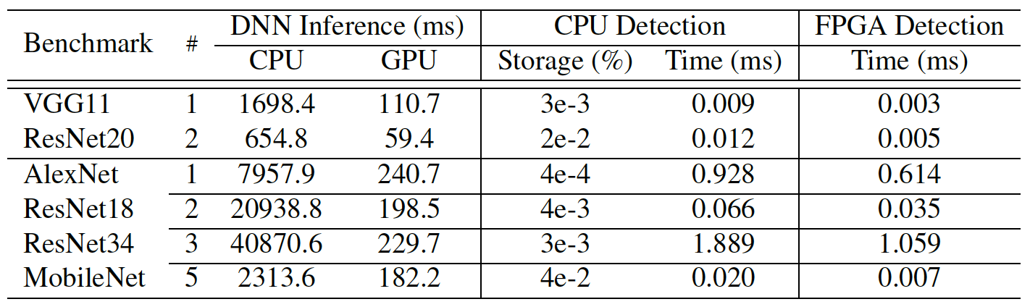
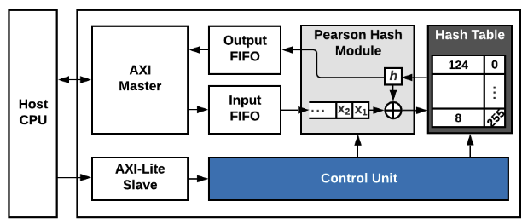

AccHASHTAG: Accelerated Hashing for Detecting Fault-Injection Attacks on Embedded Neural Networks
﻿Nojan Sheybani¹, Jung-Woo Chang¹, Mojan Javaheripi¹, and Farinaz Koushanfar¹
{﻿nsheyban, juc023, ﻿mojavahe, farinaz}@ucsd.edu
¹University of California San Diego
Abstract
AccHASHTAG’s Global Flow
Presenting AccHASHTAG, a highly-accurate ﻿real time fault detection methodology for DNNs deployed in embedded applications
Leveraging Algorithm/Software/Hardware co-design approach to develop AccHASHTAG. AccHASHTAG incorporates a lightweight methodology that ensures low-overhead fault detection
Delivers 0% false positive and has no effect on inference accuracy
Presenting AccHASHTAG’s effectiveness, reliability, and efficiency on various DNN benchmarks
Threat Model
The attacker has access to (1) victim DNN architecture and parameters (2) physical address of model parameters and (3) subset of data used for training DNN
The attacker performs a Row-Hammer Attack on DRAM locations corresponding to vulnerable parameters, to ensure stealthiness and reduce RHA overhead
AccHASHTAG computes ground-truth hashes and detects fault-injection attacks in real-time using hashes computed on an FPGA in communication with the host CPU.
2
Motivation
Changing a few bits of the victim DNN’s weights can: (1) Reduce the classification accuracy below a random guess or (2) Cause misprediction to attacker’s desired output class
There are many defenses of bitflip attacks, but no prior works with 0% false positive rate and provable performance bounds
Experimental Results
We evaluate AccHASHTAG on various benchmarks to corroborate its properties:
Attack Analysis: We show that oftentimes the attacks are focused on the sign bits of the weights, and layers are not targeted more than around 5 times by an attacker.
Detection Performance: AccHASHTAG achieves 100% detection rate with very few checkpoints. 2 checkpoint layers for CIFAR10 and 5 checkpoint layers for ImageNet.
Overhead Analysis: AccHASHTAG delivers perfect detection performance while incurring a negligible storage and computation cost, making it suitable for embedded DNN applications. The FPGA modules enable 1.5-2.6x faster hash generation compared to CPU execution
Methodology
AccHASHTAG consists of two phases:
Pre-Processing: One-time process where mechanism is calibrate for victim’s DNN. Sensitivity analysis is performed to find top-k most vulnerable layers, called checkpoint layers. Parameter sensitivity is defined as the effect of per-layer weight change ($P$) on DNN loss ($ℒ$):
$$S\left(p_{n}\right)=(ℒ\left(P\right)−ℒ\left(\tilde{P} | \tilde{p_{n}}=−p_{n}\right))^{2}≈2p_{n}\frac{∂ℒ}{∂p_{n}} Taylor$$
$S\left(p_{n}\right)$= $p_{n}\frac{∂ℒ}{∂p_{n}}$
Layer sensitivity is defined as the average top-5 sensitivity of the enclosed parameters.
Online Execution: New Pearson hashes are extracted from checkpoint layers in parallel to each DNN inference. Hashes are validated against ground-truth hashes gathered in pre-processing phase. Upon hash-mismatch, an alarm is raised and ground-truth weights are reloaded. Operations in this phase are done on a customized FPGA.
Hardware Optimization
To increase throughput of the online execution phase, we (1) parallelize Pearson Hash module with deep pipelining (2) implement hash tables entirely using 8-bit FF registers and (3) optimize AXI reads.
Conclusion
Presenting AccHASHTAG, a fault-injection detection methodology that incurs negligible storage and runtime overhead on resource-constrained embedded devices.
Leveraging Algorithm/Software/Hardware co-design principle to achieve 100% detection rate with 0% false alarms and guaranteed detection performance with provable statistical bounds
Notes:
long easel with dimensions 94.75" x 45.875" (240.67 cm x 116.5 cm). Your poster need not consume all of this area.

