Slide 1


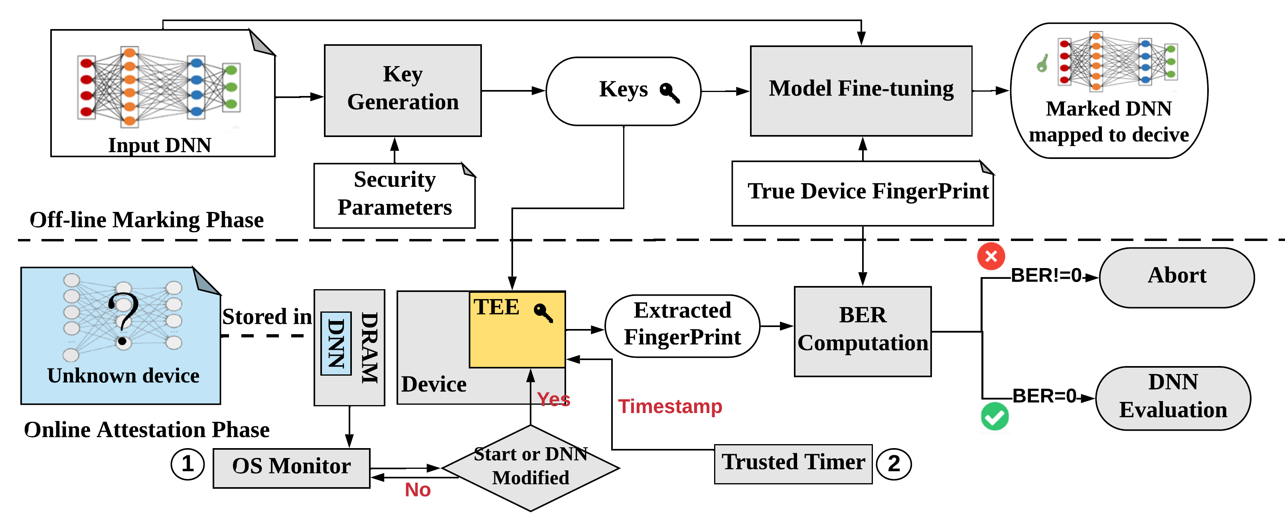
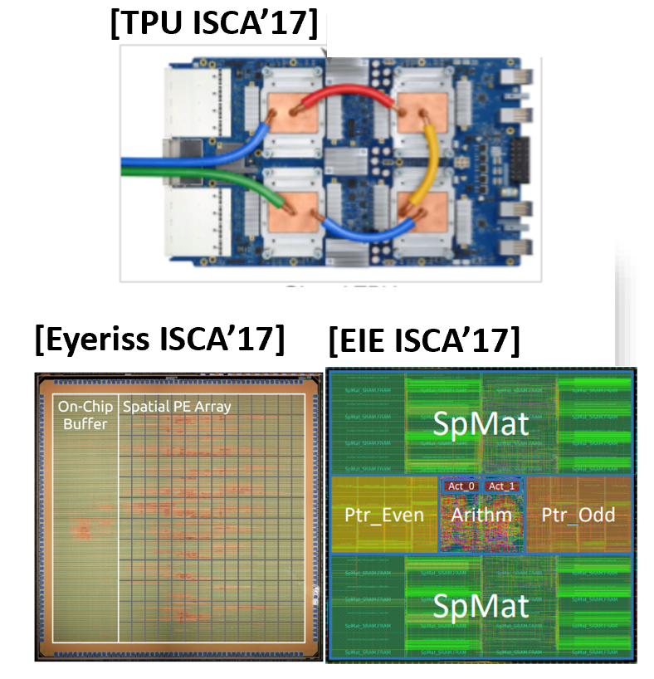
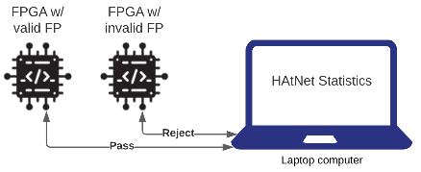

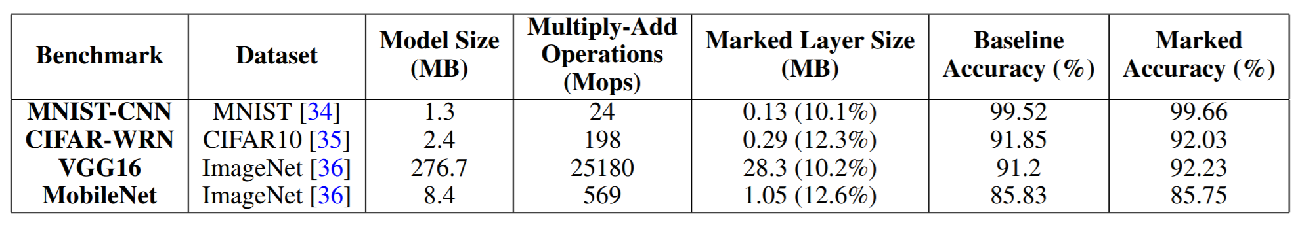

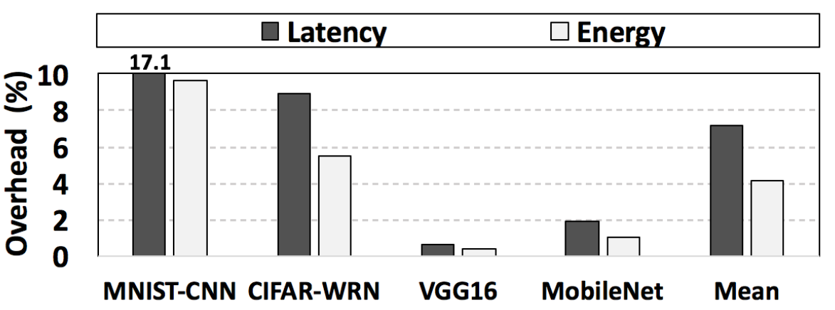
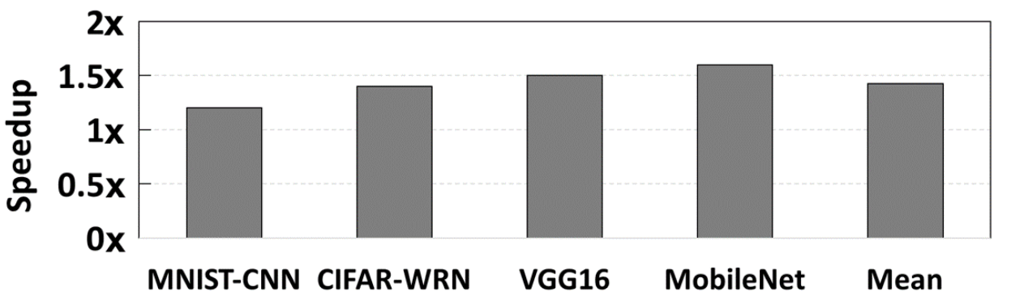
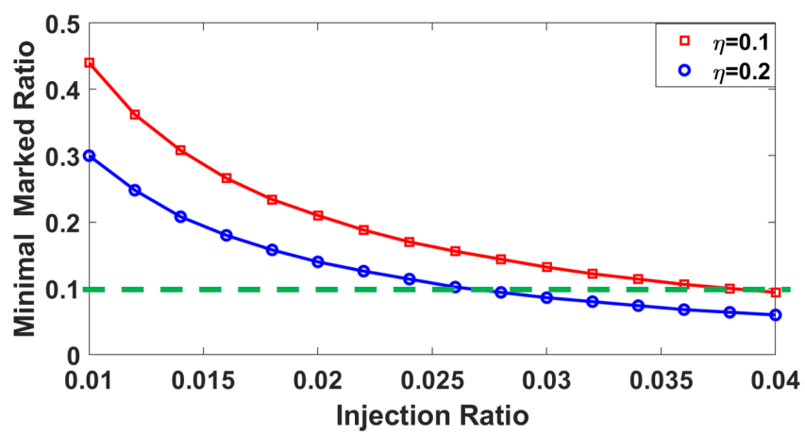
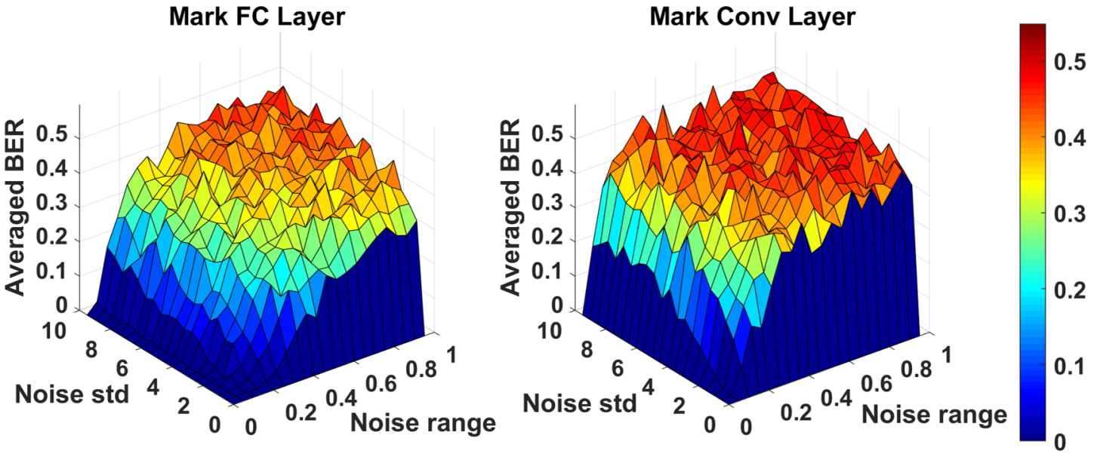
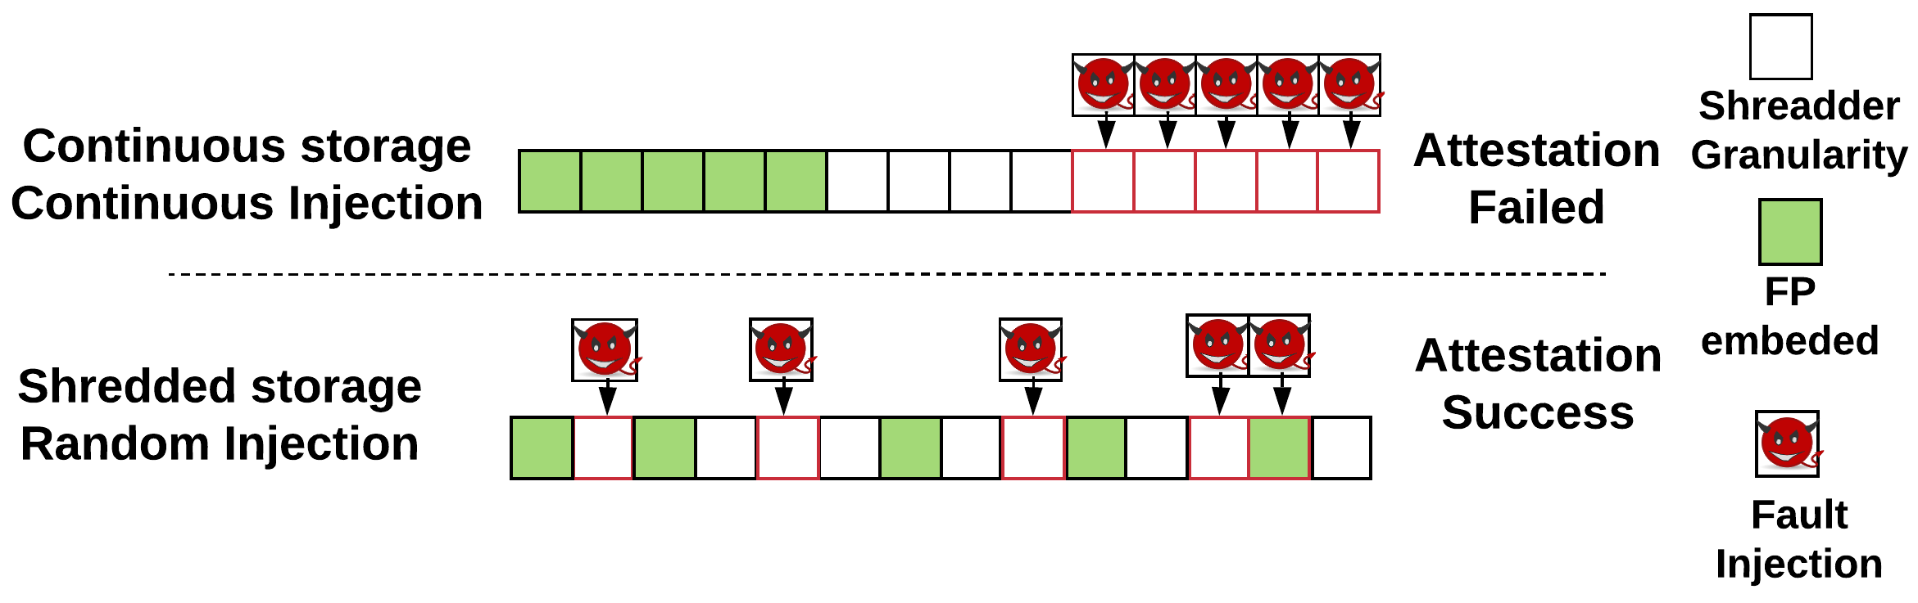
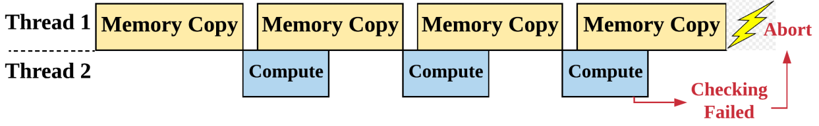

﻿HAtNet: Hardware Attestation of Neural Networks
﻿Nojan Sheybani¹, Huili Chen¹, Xinqiao Zhang¹, Siam Hussain¹, and Farinaz Koushanfar¹
{﻿nsheyban, huc044, ﻿x5zhang, ﻿siamumar, farinaz}@ucsd.edu
¹University of California San Diego
Abstract
HAtNet’s Global Flow
Presenting HAtNet, an ﻿on-device DNN attestation method that certifies the legitimacy of underlying hardware for running a given DL model
Leveraging Algorithm/Software/Hardware co-design approach to develop HAtNet. HAtNet binds the parameter distribution of the trained model with a legitimate hardware platform
Enabling usage control and intellectual property (IP) protection of DL platforms
Corroborating HatNet’s effectiveness, reliability, and efficiency on various DNN benchmarks
Threat Model
The company is the IP holder. He / She sells the pre-trained DNNs together with the legitimate DL device.
The attacker could be a malicious user who wants to run the DNN on an unauthorized hardware platform
HAtNet generates device-specific fingerprint (FP) and binds device’s FP to the DNN by embedding the FP in the weight distribution of the DL model
2
Motivation
Developing high-performance, large-scale DL models (e.g., Transformer, BERT, GPT-3) is both time- and resource-consuming
Functional DL model shall be considered as IP of the designer and needs to be protected to preserve the commercial advantage of the DL model owner
Experimental Results
We evaluate HAtNet on various DNN benchmarks to corroborate its properties:
Fidelity: Test accuracy of the marked DNN is comparable as the corresponding baseline
Efficiency: (a) Low runtime and energy overhead of online attestation, (b) data pipeline speedup
Security and Reliability analysis:
Methodology
HAtNet consists of two stages:
Off-line marking phase: Hardware provider generates a unique, device-specific FP and finetunes the model with the FP-regularized loss:
$𝓛= 𝓛_{0}+ γ MSE\left(f_{j} −Xw \right), f_{j}= \sum_{i=1}^{v}{b_{ij} }u_{j}$.
FP is stored in secure memory of the target hardware
Online attestation phase: Extracts FP from the unknown/queried device when the trigger is activated:
$f_{j}^{′}=Xw′$, $b_{j}′=f_{j}^{′T}$ * U
HAtNet deploys a hybrid trigger mechanism:
Static trigger: OS detects DNN program’s start request
Dynamic trigger: Two sources: (1) memory change signal from OS monitor, and (2) fixed-frequency timer
Hardware Optimization
HAtNet incorporates multiple HW optimization techniques for security and overhead consideration
Shredder storage: shuffle weight data before storing it in untrusted memory
Data pipeline: Hide the data communication latency
Early stopping: Skip unnecessary computation
Conclusion
Devising HAtNet, an effective, lightweight, reliable and secure on-device attestation framework that authenticates the legitimacy of the hardware to run the protected DL model
Leveraging Algorithm/Software/Hardware co-design principle to achieve hardware-bounded IP protection and device usage control of DL hardware.
Notes:
long easel with dimensions 94.75" x 45.875" (240.67 cm x 116.5 cm). Your poster need not consume all of this area.

