Slide 1

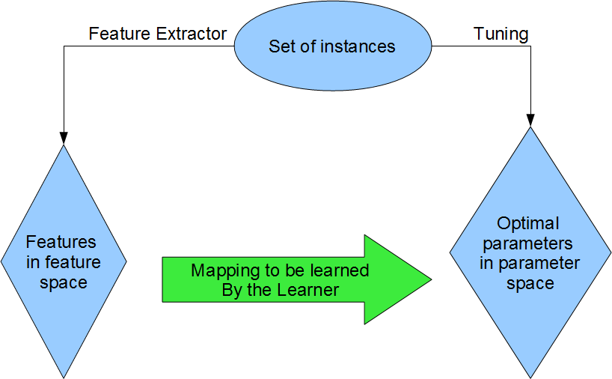
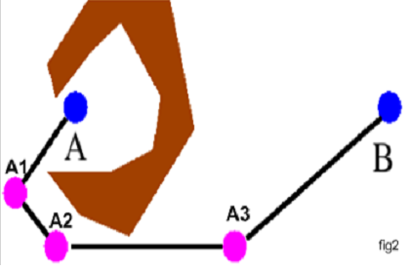

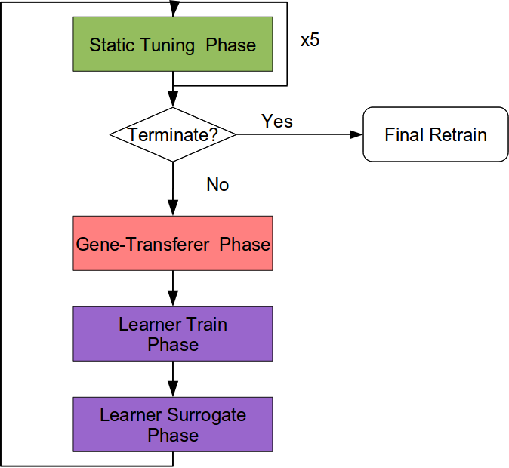
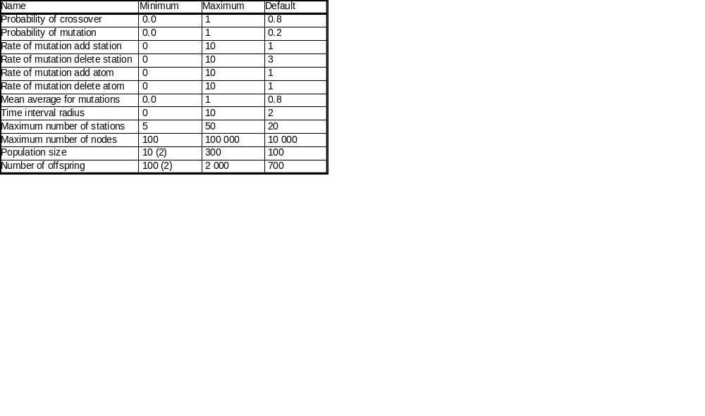
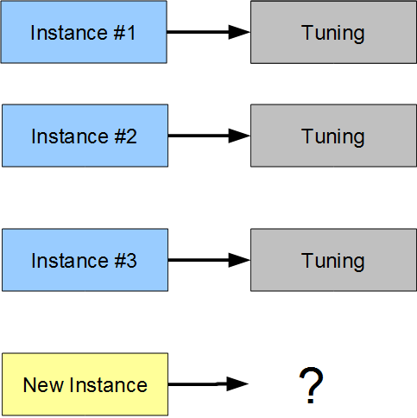
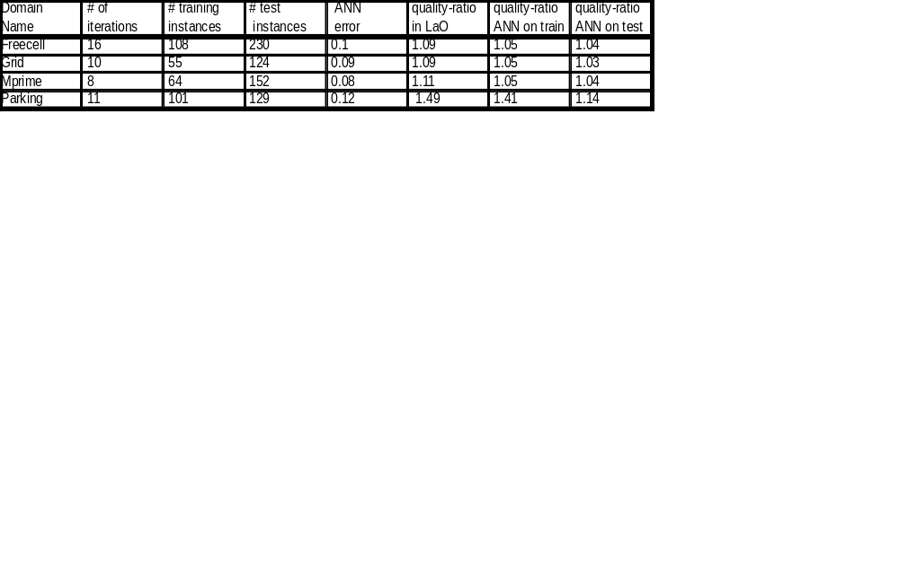
Instance-Based Parameter Tuning and Learning for Evolutionary AI Planning
Mátyás Brende, Marc Schoenauer
Projet TAO, INRIA Saclay & LRI,Université Paris Sud, Orsay, France
Motivations
Parameter Learning
By learning about the relation between best parameters
and features:
  Make tuning of many instances more effective
  Make generalization to new instances possible
The Target Algorithm: Divide-and-Evolve
Problem
<A, O, I, G> = PD(I,G)
Representation
Ordered list of partial states
S₀=I, S₁, ... S_{n}, S_{n+1}=G
Evaluation
Solve consecutive sub-problems PD(S_{k},S_{k+1}), kϵ[0,n]
with 'greedy' planner CPT or 'weak' planner YAHSP
Fitness
        All problems solved: sum of plan qualities
        Fails solving PD(S_{l}, S_{l+1}): penalty + “dist”(S_{l},G)
The Learn-and-Optimize Algorithm
The Parameters of DaE to be tuned
Features
  # fluents
  # goals
  # predicates
  # objects
  # types
  mutex-density=#mutexes/#fluent-pairs
  # lines in the domain-file
  # words in the domain-file
  # byte-count in the domain-file
  # lines in the instance-file
  # words in the instance-file
  # byte-count in the instance-file
The Problem with Per Instance Static Tuning
Results
References
[1] J. Bibai, P. Savméant, M. Schoenauer, and V. Vidal. On
the generality of parameter tuning in evolutionary
planning. In J. B. et al., editor, Genetic and
Evolutionary Computation Conference (GECCO),
pages 241–248. ACM Press, July 2010.
[2] N. Hansen and A. Ostermeier. Completely
derandomized self-adaptation in evolution strategies.
Evolutionary Computation, 9(2):159–195, 2001.
C. Igel, T. Glasmachers, and V. Heidrich-Meisner.
Shark. Journal of Machine Learning Research,
9:993–996, 2008.
[3] C. Igel, T. Glasmachers, and V. Heidrich-Meisner.
Shark. Journal of Machine Learning Research,
9:993–996, 2008.
[3] N. Nissen. Implementation of a Fast Artificial Neural
Network Library (FANN). Technical report,
Department of Computer Science University of
Copenhagen (DIKU), 2003.
Perspectives
More sophisticated features (e.g. statistical and probing features)
Develop GeneTransferer further along Active Learning techniques
Single, domain independent model and test extra-domain generalization capabilities
Use other optimizers and learners
Investigate indirect learning

