Slide 1
Parameter Tuning Scenario
Parameters
Parameter Tuning Algorithm
Target Algorithm (DaE)
Fitness Value (Makespan, Totalcost)
Parameter tuning is parameter setting carried out offline.

Slide 2
Per Instance Parameter Tuning is actually “simple” Global Optimization
Fitness
Parameter

Slide 3
Parameter Tuning: State of the Art
Per instance Parameter Tuning is actually a “simple” global optimization problem
REVAC: Relevance Estimation and VAlue Calibration, Evolutionary Algorithm based
ParamILS: Local Search based
SPO: Sequential Parameter Optimization, Gaussian correlation function based regression as a surrogate model
Racing: Is based on reducing number of evaluations for stochastic target-algorithm
Performance Prediction and Automated Tuning for the SAT domain (Hutter et. al. 2006)

Slide 4
State of the art drawbacks
Many instances and domains
  Either separate tuning per instances
  Or one (suboptimal) parameter for many instances
Intra-domain generalization: extrapolating from tuned instances to new ones
Extra-domain generalization: extrapolating from one domain to another
Hutter et. al.: special for SAT domain.

Slide 5
Solution for generalization
Set of instances
Feature Extractor
Tuning
Parameter
space
Feature
space
Mapping to be learned
By the Learner

Slide 6
Feature-parameter mapping
Optimal parameter
Under-fitted or suboptimal model
Ideal curve
Feature
One point on the curve represents one instance, which has a certain feature-value and optimal parameter value. Vertical line represent that there might be ambiguities, which can be considered as noise from the model-training perspective.

Slide 7
A second possible scenario for solution
Set of instances
Feature Extractor
Solver
Feature
space
Mapping to be learned
Tuning
Fitness
Parameter
space
This would be similar to the work done in SAT domain. This “simple” mapping has to be solved when applying it to new instances. This scenario has not yet been tested.

Slide 8
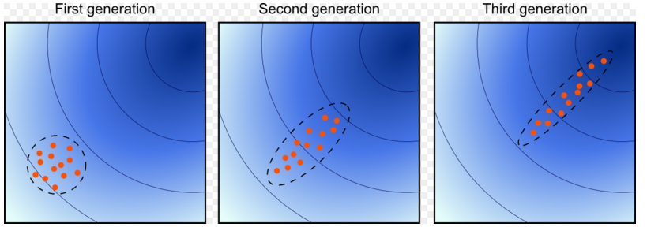
CMA-ES
Simple, robust optimization strategy, used for tuning instances (Auger et. al. 2005)
Covariance Matrix Adaptation Evolutionary Strategy
Estimate natural gradient

Slide 9
Learn-and-Optimize in train
Features, Parameters
G
e
n
e
T
r
a
n
s
f
e
r
e
r
Param.
Instance #1
Param.
Optimizer #1
Optimizer #1
(CMA-ES)
Learner
for the
Mapping
(ANN)
Instance #2
Param.
Optimizer #2
(CMA-ES)
Instance #3
Param.
Optimizer #3
(CMA-ES)
Param.
Instance #4
Param.
Optimizer #4
(CMA-ES)
Parameters

Slide 10
LaO Train: Optimizer (Tuning) Phase
G
e
n
e
T
r
a
n
s
f
e
r
e
r
Fitness
Instance #1
Optimizer #1
Optimizer #1
(CMA-ES)
Learner
(ANN)
Parameter
Fitness
Instance #2
Optimizer #2
(CMA-ES)
Parameter
Instance #3
Fitness
Optimizer #3
(CMA-ES)
Parameter
Fitness
Instance #4
Optimizer #4
(CMA-ES)
Parameter

Slide 11
LaO Train: Gene-Transfer Phase
Features, Parameters
G
e
n
e
T
r
a
n
s
f
e
r
e
r
Param.
Instance #1
Optimizer #1
Optimizer #1
(CMA-ES)
Learner
(ANN)
Instance #2
Optimizer #2
(CMA-ES)
Instance #3
Optimizer #3
(CMA-ES)
Param.
Instance #4
Optimizer #4
(CMA-ES)

Slide 12
LaO Train: Learner-Train Phase
G
e
n
e
T
r
a
n
s
f
e
r
e
r
Features
Instance #1
Optimizer #1
Optimizer #1
(CMA-ES)
Learner
(ANN)
Target Param.
Instance #2
Features
Optimizer #2
(CMA-ES)
Target Param.
Instance #3
Features
Optimizer #3
(CMA-ES)
Target Param.
Instance #4
Features
Optimizer #4
(CMA-ES)
Target Parameters

Slide 13
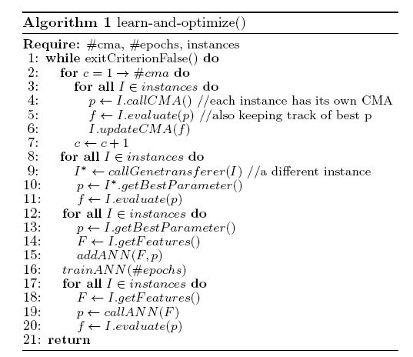
Learn-and-Optimize Algorithm Train

Slide 14
LaO Train: Learner-Hint Phase
(surrogate model)
G
e
n
t
r
a
n
s
f
e
r
e
r
Features
Instance #1
Optimizer #1
Optimizer #1
(CMA-ES)
Learner
(ANN)
Pred. Param.
Features
Instance #2
Optimizer #2
(CMA-ES)
Pred. Param.
Instance #3
Features
Optimizer #3
(CMA-ES)
Pred. Param.
Instance #4
Features
Optimizer #4
(CMA-ES)
Predicted Parameters

Slide 15
LaO Test: only Learner-Hint
Features
Instance #5
Learner
(ANN)
Predicted Parameters
Features
Instance #6
Predicted Parameters
Instance #7
Features
Predicted Parameters
Instance #8
Features
Predicted Parameters

Slide 16
Features
12 features:
  # fluents
  # goals
  # predicates
  # objects
  # types
  mutex-density=#mutexes/#fluent-pairs
  # lines in the domain-file
  # words in the domain-file
  # byte-count in the domain-file
  # lines in the instance-file
  # words in the instance-file
  # byte-count in the instance-file

Slide 17
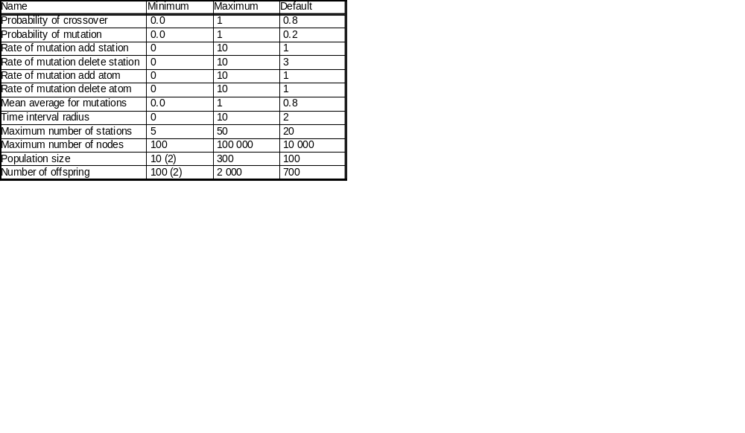
Parameters
Table 1: The two values in brackets (2) were changed for the domain Parking.

Slide 18
Artificial Neural Network Configuration
We use the Fast Artificial Neural Network Library (Nissen 2003)
12 input neurons, 12 output neurons, 12 interneurons (= # of inputs)
50 epochs per iterations in LaO
300 epochs train a posteriori
1 LaO iteration=5 CMA-ES+1 Genetransferer+1 ANN

Slide 19
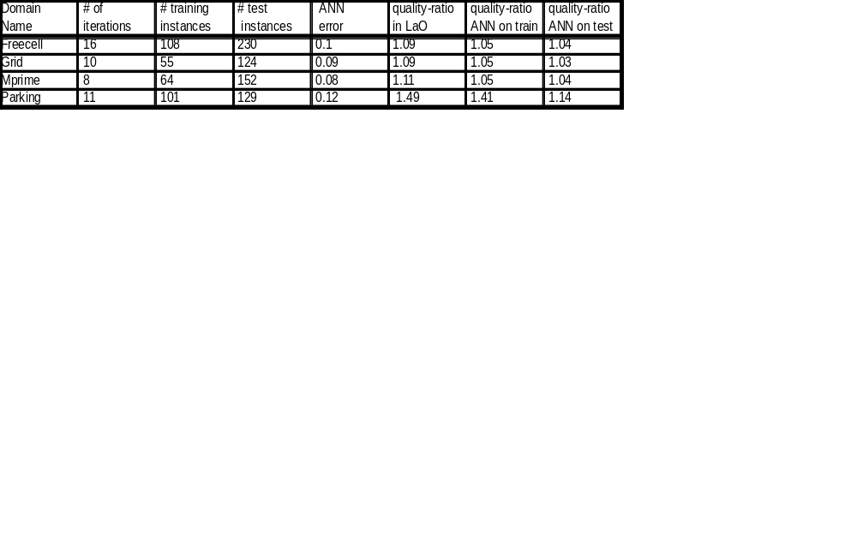
Domains
Table 2: Results by domains (only the actually usable training instances are shown). ANN-error is given as MSE, as returned by FANN. The quality-improvement ratio in Lao is that of the best parameter-set found by LaO. Quality-ratio=Fitness_{Default}/Fitness_{Tuned}

Slide 20
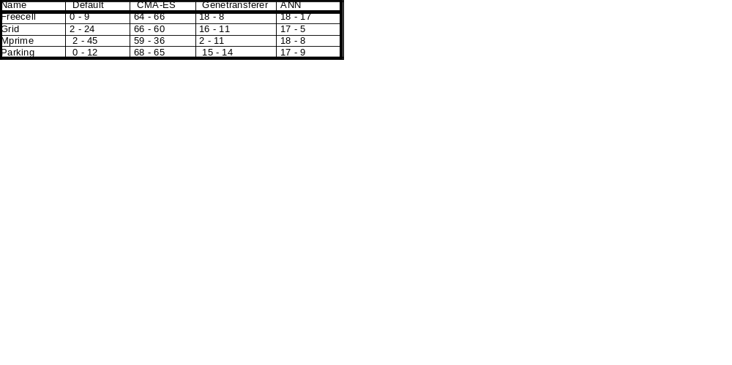
Contribution of algorithmic parts
Table 3: For each method (default, CMA-ES, Genetransferer or ANN), the percentage of instances on which this method gave the best parameter set. Each cell shows 2 figures: the first one considers all occurrences of a method, no matter if another method also lead an equivalent parameter set, as good as the first one. The second figures only considers the first method (from left to right) that discovered the best parameter-set.

Slide 21
Conclusions
Learning time was short (~10 iterations)
Learner (ANN) is not good enough, probably features are poor (see table 2)
Relation learned can be generalized well in the same domain for new instances (see table 2)
Learner as surrogate contributed well and Genetransferer also (See table 3)
Some gain in quality-ratio even with a few iterations achieved (see table 2)

Slide 22
Ongoing and Future Work
Longer run (50-200 iterations, ongoing)
More sophisticated features (e.g. statistical (ongoing) and probing features)
Develop Genetransferer further (ongoing)
Use other optimizers and learners
Try to learn a single, domain independent model and test extra-domain generalization capabilities (ongoing)

