Slide 1
Instance-Based Parameter Tuning and Learning
for Evolutionary AI Planning
Mátyás Brendel, Marc Schoenauer, INRIA/TAO
2011.06.13., Freiburg,
ICAPS'2011, PAL Workshop

Slide 2
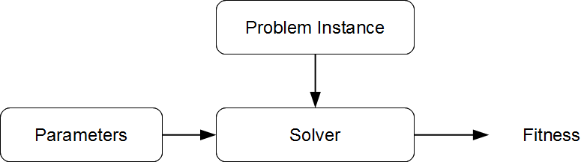
Overview
Basic technique: per instance tuning
Our Approach: add machine learning
Expected:
  improve tuning
  generalize to new instances or domains

Slide 3
Agenda
Divide-and-Evolve solver for AI Planning
Parameter Tuning
Learn and Optimize
Conclusions

Slide 4
Divide-and-Evolve solver
for AI Planning

Slide 5
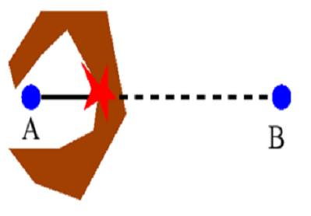
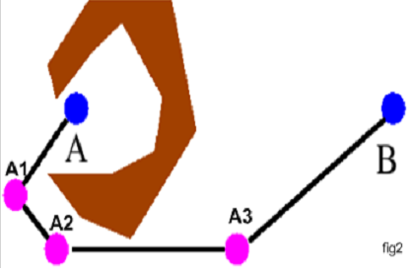
Divide-and-Evolve
Motivation
    Given a 'local' ('weak' or 'greedy') algorithm for AI planning
    Solve a problem this local algorithm cannot solve
    Improve quality of solutions of the weak/greedy algorithm
Rationale: evolutionary sequential Divide-and-Conquer
Local algorithm can solve the sequence of easy problems
Local algorithm fails

Slide 6

Application to AI planning
Problem
<A, O, I, G> = PD(I,G)
Representation
Ordered list of partial states
S₀=I, S₁, ... S_{n}, S_{n+1}=G
Evaluation
Solve consecutive sub-problems PD(S_{k},S_{k+1}), kϵ[0,n]
with 'greedy' planner CPT or 'weak' planner YAHSP
Fitness
        All problems solved: sum of plan qualities
        Fails solving PD(S_{l}, S_{l+1}): penalty + “dist”(S_{l},G)
DaE was first presented in Schoenauer et. al. EvoCOP 2006, and in this work we use it
as a blackbox-algorithm as presented in Bibai et. al. ICAPS 2010

Slide 7
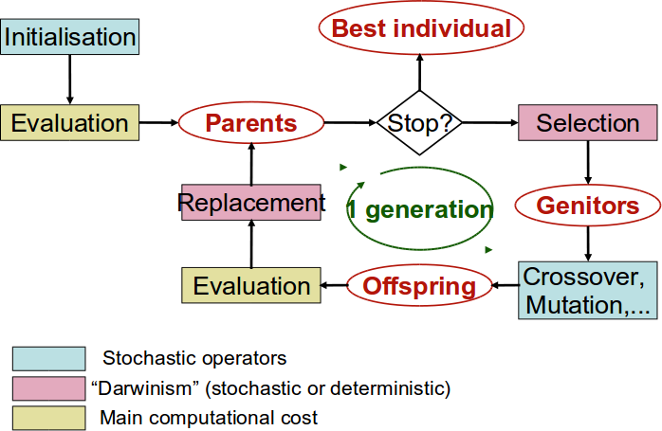
Schema of the Evolutionary Algorithm

Slide 8
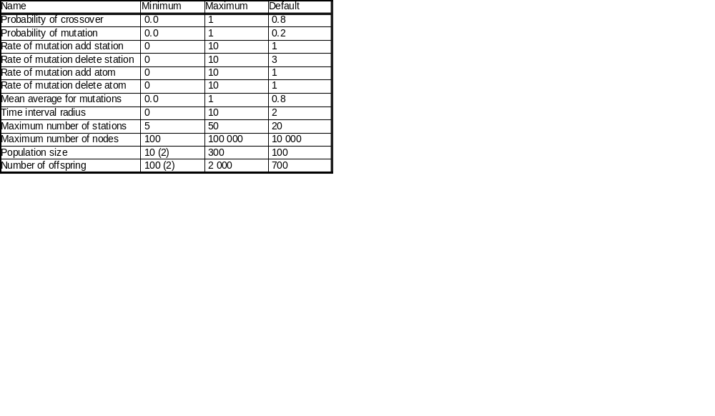
Parameters of DaE
The two values in brackets (2) were changed for the domain Parking.

Slide 9
Parameter Tuning

Slide 10
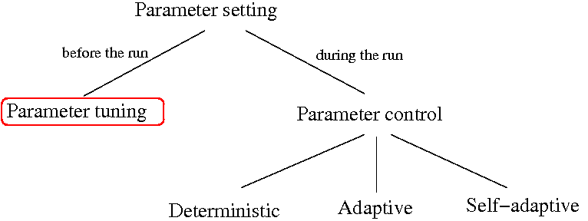
Taxonomy of Parameter Setting
According to Eiben 2007

Slide 11
Refining the Taxonomy
Static
Non-static

Slide 12
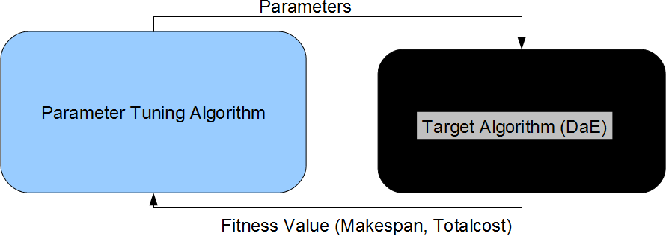
The Classical (Static) Parameter Tuning Scenario
In static parameter tuning the result is one, fixed optimal parameter-set per instance or per training set.

Slide 13
Static Tuning: State of the Art
Racing: aims at reducing the number of evaluations for a stochastic target-algorithm based on statistical tests (Kauffmann et. al. 1994)
SPO: Sequential Parameter Optimization, Gaussian process based regression as a surrogate model (Bartz-Beielstein, 2006)
ParamILS: Iterative Local Search (Hutter et. al. 2007)
REVAC: Relevance Estimation and VAlue Calibration, Evolutionary Algorithm based distribution-estimation (Nannen et. al. 2008)

Slide 14
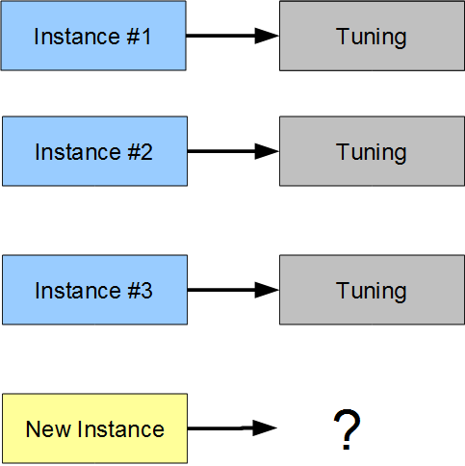
Per Instance Static Tuning

Slide 15
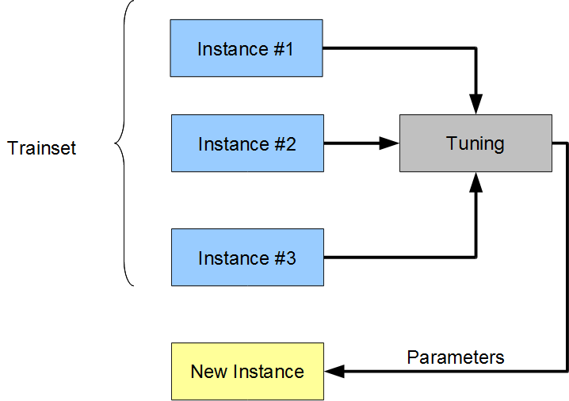
Per Trainset Static Tuning
Bibai 2010, this will be our baseline

Slide 16
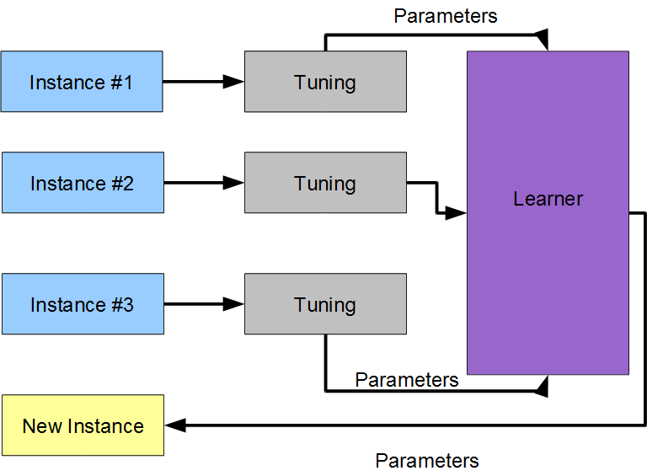
Adding Learning (sketch)

Slide 17
Non-static Tuning: an example
Performance Prediction and Automated Tuning (Hutter et. al. 2006)
Only for the SAT domain
They had running time prediction, we would like fitness as performance

Slide 18
Our Learn-and-Optimize Method

Slide 19
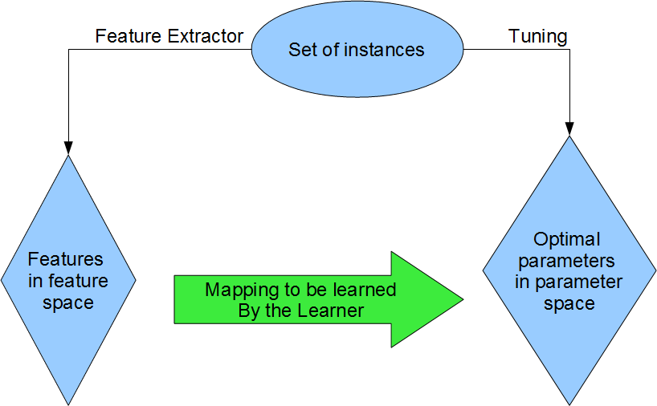
Direct Scenario for Learning

Slide 20
Direct learning
For each instance i
  Eff(i,y) is the fitness of the solver with parameters y
  Features: x_{i}ͼR^{d}
  Best known parameters: y_{i}ͼR^{d'}, estimates of y_{i}*=argmin_{y}{Eff(i,y)}
Based on {(x_{i},y_{i})} learn regression f
Prediction error: |f(x_{i})-y_{i}|
Efficacy loss of regression: |Eff(i,_{i}y_{i})-Eff(i,f(x_{i}))|

Slide 21
The Benefits of Learning
Ability to generalize for new instances in the domain: intra-domain generalization
Ability to generalize for new domains: inter-domain generalization
Computing features and evaluating a model for a new instance is quick
Model can be used as a surrogate-like technique, furthering optimization

Slide 22
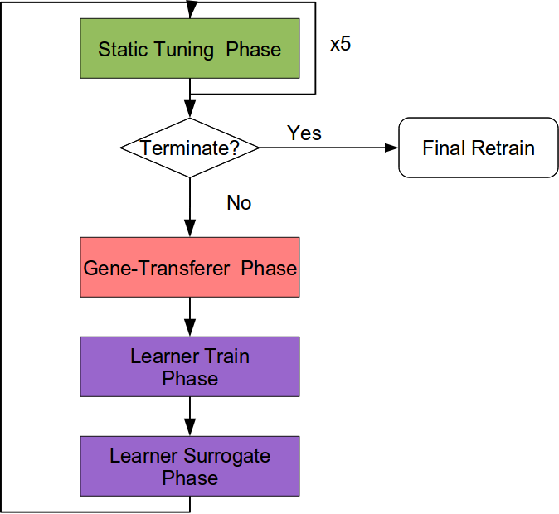
Learn-and-Optimize Serial Outline

Slide 23
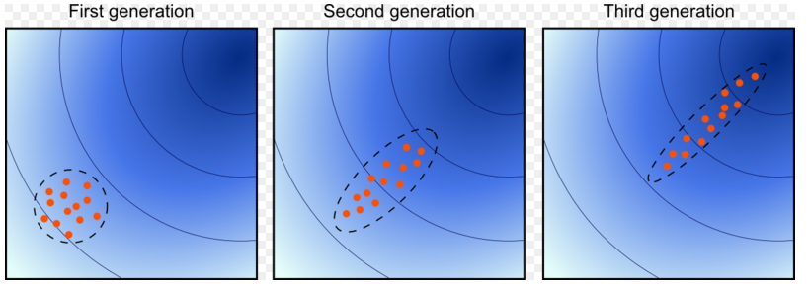
CMA-ES used for static tuning
Covariance Matrix Adaptation Evolutionary Strategy (Auger et. al. 2005, Hansen et. al. 2001)
Quick, robust optimization strategy, used for tuning instances, in fact we use (1+1)-CMA-ES
Estimates the natural gradient

Slide 24
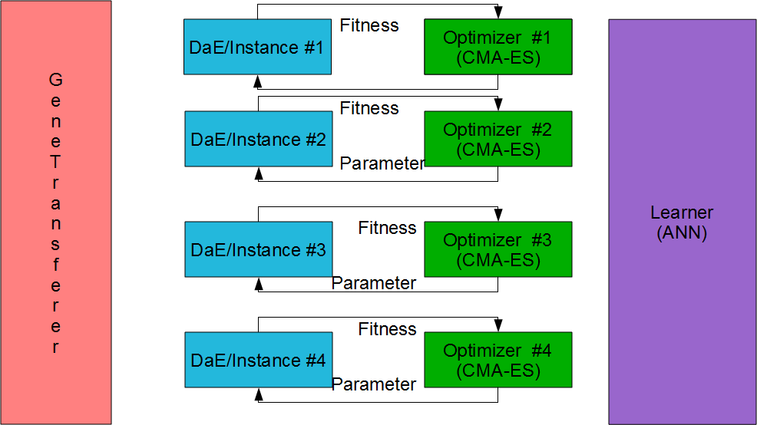
LaO Train: Static Tuning Phase

Slide 25
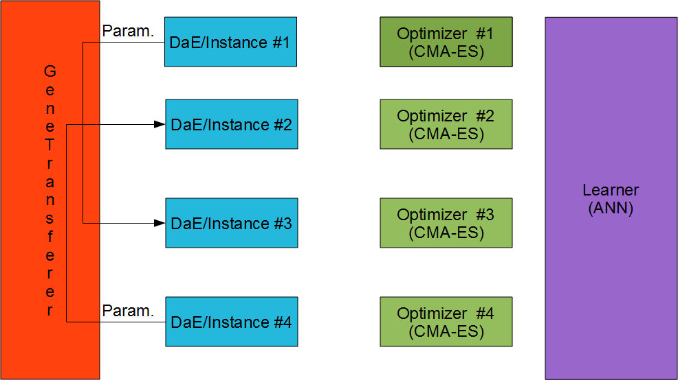
LaO Train: Gene-Transfer Phase

Slide 26
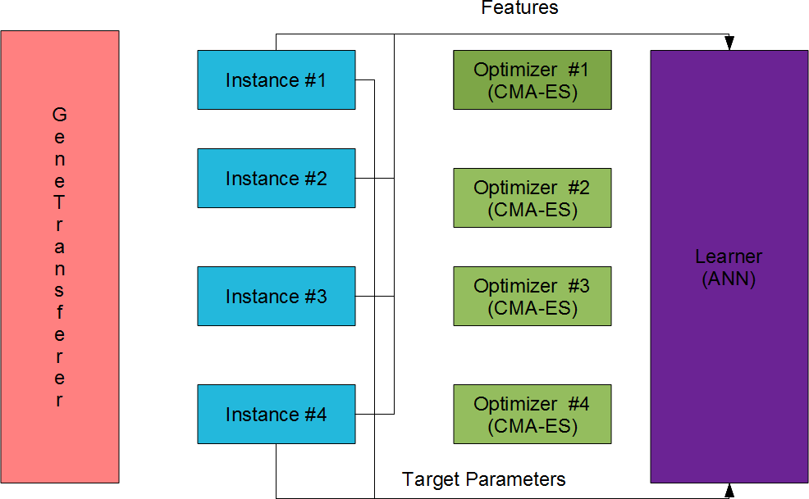
LaO Train: Learner-Train Phase

Slide 27
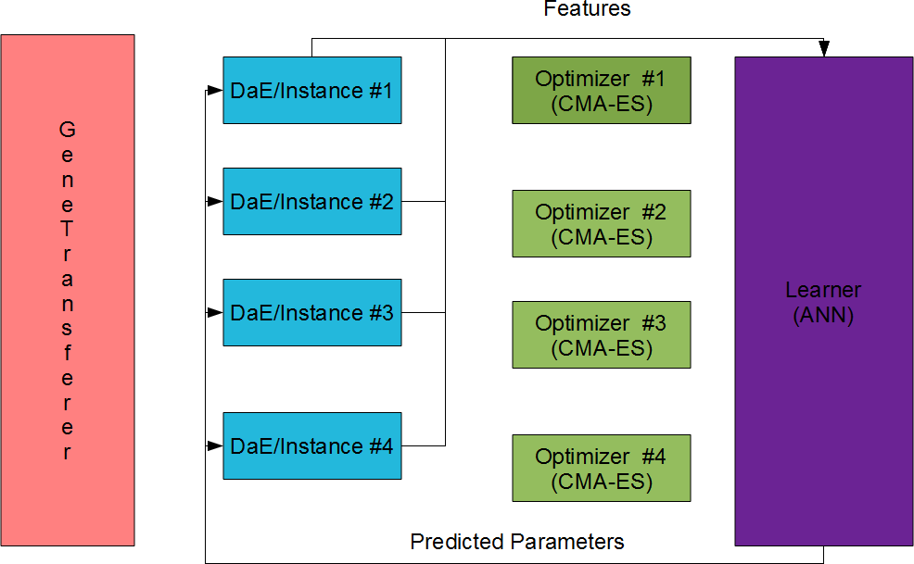
LaO Train: Surrogate Phase

Slide 28
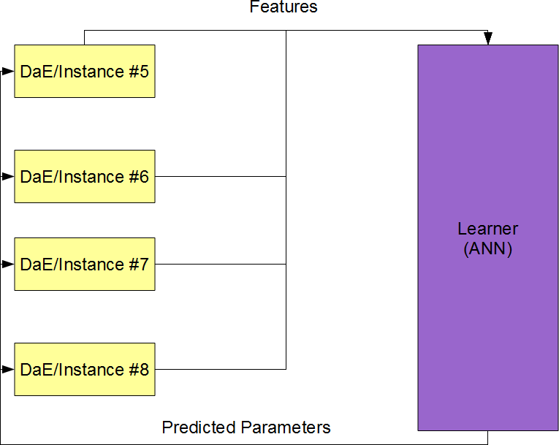
LaO Test: only Learner-Hint

Slide 29
GeneTransferer
Presented results are with random transfer
I.e. for each instance one of the other instances is selected with uniform random distribution, and its current best parameter is tested
GeneTransferer can be developed further along lines of Active Learning, taking into account distances in features and distances of parameters.

Slide 30
Features
12 features:
  # fluents
  # goals
  # predicates
  # objects
  # types
  mutex-density=#mutexes/#fluent-pairs
  # lines in the domain-file
  # words in the domain-file
  # byte-count in the domain-file
  # lines in the instance-file
  # words in the instance-file
  # byte-count in the instance-file

Slide 31
Artificial Neural Network Configuration
We use the Fast Artificial Neural Network Library (Nissen 2003)
12 input neurons, 12 output neurons, 12 hidden neurons (= # of inputs)
50 epochs per iterations in LaO
300 epochs train a posteriori

Slide 32
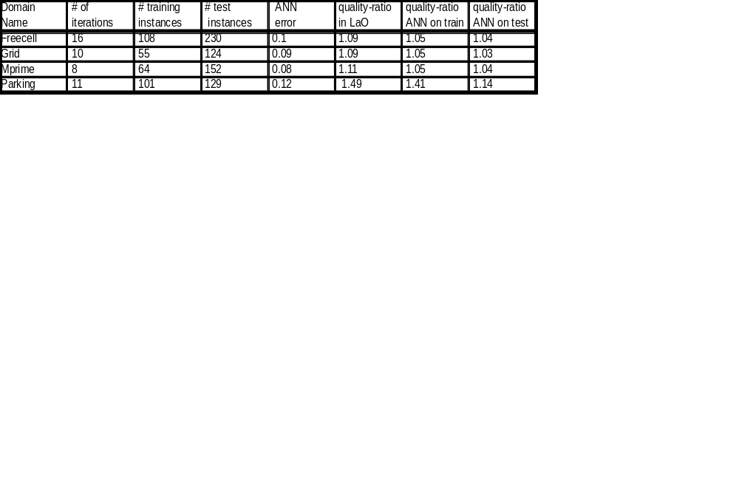
Results
Results by domains (only the actually usable training instances are shown). ANN-error is given as MSE, as returned by FANN. The quality-improvement ratio in Lao is that of the best parameter-set found by LaO. Quality-ratio=Fitness_{Default}/Fitness_{Tuned} this is IPC metric. Default= Per trainset static tuning, taken from Bibai et. al. 2010.

Slide 33
Computational Cost
One evaluation takes 15 minutes by definition of IPC
11 evaluations per instance per parameters
5+1+1 evaluations per LaO iterations
8-16 LaO iterations
4 domains
Approximately 200 cores available in our cluster
As a result, this takes approximately 2 weeks

Slide 34
Conclusions

Slide 35
Conclusions of the experiments
Learning time was limited (~10 iterations, approximately 2 weeks on a cluster with approximately 100 cores)
Learner (ANN) is not good enough, probably features are poor
Relation learned can be generalized well in the same domain for new instances
Learner as surrogate contributed well and Genetransferer also
Some gain in quality-ratio even with a few iterations achieved, over static tuning

Slide 36
The Scope of our Algorithm
Our parameter tuning algorithm is a framework
It can be applied to any optimization method to be tuned, which has different instances (problems) to solve and some features can be extracted
CMA-ES can be replaced by any suitable optimization method
FANN can be replaced by any method capable of learning (a regression of) multidimensional functions

Slide 37
Ongoing and Future Work
Longer runs (50-200 iterations)
More sophisticated features (e.g. statistical and probing features)
Develop GeneTransferer further along Active Learning techniques
Try to learn a single, domain independent model and test extra-domain generalization capabilities
Use other optimizers and learners
Investigate indirect learning

Slide 38
Thank You
Questions?

Slide 39
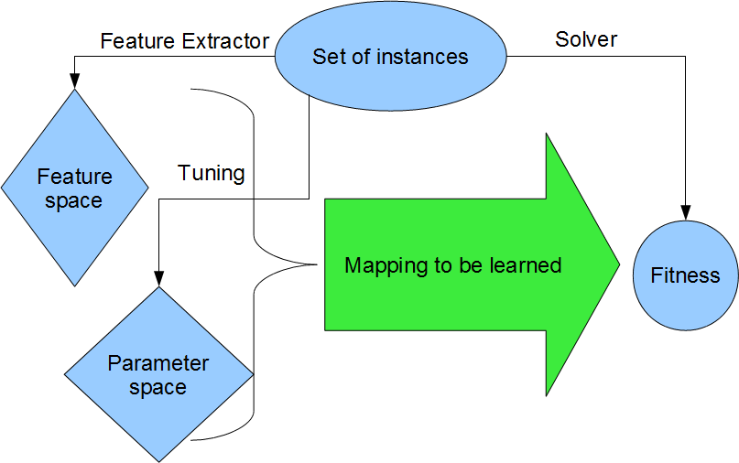
Indirect Learning as in Hutter et. al.

Slide 40
Indirect learning
For each instance i
  Eff(i,y) is the fitness of the solver with parameters y
  Features: x_{i}ͼR^{d}
  Best known parameters: y_{i}ͼR^{d'}, estimates of y_{i}*=argmin_{y}{Eff(i,y)}
Based on {(x_{i},y_{i},Eff(i,y_{i}))} learn regression f
Regression has always to be solved for optimal y_{i}

