Slide 1


Parallel Divide-and-Evolve
Experiments with OpenMP on a Multicore Machine
Caner Candan, Johann Dréo, Pierre Savéant, Vincent Vidal
Dublin, Ireland
July 12-16, 2011
Notes:
Johann Dréo, research engineer at Thales, speaker, stochastic metaheuristics.
Pierre Savéant, research scientist at Thales, attending the conference, planning.
Caner Candan, post-graduate internship at Thales, parallelization.
Vincent Vidal, researcher at ONERA, planning solver.

Slide 2

Evolving Objects Framework
Evolving Objects
  Framework
  C++
  Components
    Templates for representation-dependent parts
    Functors for operators
Notes:
EO is a template-based, ANSI-C++ evolutionary computation library which helps you to write your own stochastic optimization algorithms insanely fast.

Slide 3
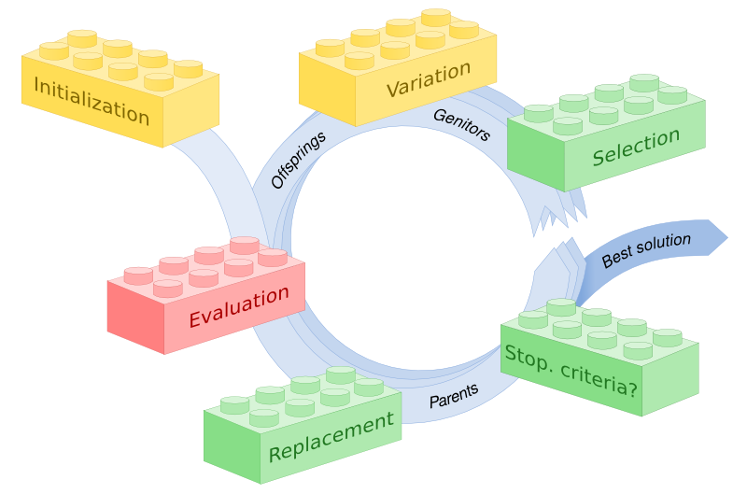
Evolving Objects Framework
Problem dependent
Representation dependent
Independent
Notes:
Designing an algorithm with EO consists in choosing what components you want to use for your specific needs, just as building a structure with Lego blocks.
If you have a classical problem for which available code exists (for example if you have a black-box problem with real-valued variables), you will just choose components to form an algorithm and connect it to your fitness function (which computes the quality of a given solution).
If your problem is a bit more exotic, you will have to code a class that represents how your individuals (a solution to your problem) are represented, and perhaps some variations operators, but most of the other operators (selection, replacement, stopping criteria, command-line interface, etc.) are already available in EO.

Slide 4
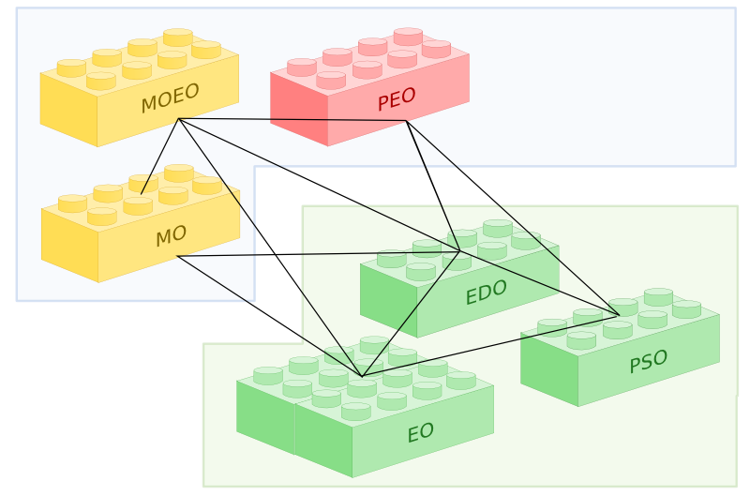


EO*
Evolutionary
  Parallel
  Local Search
  Particle Swarm
  Multi-Objective
  Estimation of Distribution
Notes:
There is several components in
ParadisEO provides EO extensions for the flexible design of single solution-based metaheuristics, metaheuristics for multi objective optimization as well as hybrid, parallel and distributed metaheuristics.

Slide 5
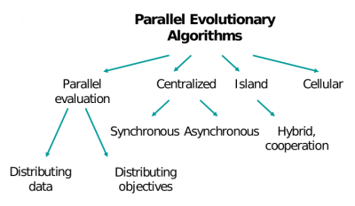
Parallelization levels
Parallelization levels
  Runs
  Island
  Evaluation
  Operators
  Algorithms
PEO (MPI)

Slide 6
Parallelize
Main CPU cost

Slide 7
Multi-core
Message Passing (done)
  More complex
  Communications cost
  Memory copies
Shared Memory
  Easy to use
  Less communication
  Shared memory
GPGPU
  Even more complex
  Memory copies

Slide 8

Shared-memory parallelization framework
OpenMP
  Shared-memory parallelism
  Directive-based API
  Available on standard C++ compilers
  Threads mapped onto cores: static vs. dynamic scheduling
  Concurrent accesses protection

Slide 9
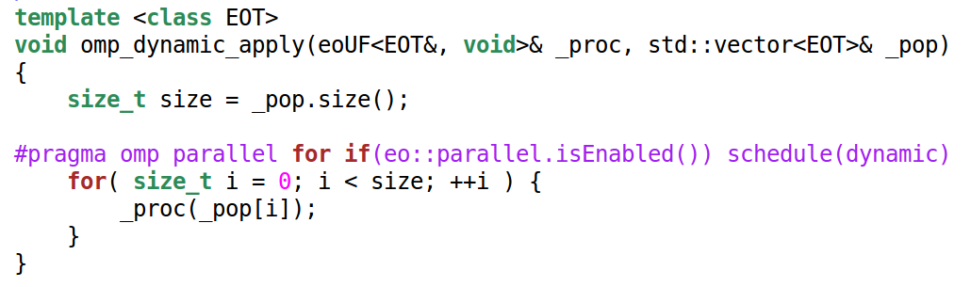
apply

Slide 10
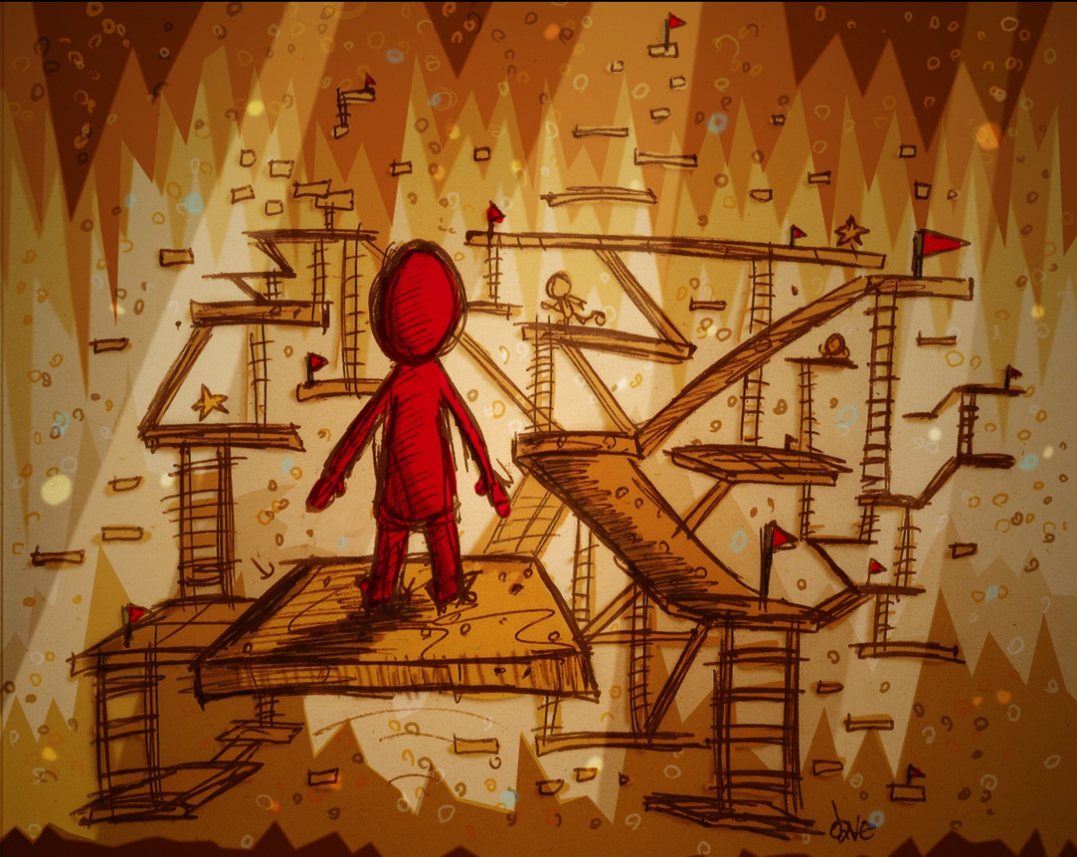
PoC
Proof of Concept
  Parallelization of “Divide and Evolve” (DAE)
  Planning solver
http://www.flickr.com/photos/okaysamurai/2086978108 — David Werner CC-BY-NC-ND

Slide 11
Domain-Independent Planning
The Classical Planning Problem
  Find a solution path in a transition system:
a sequence of actions which maps an initial state I into a state G satisfying a set of desired goals.
  Metrics: length, cost, duration
  Planning tasks: abstract reasoning problems
PDDL: Planning Domain Definition Language
  Domain-independent planners
  Predicate-oriented description of the world
Initial State
Final State

Slide 12
DAE_{x}
A state-based decomposition principle
An evolutionary algorithm to drive the optimization process
An embedded planner (e.g. X=YAHSP)
DAE_{YAHSP}
Winner of the Seventh International Planning Competition
(Deterministic Temporal Satisficing track)

Slide 13
Evolutionary Loop
Parental Selection
Population
Parents
Crossover,
Mutations
Survival Selection
DAE_{X}
Stop?
Offspring
Evaluation
Best Individual
Initialisation
Planner X

Slide 14
Evaluate(Ind,planner)
Try to reach the goals successively from I to G
  Call planner with a boundary on the number of search steps
  If FAILURE
    Return bad-fitness
  If SUCCESS
    Compute the next initial state by executing the plan found
    Iterate
If G is reached
  Compress sub-plans into one global plan
  Return good-fitness

Slide 15
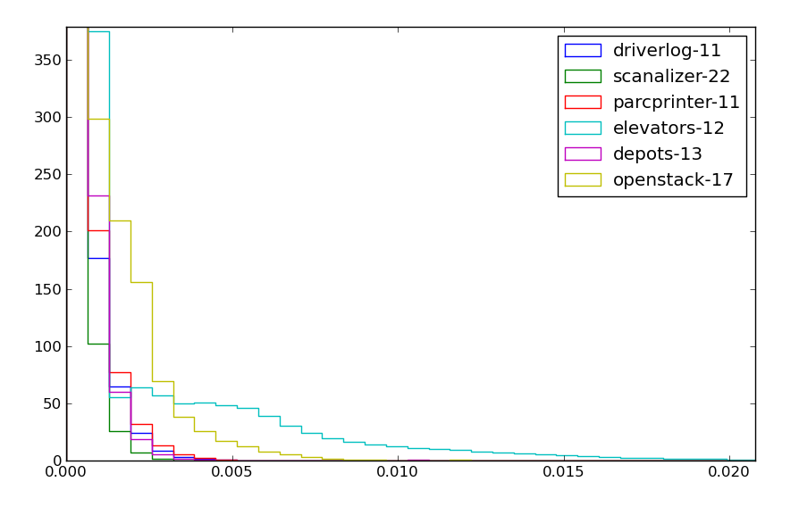
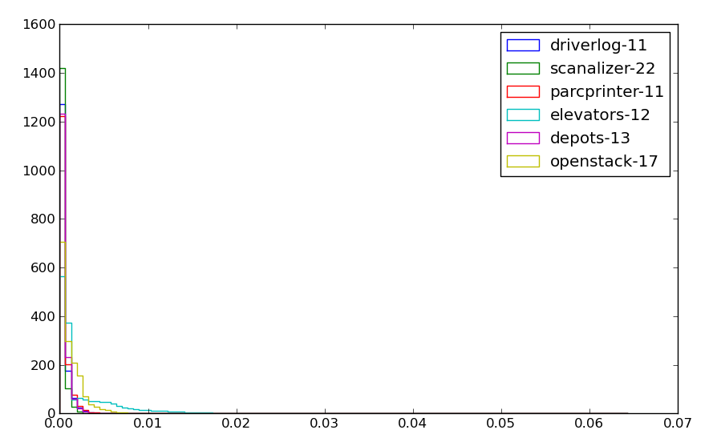
Evaluation function
YAHSP on sub-goals
  High cost
  Unstable
#
time (s)

Slide 16
Parallelization issues
Thread-local
  Intermediate variables
    from Evaluator to Individual
Memory allocation
  Importance of correct allocations
    Local variables as members
    Vectors.reserve() at the correct location
Critical section
  Shared memoïzation globals

Slide 17
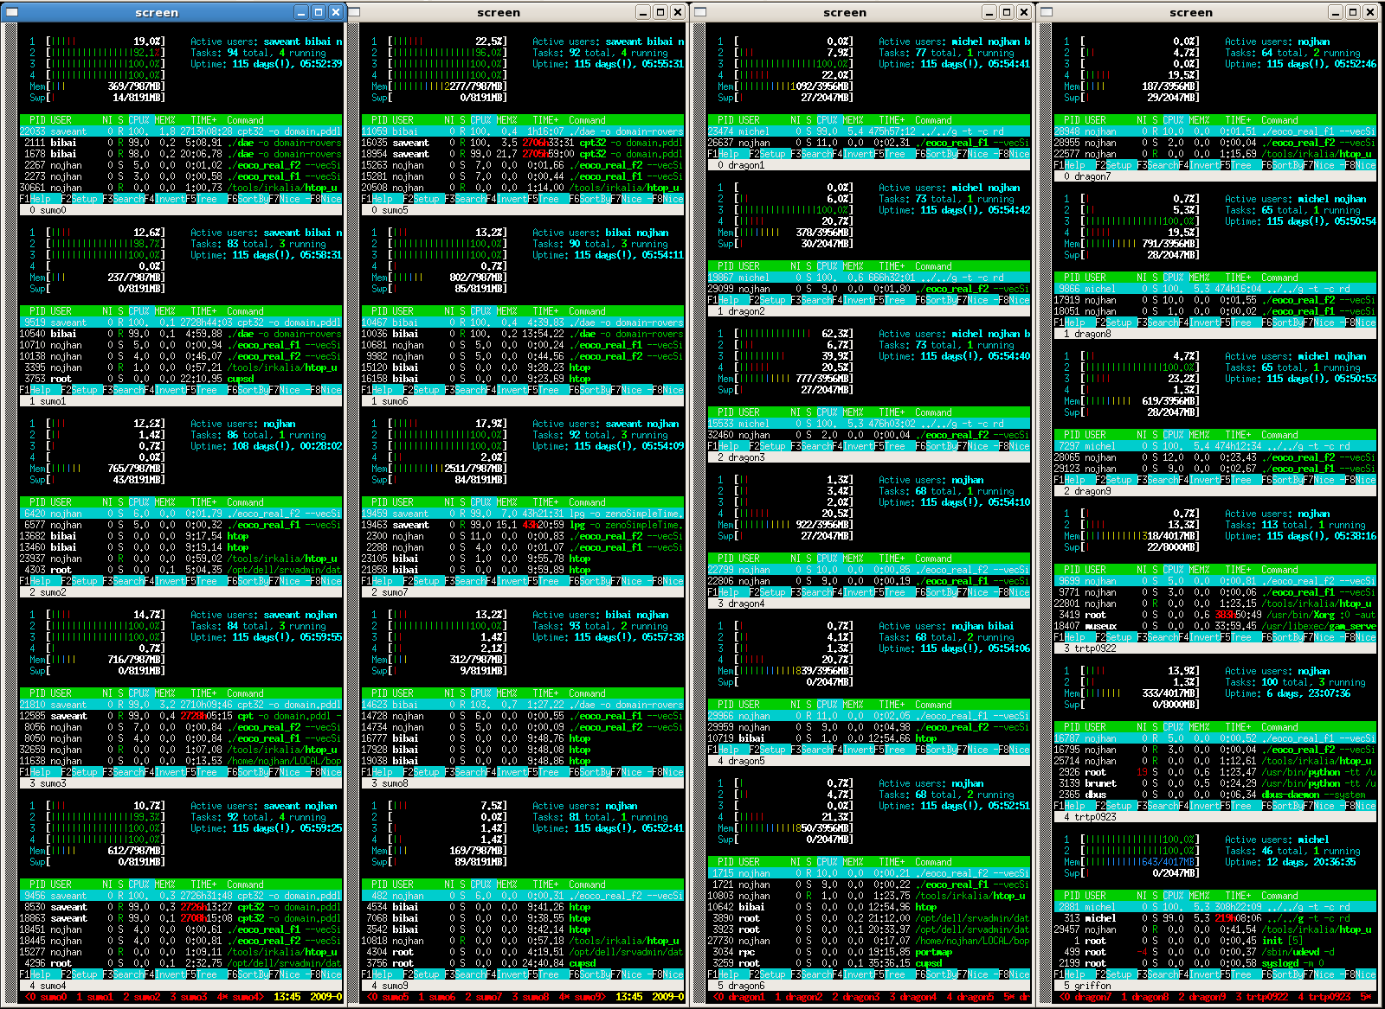
Experiments

Slide 18
Experimental setup
Experimental setup
  GCC / GNU OpenMP 4.4.4
  48-core DELL PowerEdge R815 Rack Server
    four 12-core AMD Opteron(tm) 6174,
    2.2GHz (12x512 KB cache) processors
    192GB of RAM,
  GNU/Linux 2.6.32 x86-64
    “time” command
    omp_get_wtime()

Slide 19
Benchmark
International Planning Competition (IPC)
  Elevators 12 — cost
  Scanalyser 22 — cost
  Openstacks 17 — temporal
  Parc Printer 11 — temporal
  Depot 13 — STRIPS
  DriverLog 11 — STRIPS

Slide 20
Experiments
Parameters
  (popsize + 7× popsize)-ES
  Stopping criterion: 10 < steady state 50 < 1000 generations
Experiments
  Steady state, varying cores, 21 runs
  30 minutes restarts, varying popsize, 11 runs

Slide 21
Questions
Questions
  Speedup against number of processors?
  Best parallelization scheme?
    Static VS dynamic?
    Shared memoïzation?
  Impact of the population size?
  Impact on quality?

Slide 22
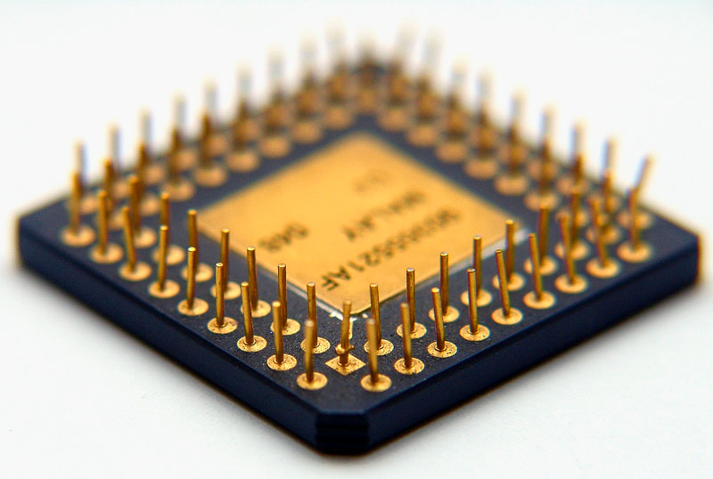

<number> /
Effect of number of processors
http://www.flickr.com/photos/luisferfranco/184524513 — Luis Ferfranco CC-BY-NC-ND

Slide 23
Efficiency against number of processors
TODO
  Multi-instances
  efficiency VS cores
  SM-static & SM-dynamic

Slide 24
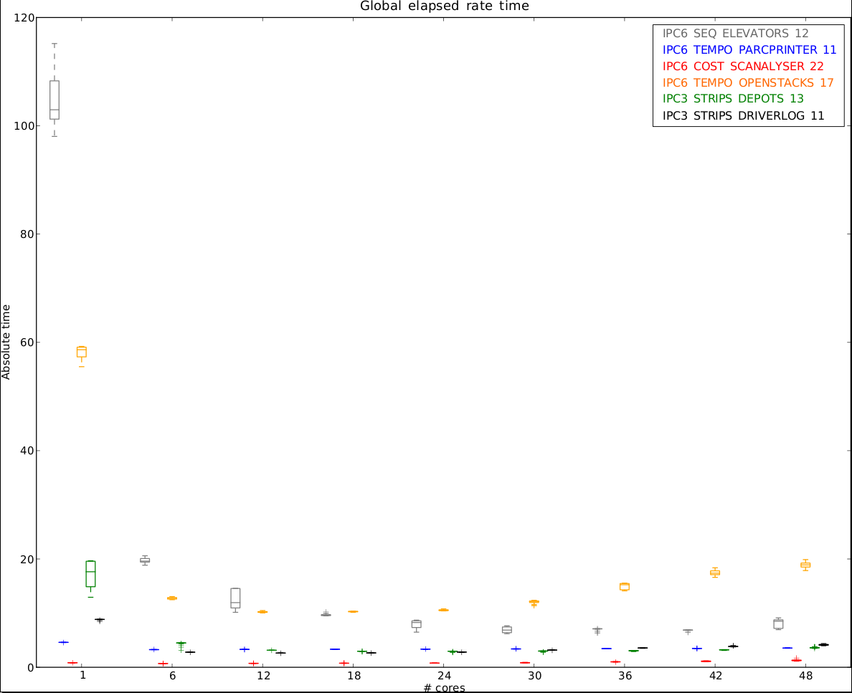
Speedup against number of processors

Slide 25
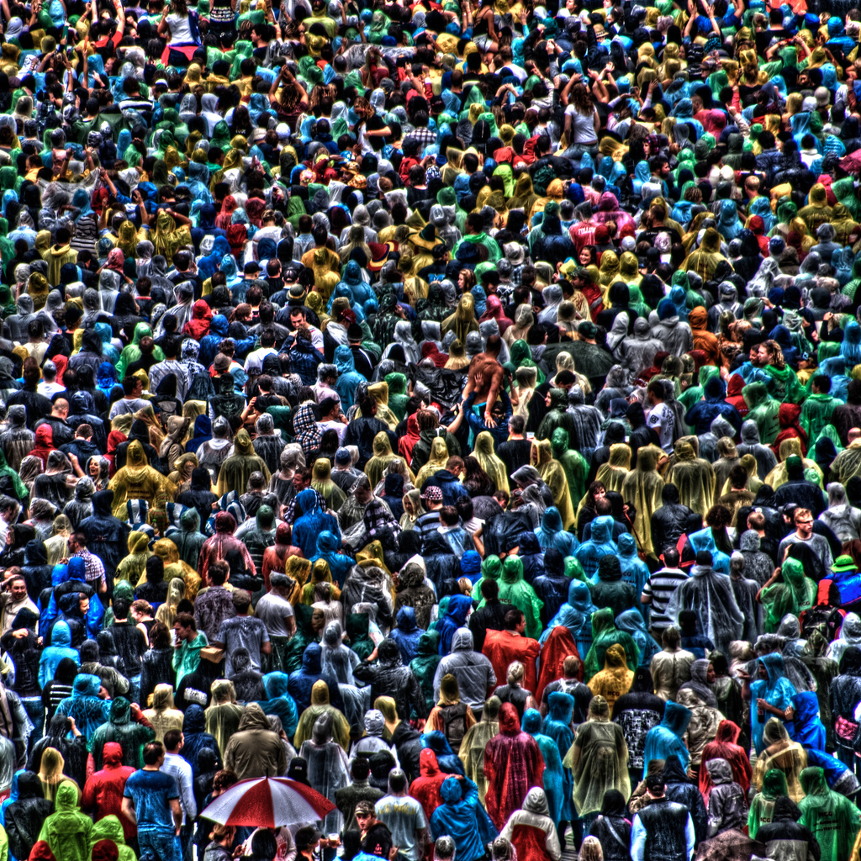
<number> /
Effect of population size
http://www.flickr.com/photos/akc77/3370167184/ — Alexander Kesselaar CC-BY-NC-ND

Slide 26
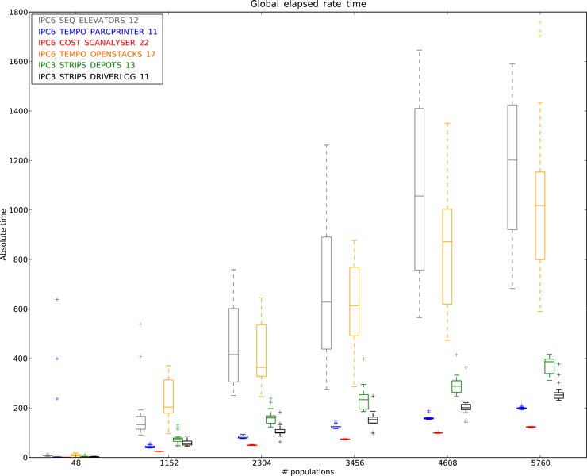
Absolute time VS popsize

Slide 27
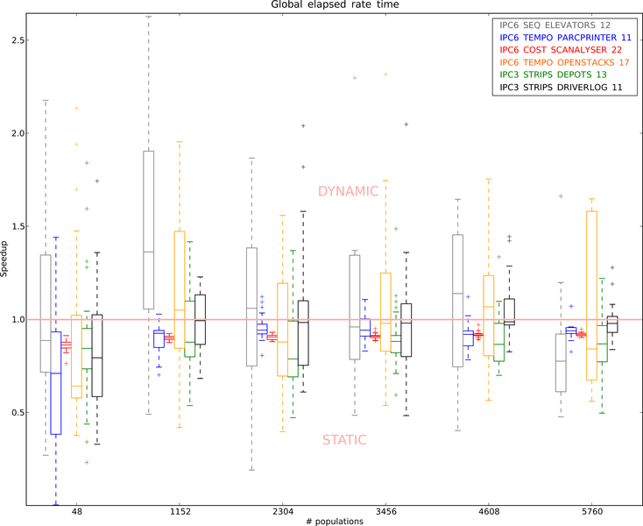
Static VS Dynamic parallelization

Slide 28
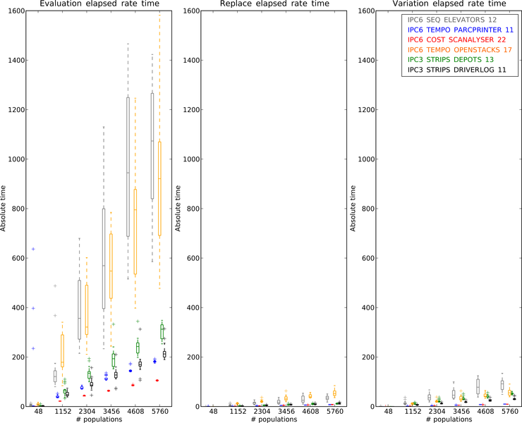
Evaluation, Replacement, Variation

Slide 29
Solution plan qualities

Slide 30

Conclusion
Available in the EO framework
Some debug
But most of the work still in the algorithm
Linear speedup
Best scheme
  Shared memoïzation
  Dynamic Static schedule
    More robust
    But depends on the instance
Small popsize effect
No quality impact
  Algorithm too convergent

Slide 31
Perspective
GPGPU — not a good option?
  heavy memory footprint of memoïzation (up to 100%)
Other operators
  evaluation is still the longer part
Sub -algorithms
  tests with GNU parallel STL shows no improvement
Cores-Popsize-Instance correlations?
  parameter setting

Slide 32

End
DAE_{YAHSP}
eodev.sourceforge.net
www.plg.inf.uc3m.es/ipc2011-deterministic
{ johann.dreo , pierre.saveant }@thalesgroup.com
ANR funding
gforge.inria.fr/projects/paradiseo/
descarwin.lri.fr

Slide 33
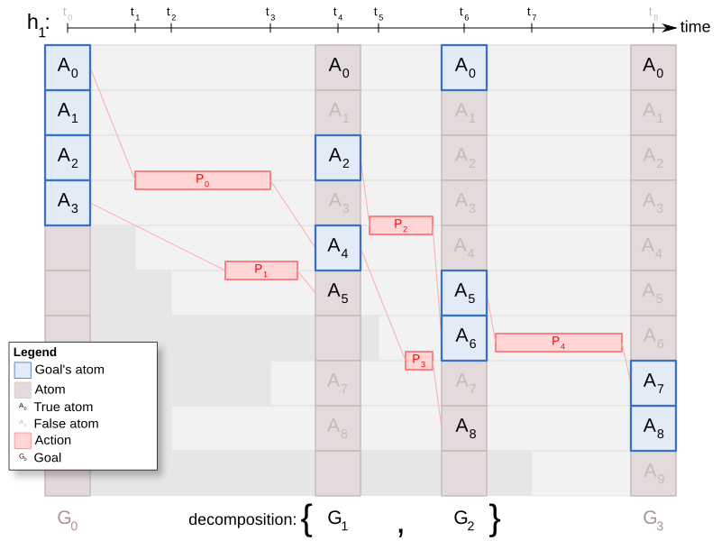
DAEx: decomposition

Slide 34
DAE_{X} Decomposition Principle
Start
t₁
t₂
t₃
End
h¹
A_{t1}
a₁
a₄
mutex free
a₃
A_{t2}
a₂
a₅
a₆
mutex free
a₇
I
g₁
g₂
G

