Slide 1
Instance-Based Parameter Tuning for Evolutionary AI Planning
Matthias Brendel, INRIA/TAO
2011.06.13., Freiburg, ICAPS-PAL

Slide 2
Agenda
Our Divide and Evolve solver for AI Planning
Parameter Tuning in General
Our Learn and Optimize method (my work)
Conclusions

Slide 3
Our Divide and Evolve solver
for AI Planning

Slide 4
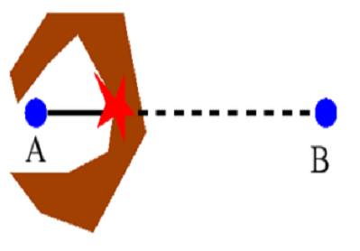
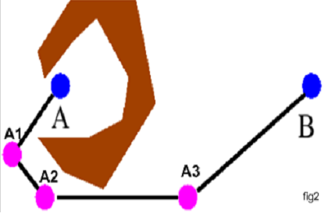
Divide-and-Evolve
Motivation
    Given a 'local' ('weak' or 'greedy') algorithm
    Solve problem this local algorithm cannot solve
    Improve quality of solutions of the weak/greedy algorithm
Rationale: evolutionary sequential Divide-and-Conquer
Local algorithm can solve the sequence of easy problems
Local algorithm fails

Slide 5

Application to AI planning
Problem
<A, O, I, G> = PD(I,G)
Representation
Ordered list of partial states
S₀=I, S₁, ..., S_{n}, S_{n+1}=G
Evaluation
Solve consecutive sub-problems PD(S_{k},S_{k+1}), kϵ[0,n]
with 'greedy' planner CPT or 'weak' planner YAHSP
Fitness
        All problems solved: sum of plan qualities
        Fails solving PD(S_{l}, S_{l+1}): penalty + “dist”(S_{l},G)

Slide 6
Schema of the Evolutionary Algorithm
Initialisation
Best individual
Evaluation
Parents
Stop?
Selection
Replacement
1 generation
Genitors
Evaluation
Offspring
Crossover,
Mutation,...
Stochastic operators
“Darwinism” (stochastic or deterministic)
Main computational cost

Slide 7
Parameter Tuning

Slide 8
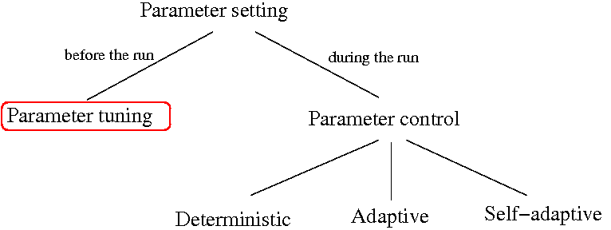
Taxonomy of Parameter Setting

Slide 9
Refining the Taxonomy
Static
Non-static

Slide 10
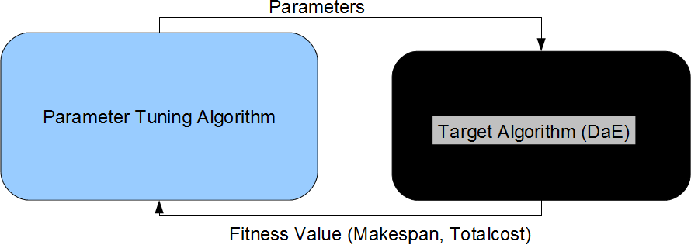
Static Parameter Tuning Scenario
In static parameter tuning the result is one, fixed optimal parameter-set per instance or per training set.

Slide 11
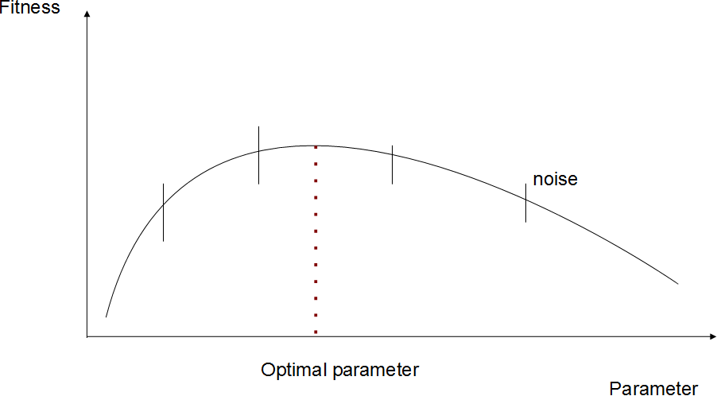
Static Parameter Tuning is actually “simple” Global Optimization

Slide 12
Static Tuning: State of the Art
REVAC: Relevance Estimation and VAlue Calibration, Evolutionary Algorithm based distribution-estimation (Nannen et. al. 2008)
ParamILS: Iterative Local Search (Hutter et. al. 2007)
SPO: Sequential Parameter Optimization, Gaussian process based regression as a surrogate model (Bartz-Beielstein, 2009)
Racing: aims at reducing the number of evaluations for a stochastic target-algorithm based on statistical tests (Kauffmann et. al. 1994)

Slide 13
Drawbacks of Static Tuning
There are many instances and domains
  Either separate tuning per instances
  Or a single (suboptimal) average-like parameter-set for many instances
Intra-domain generalization: extrapolating from tuned instances to new ones is not really possible
Extra-domain generalization: extrapolating from one domain to another is not really possible

Slide 14
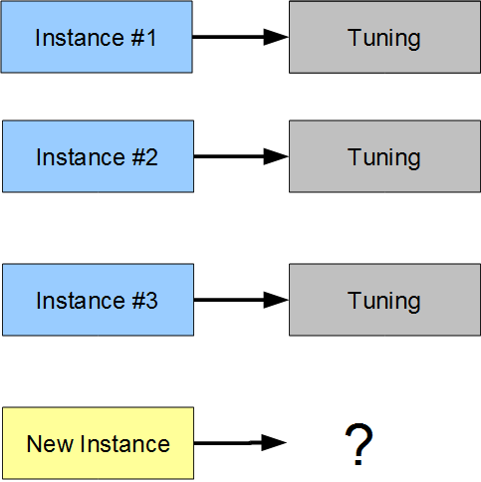
Per Instance Static Tuning

Slide 15
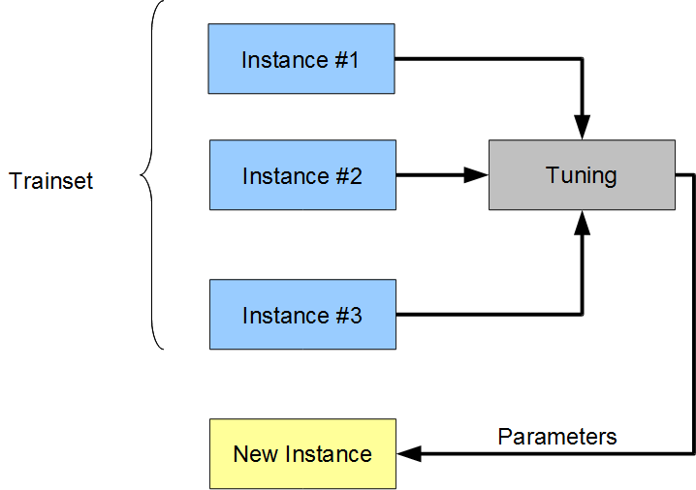
Per Trainset Static Tuning

Slide 16
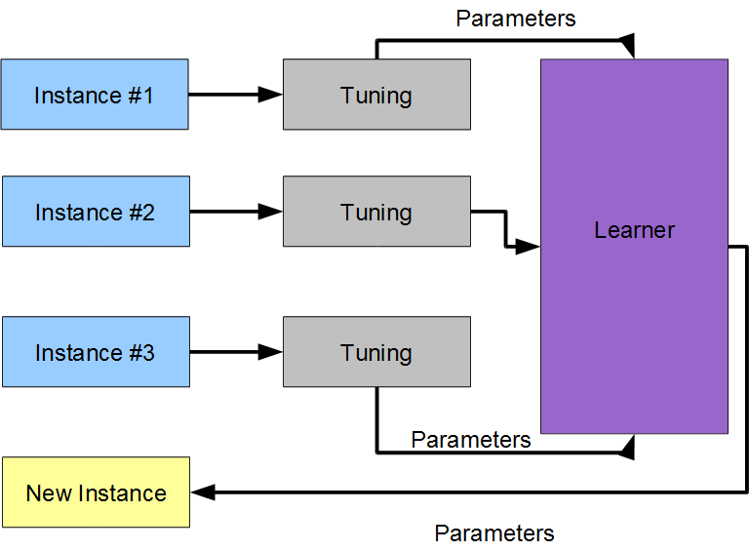
Adding Learning (sketchy)

Slide 17
Non-static Tuning: State of the Art
Performance Prediction and Automated Tuning (Hutter et. al. 2006)
Only for the SAT domain
Running time prediction, we have fitness as performance
We would like to generalize this approach

Slide 18
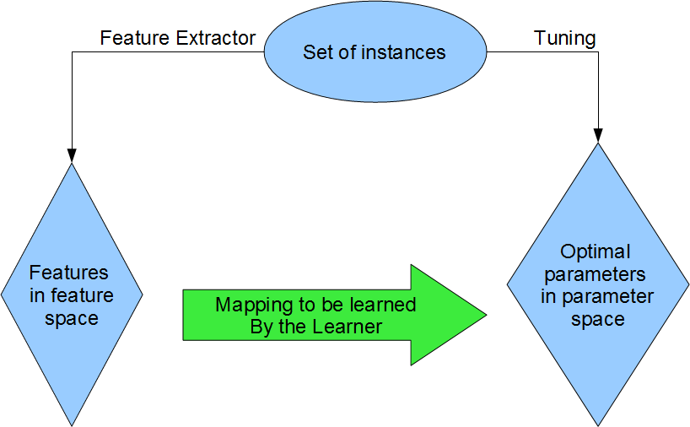
Solution of opting for generalization

Slide 19
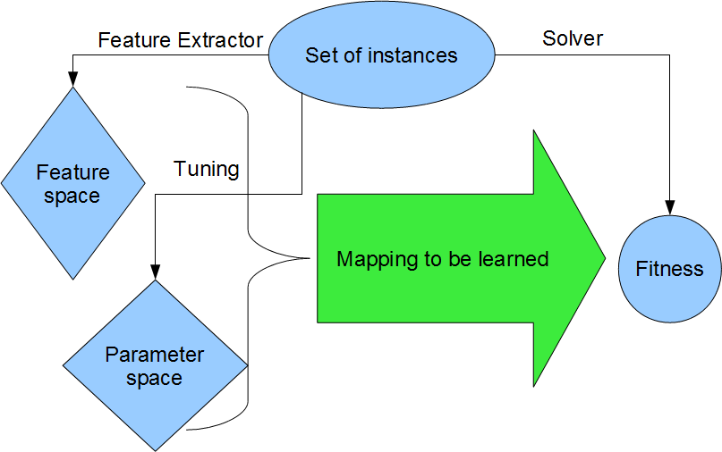
Indirect learning as in Hutter et. al.

Slide 20
Indirect Learning
This schema can also be interpreted as an Energy-Based Learning scenario (EBM). See LeCun et. al. “A Tutorial on Energy-Based Learning”, 2006,
The learned mapping however has to be “inferred” when using.

Slide 21
Our Learn-and-Optimize Method

Slide 22
The Benefits of Learning
Ability to generalize for new instances in the domain: intra-domain generalization
Ability to generalize for new domains: inter-domain generalization
Computing features and evaluating a model for a new instance is quick
Model can be used as a surrogate-like technique, thus furthering optimization

Slide 23
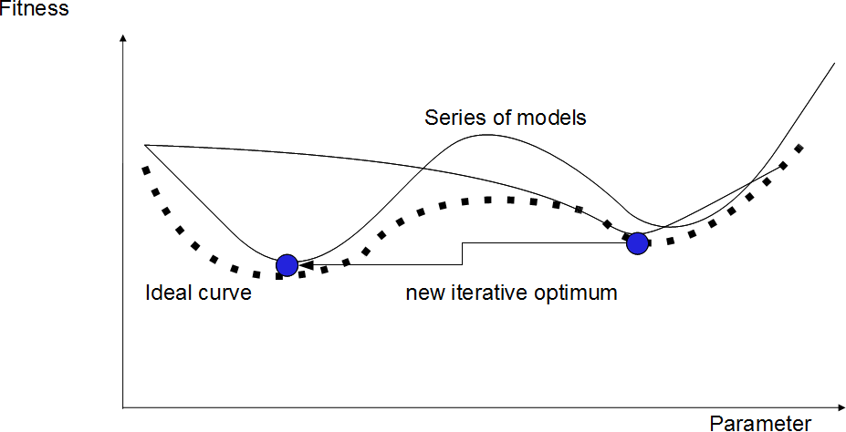
Classical Surrogate Technique
Illustration in 2 dimension

Slide 24
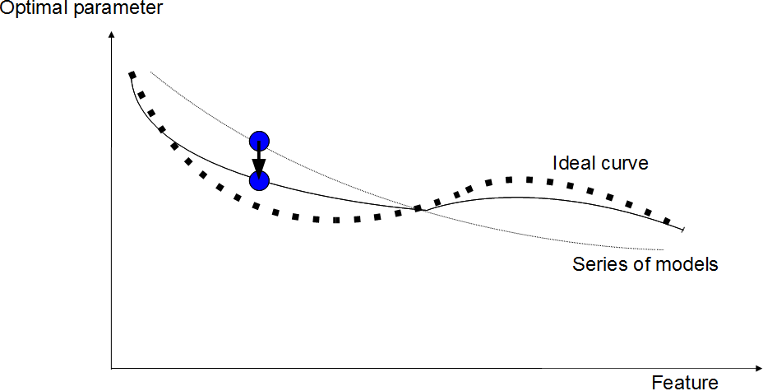
Feature-Parameter Mapping as a kind of Surrogate
2 dimensional illustration. The mapping can be used as a “kind of' surrogate model

Slide 25
Sources of Noise/Ambiguity
Instance-sampling
Optimization error: ideal values not known
Multiple optima
Weak features: multiple instances with the same feature-values

Slide 26
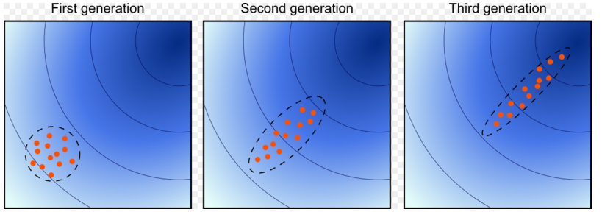
CMA-ES global optimization
Covariance Matrix Adaptation Evolutionary Strategy (Auger et. al. 2005)
Simple, robust optimization strategy, used for tuning instances
Estimates the natural gradient

Slide 27
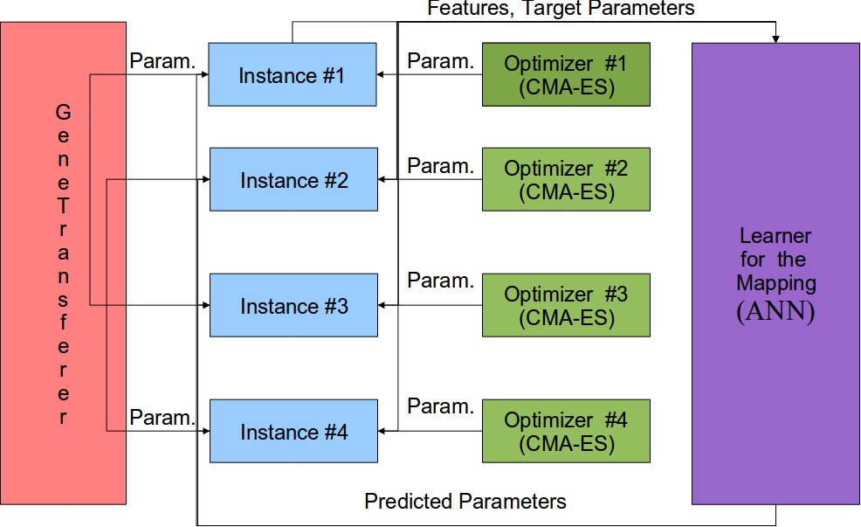
LaO Train Sketch

Slide 28
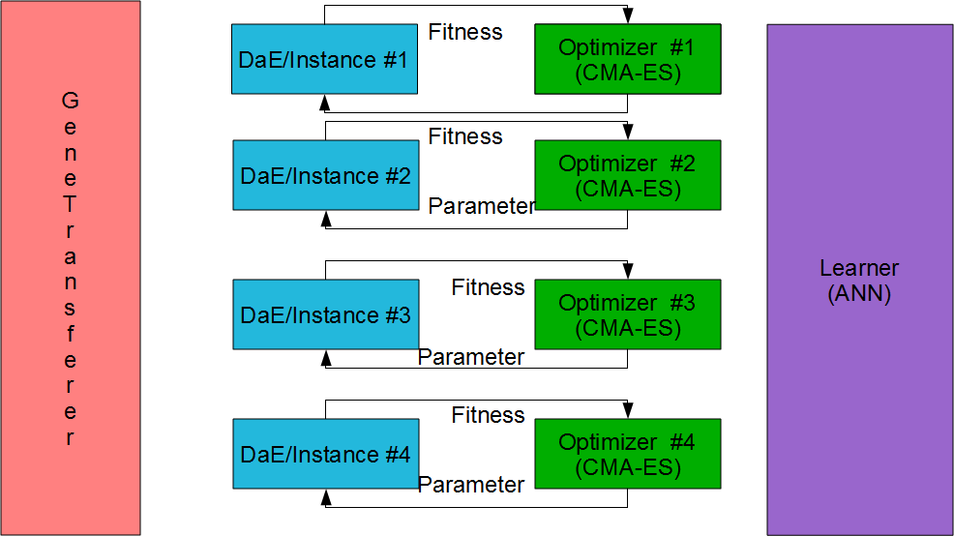
LaO Train: Optimizer (Static Tuning) Phase

Slide 29
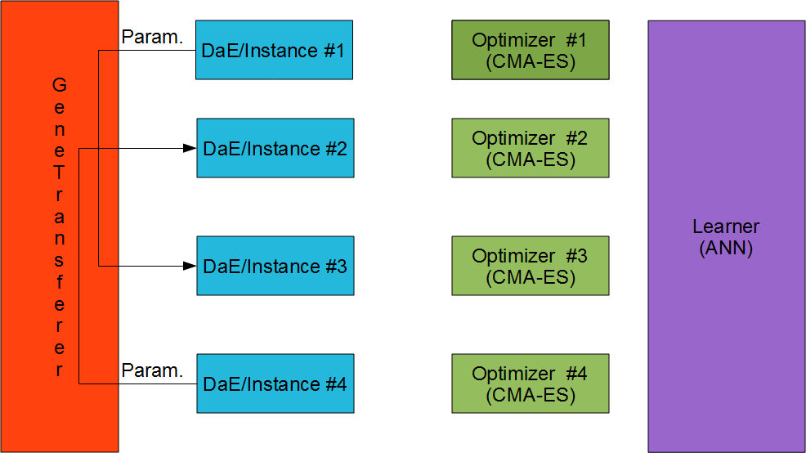
LaO Train: Gene-Transfer Phase

Slide 30
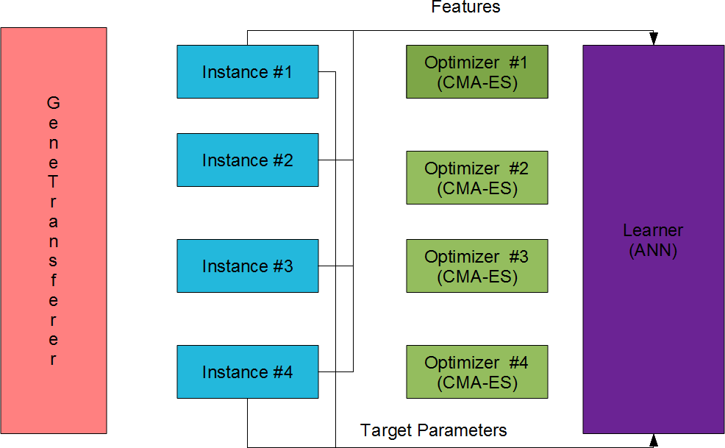
LaO Train: Learner-Train Phase

Slide 31
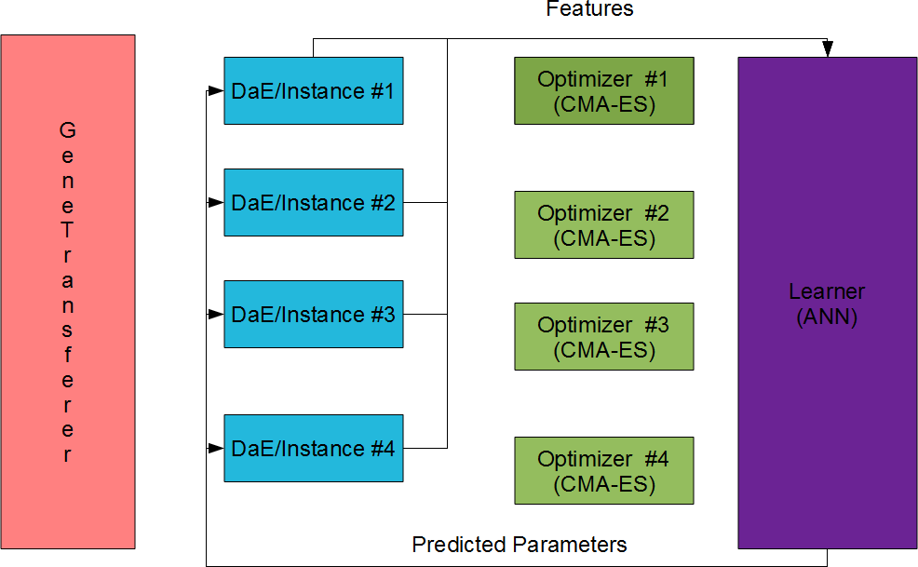
LaO Train: Learner-Hint Phase

Slide 32
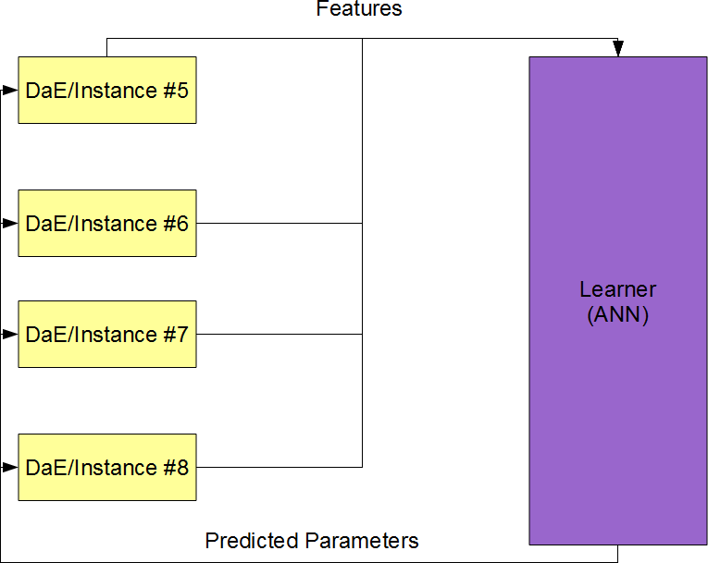
LaO Test: only Learner-Hint

Slide 33
Features
12 features:
  # fluents
  # goals
  # predicates
  # objects
  # types
  mutex-density=#mutexes/#fluent-pairs
  # lines in the domain-file
  # words in the domain-file
  # byte-count in the domain-file
  # lines in the instance-file
  # words in the instance-file
  # byte-count in the instance-file

Slide 34
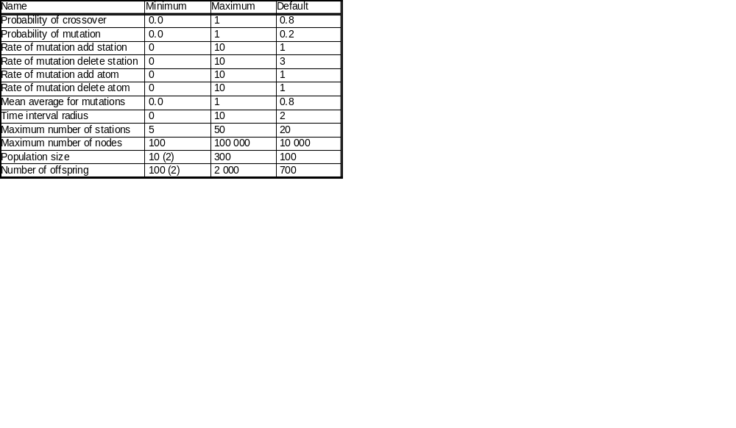
Parameters of DaE
Table 1: The two values in brackets (2) were changed for the domain Parking.

Slide 35
Artificial Neural Network Configuration
We use the Fast Artificial Neural Network Library (Nissen 2003)
12 input neurons, 12 output neurons, 12 interneurons (= # of inputs)
50 epochs per iterations in LaO
300 epochs train a posteriori
1 LaO iteration=5 CMA-ES+1 Genetransferer+1 ANN

Slide 36
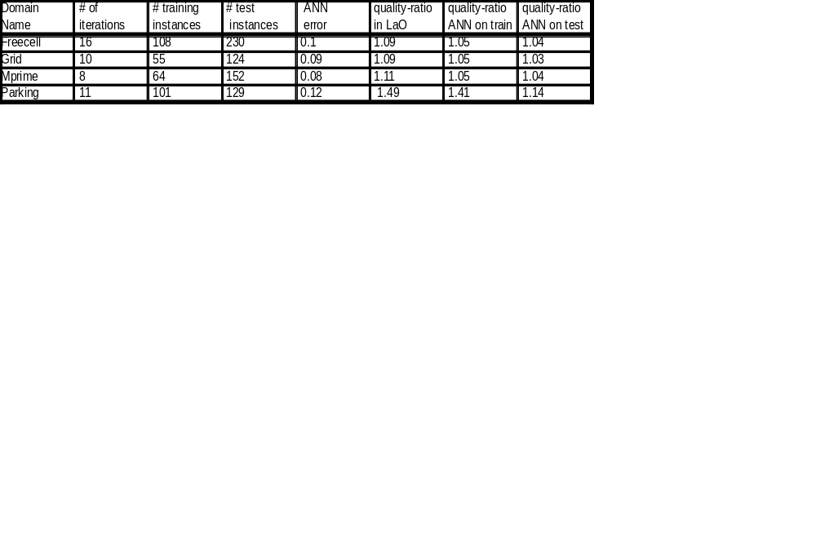
Domains
Table 2: Results by domains (only the actually usable training instances are shown). ANN-error is given as MSE, as returned by FANN. The quality-improvement ratio in Lao is that of the best parameter-set found by LaO. Quality-ratio=Fitness_{Default}/Fitness_{Tuned}

Slide 37
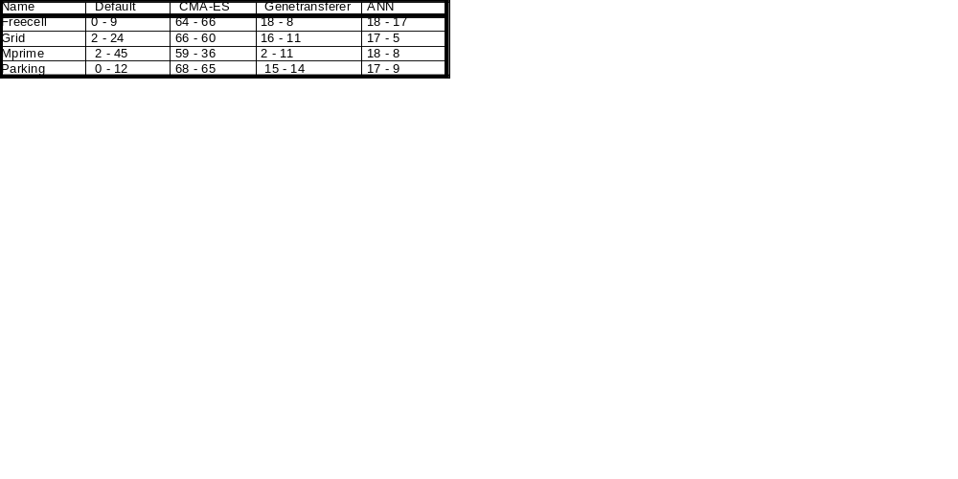
Contribution of algorithmic parts
Table 3: For each method (default, CMA-ES, Genetransferer or ANN), the percentage of instances on which this method gave the best parameter set. Each cell shows 2 figures: the first one considers all occurrences of a method, no matter if another method also lead an equivalent parameter set, as good as the first one. The second figures only considers the first method (from left to right) that discovered the best parameter-set.

Slide 38
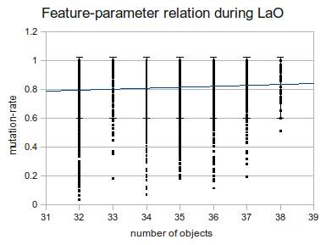
Feature-parameter relation in LaO

Slide 39
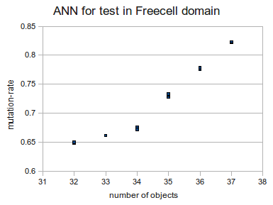
Model learned

Slide 40
Conclusions

Slide 41
Conclusions
Learning time was short (~10 iterations)
Learner (ANN) is not good enough, probably features are poor (see table 2)
Relation learned can be generalized well in the same domain for new instances (see table 2)
Learner as surrogate contributed well and Genetransferer also (See table 3)
Some gain in quality-ratio even with a few iterations achieved (see table 2)

Slide 42
Scope of our Algorithm
Our parameter tuning algorithm is a framework
It can be applied to any optimization method to be tuned, which has instances and some features can be extracted
CMA-ES can be replaced by any suitable optimization method
FANN can be replaced by any method capable of learning (a regression of) multidimensional functions

Slide 43
Ongoing and Future Work
Longer run (50-200 iterations, ongoing)
More sophisticated features (e.g. statistical (ongoing) and probing features)
Develop Genetransferer further (ongoing)
Use other optimizers and learners
Try to learn a single, domain independent model and test extra-domain generalization capabilities (ongoing)
Try EBM (indirect learning)

Slide 44
Thank You
Questions?

