Slide 1
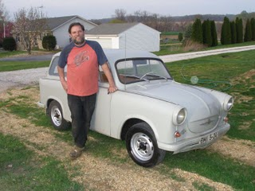
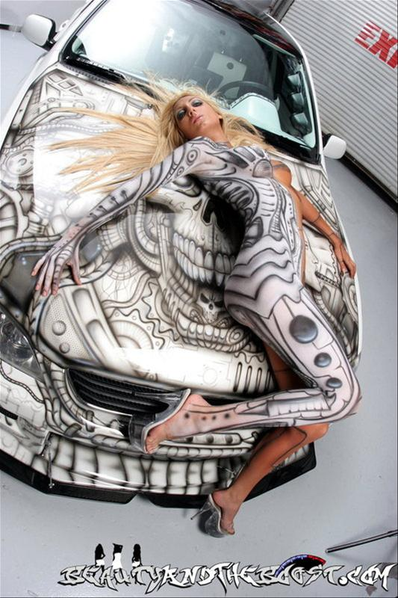
Tuning in a Nutshell:)

Slide 2
Problem Instance
Parameters
Solver
Fitness

Slide 3
Parameters
Parameter Tuning Algorithm
Target Algorithm (DaE)
Fitness Value (Makespan, Totalcost)

Slide 4
Instance #1
Tuning
Tuning
Instance #2
Tuning
Instance #3
Tuning
New Instance
?

Slide 5
Instance #1
Instance #2
Tuning
Trainset
Instance #3
New Instance
Parameters

Slide 6
Parameters
Learner
Instance #1
Tuning
Tuning
Instance #2
Tuning
Instance #3
Tuning
Parameters
New Instance
Parameters

Slide 7
Set of instances
Feature Extractor
Tuning
Optimal
parameters
in parameter
space
Features
in feature
space
Mapping to be learned
By the Learner

Slide 8
Set of instances
Feature Extractor
Solver
Feature
space
Mapping to be learned
Tuning
Fitness
Parameter
space

Slide 9
Fitness
noise
Optimal parameter
Parameter

Slide 10
Optimal parameter
Ideal curve
Series of models
Feature

Slide 11
Fitness
Series of models
Ideal curve
new iterative optimum
Parameter

Slide 12
Features, Target Parameters
G
e
n
e
T
r
a
n
s
f
e
r
e
r
Param.
Instance #1
Param.
Optimizer #1
Optimizer #1
(CMA-ES)
Learner
for the
Mapping
(ANN)
Instance #2
Param.
Optimizer #2
(CMA-ES)
Instance #3
Param.
Optimizer #3
(CMA-ES)
Param.
Instance #4
Param.
Optimizer #4
(CMA-ES)
Predicted Parameters

Slide 13
G
e
n
e
T
r
a
n
s
f
e
r
e
r
Fitness
DaE/Instance #1
Optimizer #1
Optimizer #1
(CMA-ES)
Learner
(ANN)
Fitness
DaE/Instance #2
Optimizer #2
(CMA-ES)
Parameter
DaE/Instance #3
Fitness
Optimizer #3
(CMA-ES)
Parameter
Fitness
DaE/Instance #4
Optimizer #4
(CMA-ES)
Parameter

Slide 14
G
e
n
e
T
r
a
n
s
f
e
r
e
r
Param.
DaE/Instance #1
Optimizer #1
Optimizer #1
(CMA-ES)
Learner
(ANN)
DaE/Instance #2
Optimizer #2
(CMA-ES)
DaE/Instance #3
Optimizer #3
(CMA-ES)
Param.
DaE/Instance #4
Optimizer #4
(CMA-ES)

Slide 15
Features
G
e
n
e
T
r
a
n
s
f
e
r
e
r
Instance #1
Optimizer #1
Optimizer #1
(CMA-ES)
Learner
(ANN)
Instance #2
Optimizer #2
(CMA-ES)
Instance #3
Optimizer #3
(CMA-ES)
Instance #4
Optimizer #4
(CMA-ES)
Target Parameters

Slide 16
Features
G
e
n
e
T
r
a
n
s
f
e
r
e
r
DaE/Instance #1
Optimizer #1
Optimizer #1
(CMA-ES)
Learner
(ANN)
DaE/Instance #2
Optimizer #2
(CMA-ES)
DaE/Instance #3
Optimizer #3
(CMA-ES)
DaE/Instance #4
Optimizer #4
(CMA-ES)
Predicted Parameters

Slide 17
Features
DaE/Instance #5
Learner
(ANN)
DaE/Instance #6
DaE/Instance #7
DaE/Instance #8
Predicted Parameters

