Slide 1
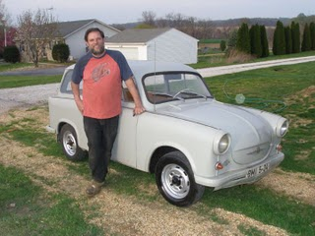
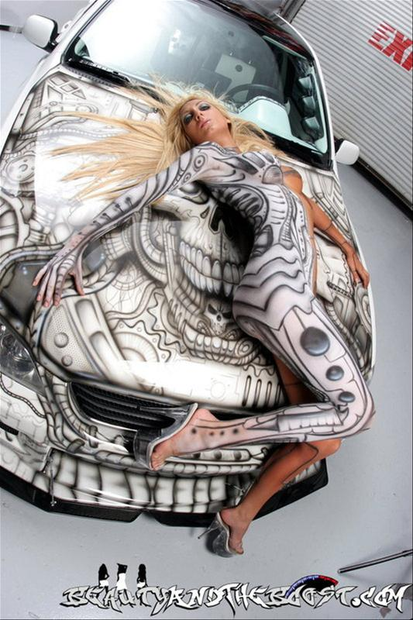
Tuning in a Nutshell:)

Slide 2
Parameters
Parameter Tuning Algorithm
Target Algorithm (DaE)
Fitness Value (Makespan, Totalcost)

Slide 3
Instance #1
Tuning
Tuning
Instance #2
Tuning
Instance #3
Tuning
New Instance
?

Slide 4
Instance #1
Instance #2
Tuning
Trainset
Instance #3
New Instance
Parameters

Slide 5
Parameters
Instance #1
Tuning
Tuning
Learner
Instance #2
Tuning
Instance #3
Tuning
Parameters
New Instance
Parameters

Slide 6
Set of instances
Feature Extractor
Tuning
Optimal
parameters
in parameter
space
Features
in feature
space
Mapping to be learned
By the Learner

Slide 7
Set of instances
Feature Extractor
Solver
Feature
space
Mapping to be learned
Tuning
Fitness
Parameter
space

Slide 8
Fitness
noise
Optimal parameter
Parameter

Slide 9
Optimal parameter
Ideal curve
Series of models
Feature

Slide 10
Fitness
Series of models
Ideal curve
new iterative optimum
Parameter

Slide 11
Features, Target Parameters
G
e
n
e
T
r
a
n
s
f
e
r
e
r
Param.
Instance #1
Param.
Optimizer #1
Optimizer #1
(CMA-ES)
Learner
for the
Mapping
(ANN)
Instance #2
Param.
Optimizer #2
(CMA-ES)
Instance #3
Param.
Optimizer #3
(CMA-ES)
Param.
Instance #4
Param.
Optimizer #4
(CMA-ES)
Predicted Parameters

Slide 12
G
e
n
e
T
r
a
n
s
f
e
r
e
r
Fitness
DaE/Instance #1
Optimizer #1
Optimizer #1
(CMA-ES)
Learner
(ANN)
Fitness
DaE/Instance #2
Optimizer #2
(CMA-ES)
Parameter
DaE/Instance #3
Fitness
Optimizer #3
(CMA-ES)
Parameter
Fitness
DaE/Instance #4
Optimizer #4
(CMA-ES)
Parameter

Slide 13
G
e
n
e
T
r
a
n
s
f
e
r
e
r
Param.
DaE/Instance #1
Optimizer #1
Optimizer #1
(CMA-ES)
Learner
(ANN)
DaE/Instance #2
Optimizer #2
(CMA-ES)
DaE/Instance #3
Optimizer #3
(CMA-ES)
Param.
DaE/Instance #4
Optimizer #4
(CMA-ES)

Slide 14
Features
G
e
n
e
T
r
a
n
s
f
e
r
e
r
Instance #1
Optimizer #1
Optimizer #1
(CMA-ES)
Learner
(ANN)
Instance #2
Optimizer #2
(CMA-ES)
Instance #3
Optimizer #3
(CMA-ES)
Instance #4
Optimizer #4
(CMA-ES)
Target Parameters

Slide 15
Features
G
e
n
e
T
r
a
n
s
f
e
r
e
r
DaE/Instance #1
Optimizer #1
Optimizer #1
(CMA-ES)
Learner
(ANN)
DaE/Instance #2
Optimizer #2
(CMA-ES)
DaE/Instance #3
Optimizer #3
(CMA-ES)
DaE/Instance #4
Optimizer #4
(CMA-ES)
Predicted Parameters

Slide 16
Features
DaE/Instance #5
Learner
(ANN)
DaE/Instance #6
DaE/Instance #7
DaE/Instance #8
Predicted Parameters

