Slide 1
Instance-Based Parameter Tuning for Evolutionary AI Planning
Presentation of my work
done in TAO/INRIA
since April 2010
Matthias Brendel
TAO seminar, 2011.06.06.

Slide 2
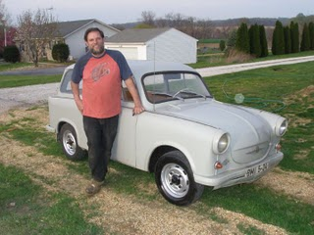
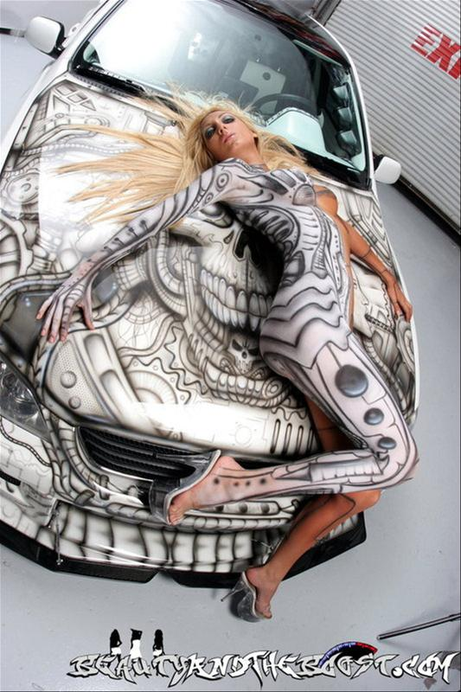
Tuning in a Nutshell:)

Slide 3
Previous Research Areas
Cellular Neural Networks
Image Processing
Content Based Image Retrieval (Data-mining)
Emotion-recognition from speech (audio)

Slide 4
Agenda
Artificial Intelligence Planning
The Divide and Evolve method
Parameter Tuning in General
Our Learn and Optimize method (my work)
Conclusions

Slide 5
Artificial Intelligence Planning

Slide 6
AI Planning problem
AI Planning problem
Input : <A, O, I, G>
Input : <A, O, I, G>
Domain:
A: set of atoms, O: set of actions
Instance:
I: initial state, G: Goal state
Output : Optimal Plan
Ordered set of actions: when executed in state I, leads to a state where G is satisfied
Quality :
Classic problems (aka STRIPS): Number of actions
Actions with cost: Total cost
Temporal planning: makespan (total duration)
actions can be run in parallel

Slide 7
PDDL representation model
    Developed for the International Planning Competition (IPC) series
    Allows to compare different planners on given benchmarks problems
Example
Domain: Mystic_puzzle
(define (domain MYSTIC_PUZZLE)‏
(:types position tile)‏
(:predicates (at ?tile - tile ?position - position)‏
(neighbor ?p1 - position ?p2 - position)
(empty ?position – position))
(:action move
:parameters (?tile - tile ?from ?to - position)‏
:precondition (and (neighbor ?from ?to)‏
(at ?tile ?from)‏
(empty ?to))‏
:effect (and (at ?tile ?to)
(empty ?from)
(not (at ?tile ?from))
(not (empty ?to))))
)‏‏
1
2
3
4
5
6
7
8
Notes:
Pas de symboles de fonctions. A ensemble d’atomes, I état initial, O ensemble d’opérateurs, G état final

Slide 8
3x3 Mystic Puzzle
Instance
(define (problem MYSTIC_PUZZLE-3x3)‏
(:domain MYSTIC_PUZZLE)‏
(:objects
p_1_1 p_1_2 p_1_3 p_2_1 p_2_2 p_2_3 p_3_1 p_3_2 p_3_3 - position
t_1 t_2 t_3 t_4 t_5 t_6 t_7 t_8 - tile)‏
(:init
(neighbor p_1_1 p_1_2) (neighbor p_1_2 p_1_1) (neighbor p_1_2 p_1_3)‏
(neighbor p_1_3 p_1_2) (neighbor p_2_1 p_2_2) (neighbor p_2_2 p_2_1)‏
(neighbor p_2_2 p_2_3) (neighbor p_2_3 p_2_2) (neighbor p_3_1 p_3_2)‏
(neighbor p_3_2 p_3_1) (neighbor p_3_2 p_3_3) (neighbor p_3_3 p_3_2)‏
(neighbor p_1_1 p_2_1) (neighbor p_2_1 p_1_1) (neighbor p_1_2 p_2_2)‏
(neighbor p_2_2 p_1_2) (neighbor p_1_3 p_2_3) (neighbor p_2_3 p_1_3)‏
(neighbor p_2_1 p_3_1) (neighbor p_3_1 p_2_1) (neighbor p_2_2 p_3_2)‏
(neighbor p_3_2 p_2_2) (neighbor p_2_3 p_3_3) (neighbor p_3_3 p_2_3)
‏ (at t_4 p_1_1)‏ (empty p_1_2)‏ (at t_8 p_1_3)‏ (at t_6 p_2_1)‏ (at t_3 p_2_2)‏
(at t_2 p_2_3)‏ (at t_1 p_3_1)‏ (at t_5 p_3_2)‏ (at t_7 p_3_3))‏
(:goal
(at t_1 p_1_1)‏ (at t_2 p_1_2)‏ (at t_3 p_1_3)‏ (at t_4 p_2_1)‏ (at t_5 p_2_2)
(at t_6 p_2_3)‏ (at t_7 p_3_1)‏ (at t_8 p_3_2)‏)
4
8
6
3
2
1
5
7
1
2
3
4
5
6
7
8
Notes:
Pas de symboles de fonctions. A ensemble d’atomes, I état initial, O ensemble d’opérateurs, G état final

Slide 9
Divide-and-Evolve

Slide 10
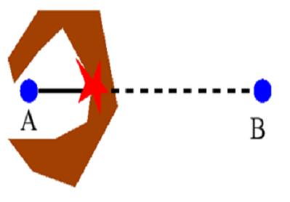
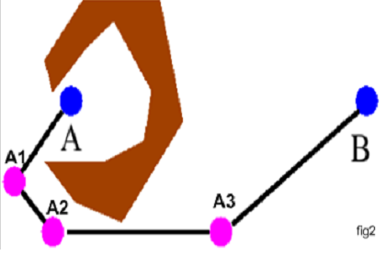
Divide-and-Evolve
Motivation
    Given a 'local' ('weak' or 'greedy') algorithm
    Solve problem this local algorithm cannot solve
    Improve quality of solutions of the weak/greedy algorithm
Rationale: evolutionary sequential Divide-and-Conquer
Local algorithm can solve the sequence of easy problems
Local algorithm fails

Slide 11

Application to AI planning
Problem
<A, O, I, G> = PD(I,G)
Representation
Ordered list of partial states
S₀=I, S₁, ..., S_{n}, S_{n+1}=G
Evaluation
Solve consecutive sub-problems PD(S_{k},S_{k+1}), kϵ[0,n]
with 'greedy' planner CPT or 'weak' planner YAHSP
Fitness
        All problems solved: sum of plan qualities
        Fails solving PD(S_{l}, S_{l+1}): penalty + “dist”(S_{l},G)

Slide 12
Schema of the Evolutionary Algorithm
Initialisation
Best individual
Evaluation
Parents
Stop?
Selection
Replacement
1 generation
Genitors
Evaluation
Offspring
Crossover,
Mutation,...
Stochastic operators
“Darwinism” (stochastic or deterministic)
Main computational cost

Slide 13
Parameter Tuning

Slide 14
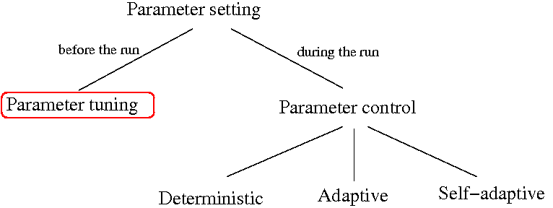
Taxonomy of Parameter Setting

Slide 15
Refining the Taxonomy
Static
Non-static

Slide 16
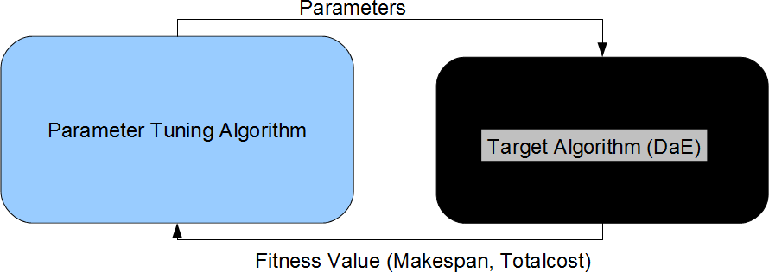
Static Parameter Tuning Scenario
In static parameter tuning the result is one, fixed optimal parameter-set per instance or per training set.

Slide 17
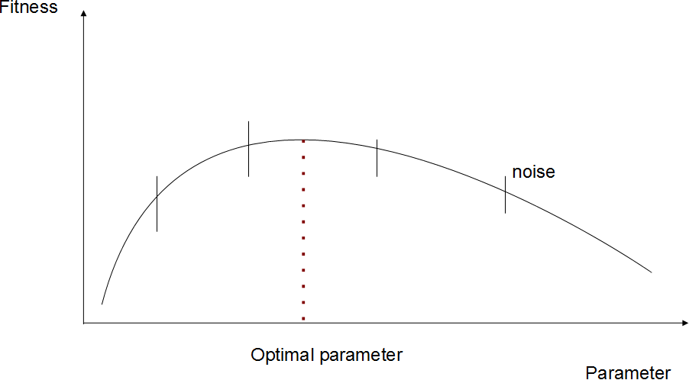
Static Parameter Tuning is actually “simple” Global Optimization

Slide 18
Static Tuning: State of the Art
REVAC: Relevance Estimation and VAlue Calibration, Evolutionary Algorithm based distribution-estimation
ParamILS: Iterative Local Search
SPO: Sequential Parameter Optimization, Gaussian process based regression as a surrogate model
Racing: aims at reducing the number of evaluations for a stochastic target-algorithm based on statistical tests

Slide 19
Drawbacks of Static Tuning
There are many instances and domains
  Either separate tuning per instances
  Or a single (suboptimal) average-like parameter-set for many instances
Intra-domain generalization: extrapolating from tuned instances to new ones is not really possible
Extra-domain generalization: extrapolating from one domain to another is not really possible

Slide 20
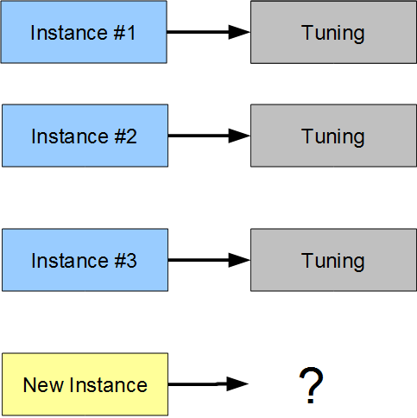
Per Instance Static Tuning

Slide 21
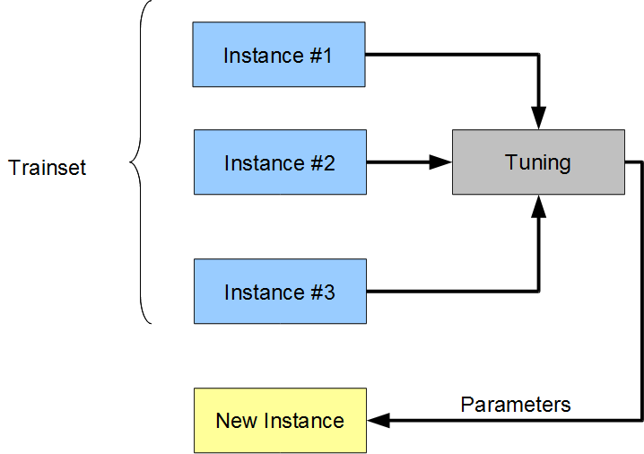
Per Trainset Tuning

Slide 22
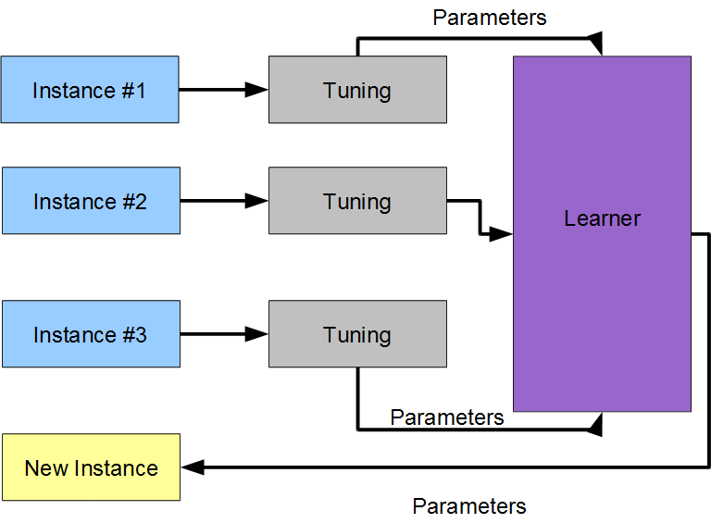
Adding Learning (sketchy)

Slide 23
Non-static Tuning: State of the Art
Performance Prediction and Automated Tuning (Hutter et. al. 2006)
Only for the SAT domain
We would like to generalize this approach

Slide 24
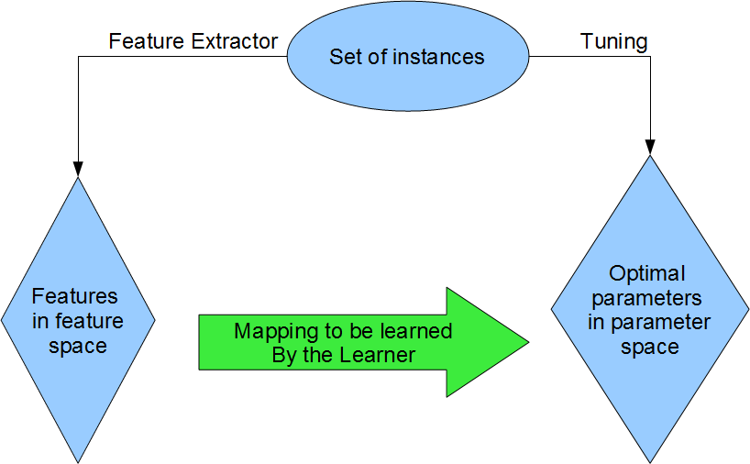
Solution of opting for generalization

Slide 25
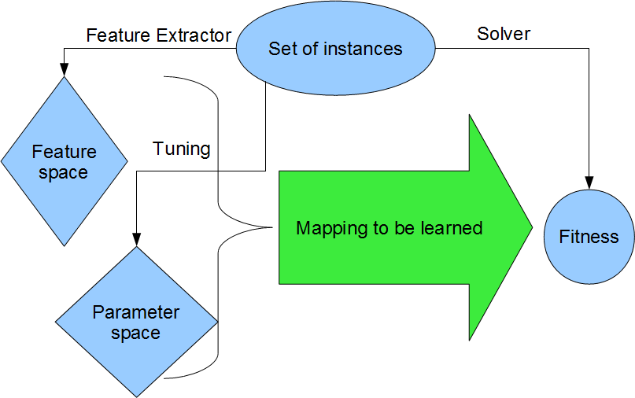
Indirect learning as in Hutter et. al.
Mapping has to be “solved” when using.

Slide 26
Our Learn-and-Optimize Method

Slide 27
The Benefits of Learning
Ability to generalize for new instances in the domain: intra-domain generalization
Ability to generalize for new domains: inter-domain generalization
Computing features and evaluating a model for a new instance is quick
Model can be used as a surrogate-like technique, thus furthering optimization

Slide 28
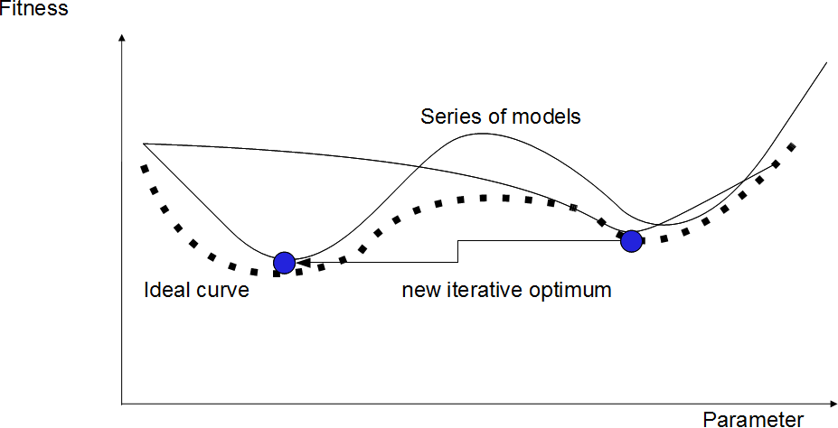
Classical Surrogate Technique
Illustration in 2 dimension

Slide 29
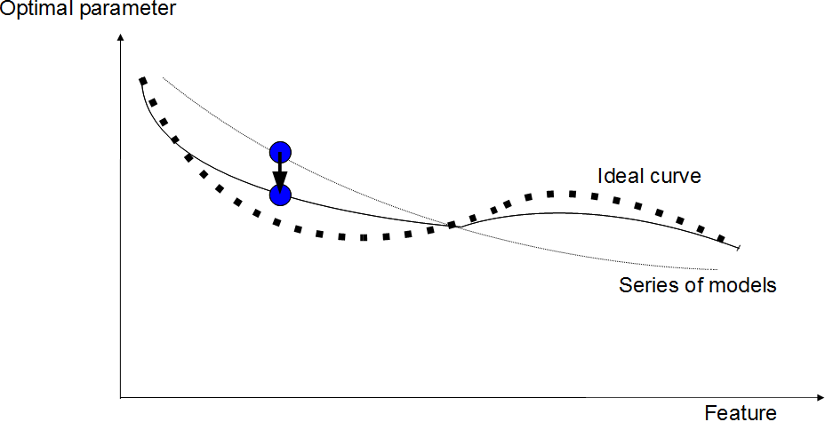
Feature-Parameter Mapping
2 dimensional illustration. The mapping can be used as a “kind of' surrogate model

Slide 30
Sources of Noise/Ambiguity
Instance-sampling
Optimization error: ideal values not known
Multiple optima
Weak features: multiple instances with the same feature-values

Slide 31
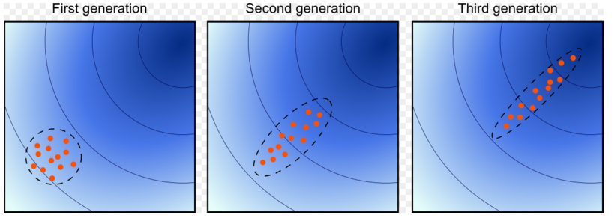
CMA-ES global optimization
Covariance Matrix Adaptation Evolutionary Strategy (Auger et. al. 2005)
Simple, robust optimization strategy, used for tuning instances
Estimates the natural gradient

Slide 32
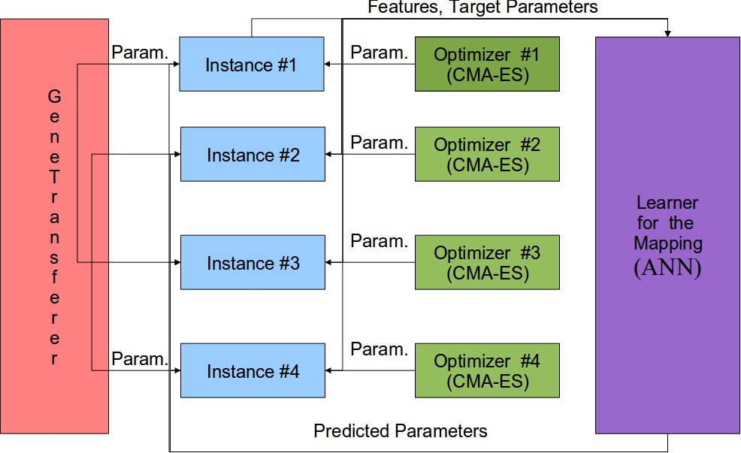
LaO Train Overview

Slide 33
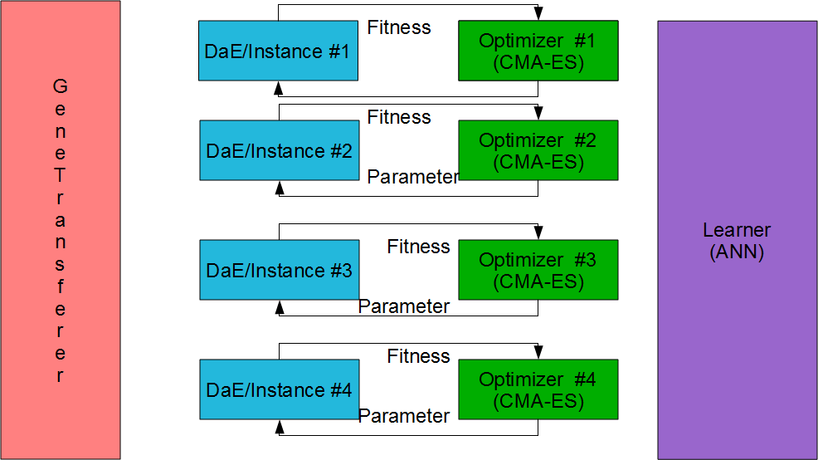
LaO Train: Optimizer (Static Tuning) Phase

Slide 34
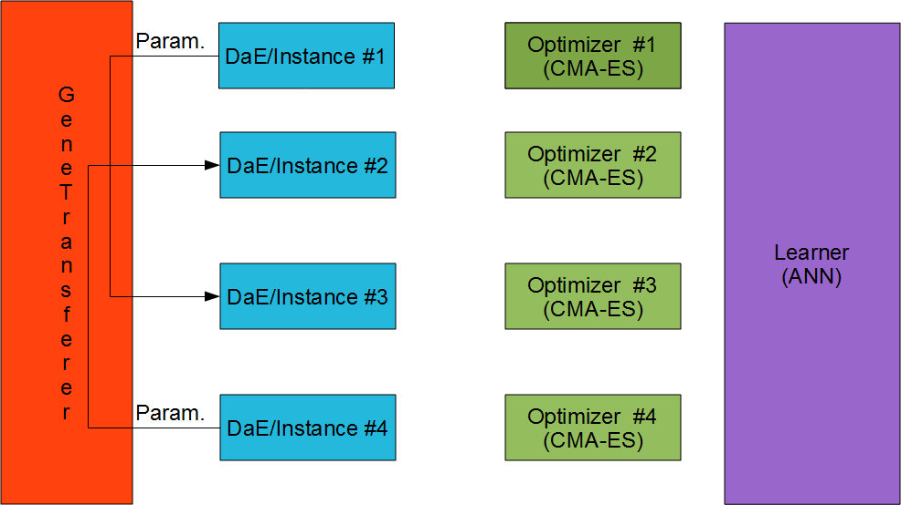
LaO Train: Gene-Transfer Phase

Slide 35
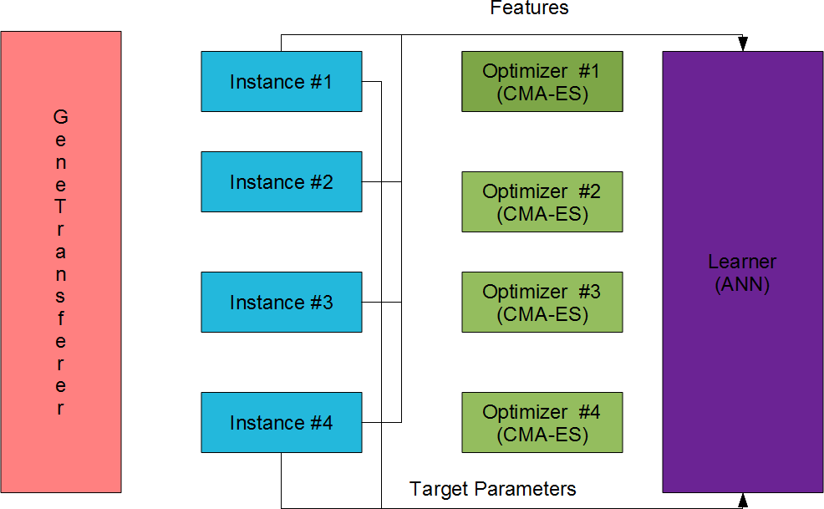
LaO Train: Learner-Train Phase

Slide 36
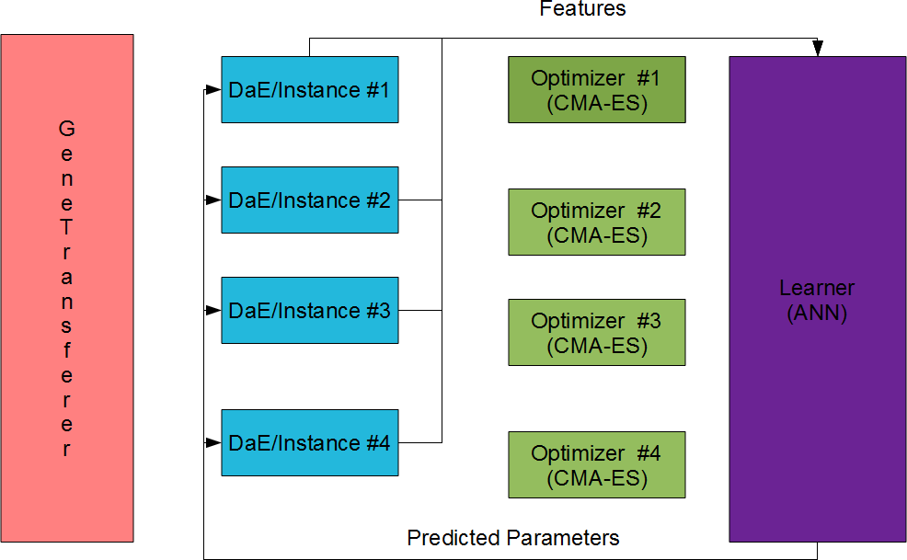
LaO Train: Learner-Hint Phase

Slide 37
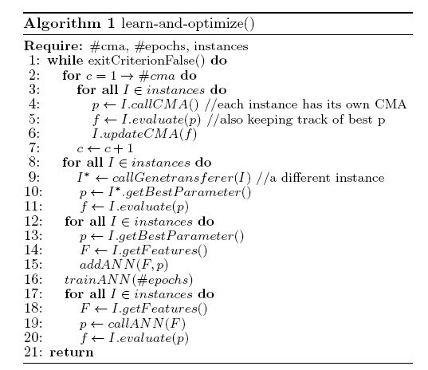
Learn-and-Optimize Algorithm Train

Slide 38
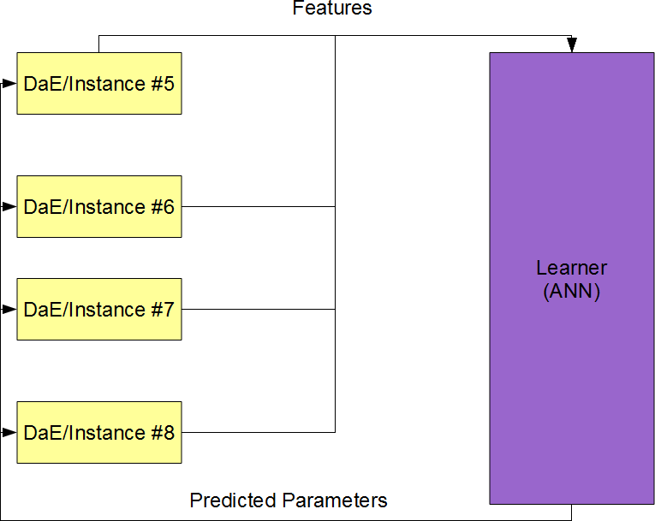
LaO Test: only Learner-Hint

Slide 39
Features
12 features:
  # fluents
  # goals
  # predicates
  # objects
  # types
  mutex-density=#mutexes/#fluent-pairs
  # lines in the domain-file
  # words in the domain-file
  # byte-count in the domain-file
  # lines in the instance-file
  # words in the instance-file
  # byte-count in the instance-file

Slide 40
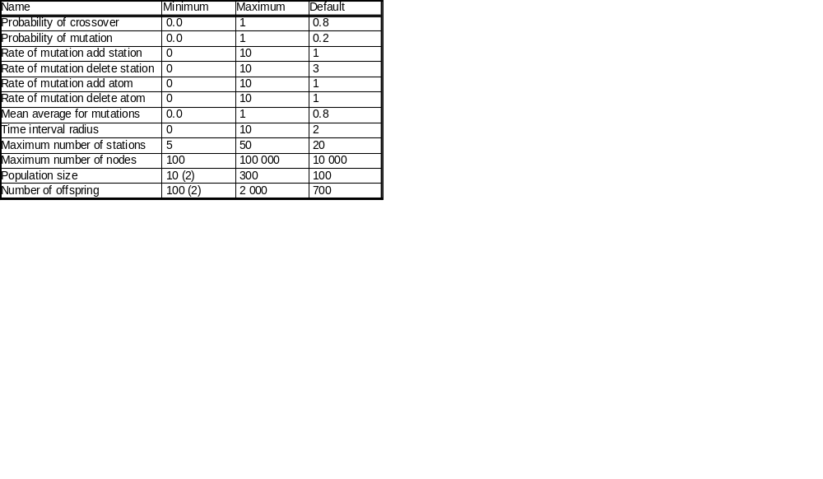
Parameters of DaE
Table 1: The two values in brackets (2) were changed for the domain Parking.

Slide 41
Artificial Neural Network Configuration
We use the Fast Artificial Neural Network Library (Nissen 2003)
12 input neurons, 12 output neurons, 12 interneurons (= # of inputs)
50 epochs per iterations in LaO
300 epochs train a posteriori
1 LaO iteration=5 CMA-ES+1 Genetransferer+1 ANN

Slide 42
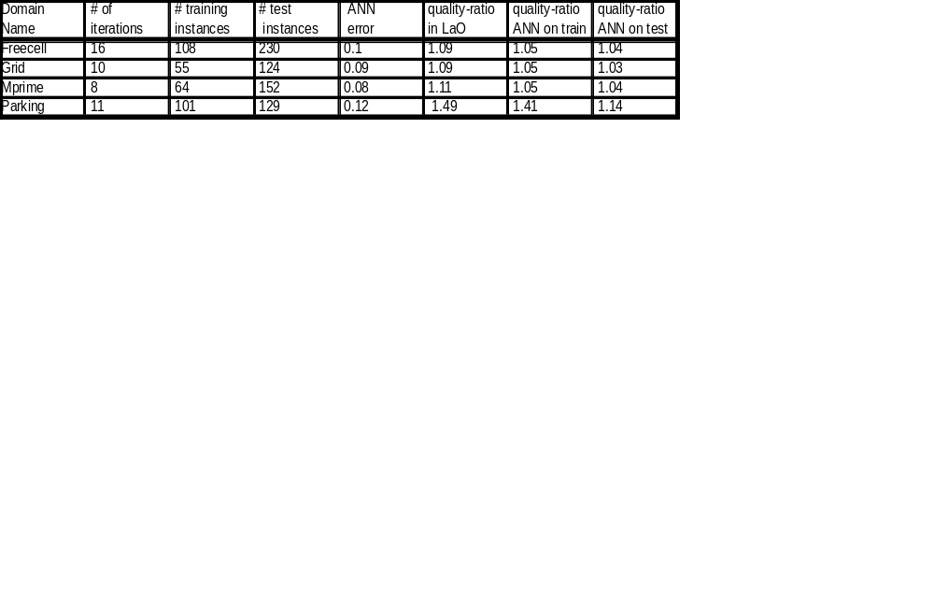
Domains
Table 2: Results by domains (only the actually usable training instances are shown). ANN-error is given as MSE, as returned by FANN. The quality-improvement ratio in Lao is that of the best parameter-set found by LaO. Quality-ratio=Fitness_{Default}/Fitness_{Tuned}

Slide 43
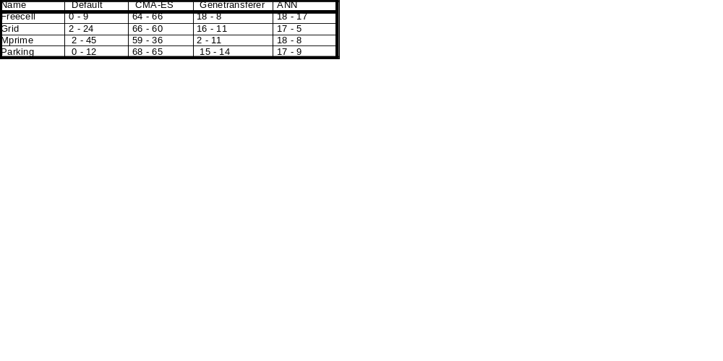
Contribution of algorithmic parts
Table 3: For each method (default, CMA-ES, Genetransferer or ANN), the percentage of instances on which this method gave the best parameter set. Each cell shows 2 figures: the first one considers all occurrences of a method, no matter if another method also lead an equivalent parameter set, as good as the first one. The second figures only considers the first method (from left to right) that discovered the best parameter-set.

Slide 44
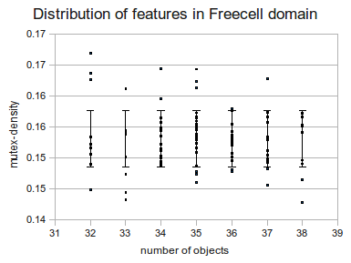
Distribution of the feature-values

Slide 45
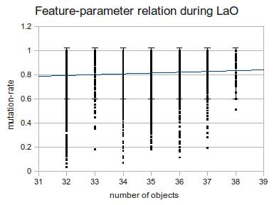
Feature-parameter relation in LaO

Slide 46
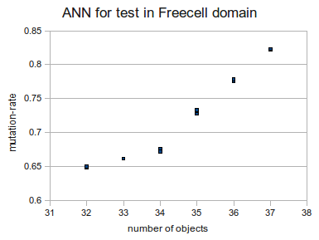
Model learned

Slide 47
Conclusions

Slide 48
Conclusions
Learning time was short (~10 iterations)
Learner (ANN) is not good enough, probably features are poor (see table 2)
Relation learned can be generalized well in the same domain for new instances (see table 2)
Learner as surrogate contributed well and Genetransferer also (See table 3)
Some gain in quality-ratio even with a few iterations achieved (see table 2)

Slide 49
Scope of our Algorithm
Our parameter tuning algorithm is a framework
It can be applied to any optimization method to be tuned, which has instances and some features can be extracted
CMA-ES can be replaced by any suitable optimization method
FANN can be replaced by any method capable of learning (a regression of) multidimensional functions

Slide 50
Ongoing and Future Work
Longer run (50-200 iterations, ongoing)
More sophisticated features (e.g. statistical (ongoing) and probing features)
Develop Genetransferer further (ongoing)
Use other optimizers and learners
Try to learn a single, domain independent model and test extra-domain generalization capabilities (ongoing)
Try indirect learning

Slide 51
Accepted Papers
ICQPS 2011, Freiburg, main conference on AI Planning
GECCO 2011, Dublin, main conference for Evolutionary Computing

Slide 52
Thank You
Questions?

