Slide 1



Pareto-based
Multi-Objective AI Planning
Mostepha Khouadjia, Marc Schoenauer, Vincent Vidal, Johann Dréo, Pierre Savéant
INRIA Saclay
ONERA, Toulouse
Thalès R&D, Palaiseau
EvoPS wkp@ICAPS 2013
DESCARWIN
Notes:
Tao team

Slide 2
Agenda
Multi-Objective Optimization
Multi-Objective AI Planning
Divide-and-Evolve (DaE)
Experiments
Conclusions

Slide 3
Agenda
Multi-Objective Optimization
Multi-Objective AI Planning
Divide-and-Evolve (DaE)
Experiments
Conclusions

Slide 4
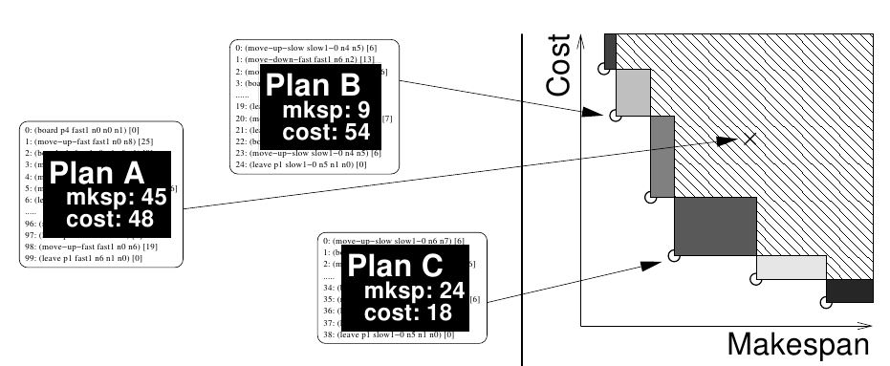
Multi-Objective Optimization
Real-world problems are multi-objective:
  Quality/cost, makespan/cost, ...
  No single solution, but a set of trade-offs
Design space: solution plans
Objective space: plan qualities

Slide 5
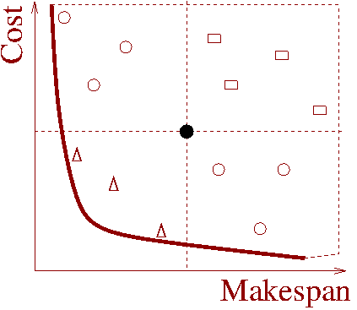


Multi-Objective Optimization
Pareto-dominance:
  A dominates B is A is better than B on all objectives
  The set of non-dominated points in objective space is called Pareto front(ier)
dominates
is dominated by
is not comparable with

Slide 6
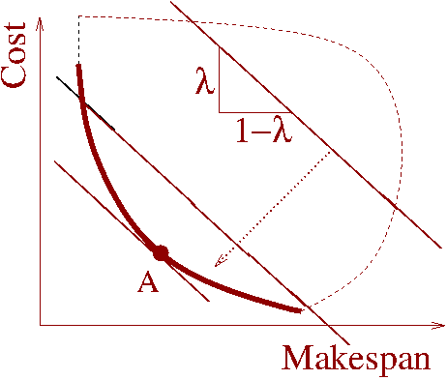
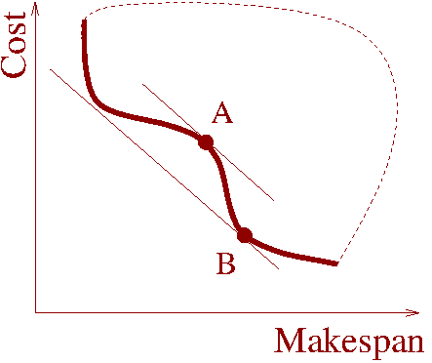
Non-Pareto approaches
Aggregation of objectives
minimize λ makespan + (1-λ) cost, λ Є [0,1]
→ single objective optimization
Fails on concave parts of Pareto Front

Slide 7
Evolutionary Algorithms
Stochastic Optimization Algorithms
  Population-based – distribution based
  Very flexible
    Any search space (with proper variation operators)
    Any objective/constrts (very weak hypotheses)
  Very costly
Empirical successes
  The second best method for any problem
  The method of choice when everything else has failed

Slide 8
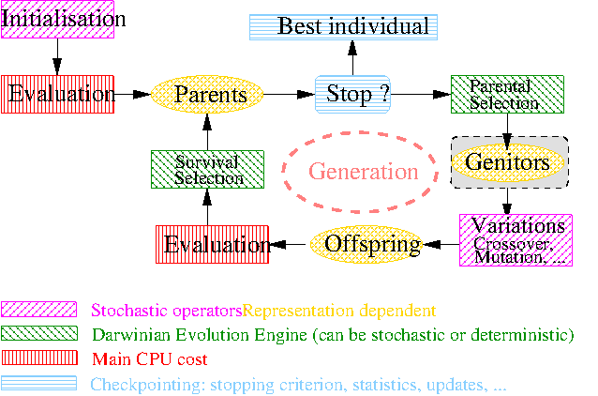
Evolutionary Algorithms

Slide 9
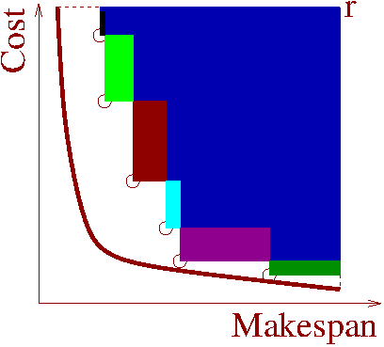
Evolutionary Multi-Objective Optimization
Use Pareto-based selection
  Pareto-ranking + diversity preserving
  e.g., NSGA2, SPEA2, ...
  Hypervolume contribution,
  IBEAH [Zitzler & Künzli 2004],
+ archive all non-dominated points

Slide 10
Agenda
Multi-Objective Optimization
Multi-Objective AI Planning
Divide-and-Evolve (DaE)
Experiments
Conclusions

Slide 11
AI Planning & Benchmarks
Biennal IPC (International Planning Competition)
  Since 1998 (7th in 20...11)
  Drive for PDDL design/improvements
  Endless source of benchmarks
Lots of exact or satisficing single-objective planners
Either cost-based (purely sequential)
or temporal (actions can be run in parallel)

Slide 12
Multi-objective AI Planning
PDDL 3.0 (2006) allows for several objectives
But existing strategies/heuristics are not Pareto-compliant
→ aggregation of objectives
A multi-objective track in IPC 5 and IPC 6
… not in IPC 7
+ recent approach [Sroka & Long, STAIRS 2012]
using LPG [Gerevini et al., AI 08]

Slide 13
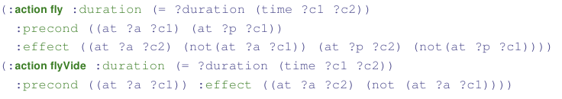
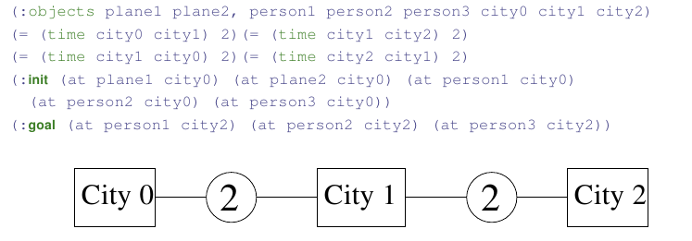
MiniZeno Benchmark (best makespan 8)
Domain: unique predicate at
Instance: 3 cities, 2 planes, 3 passengers

Slide 14
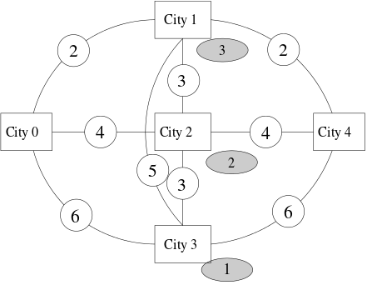
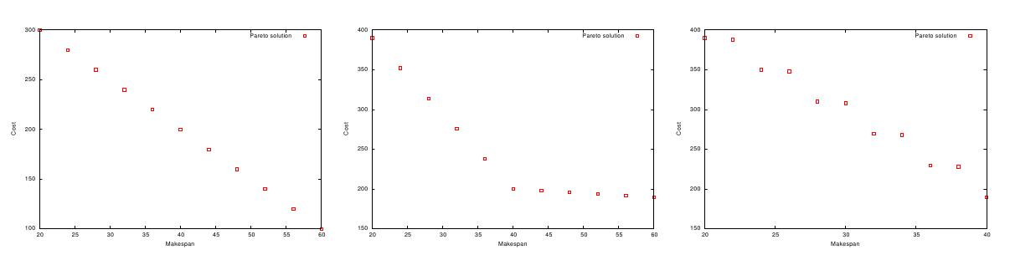
Multi-Objective MiniZeno Benchmark
2 planes to bring 3 persons
from city0 to city 4
Two problems
  Cost: additive
  (tax at every landing)
  Risk: max
  (only highest value matters)
Pareto fronts for 6 passengers and varying cost/durations values

Slide 15
Multi-objectivization of IPC7 benchmarks
From sequential satisficing and temporal satisficing tracks at IPC7
  Merge identical instances of same domains if makespan and cost are contradictory (Elevators)
  Set cost = Cst – makespan if not (CrewPlanning, FloorTile, ParcPrinter)
  Add single cost action to temporal domain (OpenStacks)

Slide 16
Agenda
Multi-Objective Optimization
Multi-Objective AI Planning
Divide-and-Evolve (DaE)
Experiments
Conclusions

Slide 17
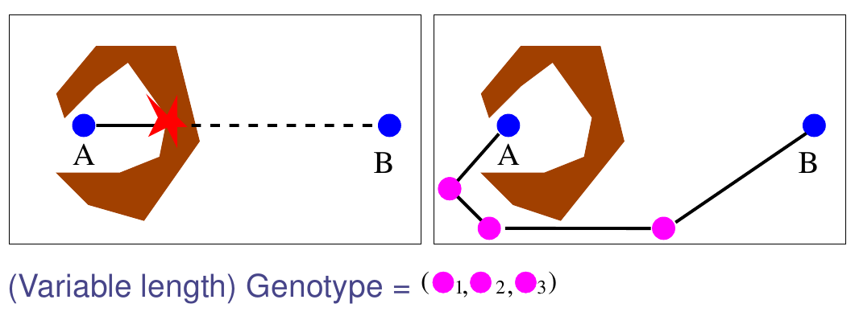
DaE: the Paradigm
Slicing the original problem into a series of (hopefully simpler) sub-problems
Using a 'dumb' solver on each sub-problem

Slide 18
DaE-YAHSP
Problem
<S, A, I, G> = PD(I,G)
Representation
Ordered list of (partial) states S₀= I, S₁, ..., S_{n}, S_{n+1}= G
Evaluation
Solve consecutive sub-problems PD(S_{k},S_{k+1})/ kϵ[0,n]
with embedded single-objective planner YAHSP [Vidal, ICAPS 04]
Fitness
All problems solved: concatenate partial plans
Fails solving PD(S_{l}, S_{l+1}): Penalization
Crossover: One-point crossover
Mutations : AddGoal, delGoal, addAtom, delAtom

Slide 19
Single-objective DAE-YAHSP
An original (intricate) memetization strategy
A very noisy fitness
but
YAHSP is both cost- and temporal planner
DAE-YAHSP: state-of-the-art performance in both domains [Bibai et al., ICAPS 2010]
Silver medal, Humies Awards 2010
Ranked 1st, temporal satisficing, IPC 2011

Slide 20
Multi-objective DAE-YAHSP
YAHSP is both cost- and temporal planner
… can compute one while optimizing the other
« Only » need to change the EC engine !
[Schoenauer, Saveant, Vidal, EvoCOP'06]
Two possible strategies for YAHSP:
Optimize makespan or cost/risk

Slide 21
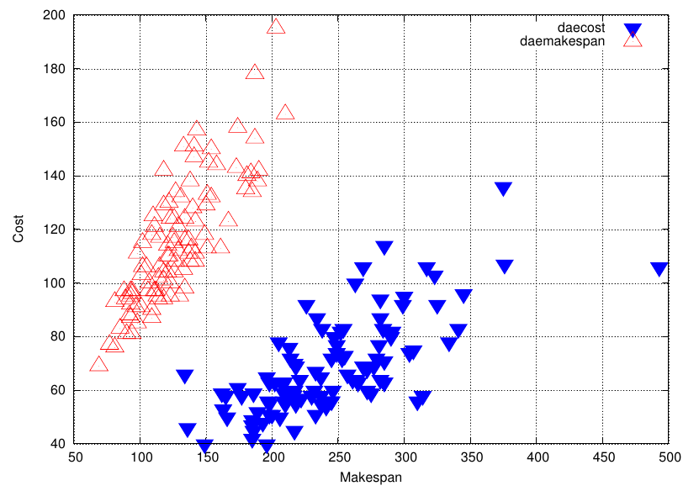
YAHSP strategy
Optimize cost or makespan?
→ randomize, and use weights (individual level)
Weight-makespan=1
Weight-cost=0
Weight-makespan=0
Weight-cost=1
Noisy fitness : objectives of a single individual computed by YAHSP with both pure strategies

Slide 22
Contributions
The MiniZeno benchmark suite [EMO'13]
  And the multi-objecvivization of some IPC7 problems
IBEA best MO engine for MO-DAE [EMO'13]
Parameter tuning: which fitness measure for the λ-runs? [LION'13]
Comparison with aggregated approaches :
  AGG-DAE [EvoCOP'13]
  LPG [IJCAI'13]

Slide 23
Agenda
Multi-Objective Optimization
Multi-Objective AI Planning
Divide-and-Evolve (DaE)
Experiments
Conclusions

Slide 24
Aggregated Approaches
Metric-sensitive planners directly optimize
λ makespan + (1-λ) cost, λ Є [0,1]
  E.g. LPG [Gerevini et al., AI'08]
YAHSP is not metric sensitive
  but DAE is agnostic
Repeated calls with different values of λ to approximate the whole Pareto front
→ Comparison of MO-DAE with both
AGG-DAE and LPG

Slide 25
Experimental Conditions
EC engine IBEA-Hv [EMO'13]
Aggregation λ = {0, 0.3, 0.5, 0.7, 1}
Implementation ParadisEO, C++
Instances
  MiniZeno3, MiniZeno6, MiniZeno9
  Multi-objectivization of IPC7 instances
11 independent runs (also for each λ)
Stopping criterion
  ParamILS 48h (zeno3 and 6), 72h (zeno9, IPC7)
  Optimization 300, 600 and 900s

Slide 26

Off-line Parameter Tuning
Parameters ranges/discretization
ParamILS,
Irace,
...
Tuner
Target
Algorithm
Solves
Problem
instances
Calls with different
parameter settings
Returns solution quality (here hypervolume)
UBC ParamILS [Hutter et al., JAIR 2009]

Slide 27
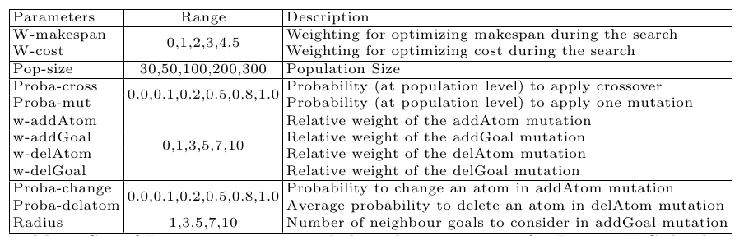
The Parameters
→ 1.5 * 10⁹ Possible configurations

Slide 28
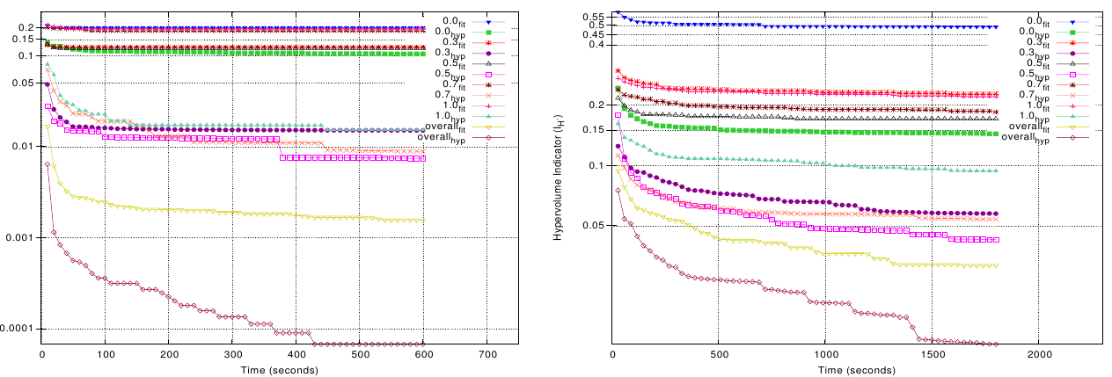
Metric for Parameter Tuning
Hypervolume for MO runs
Which metric for each of the λ-runs?
  Hypervolume better choice than (aggregated) fitness [LION'13]
Zeno6 Zeno9

Slide 29
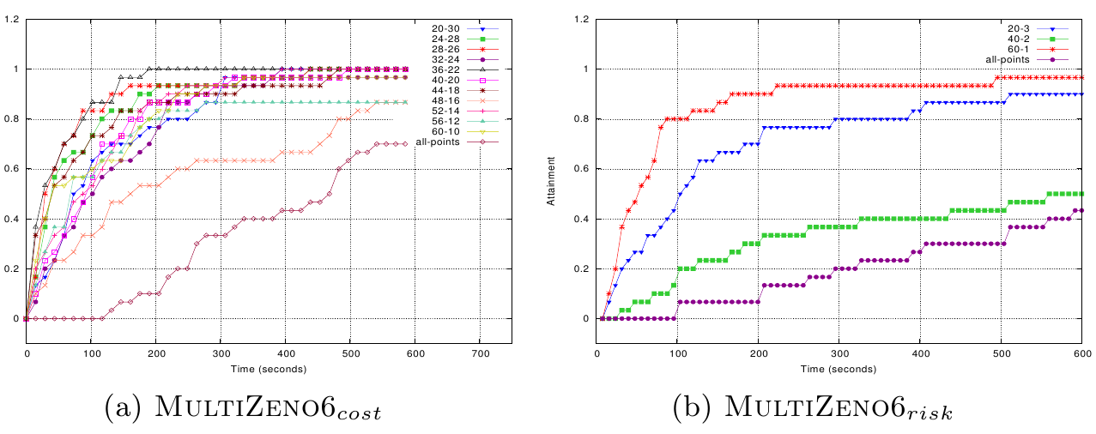
Pareto Front Attainability
Hitting plots for Ibea-Hv on Zeno6 (Cost and Risk)

Slide 30
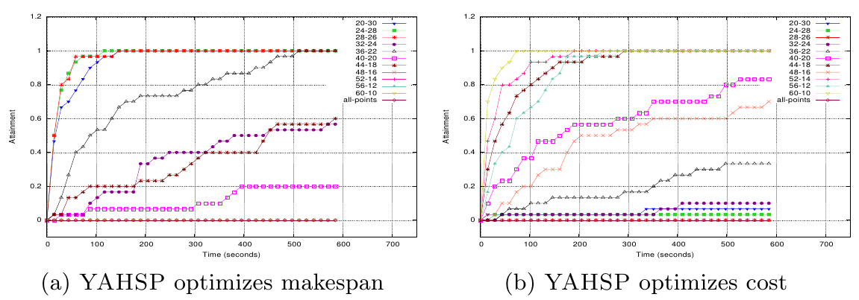
Influence of YAHSP strategy
Hitting plots for Ibea-Hv on Zeno6 for the 2 'pure' strategies

Slide 31
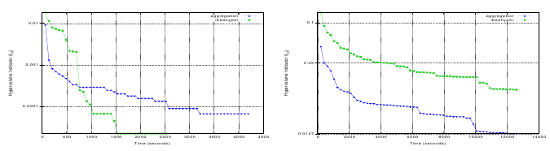
Pareto vs Aggregation - Cost
Zeno6
Zeno9
Hypervolume evolution for MO-DAE and AGG-DAE

Slide 32
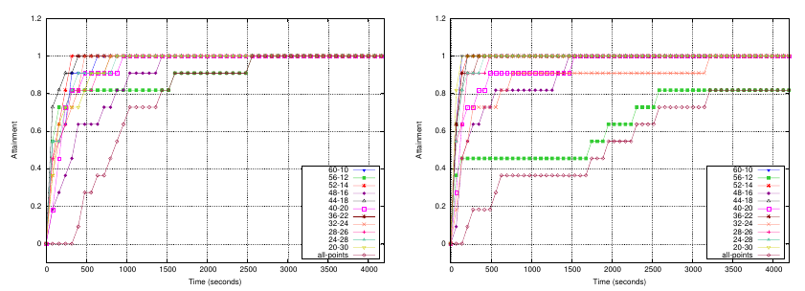
Pareto vs Aggregation – Cost (2)
MO-DAE
AGG-DAE
Hitting plots on Zeno6 for MO-DAE and AGG-DAE

Slide 33
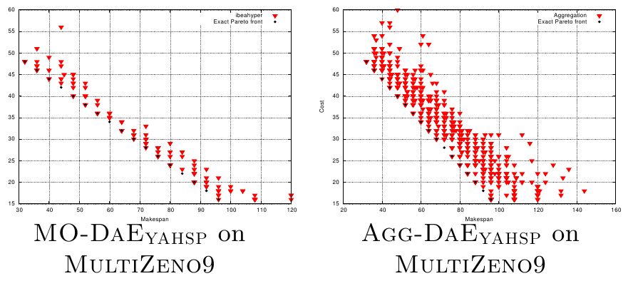
Pareto Fronts for Zeno9-Cost
Pareto Fronts (from 11 runs) for Zeno9 (scales are different)

Slide 34
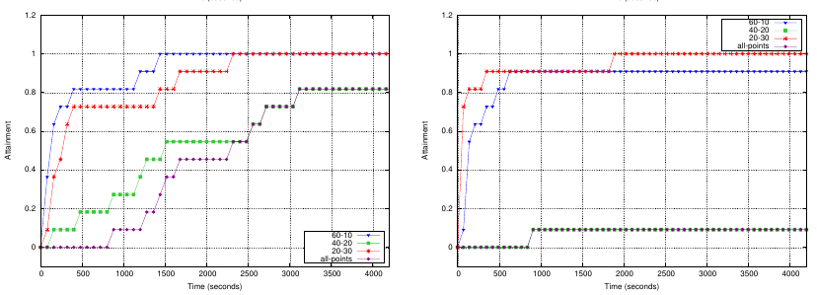
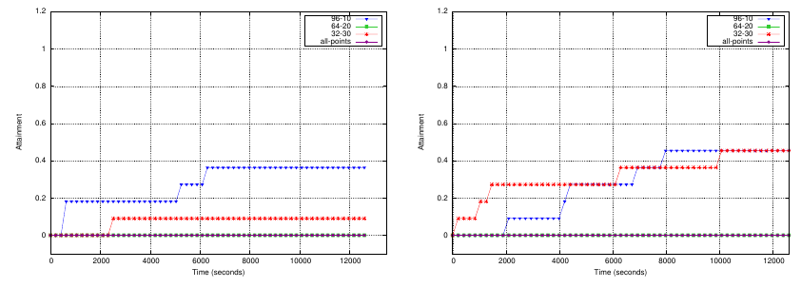
Hitting Plots for Zeno-Risk
MO-DAE (left) vs AGG-DAE (right) on Zeno6 (top) and Zeno9 (bottom)

Slide 35
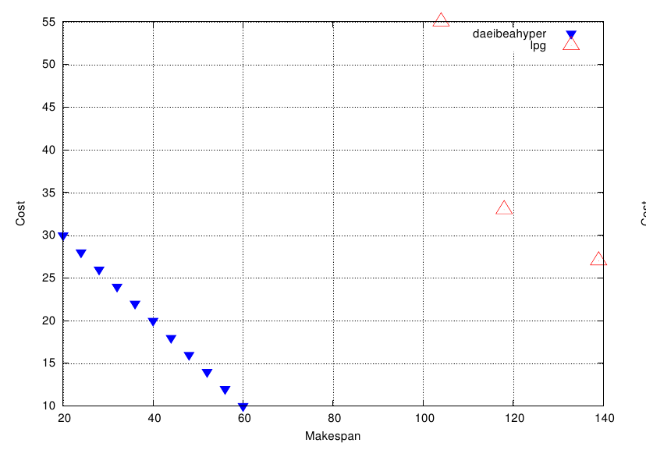
Comparison with LPG
Pareto Fronts for MO-DAE and LPG on MiniZeno6
(LPG fails on MiniZeno9)

Slide 36
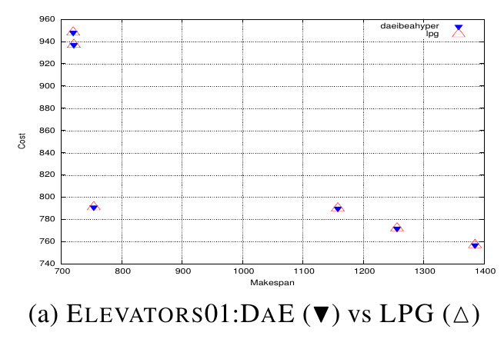
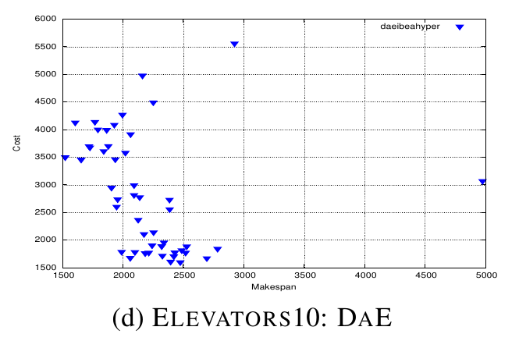
Comparison with LPG (2)
Identical Pareto Fronts for MO-DAE vs LPG on Elevators01
Solution set for MO-DAE on Elevators10
(LPG fails on instances > 01)

Slide 37
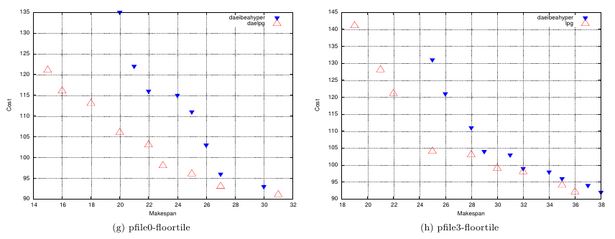
Comparison with LPG (3)
Pareto Fronts for MO-DAE and LPG
on FloorTiles problems

Slide 38
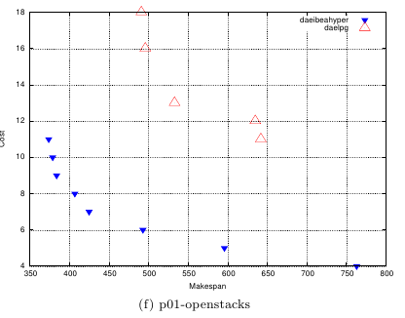
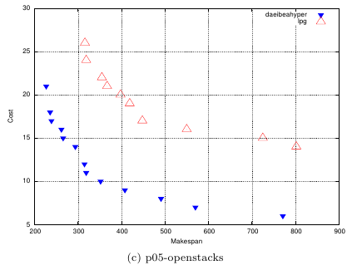
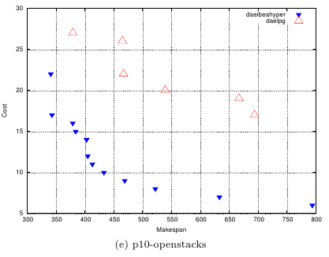
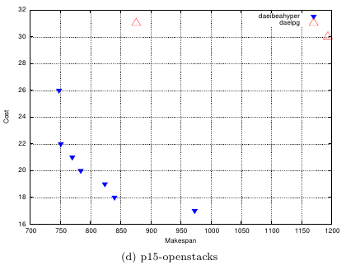
Comparison with LPG (4)
Paerto Fronts for MO-DAE vs LPG
on OpenStacks problems

Slide 39
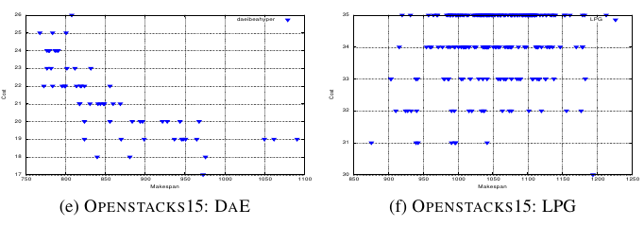
Comparison with LPG (5)
Solution sets for MO-DAE and LPG on OpenStacks15
(scales are different)

Slide 40
Agenda
Multi-Objective Optimization
Multi-Objective AI Planning
Divide-and-Evolve (DaE)
Experiments
Conclusions

Slide 41
Summary
MO-DAE-YAHSP : a multi-objective evolutionary planner based on a single-objective classical planner
MiniZeno, a tunable MO benchmark
Randomized YAHSP strategy
IBEA-Hv best choice (on Zeno benchmarks)
Outperforms aggregation approaches
  Single-objective DAE
  Metric-sensitive LPG

Slide 42
Perspectives
Extended experiments on large IPC instances
  What happens on FloorTiles Problems?
Self-adaptive choice of YAHSP strategy
  Individual or sub-goal level?
On-line setting of (other) parameters
  Adaptive operator selection
Better handling of risk
  Smoothing the needle effect

Slide 43


Slide 44
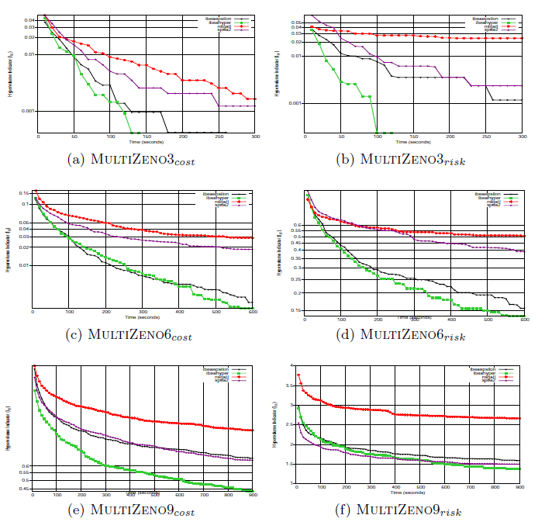
Comparative Results
Evolution of hypervolume / reference set for all 4 MOEAs

Slide 45
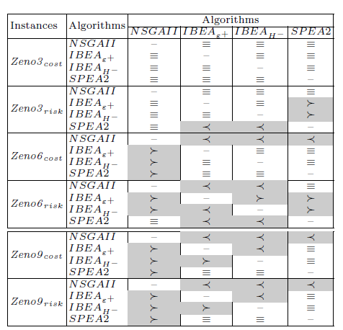
Statistical tests
Ibea-Hv performs significantly better

